Slide 1
Strategic Business Communications Consultants, LLC
MBA consultants since 2023
Notes:
Joseph:
Welcome, We are Strategic Business Communication Consultants and we have been MBA consultants since 2023.
Everyone:
I am Joseph, Aditya, Zach, Chase, and Ebony.

Slide 2
Customer Commitment
2023
Notes:
Joseph:
Today we will be presenting our communication strategy where Wells Fargo will be focusing on the Customer moving forward.
Why do we start with the Customer?

Slide 3
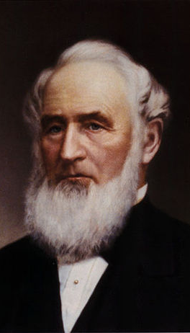
Our Fellow Man
Our lives are not measured by the number of years and days we exist but by what we accomplish … and the good we may render to our fellow men.”
- Henry Wells, 1875
Notes:
Joseph:
We start with the customer due to what Henry Wells, a founder of Wells Fargo, said, (Repeat Quote).
We think he mentions “Our Fellow Man” as the people he expected his legacy to serve.
Your customers. Our fellow man.

Slide 4
Overview
Final Recommendations
5
Conclusions
4
Findings
3
Analysis
2
Objective and Focus
1
Notes:
Joseph:
In order to find how you serve your customers better we will address a few key points today.
We completed a communication audit. We will discuss the objective and focus which built the foundation of this Audit.
Secondly, we will talk about how we analyzed the data we collected.
Then, we will discuss our findings and the conclusions we came to.
Finally, we have our recommendations for you.

Slide 5
Since 2016
2017
2018
2019
2020
2021
2022
Initial FInes
SEC and State Settlements
DOJ Settlement
OCC Fines
Second SEC Settlement
CFPB Fines
628 Million fines paid to various agencies.
Over a billion more fines and a settlement paid.
3 billion more dollars spent to settle.
Yet another 15 million in fines.
100 million in settlements for misleading investors.
A total of 3.7 Billion in fines to close out last year.
Over 8.4 Billion in fines and settlements.
Notes:
Joseph:
A brief history of the cross-selling scandal.

Slide 6
Business Objective
To be the leader in financial services in areas of team member engagement, customer services and advice, shareholder value, innovation, corporate citizenship, and risk management.
Notes:
Joseph:
We have found that you have determined the business objective for Wells Fargo as the following, “Read off Business Objective.”
This has been listed in several of your reports and we kept this in mind when we completed this audit.

Slide 7
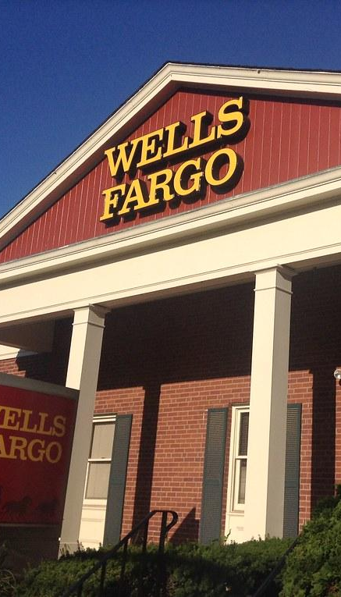
Focus of the Audit
Top level communications from Public Affairs and Investor Relations. Between 2016-2022 for the duration of the cross-selling fallout.
Notes:
Joseph:
The focus of the communication we have completed over the past couple weeks has had a top down look at Public Affairs releases and Investor Relations report since the beginning of the scandal in 2016 to the present.

Slide 8

Methodology
25 Communications
8 questions
Communicator
Message
Delivery
Rated 1-5
Statistical Analysis
Notes:
Joseph:
To complete the audit we found 25 communications related to our focus and determined 8 questions that related to the Communicator, Message, an Deliver of each message in regards to the scandal.
We rated each question a range of 1-5 and completed statistical analysis on the results.
Here to present that analysis is Aditya.

Slide 9
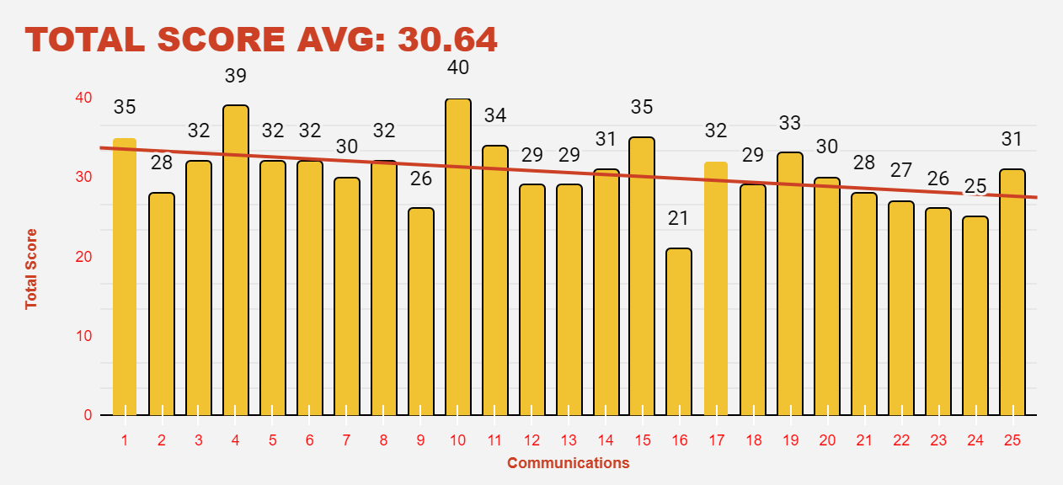
Analysis of the Data
Overall positive evaluation by audience (Avg score ~31)
Credibility and appropriateness rated positively (Avg score >4)
Key point structure received higher score (Avg score 4.20)
Message scored low on addressing needs (Avg score 3.20)
Anticipating resistance scored the lowest (Avg score 2.96)
Notes:
Aadi

Slide 10
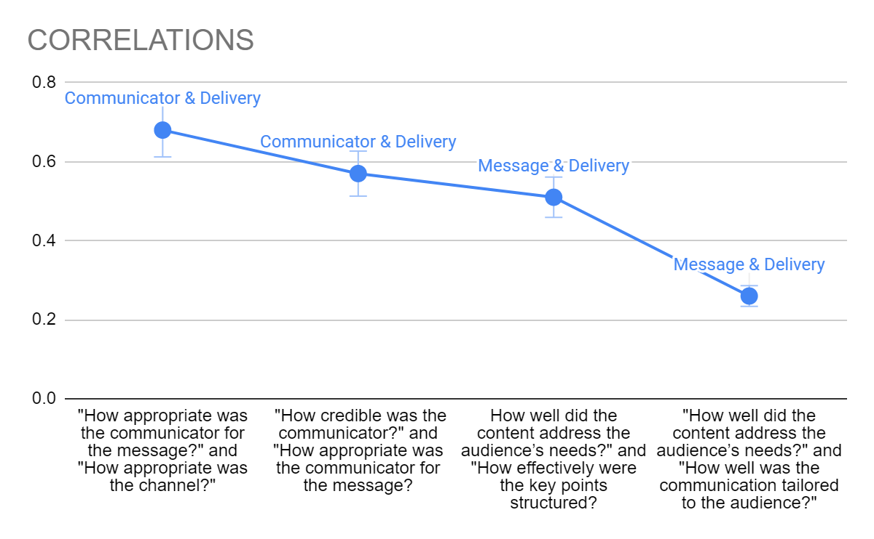
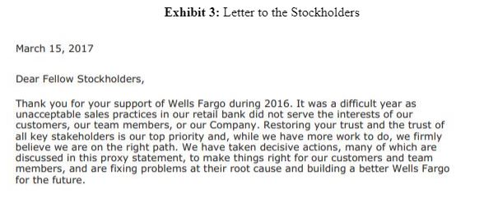
Analysis of the Data
Positive correlation between appropriateness of communicator and channel (r=0.68)
Moderate correlation between credibility of communicator and appropriateness for message (r=0.57)
Weak relationship between message and delivery (r=0.26)
Notes:
Aadi

Slide 11
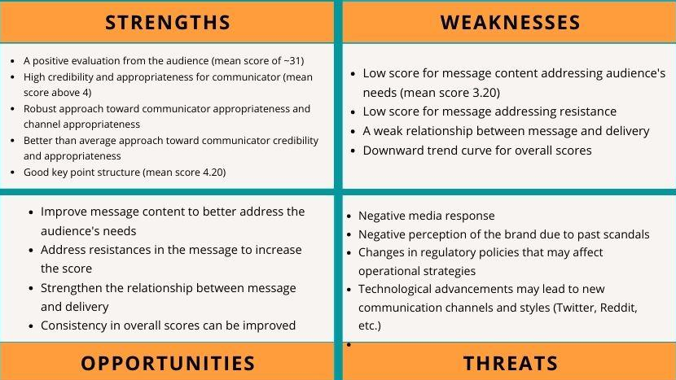
Findings of the Analysis
STRENGTHS
WEAKNESSES
OPPORTUNITIES
THREATS
Notes:
Zach
Prioritize appropriateness of communicator & channel to enhance credibility and effectiveness of the communication
Tailor content to audience's needs to better communication

Slide 12
Conclusions
Communicator perceived as credible and appropriate
Key points structured effectively with appropriate channel
Slightly negative trendline
less effective communication over time
Low score in addressing audience's needs and anticipating resistances
Extrapolate that more communications should expect low scores in each of these two areas
Notes:
Zach

Slide 13
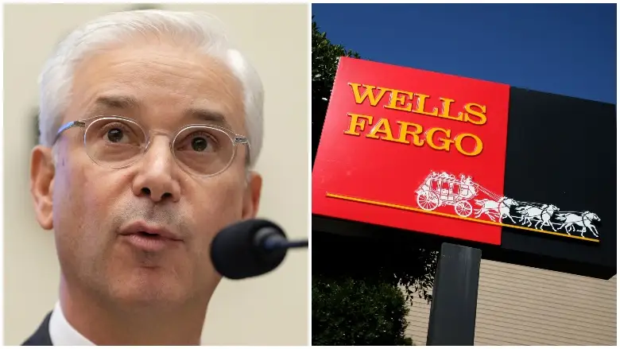
Recommendations
A direct, formal, and consultative approach
A memo to current and former customers of Wells Fargo
Attach a survey to help build trust and transparency for Wells Fargo's future
Highly recommend the CEO as the spokesperson for the memo
Notes:
Chase

Slide 14
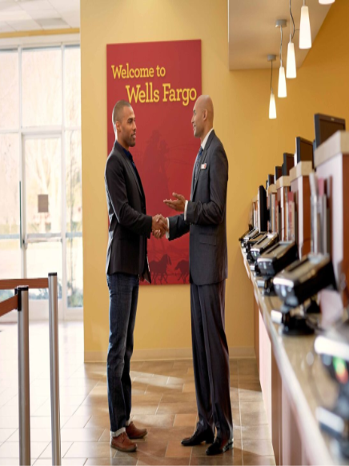
Benefits of Recommendations
Regain trust of current clients
Maintain position as a leading financial institution in the general market
Attract new customers
Provide better services to current customers from additional revenues
Notes:
Chase

Slide 15
Evidence Supporting the Recommendations
Improve on addressing customers needs and anticipating their resistances
Provide more Authenticity and Sincerity
Show WF has accepted responsibility for its part
Show WF has taken action against those involved
Show WF has changed its leadership structure
Show WF has changed its sales culture
Notes:
Chase

Slide 16
Evidence Supporting the Recommendations
Centralized Risk Management and Human Resources
Cut the compensation of its Executive Board
Financial difficulties from unauthorized open accounts are fully compensated
External CEO brings fresh perspective with better solutions
New Regulatory Relations Position
Notes:
Chase

Slide 17
Next Steps
Survey Current and Former Customers
Address Remaining Damage
Reinforce Company Values
Be Transparent
What Would Your Customers Want
Notes:
Ebony

Slide 18
Summary
What We Did
How We Did It
What We Found
Notes:
Ebony
and remember the good we may render to our fellow men.”
Thank you for your time. Any Questions?

