Slide 1
🦞 ReClaw
Revive Your Old Smartphone with AI
PRISM Hackathon 2026 | Theme 2: Daily Utility (Smartphones)
PyTorch QAT + Multi-Runtime + PicoClaw (NDK) + Qwen3-0.6B
Team ReClaw — Giving old phones a new brain 🧠📱

Slide 2
The Problem
5.3 BILLION
📋 Problem Statement 1: Intelligent Customizer
Context-aware phone behavior based on
location & time. Auto-profiles for home,
office, transit. Personalized wallpaper,
ringtones, volume, notification settings.
old smartphones sit unused worldwide
• Functional processors, cameras, sensors, Wi-Fi, displays
• Become e-waste because software is no longer supported
• No affordable AI assistant for low-end devices
• Privacy concerns with cloud-only AI solutions
• Users can't repurpose them without technical expertise
📋 Problem Statement 2: Daily Commute Planner
Read calendar → calculate departure time →
get real-time transit info → push alert via
Telegram/WhatsApp 30 min before departure.
Never miss a metro or bus again.

Slide 3
Our Solution: ReClaw
Transform any old Android phone into an AI-powered personal assistant — fully offline, privacy-first
🧠 Fine-tuned SLM
Qwen3-0.6B with PyTorch QAT
INT8-INT4 via TorchAO
Multi-format export
Device benchmarking first
Adaptive runtime selection
Fully offline inference
🦞 PicoClaw (NDK)
Natively compiled via Android NDK
<20MB · <1s boot · ARM native
Skill-based architecture
Master-Slave for passive agent
proot distro for advanced mgmt
Memory & learning store
📱 Smart Skills
Routine Manager — auto profiles
Commute Planner — departure alerts
Smart Customizer — adaptive UX
Notification Hub — smart digest
Voice/Chat — natural language
Cron — scheduled automations

Slide 4
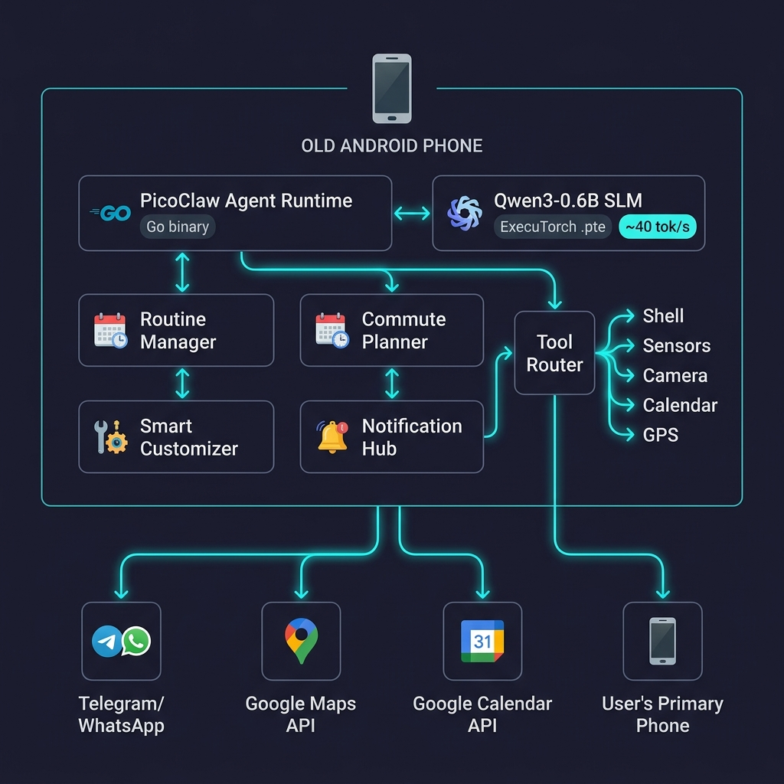
System Architecture

Slide 5
SLM Fine-Tuning Pipeline
Step 1
Step 2
Step 3
Step 4
Data Curation
PyTorch QAT
Multi-Export
Benchmark & Deploy
1,700+ examples Alpaca format 6 categories 30% Hinglish
TorchAO quantize_() INT8 activation + INT4 weight Full fine-tuning on Colab T4
.pte (ExecuTorch) .gguf (llama.cpp) .tflite / .mnn Same QAT checkpoint
Device probe on first run Auto-select best runtime PicoClaw NDK binary Fully offline
→
→
→

Slide 6
Key Features
🏠 Intelligent Customizer
Auto-switches phone profiles
🏠 Home: Normal vol, personal wallpaper
🏢 Office: Silent, minimal UI, DND
🚌 Transit: Medium vol, transit display
🌙 Sleep: Zero brightness, DND on
🚇 Daily Commute Planner
Reads Google Calendar automatically
Calculates departure via Maps API
30-min buffer before each event
Pushes alert: route, ETA, transport
Real-time traffic awareness
📋 Notification Hub
Aggregates & prioritizes alerts
SLM summarizes message threads
Filters noise by learned preference
Post-profile digest when available
"You missed 8 msgs, 2 urgent"
💬 Natural Language Control
Chat via Telegram to control phone
"Set everything up for sleeping"
SLM interprets → executes → confirms
No app needed, just messaging
Works on any messaging platform

Slide 7
User Journey: Morning Commute
📅
🗺️
📲
🚇
🏢
7:00 AM
7:01 AM
8:15 AM
8:30 AM
9:45 AM
ReClaw checks calendar → 10 AM meeting
Queries Google Maps: metro + walk = 75 min
Telegram alert: 'Leave by 8:30 for 10 AM mtg'
User leaves → GPS detects → Transit profile
Arrives office → Auto-switch to Office profile
→
→
→
→

Slide 8
Adaptive Multi-Runtime & Architecture
No single-runtime lock-in — the app benchmarks the device first, then selects the best runtime.
ExecuTorch
.pte · Snapdragon 6xx+
XNNPACK backend
Meta production runtime
llama.cpp
.gguf · Broad ARM64
Mature ecosystem
Wide model support
PicoLM (fork)
Custom · <1GB RAM
Forked & customised
Extreme edge devices
LiteRT / MNN
.tflite / .mnn
GPU delegate support
MediaTek/Kirin SoCs
🦞 PicoClaw (NDK)
Natively compiled via Android NDK
Native ARM binary · <15MB · <1s boot
No Go/Termux dependency for core
🔗 Master-Slave Arch
Old phone = passive agent (slave)
Primary phone controls via Telegram
Remote status, profile push, overrides
🐧 proot Distro
For advanced usage & management
Full Linux pkg mgmt, no root needed
Python, Node, any Linux tool available

Slide 9
Development Timeline
✅
🔨
⚡
✨
🎬
Phase 1 Registration
Week 1 Foundation
Week 2 Implement
Week 3 Polish
Phase 3 Demo
→
→
→
→
Apr 24
Apr 25–May 1
May 2–8
May 9–15
May 16–19
Proposal Architecture User Stories
Dataset curation QAT pipeline setup PicoClaw NDK build
SLM fine-tuning Skill files built Telegram integration
UX polish Benchmarks Documentation
Demo video (10m) 3 usage scenarios Final report

Slide 10
Impact & Closing
♻️ E-Waste
Extends phone life by 3-5 years
💰 Zero Cost
Free APIs + open-source stack
🔒 Privacy
All inference on-device, offline
🌍 Inclusion
AI assistant on $20 hardware
🦞 ReClaw — Giving old phones a new brain
Built with PyTorch · TorchAO · Multi-Runtime · PicoClaw (NDK) · Qwen3-0.6B
PRISM Hackathon 2026 | Theme 2: Daily Utility (Smartphones)
Thank you! 🙏

