Slide 1
Hadoop/MapReduce Computing Paradigm
http://developer.yahoo.com/hadoop/tutorial/module4.html
Spring 2015
Taken from: WPI, Mohamed Eltabakh

Slide 2


Large-Scale Data Analytics
MapReduce computing paradigm (E.g., Hadoop) vs. Traditional database systems
Database
vs.
Many enterprises are turning to Hadoop
Especially applications generating big data
Web applications, social networks, scientific applications

Slide 3






Why Hadoop is able to compete?
Database
vs.
Scalability (petabytes of data, thousands of machines)
Performance (tons of indexing, tuning, data organization tech.)
Flexibility in accepting all data formats (no schema)
Features:
- Provenance tracking
- Annotation management
- ….
Efficient and simple fault-tolerant mechanism
Commodity inexpensive hardware

Slide 4
What is Hadoop
Hadoop is a software framework for distributed processing of large datasets across large clusters of computers
Large datasets → Terabytes or petabytes of data
Large clusters → hundreds or thousands of nodes
Hadoop is open-source implementation for Google MapReduce
Hadoop is based on a simple programming model called MapReduce
Hadoop is based on a simple data model, any data will fit

Slide 5
Single Node Architecture
CPU
Machine Learning, Statistics
Memory
“Classical” Data Mining
Disk

Slide 6
Motivation: Google Example
20+ billion web pages x 20KB = 400+ TB
1 computer reads 30-35 MB/sec from disk
~4 months to read the web
~1,000 hard drives to store the web
Takes even more to do something useful with the data!
Today, a standard architecture for such problems is emerging:
Cluster of commodity Linux nodes
Commodity network (ethernet) to connect them

Slide 7
Cluster Architecture
2-10 Gbps backbone between racks
1 Gbps between
any pair of nodes
in a rack
Switch
Switch
Switch
CPU
CPU
CPU
CPU
Mem
…
Mem
Mem
…
Mem
Disk
Disk
Disk
Disk
Each rack contains 16-64 nodes
In 2011 it was guestimated that Google had 1M machines, http://bit.ly/Shh0RO

Slide 8
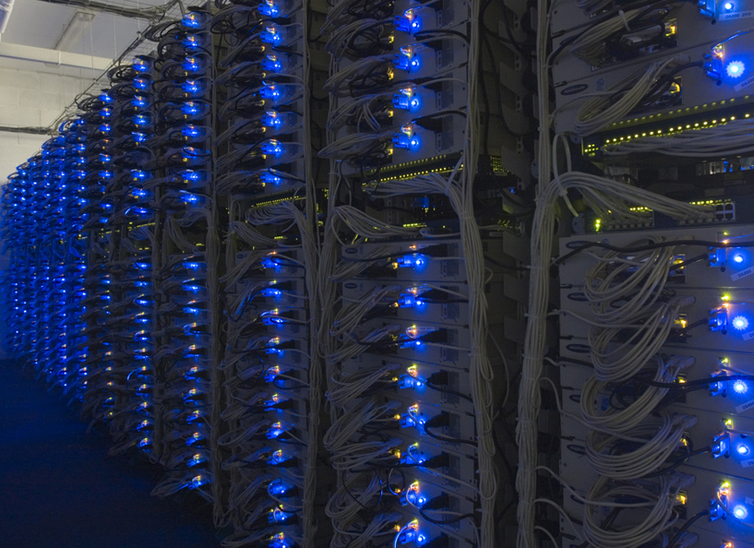

Slide 9
Large-scale Computing
Large-scale computing for data mining problems on commodity hardware
Challenges:
How do you distribute computation?
How can we make it easy to write distributed programs?
Machines fail:
One server may stay up 3 years (1,000 days)
If you have 1,000 servers, expect to loose 1/day
People estimated Google had ~1M machines in 2011
1,000 machines fail every day!

Slide 10
Idea and Solution
Issue: Copying data over a network takes time
Idea:
Bring computation close to the data
Store files multiple times for reliability
Map-reduce addresses these problems
Google’s computational/data manipulation model
Elegant way to work with big data
Storage Infrastructure – File system
Google: GFS. Hadoop: HDFS
Programming model
Map-Reduce

Slide 11
Storage Infrastructure
Problem:
If nodes fail, how to store data persistently?
Answer:
Distributed File System:
Provides global file namespace
Google GFS; Hadoop HDFS;
Typical usage pattern
Huge files (100s of GB to TB)
Data is rarely updated in place
Reads and appends are common

Slide 12
Distributed File System
Chunk servers
File is split into contiguous chunks
Typically each chunk is 16-64MB
Each chunk replicated (usually 2x or 3x)
Try to keep replicas in different racks
Master node
a.k.a. Name Node in Hadoop’s HDFS
Stores metadata about where files are stored
Might be replicated
Client library for file access
Talks to master to find chunk servers
Connects directly to chunk servers to access data

Slide 13
Distributed File System
Reliable distributed file system
Data kept in “chunks” spread across machines
Each chunk replicated on different machines
Seamless recovery from disk or machine failure
C₀
C₁
D₀
C₁
C₂
C₅
C₀
C₅
…
C₅
Chunk server 1
C₂
C₅
Chunk server 2
C₃
D₀
Chunk server 3
D₁
D₀
Chunk server N
C₂
Bring computation directly to the data!
Chunk servers also serve as compute servers
Notes:
13

Slide 14
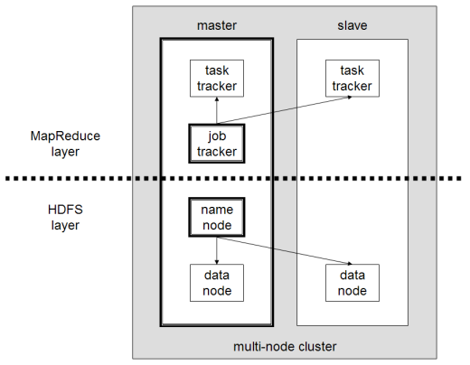
What is Hadoop
Hadoop framework consists on two main layers
Distributed file system (HDFS)
Execution engine (MapReduce)

Slide 15
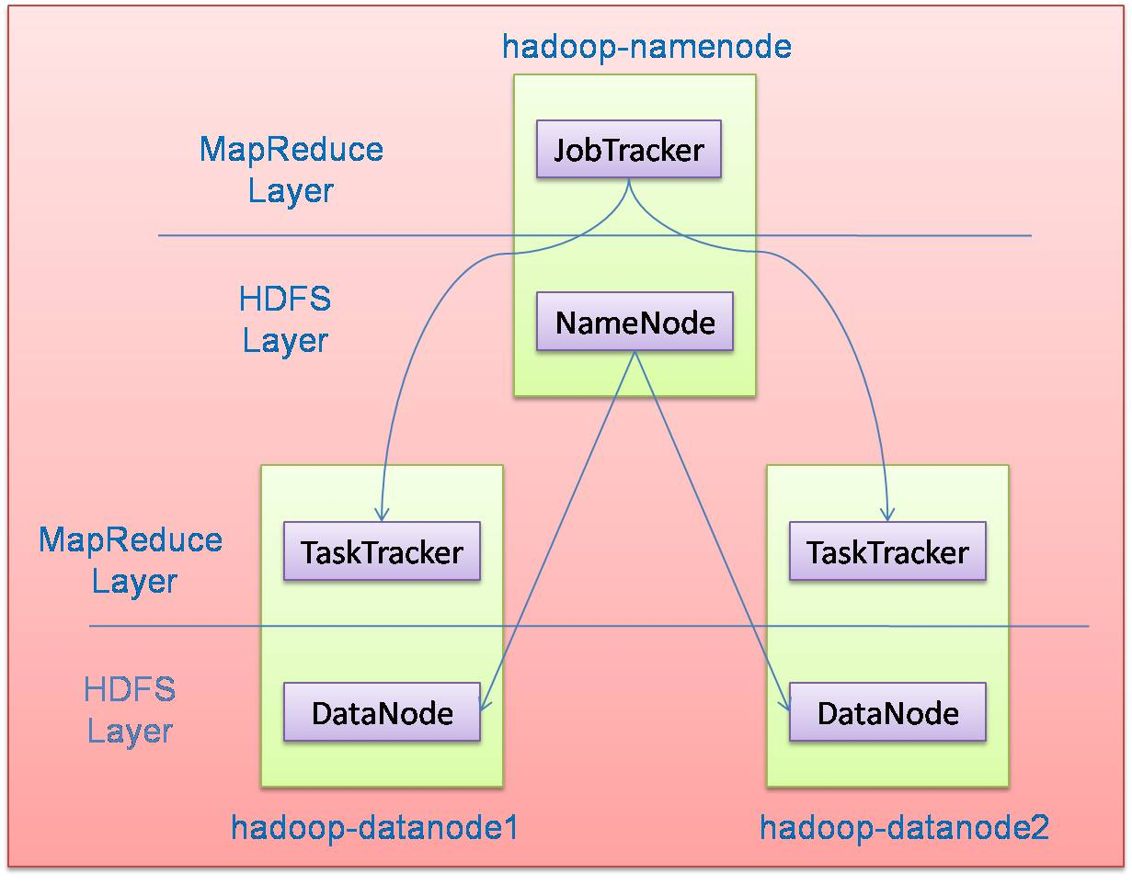
Hadoop Master/Slave Architecture
Hadoop is designed as a master-slave shared-nothing architecture
Master node (single node)
Many slave nodes

Slide 16
Design Principles of Hadoop
Need to process big data
Need to parallelize computation across thousands of nodes
Commodity hardware
Large number of low-end cheap machines working in parallel to solve a computing problem
This is in contrast to Parallel DBs
Small number of high-end expensive machines

Slide 17
Commodity Clusters
MapReduce is designed to efficiently process large volumes of data by connecting many commodity computers together to work in parallel
A theoretical 1000-CPU machine would cost a very large amount of money, far more than 1000 single-CPU or 250 quad-core machines
MapReduce ties smaller and more reasonably priced machines together into a single cost-effective commodity cluster

Slide 18
Design Principles of Hadoop
Automatic parallelization & distribution
Hidden from the end-user
Fault tolerance and automatic recovery
Nodes/tasks will fail and will recover automatically
Clean and simple programming abstraction
Users only provide two functions “map” and “reduce”

Slide 19
How Uses MapReduce/Hadoop
Google: Inventors of MapReduce computing paradigm
Yahoo: Developing Hadoop open-source of MapReduce
IBM, Microsoft, Oracle
Facebook, Amazon, AOL, NetFlex
Many others + universities and research labs

Slide 20
Hadoop: How it Works

Slide 21
Hadoop Architecture
Distributed file system (HDFS)
Execution engine (MapReduce)
Master node (single node)
Many slave nodes

Slide 22
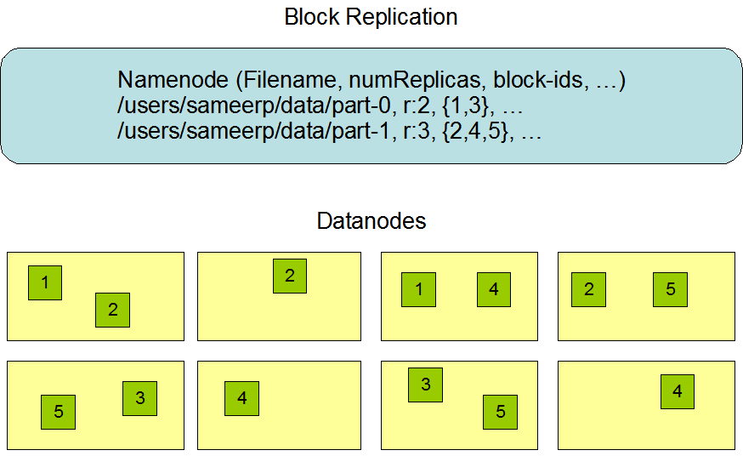
Hadoop Distributed File System (HDFS)
Centralized namenode
- Maintains metadata info about files
File F
1
2
3
4
5
Blocks (64 MB)
Many datanode (1000s)
- Store the actual data
- Files are divided into blocks
- Each block is replicated N times
(Default = 3)

Slide 23
HDFS Architecture
NameNode
1. filename
2. BlckId, DataNodes
o
Secondary
NameNode
Client
3.Read data
DataNodes
NameNode : Maps a file to a file-id and list of MapNodes
DataNode : Maps a block-id to a physical location on disk
Notes:
23

Slide 24
Main Properties of HDFS
Large: A HDFS instance may consist of thousands of server machines, each storing part of the file system’s data
Replication: Each data block is replicated many times (default is 3)
Failure: Failure is the norm rather than exception
Fault Tolerance: Detection of faults is quick, and automatic recovery from them is a core architectural goal of HDFS
Namenode is consistently checking Datanodes

Slide 25
Map-Reduce Execution Engine (Example: Color Count)
Input blocks on HDFS
Produces (k, v)
( , 1)
Shuffle & Sorting based on k
Consumes(k, [v])
( , [1,1,1,1,1,1..])
Produces(k’, v’)
( , 100)
Users only provide the “Map” and “Reduce” functions

Slide 26
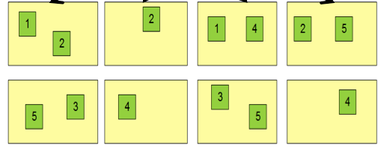
Properties of MapReduce Engine
Job Tracker is the master node (runs with the namenode)
Receives the user’s job
Decides on how many tasks will run (number of mappers)
Decides on where to run each mapper (concept of locality)
Node 1
Node 2
Node 3
This file has 5 Blocks → run 5 map tasks
Where to run the task reading block “1”
Try to run it on Node 1 or Node 3

Slide 27
Properties of MapReduce Engine (Cont’d)
Task Tracker is the slave node (runs on each datanode)
Receives the task from Job Tracker
Runs the task until completion (either map or reduce task)
Always in communication with the Job Tracker reporting progress
In this example, 1 map-reduce job consists of 4 map tasks and 3 reduce tasks

Slide 28
Isolated Tasks
MapReduce divides the workload into multiple independent tasks and schedule them across cluster nodes
A work performed by each task is done in isolation from one another
The amount of communication which can be performed by tasks is mainly limited for scalability reasons

Slide 29
Key-Value Pairs
Mappers and Reducers are users’ code (provided functions)
Just need to obey the Key-Value pairs interface
Mappers:
Consume <key, value> pairs
Produce <key, value> pairs
Reducers:
Consume <key, <list of values>>
Produce <key, value>
Shuffling and Sorting:
Hidden phase between mappers and reducers
Groups all similar keys from all mappers, sorts and passes them to a certain reducer in the form of <key, <list of values>>

Slide 30
Programming Model: MapReduce
Warm-up task:
We have a huge text document
Count the number of times each distinct word appears in the file
Sample application:
Analyze web server logs to find popular URLs

Slide 31
Task: Word Count
Case 1:
File too large for memory, but all <word, count> pairs fit in memory
Case 2:
Count occurrences of words:
words(doc.txt) | sort | uniq -c
where words takes a file and outputs the words in it, one per a line
Case 2 captures the essence of MapReduce
Great thing is that it is naturally parallelizable

Slide 32
MapReduce: Overview
Sequentially read a lot of data
Map:
Extract something you care about
Group by key: Sort and Shuffle
Reduce:
Aggregate, summarize, filter or transform
Write the result
Outline stays the same, Map and Reduce change to fit the problem

Slide 33
MapReduce: The Map Step
Input
key-value pairs
Intermediate
key-value pairs
k
v
map
k
v
k
v
map
k
v
k
v
…
…
k
v
k
v

Slide 34
MapReduce: The Reduce Step
Output
key-value pairs
Intermediate
key-value pairs
Key-value groups
reduce
k
v
k
v
v
v
k
v
Group
by key
reduce
k
v
k
v
v
k
v
k
v
…
…
…
k
v
k
v
k
v

Slide 35
More Specifically
Input: a set of key-value pairs
Programmer specifies two methods:
Map(k, v) → <k’, v’>*
Takes a key-value pair and outputs a set of key-value pairs
E.g., key is the filename, value is a single line in the file
There is one Map call for every (k,v) pair
Reduce(k’, <v’>*) → <k’, v’’>*
All values v’ with same key k’ are reduced together and processed in v’ order
There is one Reduce function call per unique key k’

Slide 36
MapReduce: Word Counting
Provided by the programmer
Provided by the programmer
MAP:
Read input and produces a set of key-value pairs
Group by key:
Collect all pairs with same key
Reduce:
Collect all values belonging to the key and output
The crew of the space shuttle Endeavor recently returned to Earth as ambassadors, harbingers of a new era of space exploration. Scientists at NASA are saying that the recent assembly of the Dextre bot is the first step in a long-term space-based man/mache partnership. '"The work we're doing now -- the robotics we're doing -- is what we're going to need ……………………..
(The, 1)
(crew, 1)
(of, 1)
(the, 1)
(space, 1)
(shuttle, 1)
(Endeavor, 1)
(recently, 1)
….
(crew, 1)
(crew, 1)
(space, 1)
(the, 1)
(the, 1)
(the, 1)
(shuttle, 1)
(recently, 1)
…
(crew, 2)
(space, 1)
(the, 3)
(shuttle, 1)
(recently, 1)
…
Sequentially read the data
Only sequential reads
Big document
(key, value)
(key, value)
(key, value)

Slide 37
Word Count Using MapReduce
map(key, value):
// key: document name; value: text of the document
for each word w in value:
emit(w, 1)
reduce(key, values):
// key: a word; value: an iterator over counts
result = 0
for each count v in values:
result += v
emit(key, result)

Slide 38
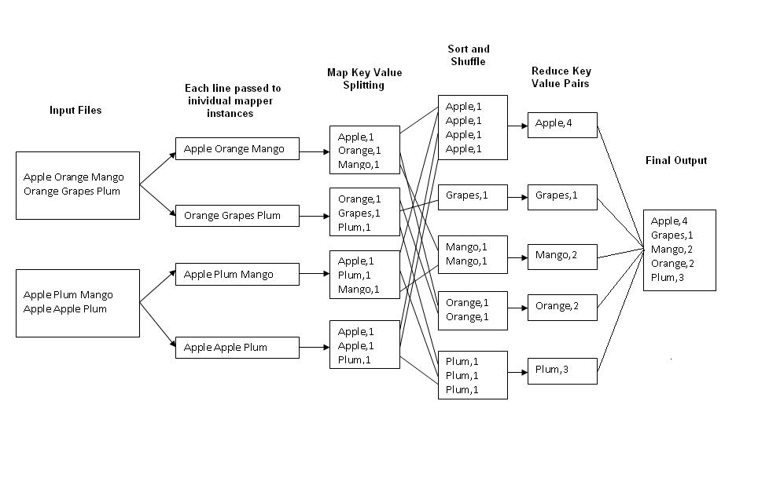
Example: Word Count
Job: Count the occurrences of each word in a data set
Map
Tasks
Reduce
Tasks

Slide 39
Map-Reduce: Environment
Map-Reduce environment takes care of:
Partitioning the input data
Scheduling the program’s execution across a set of machines
Performing the group by key step
Handling machine failures
Managing required inter-machine communication

Slide 40
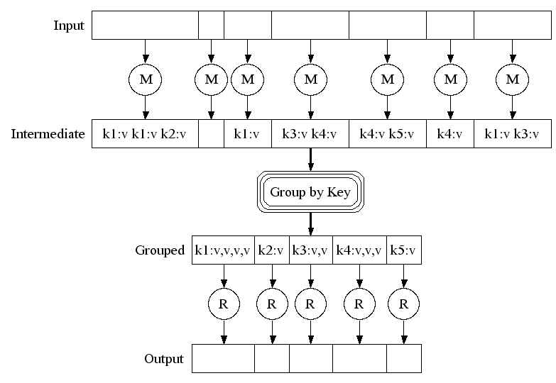
Map-Reduce: A diagram
Big document
MAP:
Read input and produces a set of key-value pairs
Group by key:
Collect all pairs with same key
(Hash merge, Shuffle, Sort, Partition)
Reduce:
Collect all values belonging to the key and output

Slide 41
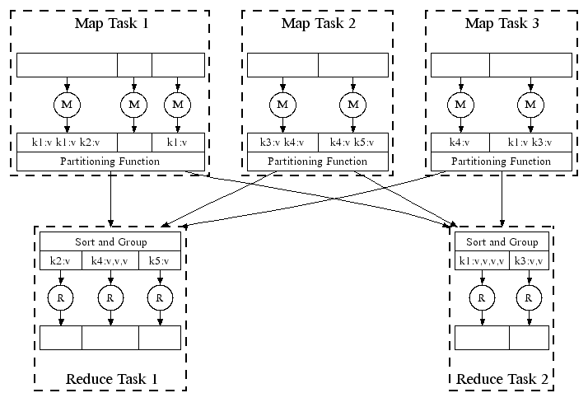
Map-Reduce: In Parallel
All phases are distributed with many tasks doing the work

Slide 42
Map-Reduce
Programmer specifies:
Map and Reduce and input files
Workflow:
Read inputs as a set of key-value-pairs
Map transforms input kv-pairs into a new set of k'v'-pairs
Sorts & Shuffles the k'v'-pairs to output nodes
All k’v’-pairs with a given k’ are sent to the same reduce
Reduce processes all k'v'-pairs grouped by key into new k''v''-pairs
Write the resulting pairs to files
All phases are distributed with many tasks doing the work
Input 0
Input 1
Input 2
Map 0
Map 1
Map 2
Shuffle
Reduce 0
Reduce 1
Out 0
Out 1

Slide 43
Data Flow
Input and final output are stored on a distributed file system (FS):
Scheduler tries to schedule map tasks “close” to physical storage location of input data
Intermediate results are stored on local FS of Map and Reduce workers
Output is often input to another MapReduce task

Slide 44
Coordination: Master
Master node takes care of coordination:
Task status: (idle, in-progress, completed)
Idle tasks get scheduled as workers become available
When a map task completes, it sends the master the location and sizes of its R intermediate files, one for each reducer
Master pushes this info to reducers
Master pings workers periodically to detect failures

Slide 45
Refinement: Combiners
Often a Map task will produce many pairs of the form (k,v₁), (k,v₂), … for the same key k
E.g., popular words in the word count example
Can save network time by pre-aggregating values in the mapper:
combine(k, list(v₁)) → v₂
Combiner is usually same as the reduce function
Works only if reduce function is commutative and associative

Slide 46
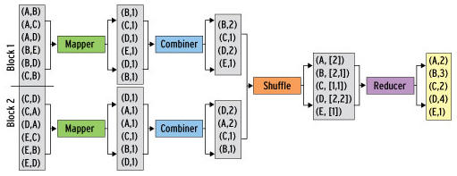
Refinement: Combiners
Back to our word counting example:
Combiner combines the values of all keys of a single mapper (single machine):
Much less data needs to be copied and shuffled!

Slide 47
Combiner Functions
MapReduce applications are limited by the bandwidth available on the cluster
It pays to minimize the data shuffled between map and reduce tasks
Hadoop allows the user to specify a combiner function (just like the reduce function) to be run on a map output
Map
output
(Y, T)
Combiner
output
MT
(1950, 0)
(1950, 20)
(1950, 10)
MT
(1950, 20)
N
MT
R
N
MT
LEGEND:
R = Rack
N = Node
MT = Map Task
RT = Reduce Task
Y = Year
T = Temperature
RT
MT
N
MT
R
N
MT

Slide 48
Shuffle and Sort
Mapper
intermediate files (on disk)
merged spills (on disk)
Combiner
Reducer
circular buffer (in memory)
Combiner
other reducers
spills (on disk)
other mappers

Slide 49
Shuffle and Sort in Hadoop
Probably the most complex aspect of MapReduce!
Map side
Map outputs are buffered in memory in a circular buffer
When buffer reaches threshold, contents are “spilled” to disk
Spills merged in a single, partitioned file (sorted within each partition): combiner runs here
Reduce side
First, map outputs are copied over to reducer machine
“Sort” is a multi-pass merge of map outputs (happens in memory and on disk): combiner runs here
Final merge pass goes directly into reducer

Slide 50
Partitions
In MapReduce, intermediate output values are not usually reduced together
All values with the same key are presented to a single Reducer together
More specifically, a different subset of intermediate key space is assigned to each Reducer
These subsets are known as partitions
Different colors represent
different keys (potentially)
from different Mappers
Partitions are the input to Reducers

Slide 51
Refinement: Partition Function
Want to control how keys get partitioned
Inputs to map tasks are created by contiguous splits of input file
Reduce needs to ensure that records with the same intermediate key end up at the same worker
System uses a default partition function:
hash(key) mod R
Sometimes useful to override the hash function:
E.g., hash(hostname(URL)) mod R ensures URLs from a host end up in the same output file

Slide 52
Example 2: Color Count
Job: Count the number of each color in a data set
Input blocks on HDFS
Produces (k, v)
( , 1)
Shuffle & Sorting based on k
Consumes(k, [v])
( , [1,1,1,1,1,1..])
Produces(k’, v’)
( , 100)
Part0001
Part0002
Part0003
That’s the output file, it has 3 parts on probably 3 different machines

Slide 53
Example 3: Color Filter
Job: Select only the blue and the green colors
Each map task will select only the blue or green colors
No need for reduce phase
Input blocks on HDFS
Produces (k, v)
( , 1)
Write to HDFS
Part0001
Write to HDFS
Part0002
That’s the output file, it has 4 parts on probably 4 different machines
Write to HDFS
Part0003
Write to HDFS
Part0004

Slide 54
Task Scheduling in MapReduce
TT
MapReduce adopts a master-slave architecture
The master node in MapReduce is referred to as Job Tracker (JT)
Each slave node in MapReduce is referred to as Task Tracker (TT)
MapReduce adopts a pull scheduling strategy rather than a push one
I.e., JT does not push map and reduce tasks to TTs but rather TTs pull them by making pertaining requests
Task Slots
JT
Request
Reply
Tasks Queue
T0
T1
Reply
T0
T1
T2
Request
TT
Task Slots

Slide 55
Map and Reduce Task Scheduling
Every TT sends a heartbeat message periodically to JT encompassing a request for a map or a reduce task to run
Map Task Scheduling:
JT satisfies requests for map tasks via attempting to schedule mappers in the vicinity of their input splits (i.e., it considers locality)
Reduce Task Scheduling:
However, JT simply assigns the next yet-to-run reduce task to a requesting TT regardless of TT’s network location and its implied effect on the reducer’s shuffle time (i.e., it does not consider locality)

Slide 56
Job Scheduling in MapReduce
In MapReduce, an application is represented as a job
A job encompasses multiple map and reduce tasks
MapReduce in Hadoop comes with a choice of schedulers:
The default is the FIFO scheduler which schedules jobs in order of submission
There is also a multi-user scheduler called the Fair scheduler which aims to give every user a fair share of the cluster capacity over time

Slide 57
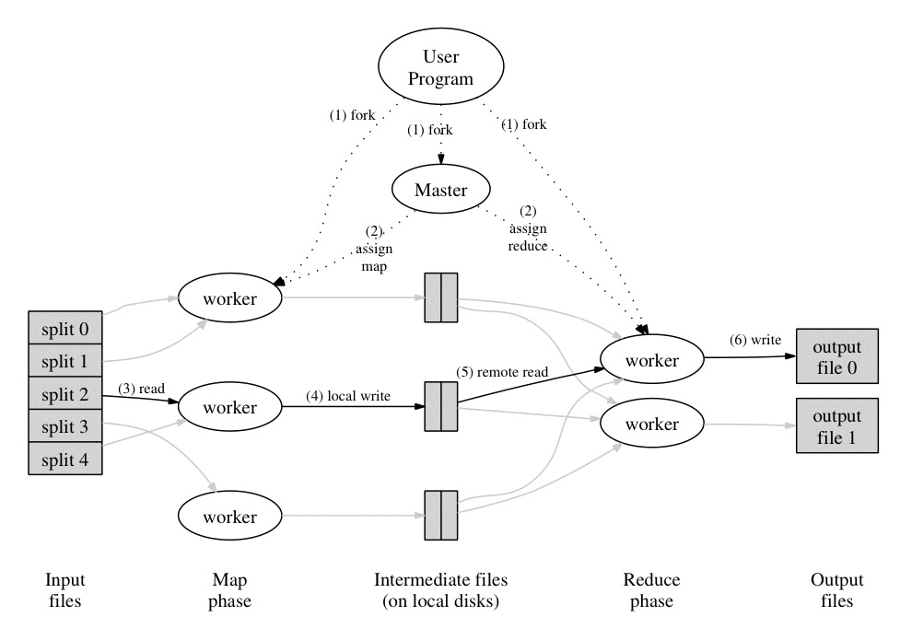
Execution Overview

Slide 58
How many Map and Reduce jobs?
M map tasks, R reduce tasks
Rule of a thumb:
Make M much larger than the number of nodes in the cluster
One DFS chunk per map is common
Improves dynamic load balancing and speeds up recovery from worker failures
Usually R is smaller than M
Because output is spread across R files

Slide 59
Dealing with Failures
Map worker failure
Map tasks completed or in-progress at worker are reset to idle
Reduce workers are notified when task is rescheduled on another worker
Reduce worker failure
Only in-progress tasks are reset to idle
Reduce task is restarted
Master failure
MapReduce task is aborted and client is notified

Slide 60
Fault Tolerance in Hadoop
MapReduce can guide jobs toward a successful completion even when jobs are run on a large cluster where probability of failures increases
The primary way that MapReduce achieves fault tolerance is through restarting tasks
If a TT fails to communicate with JT for a period of time (by default, 1 minute in Hadoop), JT will assume that TT in question has crashed
If the job is still in the map phase, JT asks another TT to re-execute all Mappers that previously ran at the failed TT
If the job is in the reduce phase, JT asks another TT to re-execute all Reducers that were in progress on the failed TT

Slide 61
Worker Failure

Slide 62
Master Failure

Slide 63
Fault Tolerance / Workers
Handled via re-execution
Detect failure via periodic heartbeats
Re-execute completed + in-progress map tasks
Why????
Re-execute in progress reduce tasks
Task completion committed through master
Robust:
lost 1600/1800 machines once → finished ok
Semantics in presence of failures: see paper

Slide 64
Refinements: Backup Tasks
Problem
Slow workers significantly lengthen the job completion time:
Other jobs on the machine
Bad disks
Weird things
Solution
Near end of phase, spawn backup copies of tasks
Whichever one finishes first “wins”
Effect
Dramatically shortens job completion time

Slide 65
Speculative Execution
A MapReduce job is dominated by the slowest task
MapReduce attempts to locate slow tasks (stragglers) and run redundant (speculative) tasks that will optimistically commit before the corresponding stragglers
This process is known as speculative execution
Only one copy of a straggler is allowed to be speculated
Whichever copy (among the two copies) of a task commits first, it becomes the definitive copy, and the other copy is killed by JT

Slide 66
Locating Stragglers
How does Hadoop locate stragglers?
Hadoop monitors each task progress using a progress score between 0 and 1
If a task’s progress score is less than (average – 0.2), and the task has run for at least 1 minute, it is marked as a straggler
T1
Not a straggler
PS= 2/3
T2
A straggler
PS= 1/12
Time

Slide 67
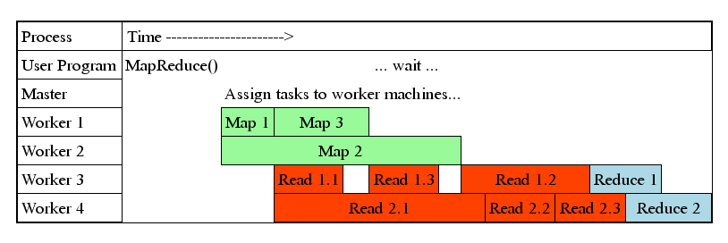
Task Granularity & Pipelining
Fine granularity tasks: map tasks >> machines
Minimizes time for fault recovery
Can do pipeline shuffling with map execution
Better dynamic load balancing

Slide 68
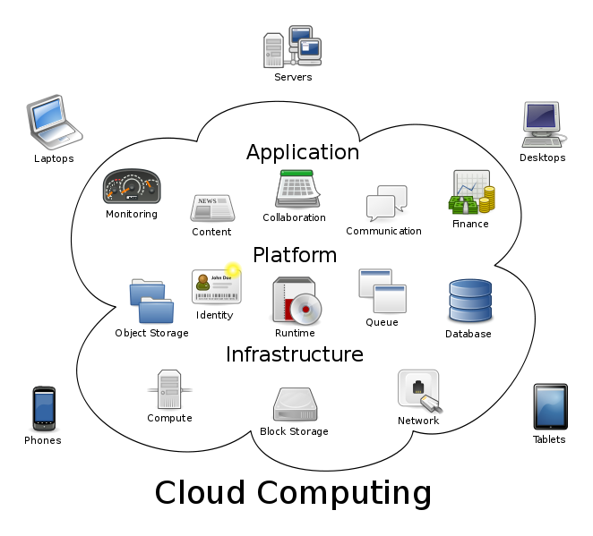
Bigger Picture: Hadoop vs. Other Systems
 | Distributed Databases | Hadoop
Computing Model | Notion of transactions Transaction is the unit of work ACID properties, Concurrency control | Notion of jobs Job is the unit of work No concurrency control
Data Model | Structured data with known schema Read/Write mode | Any data will fit in any format (un)(semi)structured ReadOnly mode
Cost Model | Expensive servers | Cheap commodity machines
Fault Tolerance | Failures are rare Recovery mechanisms | Failures are common over thousands of machines Simple yet efficient fault tolerance
Key Characteristics | - Efficiency, optimizations, fine-tuning | - Scalability, flexibility, fault tolerance
Cloud Computing
A computing model where any computing infrastructure can run on the cloud
Hardware & Software are provided as remote services
Elastic: grows and shrinks based on the user’s demand
Example: Amazon EC2

