Slide 1
MapReduce algorithms for processing relational data

Slide 2
Design Pattern: Secondary Sorting
MapReduce sorts input to reducers by key
Values are arbitrarily ordered
What if want to sort value also?
E.g., k → (v₁, r), (v₃, r), (v₄, r), (v₈, r)…

Slide 3
Secondary Sorting: Solutions
Solution 1:
Buffer values in memory, then sort
Why is this a bad idea?
Solution 2:
“Value-to-key conversion” design pattern: form composite intermediate key, (k, v₁)
Let execution framework do the sorting
Preserve state across multiple key-value pairs to handle processing
Anything else we need to do?

Slide 4
Value-to-Key Conversion
Before
k → (v₁, r), (v₄, r), (v₈, r), (v₃, r)…
Values arrive in arbitrary order…
After
(k, v₁) → (v₁, r)
Values arrive in sorted order…
(k, v₃) → (v₃, r)
Process by preserving state across multiple keys
(k, v₄) → (v₄, r)
Remember to partition correctly!
(k, v₈) → (v₈, r)
…

Slide 5
Working Scenario
Two tables:
User demographics (gender, age, income, etc.)
User page visits (URL, time spent, etc.)
Analyses we might want to perform:
Statistics on demographic characteristics
Statistics on page visits
Statistics on page visits by URL
Statistics on page visits by demographic characteristic
…

Slide 6
Relational Algebra
Primitives
Projection (π)
Selection (σ)
Cartesian product (×)
Set union (∪)
Set difference (−)
Rename (ρ)
Other operations
Join (⋈)
Group by… aggregation
…

Slide 7
Projection
R₁
R₁
R₂
R₂
R₃
R₃
R₄
R₄
R₅
R₅

Slide 8
Projection in MapReduce
Easy!
Map over tuples, emit new tuples with appropriate attributes
No reducers, unless for regrouping or resorting tuples
Alternatively: perform in reducer, after some other processing
Basically limited by HDFS streaming speeds
Speed of encoding/decoding tuples becomes important
Relational databases take advantage of compression
Semistructured data? No problem!

Slide 9
Selection
R₁
R₂
R₁
R₃
R₃
R₄
R₅

Slide 10
Selection in MapReduce
Easy!
Map over tuples, emit only tuples that meet criteria
No reducers, unless for regrouping or resorting tuples
Alternatively: perform in reducer, after some other processing
Basically limited by HDFS streaming speeds
Speed of encoding/decoding tuples becomes important
Relational databases take advantage of compression
Semistructured data? No problem!

Slide 11
Group by… Aggregation
Example: What is the average time spent per URL?
In SQL:
SELECT url, AVG(time) FROM visits GROUP BY url
In MapReduce:
Map over tuples, emit time, keyed by url
Framework automatically groups values by keys
Compute average in reducer
Optimize with combiners

Slide 12

Relational Joins
Source: Microsoft Office Clip Art

Slide 13
Relational Joins
R₁
S₁
R₂
S₂
R₃
S₃
R₄
S₄
R₁
S₂
R₂
S₄
R₃
S₁
R₄
S₃

Slide 14
Natural Join Operation – Example
Relations r, s:
A
B
C
D
B
D
E
α
β
γ
α
δ
1
2
4
1
2
α
γ
β
γ
β
a
a
b
a
b
1
3
1
2
3
a
a
a
b
b
α
β
γ
δ
∈
r
s
r s
A
B
C
D
E
α
α
α
α
δ
1
1
1
1
2
α
α
γ
γ
β
a
a
a
a
b
α
γ
α
γ
δ

Slide 15
Natural Join Example
R1
S1
R1 S1 =

Slide 16
Types of Relationships
Many-to-Many
One-to-Many
One-to-One

Slide 17
Join Algorithms in MapReduce
Reduce-side join
Map-side join
In-memory join
Striped variant
Memcached variant

Slide 18
Reduce-side Join
Basic idea: group by join key
Map over both sets of tuples
Emit tuple as value with join key as the intermediate key
Execution framework brings together tuples sharing the same key
Perform actual join in reducer
Similar to a “sort-merge join” in database terminology
Two variants
1-to-1 joins
1-to-many and many-to-many joins

Slide 19
Reduce-side Join: 1-to-1
Map
keys
values
R₁
R₁
R₄
R₄
S₂
S₂
S₃
S₃
Reduce
keys
values
R₁
S₂
S₃
R₄
Note: no guarantee if R is going to come first or S

Slide 20
Reduce-side Join: 1-to-many
Map
keys
values
R₁
R₁
S₂
S₂
S₃
S₃
S₉
S₉
Reduce
keys
values
R₁
S₂
S₃
…
What’s the problem?

Slide 21
Reduce-side Join: V-to-K Conversion
In reducer…
keys
values
R₁
New key encountered: hold in memory
S₂
Cross with records from other set
S₃
S₉
R₄
New key encountered: hold in memory
S₃
Cross with records from other set
S₇

Slide 22
Reduce-side Join: many-to-many
In reducer…
keys
values
R₁
R₅
Hold in memory
R₈
S₂
Cross with records from other set
S₃
S₉
What’s the problem?

Slide 23
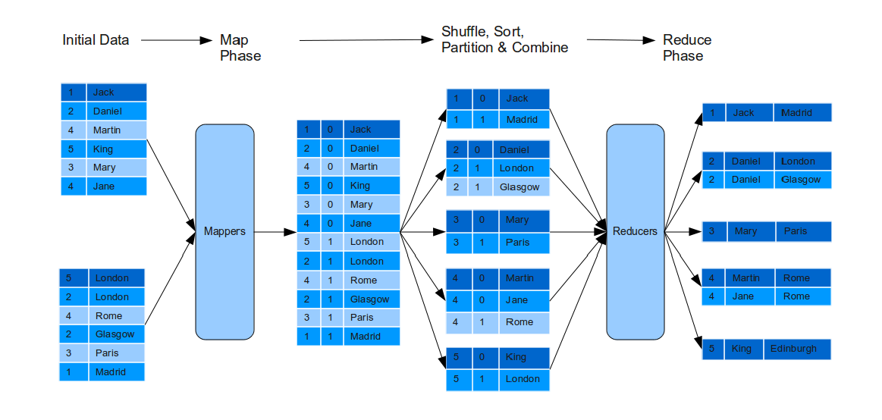
Reduce-side Join: many-to-many
Produce mapper output with composite key that includes foreign key and table name

Slide 24
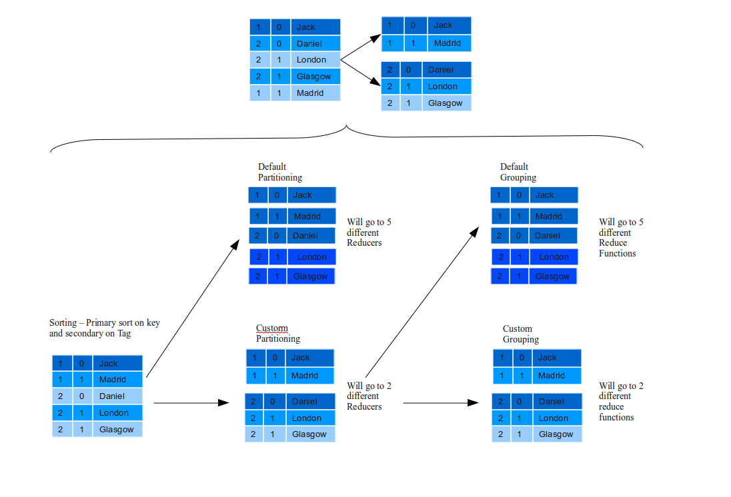
Reduce-side Join: many-to-many
Use custom partitioning and grouping to send data with same key to a single reducer

Slide 25
Map-side Join: Basic Idea
Assume two datasets are sorted by the join key:
R₁
S₂
R₂
S₄
R₄
S₃
R₃
S₁
A sequential scan through both datasets to join (called a “merge join” in database terminology)

Slide 26
Map-side Join: Parallel Scans
If datasets are sorted by join key, join can be accomplished by a scan over both datasets
How can we accomplish this in parallel?
Partition and sort both datasets in the same manner
In MapReduce:
Map over one dataset, read from other corresponding partition
No reducers necessary (unless to repartition or resort)
Consistently partitioned datasets: realistic to expect?

Slide 27
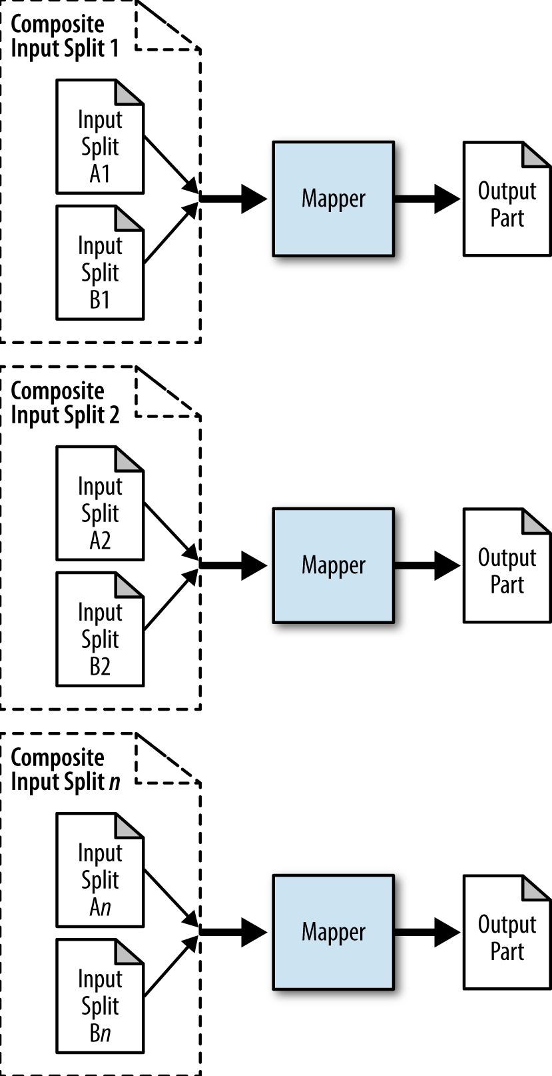
Map-side Join: Parallel Scans
Sort and split both A and B before sending to mapper. Mapper will produce output,
no reducer needed.

Slide 28
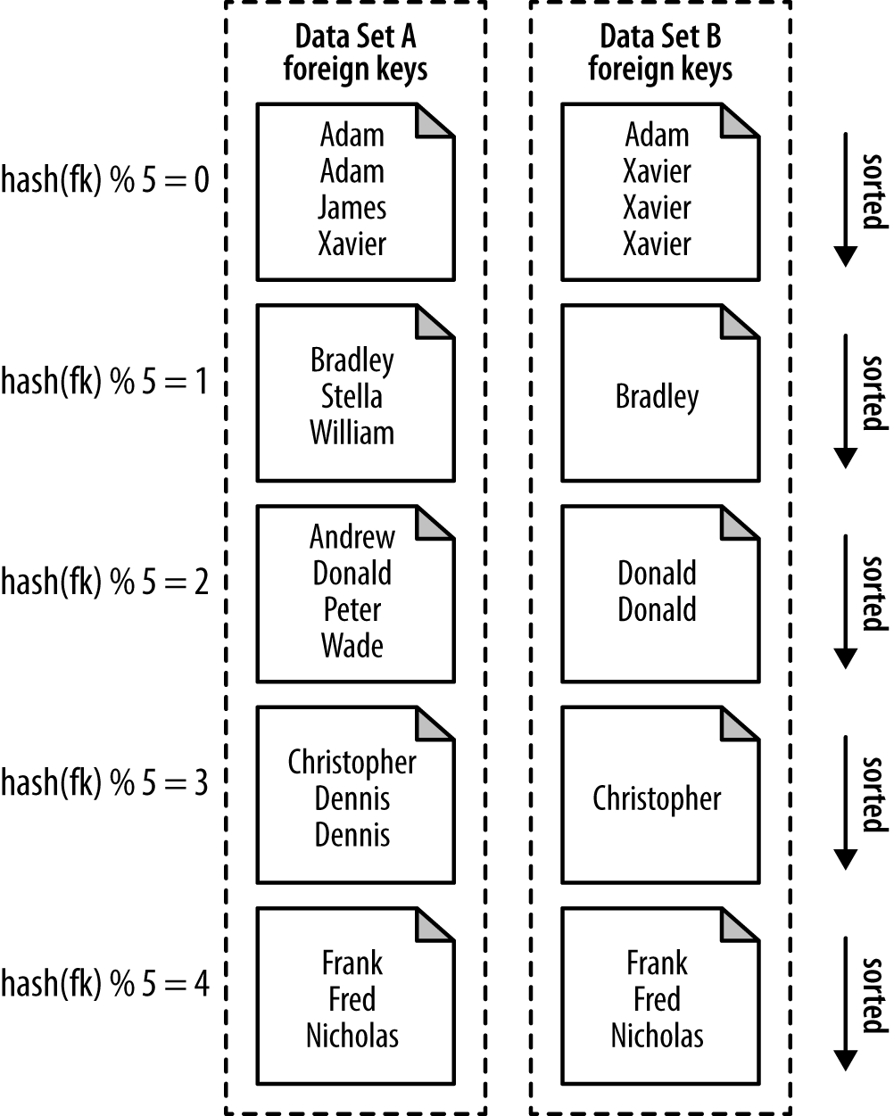
Map-side Join: Parallel Scans

Slide 29
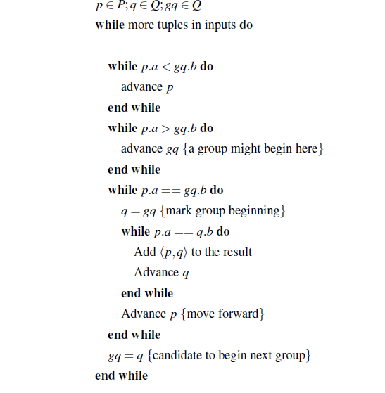
Parallel Scan & Join

Slide 30
In-Memory Join
Basic idea: load one dataset into memory, stream over other dataset
Works if R << S and R fits into memory
Called a “hash join” in database terminology
MapReduce implementation
Distribute R to all nodes
Map over S, each mapper loads R in memory, hashed by join key
For every tuple in S, look up join key in R
No reducers, unless for regrouping or resorting tuples

Slide 31
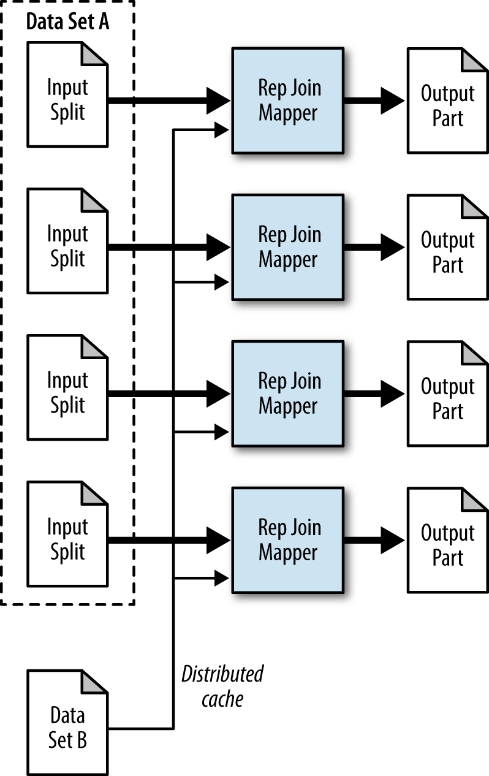
In-Memory Join
Split A and distribute dataset B to all the mappers. For each key in B, iterate over all the data
in A for joining

Slide 32
In-Memory Join: Variants
Striped variant:
R too big to fit into memory?
Divide R into R₁, R₂, R₃, … s.t. each R_{n} fits into memory
Perform in-memory join: ∀n, R_{n} ⋈ S
Take the union of all join results
Memcached join:
Load R into memcached
Replace in-memory hash lookup with memcached lookup

Slide 33
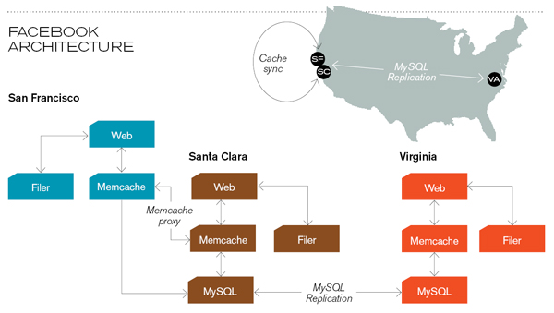
Memcached
Caching servers: 15 million requests per second, 95% handled by memcache (15 TB of RAM)
Database layer: 800 eight-core Linux servers running MySQL (40 TB user data)
Source: Technology Review (July/August, 2008)

Slide 34
Memcached Join
Memcached join:
Load R into memcached
Replace in-memory hash lookup with memcached lookup
Capacity and scalability?
Memcached capacity >> RAM of individual node
Memcached scales out with cluster
Latency?
Memcached is fast (basically, speed of network)
Batch requests to amortize latency costs
Source: See tech report by Lin et al. (2009)

Slide 35
Which join to use?
In-memory join > map-side join > reduce-side join
Why?
Limitations of each?
In-memory join: memory
Map-side join: sort order and partitioning
Reduce-side join: general purpose

Slide 36
Processing Relational Data: Summary
MapReduce algorithms for processing relational data:
Group by, sorting, partitioning are handled automatically by shuffle/sort in MapReduce
Selection, projection, and other computations (e.g., aggregation), are performed either in mapper or reducer
Multiple strategies for relational joins
Complex operations require multiple MapReduce jobs
Example: top ten URLs in terms of average time spent
Opportunities for automatic optimization

