Slide 1
Kafka Installation & Visualization Tutorial
Hemeng Tao

Slide 2
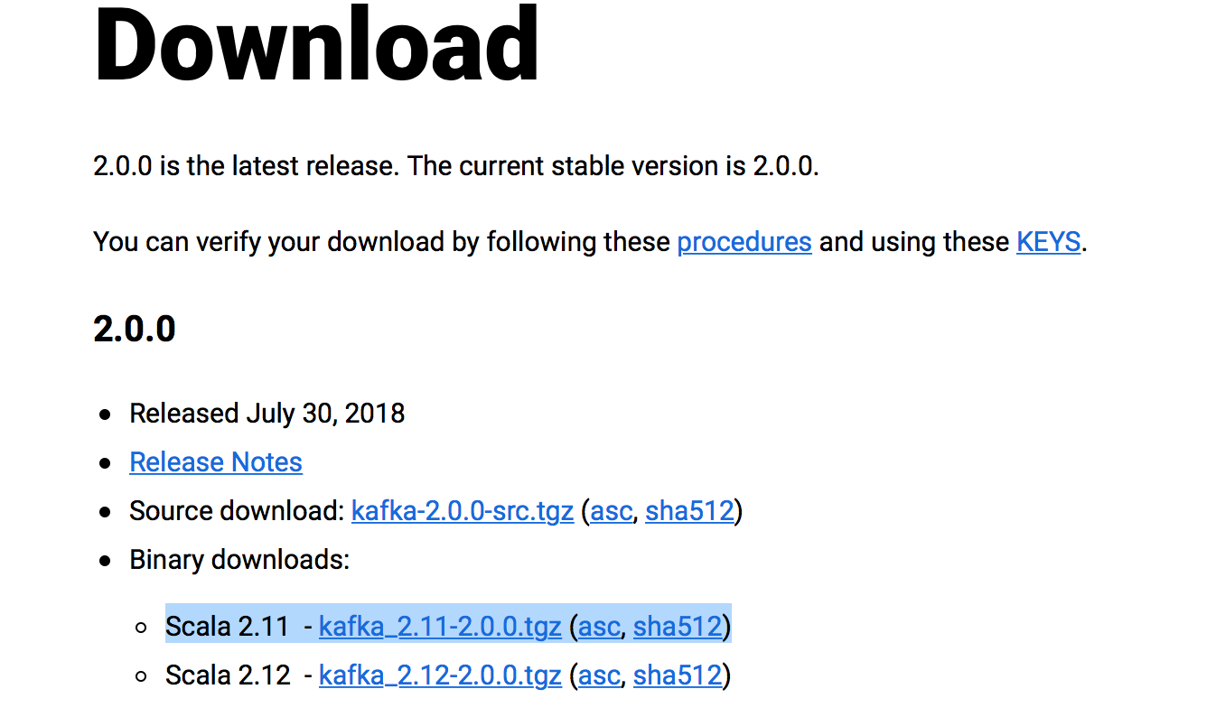
Kafka Installation
You need to have Spark and Python installed on your machine, if you don’t have them, please refer the spark installation instructions first.
Kafka can build real-time streaming applications that transform or react to the streams of data.
Go to https://kafka.apache.org/downloads
Download the binary source and unzip it.
Run: pip install kafka-python
pip install tweepy

Slide 3
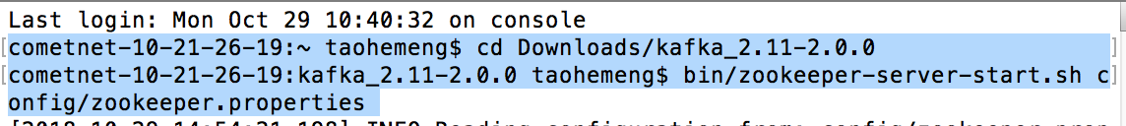
Run Kafka
Go to your kafka folder and run the command:
bin/zookeeper-server-start.sh config/zookeeper.properties
Then open another terminal and run the command:
bin/kafka-server-start.sh config/server.properties

Slide 4
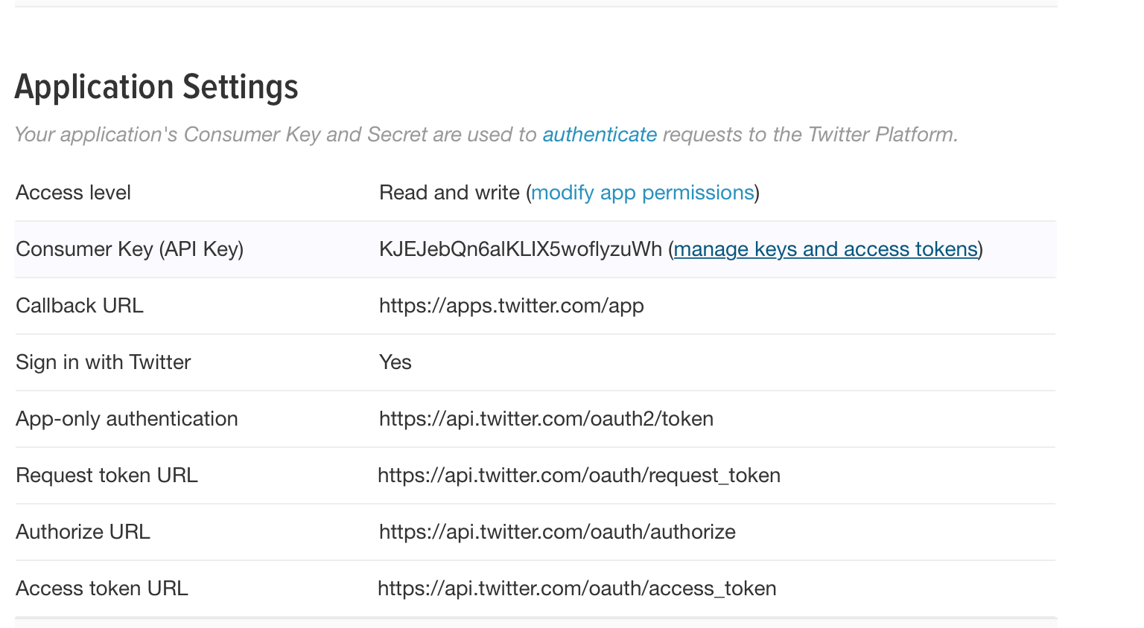
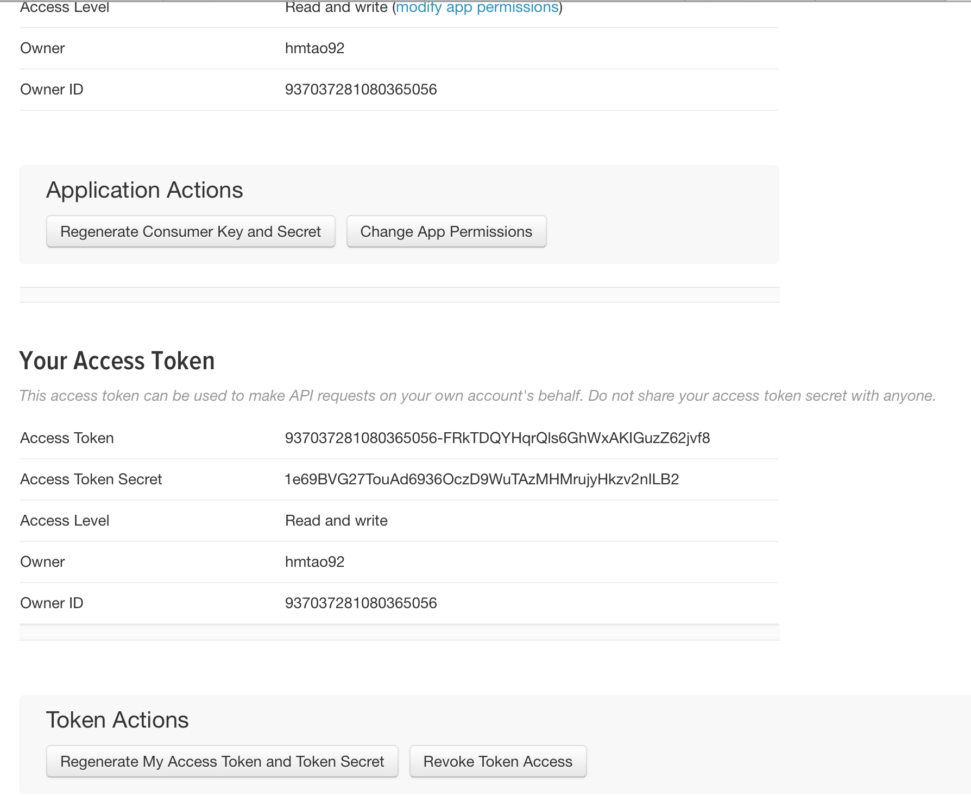
Twitter API
Go to https://apps.twitter.com. Apply a developer account and create app.
Then generate consumer key, secret, access token , and access token secret.
Note: the developer account can take up to one week to be approved by Twitter, so please create is ASAP!

Slide 5
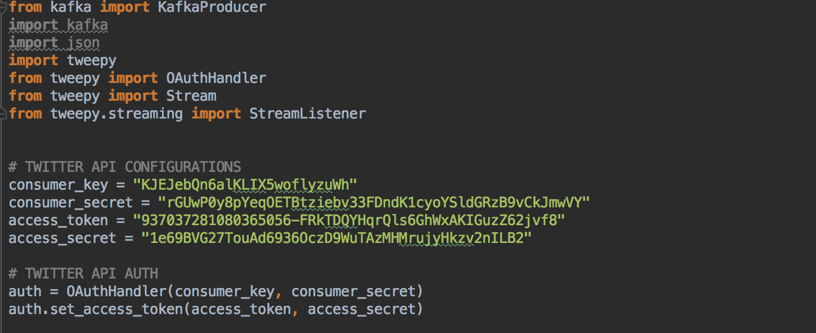
Twitter api
Paste those keys and tokens into your StreamProducer.py and run it.
Then check if the topic “twitter ” is created:
bin/kafka-topics.sh --list --zookeeper localhost:2181
And run StreamConsumer.py, it will output the real time tweets containing #trump (you can run the python code in pycharm)
Note: please create your own keys. If you are getting 401 error, try to reset your system's clock according to world clock or let it govern by internet

Slide 6
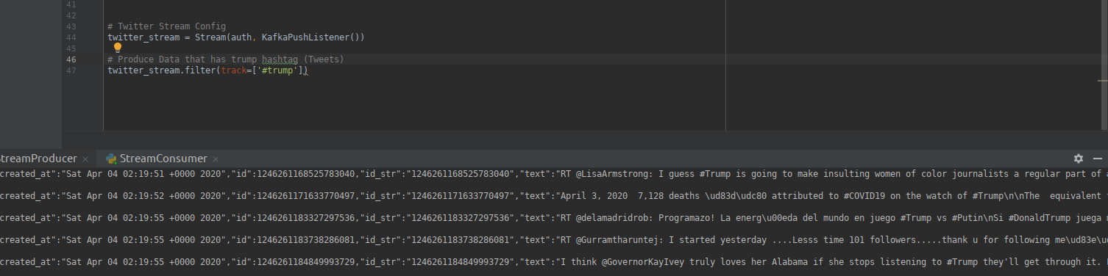
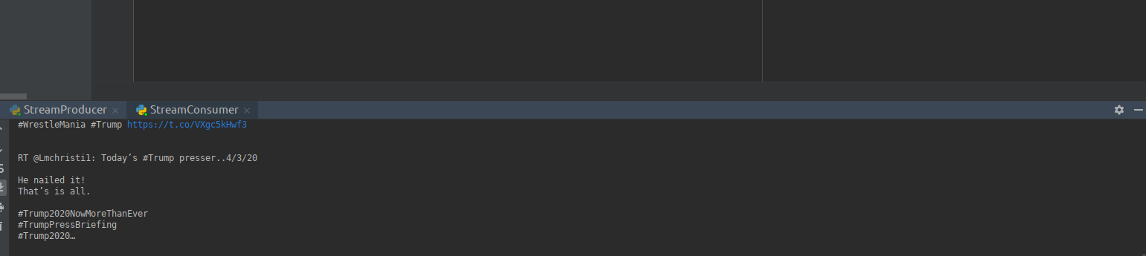

Slide 7
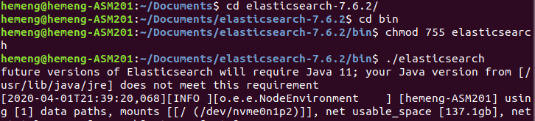
Visualization
Download elasticsearch:
https://www.elastic.co/downloads/elasticsearch
Download kibana
https://www.elastic.co/downloads/kibana
Unzip elasticsearch and go to the bin folder run:
Chmod 755 elasticsearch
./elasticsearch
Install elasticsearch-py package by running:
pip install elasticsearch

Slide 8
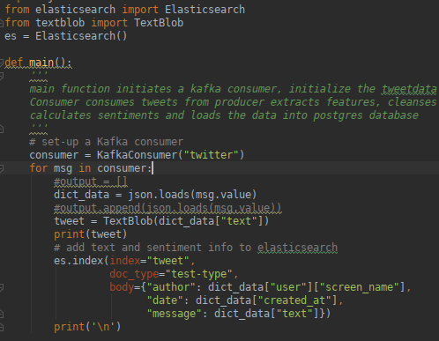
Twitter and elasticsearch
Now, we edit the Stream Consumer.py a little bit to store the tweets into elasticsearch
Rerun the StreamProducer and StreamConsumer
Note: do not close the kafka terminal windows, keep it running
Now the tweets are stored in the elasticsearch
Next, we want to visualize our data

Slide 9
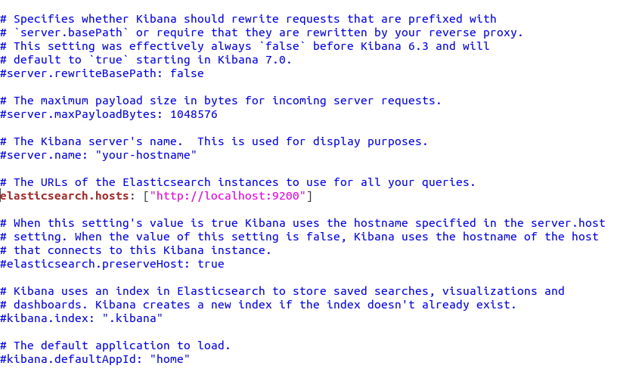
Kibana
Unzip kibana
Go to kibana folder
Edit config/kibana.yml
Set elasticsearch.hosts to point at your Elasticsearch instance

Slide 10

Kibana
Open another terminal window
Go to bin folder
Run: chmod 755 kibana
./kibana
Point your browser at http://localhost:5601 to open the Kibana

Slide 11
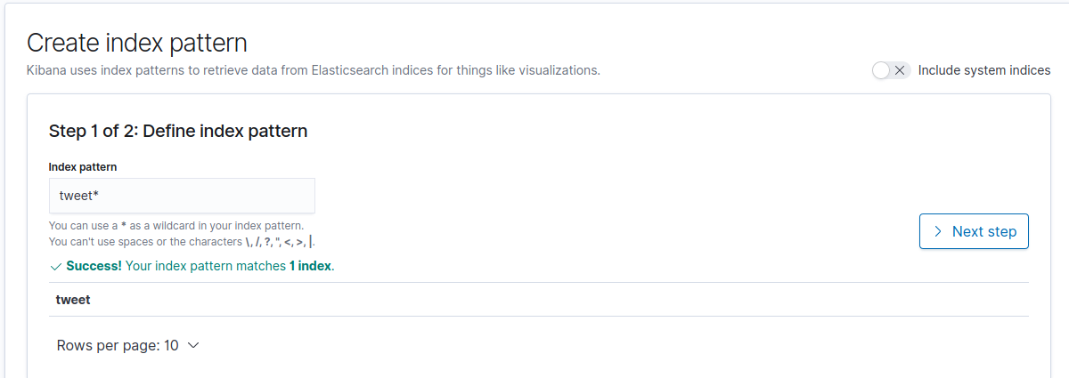
Kibana
In order to use the visualization tool, you need to create index pattern to retrieve data from elasticsearch, in our case, the index is tweet* (defined in the StreamConsumer.py)

Slide 12
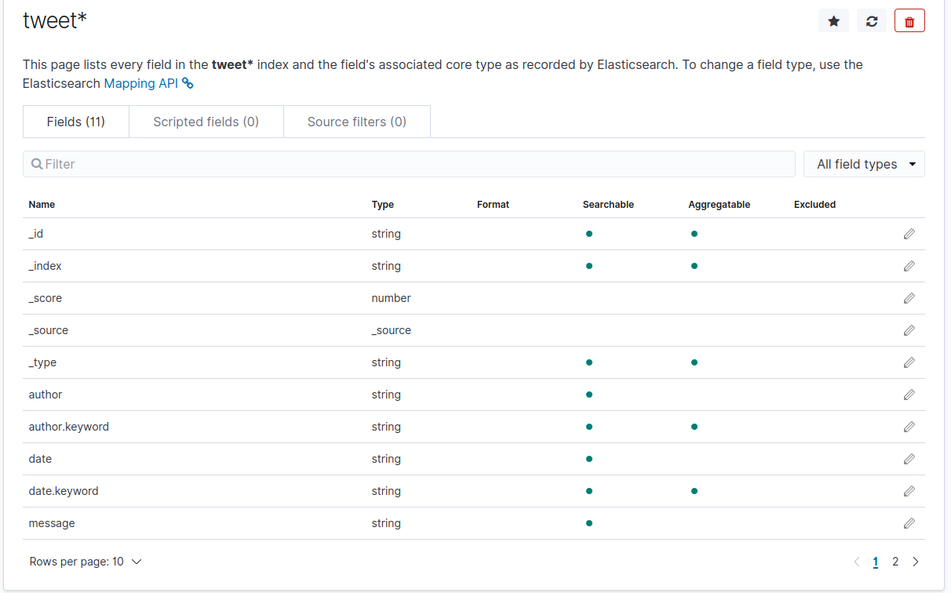

Slide 13
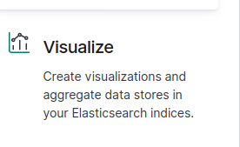
Kibana
Then we can use the visualization tooI. I will create a pie chart to give you an insight.
The pie chart in next page shows the top 10 users who post the most number of tweets regarding #trump.

Slide 14
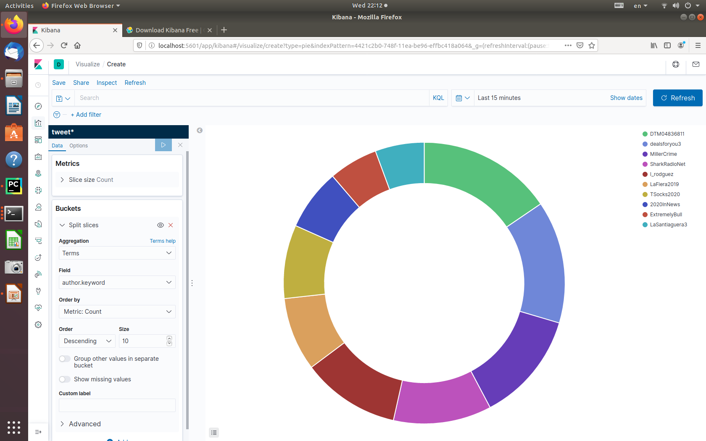
Kibana

