Slide 1
The e- MCQ SYSTEM
Author & Developer : ADITYA ANAND

Slide 2
The e-MCQ SYSTEM
The idea of this project is to prepare a system for the conduction of an online test consisting of MCQs for the students. The main advantage of having this kind of system lies in the fact that the result of many students giving the test simultaneously is published instantly as the test is over.

Slide 3


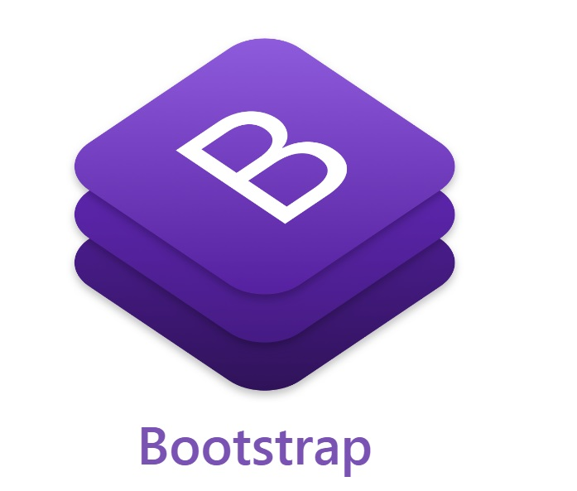




Technologies Used
Frontend :- HTML & CSS , Bootstrap , Bulma , Java Script , Jinja
Database :- MySQL
Backend Driving Framework :- Flask , Python

Slide 4
Database Tables
email
Password
First_Name
Last_Name
email
DOB
Gender
Phone no.
q_no
Question
Option A
Option B
Option C
Option D
Marks
Correct_Opt
User Question
Leaderboard
User_name
marks

Slide 5
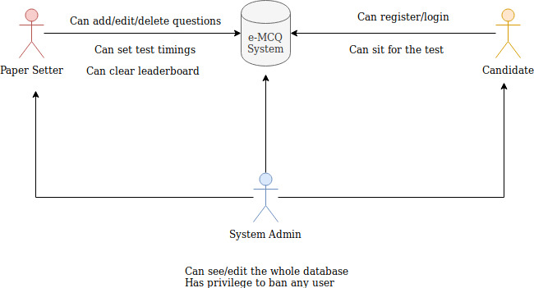
System Overview

Slide 6
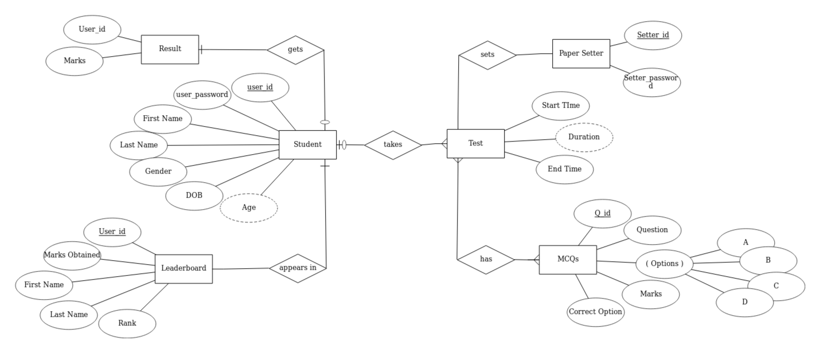
ER DIAGRAM

Slide 7
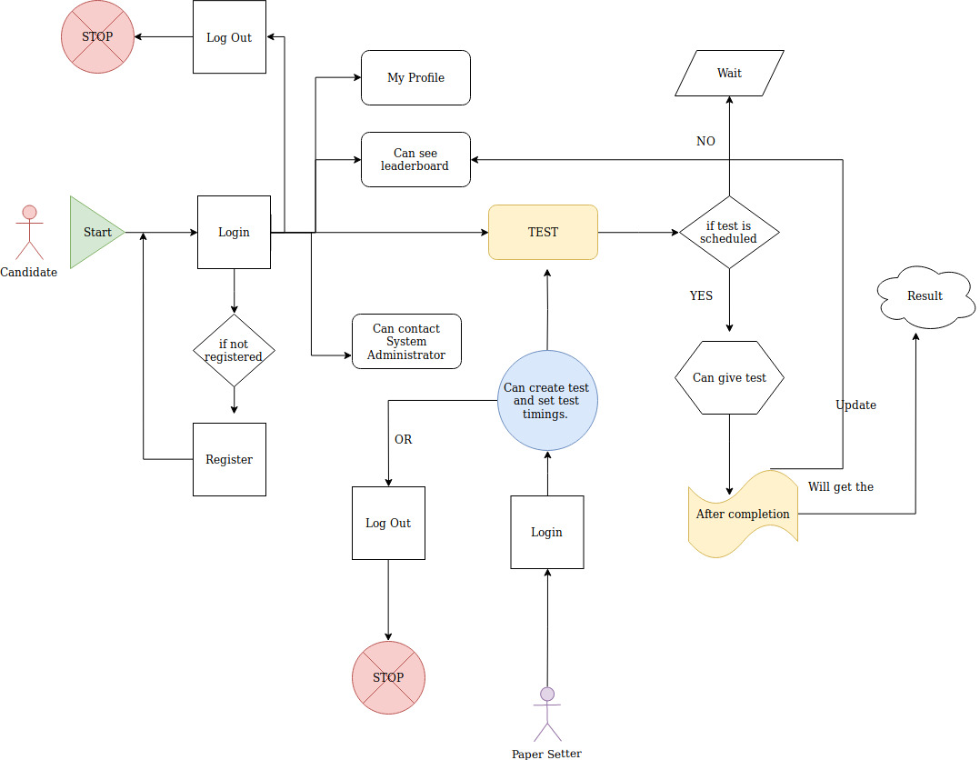
Activity Diagram

