Slide 1
Adaptive NAT Traversal
Behaviour-Aware Hole Punching
Aditya Jaiswal (24BCE2365) · Chiranjib Dash (24BCE2411)
BCSE308P Computer Networks · Guide: Jaya Subalakshmi R
Our agent
Standard ICE baseline
Notes:
We built an agent that measures each router first, then picks the cheapest way to connect two peers directly.

Slide 2
RESULTS AT A GLANCE (MEASURED)
More direct calls, set up faster
Direct connections, simulation (693 calls each)
Median time to a working path
Direct connections, real Linux NATs
Profiler accuracy
Ours
Ours
Ours
Ours
88.0%
57 ms
25/30
105/105
ICE
ICE
aioice
blocks
36.4%
2.54 s
14/30
30/30
Simulation: 231 router pairings × 3 trials. Testbed: 6 pairings × 5 runs on kernel NATs (nftables + conntrack). ICE never got more direct paths than us in any pairing; every call of both agents delivered its data.
All values measured. ICE = ICE-style baseline in simulation, the aioice library on real routers; “blocks” = port-block detection.
2
Notes:
Four numbers: direct connections in simulation, time to a working path, real Linux routers, and profiler accuracy.

Slide 3

THE PROBLEM (ILLUSTRATION)
Why video calls end up on a slow relay
Cone NAT: one public port for every destination, so a simultaneous hole punch gets through.
Symmetric NAT: a new port per destination, so the punch aims at a port that does not exist and is dropped.
Standard ICE then waits out its timeout and relays: median 2.55 s in our simulation.
3
Notes:
A symmetric router opens a new door for every destination, so the punch misses and the call falls back to the relay.

Slide 4
STEP 1 · MEASURE EACH ROUTER
Profiling a NAT (RFC 4787 behaviour)
1 · Filtering test
2 · Mapping test
3 · Allocation test
Own socket. Two parallel probes with CHANGE-REQUEST: reply from another IP+port, and from another port.
→ EI / AD / APD filtering
Compare the public port seen by two server addresses, then by the same IP on another port.
→ EI / AD / APD mapping
12 probes to 12 servers; compare port gaps.
→ sequential / fixed step / random / random inside one aligned 512-port block
Output: a profile label such as APD/APD/Blk512. Accuracy 105/105 (EI 15/15, AD 45/45, APD 45/45); block detection 30/30.
Cost: 0.9 ms on the real full-cone NAT (33 ms simulated). With AD/APD filtering a reply never comes, so it waits out 3 × 0.5 s: 1.50 s real, 1.56 s simulated.
4
Notes:
Three short tests tell us how the router maps ports, which packets it lets in, and how it picks new ports.

Slide 5
STEP 2 · DECIDE (RULES FROM STRATEGY.PY)
Cheapest method that can work
DIRECT
PREDICT
SPRAY
RELAY
Both routers keep one port for everyone (EI mapping).
Simultaneous open to each other's STUN address.
Both ports fixed or predictable (sequential / fixed step), or a lenient side to aim at.
Each side aims at a window of the other's next ports.
A random side that can open ports for the other to hit.
Opener opens N ports, prober fires M probes. Full range N=256, M=1,088; 512-block N=M=49.
Nothing above can work (filters too strict).
Go to the relay at once: median 5.4 ms instead of waiting 2.5 s.
Both peers run the same rules on both profiles, so they agree without extra messages. Port-block sides are tried first as the spray opener.
The JavaScript port in the demo matches strategy.choose() on all 441 ordered pairs of the 21 NAT types, plus the block types (7,731 cases).
5
Notes:
The agent walks down the ladder: direct, predict, spray, relay, and stops at the first rung that can work.

Slide 6

STEP 2 · EXAMPLE FROM THE LIVE DEMO
Port-restricted ↔ symmetric random: SPRAY
Measured for this pairing: ours 3/3 direct, median 83 ms; ICE 0/3, median 2.54 s.
6
Notes:
For a port-restricted router talking to a symmetric random one, the rules pick spraying, and the measured runs agree.

Slide 7
WHY SPRAYING WORKS
The birthday paradox, for ports
P(success) = 1 − e^(−N·M / R)
Full port range
One 512-port block
Measured
R = 64,512
N = 256, M = 1,088
P ≈ 98.7% (1,600 packets worst case)
R = 512
N = M = 49
P ≈ 99.1% (~147 packets)
Spray: 82/84 direct (97.6%) vs formula 98.7%
Block-aware: 98.0% of 102 vs formula 99.1%
7
Notes:
If one side opens N random ports and the other probes M, a match is likely long before every port is tried.

Slide 8
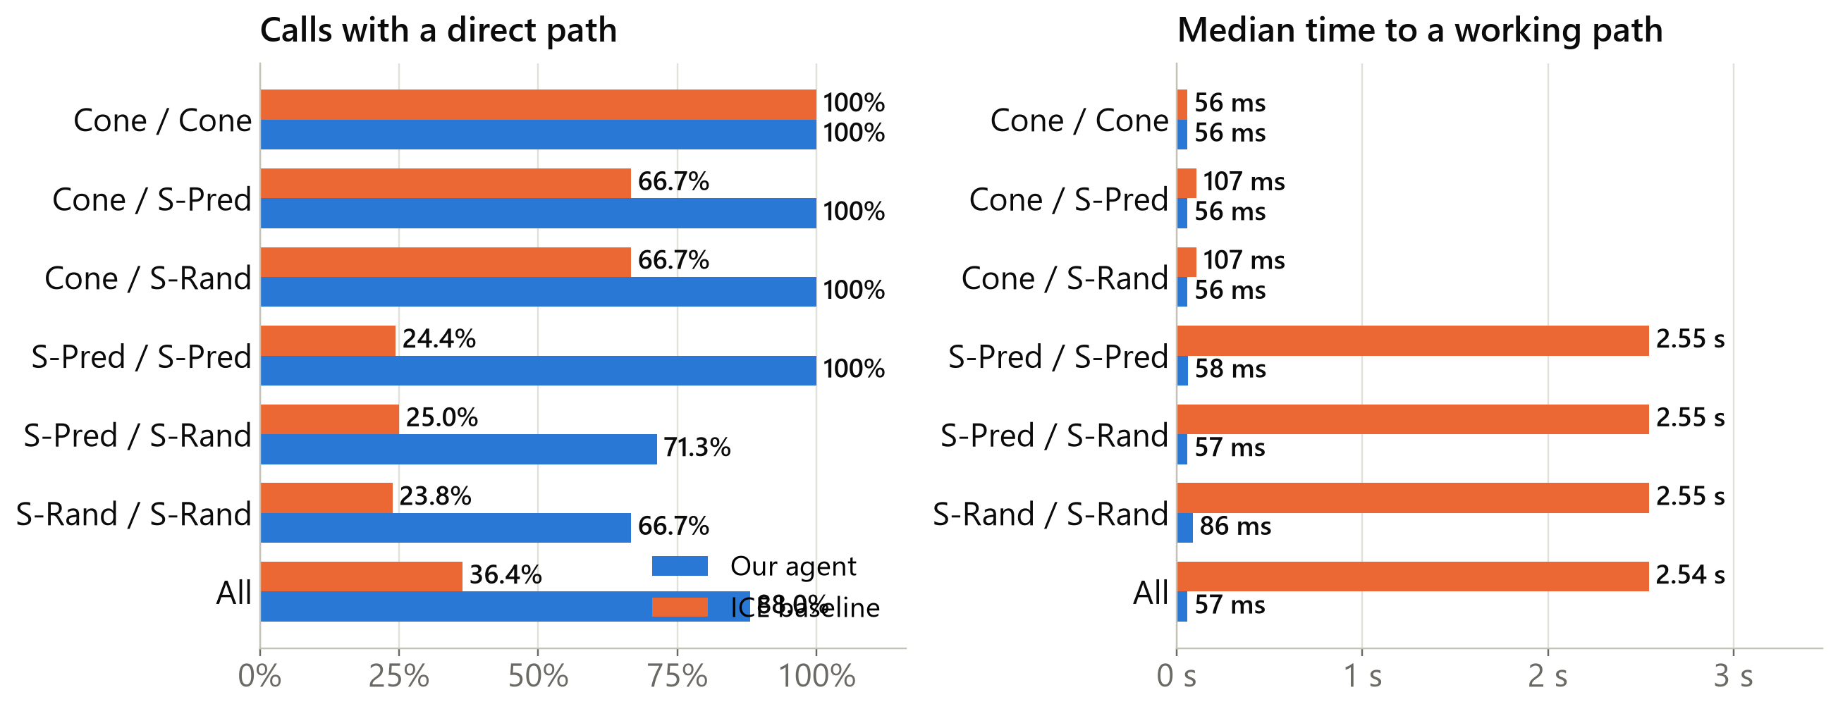
RESULTS · SIMULATION (MEASURED)
Direct paths and setup time by pairing class
231 pairings × 3 trials = 693 calls per agent. Cone = EI mapping; S-Pred = symmetric, sequential/fixed-step ports; S-Rand = symmetric, random ports. ICE was never better in any pairing (ours better in 120, equal in 111); all 693 + 693 calls delivered data.
8
Notes:
In simulation ours connects directly 88 percent of the time against 36 for ICE, and does it in tens of milliseconds instead of two and a half seconds.

Slide 9
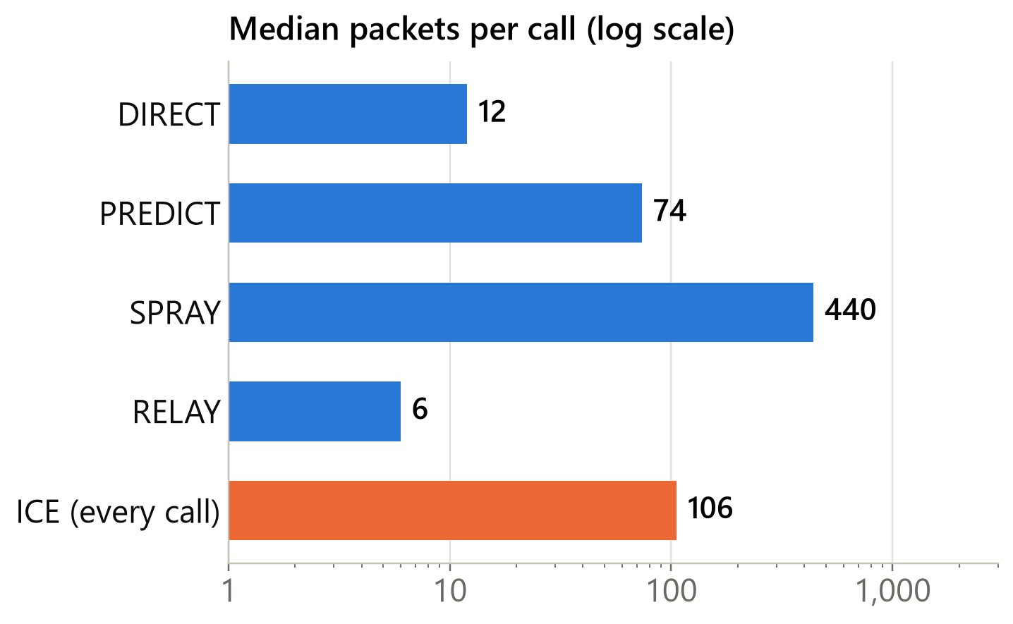
RESULTS · BY METHOD (MEASURED)
What each method costs
Method | Calls | Direct | Median packets | Median time
DIRECT | 18 | 100% | 12 | 56 ms
PREDICT | 510 | 100% | 74 | 57 ms
SPRAY | 84 | 97.6% | 440 | 199 ms
RELAY | 81 | 0% | 6 | 5.4 ms
ICE | 693 | 36.4% | 106 | 2.54 s
SPRAY: 82 of 84 calls direct, formula predicted 98.7%. RELAY pairings go to the relay in 5.4 ms.
9
Notes:
Cheap methods handle most pairings; spraying costs more but only where it is needed, and hopeless pairings go to the relay at once.

Slide 10
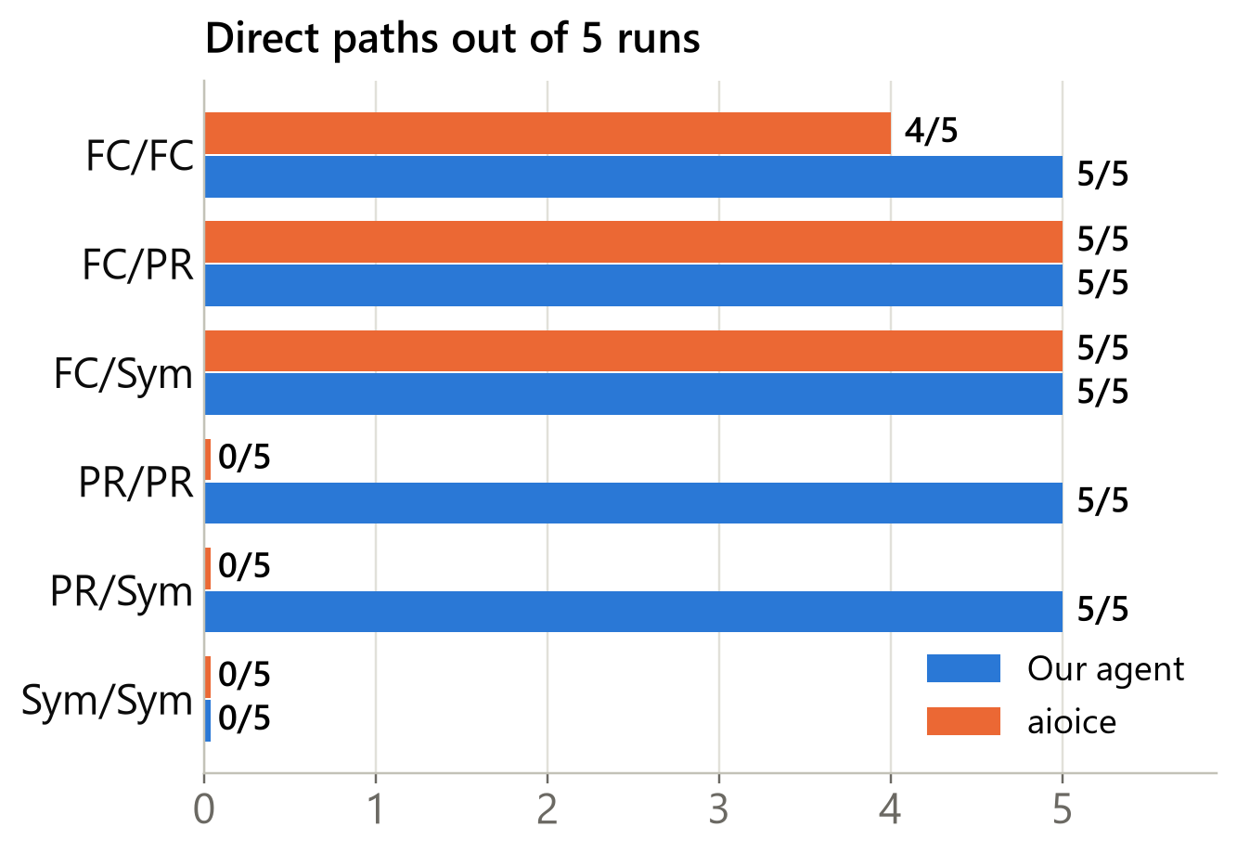
RESULTS · REAL LINUX NATS (MEASURED)
Testbed: ours 25/30 vs aioice 14/30
Pairing | Ours | Method | Median | aioice | Median
FC/FC | 5/5 | Direct | 59 ms | 4/5 | 41 ms
FC/PR | 5/5 | Direct | 60 ms | 5/5 | 42 ms
FC/Sym | 5/5 | Predict | 60 ms | 5/5 | 42 ms
PR/PR | 5/5 | Direct | 61 ms | 0/5 | 15.0 s
PR/Sym | 5/5 | Spray | 319 ms | 0/5 | 15.0 s
Sym/Sym | 0/5 | Relay | 6 ms | 0/5 | 15.0 s
FC = full cone, PR = port-restricted, Sym = symmetric (random). Kernel nftables NATs in network namespaces, 5 runs each; aioice gives up after 15 s. One aioice FC/FC session timed out, which did not reproduce in 6 reruns.
10
Notes:
On real Linux routers we got 25 of 30 direct against 14 for aioice; aioice failed every port-restricted pairing.

Slide 11
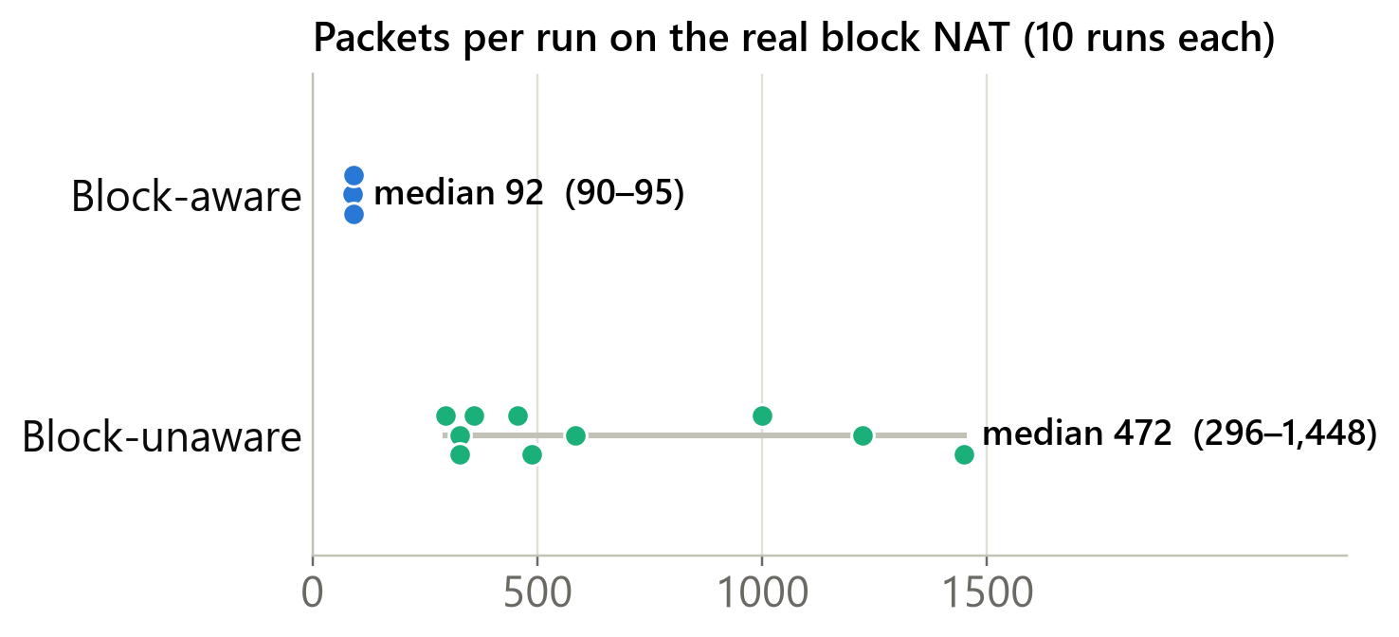
RESULTS · PORT-BLOCK-AWARE SPRAYING (MEASURED)
Same success, about 5× fewer packets
 | Block-aware | Unaware | ICE / aioice
Sim: direct | 98.0% | 98.0% | 26.5%
Sim: median packets | 92 | 424 | –
Sim: median time | 83 ms | 196 ms | 2.54 s
Real NAT: direct | 10/10 | 10/10 | 0/5
Real NAT: packets | 92 (90–95) | 472 (296–1,448) | –
Real NAT: median time | 86 ms | 228 ms | 15 s timeout
Simulation: 102 calls that sprayed into a 512-port block. Real NAT: nftables “masquerade to :40960–41471 random”.
11
Notes:
Spotting the 512-port block cuts spraying cost about five times with the same success, and makes it predictable.

Slide 12
WHAT WE LEARNED
Four findings
1 · Discovery tests contaminate each other
2 · Linux conntrack breaks naive simultaneous open
Shared socket, mapping first: strict filters looked lenient (simulator 12/15 → 15/15 after reordering). Filtering first: Linux EI NATs looked symmetric (conntrack entries). Fix: separate socket for the filtering test.
An early packet leaves an UNREPLIED entry and the NAT re-maps the port (/proc/net/nf_conntrack: 58330 became 52320). aioice: 0/10 on port-restricted pairings. Fix: TTL-2 opening packets.
3 · APD replies leave from a new port
4 · Port blocks make spraying cheap and predictable
That rules out some pairings that look feasible. The agent sends them to the relay in 5.4 ms instead of wasting 2.5 s.
About 5× fewer packets, same success: 90–95 packets every time on the real NAT, against 296–1,448.
12
Notes:
Testing on real Linux turned up four problems that the textbook description of NAT traversal leaves out.

Slide 13
HONEST SCOPE
Limitations and future work
Limitations
Future work
Simulator follows RFC 4787 exactly
Testbed: one machine, three Linux NAT types, no real delay or loss
TTL = 2 matches the testbed topology
JSON probes instead of binary STUN (aioice runs use real STUN)
Minimal relay, not coturn
Adaptive keepalive not implemented
Block detection assumes aligned blocks
Real routers and mobile / carrier-grade networks
Automatic TTL: measure hops to our own NAT
WebRTC integration: steer ICE checks with the profile
13
Notes:
Our testbed is one machine with three Linux NAT types; next we want real routers, mobile networks and WebRTC integration.

Slide 14
Thank you
Questions?
Live interactive demo: demo/index.html (works offline)
Aditya Jaiswal (24BCE2365) · Chiranjib Dash (24BCE2411)
Notes:
Happy to take questions, or show any pairing live in the demo.

