Slide 1
DengAI: Predicting Disease Spread

Slide 2
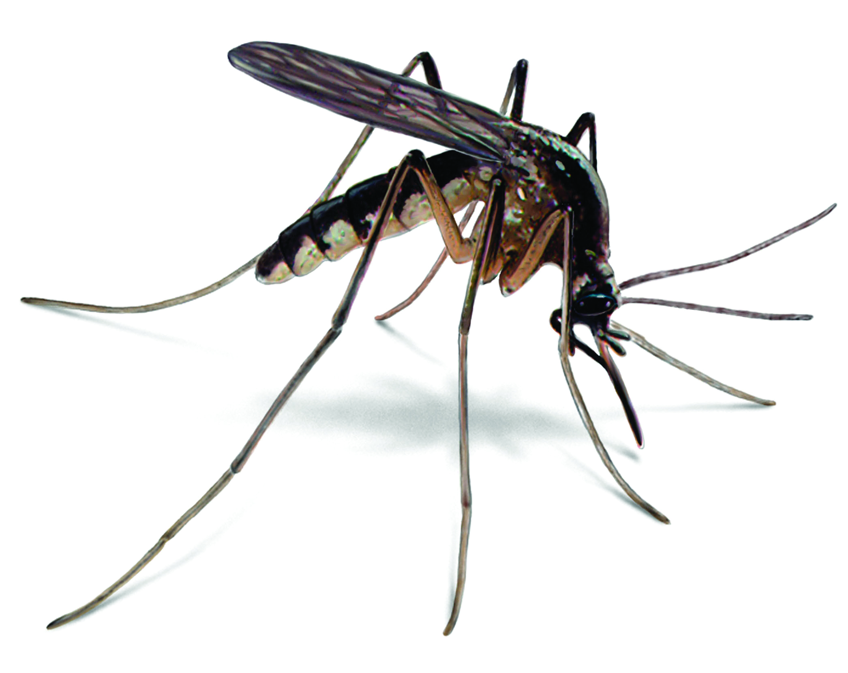
Temperature and mosquito activity goes hand in hand!
Best conditions to thrive:
Moist, relatively warm environments, functioning best at 80°F.
Once the temperature lowers to about 60°F they become lethargic and anything below 50°F they find it hard to function at all.
Any time there is rain, there is increased mosquito breeding. Mosquitoes need stagnant water to lay their eggs.
Dengue virus:
higher temperatures (23-28°C) resulted in more rapid viral growth and higher levels of virus.
Under the coolest conditions, at 18°C, the virus grew very slowly

Slide 3
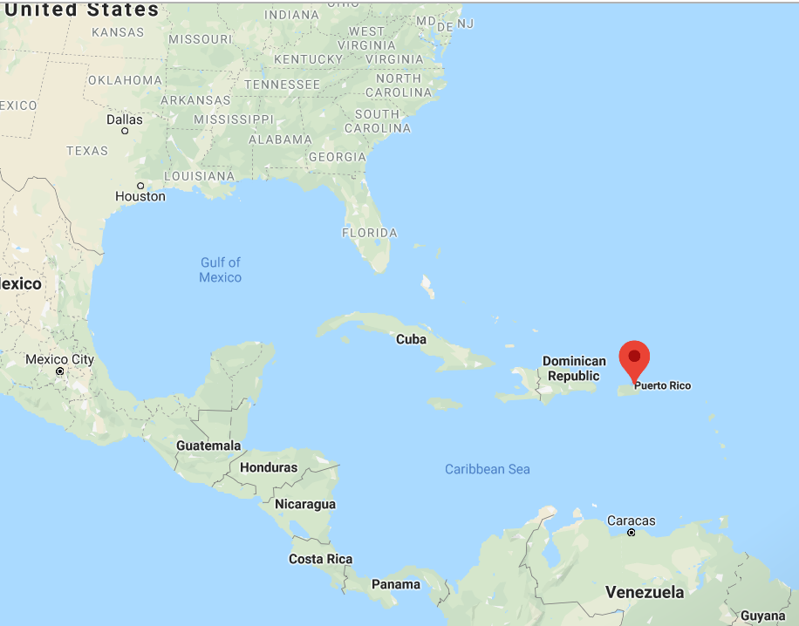
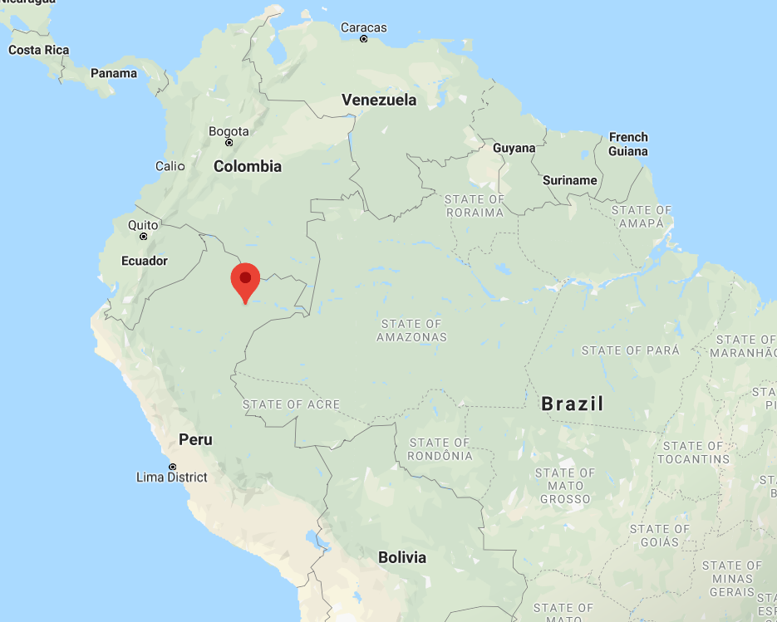
Cities at glance
San Juan
Iquitos
Coastal city in Puerto Rico
Port city in Peru
Surrounded by dense forest and river Amazon

Slide 4
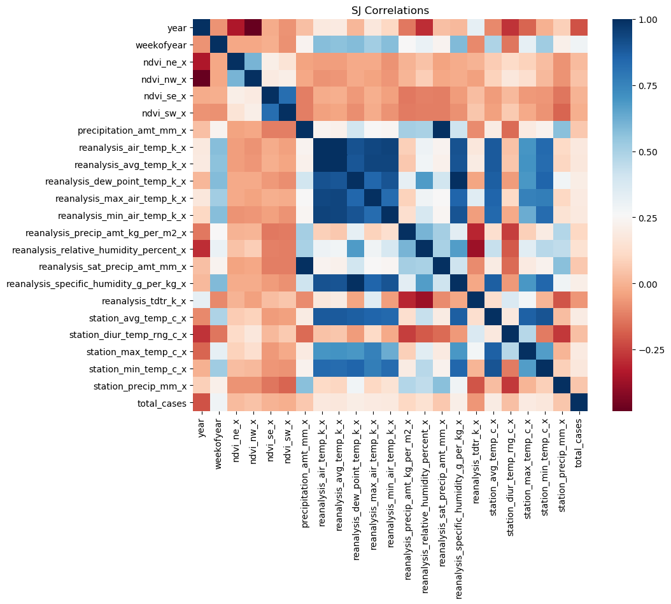
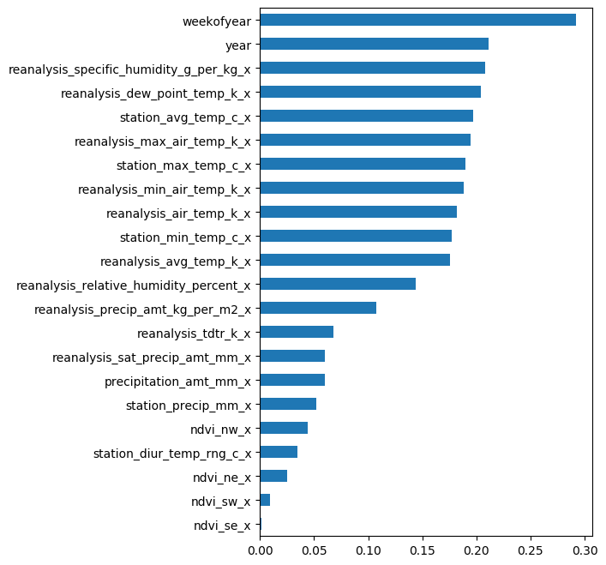
San Juan

Slide 5
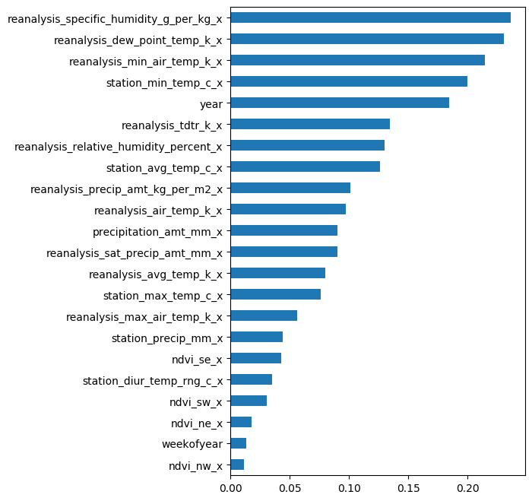
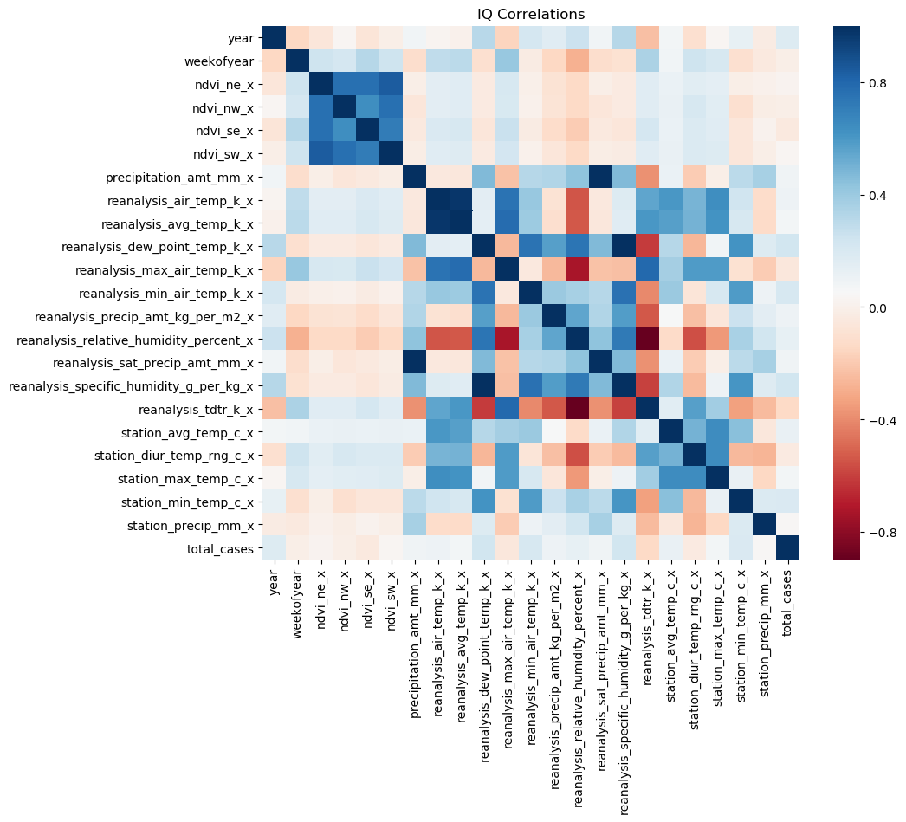
Iquitos

Slide 6
Game plan
Pre-processing
Imputing data for NaN values (train and test data)
Modelling
For each city :
Evaluating and Predicting
Evaluating best model for each city with lowest MAE
Separating data by cities and removing unnecessary columns
Random Forest
LassoCV
Gradient Boosting
Lasso regularised Gradient Boosting
Keeping a holdout sample for calculating OOB MAE
Predicting total cases using the imputed test set

Slide 7


Results – San Juan
Train: 800
Test: 130
Model | Best hyerparameters | Test set MAE | Selected
Random Forest | {'max_depth': 8, 'max_features': 'log2', 'min_samples_leaf': 0.05, 'n_estimators': 300} | 25.40
Lasso CV | Alpha= 0.04516 | 27.74
Gradient Boosting | max_depth=7 | 11.50
Lasso regularised Gradient Boosting | max_depth=3 | 11.16
Final Model | hyerparameters
Lasso regularised Gradient Boosting | Alpha= 0.0567 max_depth=3

Slide 8
Results – Iquitos
Train: 400
Test: 116
Model | Best hyerparameters | Test set MAE | Selected
Random Forest | {'max_depth': 6, 'max_features': 'log2', 'min_samples_leaf': 0.05, 'n_estimators': 50} | 6.36
Lasso CV | Alpha= 0.0278 | 6.74
Gradient Boosting | max_depth=3 | 5.63
Lasso regularised Gradient Boosting | max_depth=3 | 6.57
Final Model | hyerparameters
Gradient Boosting | max_depth=3

