Slide 1
PAC-MAN
Aditya Agarwal-14D110015
Rishabh Dosi-140110066
Rishabh Jain-140110065
Harshita Motwani-140110075

Slide 2
Problem Statement
Our project is based on the popular game Pac-man and include basic elements of a Pac-man game
We start off with Pac-Man chased by some ghosts. Pac-man’s goal is to navigate through the maze, eating the dots that are spread all over the map. Ghost’s goal is to catch the Pac-man. We have 4 directions to move Pac-Man (up-down-left-right).You will have option of choosing 1 out of two different maps
The game is for recreational purposes and for stimulating your reflexes and enhancing your gaming skills.

Slide 3
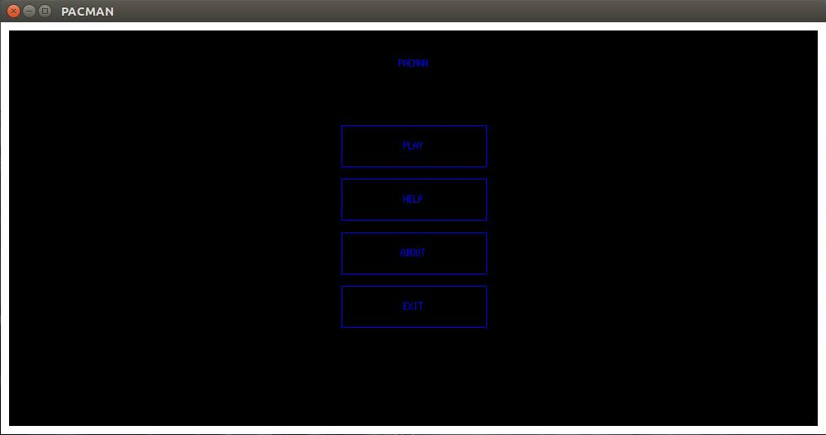

Slide 4
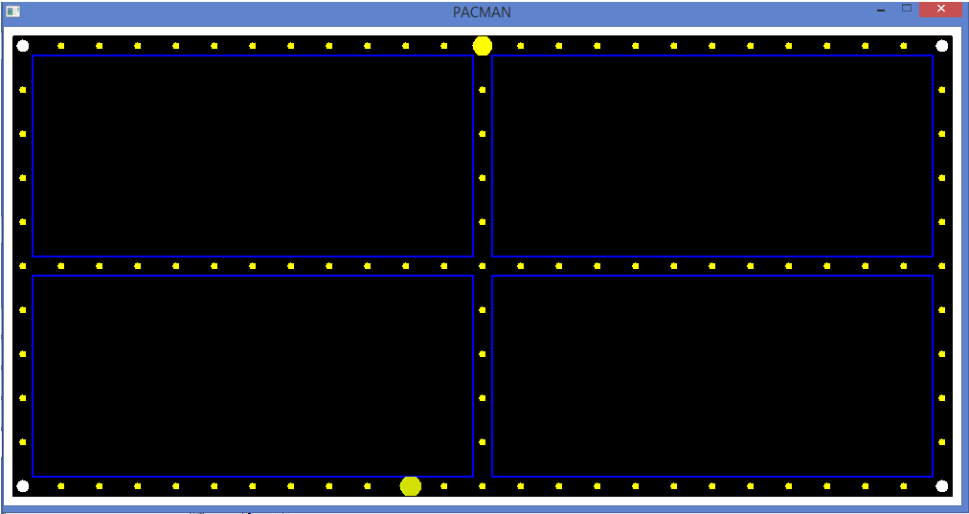

Slide 5
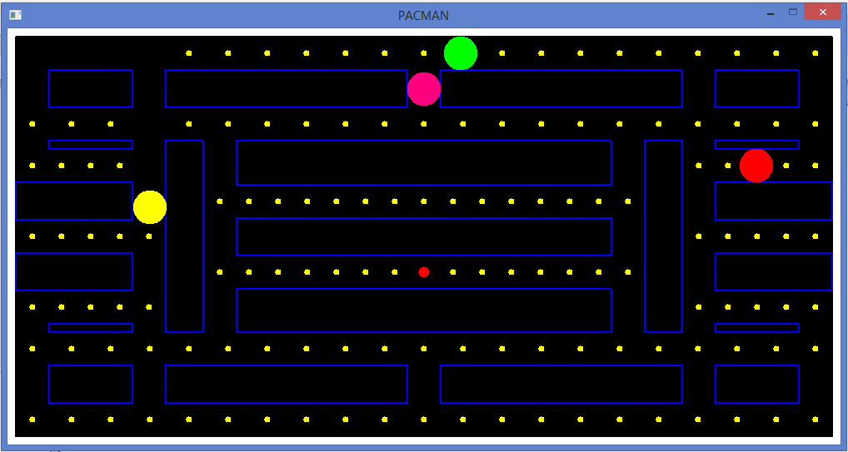

Slide 6
CHALLENGES
Moving Pac-man through large number of constraints was challenging.
Implementing the ghost which had to be fully automatic was a bit tedious.
Making maze using large number of coordinates was also little confusing.
Giving special power to Pac-man to be able to kill the ghost was a bit difficult.

Slide 7
FUTURE WORK
Program could be modified using advanced graphics like allegro.
Implementation of movement of ghost can be improved .As of now the movement of ghost is random but it can be modified to chase the Pac-man.
More mazes can be added to make the game even more fun and interesting.

Slide 8
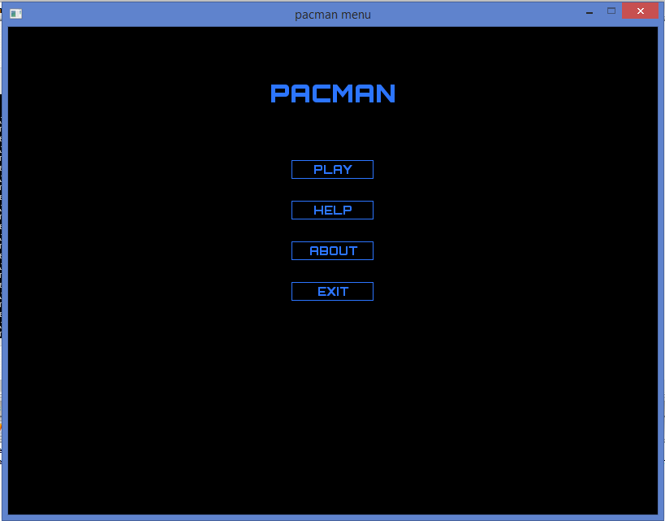

Slide 9
