Slide 1
NLP Project: Group - 1
Deception Detection
Group Members:
Aditya Gupta (2022031)
Debjit Banerji (2022146)
Sahil Gupta (2022430)

Slide 2
Introduction
Objective: Classify in-game messages in Diplomacy as deceptive or truthful
Feature Extraction:
Textual content
Contextual metadata (e.g., timing, player behavior)
Focus Areas:
Linguistic cues indicating deception
Behavioral patterns in conversation
Model Strategy:
Train and fine-tune for optimal accuracy
Impact:
Improve in-game strategic decision-making
Contribute to research in deception detection in communication

Slide 3
Related Work
Main Paper: It Takes Two to Lie: One to Lie, and One to Listen
Introduced the ConvoKit Diplomacy dataset
17,289 messages collected
~5% marked as lies (by sender/receiver)
Dual Annotation:
Sender labels intent (truth or lie)
Receiver labels perceived truthfulness
Baseline Model:
Logistic Regression using Bag-of-Words & deception cue words
Neural Approaches:
LSTM with conversational context
Integration of power dynamics and BERT embeddings
Key Challenges:
Severe class imbalance (~5% lies)
Requires weighted evaluation metrics
Human Performance Benchmark:
Lie F1 score ≈ 22.5
Best Performing Model:
LSTM + Context + Power features
Approaches human-level Lie F1 score
Key Insights:
Context and game dynamics improve prediction
Lies often blend with truth — the “veracity effect”
Relevance to Our Work:
Establishes a benchmark and methodological foundation for deception detection in Diplomacy

Slide 4
Related Work
Reference Paper 1: BERTective: Language Models and Contextual Information for Deception Detection
Focused on DECOUR dataset from Italian court hearings
Utterances labeled as True, False, or Uncertain
Strong label imbalance handled using F-measure and other metrics
Compared MLP, CNN, and various BERT-based architectures
Best performing: BERT + Transformers with speaker context
Accuracy: 71.61%, F1: ~67%
Plain BERT + Dense: lower F1 (~45.6%) despite decent accuracy
Demonstrated that context-aware models significantly outperform isolated text models
Inspired our architectural design and attention mechanisms

Slide 5
Related Work
Reference Paper 2: No Press Diplomacy: Modeling Multi-Agent Gameplay
Proposed DipNet — a model for No-Press Diplomacy (no message-based communication)
Trained on 150k+ human games, integrated with DAIDE engine
Architecture:
GCN with FiLM layers for relational game state modeling
LSTM decoder for sequential, valid unit order generation
Used masking and topological decoding for order consistency
Trained using Supervised Learning + Reinforcement Learning
Unit-order accuracy: 61.3% (teacher forcing), 47.5% (greedy)
Tournament performance (TrueSkill): 28.1 vs. 24.5 (rule-based)
Provided ideas for state encoding, relational modeling, and training strategies

Slide 6
Methodology
Baseline Model 1: Bag of Words (BOW) Model
Objective: Capture lexical patterns to detect deception based solely on word usage
Preprocessing & Feature Extraction
Text normalization: lowercase, stopword removal, lemmatization
Extracted unigrams and bigrams to capture short phrasal cues
TF-IDF vectorization to highlight discriminative words
Chi-squared feature selection for retaining key features
Classification Architecture
Logistic Regression with L2 regularization
Class weighting to address class imbalance
K-fold cross-validation for hyperparameter tuning
Limitation: Does not incorporate conversational context or sequence; relies purely on lexical features

Slide 7
Methodology
Baseline Model 2: Context + Power LSTM Model
Objective: Model deception using sequential context and interpersonal power dynamics
Text Representation
Pre-trained GloVe embeddings (300d) for semantic information
Zero-vector handling for OOV words, sequence padding for batching
Model Architecture
Bidirectional LSTM with 128 hidden units
Contextual concatenation of up to two previous messages
Game score features to encode power dynamics
Attention mechanism to focus on important parts of messages
Dense + ReLU layers for feature integration
Sigmoid output for binary classification
Training Procedure
Binary cross-entropy with class weights
Adam optimizer (LR = 1e-3) with decay
Dropout (0.3) for regularization
Early stopping based on validation loss
Batch size: 64
Advantage: Incorporates contextual flow and relational cues, making it stronger than the BOW model (but still simpler than Transformer-based methods)

Slide 8
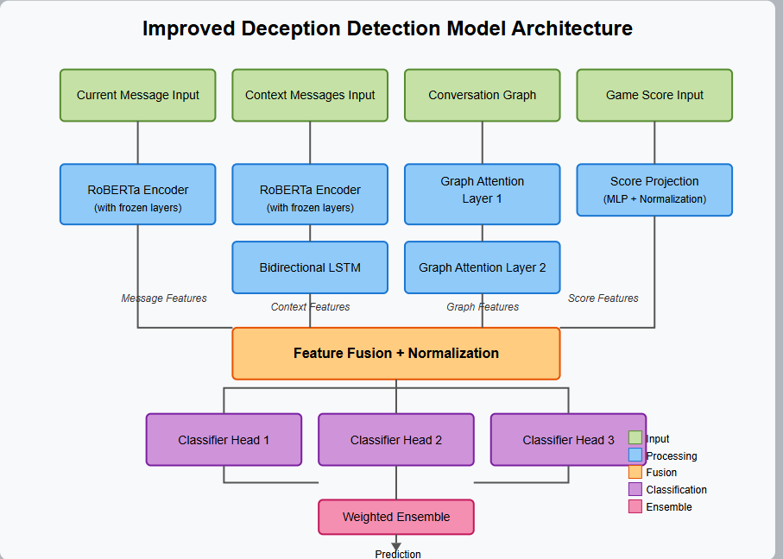
Methodology
Novel Model 1 — RoBERTa + BiLSTM + GCN
Overview
Multi-stream neural architecture combining content, context, graph-based relations, and power dynamics.
Inspired by prior work (e.g., Peskov et al., 2020), aiming for a deeper understanding of deceptive language in conversations.
Data Preparation
Dataset: Conversational messages labeled as truthful or deceptive.
High class imbalance (95.5% lies vs. 4.5% truths).
Mitigation strategies:
Oversample truths by a factor of 30.
Focal weighted loss to penalize misclassification of truths.
Class weights applied in loss function.

Slide 9
Methodology
Novel Model 1 — RoBERTa + BiLSTM + GCN
Message Content Representation
Pre-trained RoBERTa-base model for semantic understanding.
Only last layers are trained (first two frozen).
Dropout (0.3) applied for regularization.
Contextual Encoding
Two prior messages used as conversational context.
Separate RoBERTa model (not sharing weights).
BiLSTM summarizes token-level outputs.
Minimum sequence length enforced for zero-padding cases.
Graph-Based Relational Features
Messages treated as nodes; edges represent their sequence relationships.
Two Graph Attention Layers (GATs) for:
First GAT: 768+768 → 256-dimensional features.
Second GAT: further refinement.
Edge weights inversely proportional to message distance.
Game Score (Power Dynamics)
Power status derived from game scores.
Embedded using small MLP → 32-dimensional representation.
Layer normalization, ReLU activation, dropout (0.2) used.

Slide 10
Methodology
Novel Model 1 — RoBERTa + BiLSTM + GCN
Feature Fusion & Classification
Four streams concatenated and normalized.
Ensemble of three classifier heads:
Full fusion of all features.
Message + context only.
Graph features only.
Final prediction is a weighted sum (learned during training).
Loss Function Design
Custom focal weighted loss:
Class weights based on inverse frequency.
Additional penalty for misclassifying truths.
Encourages balanced learning between major and minor classes.
Evaluation Metrics
Class-specific F1 scores.
Macro-F1 to capture overall performance.
Emphasis on truth detection accuracy.

Slide 11
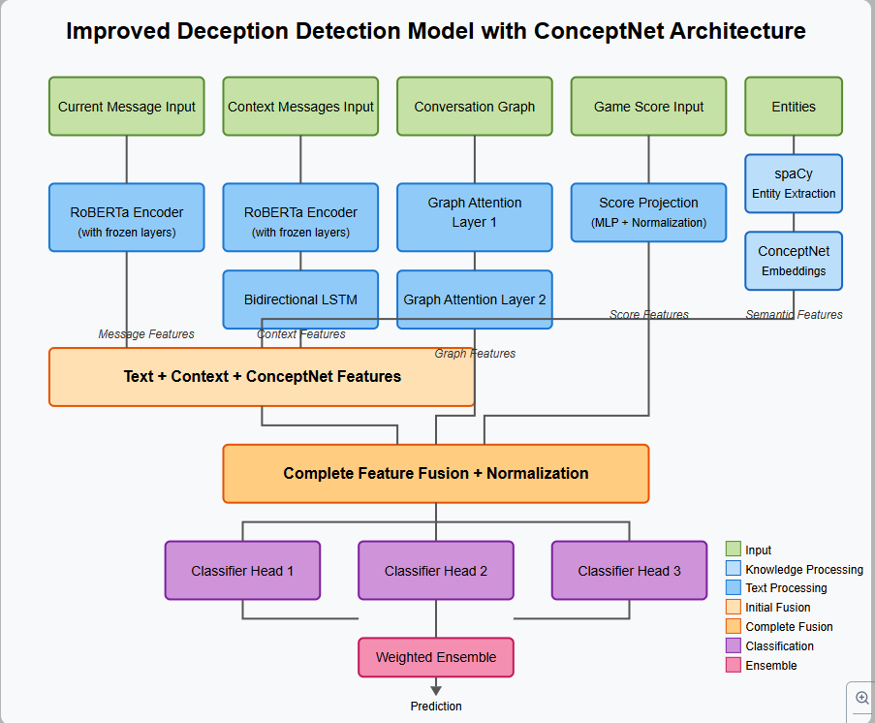
Methodology
Novel Model 2 — RoBERTa + BiLSTM + GCN + ConceptNet
Overview
Extends Model 1 by integrating external semantic knowledge from ConceptNet (Numberbatch).
Fifth information stream enhances understanding of common-sense concepts and semantic inconsistencies.
Semantic Knowledge Integration
Entity extraction using spaCy:
Named entities prioritized; fallback to nouns/proper nouns.
Up to 5 entities per message.
ConceptNet embeddings (300-dim):
Encode real-world relationships between entities.
Zero-vector used if embedding not found.
Mean pooling of entity vectors for unified semantic representation.

Slide 12
Methodology
Novel Model 2 — RoBERTa + BiLSTM + GCN + ConceptNet
Fusion & Classification Enhancements
Two-stage fusion:
Message + context + ConceptNet → GAT layers.
Then fused with game score features.
Modified ensemble:
Full fusion.
Message + context + ConceptNet only.
Graph-only classifier remains.
Significance
Adds real-world knowledge to internal conversation signals.
More semantically aware deception detection.

Slide 13
Dataset Description
Source: 2020 ACL Diplomacy Dataset (from the board game Diplomacy)
Purpose: Analyzing strategic deception in negotiation-based communication
Format: JSONLines; also available via ConvoKit (message-based structure)
Message Metadata\
speakers / receivers: Country names (e.g., "russia", "england")
messages: Raw text (words to paragraphs)
sender_labels: Ground truth (truthful/deceptive)
receiver_labels: Perceived truth/deception
game_score / score_delta: Strategic game-state data
message index / season / year / game_id: Contextual info
Game Move Data: Included for understanding communication-strategy links
Data Splits
Training: 13,132 messages (4.5% truth / 95.5% lies)
Validation: 1,416 messages (3.95% truth / 96.05% lies)
Test: 2,741 messages (8.76% truth / 91.24% lies)

Slide 14
Experimental Setup
Environment & Platform
Evaluated on Kaggle with NVIDIA GPU support
Ensured consistent setup for fair comparison between models
Preprocessing Steps
Tokenization: RoBERTa tokenizer, max length 128
Context Extraction: Included up to 2 previous messages
Class Balancing: Oversampled minority class (truth) ×30
Batch Construction: Custom collate + adjacency matrix for GCN
Training Configuration
Batch Size: 32
Learning Rate: 5e-6 (AdamW, weight decay 0.01)
Epochs: Max 5 with early stopping (patience 5)
Loss: Custom focal weighted loss (truth weight = 4.0)
Gradient Tricks: Accumulation (×2), clipping (1.0), 10% warm up
Evaluation Metrics
Truth F1, Lie F1, Macro-F1
Confusion Matrix for detailed insights
Best Models Chosen By:
Highest Lie F1 (minority class)
Highest Macro-F1 (overall balance)

Slide 15
Experimental Setup
Base Model: RoBERTa + BiLSTM + GCN
Features:
Message: 768 (RoBERTa)
Context: 768 (BiLSTM)
Graph: 256 (GAT)
Game Score: 32 (MLP)
Combined: 1,824 dimensions
Graph Construction:
Nodes: Messages
Edges: Weighted by inverse message distance
ConceptNet-Enhanced Model
Additional Feature:
Semantic: 300-d ConceptNet embeddings
Features:
Message: 768 (RoBERTa)
Context: 768 (BiLSTM)
Semantic: 300 (ConceptNet)
Graph: 256 (GAT with semantic input)
Game Score: 32 (MLP)
Combined: 2,124 dimensions
Graph Update: Same adjacency logic; GAT now receives semantic-enriched input

Slide 16

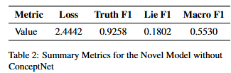
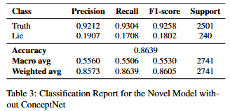
Results & Findings
Baseline Comparison & Performance of Novel Model without ConceptNet
Baseline Models:
BOW: Macro F1 = 0.5150, Lie F1 = 0.1500
Context+Power: Slightly better, Macro F1 = 0.5280
Struggle heavily on Lie class due to class imbalance.
Novel Model (No ConceptNet):
Macro F1 = 0.5530, Lie F1 = 0.1802, improved from baseline.
Very high Truth F1 = 0.9258 → model biased towards majority class.
Confusion matrix shows strong true positive rate for truth, but weak lie detection.

Slide 17
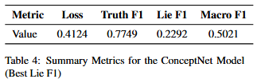
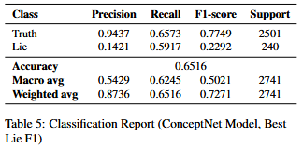
Results & Findings
ConceptNet-Enhanced Model (Optimized for Lie F1)
Focus: Improve detection of deceptive (lie) messages
Lie F1 = 0.2292 (improved from 0.1802)
Truth F1 drops to 0.7749 → trade-off introduced
Accuracy reduced to 65.16%, but better balance in detecting both classes.
External knowledge (ConceptNet) helps the minority class, though with side effects.

Slide 18
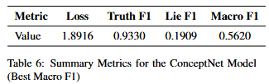
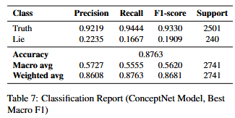
Results & Findings
ConceptNet Model (Optimized for Macro F1) & Final Observations
Balanced optimization:
Truth F1 = 0.9330, Lie F1 = 0.1909, Macro F1 = 0.5620
Highest Macro F1 across all models
Best overall trade-off between detecting truths and lies
Key Takeaways:
Novel models outperform baselines in all metrics.
Adding ConceptNet enhances minority class performance, especially for lies.
Performance depends heavily on model selection criteria (Lie F1 vs. Macro F1).

Slide 19
Analysis & Observations
Limitations of Baseline Models
Bag-of-Words (BoW) and Context+Power LSTM served as performance benchmarks.
Relied mainly on lexical features and shallow context, limiting deception detection capability.
Struggled with class imbalance, leading to:
Low Lie F1 scores (difficulty identifying deceptive class).
Moderate Macro F1, indicating imbalanced performance.
Strengths & Weaknesses of Novel Model (without ConceptNet)
Utilized transformer-based embeddings + GCN to model both text and inter-message relationships.
Achieved very high Truth F1 (0.9258) → excellent at recognizing truthful messages.
Lie F1 remained low (0.1802) → still ineffective for detecting deception.
Reveals that even deep models require additional semantic mechanisms for nuanced deception cues.

Slide 20
Analysis & Observations
Impact of Integrating ConceptNet (External Knowledge)
Introduced commonsense knowledge embeddings, improving contextual grounding.
When optimized for Macro F1:
Achieved more balanced performance across both classes.
Improved Lie F1, while maintaining high Truth F1 (0.9330).
Significantly improved Macro F1 (0.5620), addressing class imbalance better.
Key Insights
Optimization objective matters:
Focusing on Lie F1 vs. Macro F1 leads to different trade-offs in model behavior.
Deception detection benefits from a multifaceted approach combining:
Rich language representations
Graph-based context modeling
External semantic grounding (e.g., ConceptNet)

Slide 21
Conclusion & Future Work
Addressed deception detection in Diplomacy game messages using two novel deep learning models that surpass traditional approaches.
Baselines (Bag-of-Words, Context+Power LSTM) provided performance benchmarks but failed to capture nuanced deception cues.
Proposed Models:
RoBERTa + BiLSTM + GCN: Combined transformer-based language understanding with graph neural networks to capture both message content and inter-message relationships. Incorporated game score features to model power dynamics.
RoBERTa + BiLSTM + GCN + ConceptNet: Enhanced with commonsense knowledge via ConceptNet embeddings, enabling detection of subtle semantic inconsistencies missed by text-only models.

Slide 22
Conclusion & Future Work
Tackled class imbalance using focal weighted loss and balanced sampling.
Ensemble classifier approach improved robustness by leveraging diverse feature perspectives.
Results show that effective deception detection requires:
Rich language understanding
Awareness of conversational context
Modeling of power dynamics
Integration of external semantic knowledge
Future work:
Explore multimodal cues, advanced attention mechanisms, and refined loss/sampling strategies for improved performance.

Slide 23
References
Link to the dataset
Reference for the baseline model implementations
Link to dataset convokit
Link to referenced research paper
Link to research paper in related works
Link to research paper in related works
Project Github Repository Link: https://github.com/adityaaggupta2017/NLP_Project

