Slide 1
SIGN-LANGUAGE TRANSLATOR

Slide 2
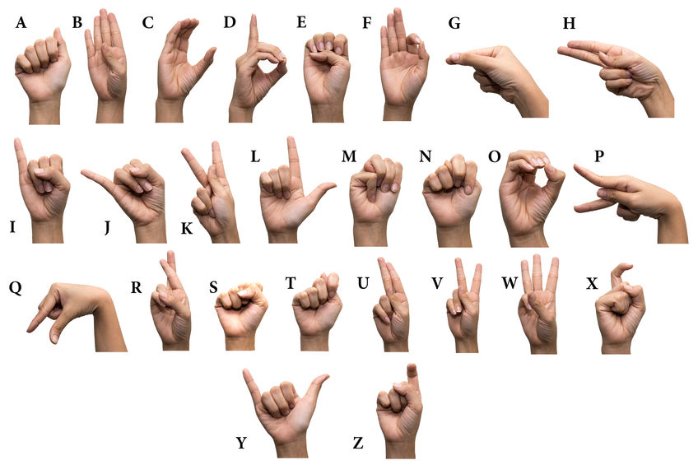
INTRODUCTION
Providing effective approach for communication with deaf and dumb people.
The message transferred will be in the form of text and speech.
All these services will be provided using a portable physical device which will access the storage, processing and software facilities of the main system using cloud.

Slide 3
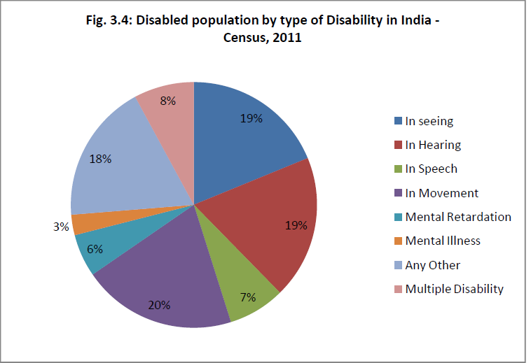
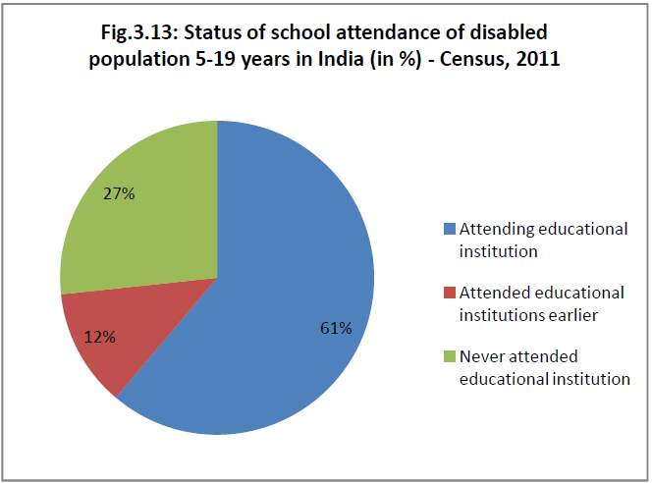
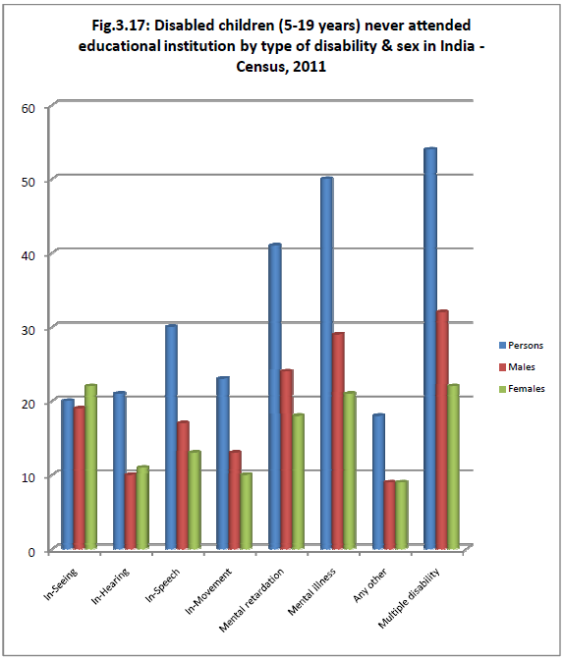
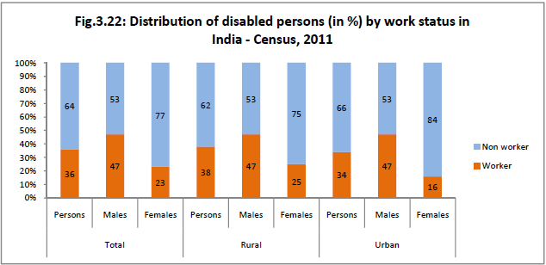

DATA ANALYSIS
Disabled population by type of disability in India
Status of school attendance of disabled population 5-19 years in India
Disabled children(5-19 years) never attended educational institution by type of disability & sex in India
Distribution of disabled persons(in %) by work status in India

Slide 4
ARCHITECT
PHYSICAL DEVICE
MAIN SYSTEM
DETECTION
IDENTIFICATION
DETECTED SYMBOL
Image processing
Deep Learning Algorithm(Classifier)
HDFS Cluster
Hand Detection

