Slide 1
Graph Neural Networks for Recommender Systems

Slide 2
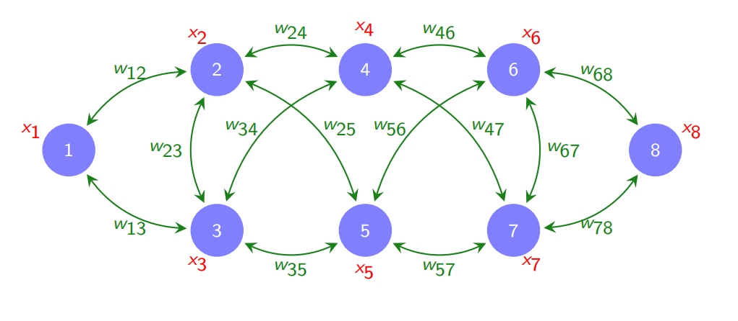
Graph Theory and why GNNs
Power of GNNs
- Graph representations are found everywhere
- Extremely Low Latency
- Accommodate large data structures
- Handle multi-level tasks
.

Slide 3
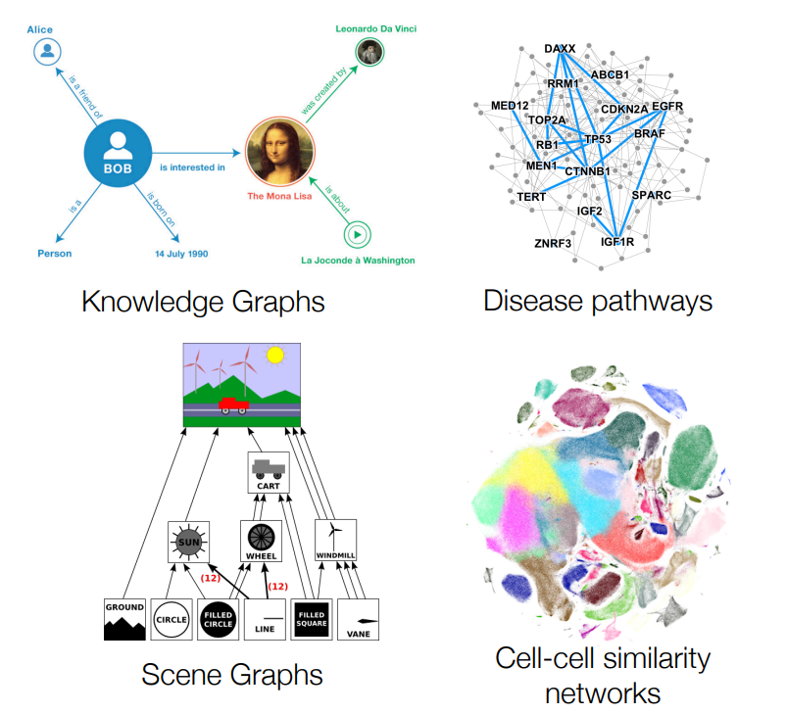
Traditional GNN Taks
1. Node Level Tasks
- Node Classification
- Node Featurization
Edge Level Tasks
- Link Prediction
- Edge Analysis
Graph Level Tasks
-Graph Generation
- Multi-graph comparison

Slide 4
GNNs for Recommender Systems
Node Similarity Embedding
Katz Index/ Adamic-Adar Index
Eigenvector/Betweennes Centrality
Link Based Features
Simple Common Neighbours
Jaccard’s Coefficient
Graph Based Prediction
Weisfeiler Lehman Kernel
Aggregational Graph representation Learning
node2Vec (Used Everywhere)
Random Walk Strategies - Deepwalk
Noise Contrastive Estimation
Adamic-Adar Index
Katz Index
Bag-of-Graphlets Kernel
Bag-of-Node-Degrees Kernel

Slide 5
My GNN Model Features
Huge Dataset
List of ~ 50,000 Games obtained from Steam API
Link Prediction Model
Based on Graph Convolutional Networks
Negative Sampling
To provide robust estimates normalized against random negative samples
Deep Feature and Edge Encodings
Self-Supervised Learning
Algorithm

Slide 6
Model Analysis
STRENGTHS
Low Space Complexity
Low Shot Learning Ability
Extremely Low Latency
WEAKNESSES
Huge Computational Time
Fails to incoroprate global nieghbourhood features
Random Link Splitting
Negative Sampling
Deep Node/Edge Encoding
Strategies Incorporated
Superior 80% Accuracy
Quick Training – Highest Accuracy
achieved in ~20 epochs
Model Evaluation

Slide 7
~51,000 GAMES
~ 500 genres
More than 1 billion edges
That’s a lot of games
And a lot of genres

Slide 8
Model Pipeline
Obtain the dataset
Describe Node Embeddings
Setup the model pipeline
Setup Node Embedding Transforms
Setup GCNN Layers
1
2
3
4
5
6
7
8
9
10
Clean
and
Preprocess
Featurize Edge Embeddings
Create a custom PyTorch Dataset
Incorporate Negative Sampling and Random Splits
Evaluate with AUC and ROC

