Slide 1
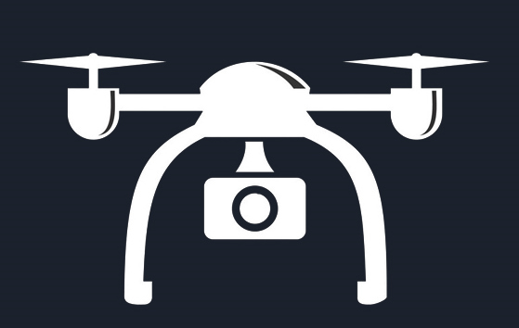


Drone
Bootcamp
Aeromodelling Club
IITK

Slide 2
TEAM MEMBERS AND MENTORS
Mentors-
1)Mohit Anand 4)Raj Agarwal
2)Moin Ahmed 5)Prathamesh Thakare
3)Pranshu Singhal
Team Members-
1)Deepanshi Maheshwari 5)Devansh Agarwal
2)Aditya Anand 6)Gargi Naladkar
3)Aditi Sinha 7)Mayank Saini
4)Palmate Aditya Tukaram

Slide 3
Project Goals
Introduction to basics of Aeromodelling .
Exploring the Fluid Mechanics of an Airplane Flight.
To learn the kinematics and dynamics of a Drone
Develop an understanding of Drones and their simulation softwares.
Simulation of flight paths using Mission Planner , ROS and other softwares .
Explore the role of Flight controller ,IMU and other Drone Avionics.

Slide 4
Timeline
Week/ Duration | Topic
Week 1 24 May 2021-30 May 2021 | Introductory Week: Mission Planner Installation Terminologies Types of Aircraft IMU Quiz 1
Week 2 31 May 2021-6 June 2021 | Drone kinematics Mission Planner Quadcopter and Hexacopter(Assignment) Matlab & Simulink Installation
Week 3 7 June 2021-13 June 2021 | Drone Dynamics PID Controls Ubuntu Installation

Slide 5
Mission Planner
About:
It is a fully-functioning GUI Ground Control Station(GCS) for multicopters, planes, helicopters & Rovers.
Downloading and Installation
Download Link and Installation walkthrough: https://ardupilot.org/planner/docs/mission-planner-installation.html
Functions of Mission planner:
Planning the flight mission before flight
Monitors and receiving flight information in Real time
Configure the Autopilot according to our needs
Virtual Simulating flights using SITL (using multicopters, planes, etc.)
Configuring the RC Remote

Slide 6
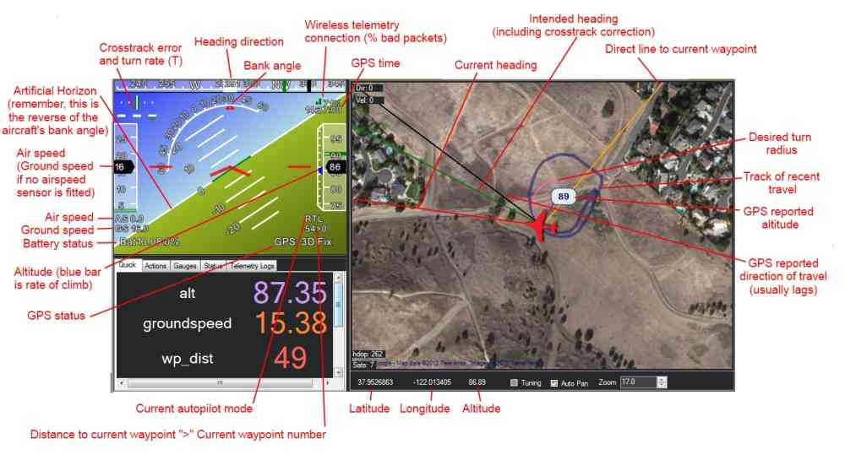
Learnings from Mission Planner Session
Screen Overview of Mission Planner:Understanding the various control options on home screen of Mission Planner.
Flight Modes :
Acro Mode -Maintain altitude level
Stabalize Mode:Allows manual control of vehicle
Loiter Mode:Current altitude,orientation and heading direction is maintained.
Flight Planning:
Manually plan vehicle motion
SITL Feature:
Virtually fly drone without hardware

Slide 7
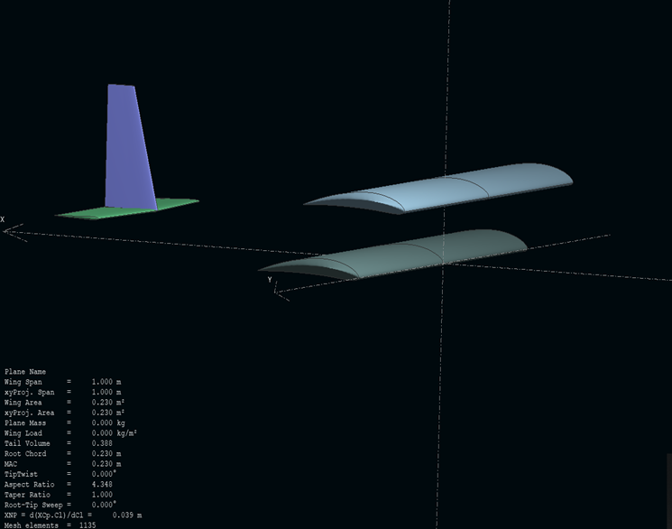
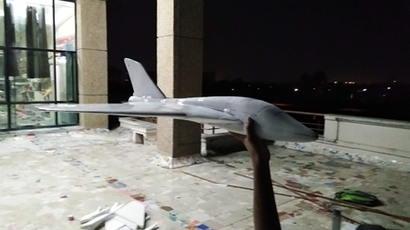
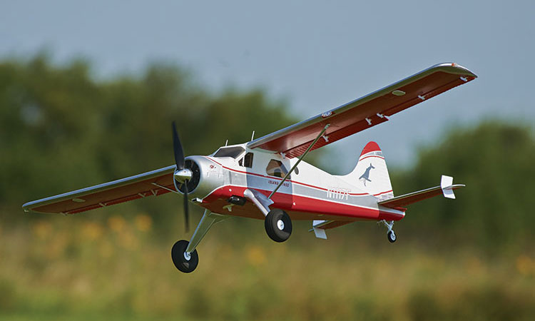
What is AEROMODELLING?
Aeromodelling is the art of designing,building and flying aircrafts.
TYPES OF FABRICATION:
Styrofoam fabrication
Biofoam
Balsa fabrication
Composite fabrication
Coroplast
DESIGN
BUILDING
FLYING
DIFFERENT TYPES OF AIRCRAFTS :
Rotary wing
Fixed wing
Rogallo wing
Flapping wing
Glider
3D Aerobatic plane
Trainer aircraft
IC Engine plane
Scale modeling
Tandem plane
Delta wing
Magnus plane
And many more…..

Slide 8
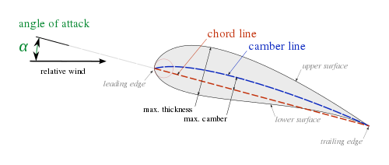
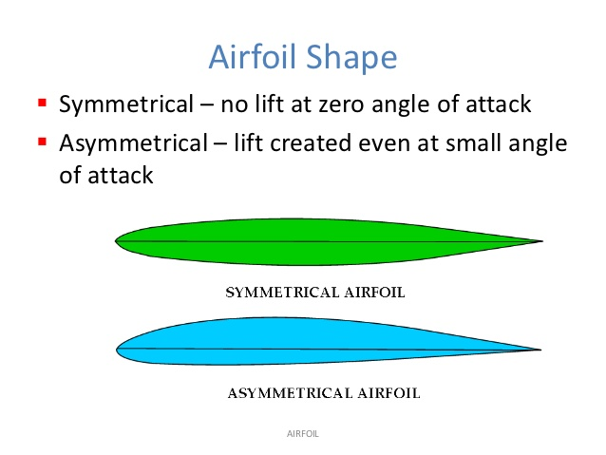
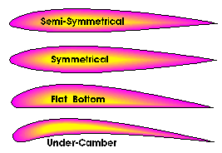
AIRFOIL:
An airfoil is the cross-sectional shape of a wing or blade of a propeller. It is designed to give the most favourable ratio of lift to drag in flight.
AVIONICS
Avionics are the electronic systems used on aircraft, artificial satellites, and spacecraft. Avionic systems include communications, navigation, the display and management of multiple systems, and the hundreds of systems that are fitted to aircraft to perform individual functions.
BASIC AVIONICS AN RC AIRCRAFT CONTAIN:
Brushless DC Motor
Electronic Speed Controller (ESC)
Servo Motor
Receiver
Transmitter
Battery
IMU
Flight Controller
Radio Telemetry
GPS
And etc…..
Both symmetrical and asymmetrical airfoils can generate lift. However, in identical conditions (same angle of attack, same airspeed etc), the asymmetric one can be designed to generate more lift and less drag.

Slide 9
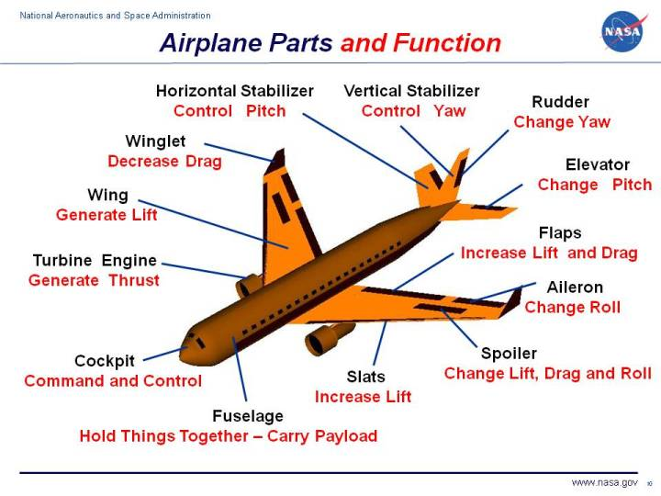
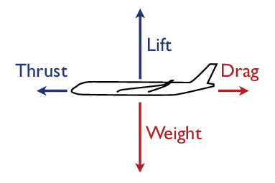
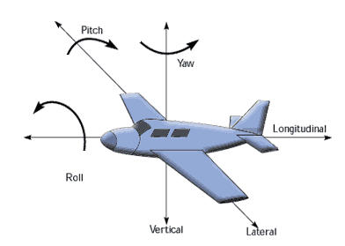
VARIOUS PARTS OF AN AIRCRAFT:
THRUST- the force that propels the aircraft
DRAG- Friction between the plane and air
LIFT- the force that causes the plane to go up
WEIGHT- the force that acts because of gravity
MOTION
ROLL- rotates the plane, controlled by ailerons
YAW- turns tha plane, controlled by the rudder
PITCH- changes the altitude, controlled by the elevator

Slide 10
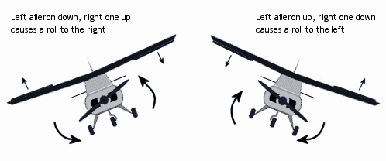
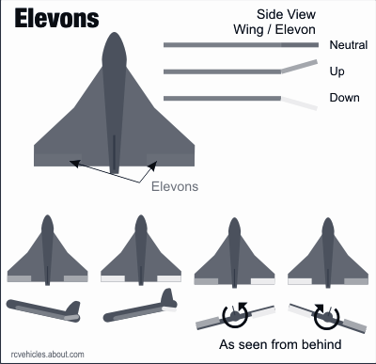
CONTROL SURFACES:
Elevons
are aircraft control surfaces that combine the functions of the elevator and the aileron, hence the name. They are frequently used on tailless aircraft such as flying wings.
AILERONS :
Moving section of the trailing edge of the wing, in pairs, (left and right) and work in opposite directions to each other (one up, one down). They roll the model to the left or right.

Slide 11
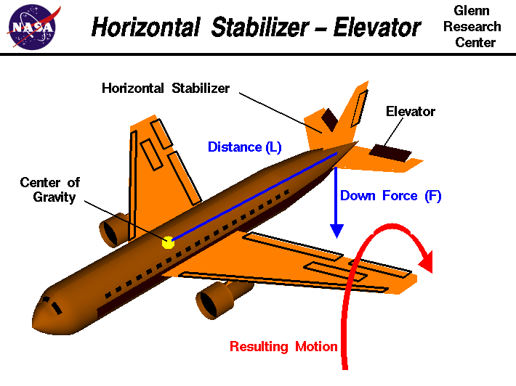
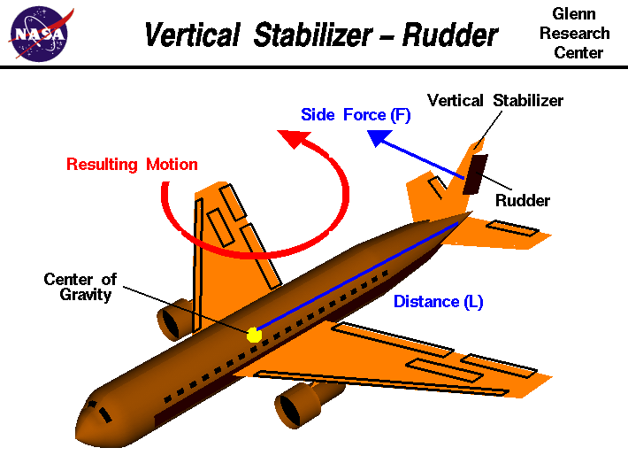
The RUDDER is a primary flight control surface which controls rotation about the vertical axis of an aircraft. This movement is referred to as "yaw". The rudder is a movable surface that is mounted on the trailing edge of the vertical stabilizer or fin
An ELEVATOR is a primary flight control surface that controls movement about the lateral axis of an aircraft. This movement is referred to as "pitch". Most aircraft have two elevators, one of which is mounted on the trailing edge of each half of the horizontal stabilizer.

Slide 12
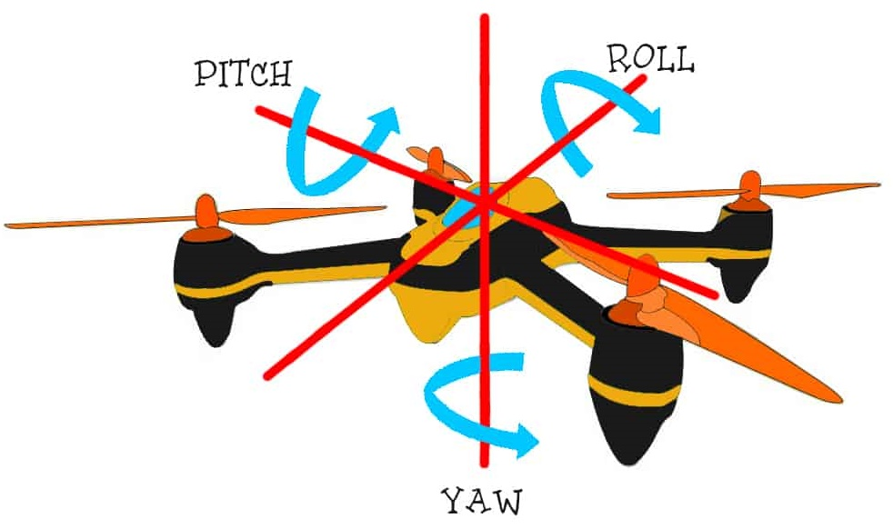
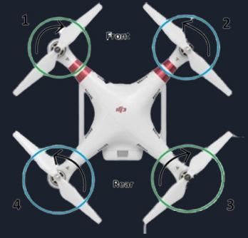
Quadcopter
A Helicopter like, 4 Rotor drone can be controlled by its 4 DOF(Degree of Freedom) pitch, yaw, roll, thrust, which are basically controlled by varying rotor speeds.
Roll- Rotation about front to back axis
Pitch- Rotation about right to left axis
Yaw- Rotation about vertical axis
The basic principle to move a drone in a particular direction is, Slow down the motor pointing in that direction and speed up the exactly opposite motor.

Slide 13
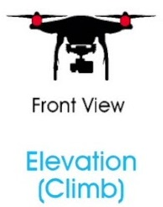
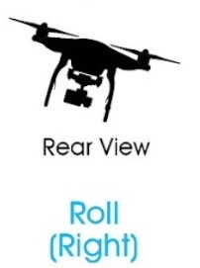
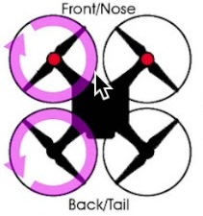
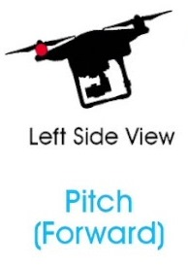
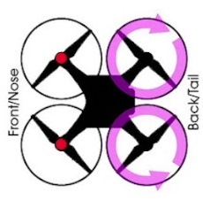
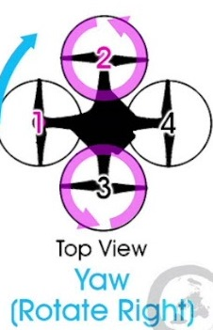
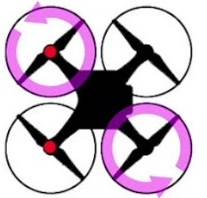
Thrust- Upward force produced by all motors of a drone.
Moving Right(or Left)-Can be done in the same manner as pitching motion but here drone tilts about rolling axis.
Moving Forward (or Forward-Upward simultaneously )- By reducing power in front motors and increasing the same in back motors, this motion is achieved. Drone gets tilted and rotor provide thrust to move forward, this motion is carried about pitching axis.
Yaw- Yaw is controlled by turning up speed of anticlockwise rotating motor and taking away power from clockwise rotating. Now, since clockwise torque is less, quadcopter will rotate in CW.

Slide 14
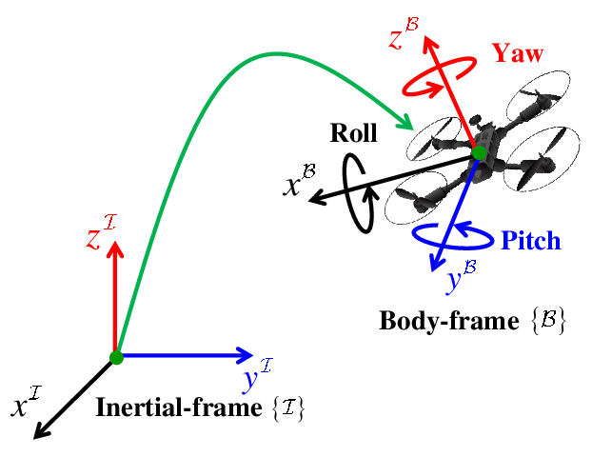
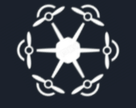
Hexacopter
Kinematics
Vector data need to be transformed from body fixed coordinate system of drone to ground coordinate system using some maths !
Euler Theorem - Any 2 configuration of a drone (rigid body) can be linked by a rotation about an axis
Rotation Tensor
Further, Velocity and acceleration of any point on drone can be calculated (provided some data) using some equations.
A
(Vector)
Rotated Vector
(About some axis n^)
One more multi-rotor drone model, Hexacopter is quite similar to quadcopter in motion principles (handling), and much better in stability and power. Diagonal motion can easily be performed due to 6 rotors

Slide 15
Drone Dynamics-Key to Automation of Drone
Modelling the Drone
Drone Dynamics
Governing Equation
Automated Controlling
Desired Configuration
Force and Momenta Control
Mathematical Model
Simulation
Error factor
Controller
Current Configuration

Slide 16
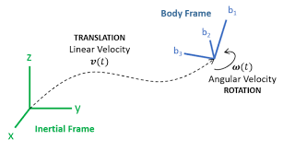
Drone dynamics - Dynamic Quantities
Mathematical Model
Dynamic quantities-
p = Mv
L= r x Mv + I⍵
where
p - linear momentum
L - angular momentum
M - mass of drone
v - velocity of COM of drone
I - moment of inertia of drone
⍵ - angular velocity
r - position of drone w.r.t reference point

Slide 17
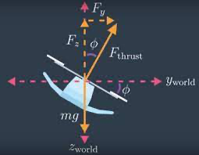
Drone Dynamics-The Laws
The three laws that help in obtaining the governing equation are as follows-
Mass balance - Drone is considered as a rigid body. The distance between any points on drone remains the same. So there is no deformity and thus there is no change in mass.
Linear momentum balance - Sum of all the forces acting on the drone is equal to mass of drone times the acceleration of COM i.e ∑F=Ma
Angular momentum balance - ∑m=⍵ x (I⍵) + I.⍺ where m- moment acting on drone and ⍺ - angular acceleration

Slide 18
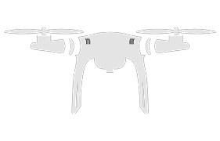
PID Controller
A PID controller is used to regulate the position, orientation of our drone.
It compares the actual configuration with the desired configuration, computes the error and reduces it with PID method.
What PID does with the error?
DRONE
ERROR
P : Proportion
I: Integral
D: Derivative
(Multiplies error with a constant)
(Total of input so far)
Desired Position &
Configuration
Current Position &
Configuration
(Current rate of change of error)

Slide 19
Working of a PID controller:
Someone said
loop?
PID control (adding the contribution of all three)
Proportion
Our Drone
Error
Term
+
What we
want
+
+
What the configuration actually is
Integral
-
+
Derivative
Feedback Loop

Slide 20
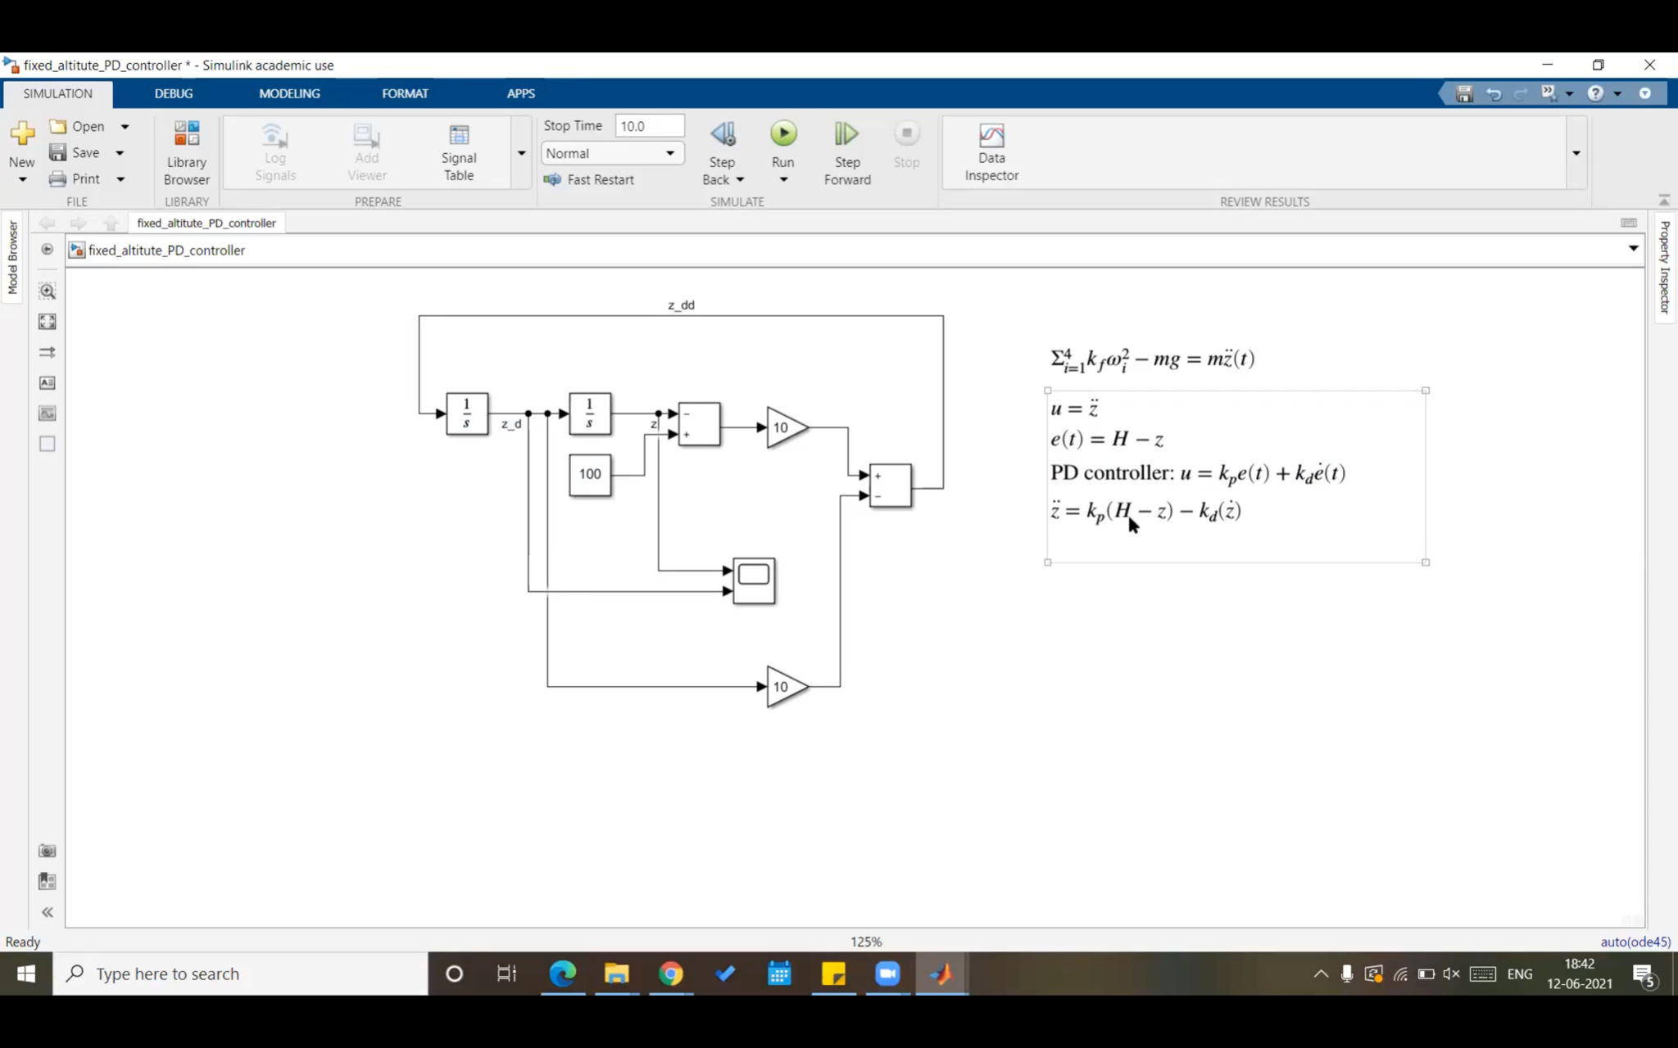
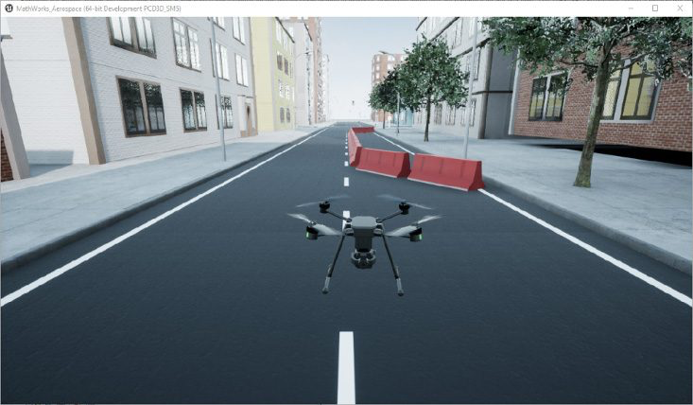
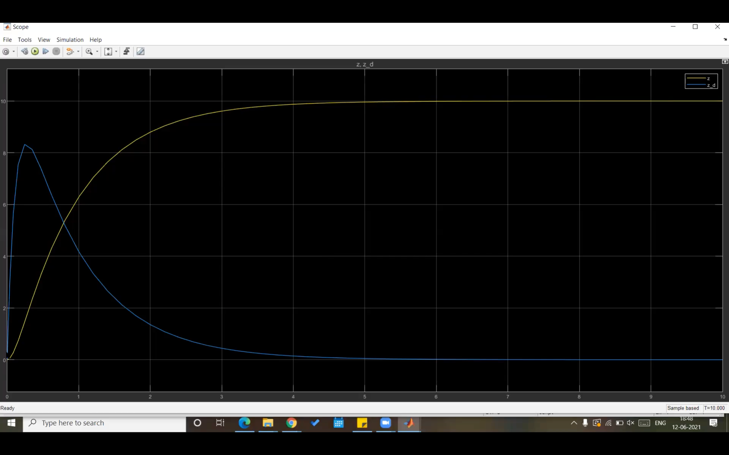
Matlab and Simulink
Download and Installation:
https://in.mathworks.com/downloads/
Drone Simulation is the behavioral modelling of a drone and evaluating its performance in a virtual environment.
Matlab supports Drone simulation by enabling:
Tune parameters and models before uploading them to drone.
Create a virtual environment tailored to the test cases.
Components of Drone Simulation:
Drone dynamic Model
Drone Flight control model
Sensor Model
Simulation Environment
Autonomous Algorithm
Drone Simulation visual from Matlab in virtual environment
Visuals from live class

