Slide 1
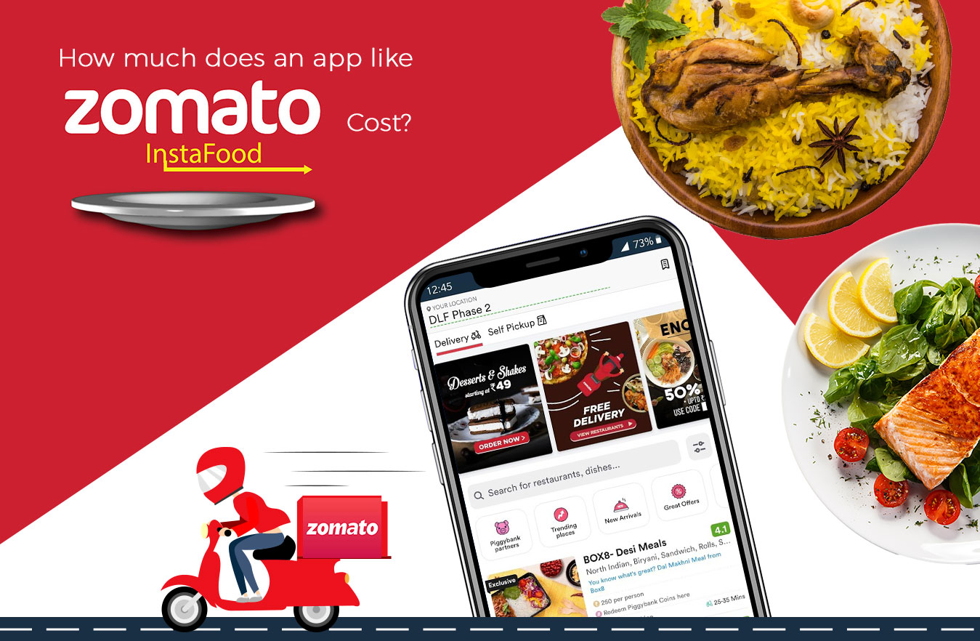
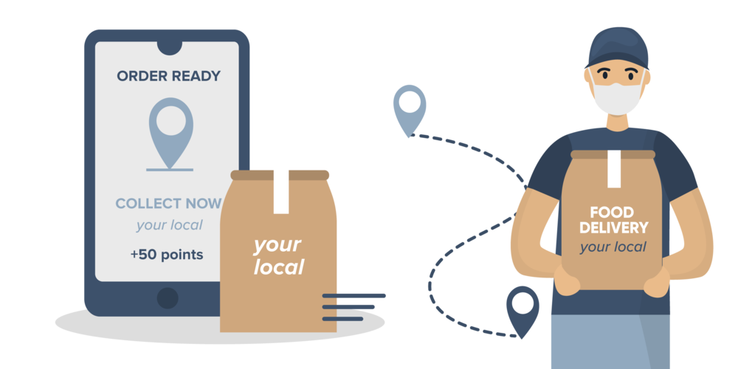
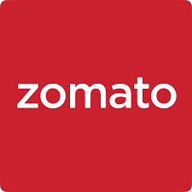
13 Years
Of Emergence With Hungry Minds
Zomato

Slide 2

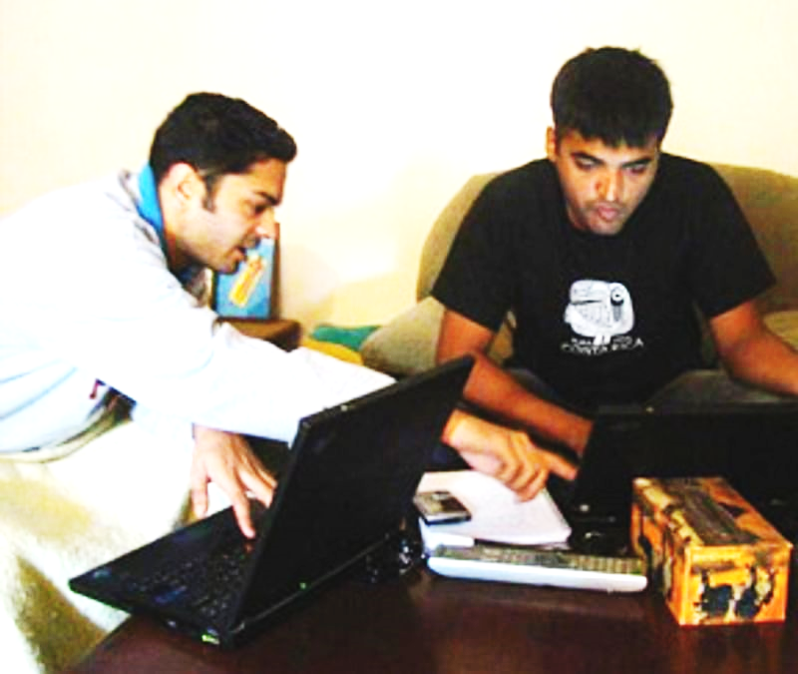

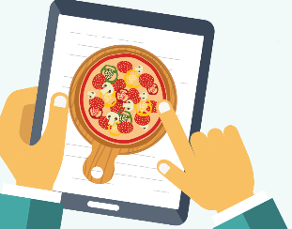
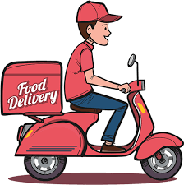

The Start: Why Foodiebay?
And how the three founders got together.
Zomato, which started as Foodiebay, was established in July 2008 by two IIT Delhi alumnus, Deepinder Goyal, and Pankaj Chaddah.
The idea struck Deepinder when his colleagues consistently had a demand for paper menu leaflets of different restaurants, to order food.
That's when he thought of converting these restaurant paper menus into a digital app, that is far more accessible and easier to use.
Gaurav Gupta is Chief Operating Officer at Zomato. Gaurav Gupta has been associated with Zomato for almost four years now and earlier, in January last year, he was made the COO of the food delivery and restaurant discovery platform. Prior to this, Gaurav worked as a consultant at AT Kearney.

Slide 3
About: Start-up launch
When the founders launched this website, it wasn’t called Zomato back then, it was called Foodiebay in year 2008. Initially started in Delhi, then the services were extended to cities like Mumbai and Kolkata.
The founders changed Foodiebay to 'Zomato’ in 2010 to take it international and make it more prominent, simple to memorize and primarily to eliminate the confusion with the website eBay.
Founders Deepinder Goyal, Gaurav Gupta, Pankaj Chaddah

Slide 4
Target Customers: As your very own!
Customer Segments: The customer segment of Zomato has been divided into three parts:
Local restaurants: Zomato enables restaurants to make themselves visible to their target audience
Users: Zomato is dedicated to users who aspire to locate restaurants or specific cuisines nearby. Zomato is the panacea for users who are fond of home delivery
Reviewers: They are content contributors of Zomato. They actively review food and places and provide relevant information to the users in textual and graphical form
Zomato Provisions: Zomato acts as the connecting bridge between customers and partner restaurants. Zomato has crafted a well-designed pricing model for their only delivery services. The inclusion of Zomato Gold has improved the quality of services provided by Zomato.
Alliances of Zomato: Recent partnerships with various big names like Uber Taxi, Visa, PayPal has enhanced the business model of Zomato. The partners have aided Zomato in various aspects, for instance, finding a location to set-up, hiring and other procedures, work placements, market research, handling operational, accounting, political and legal issues, etc.

Slide 5
Start-up challenges: To head towards the battlefield
2015
2015
Zomato’s website was hacked and hackers got access to lot of personal information of customers
Zomato changed business strategies from a Full-Stack market to an Enterprise market that led to 300 employees loosing their jobs
2016
Operations Shutdown
Situation became out of control so for the time being Zomato had to roll back its operations in US, UK, Chile, Canada, Brazil, Srilanka, Italy and Slovakia
2017
Cyber attack
The data was hacked and information of 17 million people were sold on the dark web

Slide 6
Controversies: Taste it for the better tomorrow!
Food has no religion: (ORM)
In July 2019, Zomato got a complaint regarding non Hindu delivery boy in Jabalpur. The customer cancelled the order and decided to post the incident on twitter to which Zomato replies ad food has no religion.
Logout Campaign:
On 17 August 2019, more than 1,200 restaurants logged off from Zomato because of their offer of discount programs at dine-in restaurants, saying that the corrective measures would not resolve the key issue of deep discounts. Later This was resolved by Goyal Zomato’s founder.

Slide 7
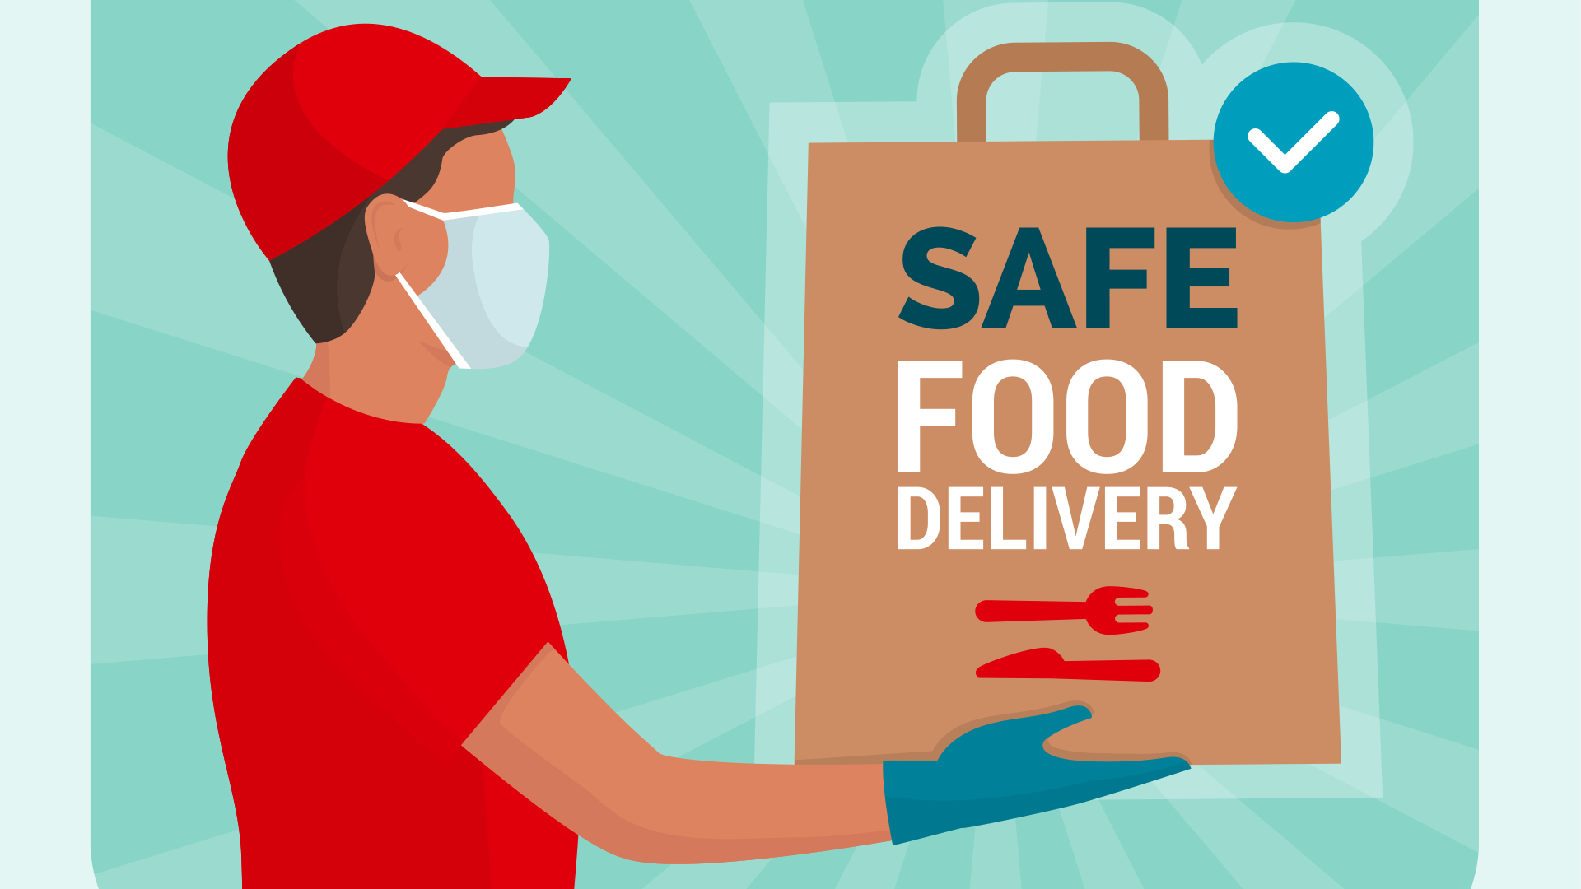
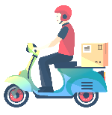
Our Initiatives: Work to bring a change!

Slide 8
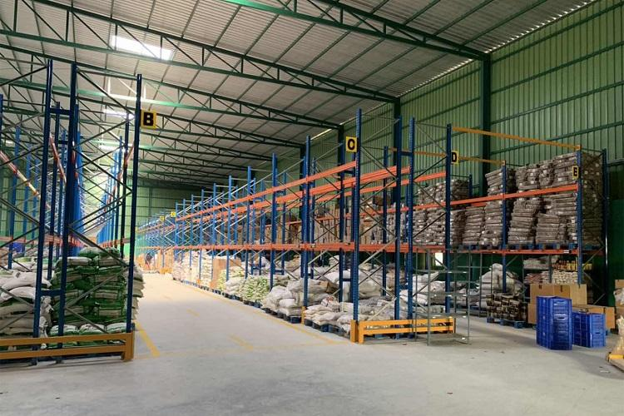



Hyper Pure: Way to happiness for b2b partners!
What is Hyper Pure by Zomato?
Hyper Pure is Zomato's supplies platform for restaurants. It allows B2B partners to purchase all sort of regular supplies.
Zomato’s revenue from Hyper Pure?
The Hyperpure revenue for 2019-20 stood at over Rs 110 crore as against about Rs 13 crore in the previous year
Why Hyper Pure by Zomato?
-The freshest, most high quality ingredients available on the market
-Antibiotic residue-free chicken, which is better for your customers than regular chicken
-Eco-friendly packaging (which is recyclable and doesn't harm the environment) for deliveries
How business is transforming in B2B ecosystem?
From 350 to 1,000 restaurants in 4 months 2019 this is the way Hyperpure by Zomato is changing the way restaurants work

Slide 9
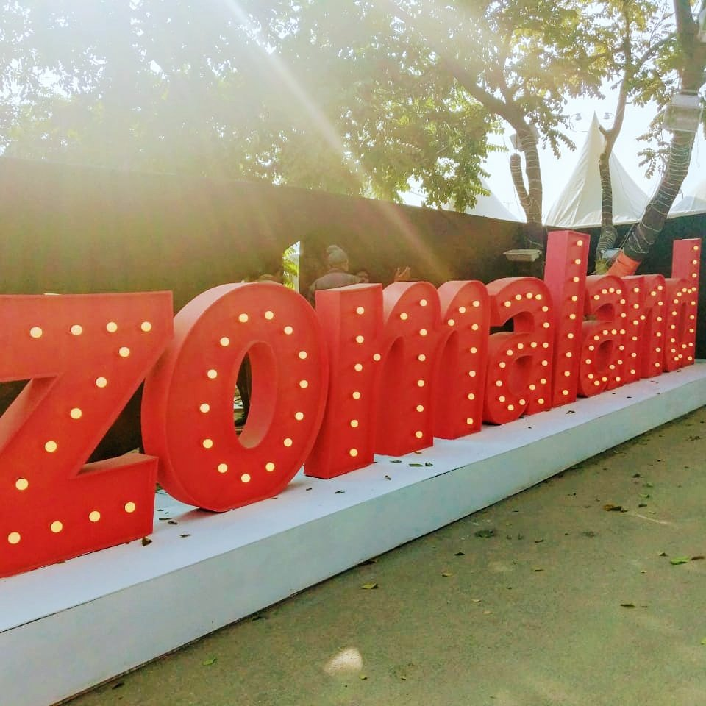
Zomaland: India’s greatest food carnival!
Zomaland is one of India’s largest Food Carnivals! We have a wide range of culinary delights, an assortment of fun games and an absolutely amazing artist line-up to ensure your weekend is truly what it should be - filled with Food, Fun and Frolic!
It brings together some of the top eateries, musicians, DJs, comedians, and interactive installations and carnival games, under one roof. It is like the offline version of its Zomato Collections, where it curates and brings the best restaurants in the city together.
It is a flagship event of Zomato. In 2018, The debut edition of this carnival across Delhi, Bengaluru and Mumbai saw over 100,000 visitors. Since then it has grown to be held in over 10 cities and has also partnered with major brands including the Singapore Tourism, Tik Tok, Jameson Music CD’s.
With Zomaland 2.0, it only gets bigger!
They cover 10 cities. 400+ pop up restaurants. 50+ performances, and a lot more.

Slide 10

Growth Marketing
In campus
ATL
360 Degree brand integration social media
Real time updates
Interactive chat feature
Customised Mobile friendly user experience
Best in class Marketing campaigns

Slide 11
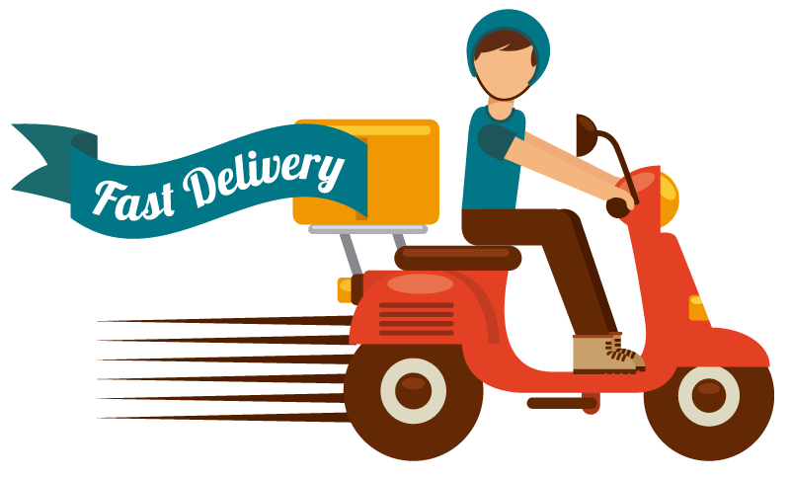
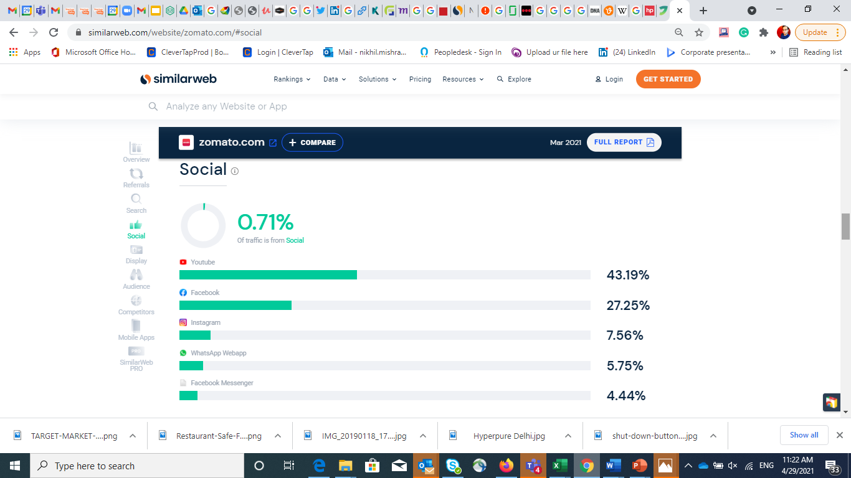
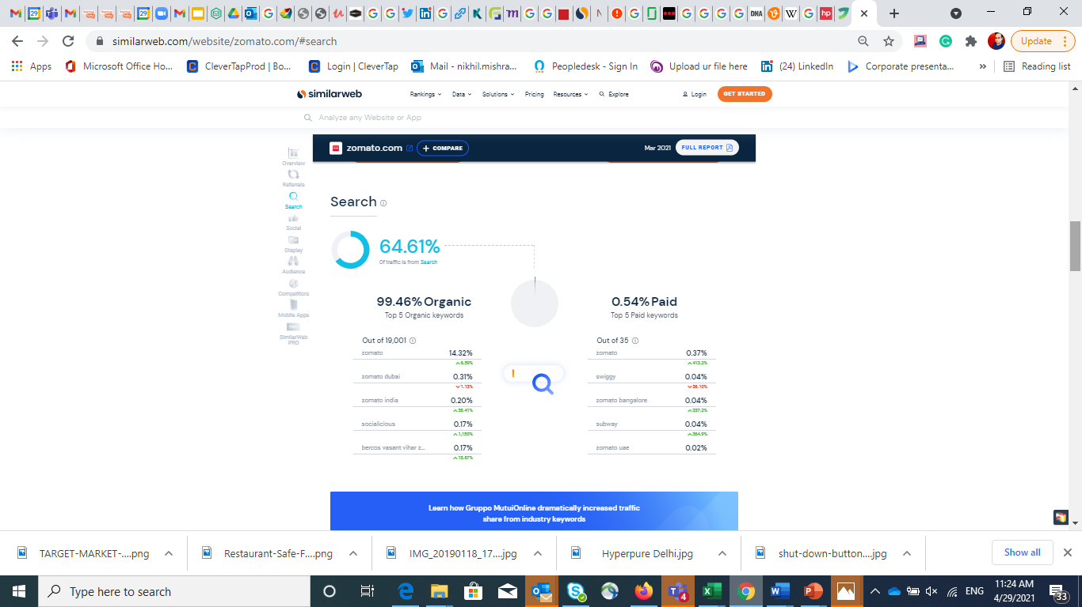
Target Customers: As your very own!

Slide 12
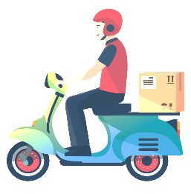
Funding and Valuation: The Steps to join the mainstream league
Date | Funding | From- Stake | Valuation | Revenue
2010-13 | US$16.7 million + US$37 million | Info Edge (57.9% stake)+ Sequoia Capital
2014 | US$60 million | Info Edge + Sequoia Capital +VY Capital | US$660 million
2015 | US$50 million | Info Edge + Sequoia Capital +VY Capital
2018 | $210 million + US$5.4 billion | Alibaba (10% stake)
2020 | $62 million + $52 million | Temasek + Kora |  | Rs. 2,604.7 Crore (FY20)
2021 | Kora | Tiger Global Management | US$5.4 billion

Slide 13
Latest funding's and more: Working towards the goal!
23 February, 2021 - Zomato has closed a $250 million funding round, led by existing investors Tiger Global, Kora and Fidelity. Zomato's valuation touches $5.4 Billion.
25 January, 2021 - Zomato Plans come up with an IPO in the first half of 2021. They will launch upto $1 Billion IPO. After the recent fund raise of $500 million, the company is valued at $5.5 Billion.
22 January, 2021 - Zomato raised $500 million from their existing investors along with Ant Group and Sunlight Fund.
December 19, 2020 - Zomato raised $660 Million in funding of Series J round led by Kora, Tiger Global Management. This round hit the Zomato's Valuation to $3.9 Billion
November 19, 2020 - Zomato announced that it will do away with commissions it charges restaurant partners on takeaway orders. In a bid to help them recover faster from the economic crisis endowed by the Covid-19 pandemic and also offer customers an alternative to home delivery.

Slide 14
Acquisitions: Thirst to hold it right in economy
Companies Acquired | Date | Price
Menu Mania | July 2014 | -
Obedovat | August 2014 | -
Lunchtime | August 2014 | -
gastronauci.pl | September 2014 | -
Cibando | December 2014 | -
Urbanspoon | January 2015 | $60 Million
Mekanist | January 2015 | -
Maple Graph Solutions Private Limited | April 2015 | -
Nextable | April 2015 | -
Sparse Labs | September 2016 | -
Runnr | September 2017 | -
Tonguestun Food Network Pvt Limited | September 2018 | $18 Million + Stocks
Tech Eagle | December 2018 | -
Uber Eats India | January 2020 | $350 Million

Slide 15
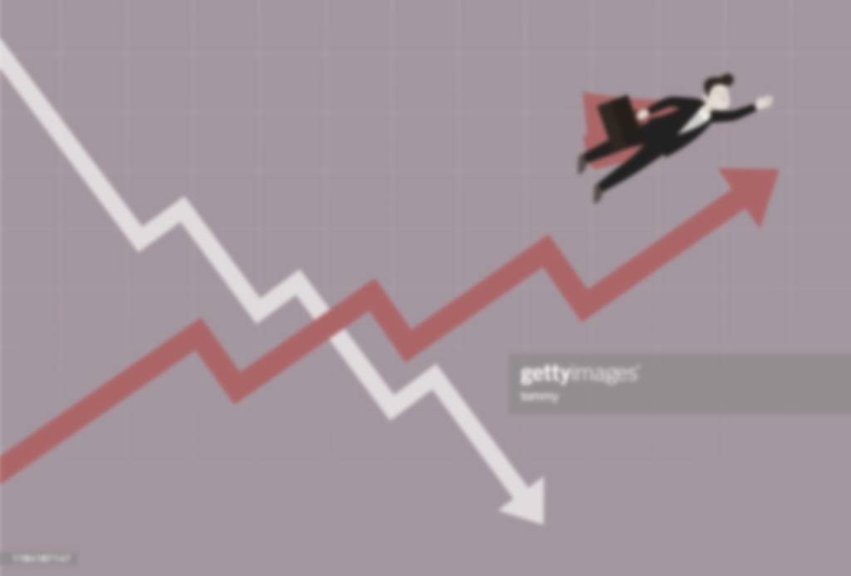

Major track change: Exploring the best for survival!
Zomato’s revenue nearly doubles, loss widens 160% in 2019-20
Zomato takes big step towards IPO, turns a public limited firm

Slide 16
Thank you

