Slide 1
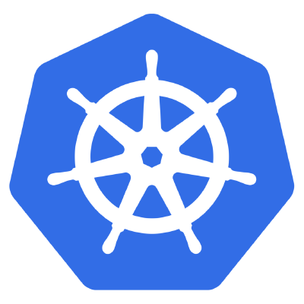
Kubernetes

Slide 2
“Something to do with containers…?

Slide 3
Assumptions
You know about containers
You know about orchestration
You know about the painful art of deploying stuff

Slide 4

Docker

Slide 5
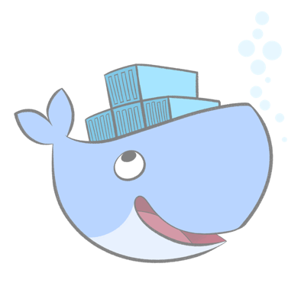
“Random containers doing their own sh*t”

Slide 6
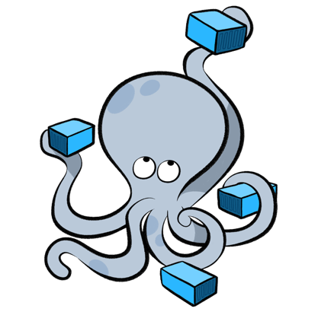
Compose

Slide 7
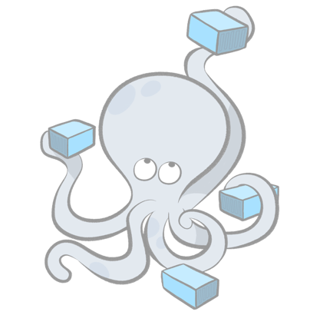
“Foreman on Acid”

Slide 8
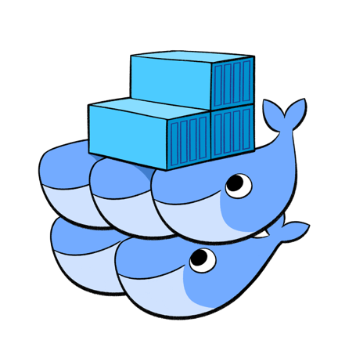
Swarm

Slide 9

“Clustering and Discovery”
(hey, we’re getting somewhere!)

Slide 10
=

Slide 11
“Batteries Included”

Slide 12
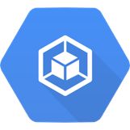
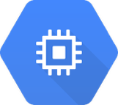

K8s on GCP
GKE
GCE
Networking
…and others

Slide 13
Basic Concepts

Slide 14
Node

Slide 15
Hosts running k8s daemons

Slide 16
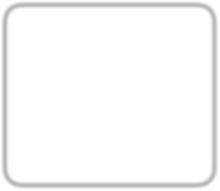

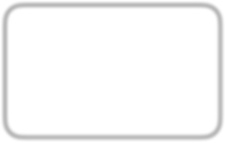
Master
API
Scheduler etc..
Node
kubelet
Node
kubelet
Node
kubelet

Slide 17
Pod

Slide 18
基本
Basic unit of deployment in k8s

Slide 19
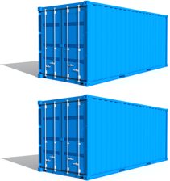
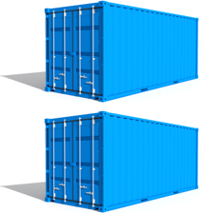
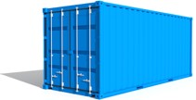

Group of Containers

Slide 20
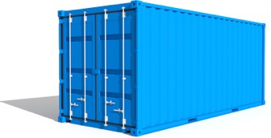


Container configurations

Slide 21

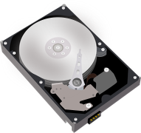
Shared storage

Slide 22


container
Pod

Slide 23
Pod
container
container

Slide 24
Pod
container
container container

Slide 25
Pod
e.g.
container
nginx
container
app
container
redis/cache

Slide 26
Scheduled together
(“co-scheduled”)

Slide 27
Guaranteed to be on the same node
(“co-located”)

Slide 28

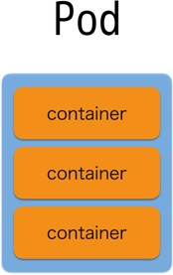
Node
Node
Node

Slide 29
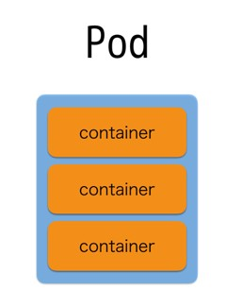
Node
Node
Node
Depends on each node’s resource availability and each pod’s resource requirements

Slide 30



Node
Node
container
container
container

Slide 31





Node Node
This will NEVER happen
container
container
container

Slide 32
Miscellaneous
Each pod has its own IP address
Pods are expected to be stateless

Slide 33
Replica Set

Slide 34
Keeps track of Pod replicas

Slide 35
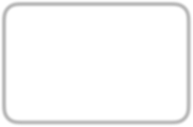
Replica Set
replicas: 3 template:

Slide 36
Replica Set
replicas: 3 template:
A

Slide 37
Replica Set
replicas: 3 template:
A
B

Slide 38
Replica Set
replicas: 3 template:
A
B
C

Slide 39

Replica Set
replicas: 3 template:
A
B
C

Slide 40
Replica Set
replicas: 3 template:
A
B

Slide 41
Replica Set
replicas: 3 template:
A
B
D

Slide 42
Deployment

Slide 43
Manages Replica Set state transitions

Slide 44
Deployment
replicas: 3 template:

Slide 45
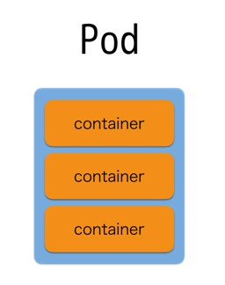
Deployment
replicas: 3 template:
Replica Set A
replicas: 3 template:

Slide 46
Deployment
replicas: 3 template:
Change some settings, please!
Replica Set A
replicas: 3 template:

Slide 47
Deployment
replicas: template:
2
3
Change some settings, please!
Replica Set A
replicas: 3 template:

Slide 48

Deployment
replicas: template:
2
3
Change some settings, please!
Replica Set A
replicas: 3 template:
Replica Set B
replicas: 2 template:

Slide 49

Deployment
replicas: template:
2
3
Change some settings, please!
Replica Set A
Replica Set B
replicas: 2 template:
replicas: 3
template:

Slide 50
Deployment
replicas: template:
2
3
Change some settings, please!
Replica Set B
replicas: 2 template:

Slide 51
Keeps track of state change history

Slide 52
Deployment
replicas: 3 template:

Slide 53
Deployment
replicas: 3 template:
A
replicas: 3 template:

Slide 54
Deployment
replicas: 3 template:
Change some settings, please!
A
replicas: 3 template:

Slide 55
Deployment
replicas: template:
2
3
Change some settings, please!
A
replicas: 3 template:

Slide 56
Deployment
replicas: template:
2
3
Change some settings, please!
A
replicas: 3 template:
B
replicas: 2 template:

Slide 57
Deployment
replicas: template:
2
3
Change some settings, please!
A
B
replicas: 2 template:
replicas: 3
template:

Slide 58
Deployment
replicas: template:
2
3
Change some settings, please!
B
replicas: 2 template:

Slide 59
Deployment
replicas: template:
2
3
Oh wait, I actually didn’t want to do that…
B
replicas: 2 template:

Slide 60
Deployment
replicas: template:
3
2
3
Oh wait, I actually didn’t want to do that…
B
replicas: 2 template:

Slide 61


Deployment
replicas: template:
3
2
3
Oh wait, I actually didn’t want to do that…
B
replicas: 2 template:
rollback

Slide 62
Deployment
replicas: template:
3
2
3
Oh wait, I actually didn’t want to do that…
A
replicas: 3 template:
B
replicas: 2 template:
rollback

Slide 63
Deployment
replicas: template:
3
2
3
Oh wait, I actually didn’t want to do that…
A
replicas: 3 template:
B
rollback
replicas: 2
template:

Slide 64
Deployment
replicas: template:
3
2
3
Oh wait, I actually didn’t want to do that…
A
replicas: 3 template:

Slide 65
Services

Slide 66
Logical set of Pods
(and ways to access them)

Slide 67
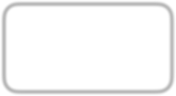

Raw Pod Access
Pod
10.0.96.2
Pod
10.0.96.3
Pod
10.0.96.3

Slide 68
Raw Pod Access
Pod
10.0.96.2
Pod
10.0.96.3
Pod
10.0.96.3

Slide 69
Raw Pod Access
Pod
10.0.96.2
_{Pod} 10.0.96.3
Pod
10.0.96.3

Slide 70
Raw Pod Access
Pod
10.0.96.2
Pod
10.0.96.3

Slide 71
Raw Pod Access
Pod
10.0.96.2
Pod
10.0.96.3

Slide 72
Access Via Service
Pod
10.0.96.2
role=web
Service
match role=web
Pod
10.0.96.3
role=web
Pod
10.0.96.4
role=web
Pod
10.0.96.5
role=db

Slide 73
Access Via Service
Pod
10.0.96.2
role=web
Service
match role=web
Pod
10.0.96.3
role=web
Pod
10.0.96.4
role=web
Pod
10.0.96.5
role=db

Slide 74
Access Via Service
Pod
10.0.96.2
role=web
Service
match role=web
Pod
10.0.96.3
role=web
Pod
10.0.96.4
role=web
Pod
10.0.96.5
role=db

Slide 75
Access Via Service
Pod
10.0.96.2
role=web
Service
match role=web
_{Pod} 10.0.96.3
role=w
eb
Pod
10.0.96.4
role=web
Pod
10.0.96.5
role=db

Slide 76
Access Via Service
Pod
10.0.96.2
role=web
Service
match role=web
Pod
10.0.96.4
role=web
Pod
10.0.96.5
role=db

Slide 77
Access Via Service
Pod
10.0.96.2
role=web
Service
match role=web
Pod
10.0.96.4
role=web
Pod
10.0.96.5
role=db

Slide 78
Access Via Service
Pod
10.0.96.2
role=web
Service
match role=web
Pod
10.0.96.6
role=web
Pod
10.0.96.4
role=web
Pod
10.0.96.5
role=db

Slide 79
Access Via Service
Pod
10.0.96.2
role=web
Service
match role=web
Pod
10.0.96.6
role=web
Pod
10.0.96.4
role=web
Pod
10.0.96.5
role=db

Slide 80
Secrets

Slide 81
Store pieces of data in k8s

Slide 82
e.g. Identity Information

Slide 83
(securely)

Slide 84
(…in the future)

Slide 85

Secret
key1 → base64 value
key2 → base64 value
key3 → base64 value

Slide 86

Pod
container: volumeMounts:
- name: certificates
mountPath: /etc/ssl/certs
container
volumes:
- name: certificates secret:
secretName: ca-certificates
volumes

Slide 87
Pod
env:
- name: foo-secret valueFrom: secretKeyRef:
name: foo
value: secret-value
container
volumes

Slide 88
ConfigMaps

Slide 89
Same as Secrets (Unprotected)

Slide 90
Ingress

Slide 91
Services are for within the cluster only
(external IPs allowed, but don’ use that to serve external requests)

Slide 92
Inbound connections to internal cluster services
(New since 1.2)

Slide 93

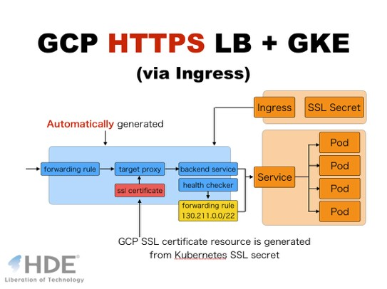
Please checkout my presentation https://docs.google.com/presentation/d/ 11ZN6qgiuZZfVyhBK2hjp1vhp_5N0DOGnAmhPreS3L5A/pub? start=false&loop=false&delayms=3000

Slide 94
DaemonSets

Slide 95

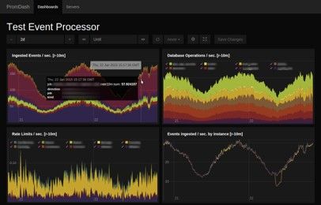
Ensure nodes run a copy of a Pod
Node Node Node
prometheus-exporter
prometheus-exporter
prometheus-exporter

