Slide 1

GROUP II Monitoring Temperature & Distance with Ethernet System
Data Communication System with Ethernet

Slide 2

Job Description
Aldi Afandi [4211611019]
Membuat Program Arduino dan Menyiapkan Spare Parts
1
Aditya Bayu Pratama [4211711003]
Membuat Program Arduino, GUI Labview, Penyimpanan Data dan Design Electrical Wiring
2
Toby Nurjanah [4211711015]
Membuat Dokumentasi dan Video
3
Riski Saputra [4211711022]
Membuat Design Mechanical dan Case
4
Muhammad Firmansyah [4211711010]
Membuat Electrical Wiring dan Case
5
Sagita Putri Arifin [4211711028]
Membuat Laporan dan Presentasi (Power Point)
6
Khairul Hafizhan [4211831005]
Membuat Electrical Wiring dan Menyiapkan Spare Parts
7

Slide 3

Monitoring Temperature & Distance with Ethernet System
PENGERTIAN
FUNGSI
MANFAAT
KELEBIHAN
KELEMAHAN
?

Slide 4
Monitoring Temperature & Distance with Ethernet System
Fungsi Broadcast
Fungsi Request

Slide 5

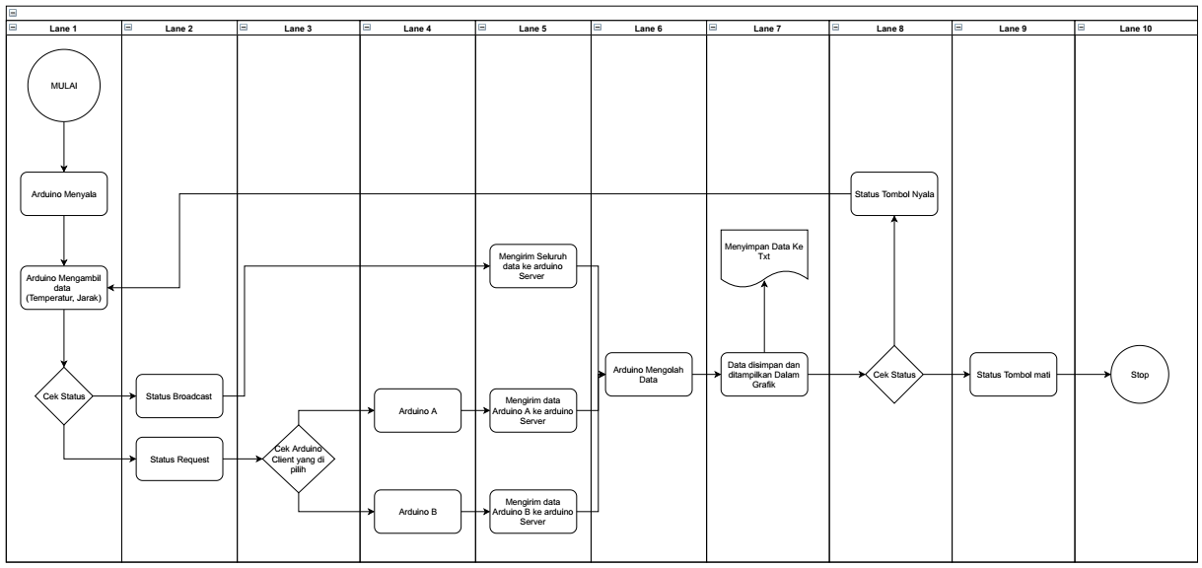
FLOWCHART SYSTEM
5

Slide 6
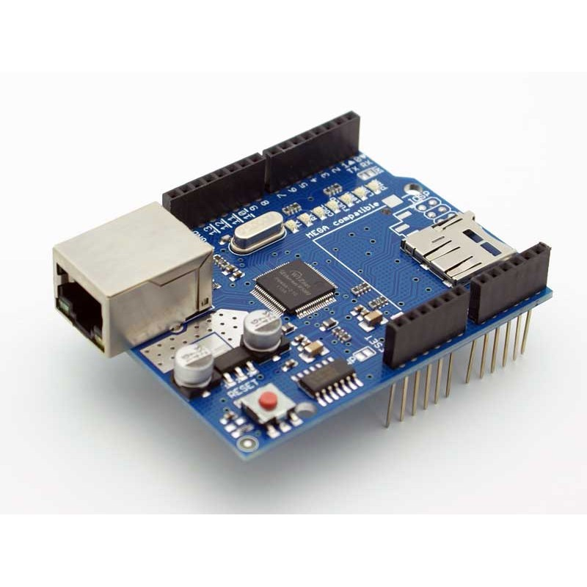
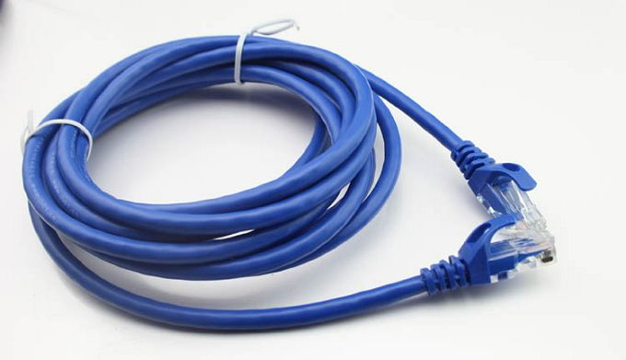
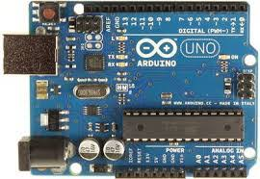
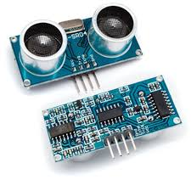
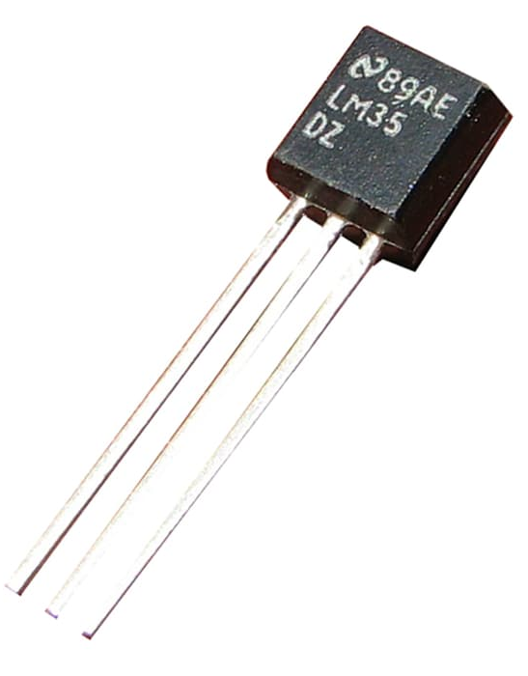
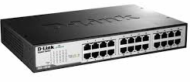
KOMPONEN UTAMA
Arduino Ethernet Shield
Arduino Uno
Kabel UTP
Sensor Suhu
Sensor Ultrasonik
Switch
6

Slide 7
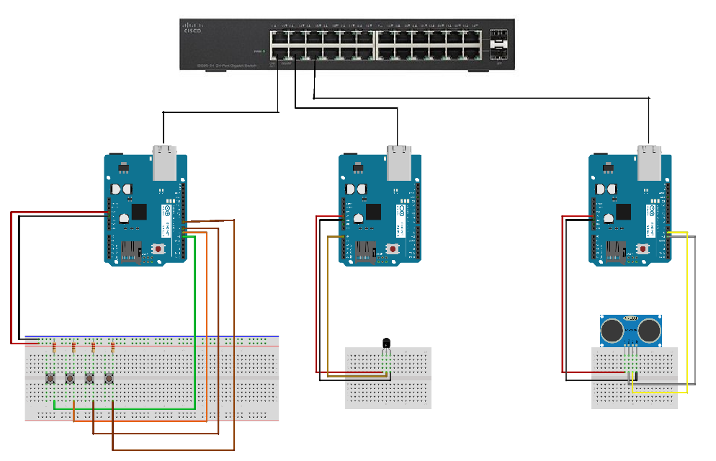
DESIGN ELECTRICAL WIRING
7

Slide 8
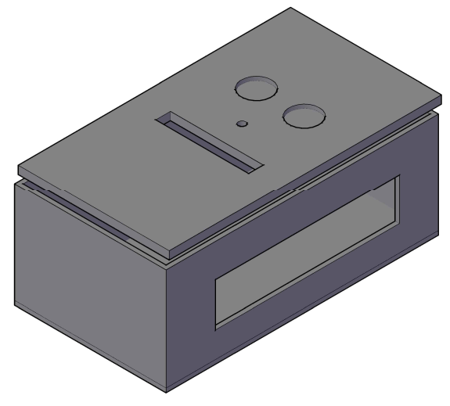
DESIGN MECHANICAL
8

Slide 9
Labview
Program
&
Database
Ms. Excel

Slide 10

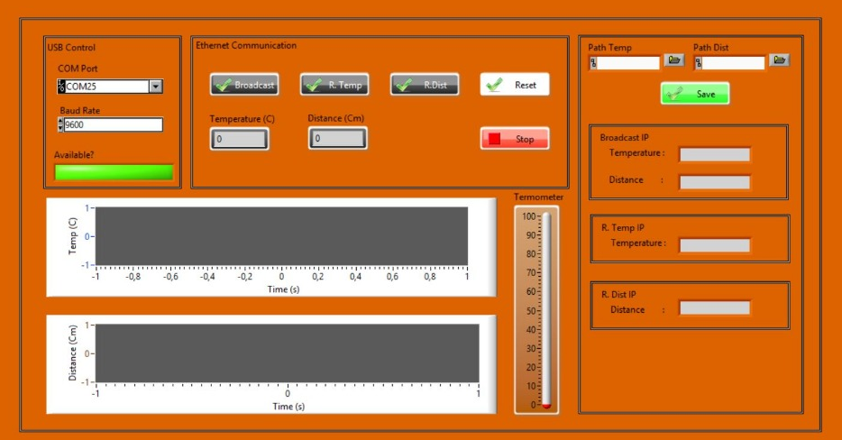
DESIGN DISPLAY GUI
10

Slide 11
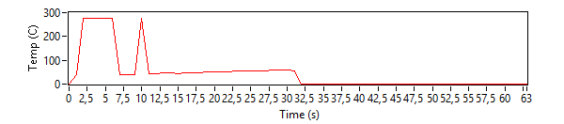
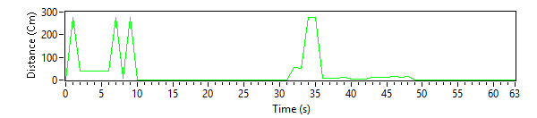
DATA HASIL PENGAMATAN
Data Suhu
Data Jarak Benda
11

Slide 12
PROBLEMA
ELECTRICAL
PROGRAM & GUI
MECHANICAL
Ethernet Shield
Split Data and Show IP
CASE

Slide 13
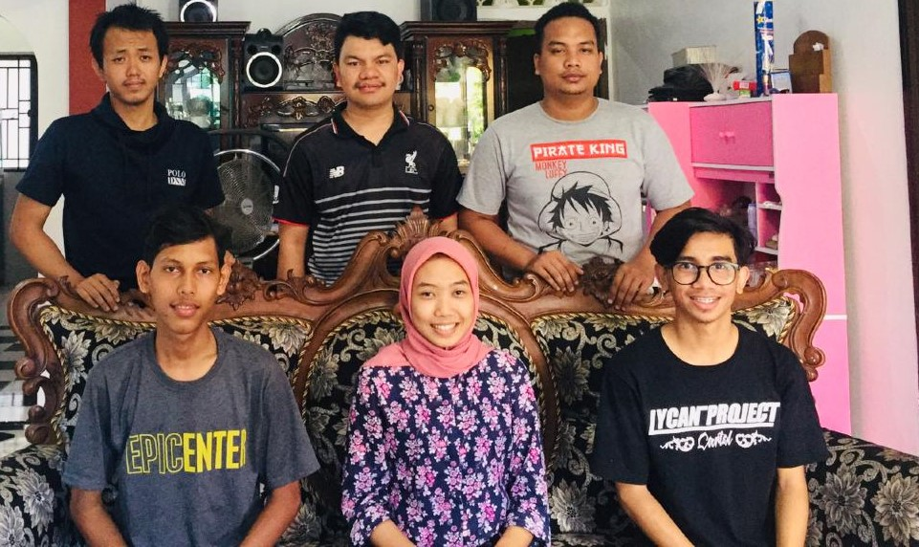
THANK YOU

