Slide 1

Analysis
of
Maze Solving Algorithms
CS 254
Department of Computer Science and Engineering, IIT Indore.
Submitted By :
Harsh Chaurasia 1018
Ayush Agrawal 1011
Notes:
Harsh

Slide 2
Introduction to the Problem
Solving a maze using computers is a complex though enticing task as one needs to come up with an algorithm that is effective in terms of time withal space for finding the shortest path.
There are ample number of graph algorithms to solve this problem, each one surpasses the other in performance aspects.
This project reviews different graph algorithms for maze solving along with their performance.
It is generally a two step task.
Conversion of Image to graph data Structure.
Finding Solutions using naive or Standard Graph Search Algorithms (with or without heuristic).
These Algorithms are of two types :
Uninformed Search Algorithms.
Informed Search Algorithms.
Notes:
Ayush

Slide 3
Two Types of Search Algorithms.
Informed Search
Uninformed Search
Additional information about the distance from the current state to the goal is provided.
Efficient and finds solution quickly.
Eg. Heuristic DFS, A* algorithm.
An uninformed search strategy is one which doesn’t have any additional information about the problem other than the problem definition and the solution intended.
Speed is slower than informed strategies.
Eg. Basic DFS, Dijkstra algorithm.
Notes:
Harsh

Slide 4
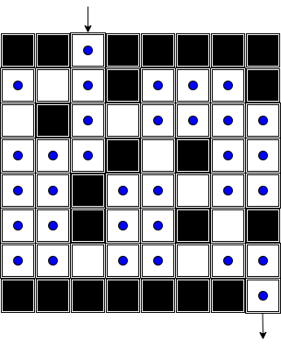
Conversion of Image to Graph Data Structure.
We make nodes wherever we can change our direction by 90°
In this way, all parts of the maze are accessible and number of nodes are kept to a minimum.
Removing the Redundant nodes, our graph data structure is now ready for algorithms.
Notes:
We Take an image input, whose dimension is equal to the dimension of the maze (each pixel is either white or black) then we start making nodes at every white point of the image.
Ayush

Slide 5
Maze Solving Algorithms
Wall Follower
DFS
BFS
Dijkstra
Flood Fill
A*
Notes:
Harsh

Slide 6
Naive Methods
Random Mouse
Wall Follower
Notes:
Harsh

Slide 7
Random Mouse
This is a very trivial method that can be implemented by a very unintelligent robot or a mouse.
In this algorithm at any junction, a random decision is made about the next direction to follow.
Although this algorithm will always find a solution, but it can be extremely slow and may not be computed efficiently even for small mazes.
Notes:
Harsh

Slide 8
Wall Follower
Wall Follower Algorithm as the name suggests traverses the maze by staying in contact with the wall at all times.
This algorithm follows either left hand rule or right hand rule in its implementation.
At every node we follow LSRB Rule (Left Straight Right Back) (in case of left hand rule) or RSLB Rule in vice versa.
This algo won’t work when the destination is surrounded by boundary having no contact with the outer boundaries (or the destination is in centre of maze).
This algo is quite slow as it does not necessarily give shortest path b/w start and end.
Notes:
Harsh

Slide 9
Graph Search Methods
DFS
BFS
Dijkstra
Flood Fill
A*
Notes:
Ayush

Slide 10
Recursive BackTracker - Depth First Search (DFS)
The Principal behind DFS is to analyse a path until we get to the goal or a dead end.
In the latter case, we backtrack until we arrive at an un-analysed node and repeat the same.
It is a sure shot way to find a path from source to destination given that such path exists. However, it may not be the shortest.
DFS is an optimal approach when it is known that the maze has atmost one correct path. (eg. Labyrinths)
It has time Complexity O(e+v).
Notes:
Ayush

Slide 11
Breadth First Search (BFS)
The Breadth First Search Algorithm explores the maze in such a way that at every node, it queues every possible direction, traversing them in that order.
If the search queue becomes empty before getting out, the maze is declared to have no solution.
BFS provides the most optimal solution to the maze but its drawback is that it consumes a lot of memory and explore un-necessary nodes.
Notes:
Ayush

Slide 12
Dijkstra Algorithm with BackTracking
Dijkstra is one of the most fundamental algorithm to find shortest path in weighted graph.
This algo maintains two lists - one having nodes already present in shortest path while other set contain nodes still to be included or “candidate” nodes.
From the included list, next move is made to the node which is at minimum distance from source and a distance list keep a record of this.
A parent list is also formed which keeps record of the parent of each node which is later used for backtracking.
Dijkstra algorithm is very inefficient for medium and large size mazes.
Its space complexity is O(b^d).
Notes:
Harsh

Slide 13
Flood Fill Algorithm
One of the best maze solving algo. Involves assigning values to each node where value represent distance of node from destination node.
It is done in four parts :-
Update Walls
Flood Maze
Turn Determination
Move to next cell
In similar way nodes are filled sequentially, if at the end, destination is not filled then the maze has no solution.
It is efficient for small and medium size mazes.
Notes:
https://www.youtube.com/watch?v=66vttAMIoL8
Harsh

Slide 14
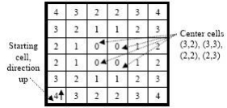
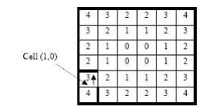
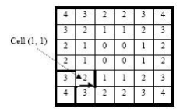
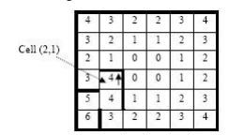

Slide 15
A* Algorithm
A* unlike any previous algorithms is in Informed search Algorithm.
It tries to explore the direction which is more closer to the goal node.
This is done using some heuristics which should not only be profitable, but consistent throughout the space as well as efficient to calculate.
In cases of mazes this can be done by simply calculating manhattan distances* of the node from the goal node.
This Algo is most useful when the cost of analysing a single node is high.**
*(manhattan distance is the sum of absolute differences of x and y coordinates.)
**(The original 1968 A* paper contained a theorem that no A*-like algorithm could expand fewer nodes than A* if the heuristic function is consistent and A*’s tie-breaking rule is suitably chosen.)
Notes:
Ayush

Slide 16
A* Algorithm Pseudocode
1. Assign dis[v] for all nodes = INT_MAX (distance from root node + heuristics of every node).
2. Assign dis[root] = 0 + heuristic(root, goal) (distance from root node to itself + heuristics).
3. Add root node to priority queue.
4. Loop on the queue as long as it's not empty.
1. In every loop, choose the node with the minimum distance from the root node in the queue +
heuristic (root node will be selected first).
2. Remove the current chosen node from the queue (vis[current] = true).
3. If the current node is the goal node, then return it.
4. For every child of the current node, do the following:
1. Assign temp = distance(root, current) + distance(current, child) + heuristic(child, goal).
2. If temp < dis[child], then, assign dist[child] = temp. This denotes a shorter path to child node
has been found.
3. And, add child node to the queue if not already in the queue (thus, it's now marked as not
visited again).
4. If queue is empty, then goal node was not found!
Notes:
Ayush

Slide 17
Comparison Between Workings
algo factors | BFS | DFS | Dijkstra | Flood | A*
Efficiency | High | Low | ~~ | ~~ | Very High
Performance | High | Low | Low | Medium | Very High
Solving times 400*400 | 0.045 | 0.014 | 0.263 | ~~ | 0.288
Optimal | Yes | No | Yes | No | Yes
Notes:
Ayush

Slide 18
Time & Space Complexity
Algorithm | Time Complexity |  | Space Complexity
 | Average Case | Worst Case | Worst
BFS | O(b^d) | O(b^d) | O(b^d)
DFS | O(d) | O(b^d) | O(N^2)
Dijkstra | O(|E|+|V|log|V|) | O(|V|^2) | O(b^d)
Flood Fill | O(|V|+|E|) | O(N^2) | O(N^2)
A* | (Depend on heuristic) | (Depend on heuristic) | O(b^d)
Notes:
Taalne ka h

Slide 19
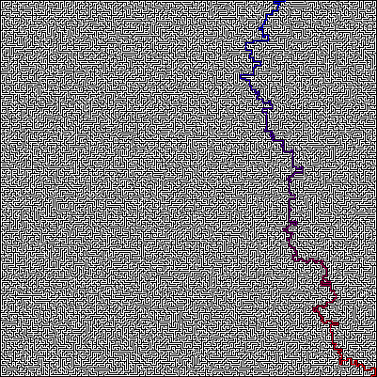

Solving 400x400 maze using various algos.
A*
Dijkstra
Notes:
Taalne ka h

Slide 20
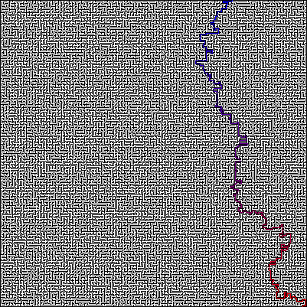
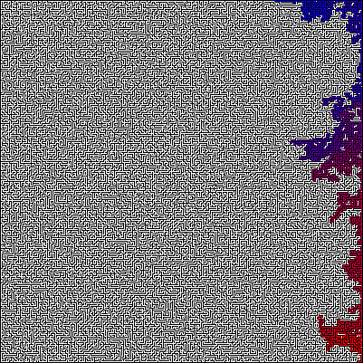
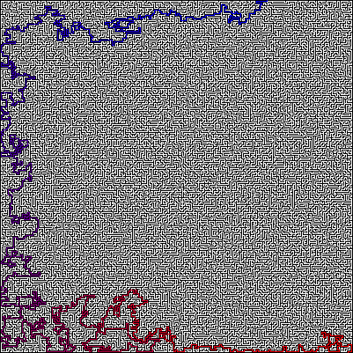
BFS
Wall Follower
DFS
Notes:
Taalne ka h

Slide 21
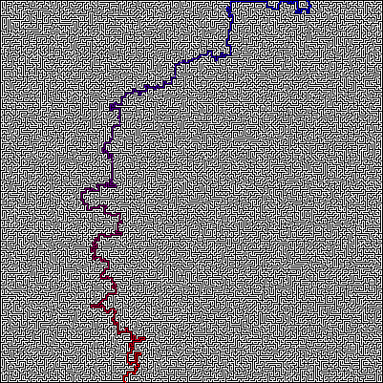
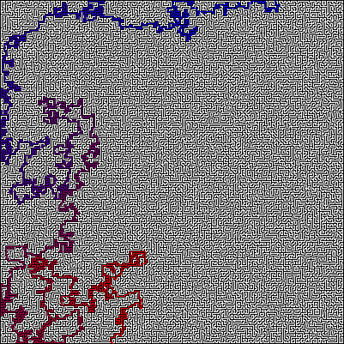
X400_braid Solves.
BFS
DFS
Notes:
Taalne ka h

Slide 22
Conclusion
Graph Search Algorithms are far superior than naive search techniques like Wall follower approach.
Informed Techniques surpass uninformed algorithms on large search space.
A* algorithm is widely used for mazes solving and other analogous problems. (Simple Straight Line Heuristics).
Notes:
Ayush

Slide 23
References :
P. E. Hart, N. J. Nilsson and B. Raphael, "A Formal Basis for the Heuristic Determination of Minimum Cost Paths," in IEEE Transactions on Systems Science and Cybernetics, vol. 4, no. 2, pp. 100-107, July 1968, doi: 10.1109/TSSC.1968.300136.
Huijuan Wang, Yuan Yu and Quan Bo Yuan, "Application of Dijkstra algorithm in robot path-planning," 2011 Second International Conference on Mechanic Automation and Control Engineering, Hohhot, 2011, pp. 1067-1069.
A. M. J. Sadik, M. A. Dhali, H. M. A. B. Farid, T. U. Rashid and A. Syeed, "A Comprehensive and Comparative Study of Maze-Solving Techniques by Implementing Graph Theory," 2010 International Conference on Artificial Intelligence and Computational Intelligence, Sanya, 2010, pp. 52-56.
T.H. Cormen, C.E. Leiserson, R.L. Rivest and C. Stein, “Introduction to Algorithms”, Third edition, Prentice Hall of India, pp. 587-748, 2009.
M. Pond, (2017, February 24). “Maze Solving - Computerphile [Video file]”. Retrieved from youtube.
Leo Willyanto Santoso, Alexander Setiawan, Andre K. Prajogo “Performance Analysis of Dijkstra, A* and Ant Algorithm for Finding Optimal Path Case Study: Surabaya CityMap”

Slide 24
THANK YOU
Ayush Agrawal (180001011)
Harsh Chaurasia (180001018)

