Slide 1

Bank Fraud Detection System Using SQL
Created by : Aditya Bet
from IT Vedant Institute
Link :
https://github.com/adityabet/Fraud_Detection_Bank

Slide 2




Project Objective
Detect & Analyze Fraud
Identify High-Risk Entities
Identify and analyze fraudulent banking transactions to understand their patterns and characteristics.
Pinpoint high-risk accounts and customers who are frequently involved in or targeted by fraudulent activities.
Generate Actionable Insights
Showcase SQL Proficiency
Provide data-driven insights that can be directly applied to minimize future fraud occurrences and protect assets.
Demonstrate advanced SQL skills through effective database creation, complex querying, and insightful reporting.

Slide 3
Data Sources Overview
Our project leverages a comprehensive dataset structured across five key tables, each providing critical information for robust fraud detection.
Table
Rows
Columns
Purpose
customers
20,000
9
Contains demographic and personal details for each bank customer.
accounts
15,000
7
Stores detailed information about each bank account, linked to customers.
transactions
100,000+
8
Records all financial transactions, including a critical fraud flag for analysis.
cards
15,000
7
Details all debit and credit cards issued, linked to specific accounts.
alerts
5,000
5
Logs suspicious activities and potential fraud alerts generated by the system.

Slide 4
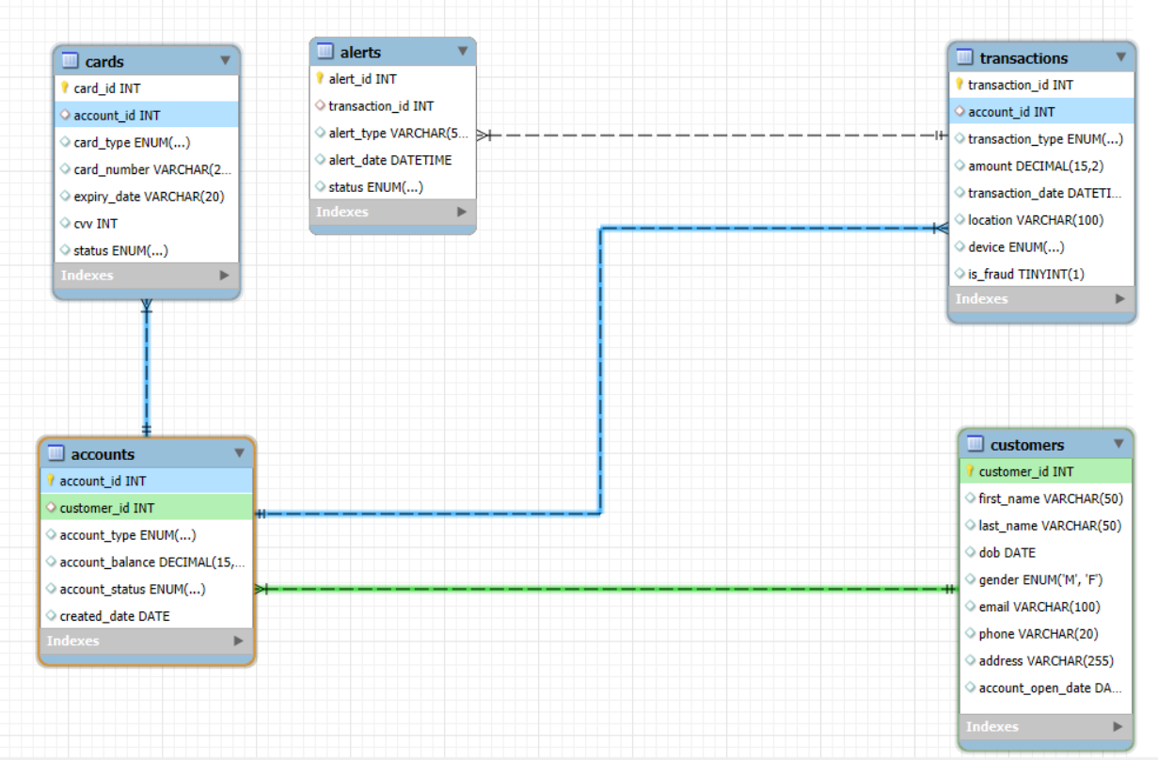
ER - Diagram
This ER Diagram visually represents the relationships between our database entities, forming the backbone for comprehensive fraud detection analysis. It highlights how different components of the banking system are interconnected, allowing us to trace activities and patterns effectively.
Primary Keys (PK) uniquely identify each record within a table.
Foreign Keys (FK) establish links between tables, ensuring data integrity and enabling complex queries.
The core flow for fraud detection analysis is : Customers → Accounts → Transactions → Alerts
Additionally, Accounts are directly linked to Cards.

Slide 5
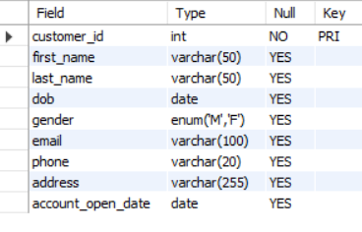
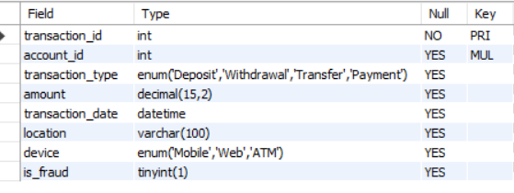
Database Structure
The database schema is meticulously designed to support detailed fraud analysis,
with specific data types chosen for optimal representation and query performance.
Customers Table Example ( DESC Customers )
Each table is designed with appropriate data types to ensure data integrity and facilitate efficient querying for fraud patterns. We leverage specific types for effective data representation:
ENUM: Used for columns with a predefined set of values, such as 'Debit' or 'Credit' for transaction types, ensuring data consistency.
BOOLEAN: Ideal for binary flags like is_fraud, clearly indicating true/false states.
DATE: Captures date information for transactions and alerts, crucial for time-series analysis in fraud detection.
Transactions Table Example ( DESC Transactions )
DECIMAL: Precisely stores monetary values, like transaction amounts, preventing floating-point inaccuracies.
These choices allow for robust data modeling, enabling complex queries and accurate insights into banking activities.

Slide 6
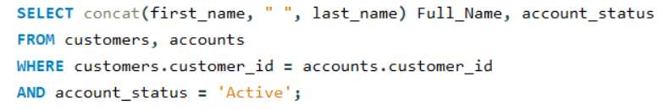

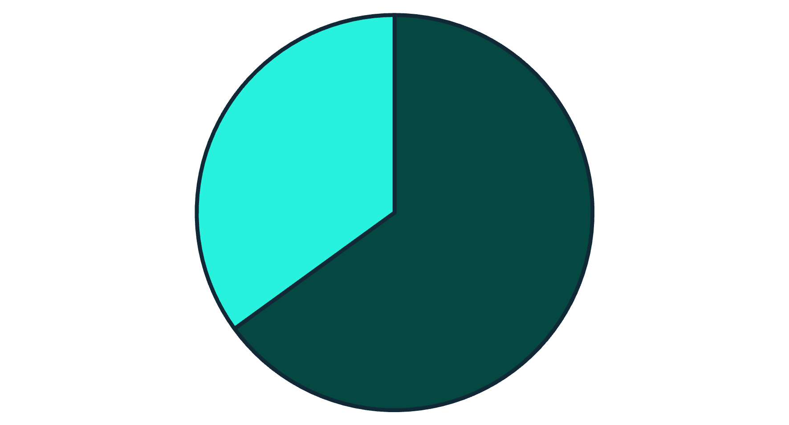
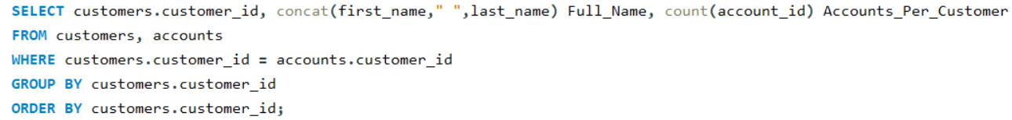
Basic SQL Queries
1. Active Accounts
2. Transactions Count per Type
This query identifies all active customer accounts by joining the customers and accounts tables. It helps in quickly assessing the operational customer base.
Aggregates the total number of transactions for each type (e.g., Debit, Credit),
providing a high-level overview of transaction activity.
3. Customer Accounts
Retrieves the full name of customers along with the type of accounts they hold,
useful for general customer profiling.
Debit
Credit

Slide 7
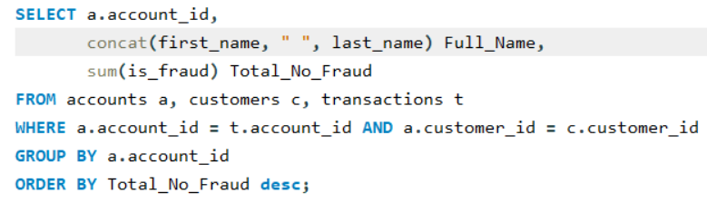
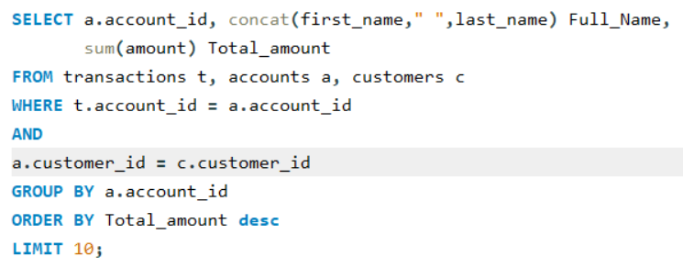
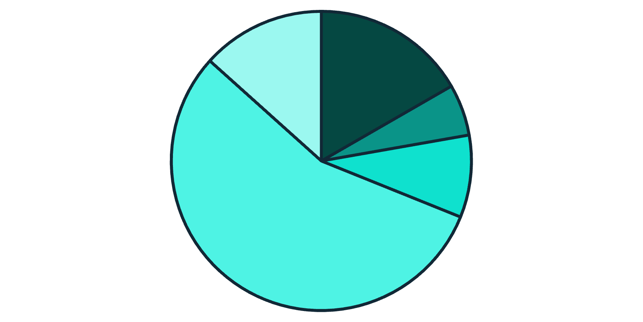
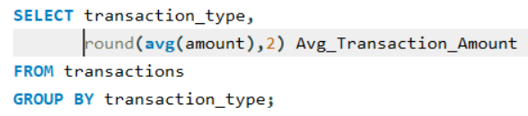
Intermediate Analysis: Fraud Insights
1. Top 10 Accounts by Transaction Amount
2. Number of Fraudulent Transactions per Account
Identifies the accounts with the highest cumulative transaction amounts, which could indicate high-value customers or potential targets for large-scale fraud.
Counts how many fraudulent transactions are associated with each account, helping to identify accounts that are frequently compromised.
3. Average Transaction Amount per Type
Calculates the average amount for each transaction type. Significant deviations could signal unusual activity.
Online Purchase
ATM Withdrawal
POS Purchase
Wire Transfer
Bill Payment

Slide 8
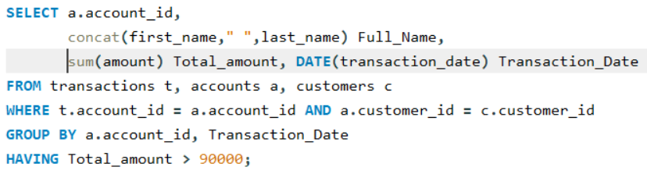
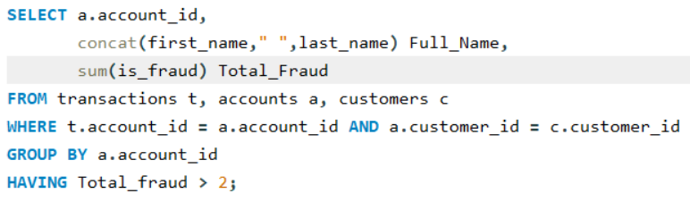
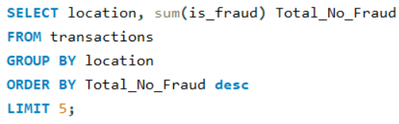
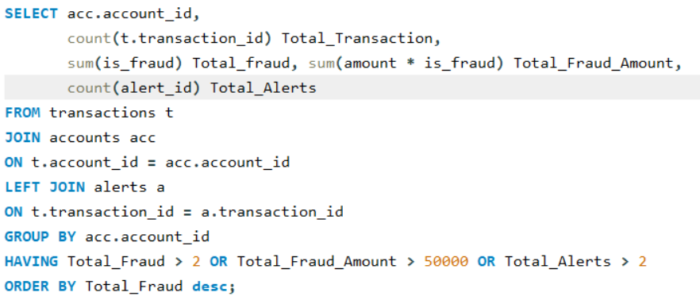
Advanced Fraud Detection Queries
Customers Exceeding ₹90,000 in a Single Day
Accounts with > 2 Fraudulent Transactions
Identifies customers with aggregate transactions surpassing a significant daily threshold, a common indicator of potential large-scale fraud or account takeover.
Flags accounts that have been associated with multiple confirmed fraudulent activities, suggesting a recurring vulnerability or a targeted account.
Top 5 Fraud Locations
High-Risk Account Combinations
Reveals geographical hotspots for fraudulent activities, allowing for targeted monitoring or enhanced security measures in those regions.
Identifies accounts exhibiting a combination of suspicious factors: high alert count, multiple fraud incidents, and significant total fraud amounts.

Slide 9
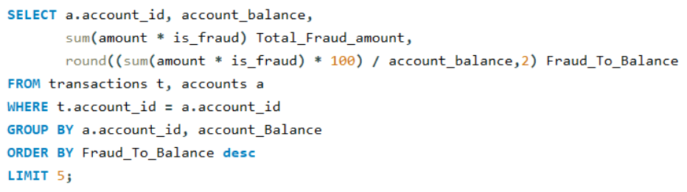
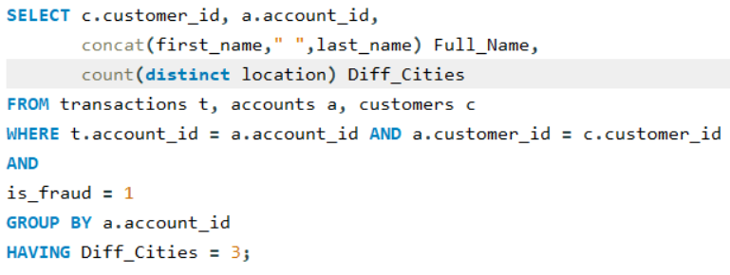
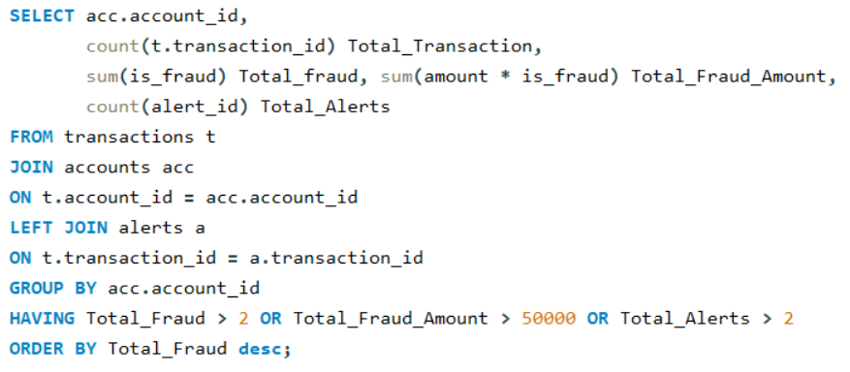
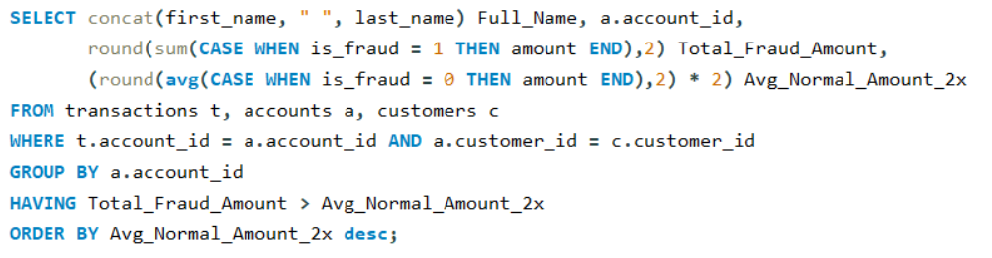
Key Insights & Findings
Fraud-to-Balance Ratio
Repeated Fraud Locations
High-risk accounts can be precisely flagged by monitoring their fraud-to
-balance ratio, indicating disproportionate fraudulent activity compared to
their typical holdings.
Certain geographical locations consistently show repeated fraud activity,
suggesting organized crime rings or compromised POS systems in those areas.
Coordinated Attacks
Sudden Large Frauds
Multiple fraudulent transactions occurring within the same hour on
different accounts often indicate highly coordinated attacks,
requiring rapid response.
Accounts experiencing sudden, unusually large fraudulent transactions (e.g., >2x average normal transaction amount) need immediate and critical attention, as these are often signs of account takeover.

Slide 10


Recommendations & Actionable Steps
Based on our findings, we propose the following actionable recommendations to bolster the bank's fraud detection and prevention capabilities, transforming insights into tangible security enhancements.
Real-time Monitoring Implementation
Dynamic Alert Thresholds
Implement continuous, real-time monitoring for all accounts identified as high-risk, enabling immediate detection and intervention at the first sign of suspicious activity.
Introduce adaptive alert thresholds based on total fraud percentage and evolving transaction patterns, ensuring that alerts are both timely and relevant, reducing false positives.
Cross-City Transaction Verification
Automate Large Fraud Blocking
Establish systems to cross-check transactions across multiple cities for same-day activities, a common indicator of card cloning or rapid money laundering operations.
Develop and deploy automated systems for detecting and immediately blocking sudden, unusually large fraudulent transactions to minimize financial losses during account takeovers.

Slide 11

Tools & References
1] Database & Queries
MySQL
MySQL Workbench
3] Visualization
Microsoft Excel
Power BI
Charts in PowerPoint
4] ER Diagram & Database Design
MySQL Workbench
5] Dataset Source
Kaggle (Simulated Bank Data)

Slide 12
Questions & Thank You
Questions:
Any doubts regarding database design or ER diagram?
Want to see how we detect high-risk accounts using SQL queries?
Curious about fraud patterns in specific locations or transactions?
Interested in implementing real-time fraud alerts in a live system?
Closing Note:
Thank you for your time and attention!
This project demonstrates how SQL can be leveraged for fraud detection and customer analytics
Your feedback and suggestions are welcome!
Thank You 🤝

