Slide 1


On the Constancy of Latency at the Internet’s Edge
Aditya, Vaibhav, Aniket, Balakrishnan, and Vinayak

Slide 2
Low latency is good, but “constancy” is great
Measuring “constancy” of latency
Methodology
Findings
Outline

Slide 3
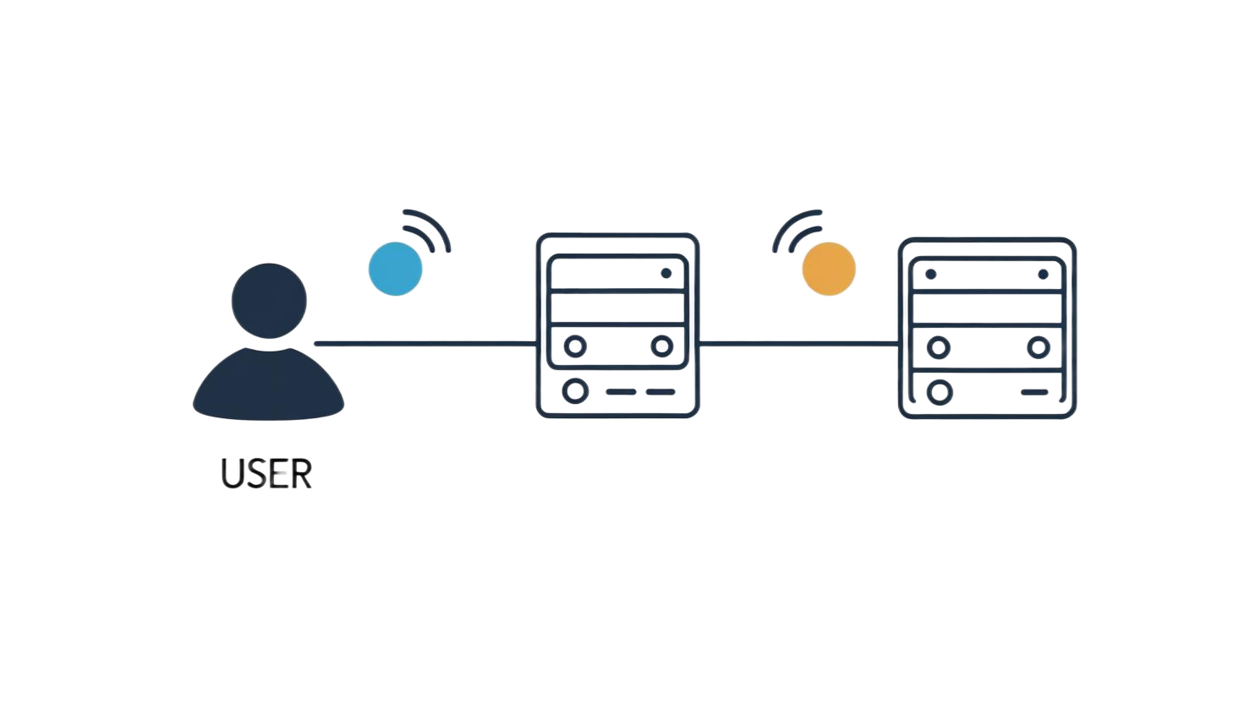



Latency matters!
Latency impacts user experience and app performance
RTT: 100 ms
CDN SERVER
ORIGIN SERVER
👎

Slide 4

Latency matters!
Nowadays, most content is served by Content Delivery Networks
RTT: 20 ms
CDN SERVER
ORIGIN SERVER
👍

Slide 5
Particularly great if latency is consistently low …
Low latency is good, but “constancy” also matters
Constancy? Consistency over time
Has implications for transport (e.g., TCP) and application performance

Slide 6
Low latency is good, but “constancy” is great
Measuring “constancy” of latency
Methodology
Findings
Outline

Slide 7
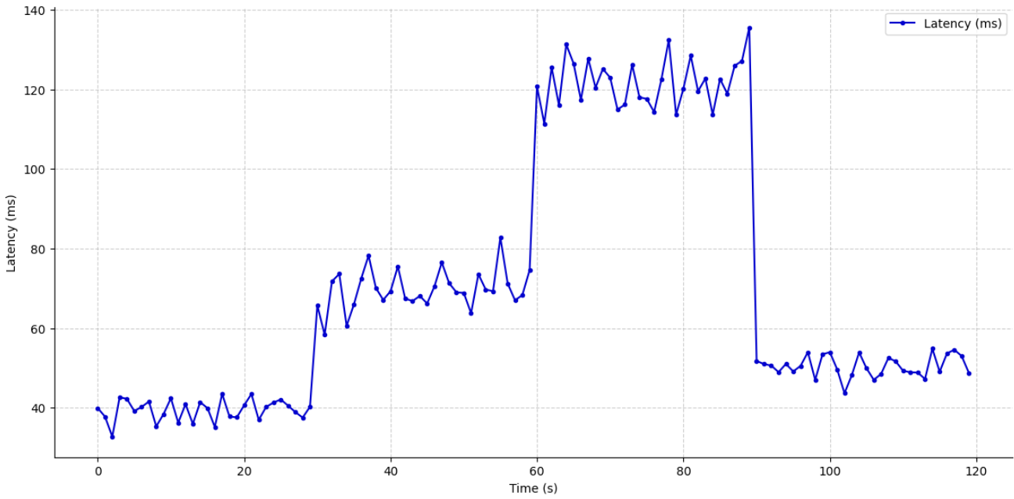
“Constancy”?

Slide 8
“Constancy”?
No!

Slide 9
“Constancy”?
What if the ‘signal’ had some “wiggle” room?
No!

Slide 10
Operational Constancy
What if the ‘signal’ had some “wiggle” room?
Changes within this range do not matter!

Slide 11
Operational Constancy
“Practical” thresholds
25ms

Slide 12
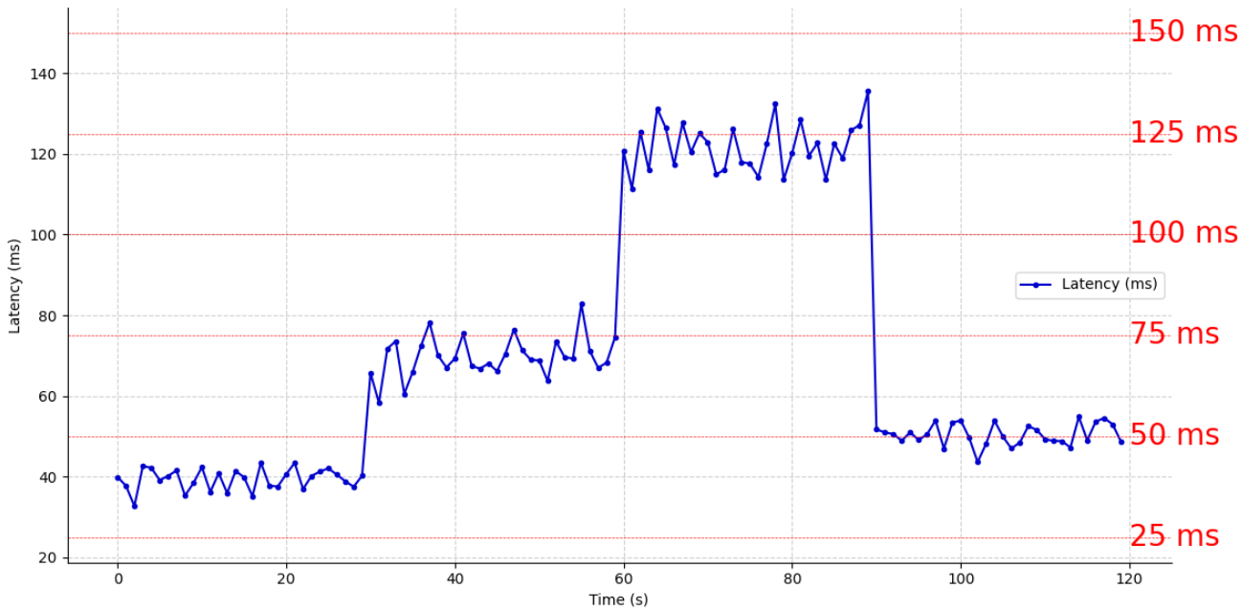
Operational Constancy

Slide 13
Operational Constancy
Within acceptable (practical) threshold

Slide 14
Predictive Constancy

Slide 15
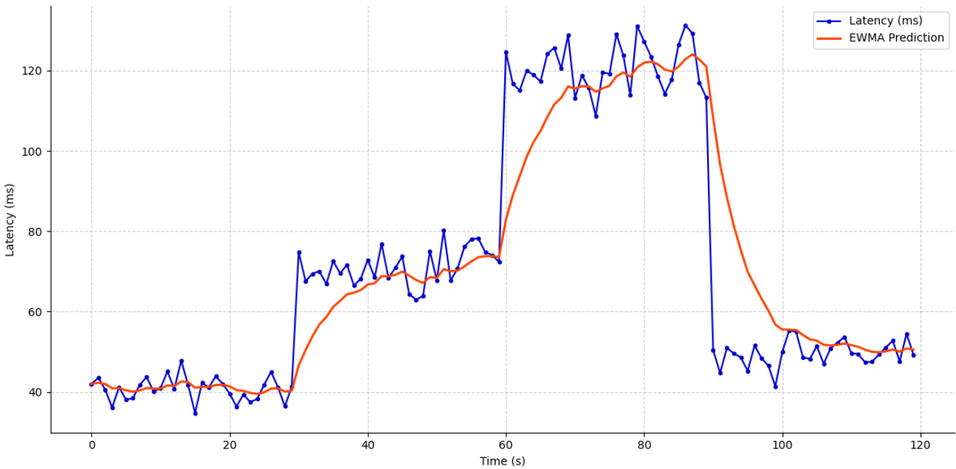
Predictive Constancy

Slide 16
Predictive Constancy
Smaller variations, better predictions, higher constancy …

Slide 17
Mathematical Constancy

Slide 18
Mathematical Constancy
Ignore “small” variations

Slide 19
Mathematical Constancy
Level shift
Level shift

Slide 20
Mathematical Constancy
Change point
Change point

Slide 21
Mathematical Constancy
Change free regions
1
2
3

Slide 22
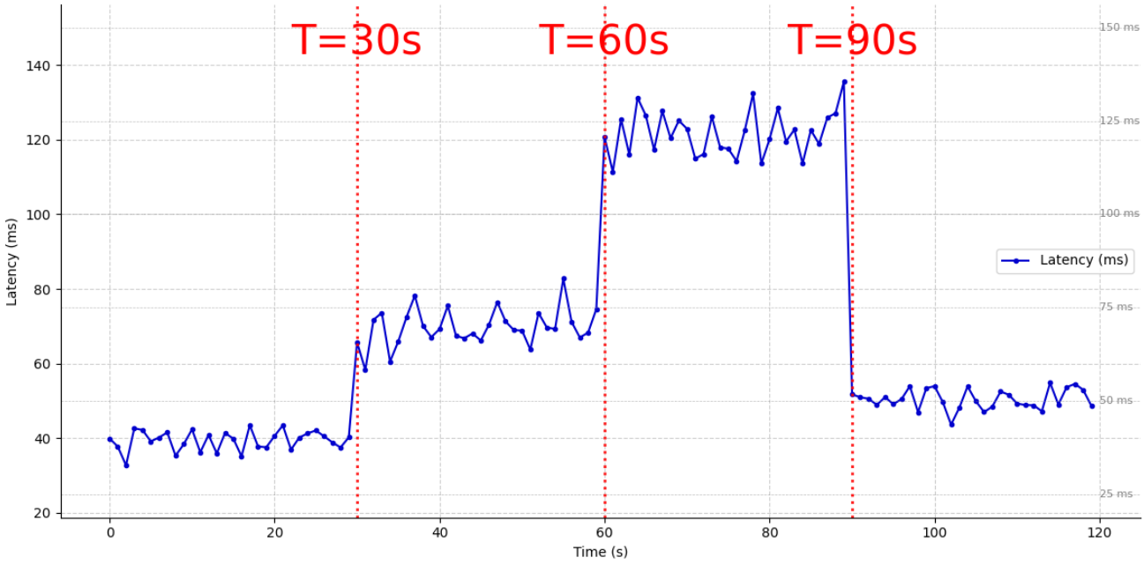
Mathematical Constancy

Slide 23
Predictive Constancy
Forecast from past data

Slide 24
Mathematical Constancy
Where do level shifts happen? At change points!
~140ms
~70ms
~50ms
~50ms

Slide 25
Mathematical Constancy
Where do level shifts happen? At change points!
~140ms
Change Free Region
~70ms
~50ms
~50ms

Slide 26
Standing on the Shoulders of Giants
Zhang et al. (2001) and Davisson et al. (2021)
Prior work measured constancy across arbitrary Internet paths
Our focus: end user – CDN server paths
Y. Zhang and N. Duffield, On the Constancy of Internet Path Properties, IMW, 2001
L. Davisson et al., Reassessing the Constancy of End-to-End Internet Latency, TMA, 2021

Slide 27
Low latency is good, but “constancy” is great
Measuring “constancy” of latency
Methodology
Findings
Outline

Slide 28
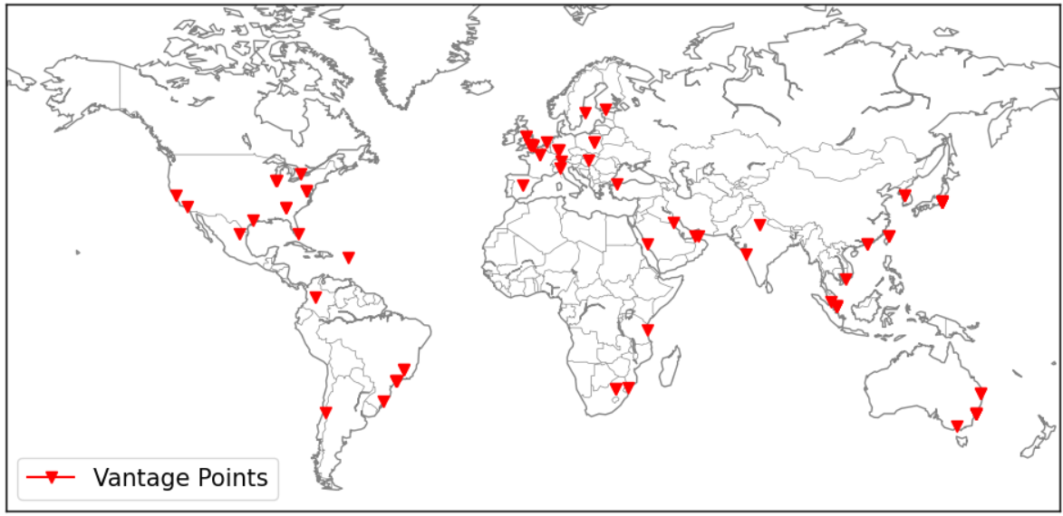

Choosing Anchors for Vantage Points
69 Anchors across 34 countries
High uptime and diversity
Spans 27 ASNs

Slide 29
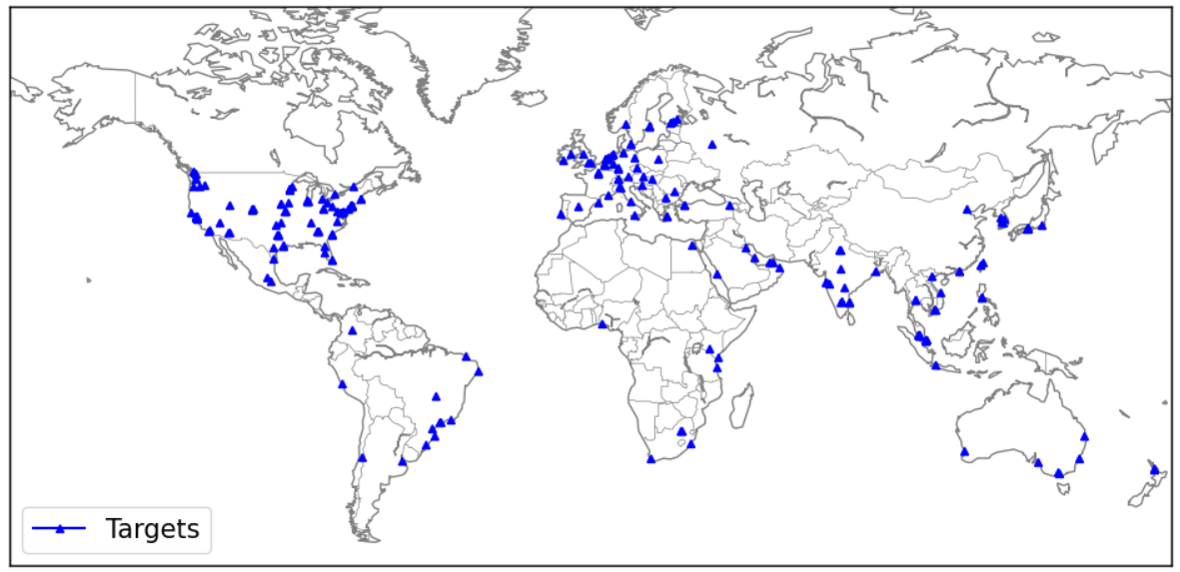
Choosing CDN Domain Names for Targets
100 domain names across 56 countries and 53 ASNs
5 CDN Providers
Resolved on anchor to 13,934 IPs
Obtained by crawling web pages sampled from Hispar list

Slide 30




Choosing CDN Domain Names for Targets

Slide 31
“Timelines”
69 Vantage Points x 100 Targets → 6900 timelines
Pings every 2 hours for 10 consecutive days (including weekends)
Timeline
RTT
Vantage Points
Targets

Slide 32
Low latency is good, but “constancy” is great
Measuring “constancy” of latency
Methodology
Findings
Outline

Slide 33
Research Questions
Do latency spikes occur ? How often and how large?
How “constant” are the observed latencies?
How does latency inflation in these paths look like?

Slide 34
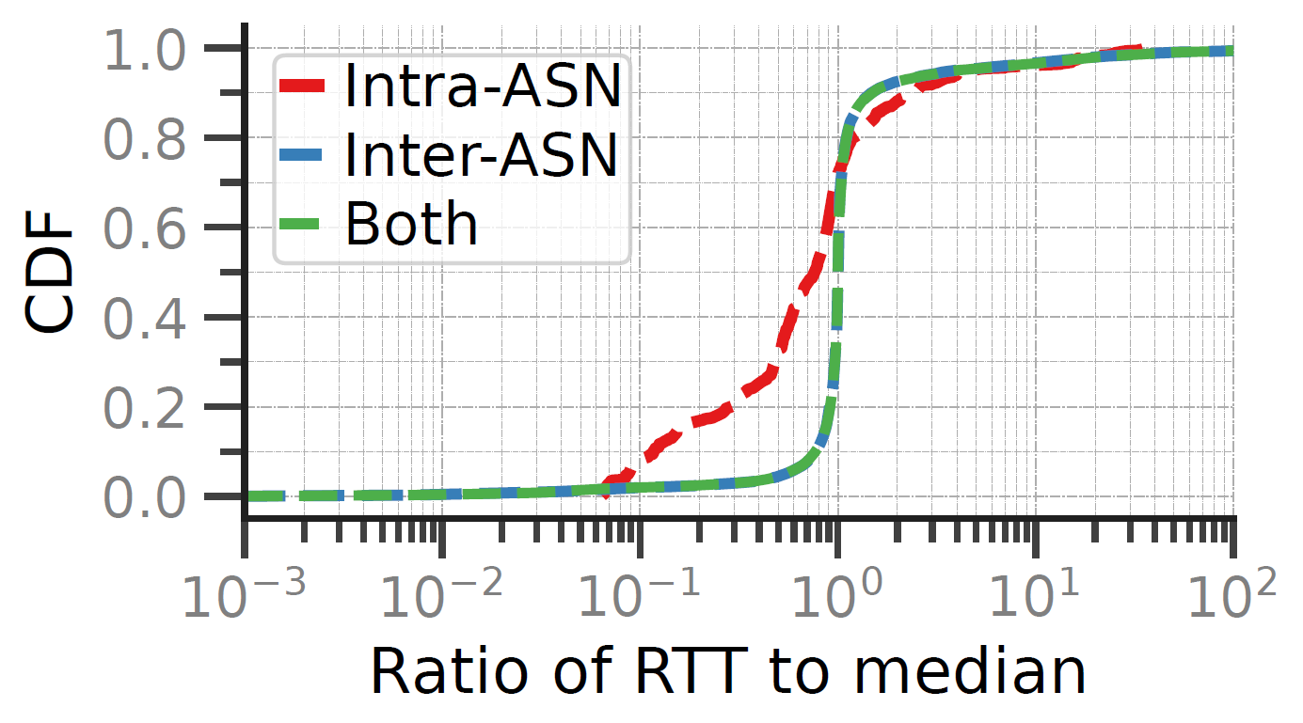
Latency Spikes

Slide 35
Latency Spikes
10 x Median RTT (spike)
Only 3.84% of RTTs > 10 x median of timeline

Slide 36
Latency Spikes
10 x Median RTT (spike)
Only 3.84% of RTTs > 10 x median of timeline
7.5% > 2 x median of timeline
Spikes mostly in inter-AS paths

Slide 37
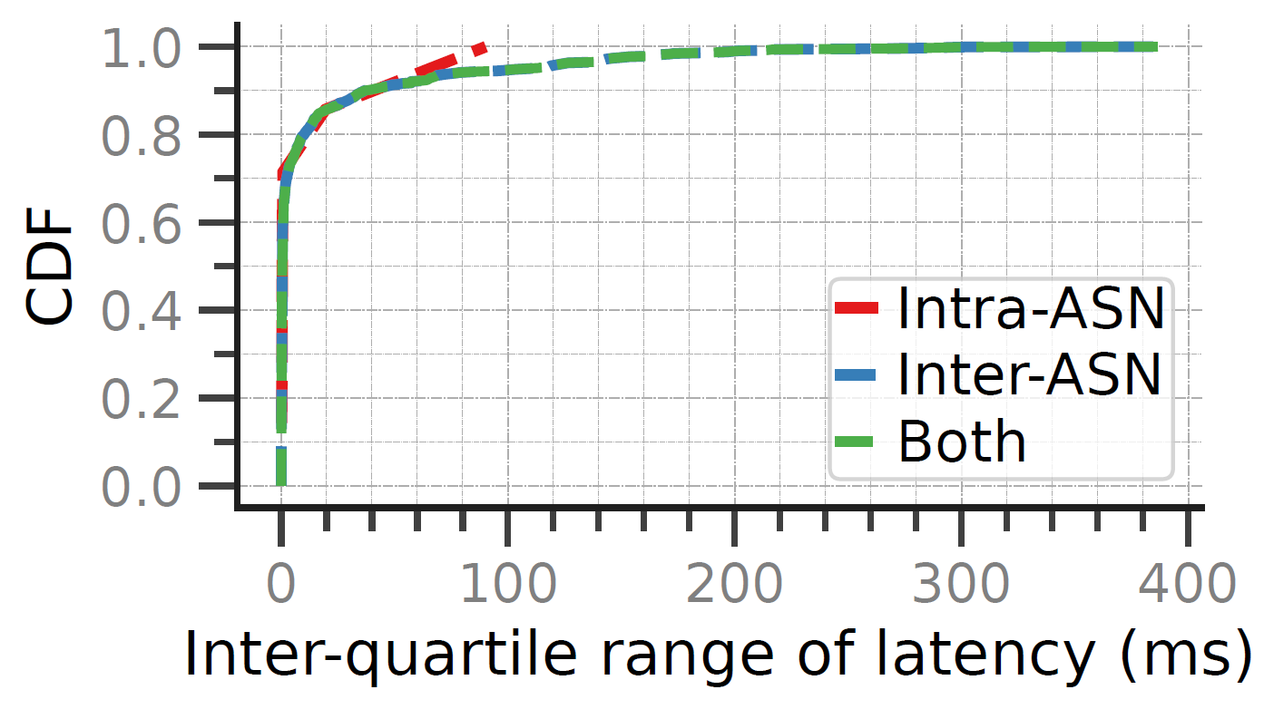
Latency Variation

Slide 38
Latency Variation
Around 70% of paths: minimal variation (IQR < 10ms)

Slide 39
Latency Variation
Around 70% of paths: minimal variation (IQR < 10ms)
5% show IQR > 100ms
Intra-AS: less variation

Slide 40
Operational Constancy
Within acceptable (practical) threshold

Slide 41
Operational Constancy
“Practical” thresholds
25ms

Slide 42
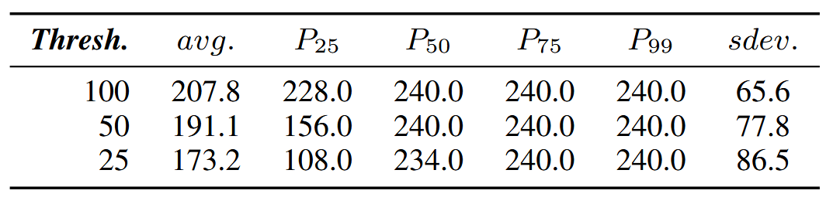
Operational Constancy
Thresholds tested – 25ms, 50ms, and 100ms
At 100ms – nearly all paths stable
MAX CFR for Operational Constancy

Slide 43
Operational Constancy
Thresholds tested – 25ms, 50ms, and 100ms
At 100ms – nearly all paths stable
25ms – most are still considered constant
MAX CFR for Operational Constancy

Slide 44
Predictive Constancy
Forecast from past data

Slide 45
Predictive Constancy
Smaller variations, better predictions, higher constancy …

Slide 46
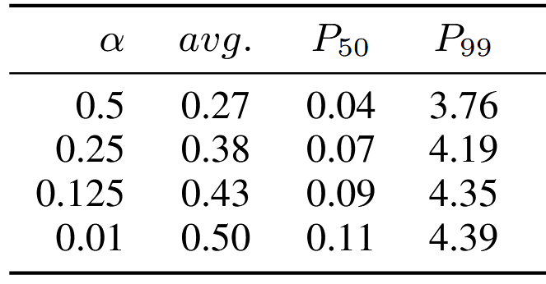
Predictive Constancy
Used EWMA, SMA, and Kalman filter
EWMA has lower prediction error than SMA
Kalman filter: lowest error, most accurate
EWMA prediction error

Slide 47
Mathematical Constancy
Where do level shifts happen? At change points!
~140ms
Change Free Region
~70ms
~50ms
~50ms

Slide 48
Mathematical Constancy
Change free regions
1
2
3

Slide 49
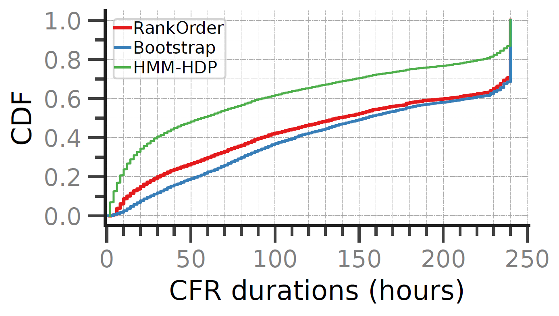
Mathematical Constancy

Slide 50
Mathematical Constancy
Median change-free region (CFR): 50–150 hours

Slide 51
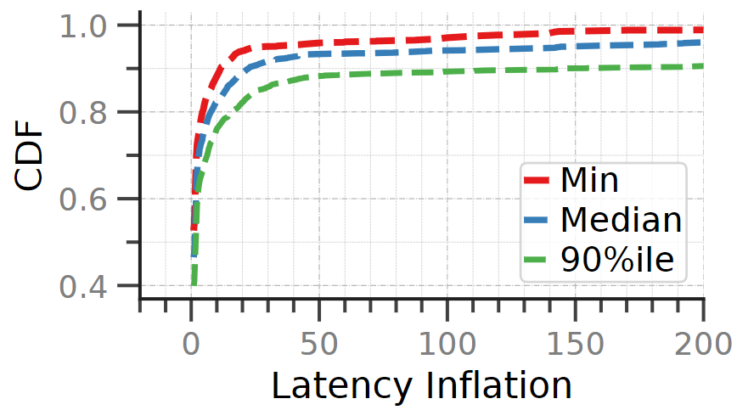
Latency Inflation
Compared to theoretical minimum fiber optic RTT

Slide 52
Latency Inflation
Compared to theoretical minimum fiber optic RTT
Most paths close to ideal
Some > 100x inflated — due to routing/ geolocation issues

Slide 53
Summary
Spikes: 3.84% show ≥ 10× spikes; prior work saw 0.01%.
Constancy: Median of Max CFR 3× longer than prior work.
Inefficiencies: Some latencies are significantly larger than theoretical minimums

Slide 54
But, wait! What about …
… short-term tendencies in a timeline?
… IPv6?
… the path that packets take between vantage points and targets?
… the reason why level shifts happen?
… last mile delivery?

Slide 55

Questions?
📧 Feel free to email me at f20212071@goa.bits-pilani.ac.in
🔗 Code and data at github.com/adityabhat3/const-lat

Slide 56

Contributions
Large-scale study of latency to CDN edge servers
Used RIPE Atlas anchors as end-user estimators
Used notions of constancy – mathematical, operational, and predictive
Compared to past studies of probe-probe paths
Released open-source tools and data

Slide 57
Implications (TODO)
Good news for:
Video streaming
Cloud gaming
Real-time apps
Helps TCP tuning, path prediction, and fault detection

Slide 58
Experiment Setup
Timeline
RTT
Vantage Points
Targets

Slide 59
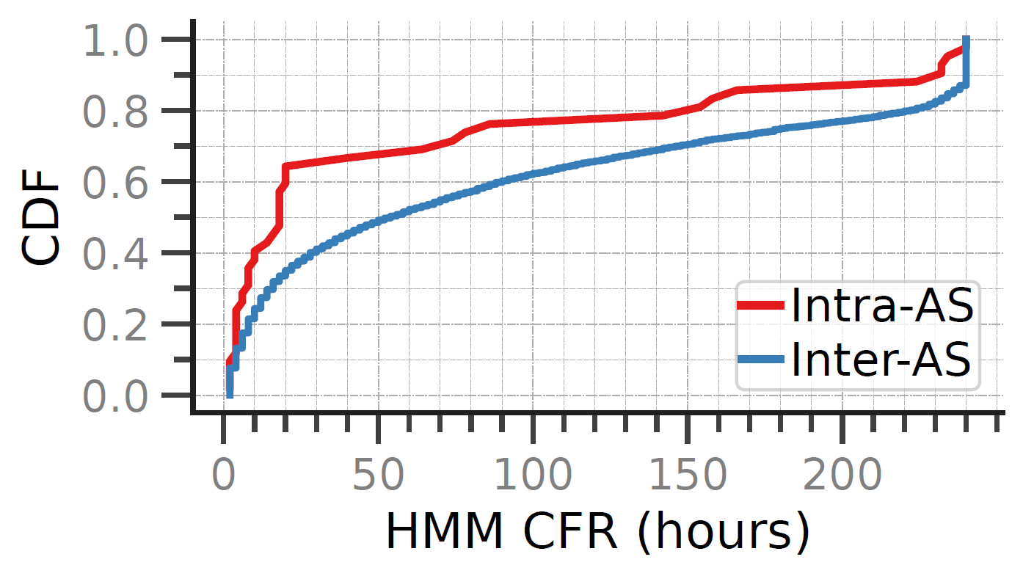
Inter-AS and Intra-AS Paths
Inter-AS: longer CFRs
Intra-AS: more frequent changes
Changes do not increase latency significantly
Inter-AS paths remain stable for longer than intra-AS paths, which may reflect internal network optimizations.

