Slide 1

Internship Progress Report
Presented By: Aditya Bhati
Reporting Manager : Mrs. Preeti Jain (CPO)

Slide 2
HR Panorama – GCC Dashboards
Project assigned by Viraj Mandalia
Below dashboards provide critical HR insights.
Headcount Dashboard
Goal Status Report
Budget Vs Actual HC Dashboard
eVidhyalaya Dashboard
Budget Position
Classroom Training Dashboard
PMS Dashboard
Attrition Dashboard
Saksham Dashboard
YTD Attrition
Saksham Pending Dashboard
Infant Attrition
Hiring Dashboard
Serving Notice
YTD/Monthly Joining
Upcoming Retirements
Upcoming Joining
Service Extension

Slide 3




Dashboard Automation
All HR dashboards are fully automated.
Data from Outlook
Incoming data is automatically extracted from Outlook emails.
Power BI Integration
Extracted data is directly processed and loaded into Power BI.
Automatic Refresh
Dashboards update immediately.
This ensures real-time accuracy and efficiency.

Slide 4




Power App: Simplified Dashboard Access
Introducing an intuitive Power App – A New Way to Access Dashboard.
Effortless Access
User Role
No login is required.
Simply give role base access.
Instant Dashboards
User Logs
Open assigned dashboards quickly.
Track User Activity.

Slide 5






Automated Greetings Initiative (in progress)
We implemented automated systems for personalized employee greetings.
Work Anniversaries Wishes
Recognizing dedication.
Birthday Wishes
Automated greetings with photos.
Leader Engagement
Personal wishes from top leaders.

Slide 6



Benefits of Automated Greetings
Automated greeting systems deliver significant advantages by enhancing employee experience and optimizing HR operations.
Enhanced Efficiency
Boosted Satisfaction
Stronger Engagement
Automated processes replace manual effort. This saves valuable HR time.
Personalized messages show appreciation. Employees feel valued and engaged.
Leaders can easily send warm wishes. This builds a deeper employee connection.

Slide 7
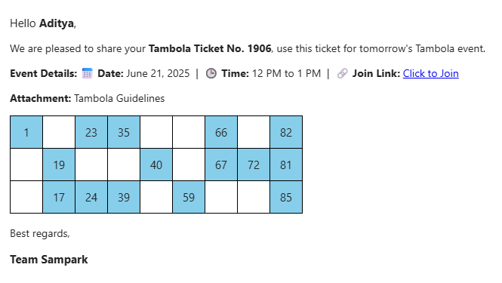
Sent Automated Tambola Tickets
2200+ Unique Tambola Tickets Sent
Utilized 29 dynamic values
Saved time to send manually tickets one by one.

Slide 8
Sent Automated Regularization Notice
270 Employees to their regularization notice
Saved time to send manually tickets one by one.

Slide 9
Power App: Desk Management System (in progress)
Introducing a user-friendly Power App for hot desking and managing vacant workstation.
Effortless Access
Universal Desk Searching
No login is required.
Simply User can search any desk details.
Instant Desk Booking
Admin Panel
Open assigned dashboards quickly.
Track user activity & manage vacant desk.

Slide 10
Thank You
I am committed to continuous improvement in HR data analytics & automation.

