Slide 1

Presented by :
Ritesh Garud
Aditya Soni
Mrudula Deo
Aditya Bhavi

Slide 2


Slide 3
About Hadoop
• Hadoop is an open-source software framework for storing data and running applications on clusters of commodity hardware.
• It provides massive storage for any kind of data, enormous processing power and the ability to handle virtually limitless concurrent tasks or jobs.
• The core of Apache Hadoop consists of a storage part (HDFS) and a processing part (MapReduce).
• Developer – Apache Software Foundation
• Written in Java

Slide 4
Benefits
• Computing power – Distributed computing model ideal for big data
• Flexibility – Store any amount of any kind of data.
• Fault Tolerance - If a node goes down, jobs are automatically redirected to other nodes. And it automatically stores multiple copies/replicas of all data.
• Low Cost - The open-source framework is free and uses commodity hardware to store large quantities of data.
• Scalability – System can be grown easily by adding more nodes.

Slide 5
HDFC Goals
Detection of faults and automatic recovery.
• High throughput of data access rather than low latency.
• Provide high aggregate data bandwidth and scale to hundreds of nodes in a single cluster.
• Write-once-read-many access model for files.
• Applications move themselves closer to where the data is located.
• Easily portable.

Slide 6
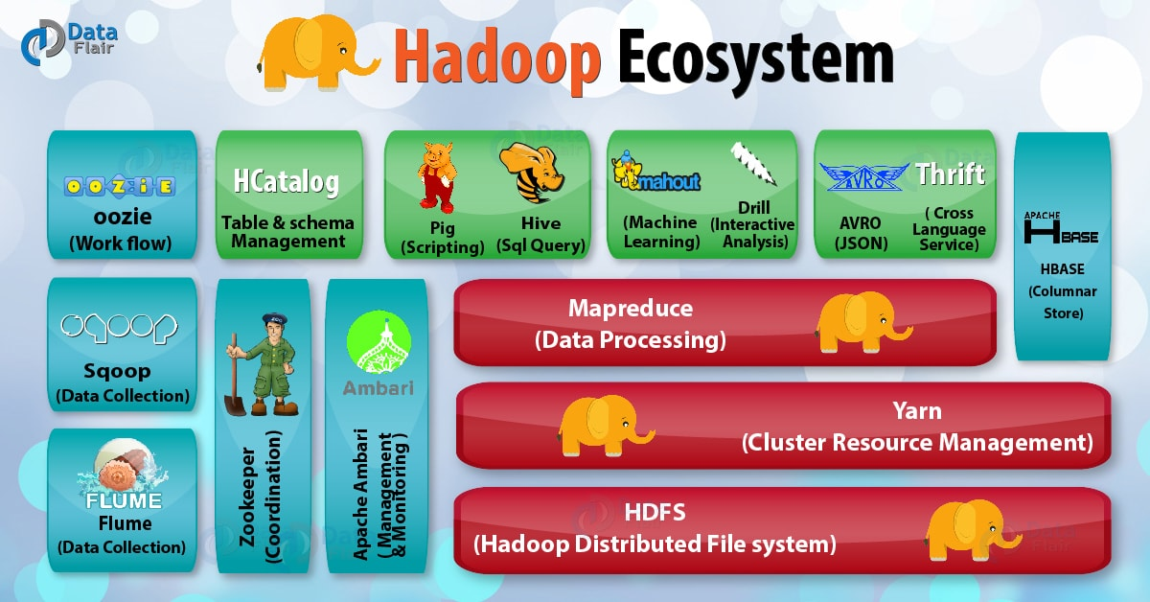

Slide 7
Some Nomenclature
• A Rack is a collection of nodes that are physically stored close together and are all on the same network.
• A Cluster is a collection of racks.
• NameNode – Manages the files system namespace and regulates access to clients. There is a single NameNode for a cluster.
• DataNode – Serves read, write requests, and performs block creation, deletion, and replication upon instruction from NameNode.
• A file is split in one or more blocks and a set of blocks are stored in DataNodes.
• A Hadoop block is a file on the underlying file system. Default size 64 MB. All blocks in a file except the last block are the same size.

Slide 8
Advantages
Scalable. Hadoop is a highly scalable storage platform because it can store and distribute very large data sets across hundreds of inexpensive servers that operate in parallel. ...
Cost-effective. ...
Flexible. ...
Fast. ...
Resilient to failure.

Slide 9
THANK YOU

