Slide 1

Your Journey To Cloud
Starts HERE !!!!
Aditya Bisht
Solution Engineer, Oracle

Slide 2
AGENDA
Introduction
Journey To Cloud
Tech Demo
Technical Q & A

Slide 3
Aditya Bisht
Technical Work Experience
City of Rochester (Information Service Developer)
City of Rochester (IT Intern – Business Analytics)
Ellucian (R & D Software Engineer – Data Engineering Team )
Rochester Institute of Technology (Teaching Assistant)

Slide 4
TIME TO MOVE
Assessment, Strategy and Roadmap
Cloud Transformation and Migration
Cloud Management and Optimization

Slide 5
ORACLE CLOUD
DaaS
SaaS
PaaS
IaaS

Slide 6



Infrastructure as a Service
Servers and Storage
Networking Firewalls / Security
Data Center
SECURITY PERFORMANCE FLEXIBILITY

Slide 7
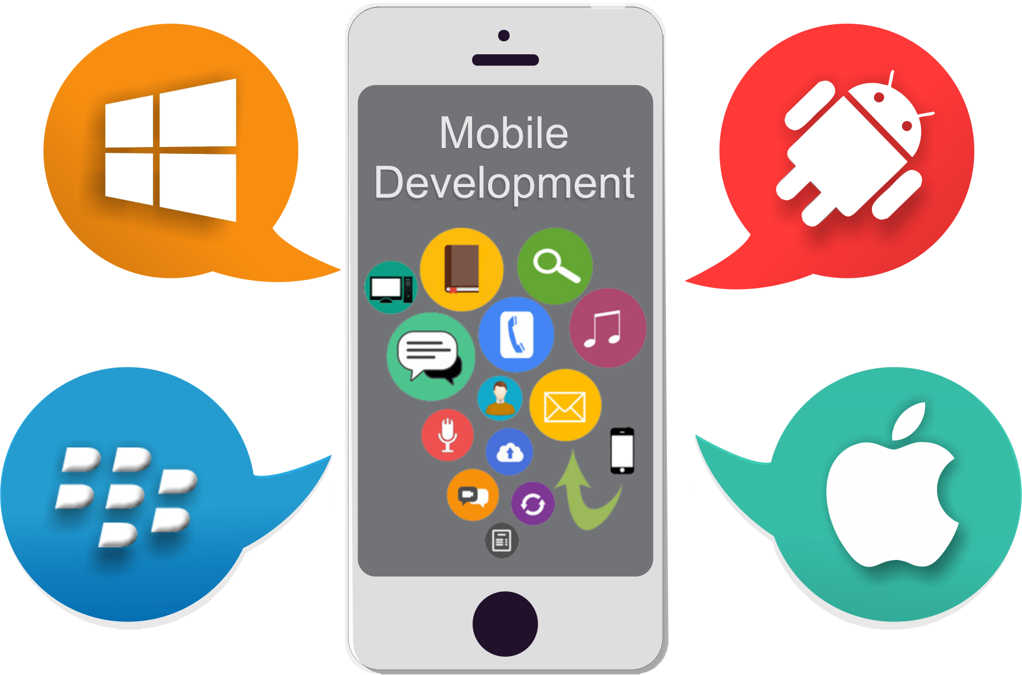

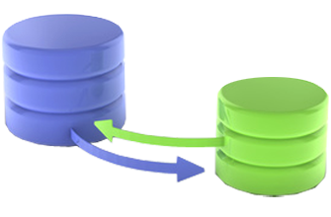
Platform as a Service
Application Development
Business Analytics
Data Migration
Servers and Storage
Networking Firewalls / Security
Data Center

Slide 8
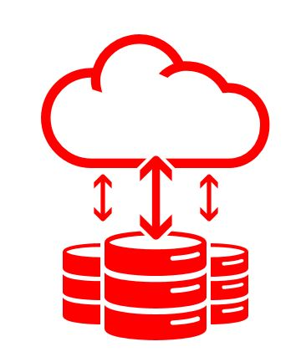
Platform as a Service
Your Data Your Cloud !!!

Slide 9

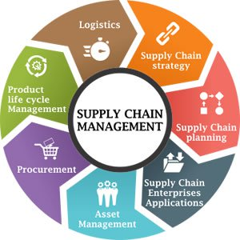
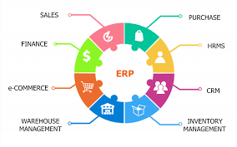
Software as a Service
HR
SCM
ERP
Application Development
Business Analytics
Data Migration
Servers and Storage
Networking Firewalls / Security
Data Center

Slide 10
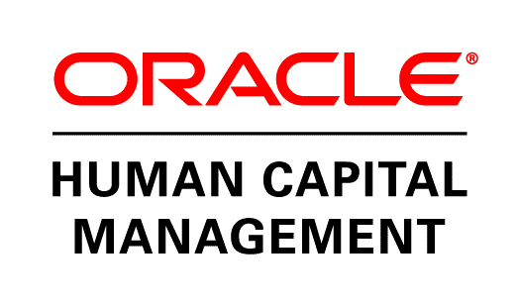
Software as a Service

Slide 11

Data as a Service
Social Data
(What Consumers Say)
Behavioral Data
(What Consumers Do)
Purchase Data
(What Consumers Buy)
Oracle Marketing Cloud
Oracle Social Cloud
Oracle Sales Cloud
Oracle Commerce Cloud
Oracle Service Cloud

Slide 12




On-Premise
Cloud At Customer
Public Cloud

Slide 13
Technical Demo
Infrastructure as Code (IaC)
DevOps approach to deploy and Configure resources on Amazon Web Services
YouTube Link : https://youtu.be/bVPlFHH7exM

Slide 14
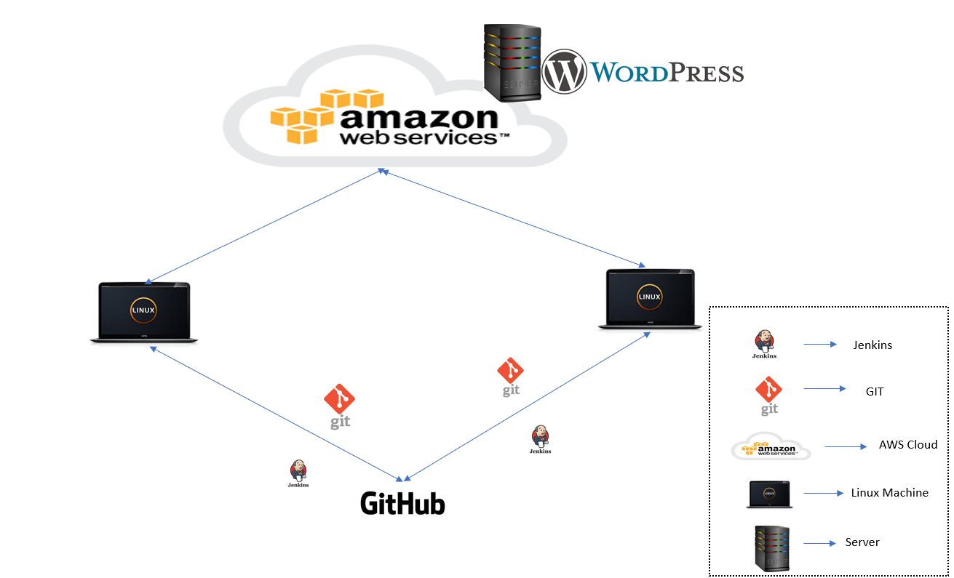
Notes:
YouTube Link : https://youtu.be/bVPlFHH7exM

Slide 15
Project Requirements Part 1
Create an AWS Provider for interacting with AWS resources.
Create a Virtual Private Cloud.
Create an Internet Gateway to give the subnet access to the open internet gateway.
Give the VPC internet access on its main route table and open it to the internet.
Create a Public Subnet to put isolated AWS launch instances into it and it has to be in the range of VPC using its CIDR block.
Create a Security Group with Ingress and Egress Rules and attach it to the VPC.
Create a EC2 instance of type Linux and install Nginx Server on it using Remote Provisioner

Slide 16
Project Requirements Part 1
Create a AWS Provider
Create a Virtual Private Cloud
Create an Internet Gateway to give the subnet access to the open internet gateway.
Creating 2 Route Tables. One public and One Private. Give the VPC internet access on its public route table and open it to the internet.
Create 3 Subnets. One public and 2 private Subnets.
Create 3 additional Private Subnets for Relational Database instance.
Create Subnet Association Rules for RDS subnets and Non RDS Subnets.
Create a Security Group with Ingress and Egress Rules and attach it to the VPC.
Create a Security group for RDS instance.
Create a RDS Instance of engine type MySQL and predefined Database Credentials.
Create a EC2 instance of type Linux and run the Ansible script called Wordpress.yml to download and install WordPress on it using Remote Provisioner.

