Slide 1
Lecture 19
Logistics
  Lab 8 this week to be done in pairs
    Find a partner before your lab period
    Otherwise you will have to wait for a pairing which will slow you down
  HW5 and HW6 solutions out today
    Graded HW5 available at review session tomorrow
  HW7 out today due Wednesday March 4
  Midterm 2 Wednesday
    Covers material up to simple FSM
    Review session tomorrow, 4:30 here, EEB 037
Last lecture
  Counter FSM design
  General Finite State Machine Design
    Vending machine example
Today
  Moore/Mealy machines
  Midterm 2 topics and logistics

Slide 2
The “WHY” slide
Moore/Mealy machines
  There are two different ways to express the FSMs with respect to the output. Both have different advantages so it is good to know them.

Slide 3
Generalized FSM model: Moore and Mealy
Combinational logic computes next state and outputs
  Next state is a function of current state and inputs
  Outputs are functions of
    Current state (Moore machine)
    Current state and inputs (Mealy machine)
output
logic
Outputs
Inputs
Next-state
logic
Next State
Current State

Slide 4
Moore versus Mealy machines
Moore machine
Outputs are a function
of current state
Outputs change
synchronously with
state changes
inputs
combinational
logic for
next state
reg
logic for
outputs
outputs
state feedback
inputs
logic for
outputs
outputs
Mealy machine
Outputs depend on state
and on inputs
Input changes can cause
immediate output changes
(asynchronous)
combinational
logic for
next state
reg
state feedback

Slide 5
Impacts start of the FSM design procedure
  Counter-design procedure
    1. State diagram
    2. State-transition table
    3. Next-state logic minimization
    4. Implement the design
  FSM-design procedure
    State diagram
    State-transition table
    3. State minimization
    4. State encoding
    5. Next-state logic minimization
    6. Implement the design

Slide 6
State Diagrams
Moore machine
  Each state is labeled by a pair:
  state-name/output or state-name [output]
Mealy machine
  Each transition arc is labeled by a pair:
  input-condition/output

Slide 7
Example 10 → 01: Moore or Mealy?
Circuits recognize AB=10 followed by AB=01
  What kinds of machines are they?
out
A
D
Q
D
Q
Q
Q
B
D
Q
D
Q
Q
Q
clock
out
Moore
A
D
Q
Q
B
D
Q
clock
Q
Mealy

Slide 8
Example “01 or 10” detector: a Moore machine
Output is a function of state only
  Specify output in the state bubble
current next current
reset input state state output
0
1
1 – – A 0
0 0 A B 0
0 1 A C 0
0 0 B B 0
0 1 B D 0
0 0 C E 0
0 1 C C 0
0 0 D E 1
0 1 D C 1
0 0 E B 1
0 1 E D 1
B/0
D/1
0
reset
0
A/0
1
0
1
1
C/0
E/1
0
1

Slide 9
Example “01 or 10” detector: a Mealy machine
Output is a function of state and inputs
  Specify outputs on transition arcs
0/0
current next current
reset input state state output
B
0/0
1 – – A 0
0 0 A B 0
0 1 A C 0
0 0 B B 0
0 1 B C 1
0 0 C B 1
0 1 C C 0
reset/0
A
0/1
1/1
1/0
C
1/0

Slide 10
Comparing Moore and Mealy machines
Moore machines
  + Safer to use because outputs change at clock edge
  – May take additional logic to decode state into outputs
Mealy machines
  + Typically have fewer states
  + React faster to inputs — don't wait for clock
  – Asynchronous outputs can be dangerous
We often design synchronous Mealy machines
  Design a Mealy machine
  Then register the outputs

Slide 11
Synchronous (registered) Mealy machine
Registered state and registered outputs
  No glitches on outputs
  No race conditions between communicating machines
inputs
logic for
outputs
reg
outputs
combinational
logic for
next state
reg
state feedback

Slide 12
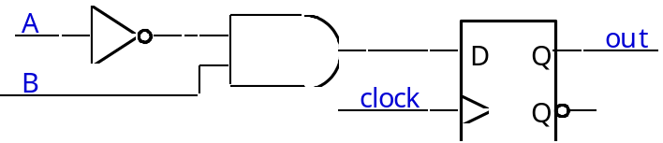
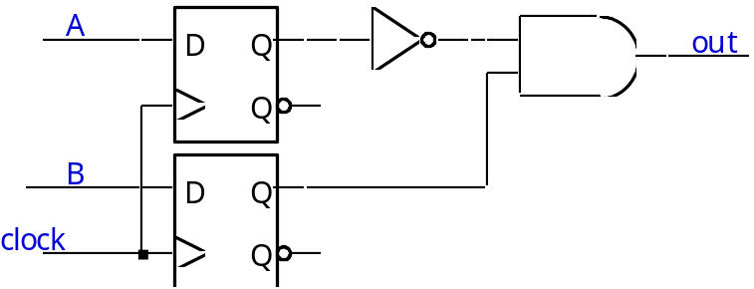
Example “=01”: Moore or Mealy?
Recognize AB = 01
  Mealy or Moore?
Registered Mealy
(actually Moore)
Moore

Slide 13
Example: A parity checker
Serial input string
  OUT=1 if odd # of 1s in input
  OUT=0 if even # of 1s in input
Let’s do this for Moore and Mealy

Slide 14
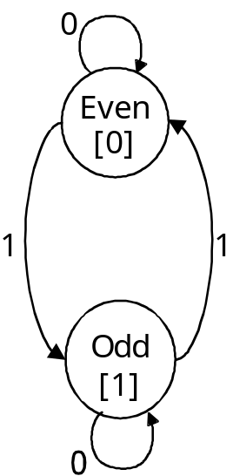
Example: A parity checker
State diagram
Moore Mealy
0/0
1/1
1/0
0/1

Slide 15
Example: A parity checker
1. State-transition table
Moore
Present Input Next Present
State State Output
Even 0 Even 0
Even 1 Odd 0
Odd 0 Odd 1
Odd 1 Even 1
Mealy
Present Input Next Present
State State Output
Even 0 Even 0
Even 1 Odd 1
Odd 0 Odd 1
Odd 1 Even 0

Slide 16
Example: A parity checker
3. State minimization: Already minimized
  Need both states (even and odd)
  Use one flip-flop

Slide 17
Example: A parity checker
4. State encoding
Assignment
Even 0
Odd 1
Moore
Present Input Next Present
State State Output
0 0 0 0
0 1 1 0
1 0 1 1
1 1 0 1
Mealy
Present Input Next Present
State State Output
0 0 0 0
0 1 1 1
1 0 1 1
1 1 0 0

Slide 18
Example: A parity checker
5. Next-state logic minimization
  Assume D flip-flops
  Next state = (present state) XOR (present input)
6. Implement the design
Mealy
Moore
Output
Input
D
Q
Input
D
Q
Output
Current
State
Q
Q
CLK
CLK

Slide 19
What was covered after midterm 1
Combinational logic applications
  PLAs/PALs
  ROMs
  Adders
  Multi-level logic
  Timing diagrams
  Hazards
1010
+ 0110
-------------
????

Slide 20
What was covered after midterm 1
Sequential logic building blocks
  Latches (R-S and D)
  Flip-flops (D and T)
  Latch and flip-flop timing (setup/hold time, prop delay)
  Timing diagrams
  Asynchronous inputs and metastability
  Registers
Remember that
the last number was 1

Slide 21
What was covered after midterm 1
Counters
  Timing diagrams
  Shift registers
  Ring counters
  State diagrams and state-transition tables
  Counter design procedure
    1. Draw a state diagram
    2. Draw a state-transition table
    3. Encode the next-state functions
    4. Implement the design
  Self-starting counters
1, 2, 3, 4, …

Slide 22
What was covered after midterm 1
Finite state machines
  FSM design procedure
    State diagram
    State-transition table
    3. State minimization
    4. State encoding
    5. Next-state logic minimization
    Implement the design
  No Mealy machines
The last coin was 25cents and
already had 50cents deposited
so let’s pop out a soda
Don’ t expect to know a ton of FSM.
Just understand what was presented in the lectures.

Slide 23
Midterm 2 logistics
45 minutes long (starts 10:35)
Materials covered from
  Lectures 9 to 18 (but not Sequential Verilog or Moore/Mealy)
  HW 4, 5, and 6
Closed book/notes, no calculator
Scratch papers provided
Just have your pencil/pen and eraser
Raise hand for questions (don’t walk to get help)

