Slide 1
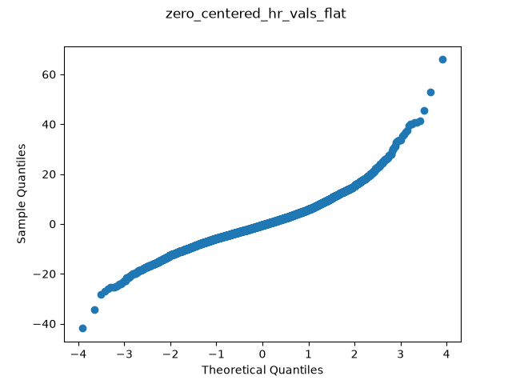

Slide 2
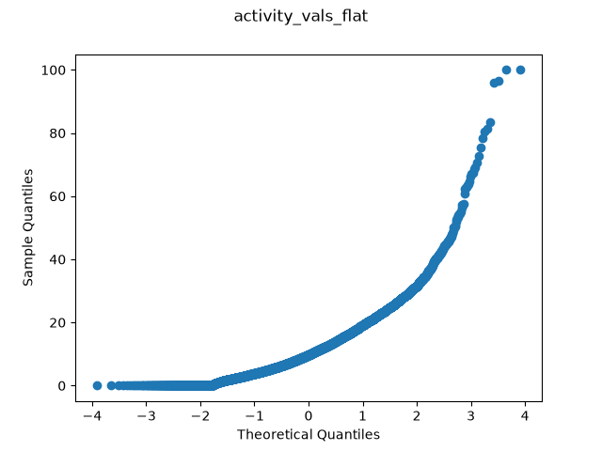

Slide 3
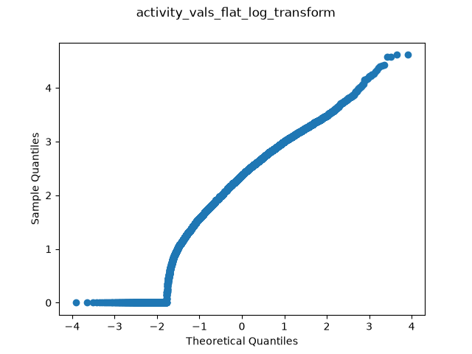

Slide 4
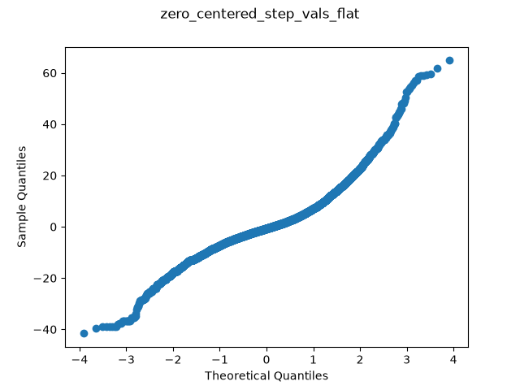

Slide 5
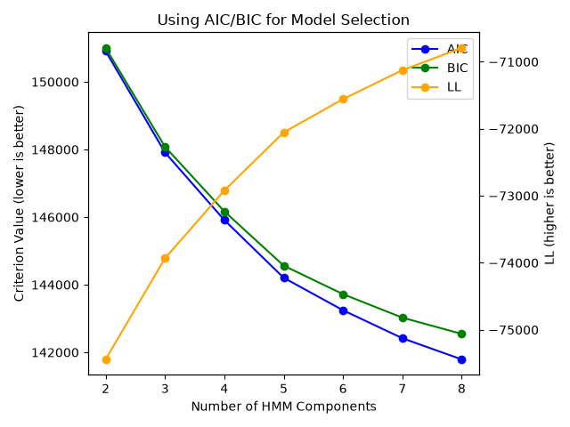

Slide 6
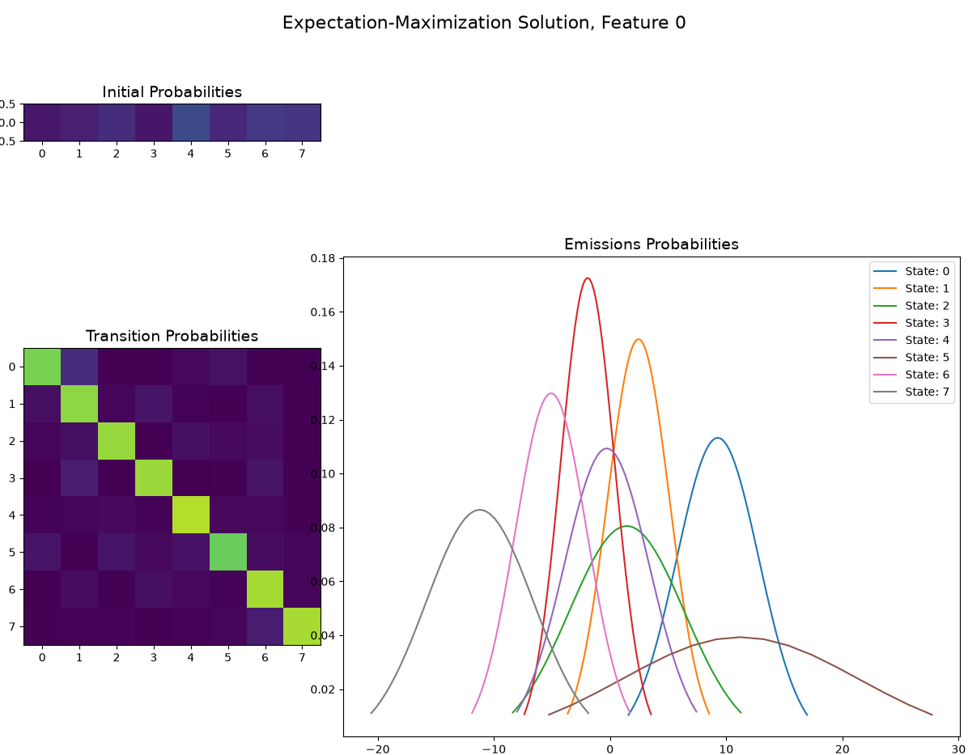

Slide 7
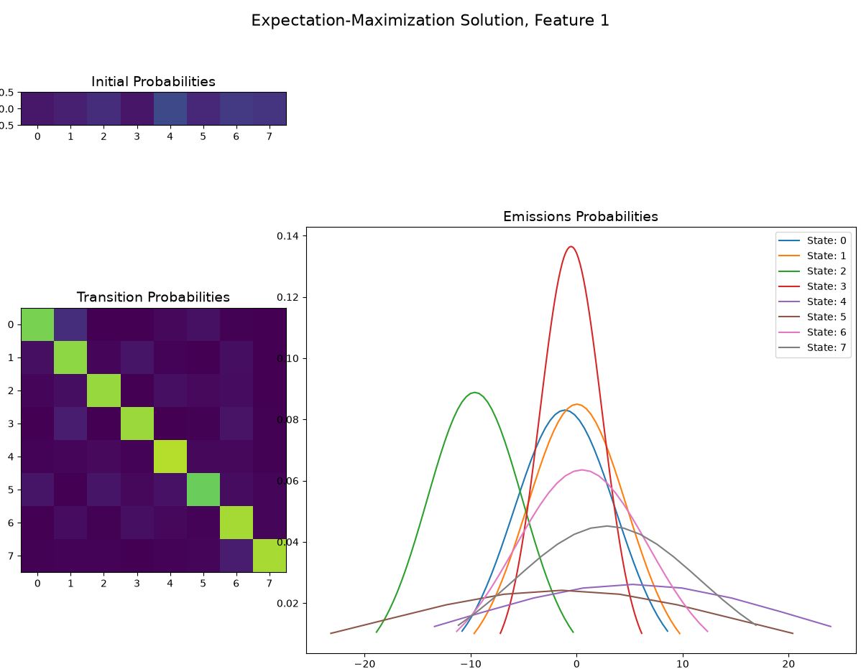

Slide 8
2 states: BIC 151004.76571254173
3 states: BIC 148080.67990439222
4 states: BIC 146169.22333796564
5 states: BIC 144565.29834649424
6 states: BIC 143721.583198373
7 states: BIC 143025.99847694652
8 states: BIC 142546.65246361404
Start probabilities:
[0.06355504 0.08781755 0.12971604 0.06097893 0.21880205 0.11610295
0.16998937 0.15303806]
Transition probabilities:
[[7.97143664e-01 1.30460379e-01 7.46247219e-44 3.71822039e-03
1.95558221e-02 4.39178044e-02 5.20410938e-03 2.63357933e-96]
[4.22027098e-02 8.30582744e-01 1.87137727e-02 5.65177814e-02
9.11165527e-03 2.75864169e-03 3.85540064e-02 1.55868832e-03]
[1.37955891e-02 3.76781076e-02 8.46265888e-01 1.00462979e-03
4.22607557e-02 2.42564524e-02 3.24239539e-02 2.31462331e-03]
[9.48064733e-05 7.99752942e-02 2.01830982e-44 8.50973362e-01
2.64443971e-03 6.71195726e-03 5.31701761e-02 6.42996470e-03]
[1.12982861e-02 1.29305410e-02 2.57545550e-02 7.85636752e-03
8.89371086e-01 2.27659265e-02 2.29970401e-02 7.02619804e-03]
[5.55255307e-02 6.15772856e-07 5.47415764e-02 2.23394158e-02
4.71403218e-02 7.69959175e-01 3.15660146e-02 1.87273497e-02]
[3.07375344e-03 3.47722353e-02 5.63090219e-03 3.97646245e-02
2.21201652e-02 8.54152759e-03 8.66790543e-01 1.93062486e-02]
[7.16085696e-03 8.31291119e-03 9.69424237e-03 2.39637553e-03
1.05701048e-02 1.66205674e-02 7.60577086e-02 8.69187233e-01]]
Means:
[[ 9.27219801 -1.11928725]
[ 2.44790821 0.02536035]
[ 1.43687956 -9.61189689]
[ -1.9276587 -0.53138956]
[ -0.28729051 5.27673531]
[ 11.2198067 -1.40119054]
[ -5.07715299 0.51140999]
[-11.20765894 2.87953364]]
Covariance matrices:
[[[1.24065815e+01 2.59381974e-01]
[2.59381974e-01 2.30780405e+01]]
[[7.08548663e+00 2.11776177e+00]
[2.11776177e+00 2.20395686e+01]]
[[2.45103426e+01 1.27479540e-01]
[1.27479540e-01 2.01711226e+01]]
[[5.34534181e+00 1.11127936e+00]
[1.11127936e+00 8.54420253e+00]]
[[1.33163850e+01 1.33396574e+01]
[1.33396574e+01 2.33582227e+02]]
[[1.03033781e+02 1.10199276e+01]
[1.10199276e+01 2.72344961e+02]]
[[9.44740466e+00 5.73222181e+00]
[5.73222181e+00 3.94385849e+01]]
[[2.12368979e+01 1.11991323e+01]
[1.11991323e+01 7.79761949e+01]]]

