Slide 1
An Introduction to Parallel Programming
Peter Pacheco
Chapter 2
Parallel Hardware and Parallel Software
Copyright © 2010, Elsevier Inc. All rights Reserved
Notes:
The University of Adelaide, School of Computer Science
Chapter 2 — Instructions: Language of the Computer

Slide 2
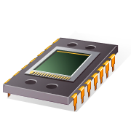
PARALLEL HARDWARE
A programmer can write code to exploit.
Copyright © 2010, Elsevier Inc. All rights Reserved

Slide 3
Flynn’s Taxonomy
SISD
Single instruction stream
Single data stream
(SIMD)
Single instruction stream
Multiple data stream
MISD
Multiple instruction stream
Single data stream
(MIMD)
Multiple instruction stream
Multiple data stream
not covered
Copyright © 2010, Elsevier Inc. All rights Reserved

Slide 4
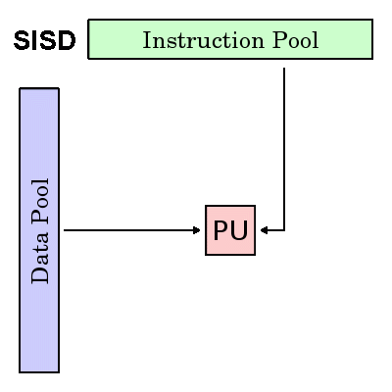
SINGLE INSTRUCTION, SINGLE DATA (SISD)
Serial (non-parallel) computer
Single Instruction: Only one instruction stream is being acted on by the CPU during any one clock cycle
Single Data: Only one data stream is being used as input during any one clock cycle

Slide 5
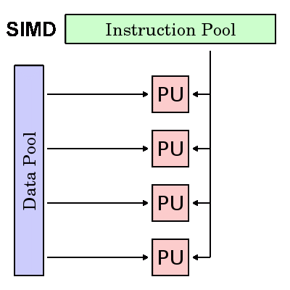
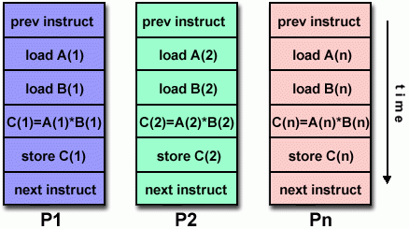
SINGLE INSTRUCTION, MULTIPLE DATA (SIMD)

Slide 6
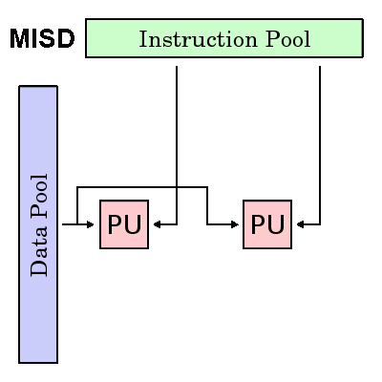
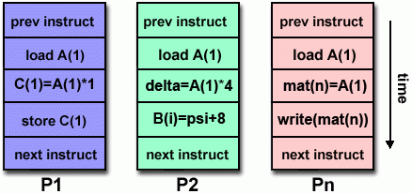
MULTIPLE INSTRUCTION, SINGLE DATA (MISD)

Slide 7
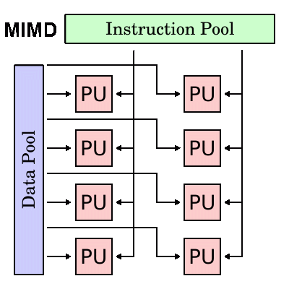
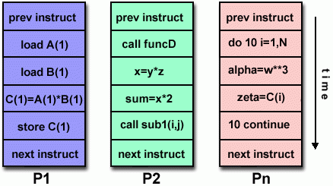
MULTIPLE INSTRUCTION, MULTIPLE DATA (MIMD)

Slide 8
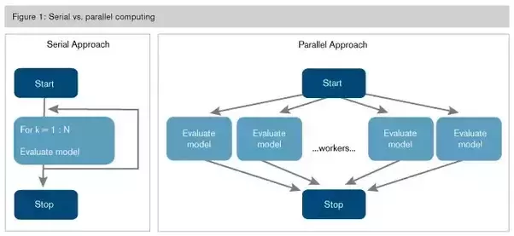

Slide 9
Alternative classification
In shared memory systems, the cores can share access to memory locations, and the cores coordinate their work by modifying shared memory locations.
In distributed memory systems, each core has its own, private memory, and the cores coordinate their work by communicating across a network.
Copyright © 2010, Elsevier Inc. All rights Reserved

Slide 10
SIMD
Parallelism achieved by dividing data among the processors.
SIMD systems operate on multiple data streams by applying the same instruction to multiple data items, so SIMD system can be thought of as having a single control unit and multiple data paths.
Applies the same instruction to multiple data items.
Parallelism that’s obtained by dividing data among the processors and having the processors all apply (more or less) the same instructions to their subsets of the data is called data-parallelism.
Copyright © 2010, Elsevier Inc. All rights Reserved

Slide 11
SIMD example
n data items
n ALUs
control unit
…
x[1]
x[2]
x[n]
ALU₁
ALU₂
ALU_{n}
for (i = 0; i < n; i++)
x[i] += y[i];
Copyright © 2010, Elsevier Inc. All rights Reserved

Slide 12
SIMD
What if we don’t have as many ALUs as data items?
Divide the work and process iteratively.
Ex. m = 4 ALUs and n = 15 data items.
Round3 | ALU₁ | ALU₂ | ALU₃ | ALU₄
1 | X[0] | X[1] | X[2] | X[3]
2 | X[4] | X[5] | X[6] | X[7]
3 | X[8] | X[9] | X[10] | X[11]
4 | X[12] | X[13] | X[14]
Copyright © 2010, Elsevier Inc. All rights Reserved

Slide 13
SIMD drawbacks
All ALUs are required to execute the same instruction, or remain idle.
In classic design, they must also operate synchronously.
The ALUs have no instruction storage.
Efficient for large data parallel problems, but not other types of more complex parallel problems.
Copyright © 2010, Elsevier Inc. All rights Reserved

Slide 14
Vector processors
Widely produced SIMD systems were vector processors.
Operate on arrays or vectors of data while conventional CPU’s operate on individual data elements or scalars.
  Typical recent systems have the following characteristics:
Vector registers: Capable of storing a vector of operands and operating simultaneously on their contents. The vector length is fixed by the system, and can range from 4 to 256, 64-bit elements.
Copyright © 2010, Elsevier Inc. All rights Reserved
Notes:
The University of Adelaide, School of Computer Science
Chapter 2 — Instructions: Language of the Computer

Slide 15
Vector processors (2)
Vectorized and pipelined functional units.
  The same operation is applied to each element in the vector (or pairs of elements). or, in the case of operations like addition, the same operation is applied to each pair of corresponding elements in the two vectors. Thus vector operations are SIMD.
Vector instructions.
  Operate on vectors rather than scalars.
  for (i = 0; i < n; i++) x [i] += y[i];
  requires only a single load, add, and store for each block of vector_length elements, while a conventional system requires a load, add, and store for each element.
Copyright © 2010, Elsevier Inc. All rights Reserved

Slide 16
Vector processors (3)
Interleaved memory.
  Multiple “banks” of memory, which can be accessed more or less independently.
  Distribute elements of a vector across multiple banks, so reduce or eliminate delay in loading/storing successive elements.
Strided memory access and hardware scatter/gather.
  The program accesses elements of a vector located at fixed intervals.
Copyright © 2010, Elsevier Inc. All rights Reserved

Slide 17

Vector processors - Pros
Fast.
Easy to use.
Vectorizing compilers are good at identifying code that can be vectorized.
Compilers also can provide information about code that cannot be vectorized.
  Helps the programmer re-evaluate code.
High memory bandwidth.
Uses every item in a cache line.
Copyright © 2010, Elsevier Inc. All rights Reserved

Slide 18

Vector processors - Cons
They don’t handle irregular
data structures as well as other
parallel architectures.
A very finite limit to their ability to handle ever larger problems. (scalability)
Copyright © 2010, Elsevier Inc. All rights Reserved

Slide 19
Graphics Processing Units (GPU)
Real time graphics application programming interfaces or API’s use points, lines, and triangles to internally represent the surface of an object.
Copyright © 2010, Elsevier Inc. All rights Reserved

Slide 20

GPUs
A graphics processing pipeline converts the internal representation into an array of pixels that can be sent to a computer screen.
Several stages of this pipeline
(called shader functions) are programmable.
  shader functions are typically just a few lines of C code.
Copyright © 2010, Elsevier Inc. All rights Reserved

Slide 21
GPUs
Shader functions are also implicitly parallel, since they can be applied to multiple elements in the graphics stream.
GPU’s can often optimize performance by using SIMD parallelism.
The current generation of GPU’s use SIMD parallelism.
  GPU’s are not pure SIMD systems. Although the data paths on a given core can use SIMD parallelism, current generation GPUs can run more than one instruction stream on a single core.
Copyright © 2010, Elsevier Inc. All rights Reserved

Slide 22
GPUs
Typical GPUs can have dozens of cores, and these cores are also capable of executing independent instruction streams.
So GPUs are neither purely SIMD nor purely MIMD.
Also note that GPUs can use shared or distributed memory. The largest systems often use both: several cores may have access to a common block of memory, but other SIMD cores may have access to a different block of shared memory, and two cores with access to different blocks of shared memory may communicate over a network.
Copyright © 2010, Elsevier Inc. All rights Reserved

Slide 23
MIMD
Supports multiple simultaneous instruction streams operating on multiple data streams.
Typically consist of a collection of fully independent processing units or cores, each of which has its own control unit and its own ALU.
MIMD systems are usually asynchronous, that is, the processors can operate at their own pace.
Copyright © 2010, Elsevier Inc. All rights Reserved

Slide 24
Shared Memory System
A collection of autonomous processors is connected to a memory system via an interconnection network.
Each processor can access each memory location.
The processors usually communicate implicitly by accessing shared data structures.
Copyright © 2010, Elsevier Inc. All rights Reserved

Slide 25
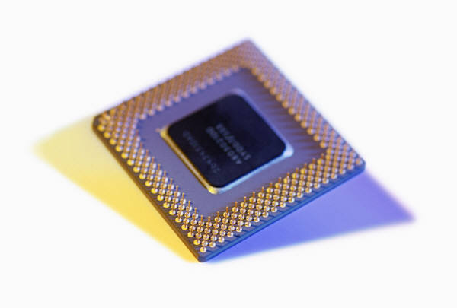
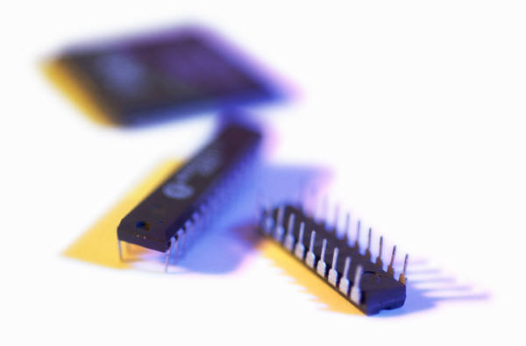
Shared Memory System (2)
Most widely available shared memory systems use one or more multicore processors.
  (multiple CPU’s or cores on a single chip)
Copyright © 2010, Elsevier Inc. All rights Reserved

Slide 26
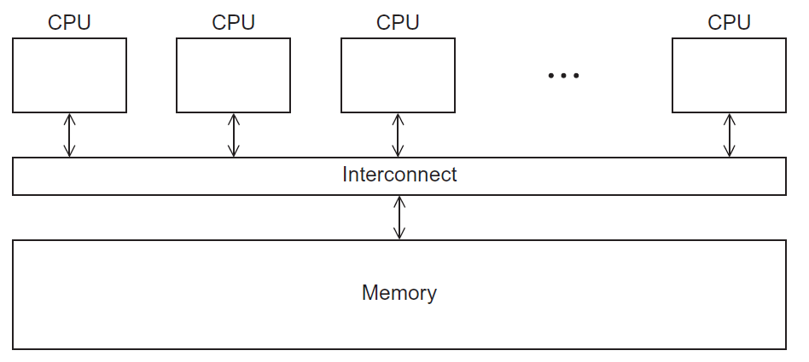
Shared Memory System
Figure 2.3
Copyright © 2010, Elsevier Inc. All rights Reserved

Slide 27
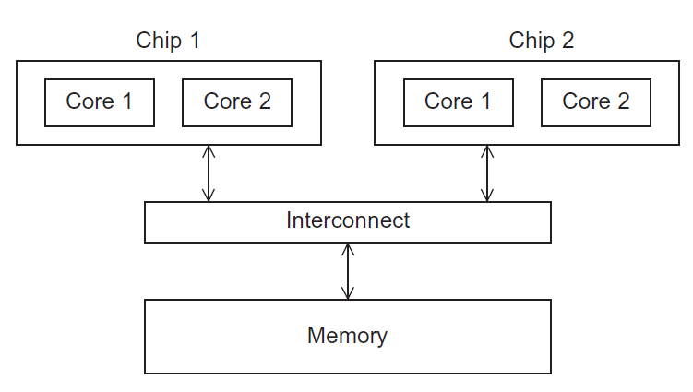
UMA(uniform memory access) multicore system
Figure 2.5
In this type of system, the time to access all the memory locations will be the same for all the cores.
Copyright © 2010, Elsevier Inc. All rights Reserved

Slide 28
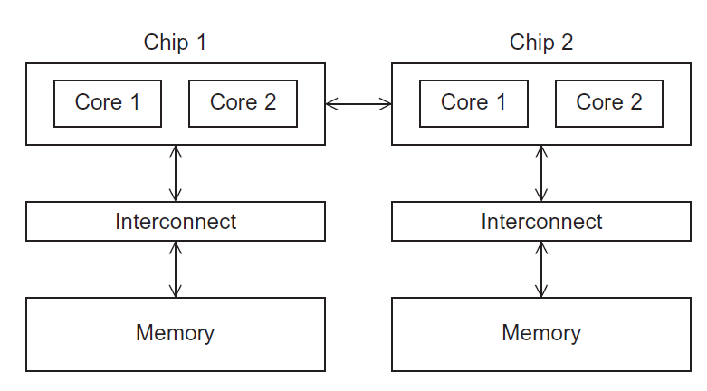
NUMA multicore system
Figure 2.6
A memory location a core is directly connected to can be accessed faster than a memory location that must be accessed through another chip.
Copyright © 2010, Elsevier Inc. All rights Reserved

Slide 29
Distributed Memory System
  The most widely available distributed-memory systems are called clusters
  A collection of commodity systems.
  Connected by a commodity interconnection network. for example: Ethernet.
  The nodes of these systems, the individual computational units joined together by the communication network, are usually shared-memory systems with one or more multicore processors.
Copyright © 2010, Elsevier Inc. All rights Reserved

Slide 30
Distributed Memory System
To distinguish such systems from pure distributed-memory systems, they are sometimes called hybrid systems. Nowadays, it’s usually understood that a cluster has shared-memory nodes.
The grid provides the infrastructure necessary to turn large networks of geographically distributed computers into a unified distributed-memory system.
In general, such a system is heterogeneous, that is, the individual nodes are built from different types of hardware.
Copyright © 2010, Elsevier Inc. All rights Reserved

Slide 31
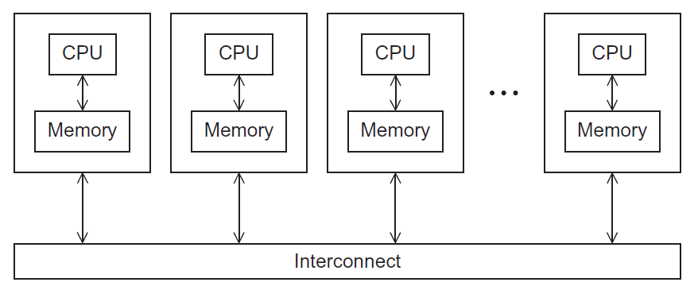
Distributed Memory System
Figure 2.4
Copyright © 2010, Elsevier Inc. All rights Reserved

Slide 32
Interconnection networks
Affects performance of both distributed and shared memory systems.
Two categories:
  Shared memory interconnects
  Distributed memory interconnects
Copyright © 2010, Elsevier Inc. All rights Reserved

Slide 33
Shared memory interconnects
Bus interconnect
  A collection of parallel communication wires together with some hardware that controls access to the bus.
  Communication wires are shared by the devices that are connected to it.
  As the number of devices connected to the bus increases, contention for use of the bus increases, and performance decreases.
Copyright © 2010, Elsevier Inc. All rights Reserved

Slide 34
Shared memory interconnects
Switched interconnect
  Uses switches to control the routing of data among the connected devices.\
  Crossbar:
    Is a relatively simple and powerful switched interconnect.
    Allows simultaneous communication among different devices.
    Faster than buses.
    But the cost of the switches and links is relatively high.
Copyright © 2010, Elsevier Inc. All rights Reserved

Slide 35
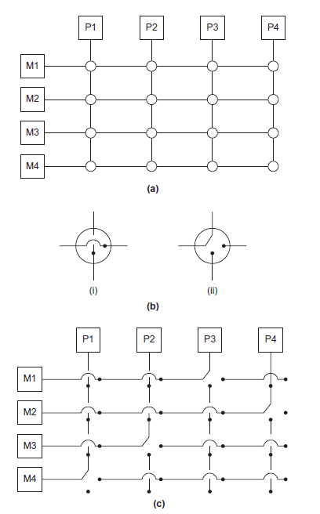
Figure 2.7
(a)
A crossbar switch connecting 4 processors (Pi) and 4 memory modules (Mj)
(b)
Configuration of internal switches in a crossbar
(c) Simultaneous memory accesses by the processors
Copyright © 2010, Elsevier Inc. All rights Reserved

Slide 36
Distributed memory interconnects
Distributed-memory interconnects are divided into two groups: direct inter connects and indirect interconnects.
Direct interconnect
    Each switch is directly connected to a processor memory pair, and the switches are connected to each other.
  Indirect interconnect
    Switches may not be directly connected to a processor.
Copyright © 2010, Elsevier Inc. All rights Reserved

Slide 37
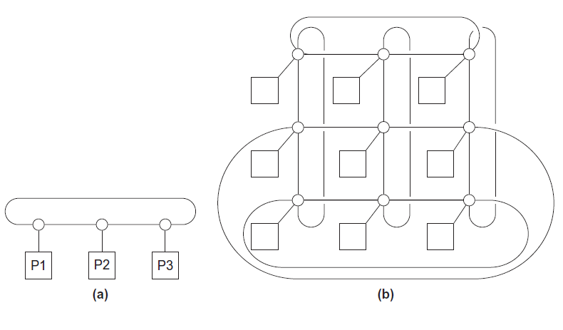
Direct interconnect
Figure 2.8
Toroidal mesh
Ring
we can usually just add the number of processors to the number of switch-to-switch links. So in the diagram for a ring (Fig. 2.8a), we would ordinarily count 3 links instead of 6, and in the diagram for the toroidal mesh (Fig. 2.8b), we would count 18 links instead of 27.
Copyright © 2010, Elsevier Inc. All rights Reserved

Slide 38

Bisection width
A measure of “number of simultaneous communications” or “connectivity”.
How many simultaneous communications can take place “across the divide” between the halves?
Copyright © 2010, Elsevier Inc. All rights Reserved

Slide 39
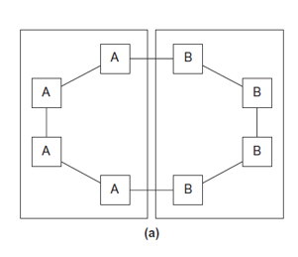
Two bisections of a ring
we’ve divided a ring with eight nodes into two groups of four nodes, and we can see that only two communications can take place between the halves.
Figure 2.9
Copyright © 2010, Elsevier Inc. All rights Reserved

Slide 40
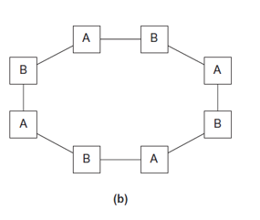
Two bisections of a ring
we’ve divided the nodes into two parts so that four simultaneous communications can take place.
Figure 2.9
Copyright © 2010, Elsevier Inc. All rights Reserved

Slide 41
A bisection of a toroidal mesh
An alternative way of computing the bisection width is to remove the minimum number of links needed to split the set of nodes into two equal halves. The number of links removed is the bisection width.
If we have a square two-dimensional toroidal mesh with p = q² nodes (where q is even), then we can split the nodes into two halves by removing the “middle” horizontal links and the “wraparound” horizontal links.
Copyright © 2010, Elsevier Inc. All rights Reserved

Slide 42
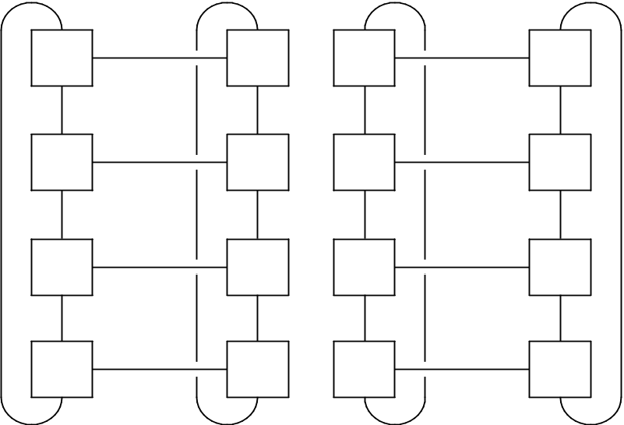
A bisection of a toroidal mesh
This suggests that the bisection width is at most 2q = 2√p.
This is the smallest possible number of links, and the bisection width of a square two-dimensional toroidal mesh is 2√p.
Figure 2.10
Copyright © 2010, Elsevier Inc. All rights Reserved

Slide 43
Definitions
Bandwidth
  The rate at which a link can transmit data.
  Usually given in megabits or megabytes per second.
Bisection bandwidth
  A measure of network quality.
  It’s similar to bisection width. However, instead of counting the number of links joining the halves, it sums the bandwidth of the links.
Copyright © 2010, Elsevier Inc. All rights Reserved

Slide 44
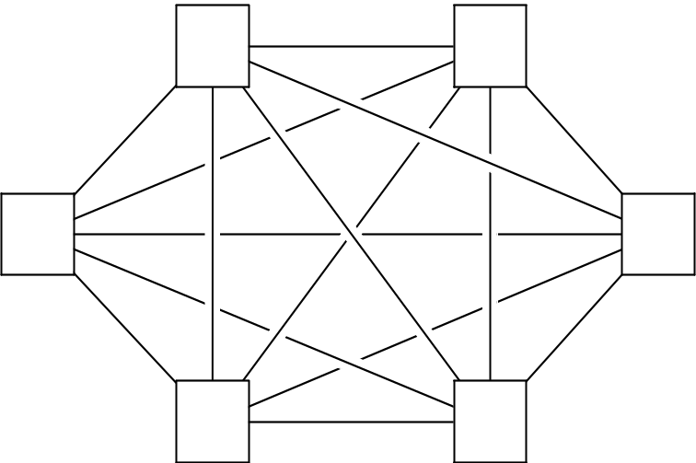
Fully connected network
Each switch is directly connected to every other switch.
It’s impractical to construct such an interconnect for systems with more than a few nodes,
bisection width = p²/4
Figure 2.11
Copyright © 2010, Elsevier Inc. All rights Reserved

Slide 45
Hypercube
Highly connected direct interconnect that has been used in actual systems.
Built inductively:
  A one-dimensional hypercube is a fully-connected system with two processors.
  A two-dimensional hypercube is built from two one-dimensional hypercubes by joining “corresponding” switches.
  Similarly a three-dimensional hypercube is built from two two-dimensional hypercubes.
Copyright © 2010, Elsevier Inc. All rights Reserved

Slide 46
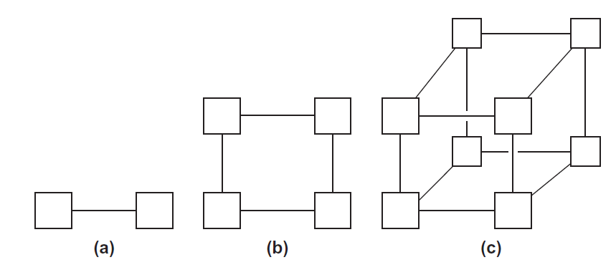
Hypercubes
Figure 2.12
One-
Two-
Three-dimensional Hypercube
Copyright © 2010, Elsevier Inc. All rights Reserved

Slide 47
Hypercubes
Thus a hypercube of dimension d has
p = 2^{d} nodes, and a switch in a d-dimensional hypercube is directly connected to a processor and d switches.
Copyright © 2010, Elsevier Inc. All rights Reserved

Slide 48
Indirect interconnects
In an indirect interconnect, the switches may not be directly connected to a processor. They’re often shown with unidirectional links and a collection of processors, each of which has an outgoing and an incoming link, and a switching network shown in fig 2.13.
Simple examples of indirect networks:
  Crossbar
  Omega network
.
Copyright © 2010, Elsevier Inc. All rights Reserved

Slide 49
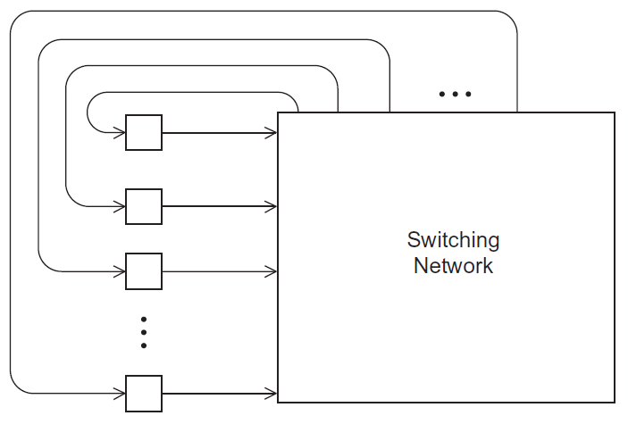
A generic indirect network
Figure 2.13
Copyright © 2010, Elsevier Inc. All rights Reserved

Slide 50
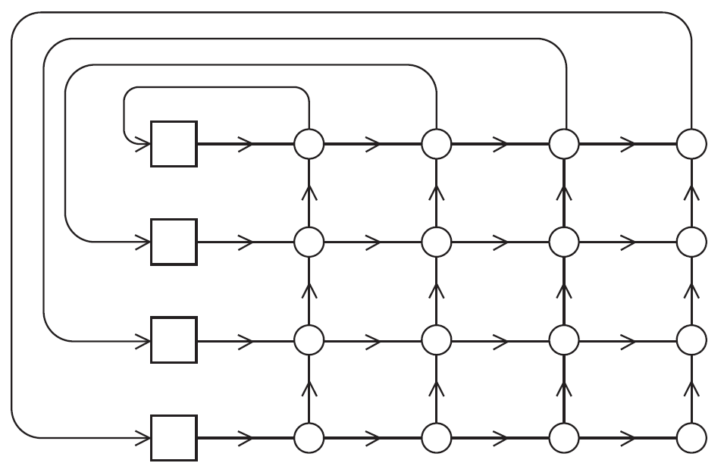
Crossbar interconnect for distributed memory
A distributed-memory crossbar shown below has unidirectional links. Notice that as long as two processors don’t attempt to communicate with the same processor, all the processors can simultaneously communicate with another processor.
Figure 2.14
Copyright © 2010, Elsevier Inc. All rights Reserved

Slide 51
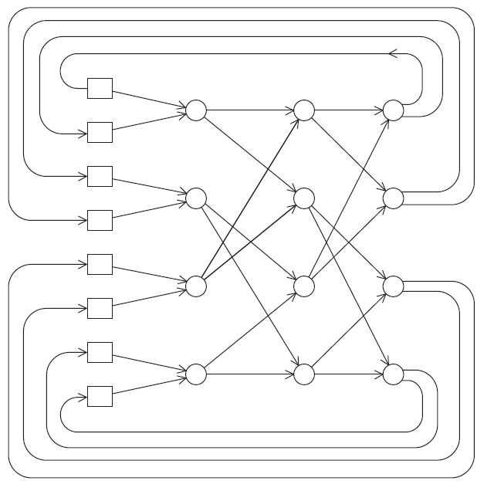
An omega network
If processor 0 sends a message to processor 6, then processor 1 cannot simultaneously send a message to processor 7.
The omega network uses ½ plog₂(p) of the 2 ×2 crossbar switches, so it uses a total of 2plog₂(p) switches, while the crossbar uses p².
Figure 2.15
Copyright © 2010, Elsevier Inc. All rights Reserved

Slide 52
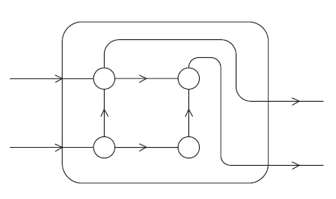
A switch in an omega network
It’s a little bit more complicated to define bisection width for indirect networks.
However, the principle is the same:
we want to divide the nodes into two groups of equal size and determine how much communication can take place between the two halves, or alternatively,
The minimum number of links that need to be removed so that the two groups can’t communicate. The bisection width of a p×p crossbar is p, and the bisection width of an omega network is p/2.
Figure 2.16
Copyright © 2010, Elsevier Inc. All rights Reserved

Slide 53
More definitions
Any time data is transmitted, we’re interested in how long it will take for the data to reach its destination.
Latency
  The time that elapses between the source’s beginning to transmit the data and the destination’s starting to receive the first byte.
Bandwidth
  The rate at which the destination receives data after it has started to receive the first byte.
Copyright © 2010, Elsevier Inc. All rights Reserved

Slide 54
If the latency of an interconnect is l seconds and the bandwidth is b bytes per second, then the time it takes to transmit a message of n bytes is
Message transmission time = l + n / b
latency (seconds)
length of message (bytes)
bandwidth (bytes per second)
Copyright © 2010, Elsevier Inc. All rights Reserved

Slide 55
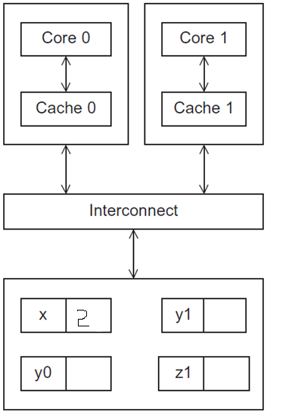
Cache coherence
Programmers have no
control over caches
and when they get updated.
Figure 2.17
A shared memory system with two cores and two caches
Copyright © 2010, Elsevier Inc. All rights Reserved
Notes:
The University of Adelaide, School of Computer Science
Chapter 2 — Instructions: Language of the Computer

Slide 56
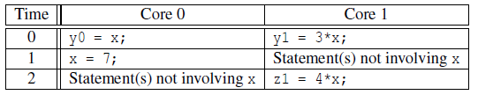
Cache coherence
y0 privately owned by Core 0
y1 and z1 privately owned by Core 1
x = 2; /* shared variable */
y0 eventually ends up = 2
y1 eventually ends up = 6
z1 = ???
Copyright © 2010, Elsevier Inc. All rights Reserved

Slide 57
Cache coherence
The unpredictable behavior will occur regardless of whether the system is using a write-through or a write-back policy.
If it’s using a write-through policy, the main memory will be updated by the assignment x =7. However, this will have no effect on the value in the cache of core 1.
If the system is using a write-back policy, the new value of x in the cache of core 0 probably won’t even be available to core 1 when it updates z1.
Copyright © 2010, Elsevier Inc. All rights Reserved

Slide 58
Cache coherence
When the caches of multiple processors store the same variable, an update by one processor to the cached variable is “seen” by the other processors. That is, that the cached value stored by the other processors is also updated. This is called the cache coherence problem.
Copyright © 2010, Elsevier Inc. All rights Reserved

Slide 59
Snooping Cache Coherence
The cores share a bus .
Any signal transmitted on the bus can be “seen” by all cores connected to the bus.
When core 0 updates the copy of x stored in its cache it also broadcasts this information across the bus.
If core 1 is “snooping” the bus, it will see that x has been updated and it can mark its copy of x as invalid.
Copyright © 2010, Elsevier Inc. All rights Reserved

Slide 60
Directory Based Cache Coherence
Uses a data structure called a directory that stores the status of each cache line.
When a variable is updated, the directory is consulted, and the cache controllers of the cores that have that variable’s cache line in their caches are invalidated.
Copyright © 2010, Elsevier Inc. All rights Reserved

Slide 61
False sharing
CPU caches are implemented in hardware, so they operate on cache lines, not individual variables.
suppose we want to repeatedly call a function f(i,j) and add the computed values into a vector:
      int i, j, m, n;
      double y[m];
      / ∗ Assign y = 0 ∗/
      for (i = 0; i < m; i++)
      for (j = 0; j < n; j++)
      y [i] += f(i,j);
Copyright © 2010, Elsevier Inc. All rights Reserved

Slide 62
False sharing
/ ∗ Private variables ∗/
int i, j, iter_count;
/ ∗ Shared variables initialized by one core ∗/
int m, n, core_count double y[m];
iter_count = m/ core_count;
/ ∗ Core 0 does this ∗/
for (i = 0; i < iter_count; i++)
for (j = 0; j < n; j++)
y [i] += f(i,j);
/ ∗ Core 1 does this ∗/
for (i = iter_count; i < 2∗iter_count; i++)
for (j = 0; j < n; j++)
y [i] += f(i,j);

Slide 63
False sharing
Since all of y is stored in a single cache line, each time one of the cores executes the statement
y[i] +=f(i,j), the line will be invalidated,
The next time the other core tries to execute this statement, it will have to fetch the updated line from memory!
So if n is large, a large percentage of the assignments
y[i] +=f(i,j)
will access main memory in spite of the fact that core 0 and core 1 never access each other’s elements of y. This is called False sharing, because the system is behaving as if the elements of y were being shared by the cores.
Copyright © 2010, Elsevier Inc. All rights Reserved

Slide 64
False sharing
False sharing does not cause incorrect results. However, it can ruin the performance of a program by causing many more accesses to main memory than necessary.
We can reduce its effect by using temporary storage that is local to the thread or process, and then copying the temporary storage to the shared storage.
Copyright © 2010, Elsevier Inc. All rights Reserved

Slide 65
Shared vs. distributed-memory
There are several issues, about software for distributed- and shared-memory.
However, the principal hardware issue is the cost of scaling the interconnect.
As we add processors to a bus, the chance that there will be conflicts over access to the bus increase dramatically, so buses are suitable for systems with only a few processors.
Large crossbars are very expensive, so it’s also unusual to find systems with large crossbar interconnects.
Copyright © 2010, Elsevier Inc. All rights Reserved

Slide 66
Shared vs. distributed-memory
On the other hand, distributed-memory interconnects, such as the hypercube and the toroidal mesh, are relatively inexpensive, and distributed-memory systems with thousands of processors that use these and other interconnects have been built.
Thus distributed-memory systems are often better suited for problems requiring vast amounts of data or computation.
Copyright © 2010, Elsevier Inc. All rights Reserved

Slide 67

PARALLEL SOFTWARE
Copyright © 2010, Elsevier Inc. All rights Reserved

Slide 68
Parallel software
  Some of the issues involved in writing software for parallel systems.
  In shared memory programs:
    Start a single process and fork multiple threads.
    Threads carry out tasks.
  In distributed memory programs:
    Start multiple processes.
    Processes carry out tasks.
Copyright © 2010, Elsevier Inc. All rights Reserved

Slide 69

Caveats
A SPMD(single program multiple data) programs consists of a single executable that can behave as if it were multiple different programs through the use of conditional branches.
if (I’m thread /process 0)
do this;
else
do that;
Copyright © 2010, Elsevier Inc. All rights Reserved

Slide 70
Caveats
Observe that SPMD programs can readily implement data-parallelism.
Example,
if (I’m thread/process 0)
operate on the first half of the array;
else /* I’m thread/process 1 ∗/
operate on the second half of the array;
A program is task parallel if it obtains its parallelism by dividing tasks among the threads or processes.
In 1st example SPMD programs can implement task parallelism also.
Copyright © 2010, Elsevier Inc. All rights Reserved

Slide 71
Coordinating the processes/threads
double x[n], y[n];
…
for (i = 0; i < n; i++)
x[i] += y[i];
Divide the work among the
processes/threads
  so each process/thread
  gets roughly the same
  amount of work(Load Balancing)
  and communication required is
  minimized.
Arrange for the processes/threads to synchronize.
Arrange for communication among the processes/threads.
Copyright © 2010, Elsevier Inc. All rights Reserved

Slide 72
Coordinating the processes/threads
The last two problems are often interrelated.
For example,
In distributed-memory programs, we often implicitly synchronize the processes by communicating among them, and
In shared-memory programs, we often communicate among the threads by synchronizing them.
Copyright © 2010, Elsevier Inc. All rights Reserved

Slide 73
Shared Memory
In shared-memory programs, variables can be shared or private.
Shared variables can be read or written by any thread.
Private variables can ordinarily only be accessed by one thread.
Communication among the threads is usually done through shared variables,
so communication is implicit rather than explicit.
Copyright © 2010, Elsevier Inc. All rights Reserved

Slide 74
Dynamic and static threads
Dynamic threads
  Master thread waits for work request, a new request arrives it forks a worker thread, the thread carries out the request and when the thread completes the work, it terminates and joins the master thread.
  Efficient use of system resources, but thread creation and termination is time consuming.
Static threads
  Pool of threads created and are allocated work, but do not terminate until all the work is completed.
Copyright © 2010, Elsevier Inc. All rights Reserved

Slide 75
Dynamic and static threads
  After the threads join the master thread, the master thread may do some cleanup (e.g., free memory), and then it also terminates.
  Less efficient use of system resources ; i.e if a thread is idle, its resources (e.g., stack, program counter, and so on) can’t be freed.
  forking and joining threads can be fairly time-consuming operations.
  Better performance, but potential waste of system resources.
Copyright © 2010, Elsevier Inc. All rights Reserved

Slide 76
Nondeterminism
A computation is nondeterministic if a given input can result in different outputs.
If multiple threads are executing independently, the relative rate at which they’ll complete statements varies from run to run, and hence the results of the program may be different from run to run.
Copyright © 2010, Elsevier Inc. All rights Reserved

Slide 77

Nondeterminism
. . .
printf ( "Thread %d > my_val = %d\n" ,
my_rank , my_x ) ;
. . .
Thread 0 > my_val = 7
Thread 1 > my_val = 19
Thread 1 > my_val = 19
Thread 0 > my_val = 7
Copyright © 2010, Elsevier Inc. All rights Reserved

Slide 78
Nondeterminism
Suppose each thread computes an int, which it stores in a private variable my_val. Suppose also that we want to add the values stored in my_val into a shared-memory location x that has been initialized to 0. Both threads therefore want to execute code that looks something like this:
Copyright © 2010, Elsevier Inc. All rights Reserved

Slide 79
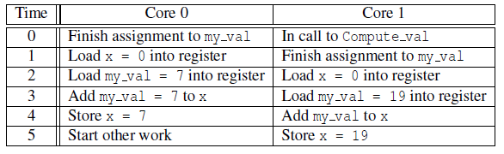
Nondeterminism
my_val = Compute_val ( my_rank ) ;
x += my_val ;
Copyright © 2010, Elsevier Inc. All rights Reserved

Slide 80
Nondeterminism
Race condition: When threads or processes attempt to simultaneously access a shared resource, and the accesses can result in an error, we often say the program has a race condition.
Critical section: A block of code that can only be executed by one thread at a time is called a critical section, and it’s usually our job as programmers to ensure mutually exclusive access to a critical section.
Copyright © 2010, Elsevier Inc. All rights Reserved

Slide 81
Nondeterminism
The most commonly used mechanism for ensuring mutual exclusion is a mutual exclusion lock or mutex, or simply lock.
The basic idea is that each critical section is protected by a lock. Before a thread can execute the code in the critical section, it must “obtain” the mutex by calling a mutex function, and when it’s done executing the code in the critical section, it should “relinquish” the mutex by calling an unlock function.
Copyright © 2010, Elsevier Inc. All rights Reserved

Slide 82
Nondeterminism
While one thread “owns” the lock—that is, has returned from a call to the lock function but hasn’t yet called the unlock function—any other thread attempting to execute the code in the critical section will wait in its call to the lock function.
Thus to ensure that our code functions correctly, we might modify it so that it looks something like this:
my_val = Compute_val ( my_rank ) ;
Lock(&add_my_val_lock ) ;
x += my_val ;
Unlock(&add_my_val_lock ) ;
Copyright © 2010, Elsevier Inc. All rights Reserved

Slide 83
Nondeterminism
The use of a mutex enforces serialization of the critical section.
only one thread at a time can execute the code in the critical section, this code is effectively serial.
There are alternatives to mutexes. In busy-waiting, a thread enters a loop, whose sole purpose is to test a condition
Copyright © 2010, Elsevier Inc. All rights Reserved

Slide 84
busy-waiting
suppose there is a shared variable ok_for_1 that has been initialized to false. Then something like the following code can ensure that thread 1 won’t update x until after thread 0 has updated it:
my_val = Compute_val ( my_rank ) ;
i f ( my_rank == 1)
whi l e ( ! ok_for_1 ) ; /* Busy−wait loop */
x += my_val ; /* Critical section */
i f ( my_rank == 0)
ok_for_1 = true ; /* Let thread 1 update x */
Copyright © 2010, Elsevier Inc. All rights Reserved

Slide 85
busy-waiting
So until thread 0 executes ok_for_1 = true, thread 1 will be stuck in the loop while (!ok_for_1). This loop is called a “busy-wait,” because the thread can be very busy waiting for the condition.
Copyright © 2010, Elsevier Inc. All rights Reserved

Slide 86
Distributed-memory
The most widely used API is message-passing.
The first thing to note regarding distributed-memory APIs is that they can be used with shared-memory hardware.
It’s perfectly feasible for programmers to logically partition shared-memory into private address spaces for the various threads, and a library or compiler can implement the communication that’s needed.
Copyright © 2010, Elsevier Inc. All rights Reserved

Slide 87
message-passing
Message-passing A message-passing API provides (at a minimum) a send and a receive function. Processes typically identify each other by ranks in the range 0,1,...,p− 1, where p is the number of processes. So, for example, process 1 might send a message to process 0 with the following pseudocode:
Copyright © 2010, Elsevier Inc. All rights Reserved

Slide 88
message-passing
char message [ 1 0 0 ] ;
. . .
my_rank = Get_rank ( ) ;
i f ( my_rank == 1) {
sprintf ( message , "Greetings from process 1" ) ;
Send ( message , MSG_CHAR , 100 , 0 ) ;
} e l s e i f ( my_rank == 0) {
Receive ( message , MSG_CHAR , 100 , 1 ) ;
printf ( "Process 0 > Received: %s\n" , message ) ;
}
Copyright © 2010, Elsevier Inc. All rights Reserved

Slide 89
message-passing
Send ( message , MSG_CHAR, 100 , 0 ) ;
The type of the elements in the message (MSG_CHAR)
The number of elements in the message (100)
The rank of the destination process (0).
Copyright © 2010, Elsevier Inc. All rights Reserved

Slide 90
message-passing
Typical message-passing APIs also provide a wide variety of additional functions.
such as a broadcast, in which a single process transmits the same data to all the processes, or a reduction, in which results computed by the individual processes are combined into a single result.
One-sided communication:
In message-passing, one process must call a send function, and the send must be matched by another process’s call to a receive function.
Copyright © 2010, Elsevier Inc. All rights Reserved

Slide 91
message-passing
Any communication requires the explicit participation of two processes. In one-sided communication, or remote memory access, a single process calls a function, which updates either local memory with a value from another process or remote memory with a value from the calling process.
Copyright © 2010, Elsevier Inc. All rights Reserved

Slide 92
Partitioned Global Address Space Languages
Partitioned global address space, or PGAS, languages provide some of the mechanisms of shared-memory programs. However, they provide the programmer with tools to avoid the problem.
Many programmers find shared-memory programming more than message-passing or one-sided communication.
Copyright © 2010, Elsevier Inc. All rights Reserved

Slide 93
Partitioned Global Address Space Languages
Accessing remote memory can take hundreds or even thousands of times longer than accessing local memory.
As an example, consider the following pseudocode for a shared-memory vector addition:
Copyright © 2010, Elsevier Inc. All rights Reserved

Slide 94
Partitioned Global Address Space Languages
shared int n = . . . ;
shared double x [ n ] , y [ n ] ;
private int i , my_first_element , my_last_element ;
my_first_element = . . . ;
my_last_element = . . . ;
/ * Initialize x and y */
. . .
f o r ( i = my_first_element ; i <= my_last_element ; i++)
x [ i ] += y [ i ] ;
Copyright © 2010, Elsevier Inc. All rights Reserved

Slide 95
Partitioned Global Address Space Languages
Private variables are allocated in the local memory of the core on which the process is executing, and the distribution of the data in shared data structures is controlled by the programmer.
Copyright © 2010, Elsevier Inc. All rights Reserved

