Slide 1
What is the difference between CPU and a GPU for parallel computing?
GPU is very good at data-parallel computing, CPU is very good at parallel processing.
GPU has thousands of cores, CPU has less than 100 cores.
GPU has around 40 hyper threads per core, CPU has around 2(sometimes a few more) hyper threads per core.
GPU has difficulty executing recursive code, CPU has less problems with it.
Copyright © 2010, Elsevier Inc. All rights Reserved

Slide 2
GPU lowest level caches are shared between 8–24 cores for intel, 64 cores for amd and up to 192 cores for nvidia.
CPU’s lowest level cache only used by single core (2 threads). CPU’s each thread can use SIMD which is data-parallel for about 8–32 work items(each comparable to a single GPU core/thread).
GPU highest level cache is only around 5MB, CPU highest level cache can get 64MB or more.
Copyright © 2010, Elsevier Inc. All rights Reserved

Slide 3
GPU is accessed through PCIe (Peripheral Component Interconnect Express) is a type of connection used for high-speed data transfer between electronic components and similar bridges and also works on a middle API that both add latency and programming effort and makes very lightly loaded works become slow.
CPU is easier to begin with and perfect at random and small workloads.
Copyright © 2010, Elsevier Inc. All rights Reserved

Slide 4
GPU has considerably higher compute per electricity energy than CPU.
GPU is for high throughput, CPU is for low latency.
Integrated GPUs still use internal pci-e connection to get commands from CPU but gets data from RAM directly so there is still some added latency in there.
With APIs like CUDA/OpenCL, GPU has addressable local memories and registers that are much faster than lowest level caches.
Copyright © 2010, Elsevier Inc. All rights Reserved

Slide 5
This makes inter-core communication easier in coding. Even number of available(and addressable like an array) private registers per core is much higher than that of a CPU. (256 vs 32).
GPU’s single core is very lightweight compared to a single CPU core. 1 CPU core has 8–16 such pipelines while 1 GPU “SM/CU” has 64/128/192 pipelines and should be called a “core”.
Copyright © 2010, Elsevier Inc. All rights Reserved

Slide 6
GPU programming
GPU’s are usually not “standalone” processors. They don’t ordinarily run an operating system and system services, such as direct access to secondary storage.
So programming a GPU also involves writing code for the CPU “host” system, which runs on an ordinary CPU.
The memory for the CPU host and the GPU memory are usually separate. So the code that runs on the host typically allocates and initializes storage on both the CPU and the GPU.
Copyright © 2010, Elsevier Inc. All rights Reserved

Slide 7
GPU programming
In the systems we’ll be using, the processors share a large block of memory, but each individual processor has a small block of much faster memory that can only be accessed by threads running on that processor.
These blocks of faster memory can be thought of as a programmer managed cache.
The threads running on a processor are typically divided into groups: the threads within a group use the SIMD model, and two threads in different groups can run independently.
Copyright © 2010, Elsevier Inc. All rights Reserved

Slide 8
GPU programming
The threads in a SIMD group may not run in lockstep.
That is, they may not all execute the same instruction at the same time.
However, no thread in the group will execute the next instruction until all the threads in the group have completed executing the current instruction.
If the threads in a group are executing a branch, it may be necessary to idle some of the threads.
For example:
Copyright © 2010, Elsevier Inc. All rights Reserved

Slide 9
GPU programming
// Thread private variables
int rank_in_gp , my_x;
. . .
if (rank_in_gp < 16)
my_x += 1;
else
my_x −= 1;
Idling half the threads for two instructions isn’t a very efficient use of the available resources.
So it’s up to the programmer to minimize branching, where the threads within a SIMD group take different branches.
Copyright © 2010, Elsevier Inc. All rights Reserved

Slide 10
GPU programming
Another issue in GPU programming that’s different from CPU programming is how the threads are scheduled to execute.
GPUs use a hardware scheduler (unlike CPUs, which use software to schedule threads and processes), and this hardware scheduler uses very little overhead means that it operates with minimal extra processing or resource consumption.
However, the scheduler will choose to execute an instruction when all the threads in the SIMD group are ready.
Copyright © 2010, Elsevier Inc. All rights Reserved

Slide 11
Programming hybrid systems
It is possible to program systems such as clusters of multicore processors using a combination of a shared-memory API on the nodes and a distributed-memory API for internode communication.
However, this is usually only done for programs that require the highest possible levels of performance, since the complexity of this “hybrid” API makes program development much more difficult.
such systems are often programmed using a single, distributed-memory API for both inter- and intra-node communication.
Copyright © 2010, Elsevier Inc. All rights Reserved

Slide 12
Input and Output
we’ll be making these assumptions and following these rules when our parallel programs need to do I/O:
In distributed memory programs, only process 0 will access stdin. In shared memory programs, only the master thread or thread 0 will access stdin.
In both distributed memory and shared memory programs all the processes/threads can access stdout and stderr.
Copyright © 2010, Elsevier Inc. All rights Reserved

Slide 13
Input and Output
However, because of the indeterminacy of the order of output to stdout, in most cases only a single process/thread will be used for all output to stdout other than debugging output.
Debug output should always include the rank or id of the process/thread that’s generating the output.
Copyright © 2010, Elsevier Inc. All rights Reserved

Slide 14
Input and Output
Only a single process/thread will attempt to access any single file other than stdin, stdout, or stderr. So, for example, each process/thread can open its own, private file for reading or writing, but no two processes/threads will open the same file.
Copyright © 2010, Elsevier Inc. All rights Reserved

Slide 15

PERFORMANCE
Copyright © 2010, Elsevier Inc. All rights Reserved

Slide 16
Speedup and efficiency
  Speedup: We run our program with p cores, one thread or process on each core, then our parallel program will run p times faster than the serial program.
    Number of cores = p
    Serial run-time = T_{serial}
    Parallel run-time = T_{parallel}
T_{parallel} = T_{serial} / p
Parallel program has linear speedup
Copyright © 2010, Elsevier Inc. All rights Reserved

Slide 17
Speedup of a parallel program
So if we define the speedup of a parallel program to be
T_{serial}
S =
T_{parallel}
Then linear speedup has S = p, which is unusual. Furthermore, as p increases, we expect S to become a smaller and smaller fraction of the ideal, linear speedup p.
Another way of saying this is that S/p will probably get smaller and smaller as p increases.
Copyright © 2010, Elsevier Inc. All rights Reserved

Slide 18

Speedups and efficiencies of a parallel program
Table 2.4
This value, S/p, is sometimes called the efficiency of the parallel program.
If we substitute the formula for S, we see that the efficiency is
Copyright © 2010, Elsevier Inc. All rights Reserved

Slide 19
Efficiency of a parallel program
T_{serial}
T_{parallel}
S
T_{serial}
E =
=
=
.
p
p
p T_{parallel}
Tparallel, S, E, and Tserial all depend on the problem size.
For example, if we half and double the problem size of the program whose speedups are shown in Table 2.4,
Copyright © 2010, Elsevier Inc. All rights Reserved

Slide 20
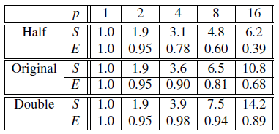
Speedups and efficiencies of parallel program on different problem sizes
Copyright © 2010, Elsevier Inc. All rights Reserved

Slide 21
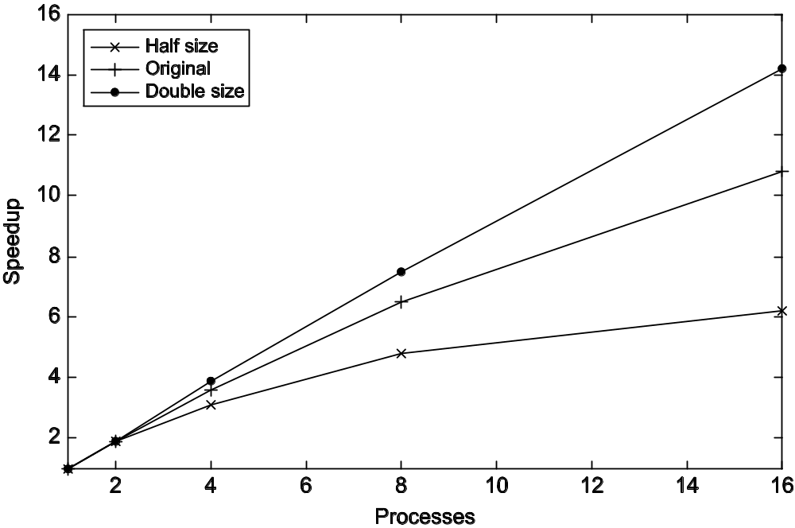
Speedup
Copyright © 2010, Elsevier Inc. All rights Reserved

Slide 22
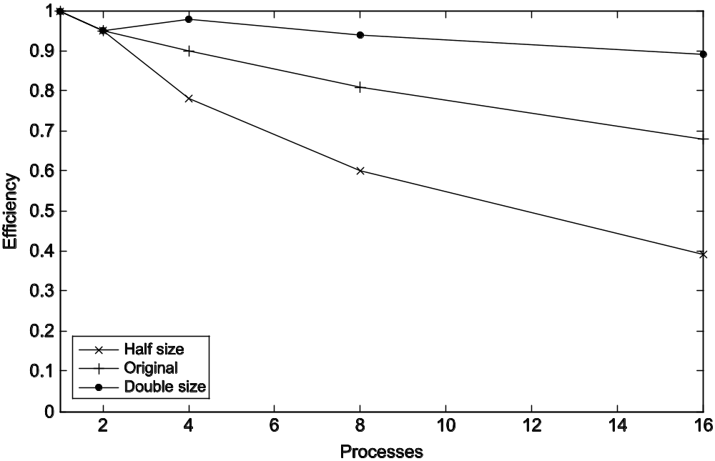
Efficiency
Copyright © 2010, Elsevier Inc. All rights Reserved

Slide 23
Effect of overhead
Many parallel programs are developed by dividing the work of the serial program among the processes/threads and adding in the necessary “parallel overhead” such as mutual exclusion or communication.
T_{parallel} = T_{serial} / p + T_{overhead}
Furthermore, as the problem size is increased, T_{overhead} often grows more slowly than T_{serial}. When this is the case the speedup and the efficiency will increase
Copyright © 2010, Elsevier Inc. All rights Reserved

Slide 24

Amdahl’s Law
Unless virtually all of a serial program is parallelized, the possible speedup is going to be very limited — regardless of the number of cores available.
Copyright © 2010, Elsevier Inc. All rights Reserved

Slide 25
Example
We can parallelize 90% of a serial program.
Parallelization is “perfect” regardless of the number of cores p we use.
T_{serial} = 20 seconds
Runtime of parallelizable part is
0.9 x T_{serial} / p = 18 / p
Copyright © 2010, Elsevier Inc. All rights Reserved

Slide 26
Example (cont.)
Runtime of “unparallelizable” part is
Overall parallel run-time is
0.1 x T_{serial} = 2
T_{parallel} = 0.9 x T_{serial} / p + 0.1 x T_{serial} = 18 / p + 2
Copyright © 2010, Elsevier Inc. All rights Reserved

Slide 27
Example (cont.)
Speed up
T_{serial}
20
S =
=
0.9 x T_{serial} / p + 0.1 x T_{serial}
18 / p + 2
Now as p gets larger and larger,
0.9 × Tserial/p = 18/p gets closer and closer to 0,
so the total parallel run-time can’t be smaller than
0.1 × Tserial = 2.
Copyright © 2010, Elsevier Inc. All rights Reserved

Slide 28
That is, the denominator in S can’t be smaller than
0.1 × Tserial = 2.
The fraction S must therefore be smaller than
S ≤ Tserial /(0.1 × Tserial) = 20/ 2 = 10.
That is, S ≤ 10.
This is saying that even though we’ve done a perfect job in parallelizing 90% of the program, and even if we have, say, 1000 cores, we’ll never get a speedup better than 10.
Copyright © 2010, Elsevier Inc. All rights Reserved

Slide 29
Scalability in MIMD systems
In general, a problem is scalable if it can handle ever increasing problem sizes.
Copyright © 2010, Elsevier Inc. All rights Reserved

Slide 30

Scalability in MIMD systems
suppose that T_{serial} = n,
where the units of T_{serial} are in microsec_x0002_onds, and n is also the problem size.
Also suppose that T_{parallel} = n/p + 1.
Then
To see if the program is scalable, we increase the number of processes/threads by a factor of k, and
we want to find the factor x that we need to increase the problem size by so that E is unchanged.
Copyright © 2010, Elsevier Inc. All rights Reserved

Slide 31


Taking Timings of MIMD programs
The number of processes/threads will be kp and the problem size will be xn, and we want to solve the following equation for x.
If x = k, there will be a common factor of k in the denominator xn + kp = kn + kp = k(n + p), and we can reduce the fraction to get
Copyright © 2010, Elsevier Inc. All rights Reserved

Slide 32
Taking Timings of MIMD programs
In other words, if we increase the problem size at the same rate that we increase the number of processes/threads, then the efficiency will be unchanged, and our program is scalable.
If we increase the number of processes/threads and keep the efficiency fixed without increasing problem size, the problem is strongly scalable.
Copyright © 2010, Elsevier Inc. All rights Reserved

Slide 33
Taking Timings of MIMD programs
If we keep the efficiency fixed by increasing the problem size at the same rate as we increase the number of processes/threads, the problem is weakly scalable.
Copyright © 2010, Elsevier Inc. All rights Reserved

Slide 34
Taking Timings of MIMD programs
During program development we may take timings in order to determine if the program is behaving as we intend.
For example, in a distributed-memory program we might be interested in finding out how much time the processes are spending waiting for messages, because if this value is large, there is almost certainly something wrong either with our design or our implementation.
Copyright © 2010, Elsevier Inc. All rights Reserved

Slide 35
Taking Timings of MIMD programs
On the other hand, once we’ve completed development of the program, we’re often interested in determining how good its performance is.
we’re usually not interested in the time that elapses between the program’s start and the program’s finish. We’re usually interested only in some part of the program:
Example:Bubble sort
Copyright © 2010, Elsevier Inc. All rights Reserved

Slide 36
Taking Timings of MIMD programs
we’re usually not interested in “CPU time.” This is the time reported by the standard C function clock. It’s the total time the program spends in code executed as part of the program.
It would include the time for code we’ve written; it would include the time we spend in library functions such as pow() or sin();
and it would include the time the operating system spends in functions we call, such as printf() and scanf().
It would not include time the program was idle.
Copyright © 2010, Elsevier Inc. All rights Reserved

Slide 37
Taking Timings of MIMD programs
For example, in a distributed-memory program, a process that calls a receive function may have to wait for the sending process to execute the matching send, and the operating system might put the receiving process to sleep while it waits. This idle time wouldn’t be counted as CPU time. since no function that’s been called by the process is active.
If each time the program is run, the process has to wait, ignoring the time it spends waiting would give a misleading picture of the actual run-time of the program.
Copyright © 2010, Elsevier Inc. All rights Reserved

Slide 38
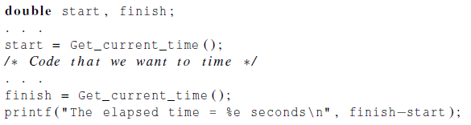
Taking Timings
theoretical
function
omp_get_wtime
MPI_Wtime
Copyright © 2010, Elsevier Inc. All rights Reserved

Slide 39
Taking Timings of MIMD programs
The actual function that is used will depend on the API.
For example, MPI has a function
MPI_ Wtime that could be used here,
and the OpenMP API for shared-memory programming has a function
omp_get_ wtime.
Both functions return wall clock time instead of CPU time
Copyright © 2010, Elsevier Inc. All rights Reserved

Slide 40
Taking Timings of MIMD programs
The resolution is the unit of measurement on the timer.
It’s the duration of the shortest event that can have a nonzero time.
Some timer functions have resolutions in milliseconds (10⁻³ seconds), and
when instructions can take times that are less than a nanosecond (10⁻⁹ seconds),
a program may have to execute millions of instructions before the timer reports a nonzero time.
Copyright © 2010, Elsevier Inc. All rights Reserved

Slide 41
Taking Timings of MIMD programs
Many APIs provide a function that reports the resolution of the timer.
Other APIs specify that a timer must have a given resolution.
In either case we, as the programmers, need to check these values.
When we’re timing parallel programs, we need to be a little more careful about how the timings are taken.
Copyright © 2010, Elsevier Inc. All rights Reserved

Slide 42
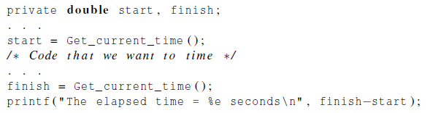
Taking Timings
In our example, the code that we want to time is probably being executed by multiple processes or threads and our original timing will result in the output of p elapsed times.
Copyright © 2010, Elsevier Inc. All rights Reserved

Slide 43
Taking Timings
we’re usually interested in is a single time: the time that has elapsed from when the first process/thread began execution of the code to the time the last process/thread finished execution of the code.
We often can’t obtain this exactly, since there may not be any correspondence between the clock on one node and the clock on another node.
Copyright © 2010, Elsevier Inc. All rights Reserved

Slide 44
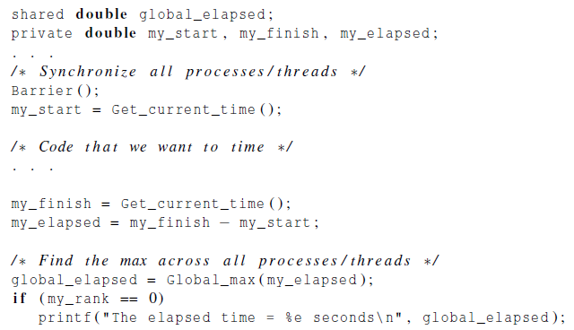
Taking Timings
Copyright © 2010, Elsevier Inc. All rights Reserved

Slide 45
Taking Timings
we first execute a barrier function that approximately synchronizes all of the processes/threads.
We would like for all the processes/threads to return from the call simultaneously, but such a function usually can only guarantee that all the processes/threads have started the call when the first process/thread returns.
Copyright © 2010, Elsevier Inc. All rights Reserved

Slide 46
Taking Timings
We then execute the code as before and each process/thread finds the time it took.
Then all the processes/threads call a global maximum function, which returns the largest of the elapsed times, and process/thread 0 prints it out.
When we run a program several times, it’s extremely likely that the elapsed time will be different for each run.
Copyright © 2010, Elsevier Inc. All rights Reserved

Slide 47
Taking Timings
This will be true even if each time we run the program we use the same input and the same systems.
It might seem that the best way to deal with this would be to report either a mean or a median run-time.
Running more than one thread per core can cause dramatic increases in the variability of timings.
Copyright © 2010, Elsevier Inc. All rights Reserved

Slide 48
Taking Timings
if we run more than one thread per core, the system will have to take extra time to schedule and deschedule cores, and this will add to the overall run-time. Therefore, we rarely run more than one thread per core.
Finally, as a practical matter, since our programs won’t be designed for high performance I/O, we’ll usually not include I/O in our reported run-times.
Copyright © 2010, Elsevier Inc. All rights Reserved

