Slide 1
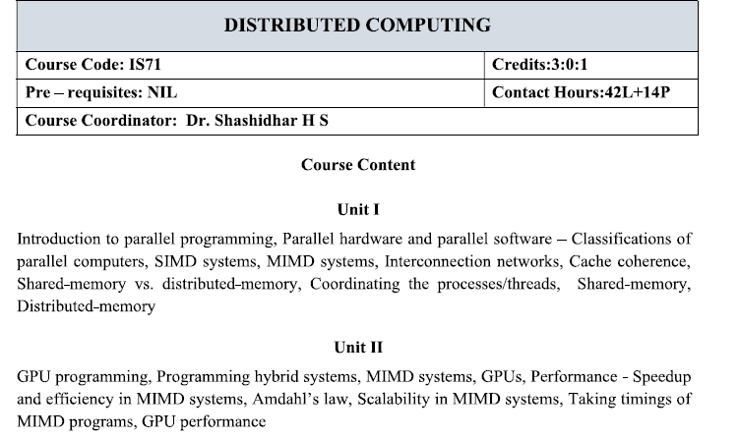
Copyright © 2010, Elsevier Inc. All rights Reserved

Slide 2
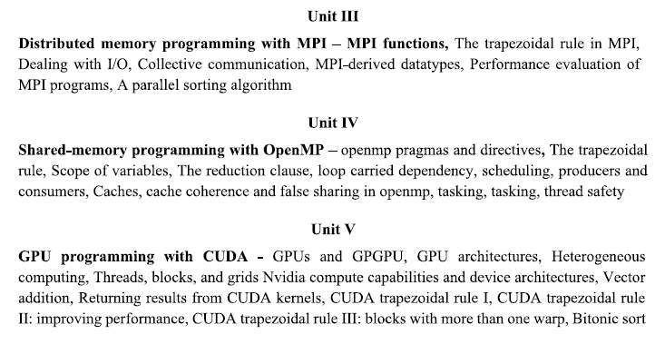
Copyright © 2010, Elsevier Inc. All rights Reserved

Slide 3
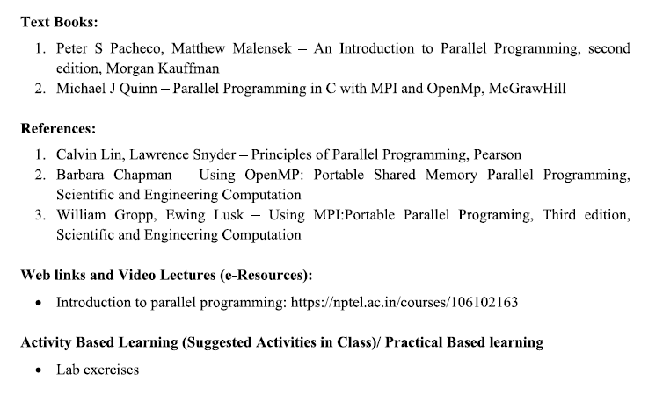
Copyright © 2010, Elsevier Inc. All rights Reserved

Slide 4
Parallel computing is simple arrangement of processors (multiple processors) in the system to enhance the performance of the same.
Parallel processing gives the way how the system works i. e. Scheduling, mapping, etc. by using multiple processors. It also concerns with synchronization concept.
# Chapter Subtitle
Notes:
The University of Adelaide, School of Computer Science
Chapter 2 — Instructions: Language of the Computer

Slide 5
Parallel Computing
Definition: Parallel computing is a broader concept that encompasses the simultaneous use of multiple compute resources to solve a computational problem. It involves dividing a task into smaller sub-tasks that can be processed concurrently.
Scope: It includes various forms of parallelism, such as data parallelism (processing large datasets simultaneously), task parallelism (executing different tasks concurrently), and pipeline parallelism (stages of a task are processed in parallel).
Applications: Used in scientific computing, simulations, big data processing, and any area requiring high computational power.
# Chapter Subtitle
Notes:
The University of Adelaide, School of Computer Science
Chapter 2 — Instructions: Language of the Computer

Slide 6
Parallel Processing
Definition: Parallel processing specifically refers to the execution of multiple processes or threads simultaneously. It focuses more on the execution aspect within a parallel computing environment.
Scope: It deals with the methods and architectures used to perform multiple operations or tasks at the same time, often at a finer granularity than parallel computing.
Applications: Commonly found in multi-core processors, distributed systems, and real-time processing tasks.
# Chapter Subtitle
Notes:
The University of Adelaide, School of Computer Science
Chapter 2 — Instructions: Language of the Computer

Slide 7
What is the difference between CPU and a GPU for parallel computing?
GPU is very good at data-parallel computing, CPU is very good at parallel processing.
GPU has thousands of cores, CPU has less than 100 cores.
GPU has around 40 hyperthreads per core, CPU has around 2(sometimes a few more) hyperthreads per core.
GPU has difficulty executing recursive code, CPU has less problems with it.
Copyright © 2010, Elsevier Inc. All rights Reserved

Slide 8
GPU lowest level caches are shared between 8–24 cores for intel, 64 cores for amd and up to 192 cores for nvidia. CPU’s lowest level cache only used by single core (2 threads). CPU’s each thread can use SIMD which is data-parallel for about 8–32 workitems(each comparable to a single GPU core/thread).
GPU highest level cache is only around 5MB, CPU highest level cache can get 64MB or more.
GPU is accessed through pci-e and similar bridges and also works on a middle API that both add latency and programming effort and makes very lighty loaded works become slow. CPU is easier to begin with and perfect at random + small workloads.
Copyright © 2010, Elsevier Inc. All rights Reserved

Slide 9
GPU has considerably higher compute per electricity energy than CPU.
GPU is for high throughput, CPU is for low latency.
Integrated GPUs still use internal pci-e connection to get commands from CPU but gets data from RAM directly so there is still some added latency in there.
With APIs like CUDA/OpenCL, GPU has addressable local memories and registers that are much faster than lowest level caches. This makes inter-core communication easier in coding. Even number of available(and addressable like an array) private registers per core is much higher than that of a CPU. (256 vs 32)
GPU’s single core is very lightweight compared to a single CPU core. 1 CPU core has 8–16 such pipelines while 1 GPU “SM/CU” has 64/128/192 pipelines and should be called a “core”.
Copyright © 2010, Elsevier Inc. All rights Reserved

Slide 10
Threads
Threads are contained within processes.
They allow programmers to divide their programs into (more or less) independent tasks.
The hope is that when one thread blocks because it is waiting on a resource, another will have work to do and can run.
Copyright © 2010, Elsevier Inc. All rights Reserved

Slide 11
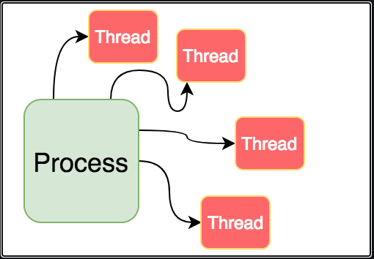
Copyright © 2010, Elsevier Inc. All rights Reserved

Slide 12
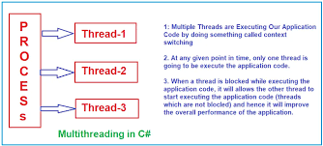
Copyright © 2010, Elsevier Inc. All rights Reserved

Slide 13
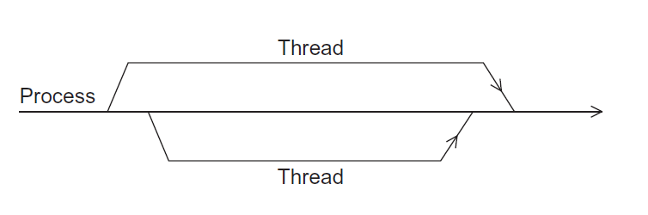
A process and two threads
the “master” thread
terminating a thread
Is called joining
starting a thread
Is called forking
Figure 2.2
Copyright © 2010, Elsevier Inc. All rights Reserved

Slide 14
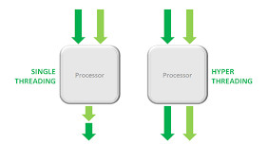
Hyper-threading is a hardware technology that allows a single processor to handle multiple tasks simultaneously, which can improve performance. It does this by dividing a CPU's physical cores into virtual cores, also known as threads, that the operating system treats as if they were physical cores.
# Chapter Subtitle
Notes:
The University of Adelaide, School of Computer Science
Chapter 2 — Instructions: Language of the Computer

Slide 15
# Chapter Subtitle
Parallelism is the ability to execute multiple tasks or operations simultaneously, rather than sequentially. Parallelism can be achieved at different levels, such as hardware, software, or network. For example, you can use multiple cores or processors, threads or processes, or asynchronous or non-blocking operations to run parallel tasks.
Notes:
The University of Adelaide, School of Computer Science
Chapter 2 — Instructions: Language of the Computer

Slide 16
Threads
A programming concept that involves creating, running, and terminating threads within a process. Threads share memory and file handlers.
Pthreads
A library that provides tools to manage threads, including functions for creating, terminating, and joining threads. Pthreads is an Application Programming Interface (API) that can be used for shared memory programming.
Copyright © 2010, Elsevier Inc. All rights Reserved

Slide 17
Why use parallelism for APIs?
One of the main reasons to use parallelism for API’s(Application Programming Interface) is to improve the performance and scalability of your applications.
By sending and receiving multiple requests and responses at the same time, you can reduce the waiting time and increase the throughput of your applications.
For example, fetch data from several APIs,
Notes:
The University of Adelaide, School of Computer Science
Chapter 2 — Instructions: Language of the Computer

Slide 18
Why use parallelism for APIs?
Another reason to use parallelism for APIs is to handle complex or dynamic scenarios that require coordination or synchronization among multiple APIs.
For example, Perform a transaction.
This can make your applications more reliable and consistent.
Notes:
The University of Adelaide, School of Computer Science
Chapter 2 — Instructions: Language of the Computer

Slide 19

Changing times
From 1986 – 2002, microprocessors were speeding like a rocket, increasing in performance an average of 50% per year.
Since then, it’s dropped to about 20% increase per year.

Slide 20
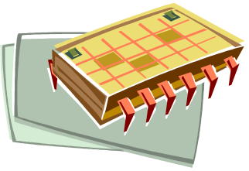
An intelligent solution
Instead of designing and building faster microprocessors, put multiple processors on a single integrated circuit.

Slide 21

Now it’s up to the programmers
Adding more processors doesn’t help much if programmers aren’t aware of them…
… or don’t know how to use them.
Serial programs don’t benefit from this approach (in most cases).

Slide 22
Why we need ever-increasing performance
Computational power is increasing, but so are our computation problems and needs.
As our computational power increases, the number of problems that we can seriously consider solving also increases.
Examples like

Slide 23

Climate modeling
In order to better understand climate change, we need far more accurate computer models, models that include interactions between the atmosphere, the oceans, solid land, and the ice caps at the poles.

Slide 24
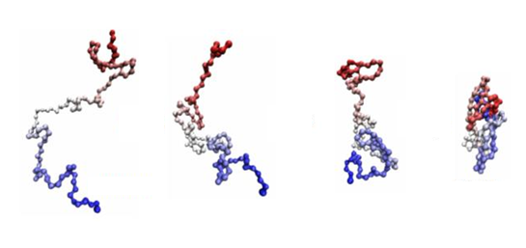
Protein folding
It’s believed that misfolded proteins may be involved in dis eases such as Huntington’s, Parkinson’s, and Alzheimer’s, but our ability to study configurations of complex molecules such as proteins is severely limited by our current computational power.

Slide 25


Drug discovery
There are many drugs that are effective in treating a relatively small fraction of those suffering from some disease. It’s possible that we can devise alternative treatments by careful analysis of the genomes of the individuals for whom the known treatment is ineffective. This, however, will involve extensive computational analysis of genomes.
Notes:
The University of Adelaide, School of Computer Science
Chapter 2 — Instructions: Language of the Computer

Slide 26


Energy research
Increased computational power will make it possible to program much more detailed models of technologies such as wind turbines, solar cells, and batteries. These programs may provide the information needed to construct far more efficient clean energy sources.

Slide 27



Data analysis
We generate tremendous amounts of data. By some estimates, the quantity of data stored worldwide doubles every two years, but the vast majority of it is largely useless unless it’s analyzed.

Slide 28
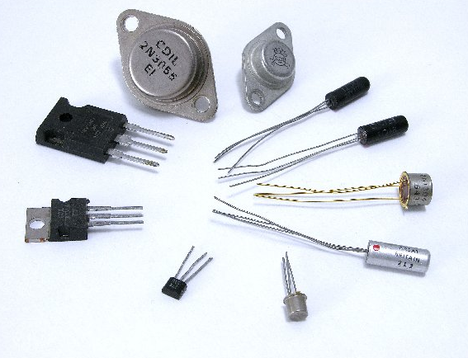
Why we’re building parallel systems
Up to now, performance increases have been attributable to increasing density of transistors.
But there are
inherent
problems.

Slide 29

A little physics lesson
Smaller transistors = faster processors.
Faster processors = increased power consumption.
Increased power consumption = increased heat.
Increased heat = unreliable processors.

Slide 30
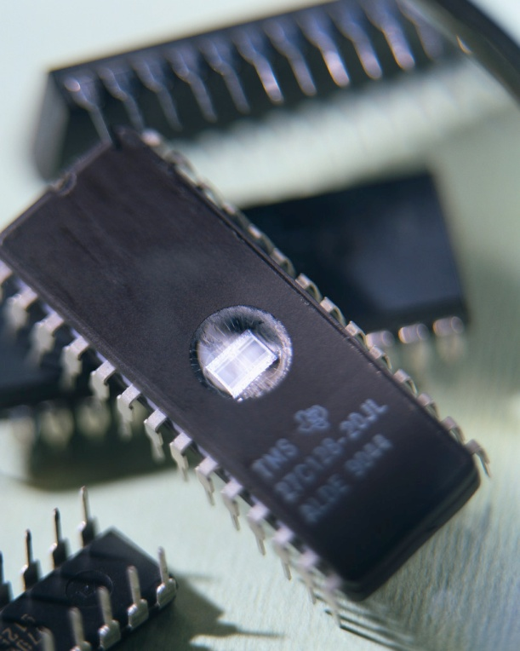
Solution
Move away from single-core systems to multicore processors.
“core” = central processing unit (CPU)
Introducing parallelism!!! Rather than building ever-faster, more complex, monolithic processors, the industry has decided to put multiple, relatively simple, complete processors on a single chip. Such integrated circuits are called multicore processors, and core has become synonymous with central processing unit, or CPU. In this setting a conventional processor with one CPU is often called a single-core system.

Slide 31

Why we need to write parallel programs
Running multiple instances of a serial program often isn’t very useful.
Think of running multiple instances of your favorite game.
What you really want is for
it to run faster.

Slide 32
Approaches to the serial problem
Rewrite serial programs so that they’re parallel.
Write translation programs that automatically convert serial programs into parallel programs.
  This is very difficult to do.
  Success has been limited.

Slide 33
More problems
Some coding constructs can be recognized by an automatic program generator, and converted to a parallel construct.
However, it’s likely that the result will be a very inefficient program.
Sometimes the best parallel solution is to step back and devise an entirely new algorithm.

Slide 34
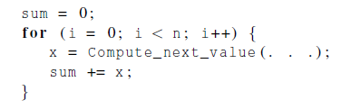
Example
Compute n values and add them together.
Serial solution:

Slide 35
Example (cont.)
We have p cores, p much smaller than n.
Each core performs a partial sum of approximately n/p values.
my_sum = 0;
my_first_i = ...; // Each core's starting index
my_last_i = ...; // Each core's ending index
// Loop through the assigned range of values
for (my_i = my_first_i; my_i < my_last_i; my_i++) {
my_x = Compute_next_value(...); // Compute the value for this index
my_sum += my_x; // Accumulate the sum
}
Each core uses it’s own private variables
and executes this block of code independently of the other cores.

Slide 36
Example (cont.)
After each core completes execution of the code, is a private variable my_sum contains the sum of the values computed by its calls to Compute_next_value.
Ex., 8 cores, n = 24, then the calls to Compute_next_value return:
1,4,3, 9,2,8, 5,1,1, 5,2,7, 2,5,0, 4,1,8, 6,5,1, 2,3,9

Slide 37
Example (cont.)
Once all the cores are done computing their private my_sum, they form a global sum by sending results to a designated “master” core which adds the final result.

Slide 38
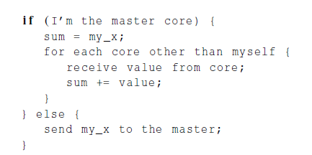
Example (cont.)

Slide 39
Example (cont.)
if (I’m the master core) {
// Initialize sum with the master's own value
sum = my_sum;
// Loop through all other cores and receive their values
for each core other than myself {
received_value = receive_value_from_core(core_id);
sum += received_value;
}
// Final sum is computed at the master
} else {
// Worker cores send their sum to the master
send_value_to_master(my_sum);
}

Slide 40
Example (cont.)
Core | 0 | 1 | 2 | 3 | 4 | 5 | 6 | 7
my_sum | 8 | 19 | 7 | 15 | 7 | 13 | 12 | 14
Global sum
8 + 19 + 7 + 15 + 7 + 13 + 12 + 14 = 95
Core | 0 | 1 | 2 | 3 | 4 | 5 | 6 | 7
my_sum | 95 | 19 | 7 | 15 | 7 | 13 | 12 | 14

Slide 41

But wait!
There’s a much better way
to compute the global sum.

Slide 42
Better parallel algorithm
Don’t make the master core do all the work.
Share it among the other cores.
Pair the cores so that core 0 adds its result with core 1’s result.
Core 2 adds its result with core 3’s result, etc.
Work with odd and even numbered pairs of cores.

Slide 43
Better parallel algorithm (cont.)
Repeat the process now with only the evenly ranked cores.
Core 0 adds result from core 2.
Core 4 adds the result from core 6, etc.
Now cores divisible by 4 repeat the process, and so forth, until core 0 has the final result.

Slide 44
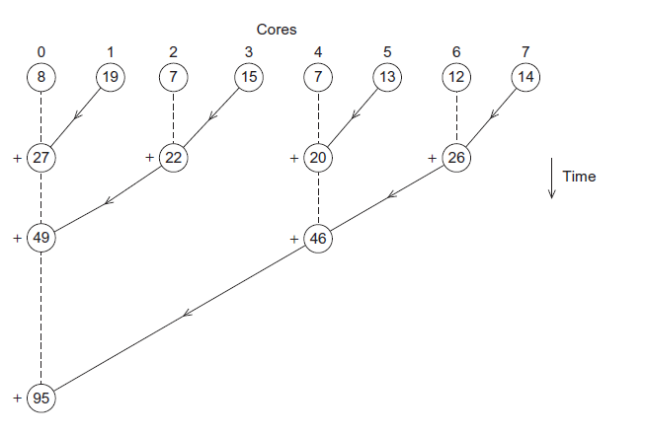
Multiple cores forming a global sum

Slide 45
Analysis
In the first example, the master core performs 7 receives and 7 additions.
In the second example, the master core performs 3 receives and 3 additions.
The improvement is more than a factor of 2!

Slide 46
Analysis (cont.)
The difference is more dramatic with a larger number of cores.
If we have 1000 cores:
  The first example would require the master to perform 999 receives and 999 additions.
  The second example would only require 10 receives and 10 additions.
That’s an improvement of almost a factor of 100!

Slide 47
How do we write parallel programs?
Partitioning of the work can be done among the cores.
Task parallelism
  Partition various tasks carried out in solving the problem among the cores.
Data parallelism
  Partition the data used in solving the problem among the cores.
  Each core carries out similar operations on it’s part of the data.

Slide 48


Professor P
15 questions
300 exams

Slide 49

Professor P’s grading assistants
TA#1
TA#2
TA#3

Slide 50
Division of work – data parallelism
TA#1
TA#3
100 exams
100 exams
TA#2
100 exams

Slide 51

Division of work – task parallelism
TA#1
TA#3
Questions 11 - 15
Questions 1 - 5
TA#2
Questions 6 - 10

Slide 52
Division of work – data Parallelism
The first part of the global sum is data Parallelism

Slide 53
Division of work – task Parallelism
The second part of the global sum is task Parallelism
Tasks
Receiving
Adding the cores partial sum

Slide 54
There are two tasks: receiving and adding the cores’ partial sums, which is carried out by the master core and giving the partial sum to the master core, which is carried out by the other cores.

Slide 55
Coordination
In both global sum examples, the coordination involves
Communication – one or more cores send their current partial sums to another core.
Load balancing – share the work evenly among the cores so that one is not heavily loaded.
Synchronization – because each core works at its own pace, make sure cores do not get too far ahead of the rest.

Slide 56
What we’ll be doing
Learning to write programs that are explicitly parallel.
Using the C language.
Using four different extensions to C.
  Message-Passing Interface (MPI)
  Posix Threads (Pthreads)
  OpenMP
  CUDA(Compute Unified Device Architecture)

Slide 57
What we’ll be doing
MPI and Pthreads are libraries of type definitions, functions, and macros that can be used in Cprograms.
OpenMP consists of a library and some modifications to the C compiler.
CUDA consists of a library and modifications to the C++ compiler.

Slide 58
Type of parallel systems
Shared-memory
  The cores can share access to the computer’s memory.
  Coordinate the cores by having them examine and update shared memory locations.
Distributed-memory
  Each core has its own, private memory.
  The cores must communicate explicitly by sending messages across a network.

Slide 59
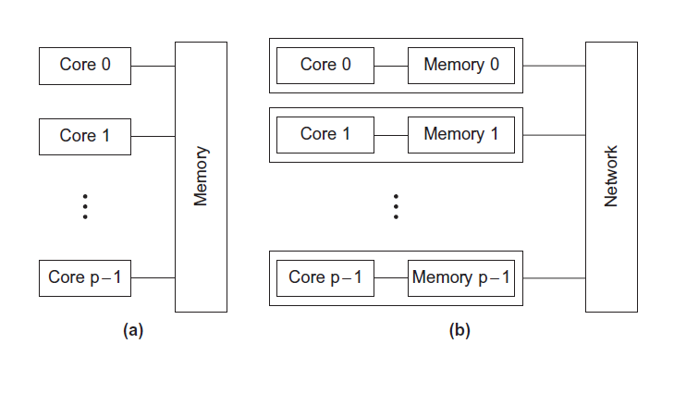
Type of parallel systems
Shared-memory
Distributed-memory

Slide 60
Our different APIs are used for programming different types of systems
• MPI is an API for programming distributed memory MIMD systems.
• Pthreads is an API for programming shared memory MIMD systems.
• OpenMP is an API for programming both shared memory MIMD and shared memory SIMD systems, although we’ll be focusing on programming MIMD sys tems.

Slide 61
• CUDA: is an API for programming Nvidia GPUs,
which have aspects of all four of our classifications: shared memory and distributed memory, SIMD, and MIMD. We will, however, be focusing on the shared memory SIMD and MIMD aspects of the API.

Slide 62
Concurrent,Parallel,Distributed
Concurrent computing – a program is one in which multiple tasks can be in progress at any instant.
Parallel computing – a program is one in which multiple tasks cooperate closely to solve a problem
Distributed computing – a program may need to cooperate with other programs to solve a problem.

Slide 63
So parallel and distributed programs are concurrent, but a program such as a multitasking operating system is also concurrent.

Slide 64
In parallel programming, APIs (Application Programming Interfaces) can be called simultaneously to improve performance and speed up processes. This is done by executing multiple API calls at the same time instead of sequentially

Slide 65
Some benefits of using parallel APIs:
Faster response times
Parallel APIs can lead to faster response times, which can improve the user experience.
Optimized resource utilization
Parallel APIs can optimize resource utilization by enabling simultaneous data retrieval.
Handling complex scenarios
Parallel APIs can handle complex or dynamic scenarios that require coordination or synchronization among multiple APIs

