Slide 1
IoT Project Presentation
T.Y. B.Tech – Computer Engineering | AY [ 2026–2027 ] | Div-A
IoT Based Dual-Layered Bridge Health Monitoring System
Submitted By
Sambare Rohit | Dabhade Aditya | Borale Samiksha
Under the Guidance of
Prof. N.Y. Siddiqui, Associate Professor

Slide 2
Index
Content
Slide No
Content
Slide No
01
Introduction
3
08
Hardware Components
11
02
Problem Statement
4
09
Prototype / Implementation
12 – 14
03
Aim & Objectives
5
10
Expected Result
15
04
Literature Survey
6
11
Applications
16
05
Research Gap & Motivation
7
12
Advantages and Limitations
17
06
Proposed System / Architecture
8
13
Conclusion
18
07
Methodology / Working
9 – 10
14
References
19

Slide 3
Introduction
STRUCTURAL HEALTH MONITORING
WHY BRIDGES NEED IT
OUR PROJECT
Structural Health Monitoring (SHM) is the process of continuously observing the condition and performance of structures such as bridges using sensors and monitoring technologies. With the integration of Internet of Things (IoT), sensor data can be collected, transmitted wirelessly, and monitored in real time, enabling early detection of abnormal structural conditions.
Bridges are exposed to various structural and environmental factors such as heavy loads, vibrations, water, moisture, and changing weather conditions, which can affect their safety and durability. Therefore, continuous monitoring can help identify abnormal changes before they develop into serious structural problems.
Our project, “IoT-Based Dual-Layer Bridge Monitoring System,” is designed to monitor important structural and environmental parameters using multiple sensors connected to an ESP32. The collected data is transmitted wirelessly to a cloud-based monitoring platform such as ThingSpeak/Blynk, where it can be observed and used to generate alerts when potentially dangerous conditions are detected.

Slide 4
Problem Statement
PROBLEM DEFINITION
NEED
Bridges are continuously exposed to loads, vibrations, environmental conditions, and structural stresses that may gradually cause cracks, corrosion, excessive vibration, tilt, and deformation.
Traditional inspection methods are periodic and largely dependent on manual observation, making it difficult to identify structural abnormalities that develop between inspections.
Such methods can also require significant time, effort, and resources for monitoring multiple structural parameters.
Therefore, a continuous and reliable monitoring system is required to detect abnormal structural changes at an early stage.
PROPOSED SOLUTION
This project proposes an IoT-based Structural Health Monitoring system that uses multiple sensors and an ESP32 to continuously collect structural and environmental data, monitor the condition of the bridge in real time, and generate timely alerts when abnormal conditions are detected.

Slide 5
Aim & Objectives
AIM
OBJECTIVES
To develop a low-cost IoT-based Structural Health Monitoring system for real-time monitoring of bridge structural and environmental conditions, enabling continuous data collection and timely detection of abnormal conditions.
Real-Time Structural Monitoring
Monitor tilt, vibration, deflection and load using multiple sensors.
01
Environmental & Material Monitoring
Monitor temperature, humidity and corrosion-related conditions.
02
Early Abnormality Detection
Identify unusual sensor readings and generate timely warnings.
03
Automated Data Collection
Use ESP32 and wireless communication to transmit sensor data to a cloud-based dashboard.
04

Slide 6
Literature Survey
Research Paper | Key Findings | Relevance to Our Project
[1] Sonbul & Rashid (2023) – Towards the Structural Health Monitoring of Bridges Using Wireless Sensor Networks: A Systematic Study | WSN, sensor deployment, wireless communication, energy constraints | Supports our wireless multi-sensor bridge monitoring using ESP32.
[2] Zhang et al. (2025) – A Review of Methods and Applications in Structural Health Monitoring (SHM) for Bridges | Sensing technologies, wireless transmission, data preprocessing, damage identification, early warning | Supports our sensor monitoring, wireless transmission and alert system.
[3] Zhang et al. (2022) – The Application of Deep Learning in Bridge Health Monitoring: A Literature Review | DL, vibration-based SHM, vision-based SHM, CNN, LSTM, Autoencoder | Provides a foundation for our future AI/TinyML-based anomaly detection.
[4] Liu (2026) – Edge-Cloud Collaborative Digital Twin Architecture for Bridge Structural Health Monitoring: Multi-Sensor Fusion and Anomaly Detection Algorithm Design | Edge-cloud collaboration, multi-sensor fusion, anomaly detection, Digital Twin | Guides our future multi-sensor fusion and intelligent cloud monitoring.

Slide 7
Research Gap & Motivation
RESEARCH GAP
MOTIVATION
Existing research uses WSN and multiple sensors for bridge monitoring.
Advanced systems use AI, anomaly detection and Digital Twin technologies.
Many advanced approaches can involve higher system complexity and implementation requirements.
There is scope for a low-cost, practical multi-sensor IoT prototype suitable for real-time bridge monitoring.
Integration of structural + environmental monitoring + wireless cloud monitoring can provide a practical solution for prototype-level SHM.
To develop a low-cost and practical ESP32-based system that combines multiple sensors, wireless communication and cloud monitoring to continuously observe bridge structural and environmental conditions.

Slide 8
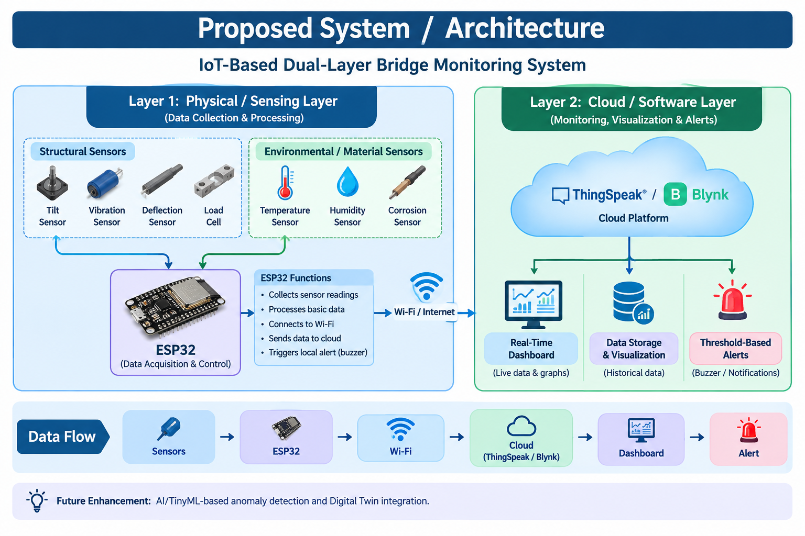
Proposed System / Architecture

Slide 9
Methodology: Data Acquisition & Processing
01
Sensor Deployment
02
Data Acquisition
03
Data Processing
Multiple sensors are deployed on the bridge prototype to monitor important structural and environmental parameters, including load, vibration, tilt, bending/deflection, temperature, humidity, and corrosion-related conditions.
The ESP32 acts as the central controller and collects readings from the connected sensors through appropriate interfaces such as GPIO, I²C, and ADC at sensor-specific sampling intervals.
The collected readings are processed by the ESP32 through unit conversion, data validation, basic filtering/averaging, and threshold comparison to identify unusual changes in sensor values.
DATA FLOW
Sensors
➜
Data Acquisition
➜
ESP32
➜
Data Processing

Slide 10
Methodology: IoT Communication & Monitoring
04
IoT Communication
05
Cloud-Based Monitoring
06
Anomaly Detection & Alerts
The ESP32 transmits processed sensor data using IEEE 802.11 b/g/n Wi-Fi in the 2.4 GHz frequency band to the cloud monitoring platform.
The collected data is transmitted to ThingSpeak/Blynk for real-time visualization through numerical values, graphs, and historical data.
Sensor readings are compared with predefined experimental threshold values. When an abnormal reading is detected, the system generates a warning/alert indication through the monitoring platform and/or local buzzer.
DATA FLOW
ESP32
➜
2.4 GHz Wi-Fi
➜
Cloud
➜
Dashboard
➜
Threshold Check
➜
Alert

Slide 11
Hardware Components
MICROCONTROLLER & COMMUNICATION
STRUCTURAL MONITORING SENSORS
ESP32 – Main controller, sensor data processing and Wi-Fi communication
Breadboard – Circuit prototyping and component connections
Jumper Wires & Power Supply – Electrical connections and power
Load Cell + HX711 – Measures applied load/structural load
MPU6050 – Measures tilt, acceleration and vibration
Flex Sensor – Detects bending/deformation
Vibration Sensor – Detects structural vibrations
Crack Sensor – Detects cracks or abnormal structural changes
Corrosion Sensor – Monitors corrosion-related changes
ENVIRONMENTAL & FOUNDATION MONITORING
ALERT & MONITORING
DHT11 – Measures temperature and humidity
DS18B20 – Measures temperature
Soil Moisture Sensor – Monitors moisture/wetness conditions
Active Buzzer – Provides warning during abnormal conditions
ThingSpeak / Blynk – Cloud-based monitoring and data visualization
Arduino IDE – Programming and ESP32 development
Sensors
➜
ESP32
➜
Wi-Fi
➜
Cloud Dashboard
➜
Monitoring
➜
Alert

Slide 12
Prototype Implementation
01
Prototype Assembly
02
Sensor Integration
03
ESP32-Based Control Unit
Plywood base, two support pillars and bridge roadway assembled.
Sensors and control unit integrated with prototype.
Vibration, tilt, crack, load, moisture, temperature and corrosion sensors installed.
ESP32 collects and processes sensor readings.
LCD, LEDs and buzzer provide local status indication.
04
Testing & Alert System
05
Cloud Monitoring
Different test conditions applied to observe sensor responses.
Green/Yellow/Red LEDs and buzzer indicate system status.
Sensor data transmitted through Wi-Fi.
Dashboard used for monitoring sensor values and system status.
Prototype Assembly
➜
Sensor Integration
➜
ESP32 Connection
➜
Testing & Validation
➜
Cloud Monitoring & Alerts

Slide 13
Prototype Dimensions & Sensor Placement
PROTOTYPE MODEL DIMENSIONS
ACTUAL SENSOR PLACEMENT
Plywood Base Foundation
3 ft × 2 ft (91.5 cm × 61.5 cm)
Top Bridge Deck
SW-420, ADXL345, Flex/Crack Sensor
01
01
Under Deck Support
5 kg Load Cell + HX711
02
Support Pillars
1 ft height (30 cm), two solid wooden pillars
02
Base Enclosure
ESP32, LCD, 3-colour LEDs, Active Buzzer
03
Bridge Roadway
2 ft × 8 inch (61.5 cm × 20.3 cm)
03
Right-Side Test Zone
Soil Moisture Probe, Corrosion Electrodes, DS18B20
04

Slide 14
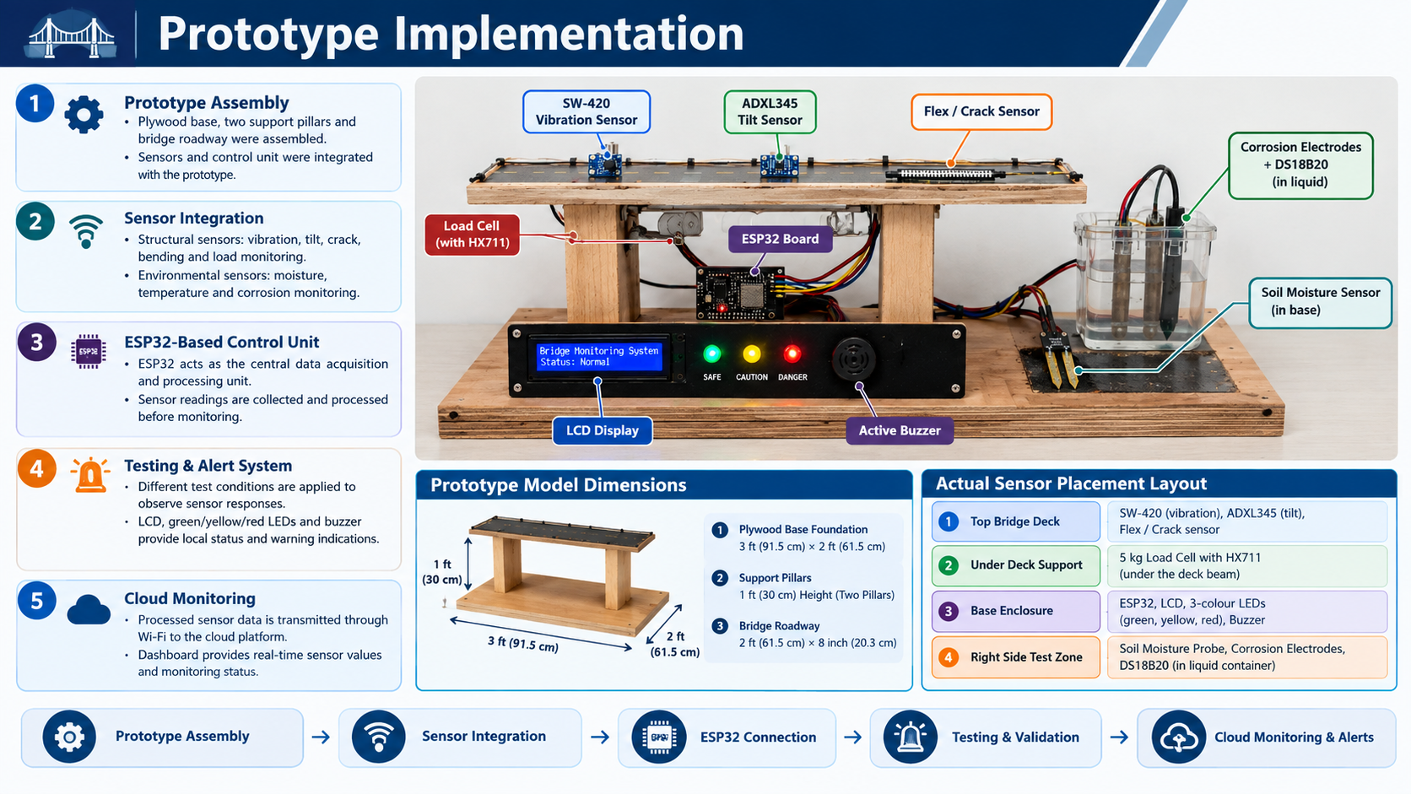
Prototype Implementation

Slide 15
Expected Results
01
Structural Monitoring
02
Environmental Monitoring
03
Real-Time Data Collection
Vibration, tilt, crack/bending and load monitoring
Detection of abnormal structural conditions
Temperature, moisture and corrosion-related monitoring
ESP32 collects and processes sensor readings
Sensor data transmitted through Wi-Fi
04
Cloud-Based Monitoring
05
Alert Generation
06
Integrated IoT Prototype
Sensor values displayed on dashboard
Real-time status and historical data visualization
Green/Yellow/Red status indication
Buzzer alert during abnormal conditions
Demonstration of multi-sensor bridge health monitoring using ESP32

Slide 16
Applications
01
Bridges & Flyovers
02
Buildings & Dams
Monitoring of traffic/load conditions
Detection of vibration, tilt and deck deformation
Monitoring of crack and corrosion-related conditions
Monitoring of structural tilt and movement
Tracking of moisture and environmental conditions
Early identification of abnormal structural changes
03
Tunnels & Industrial Structures
04
Historical & Heritage Structures
Monitoring of vibration and structural movement
Detection of corrosion/rust-related conditions
Monitoring of temperature and environmental changes
Continuous observation of structural condition
Monitoring of moisture, tilt and environmental effects
Helps support non-invasive condition monitoring

Slide 17
Advantages & Limitations
ADVANTAGES
LIMITATIONS
1. Multi-Parameter Monitoring
Monitors load, vibration, tilt, cracks/bending, moisture, temperature and corrosion in one system.
2. Real-Time Monitoring
ESP32 continuously collects sensor data and provides the current structural/environmental status.
3. Local Warning System
Green/Yellow/Red LEDs and buzzer provide immediate local indication when abnormal conditions are detected.
4. Cloud-Based Data Visualization
Sensor data can be transmitted through Wi-Fi and displayed on a cloud dashboard for monitoring and analysis.
1. Wi-Fi Dependency
Cloud-based monitoring requires a Wi-Fi connection for data transmission.
2. Small-Scale Prototype
The prototype uses laboratory-scale components, including a 5 kg load cell, so it does not represent actual bridge load capacity.
3. Power Dependency
Continuous monitoring requires a reliable power supply or suitable battery backup.
4. Experimental Thresholds
Alert thresholds are based on prototype testing and experimental conditions and cannot be directly treated as real-world bridge safety limits.

Slide 18
Conclusion
CONCLUSION
INFRA SENSE is an IoT-based Structural Health Monitoring system developed for continuous monitoring of bridge structural and environmental conditions.
The system integrates multiple sensors with ESP32 to monitor parameters such as load, vibration, tilt, bending/crack-related changes, moisture, temperature and corrosion.
The dual-layer architecture combines the physical sensing layer with data processing, wireless communication and cloud-based monitoring.
LCD, status LEDs and buzzer provide local indication, while cloud connectivity enables remote observation of sensor data.
The developed prototype demonstrates the feasibility of a low-cost, multi-sensor IoT approach for structural condition monitoring and early warning.
INFRA SENSE demonstrates how IoT and multi-sensor technology can support continuous and intelligent structural health monitoring.

Slide 19
References
[1] O. S. Sonbul and M. Rashid, “Towards the Structural Health Monitoring of Bridges Using Wireless Sensor Networks: A Systematic Study,” Sensors, 23(20), 8468, 2023.
[2] B. Zhang et al., “A Review of Methods and Applications in Structural Health Monitoring (SHM) for Bridges,” Measurement, 245, 116575, 2025.
[3] G.-Q. Zhang, B. Wang, J. Li and Y.-L. Xu, “The Application of Deep Learning in Bridge Health Monitoring: A Literature Review,” Advances in Bridge Engineering, 3, 22, 2022.
[4] Y. Liu, “Edge-Cloud Collaborative Digital Twin Architecture for Bridge Structural Health Monitoring: Multi-Sensor Fusion and Anomaly Detection Algorithm Design,” Discover Applied Sciences, 8, 938, 2026.
[5] C. R. Farrar and K. Worden, “An Introduction to Structural Health Monitoring,” Philosophical Transactions of the Royal Society A, 365, 303–315, 2007.
These references were used to study existing SHM techniques, wireless sensor networks, multi-sensor monitoring, anomaly detection and IoT-based structural monitoring.

Slide 20
Thank You
Questions / Discussion

