Slide 1
Overview of Company Performance
"Good morning Sir. My name is Aditya , and today, I'm excited to present the findings from our data analysis on the company's performance across different regions, monthly trends, and customer contributions. This analysis aims to provide actionable insights that can help us make informed business decisions moving forward."

Slide 2
Data Loading and Cleaning Process
"
We started by loading and cleaning the data in Power BI to ensure accuracy. This involved removing duplicates, handling missing values, and standardizing data formats."

Slide 3
Analysis of Monthly Revenue Trends
"We observed that the first eight months of sales from January to August were very stable."
"The increase in revenue begins in September, with a 40% growth over the previous month. This pattern persisted up until November."
"Unfortunately, data for December is insufficient, so no inferences can be made."
"This research demonstrates how seasonality—which generally happens in the last four months of the year—affects retail store sales."

Slide 4
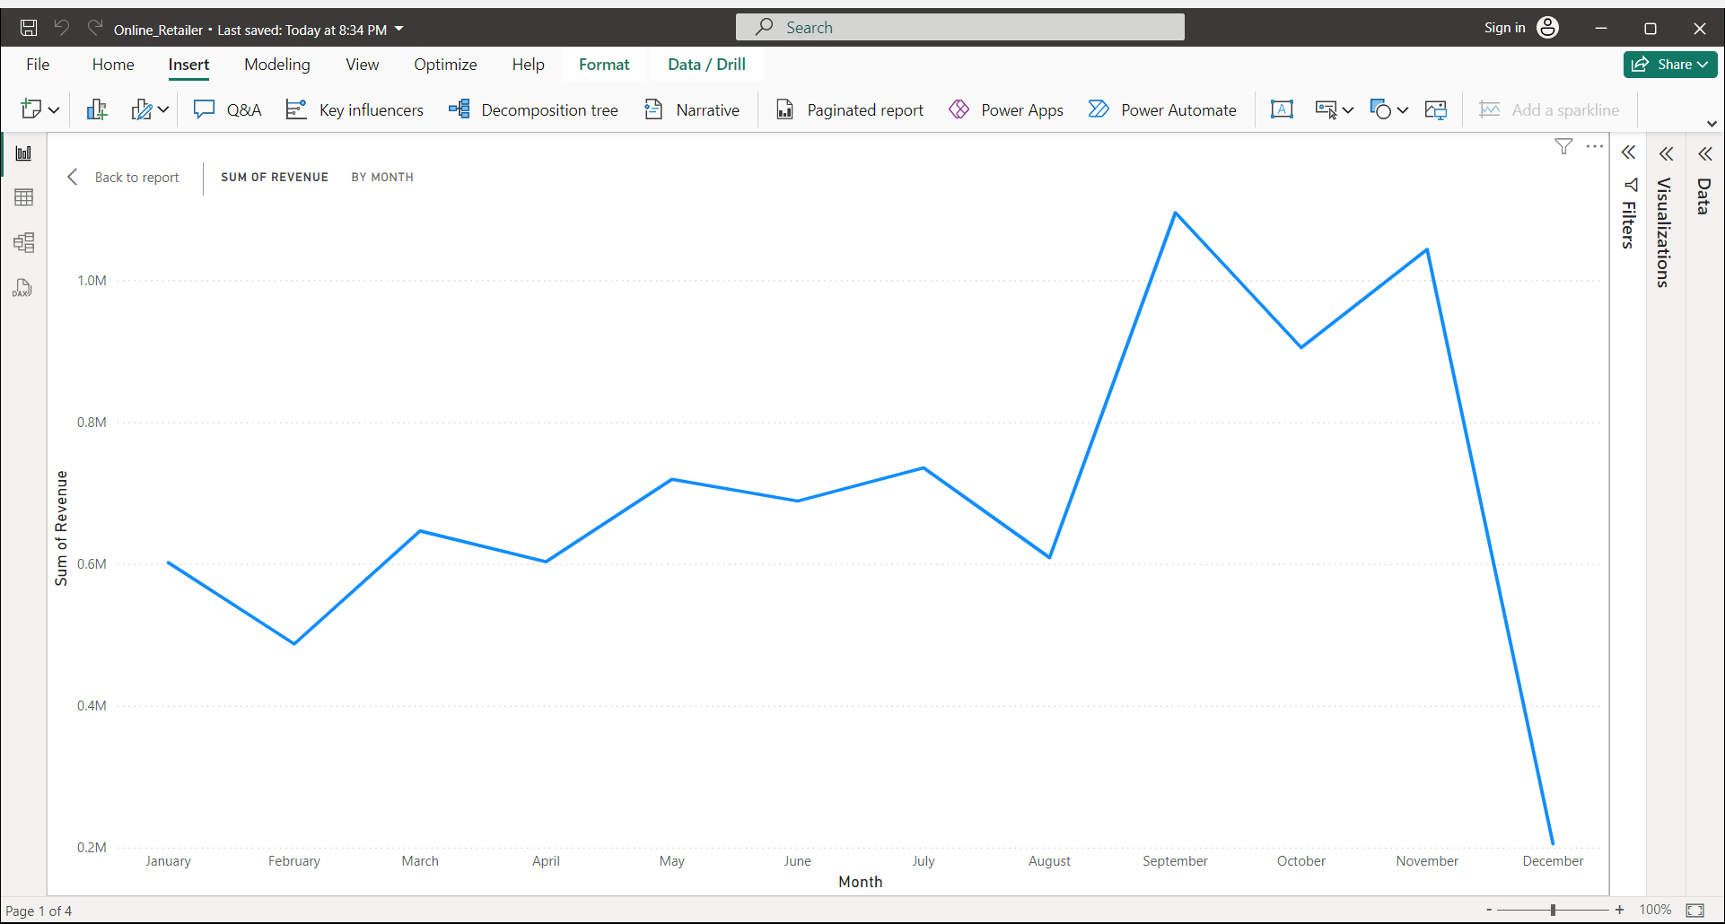

Slide 5
Revenue Analysis by Region
"Since the UK already has a large demand and I understand you are more interested in nations where demand may be boosted, the UK is not included in these statistics."
Top Performing Regions: Netherlands, Ireland, Germany, France, and Australia
"These regions have shown consistent growth, and we propose concentrating on these nations."
Low Performing Regions: Saudi Arabia, USA, Bahrain, Czech Republic, and Brazil
"We see an opportunity here to explore strategies to improve performance in these regions."

Slide 6
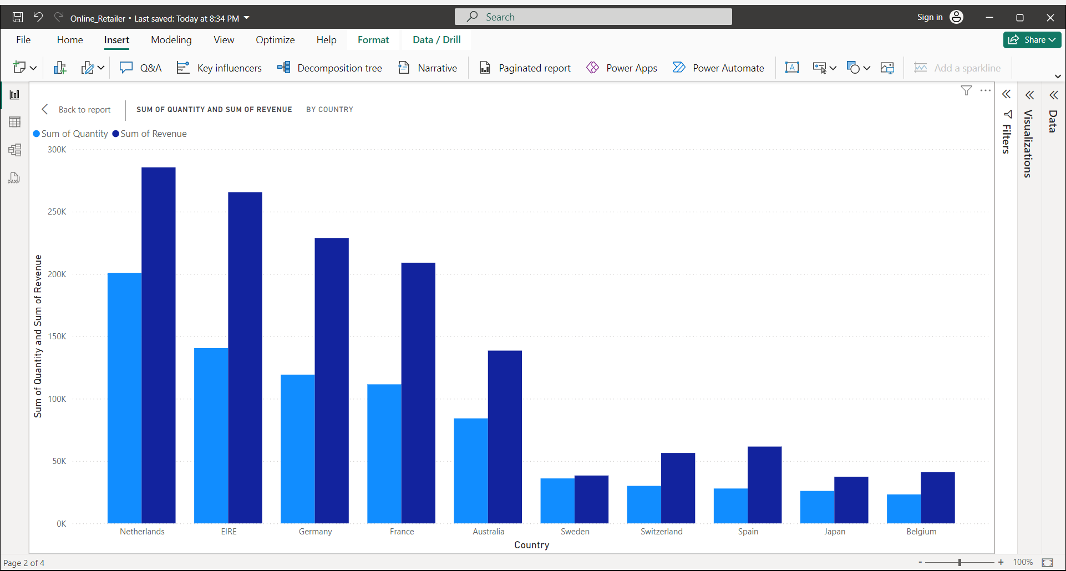

Slide 7
Analysis of Consumer Purchases
According to the statistics, there are not many differences between the top 10 consumer purchases."
"The highest revenue-producing consumer only spent 17% more than the second highest,
demonstrating that the company does not rely solely on a small number of consumers to generate income."
"This indicates limited consumer bargaining power and a positive business state."

Slide 8
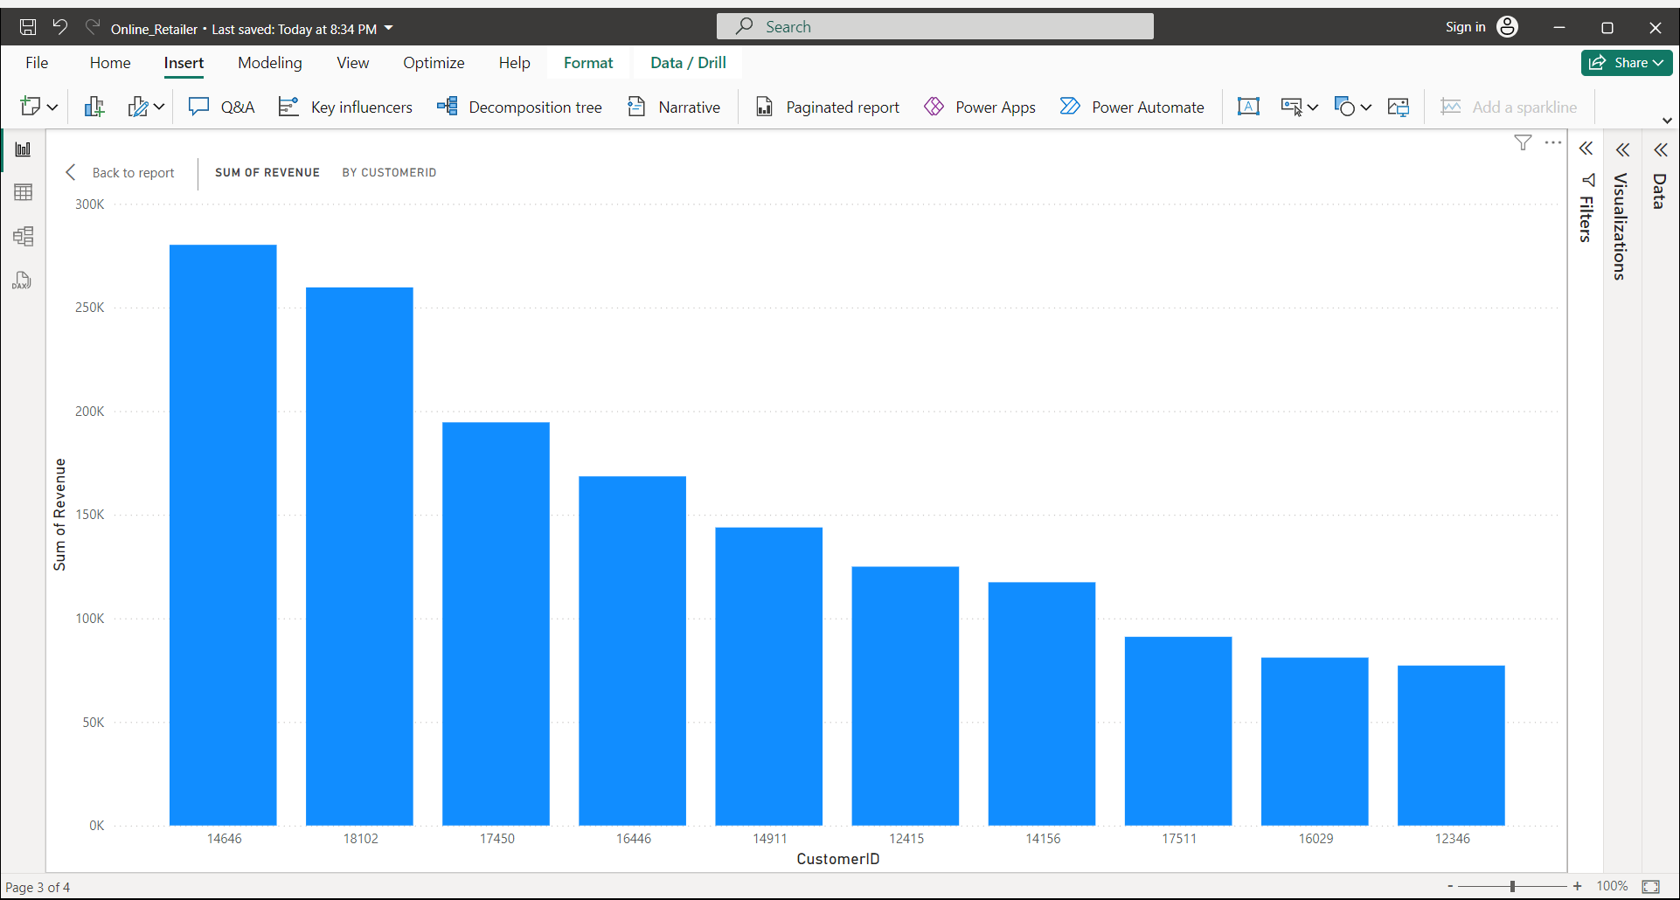

Slide 9
Geographic Revenue Distribution
The map chart compares the places that have produced the greatest revenue to those that have not.
"Apart from the UK, nations like the Netherlands, Ireland, Germany, France, and Australia generate large profits. The company should invest more in these nations to boost product demand.“
The map also reveals that the majority of sales occur in the European zone, with only a small number in the American region.
"Along with Russia, there is no market for the items in Africa or Asia. Sales revenues and profitability might increase with the implementation of a fresh strategy focused on these areas."

Slide 10
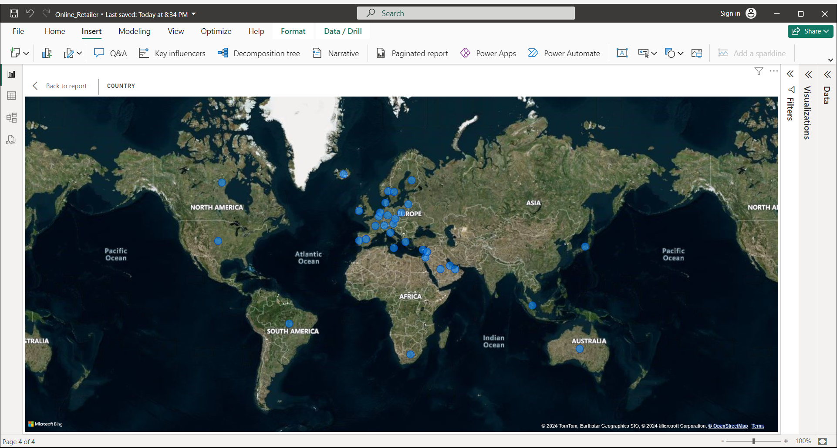

Slide 11
Strategic Recommendations
"Based on our analysis, we recommend focusing on expanding in the top-performing regions while exploring new strategies to improve performance in underperforming areas.“
"Consider targeting untapped markets in Africa and Asia to increase revenue and profitability.“
"Focus on maximizing seasonal opportunities, especially during the last four months of the year.“
"Strengthen consumer engagement strategies to maintain a diverse and robust customer base."

Slide 12
Questions and Answers
"Thank you for your attention. I am now open to any questions or comments you may have."

