Slide 1
Syllabus Highlights
Database Systems and File structures
Ali Sharifara, UTA, CSE
Fall 2018

Slide 2
Agenda
Syllabus
What is database (DB)?
Why it’s needed?
What is going to happened, if we have lack of Database systems?

Slide 3
Instructor & GTA
Instructor:
  Name: Ali Sharifara, Ph.D.
  Email: ali.sharifara@uta.edu
  Office Location: ERB 321
  Office hours: Mo & We 4:00-5:30p.m.
GTA:
  Name: TBA
  Email: TBA
  Office location: TBA
  Office hours: TBA

Slide 4
Blackboard
All the course materials will be posted on Blackboard and my website.
  Announcements, lecture notes, assignments, and other materials
Submissions and grades will also be managed using Blackboard.
Assignment (0): Read the tutorial on how to use Blackboard if you have not used it before, and check if you can login and access this course.

Slide 5
Email Communication
“UT Arlington has adopted MavMail as its official means to communicate with students … All students are assigned a MavMail account and are responsible for checking the inbox regularly…”

Slide 6
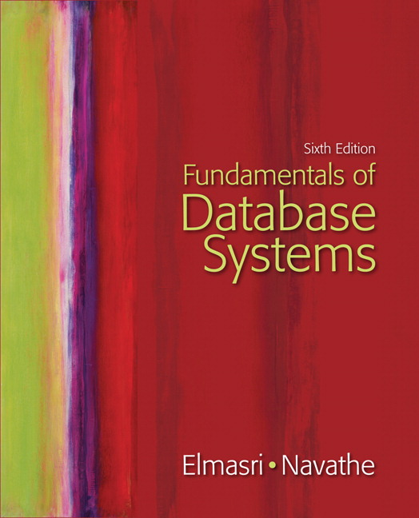
Textbook
Fundamentals of Database Systems, Sixth Edition, by Elmasri/Navathe, published by Addison-Wesley, 2012.

Slide 7
Reference
Abraham Silberschatz, Henry Korth, and S. Sudarshan, Database System Concepts, McGraw-Hill Publishers, 2010. ISBN 0073523321.
Hector Garcia-Molina, Jeffrey D. Ullman and Jennifer Widom, Database Systems: The Complete Book (2nd Edition), Prentice Hall. 2008. ISBN 0131873253.
Raghu Ramakrishnan and Johannes Gehrke, Database Management Systems (3rd Edition), McGraw-Hill Publishers, 2002. ISBN 0072465638.
Notes:
Optional materials

Slide 8
Homework
Must be solved individually
  Fine to discuss the assignments with others
  NEVER share the solutions.
Exam problems are similar to homework problems
Account for 15% of your final grade

Slide 9
Tentative schedule
Introduction to Database Systems - Chapter 01
Databases and Database Users - Chapter 01
Database System Concepts and Architecture - Chapter 02
The Relational Data Model and Relational Database Constraints - Chapter 03
Basic SQL - Chapter 04
More SQL: Complex Queries, Triggers, Views, and Schema Modification - Chapter 05
The Relational Algebra and Calculus - Chapter 06
Data Modeling Using the Entity-Relationship Model - Chapter 07
The Enhanced Entity-Relationship (EER) Model - Chapter 08
Relational Database Design by ER- and EER-to-Relational Mapping - Chapter 09
Practical Database Design Methodology and Use of UML Diagrams - Chapter 10
Functional Dependencies and Normalization for Relational Databases - Chapter 15
Disk Storage, Basic File Structures, and Hashing - Chapter 17
Indexing Structures for Files - Chapter 18
Introduction to Transaction Processing Concepts and Theory - Chapter 21
Concurrency Control Techniques - Chapter 22
Database Recovery Techniques - Chapter 23
Database Security and Authorization - Chapter 24

Slide 10
Presentation
You need to choose a chapter from the textbook (among those which are specified on the class website) , summarize and prepare the slides to present maximum 15 minutes.
Group based assignment
  Maximum 3 students
We will send you a google spreadsheet to manage the groups
Accounts for 5% of your final grade

Slide 11
Project
You will design and implement a database for keeping track of information about a system (will be explained later). You will first design an EER schema diagram for this database application. Then, you will map the EER schema into a relational database schema and implement it on ORACLE or MySQL or some other relational DBMS. Finally, you will load some data into your database, and create some queries and update transactions.
Group based project
  Maximum 3 persons (should be the same group as persentation’s)
Full project description will be posted soon.
Accounts for 20% of your final grade

Slide 12
Grading Summary
The final grade will be calculated using the following percentages:
  Presentation : 05%
  Homework : 15%
  Project: 20%
  Exams 1, 2, and 3: 60% (20% each)
If you have any questions about your grades, you MUST notify the TA or the instructor within one week after the grades become available.
  The grades become final after one week!

Slide 13
Attendance
Strongly recommended, and highly correlated with performance
The instructor reserves the right to change this policy

Slide 14
Late Assignments
Late assignments are acceptable before solutions are posted or explained in class, with 10% deduction for every 24 hours. Less than 24 will be rounded to 24.
If you have an emergency that prevents you from completing the work, contact the TA or the instructor prior to the due date.

Slide 15
NO Shortcut!
Merit-based, NOT need-based
You get what you pay for (in terms of effort)!
  Work hard from the very first day & on every assignment, presentation, and deliverable
  No make-up assignment/exam will be given (unless emergence, with evidence of support)
High correlation between attendance and grades
Change the final grade after it is posted?
  Historical records show no success!!

Slide 16
Academic Integrity
You must EARN your credits honestly and professionally.
  Merit-based, not need-based
The reasons?
  This is the only way for you to learn.
  You don’t want to lose your reputation to your fellow students.
  You don’t want to be a subject of disciplinary actions.
  …

Slide 17
Question ?
Education is what remains after one has forgotten everything he learned in school.
- Albert Einstein

