Slide 1

AI reinvention made real
Accenture Innovation Challenge 2026

Slide 2


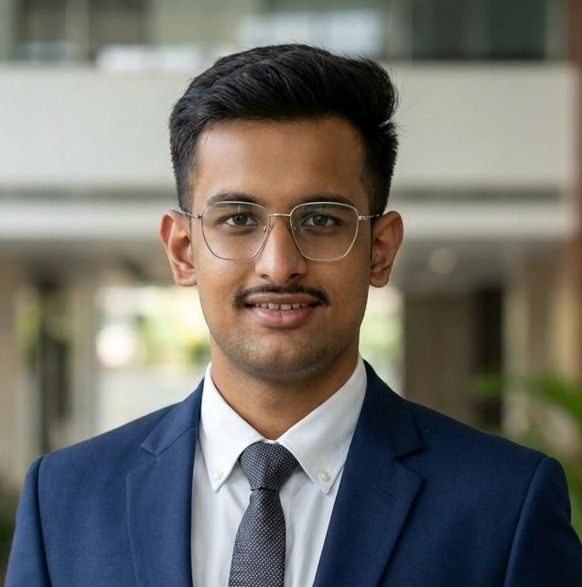
Team details
TEAM NAME: Team D Top
Ankit Kumar
Hemesh Saini
(Team Leader)​
College: IIT Kanpur
Stream: BTech ME
Year of graduation: 2027
College: IIT Kanpur
Stream: Double major ECO
Year of graduation: 2028
Photo
Aditya Deshmukh
College: IIT Kanpur
Stream: BTech MSE
Year of graduation: 2027

Slide 3
Problem statement - ControlPlane.ai: AI failures are found out, not caught first
Enterprise AI now writes answers customers act on, code that ships, and decisions that move money - with three silent risks that surface only after someone has acted on the response.
PERFORMANCE
Models are confidently wrong - discovered when a customer complaints or an auditor asks, never at response time.
COST
Retry loops, bloated prompts and silent rework burn budgets. Teams see the monthly bill, not the responses causing it.
RESPONSIBILITY
Bias, unsafe content and data leakage slip into live outputs - regulatory, legal and reputational exposure.
THE COST OF FINDING OUT LATE
In February 2024, a Canadian tribunal held Air Canada liable for a refund policy its own chatbot invented, rejecting the claim that the bot was a separate legal entity. In McKinsey’s 2025 survey, 51% of AI-using organizations report at least one negative AI consequence - inaccuracy most common. And the EU AI Act’s Article 72 makes continuous post-market monitoring a legal obligation for high-risk systems.
Why today’s tools miss it: evals run before launch; dashboards are read after incidents - nothing in the live path watches every response across all three risks.
DAY 0
Model ships
WEEKS 1–N
Thousands of responses, zero alerts
DAY X
A customer or auditor finds it first

Slide 4
Proposed solution - AEGIS: an adaptive risk engine for every AI response
A model-agnostic gateway that decides, per response, how much scrutiny it deserves and what happens next — not uniform checks, not uniform sampling.
1 · RISK PRIOR · BEFORE GENERATION
Request-time signals - endpoint, transaction value, user tier, data sensitivity - set stakes before a token is generated. High-stakes flows hold-and-release within a ~300ms latency budget; the rest stream, audited async with one-click retraction.
2 · EVIDENCE · AFTER GENERATION
Performance - a small verifier re-answers from the same context; disagreement flags. Cost - token, retry and latency telemetry. Responsibility - PII and policy inline; deeper bias async.
3 · ADAPTIVE SCRUTINY · THE EDGE
Cheap telemetry anomalies - retry storms, token spikes - are leading indicators of quality failure, so the expensive verifier fires where free signals say risk is rising. Single-lane tools can’t - they don’t see the other lanes. Every flag retrains the checker on your traffic.
AEGIS GATEWAY
GREEN - deliver
App
RISK PRIOR
request-time signals
PERFORMANCE
YELLOW - auto-edit
User
COST
RESPONSIBILITY
RED - hold / escalate
FLAGS → CHECKER TRAINING DATA
async audit
VS. TODAY’S TOOLS
Eval frameworks (promptfoo, DeepEval) test before launch; runtime guardrails (Guardrails AI, NeMo Guardrails) run the same static checks on every request; observability platforms (Langfuse, Arize) see everything — after delivery. None decides scrutiny per response, in the path.
DEPLOYMENT
A reverse proxy in front of existing LLM traffic - one base-URL change, no retraining; owned by the AI-platform team.
SEE IT RUN
The video shows a seeded failure flagged, held and rerouted live.

Slide 5
Video
Watch the AEGIS demo (2–3 min)
What it shows: a working AEGIS dashboard scoring a live RED response and rerouting it in real time.

Slide 6
Thank you

