Slide 1
Data Structures and Algorithms
CS F211
Aaditya Kulkarni
Aditya Deshpande
Anish Taori
Taresh Bansal
Yash Kumar Kandoi
R-Trees

Slide 2
01
Introduction to R-trees
02
R-Tree Index Structure
03
Searching and Updating
04
Node Splitting
05
Why is R-Tree height balanced
What is R-Tree?
Explaining the structure of R-Tree
Different Algorithms Used
The algorithm used to split nodes
Explanation of height balancing property

Slide 3
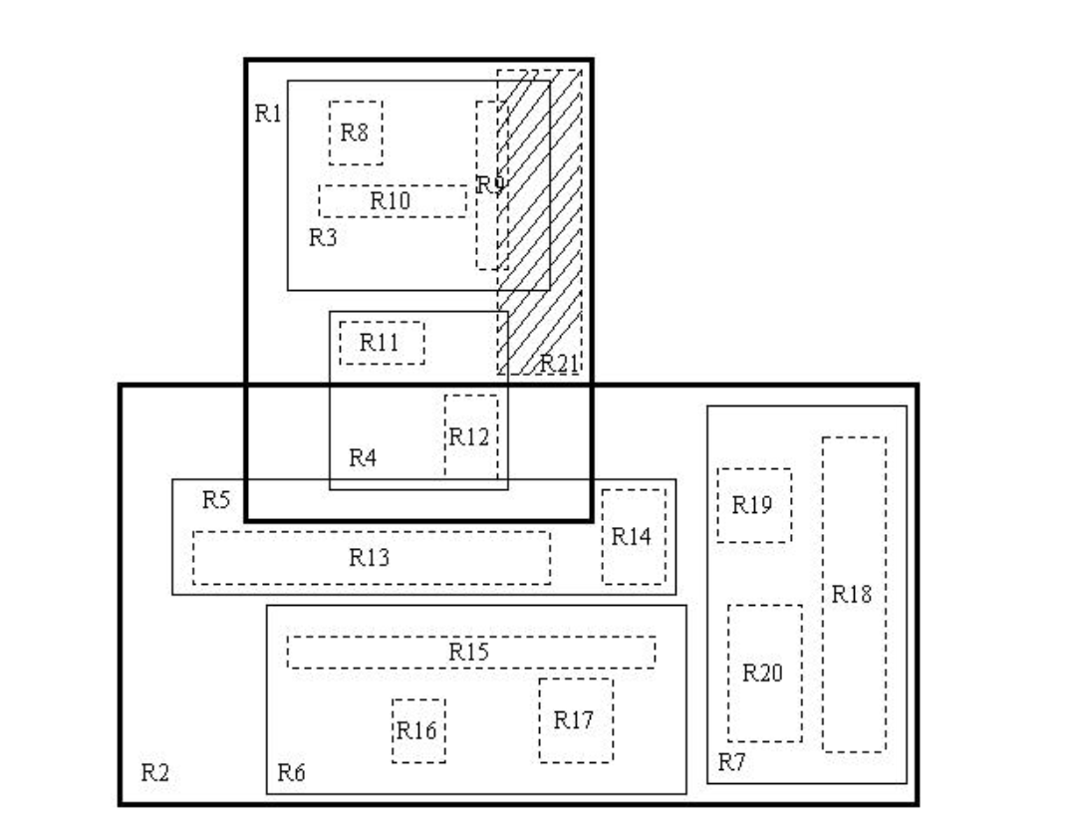
01
Introduction
R Trees is data structure used to work with spatial and multidimensional spatial data.
It has applications in Geo-location mapping and it VLSI design.

Slide 4
02
R Tree Index Structure

Slide 5
2.1 Structure of Node
Count of children
isLeaf
Address of Parent node
Node
Array of Addresses of Child nodes
Array of Point
Mbr of that node

Slide 6
2.2 Structure of Point & Mbr
Minimum Bounding Region
ymax
.
Point(x,y)
ymin
xmin
xmax

Slide 7
03
Searching and Updating
x
y

Slide 8
Searching
1. Root Node of the tree and the point to be searched are
taken as parameters.
2. If the node is the leaf node then directly it’s points
are searched.
3. Otherwise, we search which child of the node has point
through method contains_point and recursively we reach
the leaf node containing the point.
4. Method contains_point takes Mbr and Point point as
parameters and returns if the point is in the Mbr or not.

Slide 9
Pick-Seed Algorithm
Select the initial two elements from the child array for adding them in the new nodes.
Find the elements such that area in pairs of the mbrs has the worst efficiency when subtracting from bounding region.
Stores the index of the two found elements as pointers.
Names the two pointers as seed1_index and seed2_index respectively.

Slide 10
Pseudo-Code for Pick Seed
pickSeeds(Node, pointer to seed1_index, pointer to seed2_index)
0 <-max_d
For i<-0 to node->count do
For j<-i+1 to node->count do
minimum(node->child[i]->rectangle.xmin, node->child[j]->rectangle.xmin) <- mbr.xmin
maximum(node->child[i]->rectangle.xmax, node->child[j]->rectangle.xmax) <- mbr.xmax
minimum(node->child[i]->rectangle.ymin, node->child[j]->rectangle.ymin) <- mbr.ymin
maximum(node->child[i]->rectangle.ymax, node->child[j]->rectangle.ymax) <- mbr.ymax
d<-(calculateArea(mbr) - calculateArea(node->child[i]->rectangle)-calculateArea(node->child[j]->rectangle))
If d > max_d
i<-pointer to seed1_index
j<-pointer to seed2_index
d<-max_d
end if
end for
end for

Slide 11
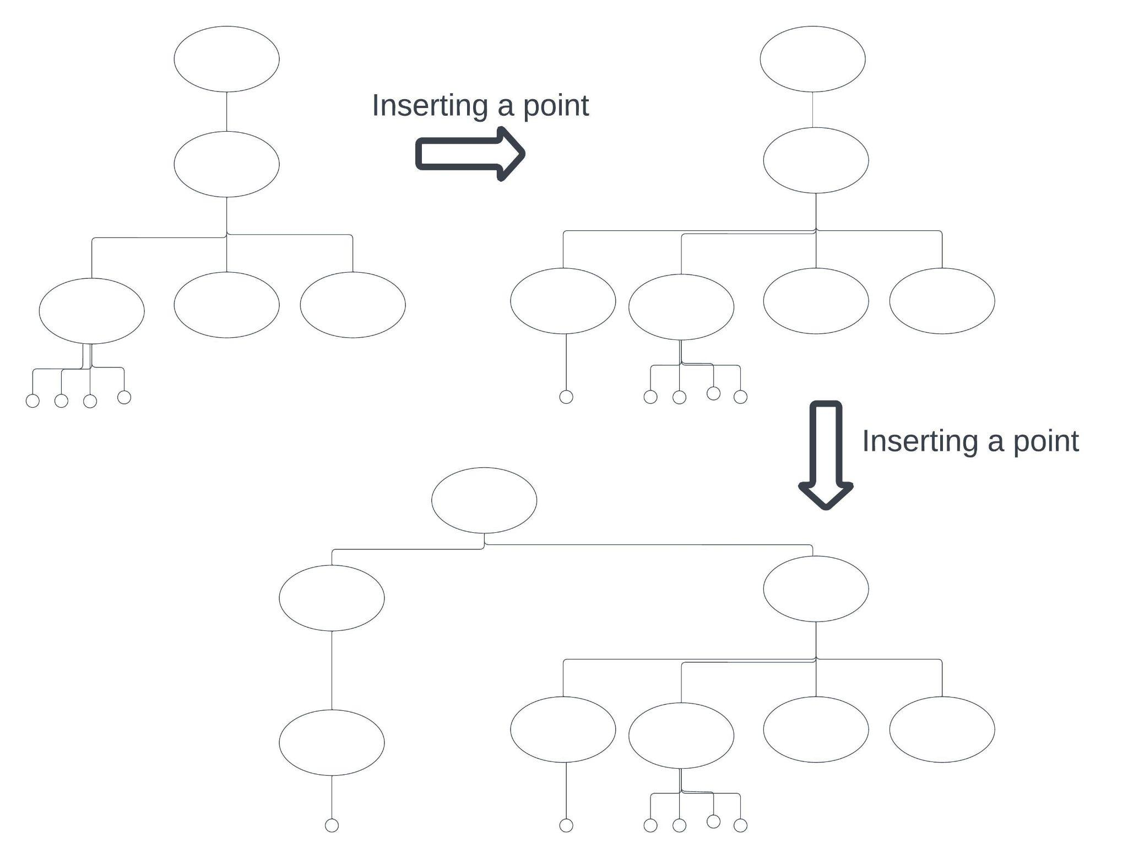

Slide 12
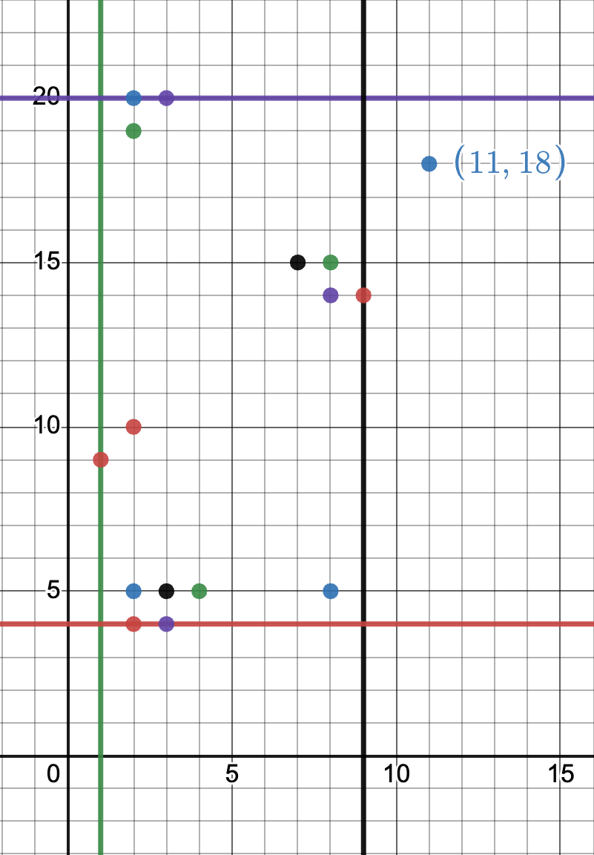
Insertion
INSERTION ALGORITHM
New entry E will be inserted into a given R-Tree.
1. [Find position for new record] Start ChooseLeaf to select a leaf node L in which to place E if the node is not a leaf node
2. [Add record to leaf node] If node L has enough space for a new entry then add E. Else start SplitNode.
3. [Update parent nodes recursively] Start AdjustTree on node L and if a split was performed then also passing LL.
4. [Grow tree taller] If node split propagation caused the root to split, create a new root whose children are the two resulting nodes.
Inserting a new point

Slide 13
Insertion Pseudocode
procedure insertData(node, point, rtree)
if node is a leaf node then
if node is not full then
add point to node
adjust node's MBR
else
add point to node
split node
adjust tree
else
find the child node with the smallest MBR that contains the point
insertData(child node, point, rtree)
adjust tree
endif
end procedure

Slide 14
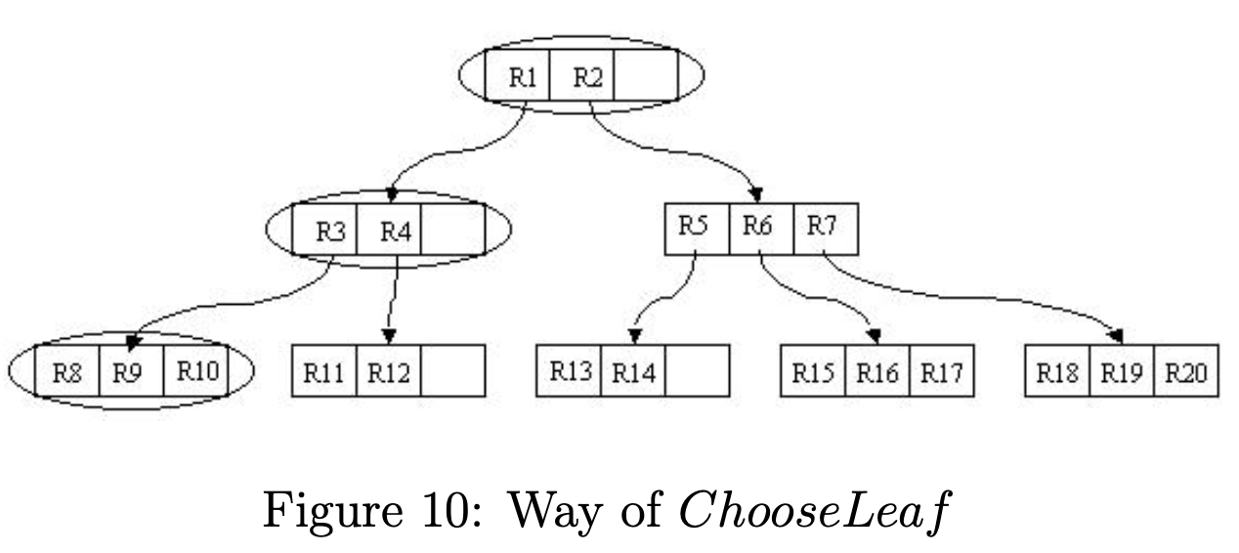
Insertion
ChooseLeaf Algorithm
ChooseLeaf selects a leaf node to place a new entry E.
1.[Initialize] Set N to be the root node.
2.[Leaf check] If N is a leaf then return N.
3.[Choose subtree] If N is not a leaf node then let F be the entry in N whose MBR F.I needs least enlargement to include E.I. When there are more than one entries in N, the entry with the rectangle of the smallest area is chosen.
4.[Descend until a leaf is reached] N is set to the child node F which is pointed to by F.p and repeat from 2.

Slide 15
Insertion Pseudocode
ChooseLeaf Algorithm Pseudocode
procedure chooseLeaf(node, point)
if node is a leaf node then
return node
else
calculate the area increase for each child node if point
is added
let minimumIndex = index of the child node with the
minimum area increase
return chooseLeaf(node->child[minimumIndex], point)
end procedure

Slide 16
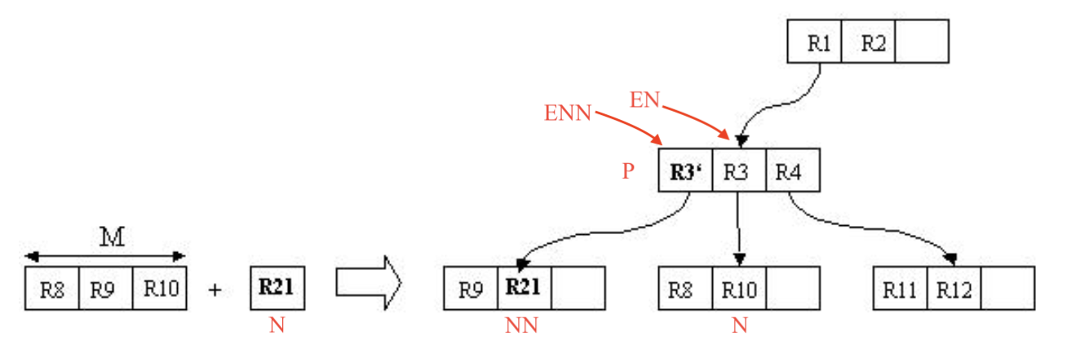
Adjust Tree Algorithm
AdjustTree Algorithm
1. [Initialize] N is equal L.
2. [Check if done] stop if N is the root.
3. [Adjust covering MBR in parent entry] P is the parent node of N and EN the entry of N in P . EN .I is adjusted so that all rectangles in N are tightly enclosed.
4. [Continue doing node split upward] If N has a partner NN which was split previously then create a new entry with EN N .p pointing to N N and EN N .I enclosing all rectangles in N N . If there is room in P then add EN N . Otherwise start SplitNode to get P and PP which include ENN and all old entries of P.
5. [Move up to next level] N is equal L and if a split occurred then NN is equal PP. Repeat from 2.
Split Node and Adjust Tree

Slide 17
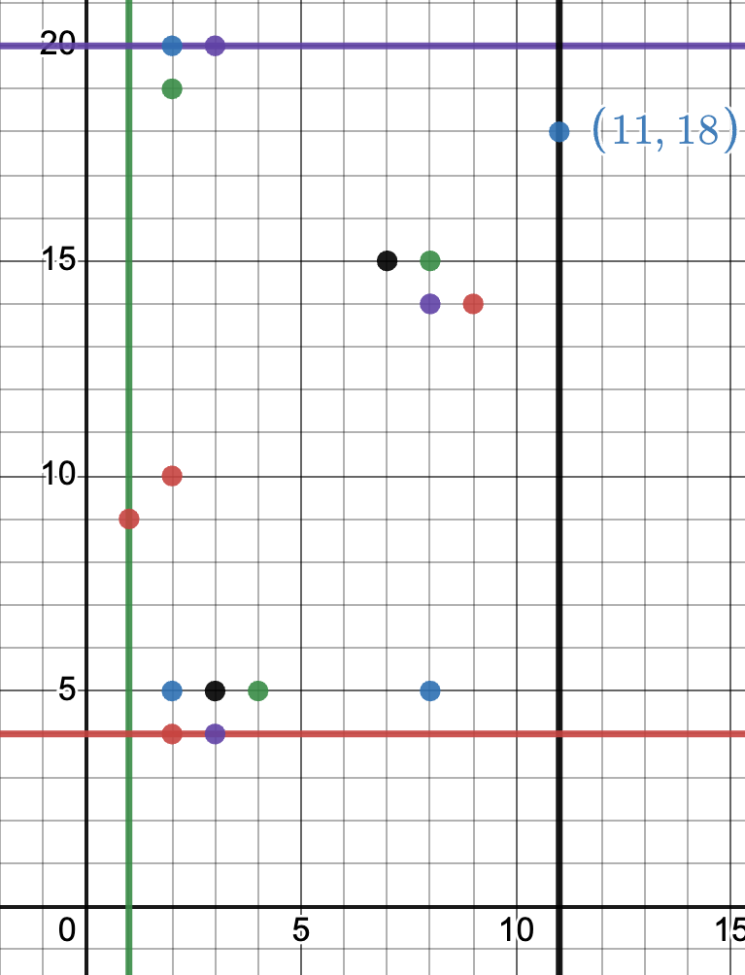
Insertion
After Insertion

Slide 18
Pre-Order Traversal
Takes the parameter as node.
We initialize a variable flag to check if the node is root node or not.
Using flag, we print if the node is root node or an internal node.
Then, if the node is leaf node we print it’s points.
Otherwise, we first print the Mbr of the first internal node and then recursive call the pre-order traversal with that internal node and this way as we reach the leaf node we print it’s points and print whole of the pre-order traversal.

Slide 19
Pseudo code for Preorder traversal
function preorderTraversal(node)
if node is not null then
print "It is a root or Internal Node with node.count children"
for i = 0 to node.count-1 do
if node.isleaf is true then
if node.data[i] is not null then
print It is a leaf node with point node.data[i].x, node.data[i].y
end if
else
if node.child[i] is not null then
print "It is a Non-leaf node with mbr (xmin=node.child[i].rectangle.xmin, xmax=node.child[i].rectangle.xmax, ymin=node.child[i].rectangle.ymin, ymax=node.child[i].rectangle.ymax)"
preorderTraversal(node.child[i])
end if
end if
end for
end if
end function

Slide 20
04 - NODE SPLITTING
What is node splitting?
Node splitting is a crucial operation in a R-tree data structure that enables efficient querying of spatial data.
Why is node splitting necessary?
The need for node splitting arises when a new element needs to be inserted into an already full node. In such a case, the node needs to be split into two smaller nodes to accommodate the new element. Node splitting is necessary in a R-tree because it ensures that the tree remains balanced.
What method was used to split the node in the R-tree?
We have used the Quadratic splitting method to split nodes in our R-tree.
Quadratic node splitting is a technique used in R-trees to split a full node into two smaller nodes in a way that minimizes the area enlargement of the bounding boxes of the new nodes.

Slide 21
Exact procedure for Quadratic Splitting
The process of quadratic node splitting involves selecting two elements that have the maximum distance from each other as the seeds for the two new nodes in case of leaf nodes and with greatest area inefficiency of mbr pairs in case of child nodes. Then, all the remaining elements in the node are assigned to one of the two new nodes based on which node would result in the minimum enlargement of the bounding boxes of the new nodes.
During the quadratic splitting process, the area of the bounding boxes of the new nodes is calculated to determine the best split. The split that results in the minimum total area enlargement of the two new nodes is chosen as the final split.

Slide 22
Quadratic Split Algorithm
1.Select two elements with the widest possible separation as the seeds for two new nodes in case of leaf node and worst efficiency in area pairs in case of internal nodes containing children.
2.Assign all remaining elements to one of the two new nodes based on which node would result in the minimum enlargement of the bounding boxes of the new nodes.
3.Calculate the total area enlargement of the bounding boxes of the two new nodes resulting from the split.
Repeat steps 2-3 until all elements have been assigned to a new node.
4.Choose the split that results in the minimum total area enlargement of the two new nodes as the final split.

Slide 23
05 - Why is R-tree Height Balanced?
R-trees are height-balanced data structures by design, meaning that the height of the tree is kept relatively constant as elements are added or removed from the tree. This is achieved through the use of node splits, which help maintain a balanced tree structure.
When a node in the R-tree becomes full, it is split into two smaller nodes. The splitting process ensures that both resulting nodes are filled to a certain minimum capacity, and the division of the elements between the two nodes is done in a way that minimizes the overlap between them. This helps ensure that the resulting nodes are as small as possible, which in turn helps keep the height of the tree relatively constant.
Since the splitting process is performed recursively, the height of the tree remains balanced even as new elements are added or removed from the tree. When a new element is inserted into the tree, it is inserted into the appropriate leaf node, which may cause the node to become full and trigger a split. When an element is removed from the tree, its corresponding entry is deleted from the appropriate leaf node, and the node may be merged with a sibling node to maintain the minimum fill requirement.

Slide 24
<Thank You>

