Slide 1
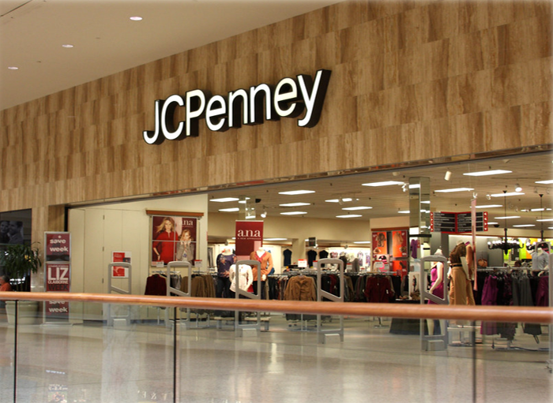
ANALYSIS
OF
JCPENNEY
Student ID - 19380096
AISO 7004: Data-Driven Decision Making

Slide 2


What led such a long- established company
to file for bankruptcy?
$4,275M
MAY 2020
REVENUE DECLINED
IN FY2012 ALONE
FILED FOR CHAPTER 11
BANKRUPTCY FILED
60.7%
OF DECADE'S LOSSES
FROM ONE DECISION

Slide 3



FOUR KEY FOCUS AREAS OF THE ANALYSIS
PRESENTED BY :
DECISION
MAKING
DATA
ANALYSIS
CONCLUSION
FINANCIAL
OPERATIONAL
MARKET
10-YEAR DATASET,
COVID SHOCK
SEC EDGAR &
U.S. CENSUS BUREAU
MARKETING
OPERATIONS
FINANCE
3 CRITICAL DECISION MAKING FAILURES
QUANTIFIED IMPACT: $4,275M
FOUR
RECOMMENDATIONS
DATA-DRIVEN APPROACH
EVALUATION
DESCRIPTIVE & DIAGNOSTIC
CORRELATION R = 0.786
R² = 0.249

Slide 4

DATA COLLECTION

Slide 5

Three types of data were used
FINANCIAL DATA
OPERATIONAL DATA
MARKET
DATA
  NET SALES
  NET INCOME/LOSS($M)
  LONG-TERM DEBT
  FY2010 TO FY 2019
AND Q1 DATA OF 2020
  STORE COUNT
  COMPARABLE STORE SALES
  AVERAGE REVENUE PER STORE
  U.S. DEPARTMENT STORE SALES
  NON-STORE RETAIL SALES
-
  E-COMMERCE % OF TOTAL RETAIL

Slide 6

ANALYSIS

Slide 7

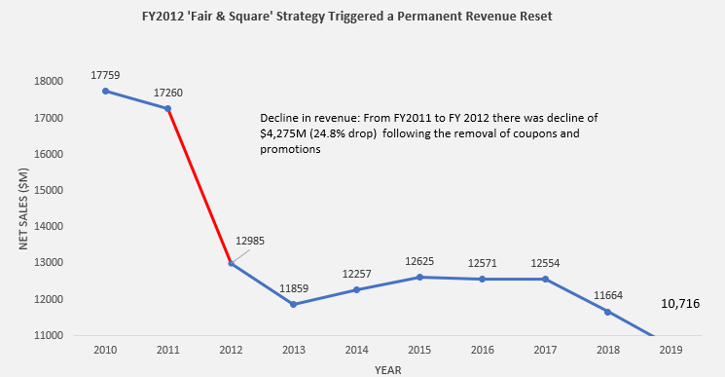


The Fair & Square Strategy Declined the Demand in a Single Year
PRESENTED BY :
NEIL TRAN
Net sales fell from $17,759M
in FY2010 to $10,716M
in FY2019 (-39.65%)
The biggest revenue decline occurred in FY2012 after the Fair & Square pricing strategy was introduced.
$4,275M
REVENUE LOST IN FY2012

Slide 8
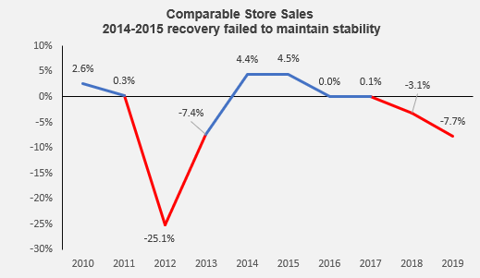
Comparable Store Sales Confirmed Customer Rejection
PRESENTED BY :
NEIL TRAN
Comparable store sales fell by 25.1% in FY2012.
Sales recovered in FY2014 & 2015, but the company was not able to sustain it
The problem was not temporary. JCPenney failed to rebuild the customer trust after the pricing shock

Slide 9
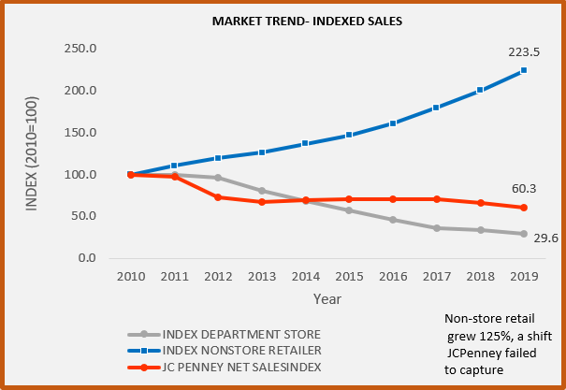
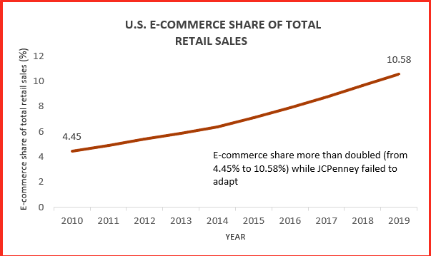
The market was moving online - JCPenney was slow to adapt to the change
PRESENTED BY :
NEIL TRAN
Department stores were declining whereas non-store retail and ecommerce were growing
E-commerce share more than doubled from 4.45% to 10.58% between FY2010- FY2019
JCPenney ignored the digital shift, which was one of the reasons for declining sales

Slide 10
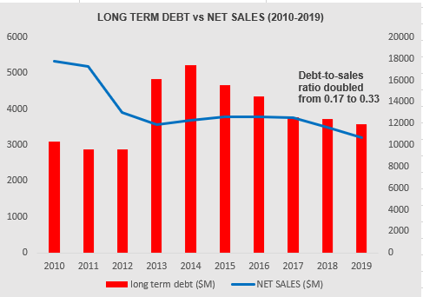
Debt Became Dangerous as Sales Declined
PRESENTED BY :
NEIL TRAN
JCPenney failed to restore sustainable profitability after 2010.
Debt remained high and sales also declined which made the recovery very difficult

Slide 11
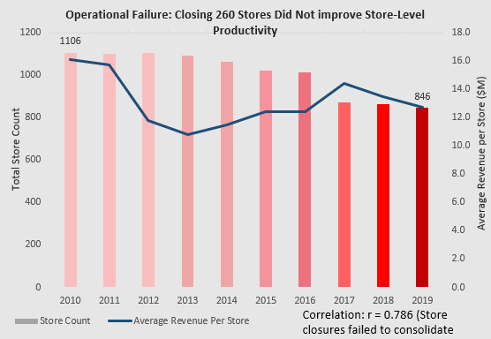
Store closure did not fix the business
PRESENTED BY :
NEIL TRAN
JCPenney closed 260 stores between FY2010 to FY2019
Average revenue still fell from $16.1M TO $12.7M

Slide 12
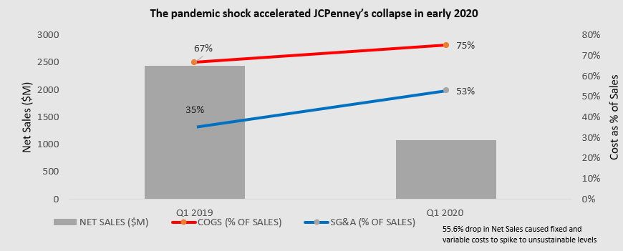
COVID-19 Accelerated an Existing Collapse
Net sales fell from
$2,439M IN
Q1 2019 to
$1,082M in Q1 2020
COGS went
from 67% to 75% of sales
whereas SG&A went
from 35.1% to 52.9% of sales
COGS went
from 67% to 75% of sales
whereas SG&A went
from 35.1% to 52.9% of sales
COVID-19 was the
final shock, not the
main cause for bankruptcy

Slide 13

DECISION
MAKING
FAILURE
1. Pricing Strategy Failure
FY2012 sales declined, indicating customer rejection, but the response was too slow.
2. Store Closure Misdiagnosis
260 Stores were closed, but the remaining stores did not become more productive.
3. Debt Warning Ignored
Debt became riskier as revenue declined.

Slide 14

Data-Driven Recommendations
2. Track store productivity, not only store closures
1. Reverse failing strategies early
3. Invest earlier in digital channels
4. Monitor
debt-to-sales ratio
Conclusion: JCPenney’s Failure Was Predictable
JCPenney did not fail because of one scenario. It failed because of poor pricing decisions & store productivity; the digital response and financial pressure were ignored for years. COVID-19 only accelerated the collapse.

Slide 15
THAN KYOU

