Slide 1
01 — CONCEPT & INSPIRATION
Vanguard Audio sits between two ideas that don't usually share a shelf: the cold precision of machined metal, and the warmth of a driver tuned by ear.
We built the identity around Symbol B, a dial that reads as both a listening control and a target. Tuning is aim.
DIRECTION — MACHINED MINIMALISM
VANGUARD
AUDIO

Slide 2
02 — BRAND IDENTITY RATIONALE
TYPOGRAPHY
COLOR
Space Grotesk carries the structure, JetBrains Mono carries the specs, the same split the product itself makes between industrial design and precision engineering.
Graphite and Char form the base. Brass is the only accent. One accent color forces restraint instead of decoration.
LOGO
PACKAGING
Symbol B repeats at every scale, from the app icon down to the earcup engraving, so the mark never has to be reinvented per surface.
The box stays dark and minimal so it reads as a technical instrument case, not a retail gadget box.

Slide 3
03 — UI/UX & RETAIL APPROACH
LANDING PAGE
Hero-first, one CTA, spec strip directly under the fold so a visitor knows what this is within seconds.
ACOUSTIC CRAFT PAGE
The driver cross-section is treated like an exhibit label, not a spec sheet.
COLLATERAL
The earcup engraving was chosen over a retail booth because it puts the brand mark on the product itself, not just around it.

Slide 4
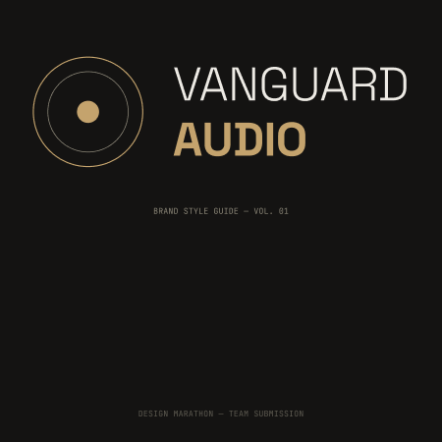
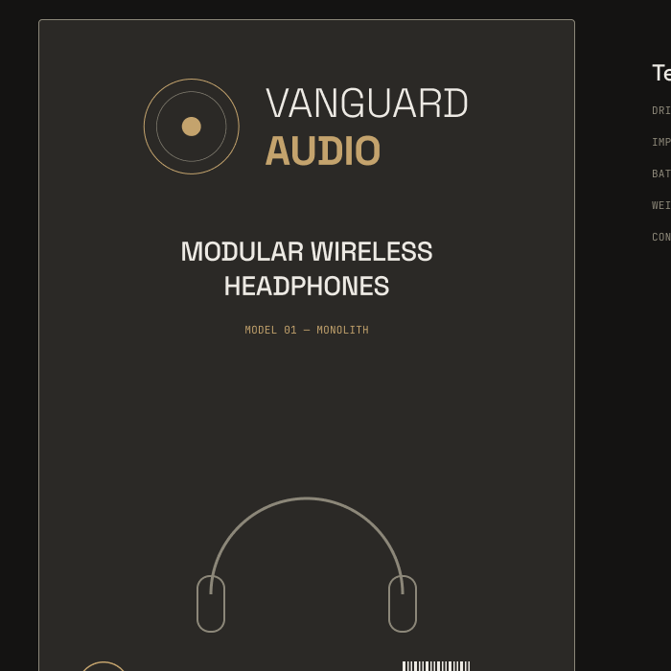
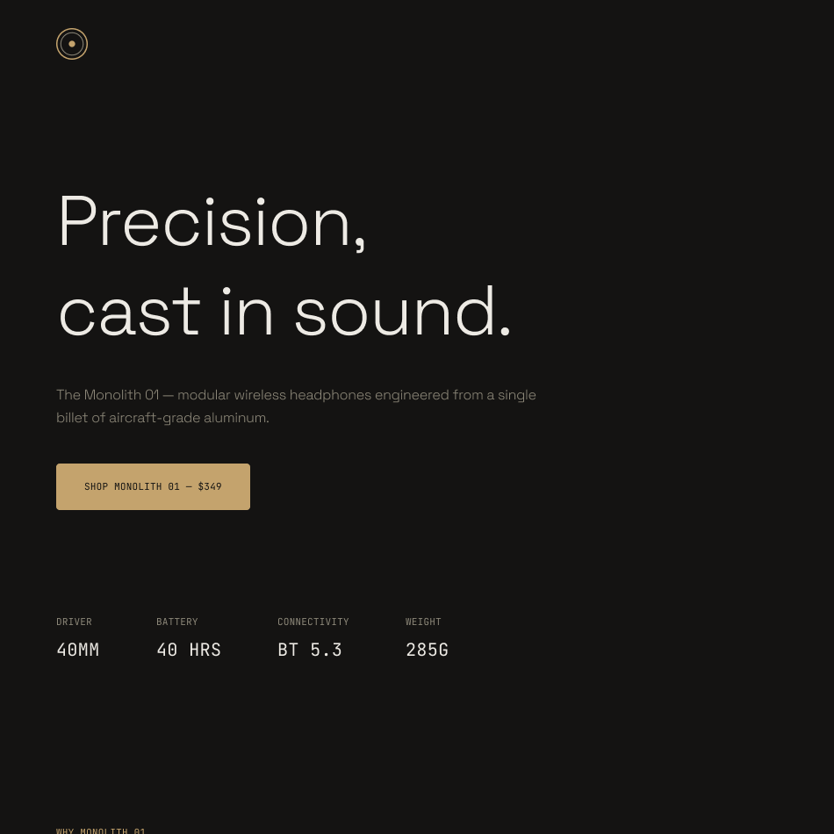

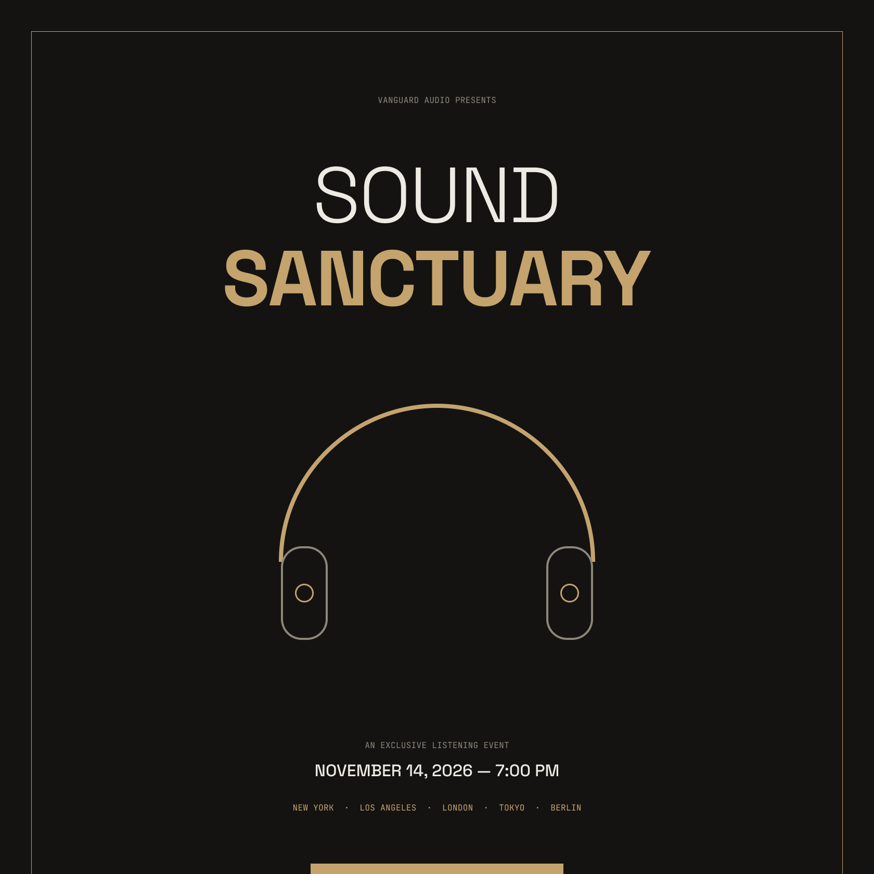
04 — DELIVERABLES OVERVIEW
BRAND STYLE GUIDE
PACKAGING & MERCH
DIGITAL UI
EARCUP PATTERN
CAMPAIGN POSTER

Slide 5
05 — TEAM & ROLE DISTRIBUTION
TEAM LEADER
Aditya Dhanawade
avdhanawade94@gmail.com
SOLE CONTRIBUTOR — ALL DELIVERABLES
BRAND IDENTITY
PACKAGING & MERCH
DIGITAL UI
PRODUCT COLLATERAL & POSTER
Logo system, color palette, typography, brand strategy — the full style guide.
Box front design and apparel colorways.
Landing page and Acoustic Craft page.
Earcup engraving pattern and the Sound Sanctuary campaign poster.

