Slide 1
Introduction to Data
Data Summary:
Data Source:
Number of rows: 3672
Number of columns: 86
Financial and nonfinancial data from 422 companies in different time span.
Col1: Company Name
Col2: Different Time Span
Col3: The Financial Distress Estimator:
If < - 0.50, Healthy
If > - 0.50, Financial Distress
Col4~Col86: Financial and non-financial characteristics of the sampled companies
Problem:
Predict financial distress level.

Slide 2
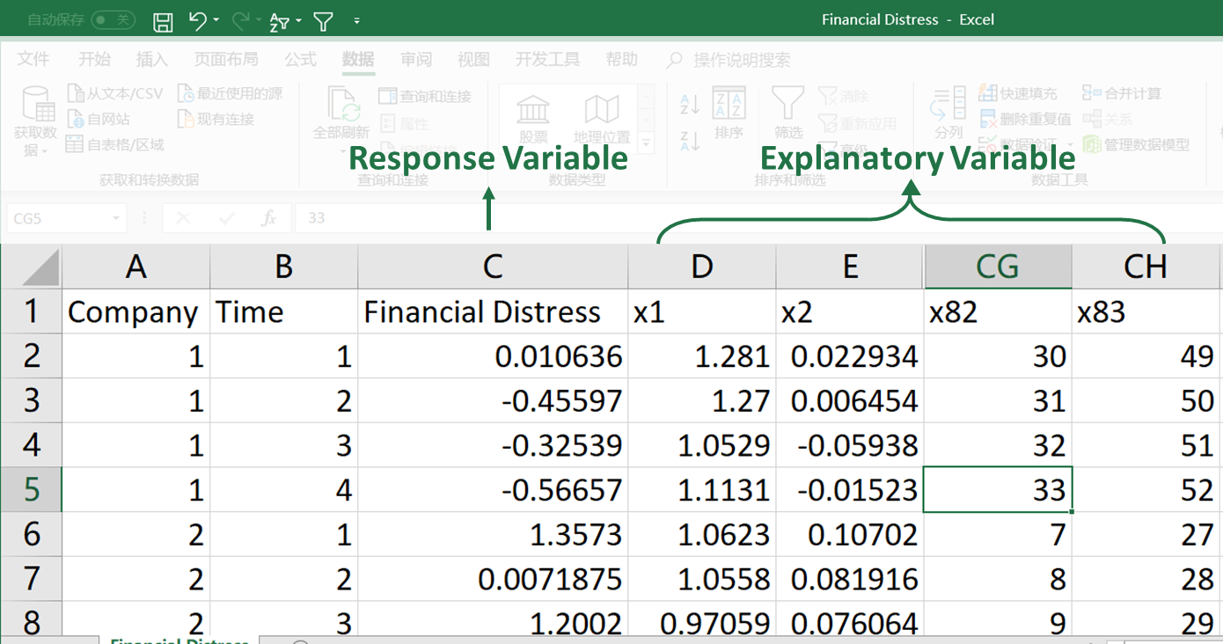
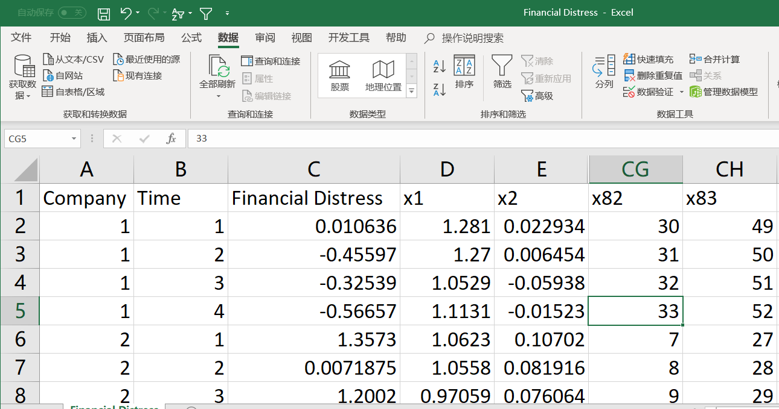
Introduction to Data
Sample Data:
Response Variable
Explanatory Variable

Slide 3
Data Modification
Model Building
We will use three different regression methods in this sample and check how good the models are.
Data clearance
Preview data set.
Find NAs and unexpected value of data.
Remove unnecessary data
Here we delete the company number and the time span variables.
Sampling train and test set
80% training and 20% testing
Ordinary Linear Regression(Least Square)
Ridge Regression
Lasso Regression
We use R to perform the three regression models.
* We are talking about the Ridge and Lasso regression. These methods work better in samples with large number of explanatory variables and small sample size. We will give more explanation latter

Slide 4
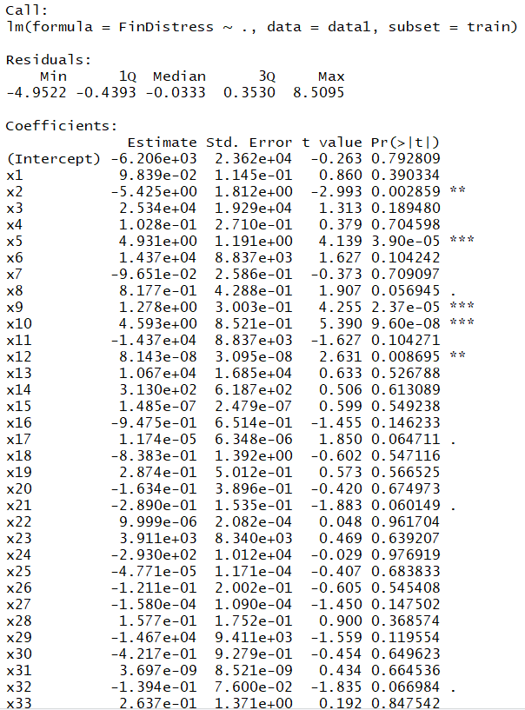
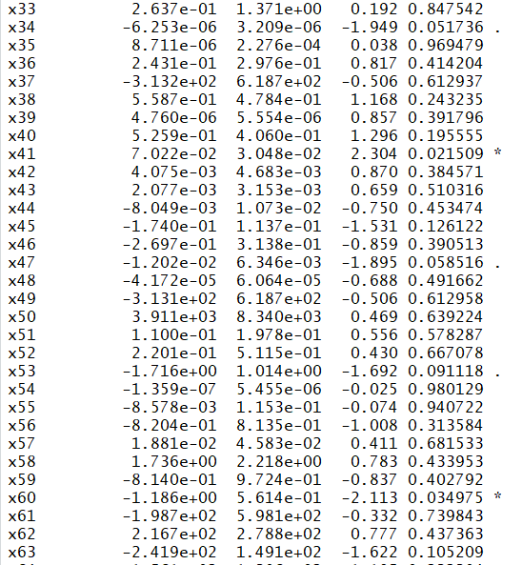
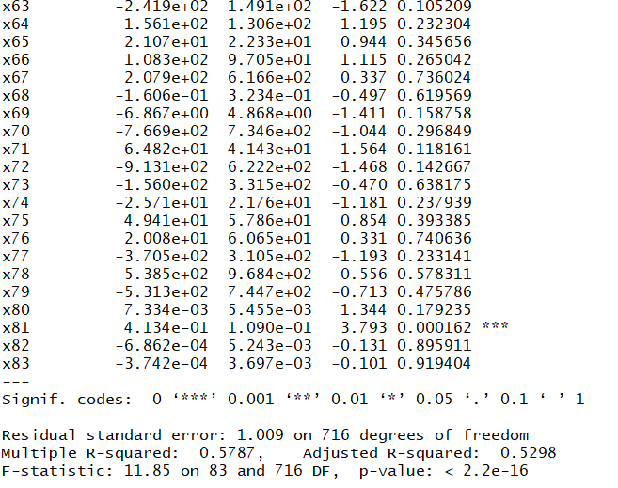
Least Square Regression

Slide 5
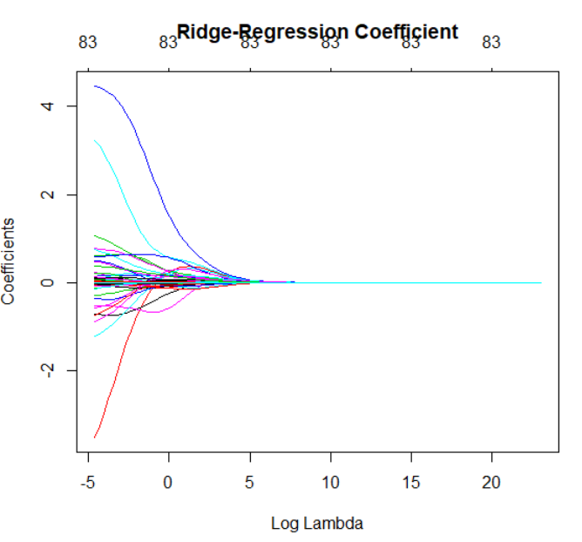
Ridge Regression
Estimate tuning parameter λ by Cross Validation

Slide 6
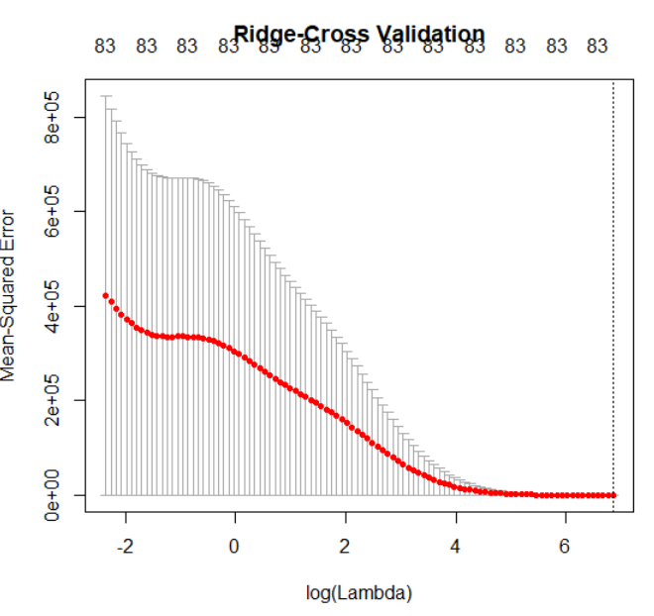
Ridge Regression
Estimate tuning parameter λ by Cross Validation
Best λ from cv output:
948.3696
(log(λ )=6.85)

Slide 7
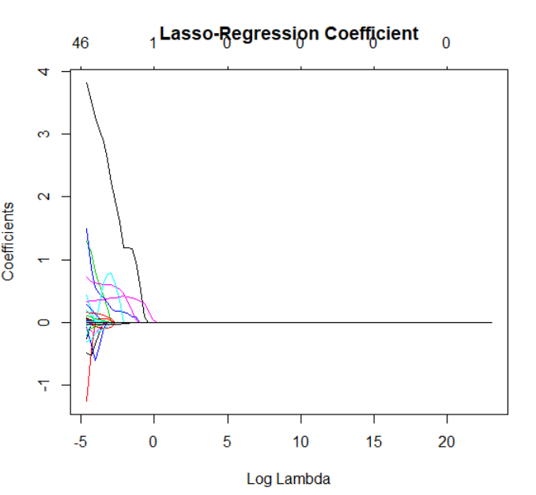
Lasso Regression
Estimate tuning parameter λ by Cross Validation

Slide 8
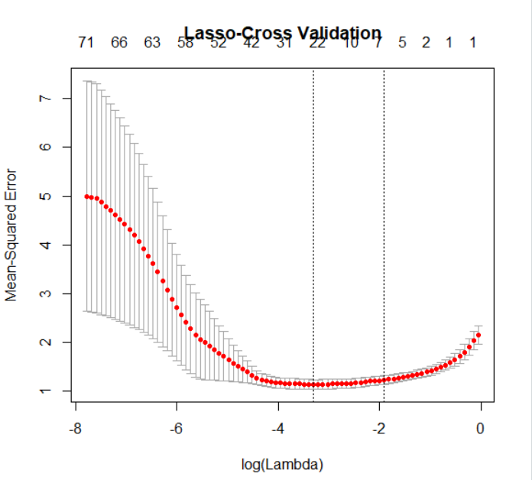
Lasso Regression
Estimate tuning parameter λ by Cross Validation
Best λ from cv output:
0.0365 (log(λ ) = -3.31)

Slide 9
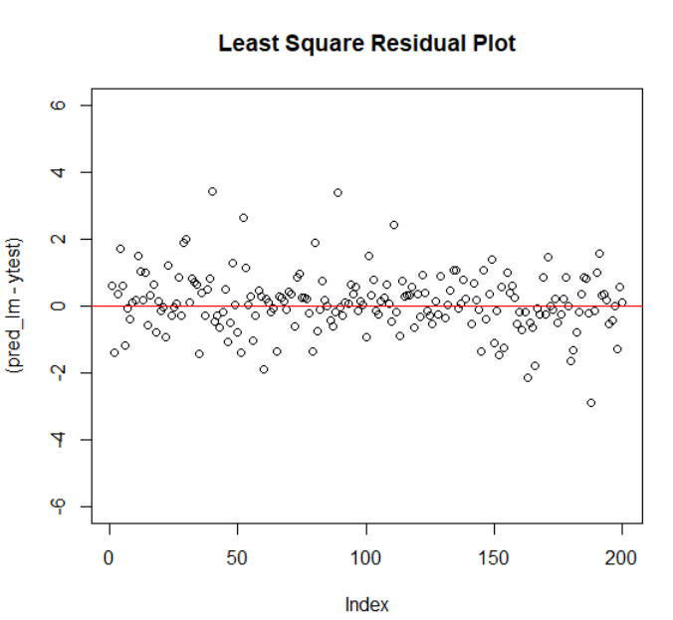
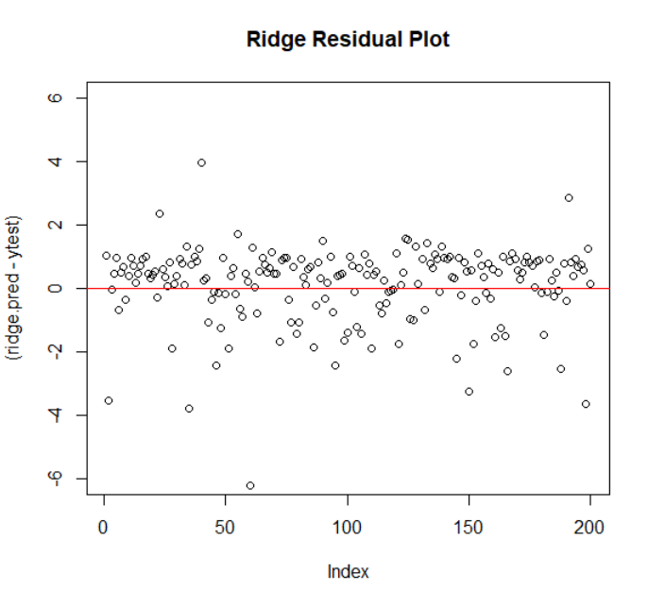
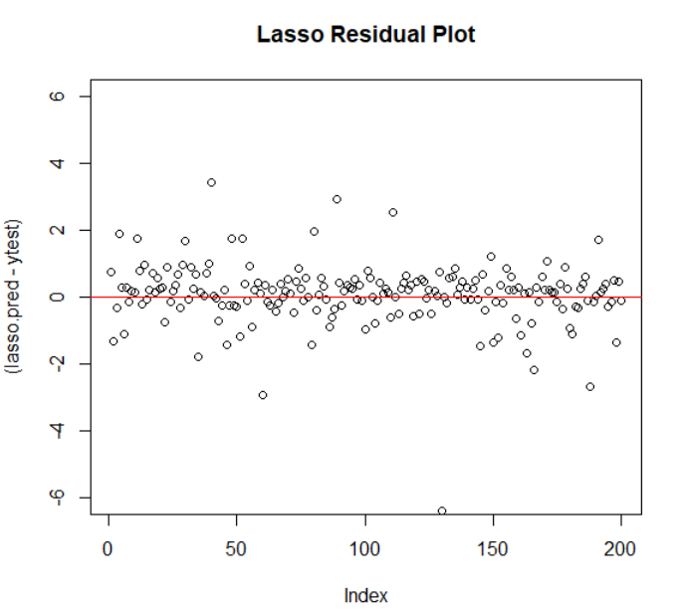
Model Comparation
Least Square:
MSE=2.693591
Ridge Best Model:
MSE=1.722545
Lasso Square:
MSE=0.8512361

Slide 10
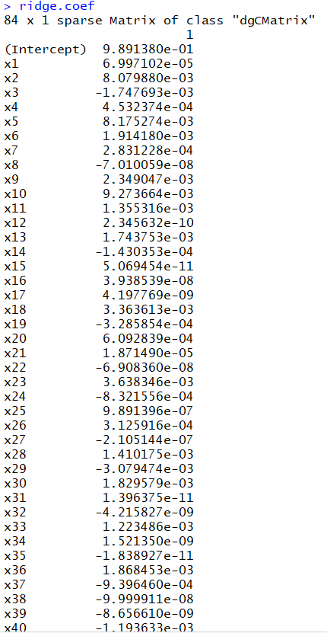
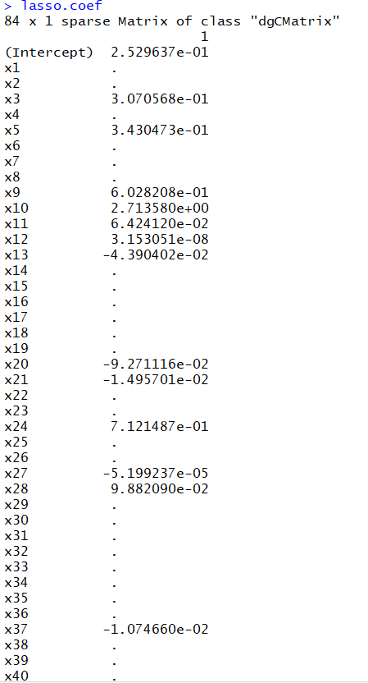
Lasso: penalty on parameters
Many betas became zeros

Slide 11
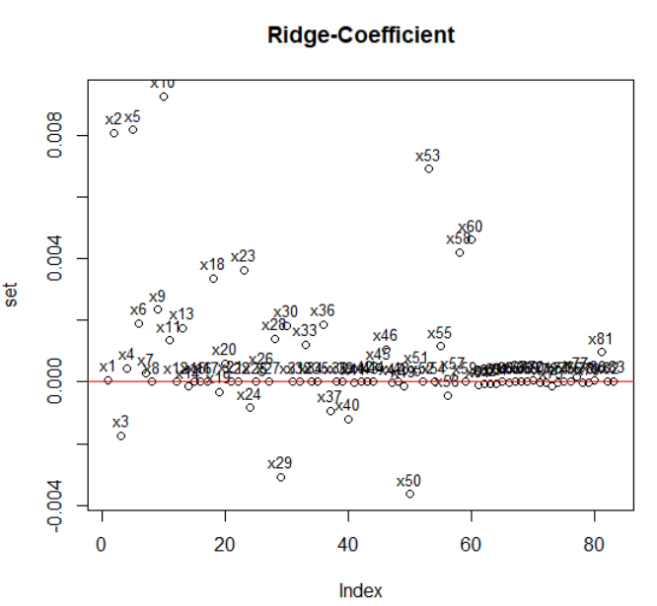
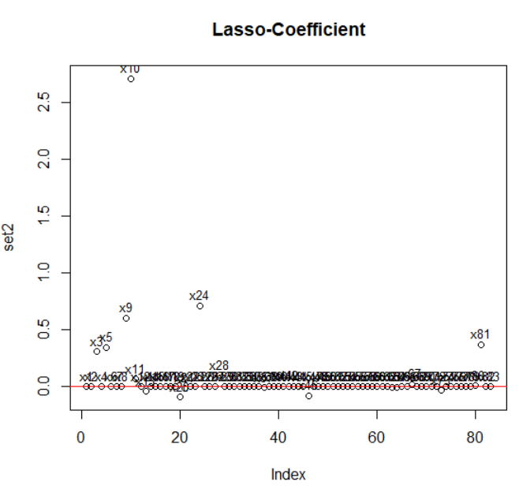
Lasso: penalty on parameters

