Slide 1


Dem smart
Making lives better

Slide 2
THE BRAIN IS ONE OF YOUR MOST VITAL ORGANS. IT PLAYS A ROLE IN EVERY ACTION AND EVERY THOUGHT, AND JUST LIKE THE REST OF YOUR BODY, IT NEEDS TO BE LOOKED AFTER.

Slide 3
About Us
We are a team of 5 programmers from various years of study and experience.
We have attempted to build a system with a vision to impact the well being of dementia patients.
bostonSacks

Slide 4




The Problem
Challenge
Audience
Finance
Learning how to utilize IoT devices to make daily life smarter.
Studying the intimate interaction of dementia patients and technology.
$341,840 is the estimated lifetime cost of care for an individual living with dementia

Slide 5
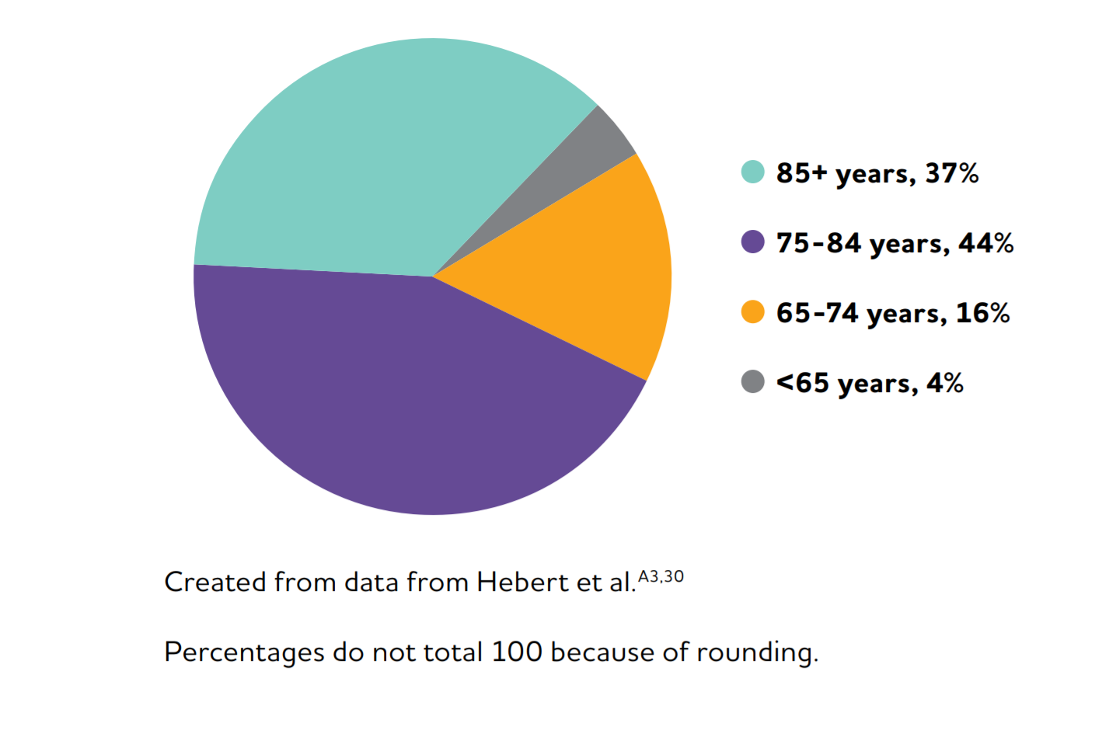
Ages of People with Alzheimer’s Dementia in the United States, 2018

Slide 6
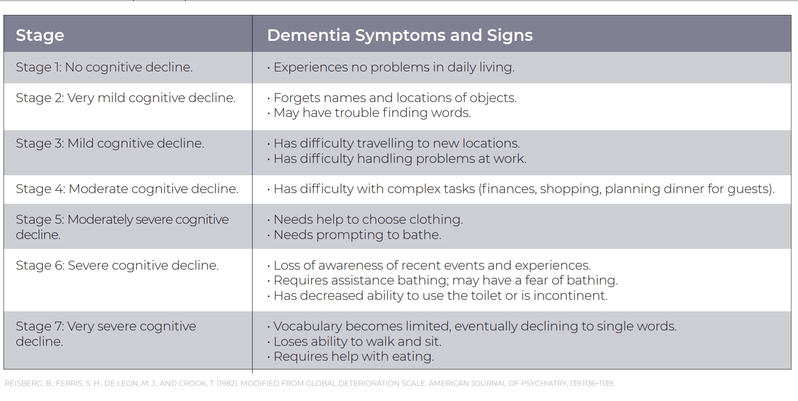
THE SEVEN STAGES OF DEMENTIA

Slide 7
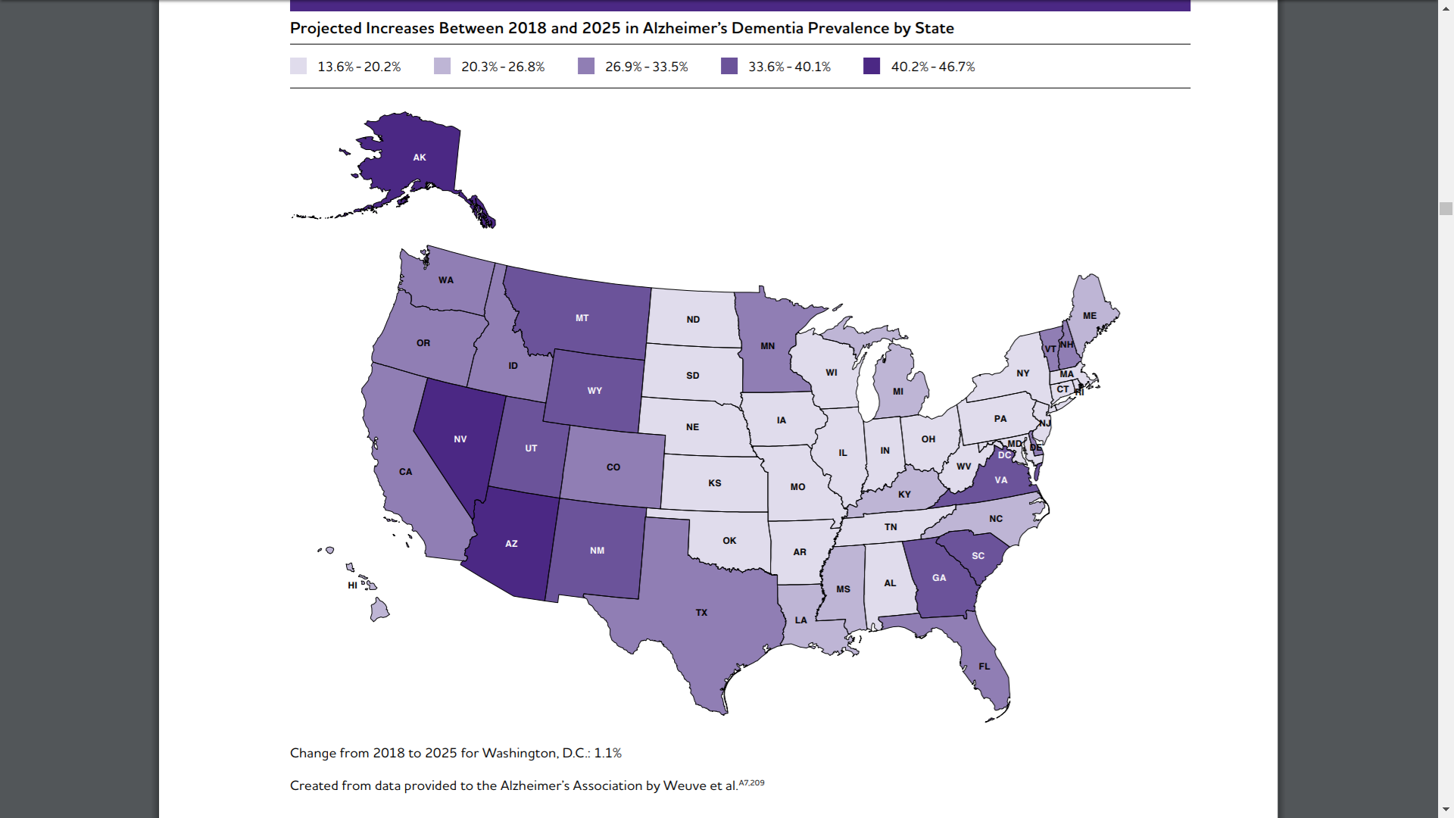
Projected Increases Between 2018 and 2025 in Alzheimer’s Dementia Prevalence by State

Slide 8



Solution
Prioritize
Authorize
Monetize
Reminding dementia patients about daily tasks
Having someone who controls the tasks
Reducing the cost of daily care

Slide 9




Product
Unique
First to Market
Provides a personalised experience to the customer
An all new experience utilizing familarity
Bose API
Google Calendar API
We use the Bose® SoundTouch Audio Notification API
We use the Google Calendar API for reminders

Slide 10

How are we different?
We provide a personalised experience for the user by having voices of their loved ones.
We have speech exercises to discuss about daily things and the reducing the aging of dementia.*
Music Therapy*
*In development

Slide 11
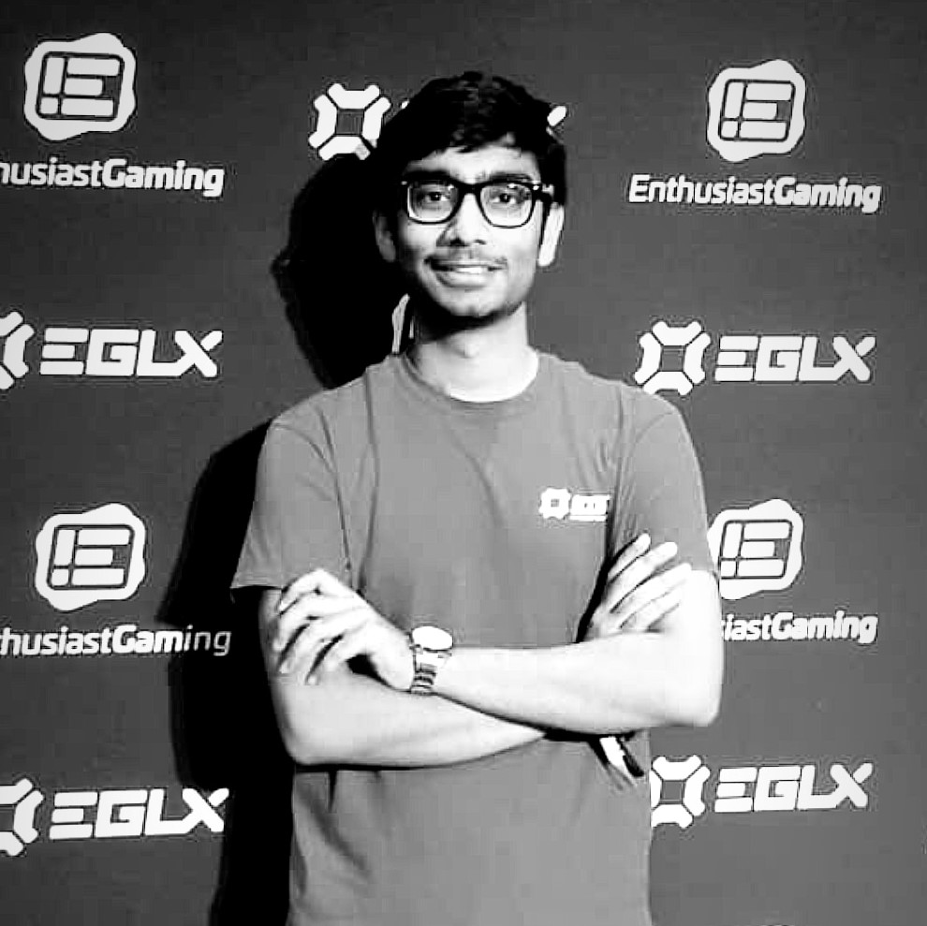
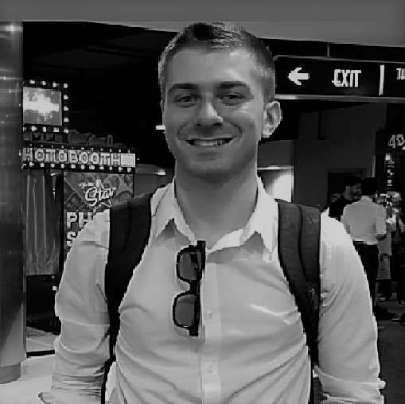
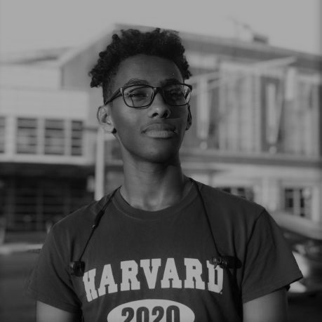

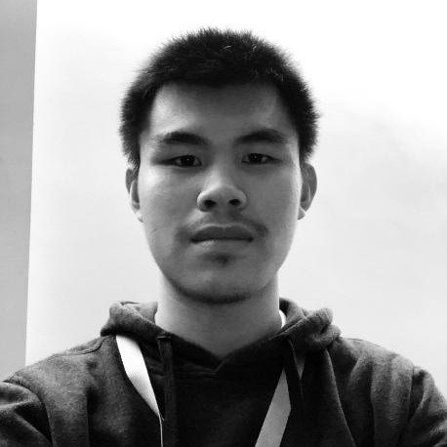
Team
Aditya Dutta
Ryan
Guido
Robel
Solomon
Anya Li
Andy Liu

Slide 12
Summary
We aim to improve the lives of our audience by providing them an experience.
We also focus on UN Sustainable Goal of good health and well being.
Let’s take a step to make their lives better

Slide 13
Thank You

