Slide 1
RDBMS Essentials – Day2
Ver. No.:4.0
Notes:
Welcome to RDBMS Essentials – Day2

Slide 2
General Guideline
© (2008) Infosys Technologies Ltd.
This document contains valuable confidential and proprietary information of Infosys. Such confidential and proprietary information includes, amongst others, proprietary intellectual property which can be legally protected and commercialized. Such information is furnished herein for training purposes only. Except with the express prior written permission of Infosys, this document and the information contained herein may not be published, disclosed, or used for any other purpose.

Slide 3
Confidential Information
This Document is confidential to Infosys Technologies Limited. This document contains information and data that Infosys considers confidential and proprietary (“Confidential Information”).
Confidential Information includes, but is not limited to, the following:
Corporate and Infrastructure information about Infosys
Infosys’ project management and quality processes
Project experiences provided included as illustrative case studies
Any disclosure of Confidential Information to, or use of it by a third party, will be damaging to Infosys.
Ownership of all Infosys Confidential Information, no matter in what media it resides, remains with Infosys.
Confidential information in this document shall not be disclosed, duplicated or used – in whole or in part – for any purpose other than reading without specific written permission of an authorized representative of Infosys.
This document also contains third party confidential and proprietary information. Such third party information has been included by Infosys after receiving due written permissions and authorizations from the party/ies. Such third party confidential and proprietary information shall not be disclosed, duplicated or used – in whole or in part – for any purpose other than reading without specific written permission of an authorized representative of Infosys.

Slide 4
Recap
Introduction to OLTP
Transaction – states, properties & types
Requirements of an OLTP system
Concurrency
Concurrency control technique – Locking
Deadlock
Notes:
Recap of Day1

Slide 5
Day2 - Session Plan
Variables and datatypes
Anchored Declaration
Operators & Expression
PL/SQL conditional & iterative constructs
Notes:
Session plan for Day2

Slide 6
Variables and Data types

Slide 7
Variables & Data types (1 of 7)
Variables
Variables are memory regions used to hold data
Type of value stored is decided by the data type
Declared in the DECLARE section
Scalar datatype
A scalar datatype can hold a single value
Subcategories
Character/String
Number
Boolean
Date/Time

Slide 8
Variables & Data types (2 of 7)
Syntax
Variable name followed by CONSTANT keyword before specifying the datatype would be treated as constants. Constants must be initialized.
Variables defined as NOT NULL also have to be initialized
variable_name [CONSTANT] datatype [ NOT NULL ] [ := value ]
Notes:
Using assignment operator (:=) or DEFAULT keyword we can assign initial values to variables and constants
Variables which are uninitialized would be having NULL values by default, irrespective of the datatype of that variable

Slide 9
Variables & Data types(3 of 7)
Character/String
CHAR(n) – Fixed length character datatype. The precision is specified in integer which represents the number of bytes
CHAR(n CHAR) – Stores n characters regardless of the number of bytes occupied per character. Useful with multibyte characters such as Chinese alphabets
VARCHAR2(n) – Variable length character datatype which can store upto 32,767 bytes(32K)
VARCHAR2(n CHAR) – Stores n characters regardless of the number of bytes occupied per character. Useful with multibyte characters
Notes:
For example,
DECLARE
v_customername VARCHAR2(20);
By default, this declaration means that the variable v_customername can store up to 20 bytes.
Using character semantics, we modify the above declaration.
DECLARE
v_customername VARCHAR2(20 CHAR);
The addition of CHAR to precision means that the string v_customername variable will now store up 20 characters, regardless of the number of bytes per character.

Slide 10
Variables & Data types(4 of 7)
Examples on Character/String
SQL> DECLARE
2 v_productcategory VARCHAR2(20) :='Mobilephone';
3 v_vendorname CHAR(20) NOT NULL:= 'Joe';
4 v_customername VARCHAR2(20 CHAR) DEFAULT 'John';
5 c_productname CONSTANT CHAR(20 CHAR) := 'NOKIA';
…..

Slide 11
Variables & Data types(5 of 7)
Number
PLS_INTEGER –used when a whole number is used in arithmetic operations but not stored in the database
NUMBER (p , s) – used for storing integer and floating-point values
p- total number of digits allowed for the value
s- number of digits to the right of the decimal place
SQL> DECLARE
2 v_itemqty PLS_INTEGER;
3 v_itemprice NUMBER(7,2);
Decimal point is ignored for width
P=7
7 – 2 = 5
.
S=2
Notes:
PLS_INTEGER - variables declared as PLS_INTEGER can be assigned values between -2**31 .. 2**31, ( -2,147,483,647 to 2,147,483,647)
PLS_INTEGER operations use machine arithmetic, so they are generally faster than NUMBER and INTEGER operations

Slide 12
Variables & Data types(6 of 7)
Boolean
Used for storing boolean value such as TRUE, FALSE, and NULL
Do not attempt to print or display the value stored in boolean variable, as it is not possible
SQL> DECLARE
2 v_test BOOLEAN;
3 BEGIN
4 v_test:='TRUE'; --Wrong
5 v_test:= TRUE; --Correct
6 END;
Notes:
When assigning values to boolean variables, do not enclose in quotes
When declared without initialization, the default value would be NULL

Slide 13
Variables & Data types(7 of 7)
Date
Used for storing DATE
Stores the century, year, month, day, hour, minute, second
Timestamp
Used for storing the date and time
Provides sub second time upto nine digits(the default is six)
SQL> DECLARE
2 v_transactiondate DATE:= SYSDATE;
3 v_billingdate TIMESTAMP := SYSTIMESTAMP;
. . .
. . .
Notes:
The DATE datatype stores the century, year, month, day, hour, minute and second. Fractional seconds are not available in the date datatype.
The TIMESTAMP datatype stores the date/time details much like DATE datatype, and in addition it also provides the subsecond details upto nine digits ( the default is six)
SQL> DECLARE
2 v_billingdate TIMESTAMP(9):= SYSTIMESTAMP;
3 BEGIN
4 DBMS_OUTPUT.PUT_LINE(v_billingdate);
5 END;
6 /
08-JUN-09 12.07.07.902000000 PM
PL/SQL procedure successfully completed.

Slide 14
DBMS_OUTPUT.PUT_LINE (1 of 2)
DBMS_OUTPUT.PUT_LINE
An oracle supplied packaged procedure
DBMS_OUTPUT is a package and PUT_LINE is a procedure within the package
The string which has to be printed should be specified in parenthesis, following the PUT_LINE keyword
Using SET SERVEROUTPUT ON this package should be enabled in SQLPLUS

Slide 15
DBMS_OUTPUT.PUT_LINE (2 of 2)
SQL> SET SERVEROUTPUT ON
SQL> DECLARE
2 v_productcategory VARCHAR2(20) :='Mobile Phone';
3 v_itemqty PLS_INTEGER := 1000;
4 v_itemprice NUMBER(7,2) DEFAULT 60.50;
5 v_transactiondate DATE:= SYSDATE;
6 v_billingdate TIMESTAMP := SYSTIMESTAMP;
7 v_test BOOLEAN:=TRUE;
8 BEGIN
9 DBMS_OUTPUT.PUT_LINE(v_productcategory);
10 DBMS_OUTPUT.PUT_LINE(v_transactiondate);
11 DBMS_OUTPUT.PUT_LINE (v_billingdate);
12 END;
13 /
Mobile Phone
10-MAR-09
10-MAR-09 03.39.27.845000 PM

Slide 16
More about DBMS_OUTPUT package
Used to display messages to the screen from an anonymous PL/SQL block
Debugging is the most popular use of this package
When executing a PL/SQL block, any DBMS_OUTPUT lines are placed in an output buffer, which displays its contents on the screen when the program has completed execution

Slide 17
DBMS_OUTPUT procedures
Procedures available | Description
DBMS_OUTPUT.ENABLE | Allows message display (not necessary if you have SERVEROUTPUT set to ON in SQL*PLUS)
DBMS_OUTPUT.DISABLE | Does not allow message display
DBMS_OUTPUT.PUT | Places information in the buffer
DBMS_OUTPUT.PUT_LINE | Places information in the buffer followed by an end-of-line marker
DBMS_OUTPUT.NEW_LINE | Places an end-of-line marker in the buffer

Slide 18
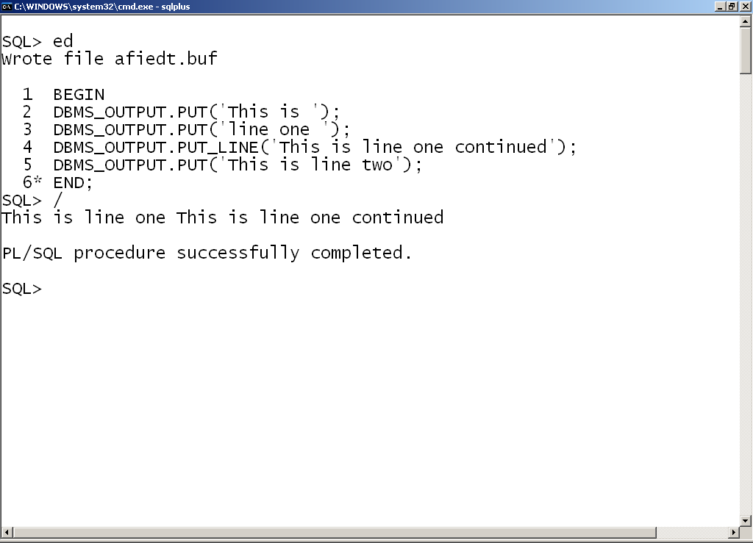
DBMS_OUTPUT procedures usage
1. PUT procedure places information in the buffer
2. PUT_LINE procedure displays all the data placed in the buffer so far
4. Output displayed on a single line
3. PUT places this value in the buffer. It is not displayed

Slide 19
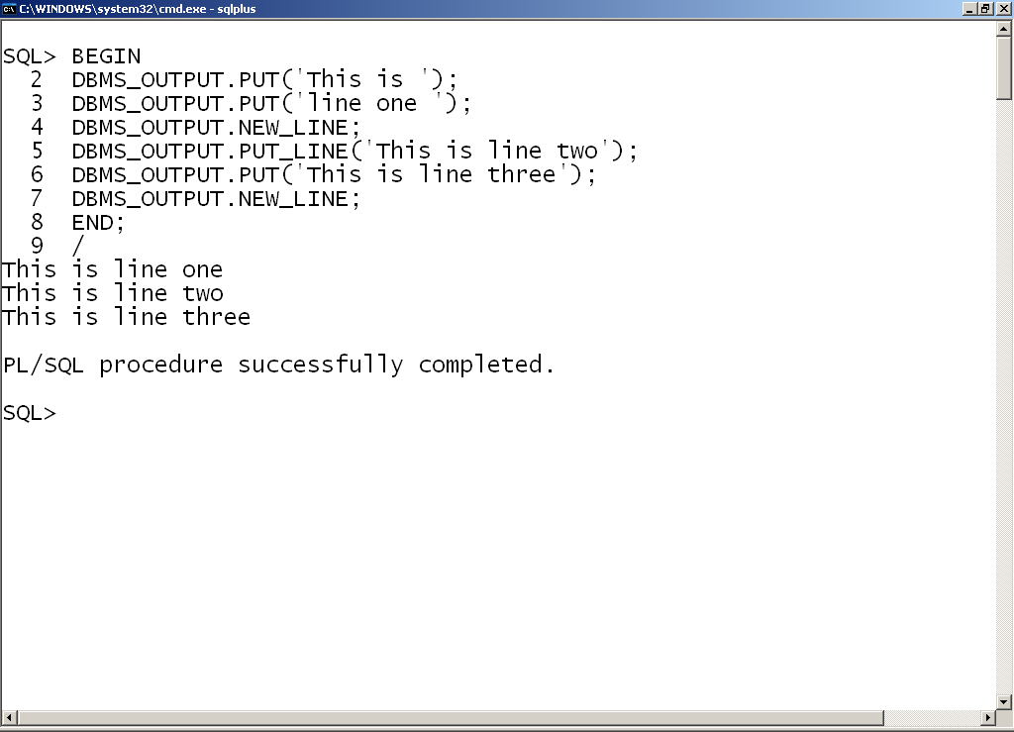
DBMS_OUTPUT procedure usage
1. NEW_LINE forces the display of buffer contents and moves to a new line for display
2. Output now shown on multiple lines

Slide 20
Anchored declarations

Slide 21
Anchored declarations %TYPE (1 of 2)
Usage 1 : Declare variables that directly maps to a column definition in the database
SQL> DECLARE
1 -- variablename TABLENAME.COLUMNNAME%TYPE; --Syntax
2 v_itemcode ITEM.ITEMCODE%TYPE;
. . . .
. . . .
Notes:
Here ITEM is a database table name, ITEMCODE is a column in ITEM table. If ITEM.ITEMCODE is VARCHAR2(6), then the same datatype would be applied to v_itemcode
Change of column precision or datatype of ITEMCODE in the database, would in turn change v_itemcode automatically as the variable is anchored

Slide 22
Anchored declarations %TYPE (2 of 2)
Convenient way of associating PL/SQL variable with database column definitions
NOT NULL constraint or CHECK constraint associated with table column would not be applicable to PL/SQL variable
Usage 2: is to declare variables that directly maps to a datatype of previously declared variable
SQL> DECLARE
2 v_quantityonhand NUMBER(7) NOT NULL:= 500;
3 v_reorderqty v_quantityonhand%TYPE :=50;
. . . .
. . . .
Notes:
The datatype of v_quantityonhand and NOT NULL constraint is applied to v_reorderqty. Value of v_quantityonhand would not be copied to v_reorderqty

Slide 23
Bind variables
Declared in the host environment such as SQL*PLUS
Used to pass runtime values out of one or more PL/SQL programs to the host environment
PRINT command helps us in displaying the value of one bind variable
Would be alive only in the current session
SQL> SET SERVEROUTPUT ON
SQL> VARIABLE g_itemid varchar2(20);
SQL> BEGIN
2 :g_itemid :='STN001';
3 END;
4 /
PL/SQL procedure successfully completed.
SQL> PRINT g_itemid
G_ITEMID
----------------
STN001

Slide 24
Substitution variables
Declared in the host environment such as SQL*PLUS
Used to pass runtime values into one or more PL/SQL programs
You will not be prompted to enter value during execution of the block
Would be alive only in the current session
SQL> SET SERVEROUTPUT ON
SQL> DEFINE g_itemid = 'PEN';
SQL> DECLARE
2 v_itemname VARCHAR2(30);
3 BEGIN
4 v_itemname :='&g_itemid';
5 DBMS_OUTPUT.PUT_LINE(v_itemname);
6 END;
7 /
PEN
PL/SQL procedure successfully completed.

Slide 25
Accepting input in PL/SQL
Declare the variables in the declaration section of PL/SQL block
Accept the value for variables in the executable block
Display the accepted values as shown below
SQL> SET SERVEROUTPUT ON
SQL> DECLARE
2 v_itemname VARCHAR2(30);
3 BEGIN
4 v_itemname :='&v_item';
5 DBMS_OUTPUT.PUT_LINE(v_itemname);
6 END;
7 /
Enter value for v_item: STN001
old 4: v_itemname :='&v_item';
new 4: v_itemname :='STN001';
STN001
PL/SQL procedure successfully completed.
Notes:
PL/SQL is not interactive. Please follow the code snippet to understand the same.
SQL> DECLARE
2 v_customername VARCHAR2(20);
3 v_qtyrequired NUMBER;
4 BEGIN
5 v_customername := '&v_customername';
6 DBMS_OUTPUT.PUT_LINE('Customer Name : '||v_customername);
7 v_qtyrequired := &v_qtyrequired;
8 DBMS_OUTPUT.PUT_LINE('Required Qty : '||v_qtyrequired);
9 END;
10 /
Enter value for v_customername: JAMES
old 5: v_customername := '&v_customername';
new 5: v_customername := 'JAMES';
Enter value for v_qtyrequired: 20
old 7: v_qtyrequired := &v_qtyrequired;
new 7: v_qtyrequired := 20;
Customer Name : JAMES
Required Qty : 20
PL/SQL procedure successfully completed.
While executing the above PL/SQL block, the system would ask us to enter the customer name and quantity required both, only after which it will display the entered customer name and quantity required details. Even though there is a presence of DBMS_OUTPUT.PUT_LINE statement immediately after accepting the customer name, the system would not do so. Please be aware of this behavior.

Slide 26
SET VERIFY ON/OFF
Prints two lines for every substitution performed within a PL/SQL block
ON – Displays the substitution performed (Default)
OFF – Suppress the display of substitution performed
SQL> SET VERIFY OFF
SQL> SET SERVEROUTPUT ON
SQL> DECLARE
2 v_itemname VARCHAR2(30);
3 BEGIN
4 v_itemname :='&v_item';
5 DBMS_OUTPUT.PUT_LINE(v_itemname);
6 END;
7 /
Enter value for v_item: STN001
STN001
PL/SQL procedure successfully completed.

Slide 27
Operators & Expressions

Slide 28
Operators & Expressions
Concatenation Operator ( || )
Arithmetic Operators( +, -, *, /,**)
Relational Operators( =, !=, <, >, <=, >=)
Logical Operators (AND, OR and NOT)

Slide 29
Concatenation Operator
|| is the concatenation operator
Concatenates two or more strings together
Do not use ‘||’ instead of Logical operator ‘OR’
DECLARE
v_customername varchar2(10):=‘John';
BEGIN
v_customername := v_customername || '10';
DBMS_OUTPUT.PUT_LINE('value of v_customername : '|| v_customername);
END;
value of v_customername : John10
Notes:
This operator attaches two or more strings (or arguments which can be converted implicitly to a string) together.

Slide 30
Arithmetic Operator - Addition
Addition of NULL with any number is NULL
Only numeric and date data types can be used along with arithmetic operators
DECLARE
v_reorderlevel NUMBER;
BEGIN
v_reorderlevel := v_reorderlevel+10; -- NULL +10
DBMS_OUTPUT.PUT_LINE(‘value of v_reorderlevel : '|| v_reorderlevel);
END;
Value of v_reorderlevel : (NULL)

Slide 31
Arithmetic Operator - Exponentiation
** is the exponential operator
DECLARE
v_number NUMBER:=2;
BEGIN
v_number:=v_number **2;
DBMS_OUTPUT.PUT_LINE( 'value of v_number : '|| v_number);
END;
value of v_number : 4

Slide 32
Arithmetic operator – With Date
Arithmetic operators can be used with date
SET SERVEROUTPUT ON
DECLARE
v_today DATE := '31-MAR-2009';
v_tomorrow DATE;
BEGIN
v_tomorrow := v_today + 1;
DBMS_OUTPUT.PUT_LINE('Tomorrow''s date is '||v_tomorrow);
END;
Tomorrow's date is 01-APR-09

Slide 33
Nested PL/SQL blocks (1 of 4)
A PL/SQL block defined within another PL/SQL block is called nested PL/SQL block
Can be nested in the executable section or in exception handling section
One or more nested blocks can be present within an anonymous PL/SQL block
Overlapping of nested blocks are not allowed
Notes:
We can define a PL/SQL block within another PL/SQL block. Thus the block defined inside is called a nested PL/SQL block. Nested PL/SQL block can also have declaration section, executable section, exception section. One or more PL/SQL blocks can be present within an anonymous PL/SQL block
Nested PL/SQL blocks can be present in the executable section or in the exception handling section. While defining nested blocks, make sure that there are no crossovers. Meaning before you complete defining one block, do not start the definition of another block.
DECLARE
BEGIN
EXCEPTION
DECLARE
END;
BEGIN
EXCEPTION
END;

Slide 34
Nested PL/SQL blocks (2 of 4)
DECLARE
--declaration of variables in the enclosed block
BEGIN
--SQL and PL/SQL statement(s)
DECLARE
--- declaration of variables in the nested block
BEGIN
-- SQL & PL/SQL statement(s) in nested block
END;
DECLARE
-- declaration of variables in the nested block
BEGIN
-- SQL & PL/SQL statement(s) in nested block
END;
--SQL and PL/SQL statement(s)
END;

Slide 35
Nested PL/SQL blocks (3 of 4)
DECLARE
--declaration of variables in the enclosed block
BEGIN
--SQL and PL/SQL statement(s)
DECLARE
-- declaration of variables in the nested block
BEGIN
-- SQL & PL/SQL statement(s) in nested block
DECLARE
-- declaration of variables
BEGIN
-- SQL and PL/SQL statement(s)
END;
END;
--SQL and PL/SQL statement(s)
END;

Slide 36
Nested PL/SQL blocks (4 of 4)
DECLARE
--declaration of variables in the enclosed block
BEGIN
--SQL and PL/SQL statement(s)
DECLARE
-- declaration of variables in the nested block
BEGIN
-- SQL & PL/SQL statement(s) in nested block
DECLARE
-- declaration of variables
END;
BEGIN
-- SQL and PL/SQL statement(s)
END;
--SQL and PL/SQL statement(s)
END;
Notes:
Overlapping of PL/SQL blocks are not allowed. The above slide is an example of the same.

Slide 37
Scope of variables(1 of 3)
Variables declared in the DECLARE section would be visible in the EXECUTABLE section and EXCEPTION section
Lifetime of variables declared in the nested block will be only within the nested block
Variables declared in the outermost block are visible in all the nested blocks

Slide 38
Scope of variables (2 of 3)
DECLARE
v_qoh NUMBER:=10;
BEGIN
DBMS_OUTPUT.PUT_LINE('The value of v_qoh: '||v_qoh);
DBMS_OUTPUT.PUT_LINE('The value of v_price: '||v_price);
END;
ERROR because scope of the variable is within the inner DECLARE to its END.
identifier 'V_PRICE' must be declared
Scope of the variable is from DECLARE to its END
DECLARE
v_price NUMBER:=20;
BEGIN
DBMS_OUTPUT.PUT_LINE('The value of v_qoh: '||v_qoh);
DBMS_OUTPUT.PUT_LINE('The value of v_price: '||v_price);
END;

Slide 39
Scope of variables(3 of 3)
DECLARE
v_itemid NUMBER(4) := 1001;
BEGIN
DECLARE
v_itemid NUMBER(4) := 1002;
BEGIN
DBMS_OUTPUT.PUT_LINE( v_itemid);
END;
DECLARE
v_quantityonhand NUMBER(4):=300;
BEGIN
DBMS_OUTPUT.PUT_LINE( v_itemid);
END;
DBMS_OUTPUT.PUT_LINE(v_itemid);
END;
Output
1002
1001
1001
Notes:
v_itemid with value 1001 declared in the outermost block is visible in both the nested blocks
But another v_itemid with value 1002 is declared in the first nested block with similar name as that of outer block
As local variable takes higher precedence within any block only v_itemid with value 1002 would be visible in the first nested block

Slide 40
Qualifying Identifiers
If the variable name is same then we can refer each variable with the help of the labels
<<supplier>>
DECLARE
v_price Number:=10;
BEGIN
<<shopkeeper>>
DECLARE
v_price Number:=20;
BEGIN
DBMS_OUTPUT.PUT_LINE(‘Supplier Price: '||supplier.v_price);
DBMS_OUTPUT.PUT_LINE(‘Shopkeeper Price: '||shopkeeper.v_price);
END;
DBMS_OUTPUT.PUT_LINE(‘Supplier Price: '||supplier.v_price);
DBMS_OUTPUT.PUT_LINE(‘Shopkeeper Price: '||shopkeeper.v_price);
END;
ERROR: label 'SHOPKEEPER' reference is out of scope
Notes:
Anonymous PL/SQL blocks can be qualified with identifiers (or names). While qualifying use << and >> angle brackets to enclose the identifiers.
For example, in the above slide, <<supplier>> is one PL/SQL block within which there is another <<shopkeeper>> PL/SQL block. These qualifying identifiers will be useful if there is a presence of one or more variables with the same name.
V_price is a variable declared within the supplier block. Similar variable with the same name exist in the shopkeeper block also. The scope or lifetime of variables would be within the PL/SQL block in which it is declared.
If you simply mention a variable without any qualifier, it will refer to the variable declared in the current block.
For ex. If you say DBMS_OUTPUT.PUT_LINE(‘Supplier Price: '||v_price); it refers to the variable declared in the supplier block
If the variable is not declared in the current block in which it is referred or invoked, PL/SQL compiler will look for the presence of the variable in the enclosing block.
For ex. If you say DBMS_OUTPUT.PUT_LINE(‘Supplied Qty: '||v_Qty); in the shopkeeper block PL/SQL compiler will check whether this v_Qty is declared in shopkeeper. If not, it will check supplier block for the declaration. If declared in supplier block execution would proceed else it would throw an error message
Accessing shopkeeper block v_price in supplier block scope is illegal. As the v_price variable is out of scope of shopkeeper, it would not be visible

Slide 41
PL/SQL Conditional Constructs

Slide 42
IF-THEN
IF condition
THEN
action;
END IF;
DECLARE
v_qoh NUMBER :=10;
v_itemrequired NUMBER :=&b_itemrequired;
BEGIN
IF v_itemrequired>v_qoh THEN
DBMS_OUTPUT.PUT_LINE('Item not available ');
END IF;
END;
Enter value for b_itemrequired: 11
old 3: v_itemrequired NUMBER :=&b_itemrequired;
new 3: v_itemrequired NUMBER :=11;
Item not available
Notes:
Condition can be any expression,variable,constant, or identifier compared to any other expression, variable, constant, or identifier.
The condition must evaluate to TRUE, FALSE or NULL

Slide 43
IF-THEN-ELSE
IF condition
THEN
action;
ELSE
action;
END IF;
DECLARE --Comparing NUMBER datatypes
v_qoh NUMBER :=10;
v_itemrequired NUMBER :=&b_itemrequired;
BEGIN
IF v_itemrequired > v_qoh THEN
DBMS_OUTPUT.PUT_LINE('Item not available ');
ELSE
DBMS_OUTPUT.PUT_LINE('Item available ');
END IF;
END;
Enter value for b_itemrequired: 9
old 3: v_itemrequired NUMBER :=&b_itemrequired;
new 3: v_itemrequired NUMBER :=9;
Item available
Notes:
Condition can be any expression,variable,constant, or identifier compared to any other expression, variable, constant, or identifier.
The condition must evaluate to TRUE, FALSE or NULL

Slide 44
IF-THEN-ELSE
Inequality of 2 given numbers or dissimilarity of strings can be checked with either != or <>
SET SERVEROUTPUT ON
DECLARE --Comparing VARCHAR2 datatypes
v_string1 VARCHAR2(10) := 'hello';
v_string2 VARCHAR2(10) := 'hello';
BEGIN
IF v_string1 <> v_string2 THEN
DBMS_OUTPUT.PUT_LINE('Both are unequal');
ELSE
DBMS_OUTPUT.PUT_LINE('Both are equal');
END IF;
END;
Both are equal

Slide 45
IF-THEN-ELSIF
IF condition
THEN
action;
ELSIF condition
THEN
action;
[ELSE
action;]
END IF;
DECLARE
v_qoh NUMBER :=10;
v_itemrequired NUMBER :=&b_itemrequired;
BEGIN
IF v_itemrequired>v_qoh THEN
DBMS_OUTPUT.PUT_LINE('Item not available ');
ELSIF v_itemrequired=10 THEN
DBMS_OUTPUT.PUT_LINE('Item available but no more stock ');
ELSE
DBMS_OUTPUT.PUT_LINE('Item not available’);
END IF;
END;
Notes:
For every IF condition there must be END IF.
If we are using ELSE IF condtion….. Then for every IF we are using we have to use END IF.
The advantage of using ELSIF is, we can close all the IF s with one END IF .
Please note the spelling of ELSIF.

Slide 46
LOOP
This is an infinite LOOP!!!
LOOP
action
END LOOP;
BEGIN
LOOP
DBMS_OUTPUT.PUT_LINE('I AM IN LOOP!!!');
END LOOP;
END;
There must be an EXIT condition to EXIT from the LOOP
DECLARE
v_price NUMBER:=1;
BEGIN
LOOP
DBMS_OUTPUT.PUT_LINE('Price: '||v_price);
v_price:=v_price+1;
EXIT WHEN v_price >5;
END LOOP;
END;
OUTPUT:
---------
Price: 1
Price: 2
Price: 3
Price: 4
Price: 5

Slide 47
Numeric FOR Loop
The variable is automatically declared and initialized
FOR counter IN low_number .. high_number
LOOP
action;
END LOOP;
BEGIN
FOR v_price IN 1..5
LOOP
DBMS_OUTPUT.PUT_LINE('Price: '||v_price);
END LOOP;
END;
OUTPUT:
---------
Price: 1
Price: 2
Price: 3
Price: 4
Price: 5
Notes:
What happens if we declare and initialize the same variable?

Slide 48
Numeric FOR Loop REVERSE
The variable is automatically declared and initialized
FOR counter IN REVERSE low_number .. high_number
LOOP
action;
END LOOP;
BEGIN
FOR v_price IN REVERSE 1..5
LOOP
DBMS_OUTPUT.PUT_LINE('Price: '||v_price);
END LOOP;
END;
OUTPUT:
---------
Price: 5
Price: 4
Price: 3
Price: 2
Price: 1
Notes:
What happens if we declare and initialize the same variable, which was used in the FOR loop?

Slide 49
WHILE Loop
WHILE condition
LOOP
action;
END LOOP;
DECLARE
v_price NUMBER:=1;
BEGIN
WHILE v_price <=5
LOOP
DBMS_OUTPUT.PUT_LINE('Price: '||v_price);
v_price:=v_price+1;
END LOOP;
END;
OUTPUT:
---------
Price: 1
Price: 2
Price: 3
Price: 4
Price: 5

Slide 50
Coding Standards
In PL/SQL
v_variable for variables
Example: v_itemname, v_productname, v_employeeno
c_constant for constants
Example: c_discount
e_Exception for user-defined exceptions (Discussed later)
Example: e_Invalid_ItemId, e_Invalid_EmpId
Notes:
Reference for coding standards: Oracle Database 10g PL/SQL programming by Scott Urman, Ron Hardman, Michael McLaughlin Tata McGraw Hill Publishing

Slide 51
Coding Standards
In PL/SQL
cur_cursorname for cursor variable (Discussed later)
Example: cur_branch, cur_emp
All table names and column names in lower case
Example: emp, employeename
All Keywords should be in UPPER case
Example: SELECT, FROM, WHERE, GROUP BY, ORDER BY
Usage: SELECT ename FROM emp WHERE empno=v_empno;

Slide 52
Summary
Variables and datatypes
Anchored Declaration
Operators & Expression
PL/SQL conditional & iterative constructs

Slide 53
Thank You
“The contents of this document are proprietary and confidential to Infosys Technologies Ltd. and may not be disclosed in whole or in part at any time, to any third party without the prior written consent of Infosys Technologies Ltd.”
“© 2008 Infosys Technologies Ltd. All rights reserved. Copyright in the whole and any part of this document belongs to Infosys Technologies Ltd. This work may not be used, sold, transferred, adapted, abridged, copied or reproduced in whole or in part, in any manner or form, or in any media, without the prior written consent of Infosys Technologies Ltd.”

