Slide 1
RDBMS Essentials - Day 5
Notes:
RDBMS Essentials Day 5

Slide 2
General Guideline
© (2008) Infosys Technologies Ltd.
This document contains valuable confidential and proprietary information of Infosys. Such confidential and proprietary information includes, amongst others, proprietary intellectual property which can be legally protected and commercialized. Such information is furnished herein for training purposes only. Except with the express prior written permission of Infosys, this document and the information contained herein may not be published, disclosed, or used for any other purpose.
Notes:
RDBMS Essentials Day 5

Slide 3
Confidential Information
This Document is confidential to Infosys Technologies Limited. This document contains information and data that Infosys considers confidential and proprietary (“Confidential Information”).
Confidential Information includes, but is not limited to, the following:
Corporate and Infrastructure information about Infosys
Infosys’ project management and quality processes
Project experiences provided included as illustrative case studies
Any disclosure of Confidential Information to, or use of it by a third party, will be damaging to Infosys.
Ownership of all Infosys Confidential Information, no matter in what media it resides, remains with Infosys.
Confidential information in this document shall not be disclosed, duplicated or used – in whole or in part – for any purpose other than reading without specific written permission of an authorized representative of Infosys.
This document also contains third party confidential and proprietary information. Such third party information has been included by Infosys after receiving due written permissions and authorizations from the party/ies. Such third party confidential and proprietary information shall not be disclosed, duplicated or used – in whole or in part – for any purpose other than reading without specific written permission of an authorized representative of Infosys.
Notes:
RDBMS Essentials Day 5

Slide 4
Recap
Implicit Cursors
Explicit Cursors
Operations on explicit cursors
Navigating cursors with loop
Cursor with FOR loop
Cursor related predefined oracle server exception
Explicit cursor with parameters
Explicit cursor with FOR update
Notes:
RDBMS Essentials Day 5

Slide 5
Day5 - Session Plan
Backup and Recovery
Transaction processing in PL/SQL
Concurrency control in oracle
Notes:
RDBMS Essentials Day 5

Slide 6
Backup and Recovery
Notes:
RDBMS Essentials Day 5

Slide 7
Failure types
Transaction failure
System crash
Disk failure
Notes:
RDBMS Essentials Day 5

Slide 8
The Transaction Log
Most important structure used to recover from database failures
Contains the before image and after image of the data item modified
Contains log records for each update activity
Each log record contains:
<Ti, Xi, V1, V2>
Transaction identifier
Data item identifier
Old value
New value
Start and commit are indicated with special records
Notes:
As soon as a transaction performs a write operation then it should create the log record and store the log record on stable storage.
Transaction log or the journal log or redo-log is a physical file. Usually the Transaction ID, the time stamp of the transaction, the old value and the new values of the data are stored in transaction logs file. Therefore the RDBMS is aware of the state of the database i.e. before and after image of data after each transaction. Every database is returned to a consistent state and the log may be truncated to remove committed transactions.
Normally there are two techniques used to maintain the log files.
Deferred Update
Immediate Update

Slide 9
Techniques to maintain log files
Deferred Update
Immediate Update
Notes:
Deferred Update
Deferred update, or NO UNDO/REDO, is an algorithm to support transaction failures owing to O/S, application, power, memory and machine failures.
While a transaction runs, not updates/alterations made by that transaction are recorded in the database but captured only in the log files.
On commit, data changes are applied to the database using the log files. This process is called as “Re-doing”
On rollback, data changes which are captured in the log files are discarded and no changes are made to the database.
On system restart, due to any of the above mentioned reasons if transaction fails and it is not committed, contents of the log files are discarded and the transaction will be restarted. If it is committed before crashing then after restart, the log file contents are applied to the database.
2. Immediate Update
Immediate update, or UNDO/REDO, is another algorithm to support transaction failure owing to O/S, application, power, memory or machine failure.
While a transaction runs, updates/alterations made by that transaction can be written to the database directly. However, the original and the new data being written must both be stored in the log BEFORE writing it to the database.
On commit, all the changes to the database are made permanent and log contents are discarded.
On rollback, using the log entries, old values are restored. All the changes which that transaction has made to the database disk are discarded. This process is called as “Un-doing”.
Database changes are made permanent once the system restarts, after the crash for committed transactions. The original values are restored using the log files for uncommitted transactions.

Slide 10
Deferred Update Scheme (1of 2)
Database modifications are written in the log
The WRITE operation is deferred until a transaction Partially Commits
A transaction is said to be in partially committed state when it completes its final action
Before the actual updates on the database begins, it must be ensured that all log records are written to the stable storage
Once all the updates are done on the database the transaction enters the ‘committed’ state
Notes:
RDBMS Essentials Day 5

Slide 11
Deferred Update Scheme (2 of 2)
The recovery scheme executes redo( Ti) and sets the value of all the data items modified by Ti to the new value as found in the log
This is done only for those transactions for which there is a
<Ti Commit> record present in the log
Notes:
RDBMS Essentials Day 5

Slide 12
Deferred DB Modification
Log Records
Database
Read(A,a1)
a1=a1-50
Write(A,a1)
Read(B,b1)
b1=b1+50
Write(B,b1)
Commit
< T1 Starts>
T1
< T1,A,950>
A=1000
A=950
< T1,B,2050>
B=2000
< T1 Commit>
B=2050
T2
read(C,c1)
c1=c1+100
Write(C,c1)
Commit
< T2 Starts>
C=700
C=600
< T2,C,700>
C=700
< T2 Commit>
Notes:
RDBMS Essentials Day 5

Slide 13
Occurrence of failure (Example)
<T0 Starts>
<T0, A,950>
<T0,B,2050>
<T0 Commits>
<T1 Starts>
<T1,C,600>
CRASH
<T0 Starts>
<T0, A,950>
<T0,B,2050>
<T0 Commits>
<T1 Starts>
<T1,C,600>
<T1 Commits>
CRASH
<T0 Starts>
<T0, A,950>
<T0,B,2050>
CRASH
Recovery: No Action
Recovery: redo(T0)
Recovery:Redo(T0),
Redo(T1)
Notes:
RDBMS Essentials Day 5

Slide 14
Immediate update scheme (1 of 2)
Allows the modifications to be output to the database while the transaction is in the ACTIVE state
This uses two procedures :UNDO and REDO
Notes:
RDBMS Essentials Day 5

Slide 15
Immediate update scheme (2 of 2)
The transaction is undone, if the log contains <Ti start> but does not contain <Ti COMMIT>
The transaction need to be redone, if the log contains both the records <Ti START> and <Ti COMMIT>
Notes:
RDBMS Essentials Day 5

Slide 16
Immediate DB Modification
Log Records
Database
Read(A,a1)
a1=a1-50
Write(A,a1)
Read(B,b1)
b1=b1+50
Write(B,b1)
Commit
< T1 Starts>
A=950
A=1000
< T1,A,1000,950>
B=2050
T1
B=2000
< T1,B,2000,2050>
< T1 Commit>
read(C,c1)
c1=c1-100
Write(C,c1)
Commit
< T2 Starts>
C=700
T2
C=600
< T2,C,700,600>
< T2 Commit>

Slide 17
Occurrence of failure (Example)
<T0 Starts>
<T0, A,1000,950>
<T0,B,2000,2050>
CRASH
<T0 Starts>
<T0, A,1000,950>
<T0,B,2000,2050>
<T0 Commits>
<T1 Starts>
<T1,C,700,600>
CRASH
<T0 Starts>
<T0, A,1000,950>
<T0,B,2000,2050>
<T0 Commits>
<T1 Starts>
<T1,C,700,600>
<T1 Commits>
CRASH
Recovery: undo(T0)
Recovery:
undo(T1)
redo(T0)
Recovery:
Redo(T0)
Redo(T1)

Slide 18
Checkpoints
Problem
Searching process is time consuming
Most transactions might have to be redone
The system regularly performs checkpoints
The transactions are not allowed to perform any updates while the checkpoints are in progress
The presence of a checkpoint allows the system to streamline its recovery process
Notes:
RDBMS Essentials Day 5

Slide 19
Checkpoints
T1: ABC
Log File
T2: AB
Log File
T4: AB
T1: ABC
T1
T1: ABC
T2: AB
T2: AB
A
B
C
T4: AB
T4: AB
T2: C
T2: C
T3: ABC
T2
T3: ABC
Database
T5: AB
T5: AB
A
A
B
B
C
C
T3
A
B
C
Memory
Memory
Memory
Memory
Memory
Memory
T4
Crash
Crash
Crash
Crash
Crash
Crash
A
B
T5
Check
Check
Check
Check
A
A
A
B
B
Point
B
Point
Point
Point
Ts
Ts
Tc
Tc
Tf
Tf
Start
Start
Failure
Check Point Scenario
Failure
Notes:
Usually in commercial RDBMS applications neither the deferred updates nor the immediate updates are used because of their disadvantages. In these commercial RDBMS applications, databases are updated at fixed intervals of time; say every 2 minutes, irrespective of the transaction commit/uncommit state. Updating the database at fixed intervals of time is called as check-pointing.
At the check point time, the contents of the log files are applied to the database. Transactions may be committed or non-committed at the check point. Later if the transaction rolls back, the database is restored to the original state using the log files. As already explained, this process is called as “Un-doing”.
If the transaction commits, changes are made permanent, again using the log files. This process is called as “Re-doing”. Hence check point based updates use both the Rollforward and the Rollback mechanism. To some extent this technique speeds up the recovery mechanism during instance failures.

Slide 20
Checkpoints
T1
T1
T1
T1
Log File
Log File
Log File
Log File
T1: ABC
T1: ABC
T1: ABC
Commits
T1: ABC
Commits
Commits
Commits
C
C
T2: AB
T2: AB
C
C
T2: AB
T1
T2: AB
T1
T1
T1
T1: ABC
T1: ABC
T1: ABC
T1: ABC
T4: AB
T4: AB
T4: AB
T4: AB
T3 : ABC
T3 : ABC
T3 : ABC
T2: AB
T3 : ABC
T2: AB
T2: AB
A
T2: AB
A
A
A
B
B
B
B
C
C
C
C
T2
T2
T2
T2
T4: AB
T4: AB
T4: AB
Commits
T4: AB
Commits
Commits
Commits
T2: C
T2: C
T2: C
T2
T2: C
T2
T2
T2
T3: ABC
T3: ABC
T3: ABC
T3: ABC
Database
Database
T5: AB
T5: AB
Database
A
Database
A
A
A
A
B
B
B
B
B
T5: AB
T5: AB
Database
C
Database
C
C
C
C
T3
T3
T3
T3
T3
T3
T3
T3
Commits
Commits
Commits
Commits
A
A
A
A
B
B
B
B
C
C
C
C
T1 : No Changes
T1 : No Changes
T1 : No Changes
T1 : No Changes
T4
T4
T4
T4
T2 : Redo C
T2 : Redo C
T2 : Redo C
T2 : Redo C
T3 : Redo ABC
T3 : Redo ABC
T3 : Redo ABC
A
T3 : Redo ABC
A
A
A
B
B
B
B
T5
T5
T4 : Undo AB
T5
T4 : Undo AB
T5
T4 : Undo AB
T4 : Undo AB
T5 : Discard AB
T5 : Discard AB
T5 : Discard AB
A
T5 : Discard AB
A
A
A
A
B
B
B
B
B
T4
T4
T4
T4
No Commit
No Commit
No Commit
No Commit
Check Point
Check Point
Memory Crash
Check Point
Memory Crash
Check Point
Memory Crash
Start
Memory Crash
Start
Start
Start
T5 No
T5 No
T5 No
T5 No
Commit
Commit
Commit
Commit
Recovery from crash
Notes:
Let us analyze the situation on a system restart, after an unfortunate crash
Transaction T1 committed before check point and also wrote to the database hence no changes are required in the database.
Transaction T2 committed before system failure but partially wrote to the database at the check point. After restart, other parts of T2 should be written to the database using the log files.
Transaction T3 began after the checkpoint hence contents were not written to the database but successfully completed before crash. Complete transaction needs to be written to the database using the log file.
Transaction T4 began before the checkpoint hence part of T4 was written to the database. The unfortunate crash happened before T4 committed. Hence it is required to undo the changes to the database using the log files and restore it to the old values.
The contents of the transaction T5 in the log files needs to be discarded and the transaction needs to be re-started as this transaction started after checkpoint and hence no traces of this transaction exist in the database.

Slide 21
Overview of transaction processing in PL/SQL

Slide 22
Transaction processing
Transaction processing available in Oracle allows multiple users to work on the database concurrently
This ensures that each user sees a consistent version of data and that all the changes are applied in the right order
No need to write any extra code to prevent problems with multiple users accessing data concurrently
Oracle uses locks to control concurrent access to data and locks only the minimal amount of data necessary, for the least possible time
Notes:
RDBMS Essentials Day 5

Slide 23
Using COMMIT in PL/SQL
COMMIT statement ends the current transaction
Makes changes made during that transaction permanent and visible to all users
Transactions are not tied to PL/SQL BEGIN .. END blocks
A block can contain multiple transactions and a transaction can span multiple blocks
Notes:
RDBMS Essentials Day 5

Slide 24
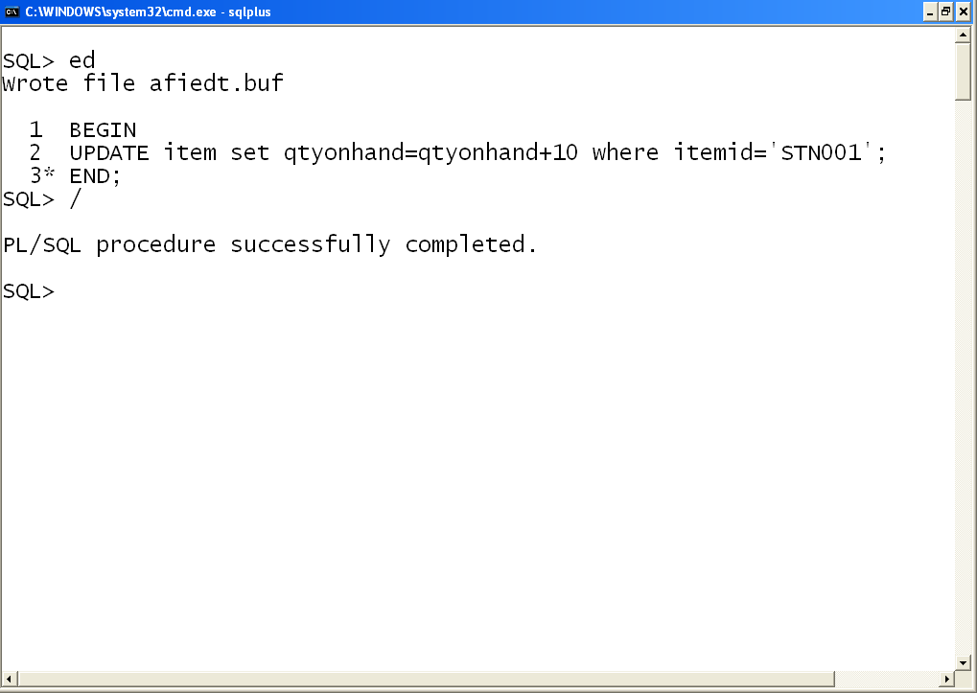
Using COMMIT in PL/SQL
1. There could be some other DML statements which would have been executed before this UPDATE statement
2. No assurance that this is first DML statement which modifies the database, hence may or may not the beginning of transaction
3. No commit statement present, hence not an end of the transaction
4. Transactions are not tied to PL/SQL BEGIN.. END blocks
Notes:
RDBMS Essentials Day 5

Slide 25
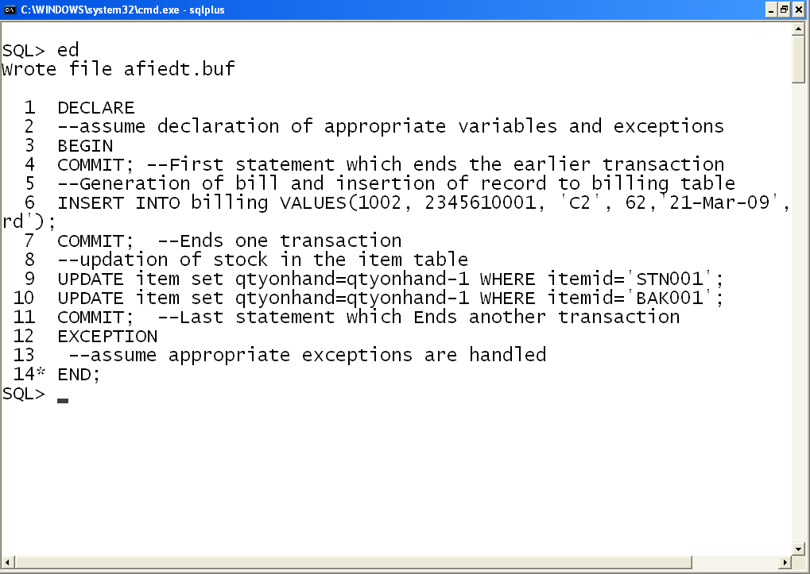
Using COMMIT in PL/SQL
1.First COMMIT statement ends the earlier transaction. A DML statement for generation of BILL which starts the transaction
2.COMMIT ends that generation of bill transaction
4.A PL/SQL block can contain multiple transactions
3.Updating of stock in the item table is another transaction which ends with a COMMIT
Notes:
RDBMS Essentials Day 5

Slide 26
Using ROLLBACK in PL/SQL
ROLLBACK statement ends the current transaction
Helps in undoing any changes made during that transaction
Making mistakes such as deleting a wrong row can be restored
Notes:
RDBMS Essentials Day 5

Slide 27
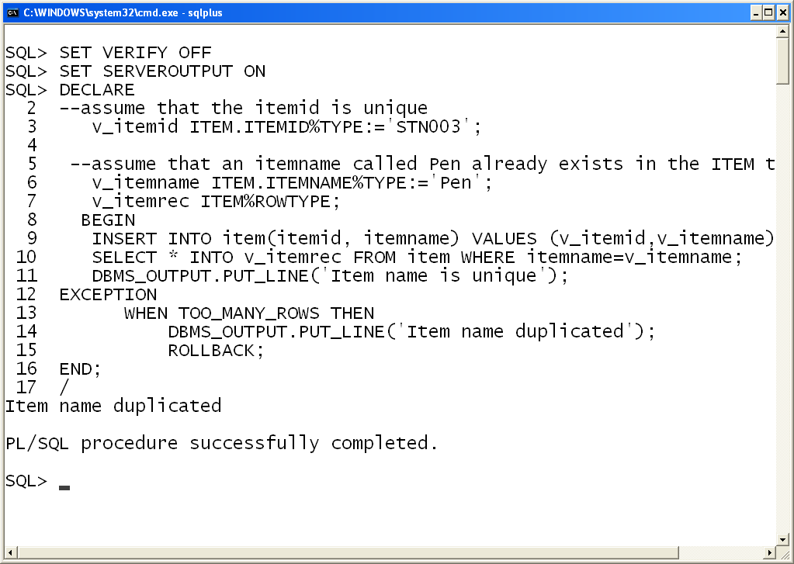
Using ROLLBACK in PL/SQL
1. Inserting an item record into ITEM table
2. An item named Pen already exists in the item table
4. TOO_MANY_ROWS exception would be thrown, where the insertion is rolled back
3. After insertion, a select for that item name is done, which fetches multiple records
Notes:
RDBMS Essentials Day 5

Slide 28
Using SAVEPOINT in PL/SQL
SAVEPOINT statement lets us to rollback part of a transaction instead of the whole transaction
SAVEPOINT names and marks the current point in the processing of a transaction
The number of save points for each session is unlimited
Notes:
RDBMS Essentials Day 5

Slide 29
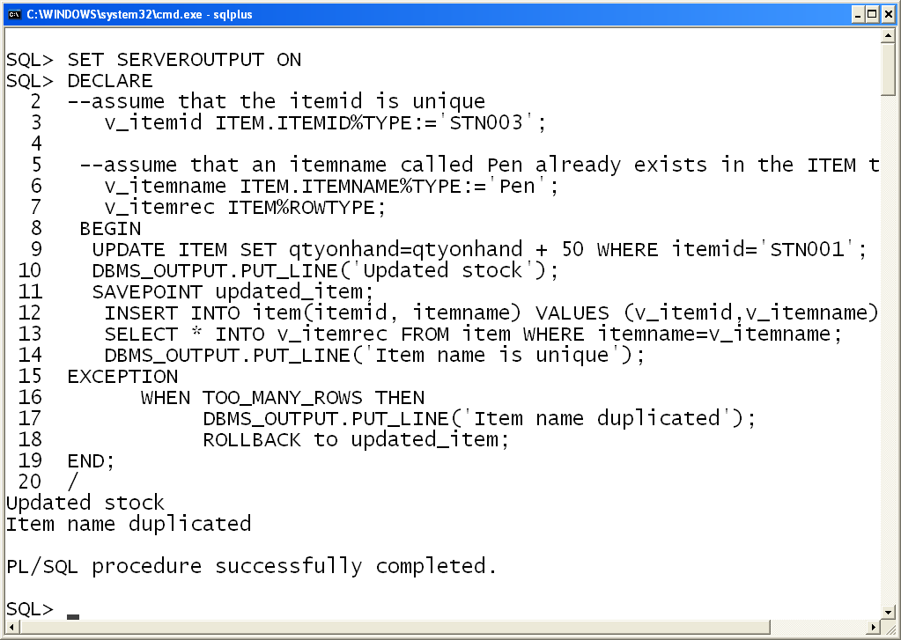
Using SAVEPOINT in PL/SQL
1.Savepoint names are undeclared identifiers
2. Stock of an itemid is updated and a savepoint created
4. If already an item named Pen exists too_many_rows exception would be thrown which rollbacks only the insertion
3. Another item with itemid STN001 named Pen is inserted into the ITEM table
Notes:
RDBMS Essentials Day 5

Slide 30
Ending transactions
We should explicitly COMMIT or ROLLBACK every transaction
If you do not explicitly COMMIT or ROLLBACK a transaction, the client environment determines the final state
Notes:
RDBMS Essentials Day 5

Slide 31
SQL*PLUS Environment – Self Study
Assume your PL/SQL block does not include a COMMIT or ROLLBACK statement which got executed, and you are presently in SQL environment
What happens to the changes made by that PL/SQL block? Would it be committed or rollbacked?
In SQL, if you subsequently execute a DDL or DCL or COMMIT or QUIT or EXIT or DISCONNECT command, Oracle commits the transaction
In SQL, if you subsequently execute a ROLLBACK or abort the SQL*PLUS session, Oracle rolls back the transaction
Notes:
RDBMS Essentials Day 5

Slide 32
Concurrency control in Oracle
A simple way to think of oracle read consistency is
Readers do not wait for Writers ( or other readers of the same data)
Writers do not wait for Readers (of the same data)
Writers only wait for other Writers if they attempt to update identical rows in concurrent transactions
Notes:
RDBMS Essentials Day 5

Slide 33
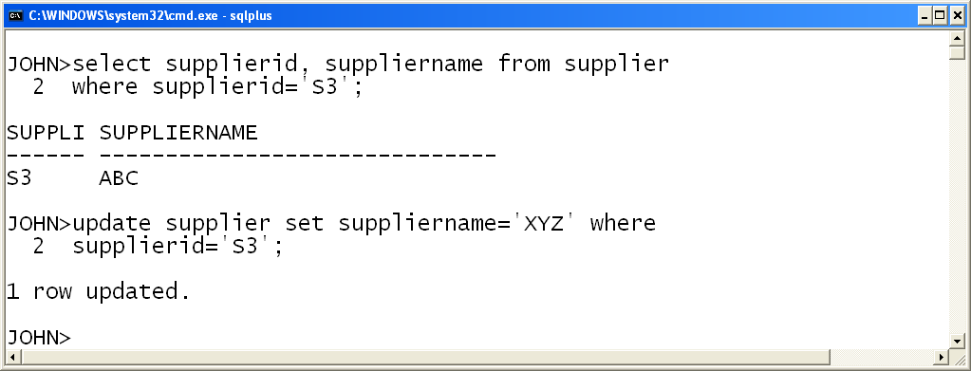
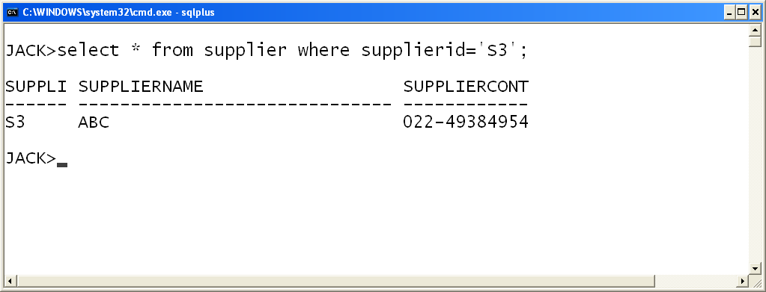
Readers do not wait for Writers
JOHN (writer) updates the supplier name where supplierid=‘S3’
JACK (reader) reads the suppliername where supplied =‘S3’ during the same time, and he need not wait for the completion of updation by JOHN
Notes:
RDBMS Essentials Day 5

Slide 34
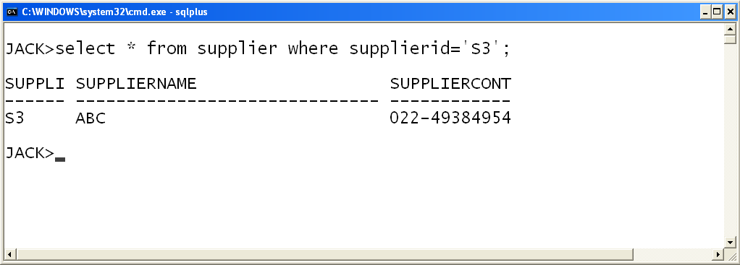
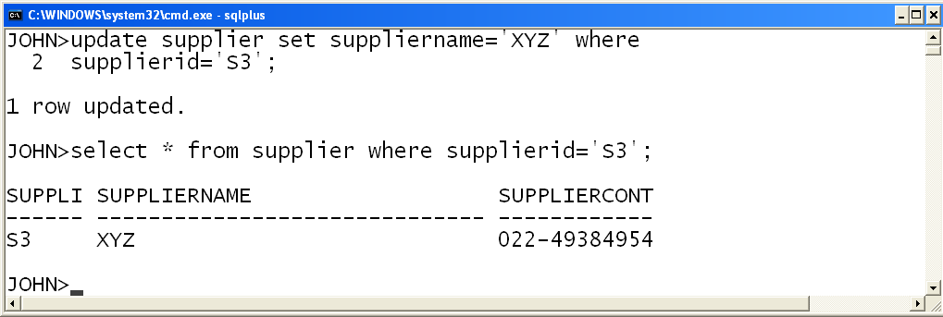
Writers do not wait for Readers
JACK (reader) reads the supplier details for supplier id=‘S3’
JOHN (writer) updates the supplier name during the same time without waiting for JACK
Notes:
RDBMS Essentials Day 5

Slide 35
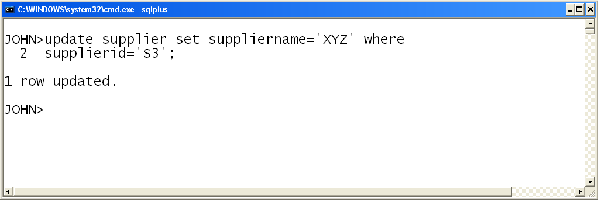
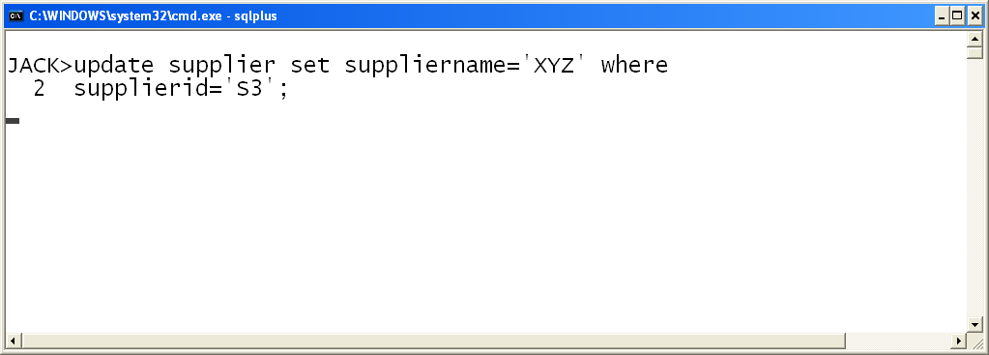
Writers wait for Writers of same data
JOHN (writer) updates the supplier name where supplierid=‘S3’
JACK (writer) also tries to update the same supplier name, where he has to wait until JOHN either commits or rollback
-
Notes:
RDBMS Essentials Day 5

Slide 36
Summary
Backup and Recovery
Transaction processing in PL/SQL
Concurrency control in oracle
Notes:
RDBMS Essentials Day 5

Slide 37
APPENDIX – Self Study
Notes:
Topics in appendix are included for assessment.

Slide 38
Using COMMIT in PL/SQL - Example
Requirement
Updation of supplier name in supplier table
Input
Accept the supplierid and new supplier name
Business logic
Check whether the old and new supplier name are same. Prevent updation if the old and new supplier names are same else perform the updation
Output
If the supplier id input is invalid print “Invalid supplierid “
If the old and new supplier names are same print “Old and new names are same”
Notes:
RDBMS Essentials Day 5

Slide 39
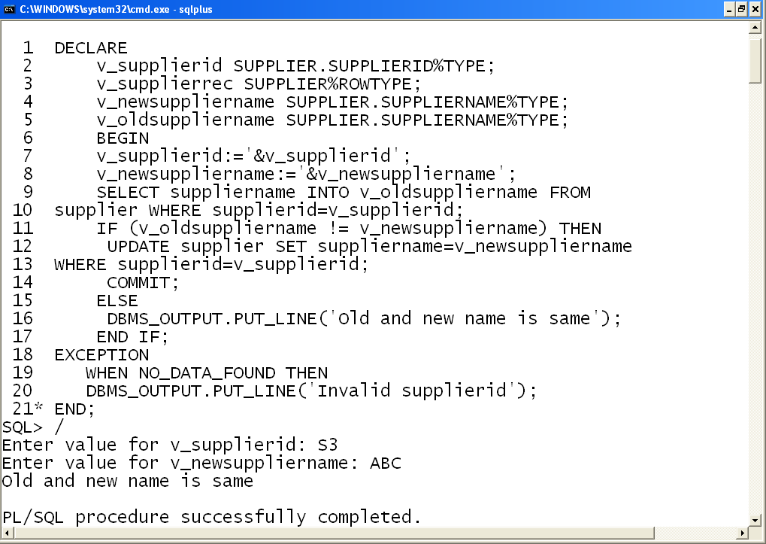
Using COMMIT in PL/SQL
Accept the supplierid, suppliername
Check the existence of the supplierid
Compare the old and new suppliername and update if both are unequal
Commit the changes done to the table
Notes:
RDBMS Essentials Day 5

Slide 40
Thank You
“The contents of this document are proprietary and confidential to Infosys Technologies Ltd. and may not be disclosed in whole or in part at any time, to any third party without the prior written consent of Infosys Technologies Ltd.”
“© 2008 Infosys Technologies Ltd. All rights reserved. Copyright in the whole and any part of this document belongs to Infosys Technologies Ltd. This work may not be used, sold, transferred, adapted, abridged, copied or reproduced in whole or in part, in any manner or form, or in any media, without the prior written consent of Infosys Technologies Ltd.”
Notes:
RDBMS Essentials Day 5

