Slide 1
RDBMS Essentials - Day 6
Notes:
RDBMS Essentials Day6

Slide 2
Recap
Backup and Recovery
Transaction processing in PL/SQL
Concurrency control in oracle
Notes:
RDBMS Essentials Day6

Slide 3
Day6 – Session Plan
SQL Tuning
PL/SQL – Best Practices
Project Briefing
Notes:
RDBMS Essentials Day6

Slide 4
SQL query tuning
Notes:
RDBMS Essentials Day6

Slide 5
SQL query tuning
What is tuning ?
Tuning is basically an activity, which helps to increase the performance of a system
Why?
To get the best throughput/response time
To make the best use of the available resources
Who is responsible ?
Notes:
Tuning goals vary for different applications
For OLTP systems, throughput is important
FOR DSS systems, response time is vital
Who is responsible?
Developer? Or DBA? developer
80% of responsibility is with developers and 20% is with DBA

Slide 6
SQL processing components
SQL Query
Result
Checks for correct statement syntax and all objects referred exist
Parser
Determines the efficient way for processing and creates execution plan
Optimizer
Processes each row source and completes the execution plan
SQL Execution engine
Identifies the row source for each step in the execution plan
Row source generator
Notes:
SQL processing architecture
An understanding of SQL processing architecture and its components is necessary in order to determine how statements can be modified to execute more efficiently. SQL processing contains components such as
Parser, Optimizer, Row source generator, SQL execution engine
Parser
Checks the correctness of statement syntax
Also checks whether all objects referenced exist
Optimizer
Determines the most efficient way to process the statement by creating an execution plan
For example the optimizer determines whether an index would be used or a join operation has to be performed.
Two types of optimizer
Rule based optimizer , is an older method, which uses a list of rules to determine processing. For example, the rule based engine typically uses an index if one is available, even if it not beneficial
Cost base optimizer, is a newer methodology that uses database object statistics such as distribution of data to determine how best to process statements. If particular rows are being retrieved from a small table, the cost-based engine may decide not to use an index, as it would not increase the performance of the query
Row source generator
The row source generator sends the execution plan and the row source for each step in the plan to the execution engine. A row source returns a set of rows for the applicable step.
SQL execution engine
The execution engine processes each row source and completes the execution plan to produce the final results.
References: Joan Casteel ,"Oracle 9i Developer: PL/SQL programming", Shroff Publishers

Slide 7
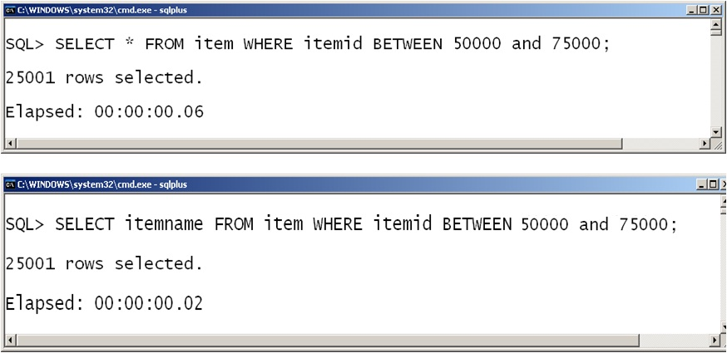
SQL Tuning - Avoid unnecessary column selection
Including columns that are not actually needed in a select list can have quite a detrimental effect on performance of a SQL query
Notes:
RDBMS Essentials Day6

Slide 8
SQL Tuning - Avoid expressions involving columns
Application developers should write conditions that compare columns with constants whenever possible
QTYONHAND > 2000
QTYONHAND > 24000/12
Computation of constants is performed only once
Do not write conditions with expressions involving columns
QTYONHAND+REORDERQTY > 24000
Notes:
RDBMS Essentials Day6

Slide 9
SQL Tuning - Rewriting IN and NOT IN
For comparing a list of variables and subqueries
Rewritten from column IN (var1, var2, var3)
to
column = var1 or column = var2 or column = var3
Notes:
Usually we use the ‘IN’ and ‘NOT IN’ operator for comparing a list of variables and subqueries. The usage of these operators in queries takes more time since it has to fetch all the records with the values given in the list and then it would check the records.
The statement column IN (var1, var2, var3) can be re-written as
column = var1 or column = var2 or column = var3
This would minimize the time taken for executing the query.
Applicable only if IN list has constant values.

Slide 10
SQL Tuning - BETWEEN and LIKE usage
BETWEEN
Used to provide a range of values
Rewritten from
Where column BETWEEN val1 and val2
to
Where column >= val1 and column <= val2
LIKE
Used to compare Wild Cards ‘%’ or ‘_’
If no Wild Cards are used, it is replaced with ‘=‘
Notes:
BETWEEN operator is used to provide a range of values. It is better to rewrite
Where column BETWEEN val1 and val2
to
Where column >= val1 and column <= val2
LIKE operator is used to compare wildcards '%' or '_' .
Usually its best to go for a LIKE operator if you want to use wildcard characters for all the places except the first position in the word.
For eg., like 'mala%' - this search works fine because it would use index
Whereas like '%alar' - this search works very slow since index could not be used.

Slide 11
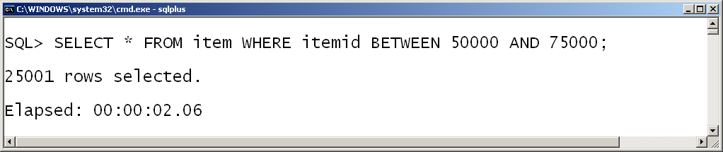
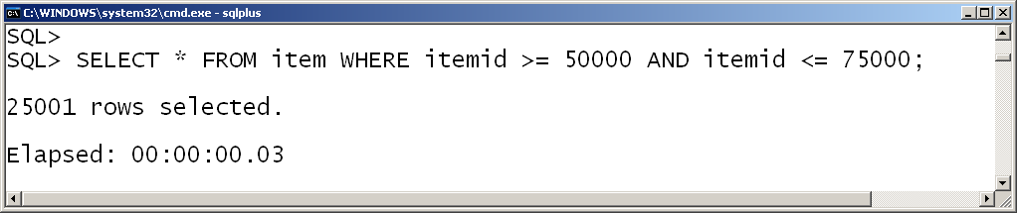
SQL Tuning - Between operator
1. Item record details are fetched and displayed using between operator
Notes:
RDBMS Essentials Day6

Slide 12
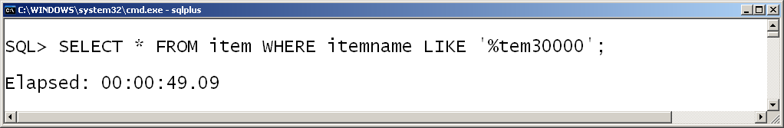
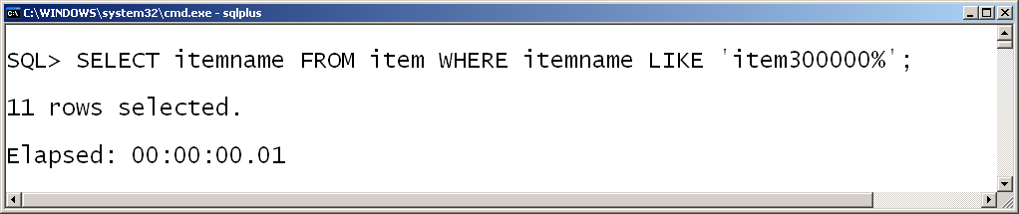
SQL Tuning - LIKE operator
1. If LIKE is used with first character as % (multi-character substitution), then index will not be used, despite its presence. Avoid writing queries like this.
1. If LIKE operator is used with % symbol but not as first character, then index is used
Notes:
RDBMS Essentials Day6

Slide 13
SQL Tuning - Don’t mix data types
Re-write from
SELECT *
FROM item
WHERE itemname||itemid = ' item90000 '
TO
SELECT *
FROM item
WHERE itemname = ‘item'
AND itemid= '90000'
Notes:
In the first statement
SELECT *
FROM item
WHERE itemname||itemid = ' item90000 '
index will not be used. If we are mixing the datatypes like this -> where itemname||itemid (here item_id is a number datatype and itemname is a varchar2 datatype), index cannot be used and it takes more time to execute. So we should not mix datatypes in our queries.
The same query can be re-written as
SELECT *
FROM item
WHERE itemname = ‘item'
AND itemid= '90000'
This uses the index and thus the execution is faster.

Slide 14
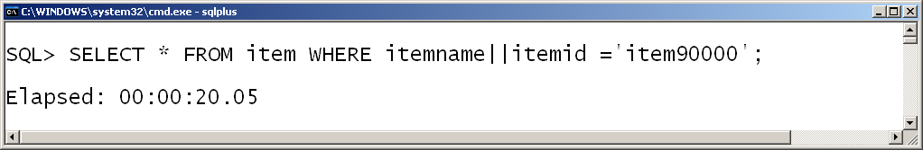
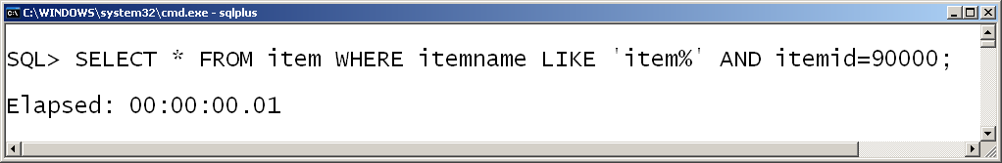
SQL Tuning - Don’t mix datatypes
1. Mixing of datatypes varchar2 and number, using concatenation operator . Index will not be used here
1. Separate condition is framed for itemname and itemid
Notes:
RDBMS Essentials Day6

Slide 15
SQL Tuning - Resource intensive operations
Resource intensive operations are those which take more time to execute, take more memory, more disk reads and disk writes to complete the process
Examples are queries which use DISTINCT, UNION, MINUS, INTERSECT, ORDER BY, GROUP BY clause are resource intensive
Most queries using set operations can be rewritten in other ways
Notes:
RDBMS Essentials Day6

Slide 16
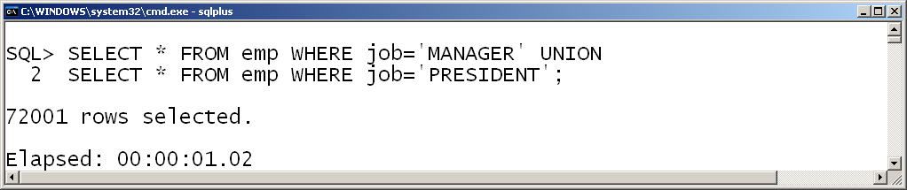
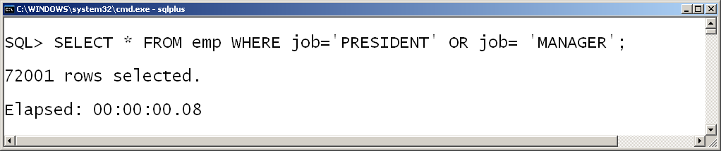
SQL Tuning - With UNION
1. Using UNION operator to select MANAGER & PRESIDENT records
1. Replacing UNION operator with OR operator
Notes:
RDBMS Essentials Day6

Slide 17
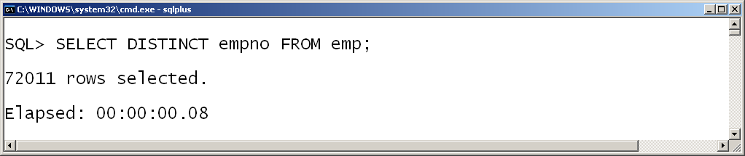
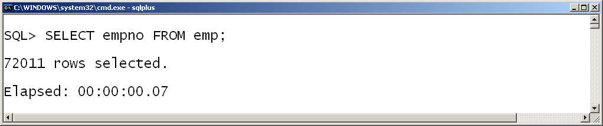
SQL Tuning - Unnecessary DISTINCT
1. Using unnecessary distinct operator with empno, despite the knowledge of empno being a primary key
1. Eliminated usage of unnecessary distinct operator with empno
Notes:
RDBMS Essentials Day6

Slide 18
SQL Tuning - EXISTS and IN
Usually EXISTS has better performance than IN, but certain circumstances it is better to use IN rather than EXISTS
If the selective predicate is in the subquery use IN operator
If the selective predicate is in the parent query use EXISTS operator
SELECT itemid FROM item k WHERE itemid IN
(SELECT itemid FROM customerpurchase c WHERE
c.qtypurchased <5)
SELECT itemid FROM item k WHERE EXISTS (SELECT
itemid FROM customerpurchase c WHERE
k.itemid = c.itemid AND k.unitprice<50)
Notes:
RDBMS Essentials Day6

Slide 19
Index
An Index is a structure that provides rapid access to the rows of a table based on the values of one or more columns
Indexing involves forming a two dimensional matrix completely independent of the table on which index is created
Here one column will hold the sorted data of the column which is been indexed
Another column called the address field identifies the location of the record i.e. Row ID
Row Id indicates exactly where the record is stored in the table
The SQL user is unaware of the presence or absence of the index on the table
Notes:
RDBMS Essentials Day6

Slide 20
Index
Syntax
Index on a single column
CREATE UNIQUE INDEX Cust_Idx
ON Customer_Details (Cust_ID);
Index on Multiple Column
CREATE UNIQUE INDEX ID_AccountNo_Idx
ON Customer_Details (Cust_ID, Account_No);
Drop a Index
DROP INDEX ID_AccountNo_Idx;
CREATE [UNIQUE] INDEX index-name ON table-name (column-name)
Notes:
INDEX:
A structure associated with tables used to speed up the queries. An index is an access path to reach the desired row faster.
Creating and dropping indexes does not affect the storage of data in the underlying tables.
One can create unique or non-unique indexes.
In most cases unique indexes are created automatically by Oracle when you create a primary key or a unique key constraint in a table.
When the primary key of the table or the unique constraint on column(s) is dropped the index which was built on them is also dropped automatically

Slide 21
Index
Advantages of having an INDEX
Greatly speeds the execution of SQL statements with search conditions that refer to the indexed column (s)
It is most appropriate when retrieval of data from tables are more frequent than inserts and updates
Disadvantages of having an INDEX
It consumes additional disk space
Additional overhead on DML statements
Notes:
RDBMS Essentials Day6

Slide 22
SQL Tuning- Columns NOT to Index
Columns that are constantly updated
Columns that contain a lot of null values
Columns that have a poor distribution of data
Columns that contain
Yes or No
True or False
Male or Female
Notes:
When we are inserting data in a table, we are implicitly inserting the same data into index also. So avoid indexing on columns that have regular updation.
Columns that have null values are not apt for indexing - null values are not stored in the index. So if we create index on columns that have null values, unnecessarily space is occupied for the index column.
Data selectivity refers to the unique values in a given column/total values in the given column. So based on the data selectivity in a column, we can decide which column to index and which not to index.

Slide 23
SQL Tuning- Indexing: The 95/5 Rule
If there are a large number of rows returned by a query, DO NOT USE AN INDEX or suppress a current index
Example: 95% of the rows have to be fetched
If there are only few rows returned by a query, USE AN INDEX
Example: 5% of the rows have to be fetched
Notes:
The 95/5 Rule says that
If there are a small number of rows returned by a query, Use an index. But it is always better to test the performance by using EXPLAIN PLAN.
If there are a Large number of rows returned by a query, Do NOT use an index or suppress a current index.

Slide 24
SQL Tuning- Understanding Indexes
Determining what to index
Primary keys are indexed by default. It is better to create indexes for foreign keys too
In transaction oriented systems there would be more inserts and more updates. In these type of systems, we need to create less no of indexes
In batch oriented systems where we face less inserts/less updates and we are going to use the systems primarily for taking reports , we can create more indexes so that we retrieve all the data faster for report generation
Notes:
RDBMS Essentials Day6

Slide 25
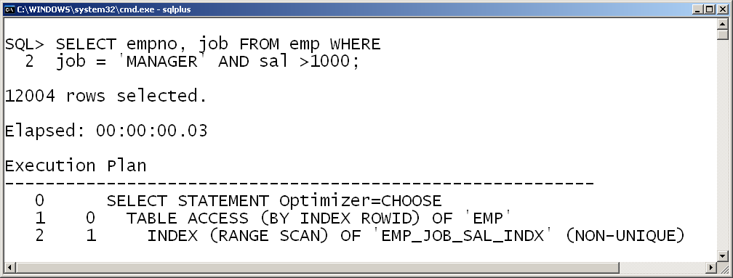
SQL Tuning- Understanding Indexes
1. Created concatenated index on job and sal column
2. Where condition operates with job and sal column
4. Completes within 3 ms
3. Concatenated Index is used followed by table access
Notes:
Concatenated index created with job and sal column would be used, while the WHERE condition of the SELECT query refers to both the columns

Slide 26
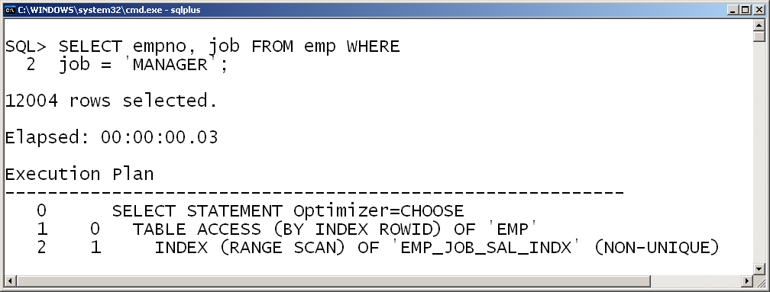
SQL Tuning- Understanding Indexes
1. Where condition operates with job column alone
3. Completes within 3 ms
2. Concatenated Index is used followed by table access
Notes:
Concatenated index created with job and sal column would be used, while the WHERE condition of the SELECT query refers to only the job column alone

Slide 27
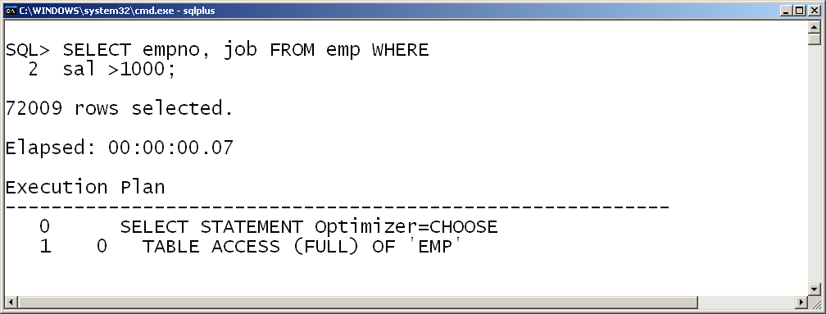
SQL Tuning- Understanding Indexes
1. Where condition operates with sal column alone
2. Concatenated Index created on job and sal, but NOT used.
3. Completes within 7 ms.
3. Where clause of Query uses second column sal. Hence table access alone
Notes:
Concatenated index created with job and sal column would NOT be used, while the WHERE condition of the SELECT query refers to only the sal column alone

Slide 28
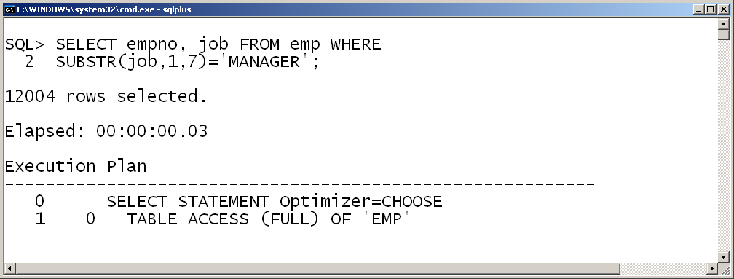
SQL Tuning- Understanding Indexes
1. Created an unique index for job column
2. Applied substring function for the job column
3. Completes within 3 ms
3. Index will not be used. Only table access is performed
Notes:
Concatenated index created with job and sal column would NOT be used, while the WHERE condition of the SELECT query refers to some SUBSTR function

Slide 29
PL/SQL – Best Practices
Notes:
RDBMS Essentials Day6

Slide 30
DECLARE – What is required by the code
After the completion of the code, search for un-used variables if any. Remove them from the code
Notes:
If the variable is not necessary, why should it be defined and executed? Due to multiple design changes or requirement changes, we might define lot of un-used variables; there may be some costly assign statements to initialize them. All of this adds to cost to performance.
Defer the execution till it required. There might be some declaration statements where the value is assigned though costly process. We can define them where it is actually being required.

Slide 31
Hand crafting the Built-in Functions
Built-in functions are more efficient
Do not handcraft one’s own versions of built-in functions for SUBSTR, RPAD, and LTRIM
Notes:
Built in functions are highly optimized and hence where ever possible usage of built in functions are recommended rather than handcrafting the same.

Slide 32
Inefficient Conditional Control Statements
Most probable condition must be placed initially
Now, consider the following AND expression:
IF discount_ok (cust_id) AND (v_amountpurchased > 5000) THEN
...
END IF;
The Boolean function discount_ok is always called
However, if one switch the operands of AND as follows:
IF (v_amountpurchased > 5000) AND discount_ok (cust_id) THEN
...
END IF;
The function is called only when the expression v_amountpurchased < 5000 is true
Notes:
When processing the IF statements, PL/SQL engine execute each condition till it returns TRUE. Once the exact match is found, it does not execute the remaining part of code under the IF statements. Therefore if most probable condition are placed initially then the processing time by PL/SQL engine comes down thus improves overall performance of the code.
The same idea applies to EXIT-WHEN statements as well.

Slide 33
Check the LOOP statements
Minimize the number of iterations inside loop. As soon as the code does the required job EXIT the loop
Loop within a loop – One common place where there is possibility of unnecessary code execution
Make sure that there should not be statements inside the loop that can be executed outside the loop
Notes:
Minimize the number of iterations inside loop. As soon as the code does the required job EXIT the loop.
Use condition like WHEN variable = <required condition>
Loop within a loop – One common place where there is possibility of unnecessary code execution. Unknowingly, the code for the first part of the loop gets executed under the inner loop.
FOR varaible1 IN 1..100 LOOP
FOR varaible2 IN 1..100 LOOP
variable3 := SQRT(variable1); => This should be executed outside this loop
Make sure that there should not be statements inside the loop that can be executed outside the loop. If there is a statement that does not refers/depends on loop variables, it may be possible to execute it outside the loop only once rather than many times.
For e.g.:
BEGIN
FOR temp_rec IN temp_cur
LOOP
Process_new_procedure(UPPER(variable1));
END LOOP
END;
Above case UPPER function is applied to the variable1 for each instance of the loop. Since the value of variable1 does not depend on the loop execution, it’s possible to execute this outside the loop.

Slide 34
Implicit Datatype Conversions
Avoiding implicit conversions can improve performance
DECLARE
V_Num NUMBER;
BEGIN
--implicit conversion required
V_Num := V_Num +15;
--no conversion required
V_Num := V_Num +15.0;
...
END;
DECLARE
V_Char CHAR(5);
BEGIN
--implicit conversion required
V_Char := 25;
--no conversion required
V_Char := '25';
...
END;
Notes:
Avoiding implicit conversions can improve performance.

Slide 35
Inappropriate Declarations for Numeric Datatypes
When one need to declare an integer variable, use the datatype PLS_INTEGER, which is the most efficient numeric type in PL/SQL
PLS_INTEGER can be assigned values between -2**31 .. 2**31, aka -2,147,483,647 to 2,147,483,647
To declare variables with PLS_INTEGER type, say
DECLARE
v_num PLS_INTEGER := 30;
BEGIN
v_num := v_num +15;
END;

Slide 36
Unnecessary NOT NULL Constraints
Unnecessary usage of NOT NULL constraints degrades the performance
DECLARE
v_number1 NUMBER NOT NULL := 0;
v_number2 NUMBER := 20;
v_number3 NUMBER := 40;
BEGIN
...
v_number1 := v_number2 + v_number3 ;
...
END;
DECLARE
v_number1 NUMBER; -- no constraint
v_number2 NUMBER :=20;
v_number3 NUMBER :=40;
BEGIN
...
v_number1 := v_number2 + v_number3 ;
IF v_number1 IS NULL THEN
-- enforce constraint programmatically
...
END IF;
END;
Notes:
Every time a NOT NULL variable is referred in the PL/SQL block, the system has to check whether is it having a NULL value or not. Hence if a variable is referred 1000 times within a PL/SQL block, 1000 times the NOT NULL constraint has to be applied.
The same can be enforced programmatically where ever necessary.

Slide 37
Summary
SQL Statement tuning
PL/SQL performance tuning
Notes:
RDBMS Essentials Day6

Slide 38
Thank You
“The contents of this document are proprietary and confidential to Infosys Technologies Ltd. and may not be disclosed in whole or in part at any time, to any third party without the prior written consent of Infosys Technologies Ltd.”
“© 2008 Infosys Technologies Ltd. All rights reserved. Copyright in the whole and any part of this document belongs to Infosys Technologies Ltd. This work may not be used, sold, transferred, adapted, abridged, copied or reproduced in whole or in part, in any manner or form, or in any media, without the prior written consent of Infosys Technologies Ltd.”
Notes:
RDBMS Essentials Day6

