Slide 1
RDBMS Essentials - Day 9
Notes:
RDBMS Essentials Day 7

Slide 2
Recap
Basic SQL query tuning
PL/SQL performance tuning
Notes:
RDBMS Essentials Day 7

Slide 3
Day9 – Session Plan
OLAP
Comparison between different vendors
Notes:
RDBMS Essentials Day 7

Slide 4
OLAP
Notes:
RDBMS Essentials Day 7

Slide 5
OLAP
An organization’s success also depends on its ability to analyze data and to make intelligent decisions that would potentially affect its future. Systems that facilitate such analysis are called On Line Analytical Processing (OLAP) systems
Notes:
RDBMS Essentials Day 7

Slide 6
Difference between OLTP and OLAP
Comparing Parameters | OLTP | OLAP
Definition | Online Transaction Processing | Online Analytical Processing
Data | Dynamic(day to day transactional / Operational data) | Static(historical data)
Data Atomicity | Data is stored at the microscopic level | Data is aggregated or summarized and stored at a higher level
Normalization | Normalized databases to facilitate insertion, updation and deletion | De-normalized databases to facilitate queries and analysis
History | Old data is purged or archived | Historical data stored to enable trend analysis and future predictions
Queries | Simple queries and updates. Queries use small amounts of data (one record or few records) For example, update account balance, enroll for a course | Complex queries. Queries use large amounts of data Example: Total annual sales for north region, Total monthly sales for north region
Notes:
RDBMS Essentials Day 7

Slide 7
Difference between OLTP and OLAP
Comparing Parameters | OLTP | OLAP
Updates | Updates are frequent | Updates are infrequent
Response time | Fast response time is important. Data must be up-to-date, consistent at all times | Transactions are slow. Queries consume a lot of bandwidth
Joins in queries | Joins are more and complex as tables are normalized. An OLTP system aims at one specific process Example: Ordering from an online store | Joins are few and simple as tables are de-normalized. An OLAP integrates data from different processes Example: Combines sales, inventory and purchasing data
Data models | Complex data models, many tables | Simple data models, fewer tables
Focus | OLTP focuses on performance | OLAP focuses on flexibility and broader scope
Notes:
RDBMS Essentials Day 7

Slide 8
Data Warehouse
A data warehouse is a repository which stores integrated information for efficient querying and analysis. Data warehouse has data collected from multiple, disparate sources of an organization. It is the basis for decision support and data analysis systems.
Notes:
RDBMS Essentials Day 7

Slide 9
Characteristics of Data Warehouse:
Subject-oriented: means that all data pertinent to a subject/ business area are collected and stored as a single unit
Integrated: means that data from multiple disparate sources are transformed and stored in a globally accepted fashion
Static/non-volatile: means data once entered into the warehouse does not change frequently. It is periodically updated if required
Time variant: Data warehouse maintains historical data which are used to analyse the business or market trends and facilitate future predictions
Notes:
References: An abstract “An Overview of Data Warehousing and OLAP Technology” by Surajit Chaudhuri & Umeshwar Dayal

Slide 10
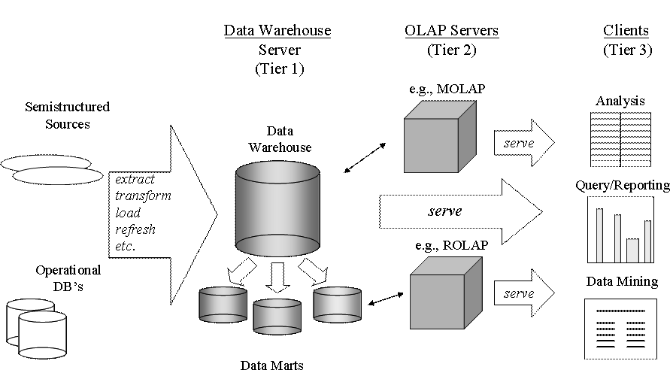
Data Warehouse Architecture
Notes:
References: An abstract “An Overview of Data Warehousing and OLAP Technology” by Surajit Chaudhuri & Umeshwar Dayal

Slide 11
Data Warehousing Terminology
Data sources: The sources of data for a data warehouse
Metadata: Metadata is the information about the data. This is the layer of the data warehouse which stores the information like
source data,
transformed data,
date and time of data extraction,
target databases,
data and time of data loading
Measure attributes: A numerical value that can be summarized or can be aggregated upon.
Dimension attributes: Dimensions can be defined as the perspectives used for looking at the data.
Dimensions are the answer to the question “How do you want to see your data?”
Notes:
Data sources: An organization has many functional units with their own data. Data from all such sources have to be consolidated and put into a consistent form that would reflect the business of an organization as a whole. These sources of data for a data warehouse are known as data sources or operational data sources.
Metadata: Metadata is the information about the data. This is the layer of the data warehouse which stores the information like the source data, transformed data, date and time of data extraction, target databases, data and time of data loading, etc.
Measure attributes: A numerical value that can be summarized or can be aggregated upon.
Dimension attributes: Dimensions can be defined as the perspectives used for looking at the data. Dimensions are the answer to the question “How do you want to see your data?”

Slide 12
ETL
Definition :
Extract, transform and load process is described as the process of selecting, migrating, transforming, cleansing and converting mapped data from the operational environment to data warehouse environment

Slide 13
ETL Process
Data is periodically extracted
User queries the data warehouse
Data Staging Area
Data
Warehouse
Data is cleansed and transformed
Source Systems

Slide 14
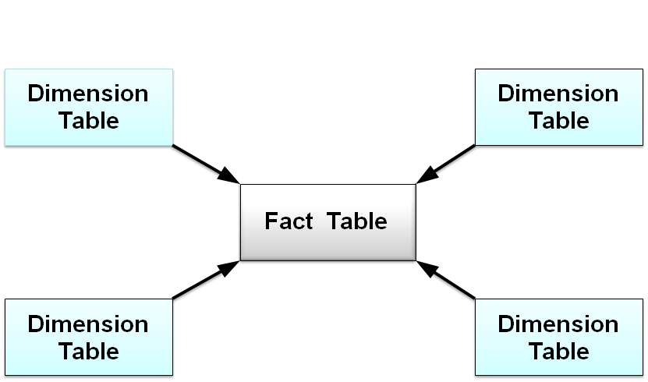
Storing of data in Data warehouse
Dimensional Modeling: The dimensional modeling is also known as star schema because in dimensional modeling there is a large central fact table with many dimension tables surrounding it
Fact Tables: Each data warehouse or data mart includes one or more fact tables. A fact table is central to a star or snowflake schema, and captures the data that measures the organization's business operations. Fact tables usually contain large numbers of rows.
Notes:
Dimensional Modeling: The dimensional modeling is also known as star schema because in dimensional modeling there is a large central fact table with many dimension tables surrounding it.
Fact Tables: Each data warehouse or data mart includes one or more fact tables. A fact table is central to a star or snowflake schema, and captures the data that measures the organization's business operations. Fact tables usually contain large numbers of rows.
Dimension Tables: The attributes in these tables describe the fact records in the fact table. It contains attributes which summarize the useful information required by the analyst. Dimension table even contains attributes providing descriptive information. Some attributes have hierarchies for example a dimension containing information about product may contain a hierarchy that separates products into categories, with each of these categories further subdivided into manufacturer.
Cube: The OLAP tools allows you to turn data stored in relational databases into meaningful, easy to navigate business information by creating data cube. The dimensions of a cube represent distinct categories for analyzing business data. Categories such as time, geography or product line breakdowns are typical cube dimensions.
References:Inmon, W.H., Building the Data Warehouse. John Wiley, 1992

Slide 15
Storing of data in Data warehouse
Dimension Tables: The attributes in these tables describe the fact records in the fact table. It contains attributes which summarize the useful information required by the analyst. Dimension table even contains attributes providing descriptive information. Some attributes have hierarchies for example a dimension containing information about product may contain a hierarchy that separates products into categories, with each of these categories further subdivided into manufacturer.
Cube: The OLAP tools allows you to turn data stored in relational databases into meaningful, easy to navigate business information by creating data cube. The dimensions of a cube represent distinct categories for analyzing business data. Categories such as geography,time or product line breakdowns are typical cube dimensions.
Notes:
RDBMS Essentials Day7

Slide 16
Storing of data in Data warehouse
Dimension hierarchies: The product dimension contains individual products. Products are classified into categories, and further classified according to manufacturer. The hierarchy for the dimension is stored in the dimension table
Day
Products_
Month
Manufacturer
Products_
Quarter
Category
Products
Year

Slide 17
Schemas for dimensional modeling
Star schema: It is the simplest data warehouse schema. It resembles a star. The center of the star consists of one or more fact tables and the points radiating from the center are the dimension tables
Snowflake Schema: It is a complex data warehouse schema. The snowflake schema has a single, central fact table surrounded by normalized dimension hierarchies. Each dimension level is represented in a table
Notes:
RDBMS Essentials Day7

Slide 18
Star Schema
Star Schema
Dimension
Dimension
Table
Table
Fact Table
Dimension
Dimension
Table
Table
Notes:
RDBMS Essentials Day7

Slide 19
Snowflake Schema
Products_
Manufacturer
Products_
Category
Products
Dimension
Table
Fact Table
E.g. Sales
Customers
Dimension
Table
Countries
Cities
Notes:
RDBMS Essentials Day7

Slide 20
Data Mart
A data mart is a subset of a data warehouse which focuses on a single area of data and it is organized for quick analysis. It can be a small data warehouse itself.
Data Warehouse
Data Mart1
Data Mart2
Data Mart3
End User 1
End User 2
End User 3
Notes:
RDBMS Essentials Day7

Slide 21
Advantages of Data Marts
It focuses on presentation rather than the organization of data
It facilitates data reporting
It provides meaningful reports to the users pertaining to their business area thereby allowing them to view and concentrate only on the data that is related to their business area
It makes the data design simpler and easier. It breaks the whole design into several smaller sub units which is beneficial to the customers and the development team. It is also easier to maintain
Reporting of data becomes faster and more efficient because reporting is generally done at the sub unit level and data marts assist in faster retrieval compared to querying the entire data warehouse
It helps in incrementally building up the enterprise data warehouse
It helps to ensure security
Notes:
RDBMS Essentials Day7

Slide 22
Difference between Data Warehouse & Data Mart
Data Warehouse | Data Mart
A data warehouse is a repository which stores integrated information from multiple disparate sources for efficient querying and analysis | A data mart is a subset of a data warehouse which focuses on a single area of data and it is organized for quick analysis.
It mainly focuses on the organization of data and offers little focus about the presentation of data. | It focuses mainly on the presentation of data to the customers rather than the way in which the data is organized in the data warehouse
There is usually a central data warehouse system | There can be several data marts that operate on the central data warehouse
Data Warehouse is used on an enterprise level | Data Mart is used on a business division / department level
Data Warehouse contains data from heterogeneous sources for analysis | Data Mart focuses on a specific subject and specific data for local analysis
Notes:
RDBMS Essentials Day7

Slide 23
Comparison between SQL Server and DB2
Notes:
RDBMS Essentials Day7

Slide 24
Current Market Leaders(Self Study)
 | Oracle | DB2 | SQL Server, MS Access
Vendor | Oracle | IBM | Microsoft
Version | Oracle 9i | DB2 v8.1 | SQL Server 2000, MS Access
Website | www.oracle.com | www.ibm.com | www.microsoft.com
Notes:
RDBMS Essentials Day7

Slide 25
Platform Requirement (Self study)
 | Windows NT/2000 | UNIX | Linux
Oracle 9i | Y | Y | Y
DB2 | Y | Y | Y
SQL Server 2000, MS Access 2003 | Y | N | N
Notes:
RDBMS Essentials Day7

Slide 26

Support Data Types (Self study)
Data Types | Oracle 9i | DB2 | SQL Server 2000
Built-in data types
User defined data types
Notes:
RDBMS Essentials Day7

Slide 27
Program Language Support (Self study)
 | Oracle 9i | DB2 | SQL Server 2000
Cobol | N | Y | N
C/C++ | Y | Y | Y
SQL | Y | Y | Y
PL/SQL | Y | N | N
Visual Basic | Y | Y | Y
Perl | Y | Y | N
Java | Y | Y | N (.NET)
XML | Y | Y | Y
Notes:
RDBMS Essentials Day7

Slide 28
Scalability(Self study)
DB2 | Oracle 9i | SQL Server 2000 | MS-Access
Handle terabytes of data | Handle gigabytes of data but gives poor performance in terabytes of data | Handle gigabytes of data but works only on Intel and Microsoft's platform | Handle only 2 gigabytes of data
Excellent scalability | Very good scalability | Good scalability | Very poor scalability
Notes:
RDBMS Essentials Day7

Slide 29
Price(Self Study)
Oracle 9i | Personal Edition $400 named user Standard Edition $15,000 per processor Enterprise Edition $40,000 per processor Extra price for Spatial, Data Mining, Label Security, Advanced Security, Enterprise Manager tools
DB2 | Version 8.1.4 of DBII Everyplace Enterprise Database package costs $15,000 per processor
SQL Server 2000 | Personal Edition Comes with Enterprise Edition Enterprise Edition range $1599.95 - $10594.02 per processor
MS-Access | MS-Access comes with MS office App.. $250
Notes:
RDBMS Essentials Day7

Slide 30
Summary
An OLAP application requires historical data because an analysis is generally based on a substantial amount of historical data to enable trend analysis and future predictions
A data warehouse is a repository which stores integrated information for efficient querying and analysis
Extract, transform and load process (ETL) is described as the process of selecting, migrating, transforming, cleansing and converting mapped data from the operational environment to data warehouse environment
A data mart is a subset of a data warehouse which focuses on a single area of data and it is organized for quick analysis.
Notes:
RDBMS Essentials Day7

Slide 31
Summary
Star Schema is the simplest data warehouse schema. It resembles a star. The center of the star consists of at least one or more than one fact tables and the points radiating from the center are the dimension tables
. The snowflake schema consists of a single, central fact table, which is surrounded by dimension hierarchies which are normalized.
Notes:
RDBMS Essentials Day7

Slide 32
Thank You
“The contents of this document are proprietary and confidential to Infosys Technologies Ltd. and may not be disclosed in whole or in part at any time, to any third party without the prior written consent of Infosys Technologies Ltd.”
“© 2008 Infosys Technologies Ltd. All rights reserved. Copyright in the whole and any part of this document belongs to Infosys Technologies Ltd. This work may not be used, sold, transferred, adapted, abridged, copied or reproduced in whole or in part, in any manner or form, or in any media, without the prior written consent of Infosys Technologies Ltd.”
Notes:
RDBMS Essentials Day7

Slide 33
Appendix (Not for Assessment)
Notes:
RDBMS Essentials Day7

Slide 34
Popular tools available for data warehousing - Reference
Reporting / Analysis Tools:
Micro Strategy: DSS Agent / Server
Cognos: Improptu
Brio Technology: Brio Query
Seagate Software: Crystal Reports
ETL:
Data Junction
Microsoft DTS (Available with SQL Server 7.0 and above)
Oracle Warehouse Builder
Informatica: PowerMart
IBM: DataPropagator
Acta: ActaWorks
Databases:
MDDB
Oracle Express
SAS
Notes:
RDBMS Essentials Day7

