Slide 1

Hotel Revenue Management

Slide 2
This project develops a Hotel Revenue Management System to analyze booking, customer, and room data for improving occupancy and revenue performance. A star schema data model is used to calculate key metrics such as Occupancy Rate, ADR, and RevPAR across time and booking channels. Guest behavior, cancellation trends, and future occupancy are analyzed to support demand forecasting. The final interactive dashboard provides actionable insights on pricing, upselling, and revenue optimization for hotel management.

Slide 3
MODULE 1 - DATA MODELING AND INGESTION
Module Overview
  This module establishes the data foundation of the HotelRevAI system.
  Raw booking, customer, room, and hotel branch data are ingested, cleaned, and standardized.
Data Architecture
  A star schema is designed with FactBookings at the center.
  Connected dimensions include Date, Room, Customer, and Hotel Branch for scalable analysis.
Data Enrichment
  Key derived fields such as booking duration, room category, and stay type are calculated.
  These enrich the dataset and enable accurate downstream analytics.
Business Impact
  Ensures data accuracy, consistency, and performance.
  Provides a reliable base for occupancy, revenue, forecasting, and strategy dashboards.

Slide 4
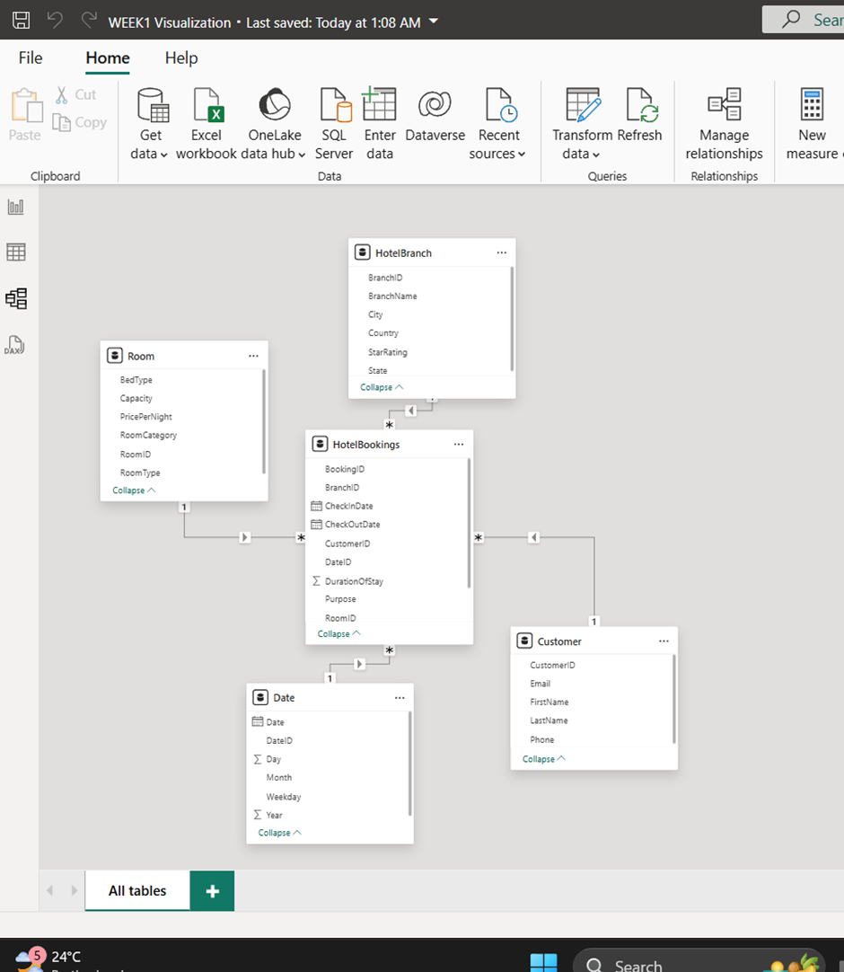
STAR SCHEMA DESIGN
  This Power BI data model uses a star schema where HotelBookings is the fact table connected to dimensions like Date, Customer, Room, and HotelBranch, enabling efficient analysis of hotel performance, revenue trends, and customer behavior.
  It enables analysis of booking trends, revenue, occupancy, and customer behavior across time and locations.
  The structure ensures better performance, easy filtering, and accurate KPI calculations.

Slide 5
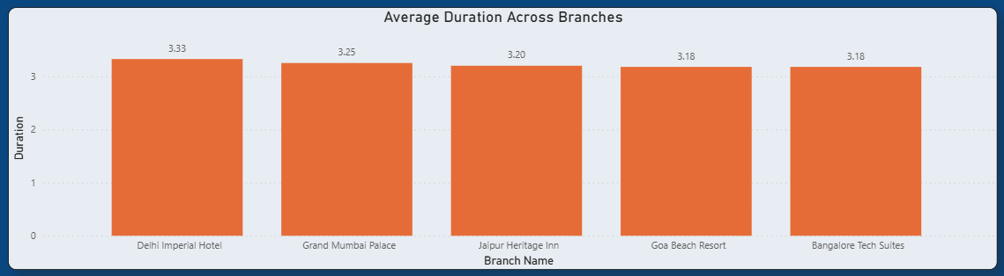
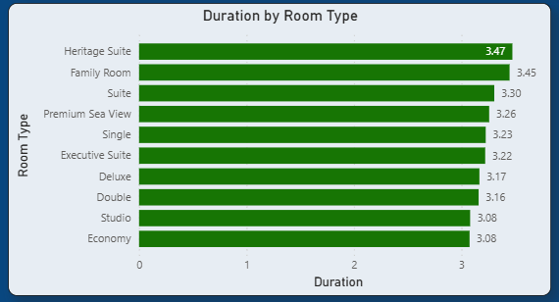
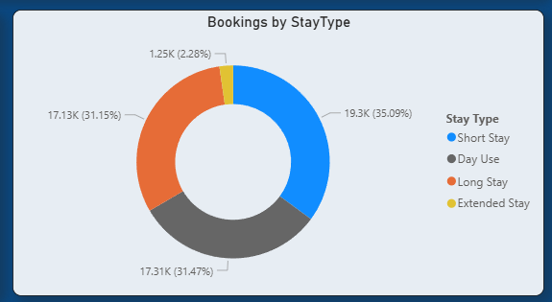
DURATION & STAY PATTERN INSIGHTS
Stay Duration Insights Across Branches, Room Categories, And Stay Types

Slide 6
MODULE 2 - OCCUPANCY AND REVENUE METRICS
Purpose of the Module
  This module evaluates hotel performance using three industry-standard KPIs:
    Occupancy %
    Average Daily Rate (ADR)
    Revenue per Available Room (RevPAR)
Key Insights Delivered
  Tracks operational efficiency (Occupancy)
  Measures pricing strength (ADR)
  Assesses overall revenue performance (RevPAR)
Business Value
  Enables hotel managers to:
    Identify demand patterns
    Optimize room pricing
    Balance occupancy and revenue growth
  Supports data-driven revenue management decisions

Slide 7
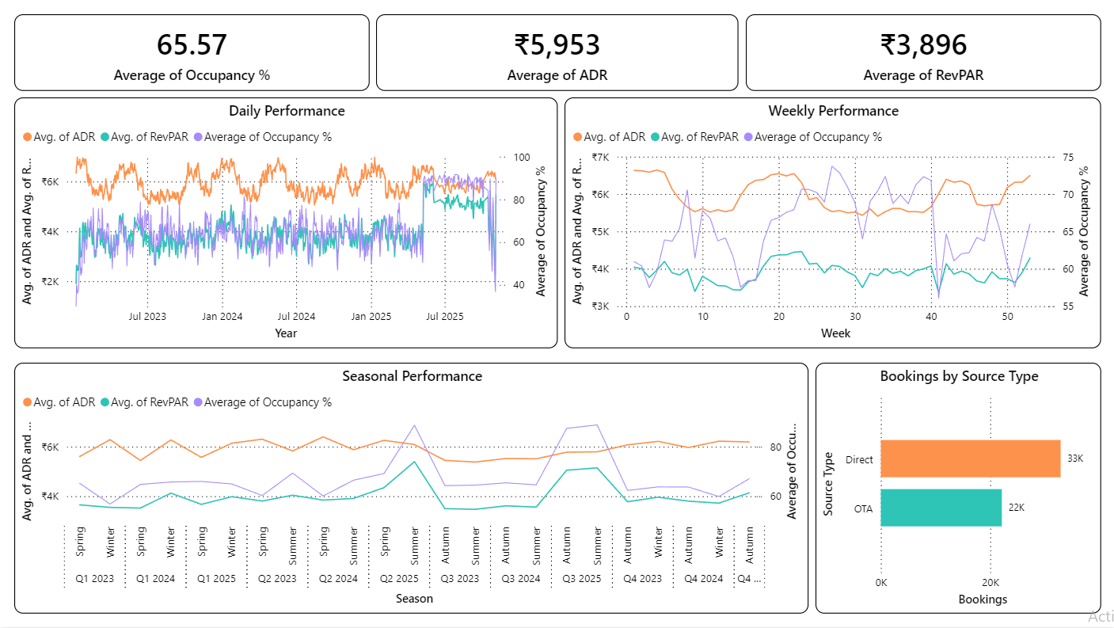
PERFORMANCE TRENDS & BOOKING CHANNEL ANALYSIS
Key Insights
  Stable occupancy (~65%) with visible daily volatility.
  Weekly trends highlight predictable high-demand periods.
  Seasonal peaks support dynamic pricing strategies.
  Direct bookings outperform OTA, reducing commission impact.

Slide 8
KPI CALCULATIONS IN POWER BI
Occupancy %
Occupancy % = DIVIDE('CalculationTable'[RoomsBooked], 'CalculationTable'[TotalRooms], 0) * 100
  Measures room utilization efficiency.
Average Daily Rate (ADR)
ADR = DIVIDE('CalculationTable'[TotalRevenue], 'CalculationTable'[RoomsBooked], 0)
  Indicates average revenue earned per occupied room.
Revenue Per Available Room (RevPAR)
RevPAR = DIVIDE('CalculationTable'[Occupancy %], 100, 0) * 'CalculationTable'[ADR]
  Combines occupancy and pricing to reflect overall revenue performance.

Slide 9
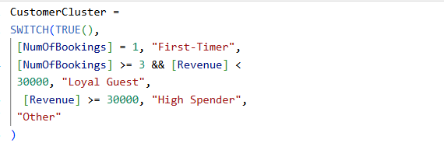
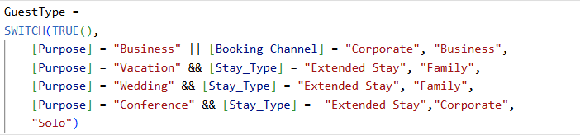
GUEST ANALYSIS
  Objective: To classify hotel guests into distinct segments and behavioral clusters to enable targeted
marketing and personalized services.
  The 3 Core Parts:
    Guest Type Analysis: Segmenting by purpose (Business, Family, Solo, Corporate).
    Customer Clustering: Grouping by value & frequency (First-Timers, Loyal Guests, High Spenders).
    Visual Dashboards: Bar Charts, Pie Charts and Geographic Maps to visualize patterns.
  PowerBI Formulas:
Customer Cluster in Fact Table (Bookings)
Guest Type in Fact Table (Bookings)

Slide 10
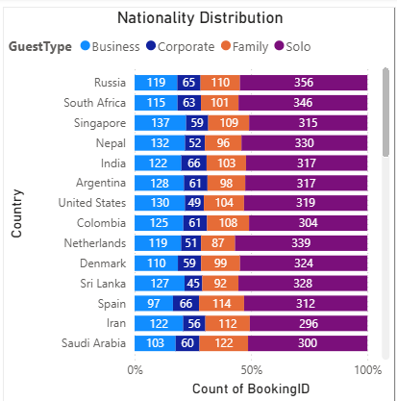
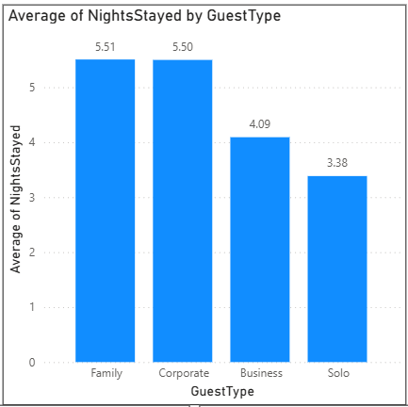
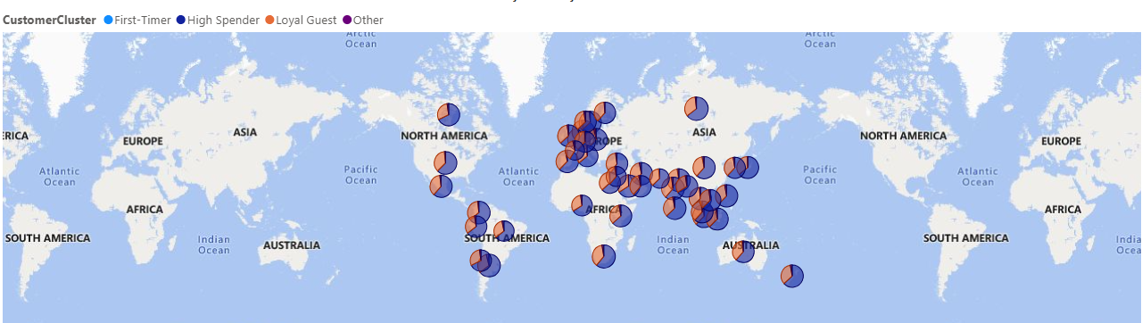
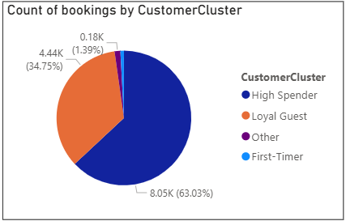
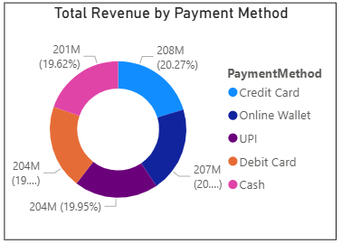
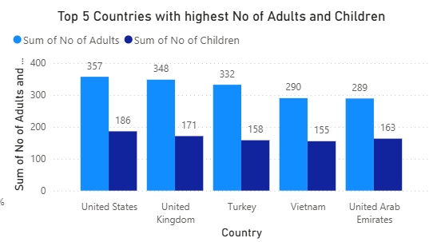
GUEST SEGMENTATION AND DEMOGRAPHIC ANALYSIS

Slide 11
INSIGHTS
  Guest Dynamics:
    Volume Driver: Solo travelers are the dominant segment across all nationalities.
    Family & Corporate guests stay significantly longer (Avg. 5.5 nights) compared to Solo travelers (3.4 nights).
  Customer Composition:
    High Retention: 63% of bookings come from "High Spenders" and 35% from "Loyal Guests."
    Acquisition Gap: "First-Timer" bookings are negligible (<2%), indicating a critical need for new customer acquisition strategies.
  Payments and Top Locations:
    Payment Equality: Revenue is evenly distributed (~20% each) across all 5 payment methods (Cash, Card, UPI, Wallet), showing flexible payment adoption.
    Key Markets: USA, UK, and Turkey are the top geographic sources for Family (Adult + Child) bookings.

Slide 12
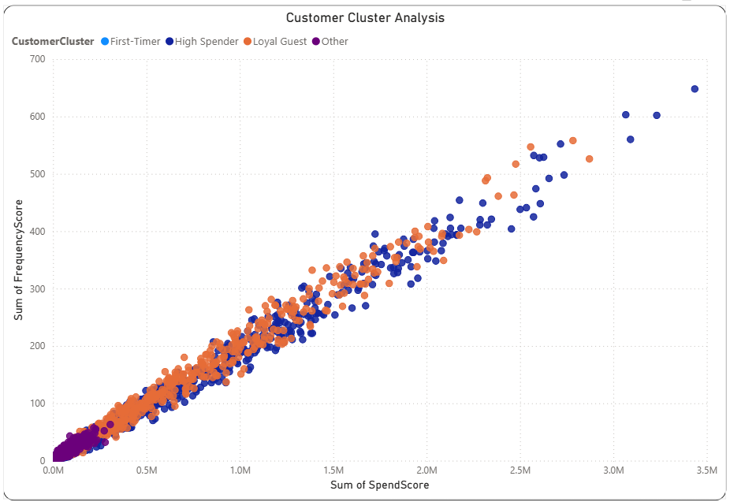
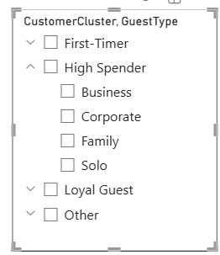
GUEST SEGMENTATION AND DEMOGRAPHIC ANALYSIS
  Visual Overview
    The chart maps Spend Score (X-Axis) against Frequency Score (Y-Axis).
    It reveals a near-perfect linear relationship:
Higher Frequency = Higher Total Spend
  Key Performance Insights
    Volume-Driven Revenue: There are no "one-time big spenders"; the highest spenders are simply the most frequent visitors.
    The "Elite" Tier: The High Spender cluster (Dark Blue) outperforms "Loyal Guests" in both visit count and total revenue.
    The "Other" Bottleneck: A massive density of low-value guests (Purple) sits at the bottom-left (<0.5M Spend). These guests visit rarely and spend little.
High Spenders significantly outperforms Loyal Guests in
both visit frequency and total spend.

Slide 13
MODULE 4: FORECASTING AND CANCELLATION TRENDS
Purpose of Module:
  This module analyzes booking behavior and operational risks that directly affect hotel revenue realization.
Key insights delivered:
  Occupancy forecasting (Future Scope)
  Cancellation trends
  Lead time distribution
  Refund and no-show behavior
Business Value:
  Helps management anticipate demand uncertainty
  Identifies revenue leakage risks due to cancellations and no-shows
  Improves forecast accuracy and capacity planning
  Supports proactive overbooking and cancellation policies

Slide 14
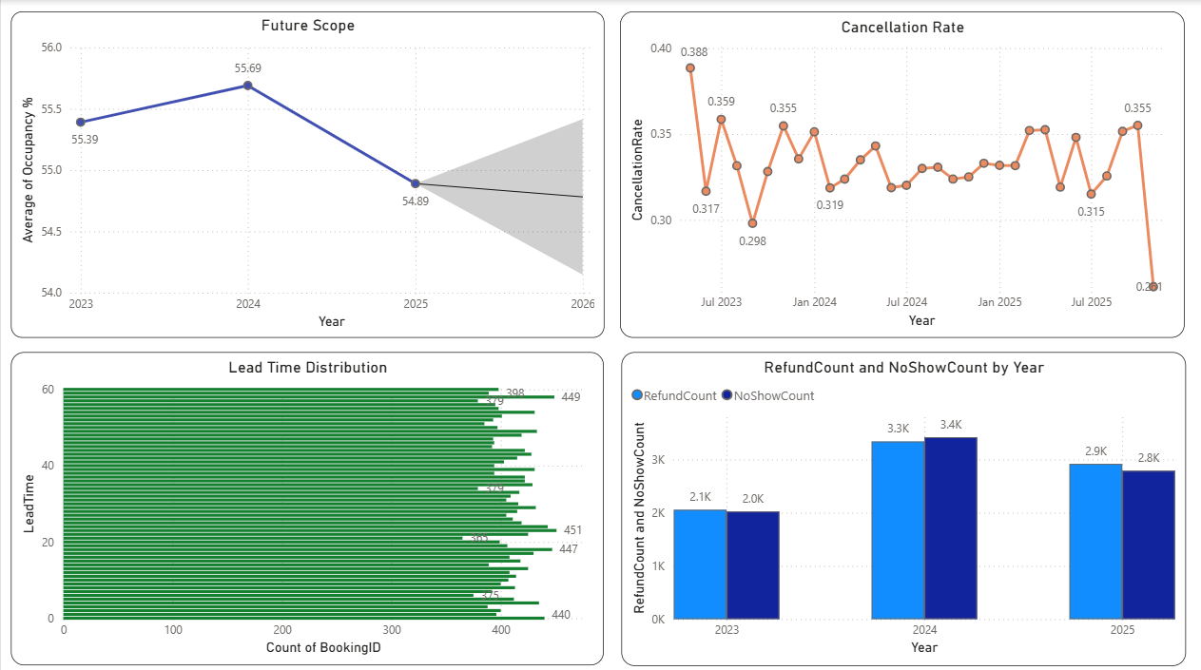
FORECASTING AND CANCELLATION INSIGHTS
Key Insights:
  Occupancy: Increased to 55.69% (2024), dropped to 54.89% (2025) with uncertain outlook.
  Cancellation Rate: Fluctuates between ~29% and ~38% across months.
  Lead Time: Majority bookings fall within 0–60 days, showing mixed booking behavior.
  Refunds & No-Shows: Around 2K–3.4K bookings per year, nearly equal in volume.

Slide 15
KEY MEASURES & CALCULATIONS USED IN POWER BI
  Occupancy % : Measures the percentage of available rooms that are occupied, indicating room utilization efficiency.
Occupancy % = DIVIDE([Room Booked], [TotalRooms]) * 100
  Cancellation Rate : Measures the proportion of bookings that are cancelled, indicating booking reliability.
CancellationRate = DIVIDE(COUNTROWS(FILTER(Bookings, Bookings[CancellationFlag] = "Yes")), COUNTROWS(Bookings))
  Lead Time : Measures the number of days between booking date and check-in date, reflecting customer booking behavior.
Lead Time = DATEDIFF( 'Bookings'[BookingDate], 'Bookings'[CheckInDate], DAY)
  Refund Count : Measures the total number of refunded bookings, highlighting revenue leakage.
RefundCount = CALCULATE(COUNTROWS(Bookings), Bookings[RefundAmount] > 0)
  No Show Count : Measures the number of guests who did not arrive, impacting realized occupancy and revenue.
NoShowCount = CALCULATE(COUNTROWS(Bookings), Bookings[BookingStatus] = "No-Show")

Slide 16
MODULE 5 - REVENUE STRATEGY DASHBOARD
Purpose of the Module
  This is the final, decision-oriented dashboard designed for General Managers and Revenue Managers.
  It converts historical performance data into actionable revenue strategies.
Key Insights Delivered
  Identifies upsell potential across ancillary services such as spa, dining, and add-on services based on guest segments.
  Recommends optimal pricing tiers by season and room type.
  Allows interactive simulation of pricing and demand scenarios.
Business Value
  Helps decision-makers understand the trade-off between ADR and occupancy.
  Supports RevPAR optimization through data-driven scenario planning.

Slide 17
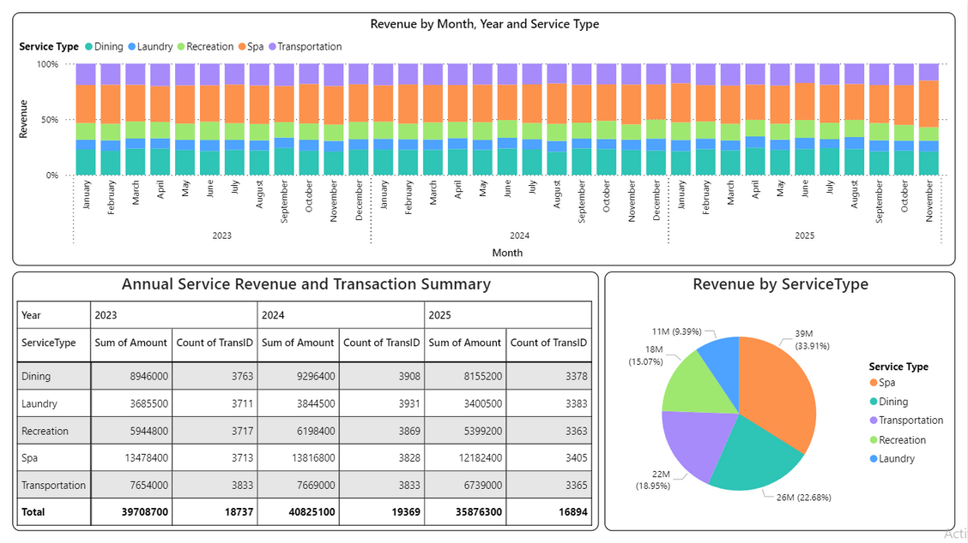
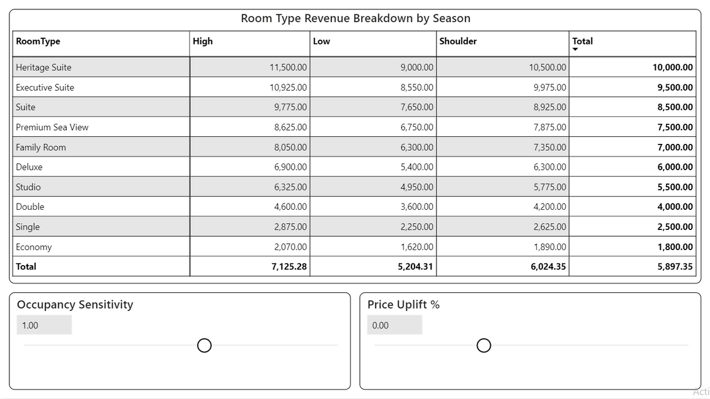
STRATEGY SIMULATION & DECISION SUPPORT DASHBOARD
Revenue by Month & Service Type
  Spa and Dining consistently contribute the largest share of ancillary revenue across all months, indicating strong upsell potential.
Annual Service Revenue & Transactions Table
  Overall service revenue peaks in 2024, with Spa remaining the highest-earning service despite similar transaction volumes across services.
Revenue by Service Type (Pie Chart)
  Spa dominates total ancillary revenue (~34%), followed by Dining, highlighting experience-driven guest spending behavior.
Room Type Revenue by Season + What-If Sliders
  Premium room types generate maximum revenue across all seasons, and interactive price and occupancy sliders help optimize RevPAR by balancing ADR and demand.

Slide 18
INTERACTIVE WHAT-IF PARAMETERS
Occupancy Sensitivity Parameter
Occupancy Sensitivity = GENERATESERIES(0.8, 1.2, 0.05)
  Simulates how occupancy may increase or decrease in response to pricing changes.
Price Uplift % Parameter
Price Uplift % = GENERATESERIES(-0.1, 0.2, 0.01)
  Allows testing of price decrease or increase scenarios (−10% to +20%).
How These Parameters Are Used
  Adjust ADR dynamically.
  Observe resulting changes in Occupancy and RevPAR.
  Support scenario-based revenue decision-making.

Slide 19
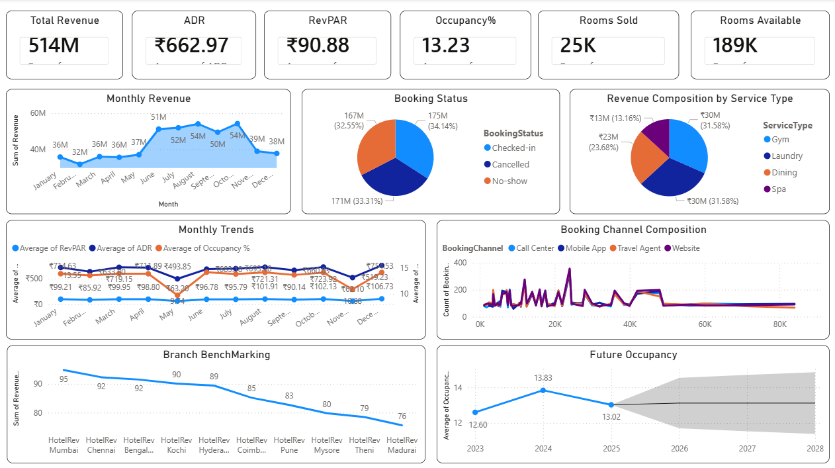
GENERAL MANAGER DASHBOARD
This dashboard provides a high-level view of overall hotel performance, covering revenue, occupancy, pricing, booking behavior, service contribution, and future demand. It enables the General Manager to monitor current performance, trends, and risks at a glance.
Key Insights:
  Total Revenue: ₹514M with steady monthly growth, peaking around ₹54M.
  Occupancy: Low overall (13.23%), indicating scope for demand improvement.
  Pricing: ADR ~₹663 with stable RevPAR trends across months.
  Bookings: Checked-in, cancelled, and no-shows contribute almost equally, impacting realized revenue.
  Channels & Services: Website and mobile app dominate bookings; Gym and Laundry contribute the highest service revenue.
  Future Outlook: Occupancy shows moderate growth with uncertainty, requiring proactive planning.

Slide 20
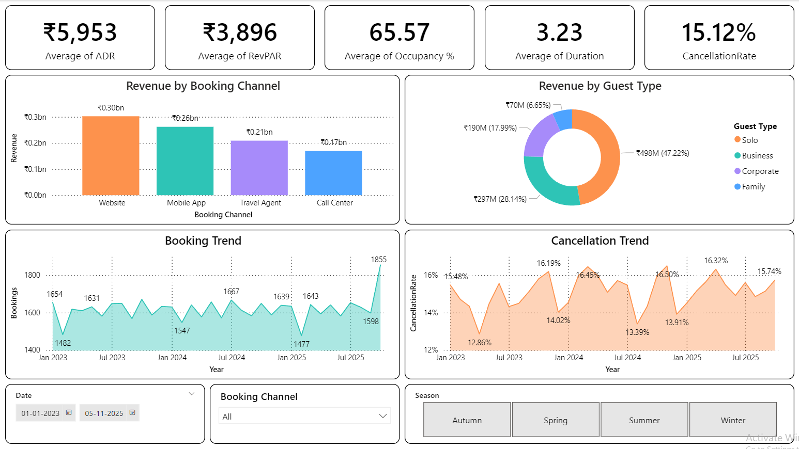
REVENUE MANAGER DASHBOARD
This dashboard delivers actionable insights on pricing, channel mix, occupancy, booking behavior, and cancellations to support effective revenue optimization and demand management.
Key Insights:
  Pricing: ADR ₹5,953 and RevPAR ₹3,896 show healthy pricing with yield improvement potential.
  Occupancy: 65.57% occupancy and 3.23 nights indicate stable demand.
  Channels: Website and Mobile App lead revenue, reducing commission costs.
  Segments: Solo and Business guests are the top revenue contributors.
  Bookings: Steady booking trends with clear seasonal peaks.
  Cancellations: 15.12% cancellation rate signals revenue leakage risk.

Slide 21
CONCLUSION
Summary & Final Thoughts
  Unified Data Foundation: Successfully transformed raw booking and room data into a robust Star Schema, enabling accurate, real-time performance tracking.
  360° Operational Insight: Established critical KPIs (Occupancy, ADR, RevPAR) and deep Guest Segmentation to pinpoint high-value customer groups and peak seasons.
  Predictive Capability: Implemented forecasting models to anticipate demand trends and mitigate revenue loss from cancellations and no-shows.
  Actionable Revenue Strategy: Delivered a comprehensive dashboard empowering managers to drive growth through dynamic pricing, targeted upselling, and data-
driven decision-making.

Slide 22

THANK YOU

