Slide 1


Noida Institute of Engineering and Technology, Greater Noida
INTRODUCTION TO BUSINESS INTELLIGENCE AND DATA VISUALIZATION
Unit: 1
Business Intelligence and Data Visualization
Garima Dhawan
Assistant Professor
CSDS
B.Tech- 6th sem

Slide 2
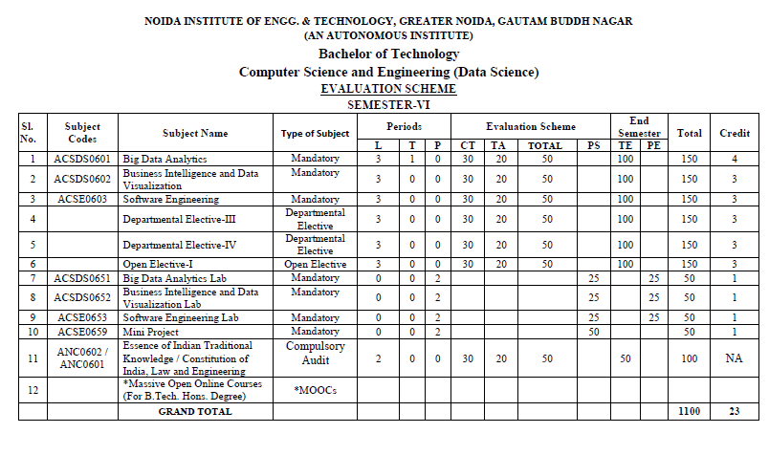
Evaluation Scheme

Slide 3

Course objective
B. TECH. (Data Science)
Course code | ACSDS0602 | L T P 3 0 0 | Credits 3
Course title | Business intelligence and Data visualization
Course objective:
This course covers fundamental concepts of Business Intelligence tools, techniques, components and its future. The course will give the student the basic ideas, knowledge and intuition behind for the elements and functionalities related to BI. as well as a bit more formal understanding of data visualization concepts and techniques. The underlying theme in the course is feature of Tableau, its capabilities and to demonstrate of Project.

Slide 4
Course Contents / Syllabus
Course Contents / Syllabus
UNIT-I | Introduction To Business Intelligence | 8 Hours
Business Intelligence (BI), Scope of BI solutions and their fitting into existing infrastructure, BI Components and architecture, BI Components, Future of Business Intelligence, Functional areas of BI tools, End user assumptions, setting up data for BI, Data warehouse, OLAP and advanced analytics, Supporting the requirements of senior executives including performance management, Glossary of terms and their definitions specific to the field of BI and BI systems.

Slide 5
Course Outcomes
Course outcomes : After completion of this course students will be able to
CO 1 | Apply quantitative modelling and data analysis techniques to the solution of real-world business problems | K1, K2
CO 2 | Understand the importance of data visualization and the design and use of many visual components | K2
CO 3 | Understand as products integrate defining various analytical process flow. | K2
CO4 | Learn the basics of troubleshooting and creating charts using various formatting tools. | K3, K4
CO 5 | Learn basics of structuring data and creating dashboard stories adding interactivity dashboard stories. | K5, K6

Slide 6
Text Books
Text Books
1. Efraim Turban, Ramesh Sharda, Dursun Delen, “Decision Support and Business Intelligence Systems”, 9th Edition, Pearson 2013.
2. Learning Tableau 10 - Second Edition: Business Intelligence and data visualization that brings your business into focus” by Joshua N. Milligan
3. Tableau Your Data! - “Daniel G. Murray and the Inter Works BI Team”-Wiley

Slide 7
Content
Introduction to Business Intelligence
Business Intelligence
Scope of Business Intelligence
Business Intelligence Components and Architecture
Future of Business intelligence
Functional areas of BI tools
Dataware House
OLAP
Advanced Analytics
Business Intelligence System

Slide 8
CO-PO and PSO Mapping
 | PO1 | PO2 | PO3 | PO4 | PO5 | PO6 | PO7 | PO8 | PO9 | PO10 | PO11 | PO12 | PSO1 | PSO2 | PSO3
CO1 | 2 | 1 | 1 |  | 2 | 2 |  |  |  | 1 |  | 1 | 1 | 1
CO2 | 1 | 2 | 2 | 1 | 3 | 1 |  | 1 | 1 | 2 | 1 | 2 | 2 | 2 | 1
CO3 | 1 | 2 | 1 | 1 | 1 | 2 |  |  |  | 1 | 2 | 2 |  | 1 | 1
CO4 | 1 | 2 |  |  | 1 | 1 |  |  | 1 | 1 | 1 | 1 | 1 | 2 | 2
CO5 | 1 | 3 | 1 | 1 | 1 |  | 1 | 1 |  |  |  | 2 |  | 1 | 2
AVG | 1.2 | 2 | 1.25 | 1 | 1.6 | 1.5 | 1 | 1 | 1 | 1.25 | 1.33 | 1.6 | 1.33 | 1.4 | 1.5

Slide 9
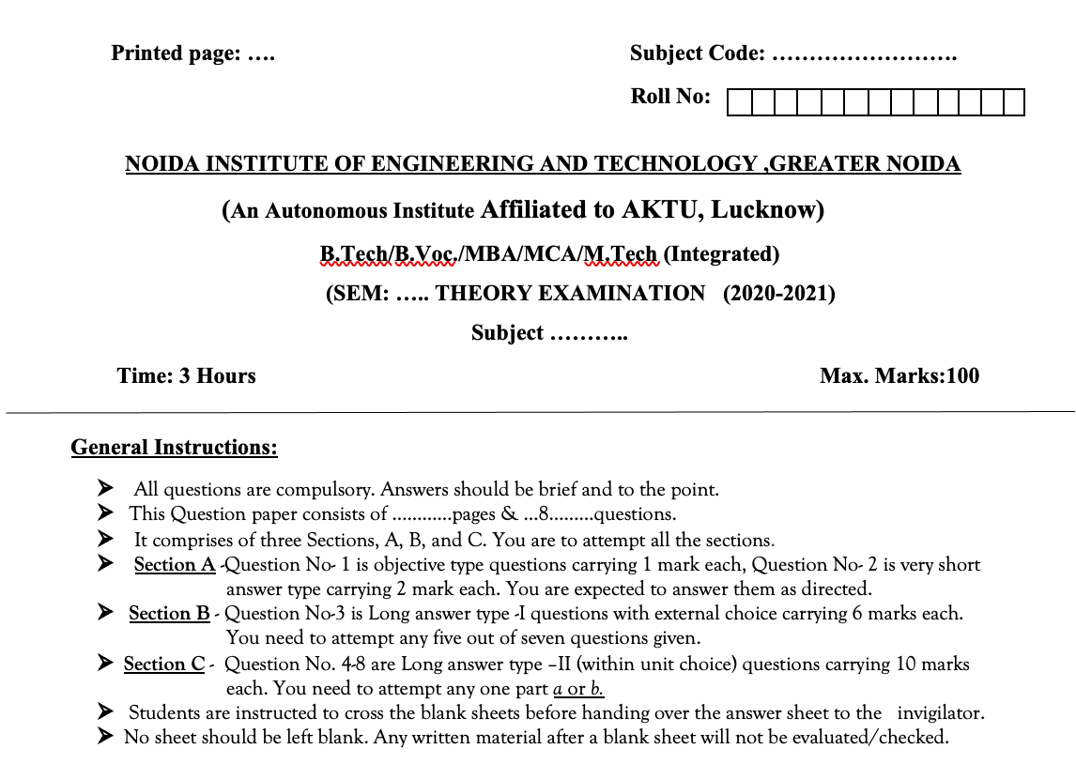
End Sem Question Paper Template

Slide 10
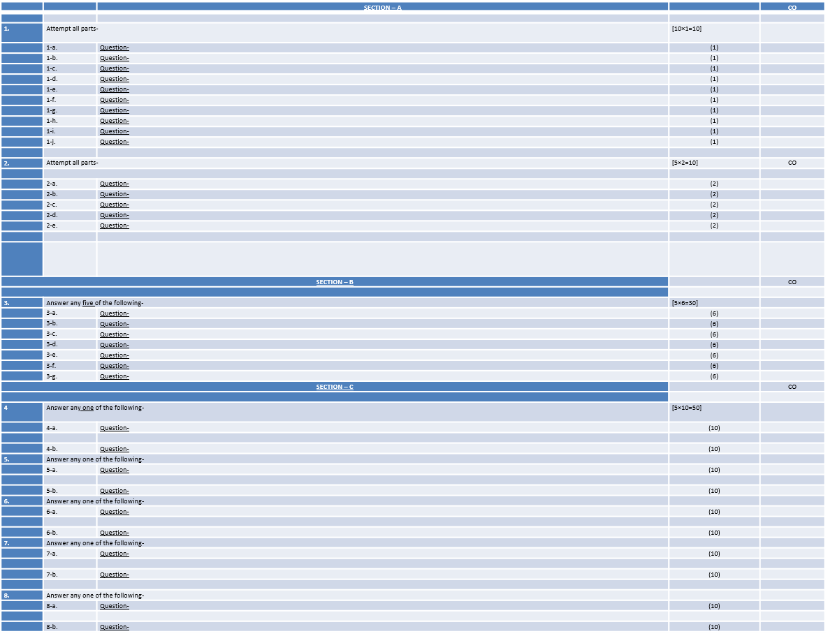
End Sem Question Paper Template

Slide 11
Prerequisite and Recap
Basic Knowledge Of Business Intelligence.
Knowledge about Data mart Data warehouse.

Slide 12
Business Intelligence and Data Visualization: An Introduction
Business Intelligence (BI) and data visualization are two powerful tools that work together to help businesses make informed decisions.
Business Intelligence (BI) BI is a broad term encompassing the processes, architectures, and technologies that analyze an organization's raw data to transform it into meaningful insights.
Key Components:
Data Warehousing: Centralized storage of data from various sources.
Data Mining: Discovering hidden patterns and relationships within large datasets.
Online Analytical Processing (OLAP): Analyzing data from multiple perspectives.
Reporting and Dashboards: Presenting data in a clear and concise format.
Data Visualization: Using visual representations to communicate insights effectively.
Data Visualization: Data visualization involves representing data graphically to make it easier to understand, interpret, and analyze.

Slide 13
Business Intelligence and Data Visualization: An Introduction
Benefits:
Improved Decision Making: Visuals help identify trends, patterns, and outliers that might be missed in raw data.
Enhanced Communication: Visuals communicate complex information quickly and effectively.
Increased Engagement: Visuals are more engaging than text-based reports.
Faster Insights: Visuals allow for rapid analysis and exploration of data.
How BI and Data Visualization Work Together:
Data Collection: Gather data from various sources.
Data Preparation: Clean, transform, and integrate data.
Data Analysis: Apply BI techniques to extract insights.
Data Visualization: Create visuals to communicate insights effectively.
Decision Making: Use insights to make informed business decisions.

Slide 14
BUSINESS INTELLIGENCE
BI(Business Intelligence) is a set of processes, architectures, and technologies that convert raw data into meaningful information that drives profitable business actions. It is a suite of software and services to transform data into actionable intelligence and knowledge.
BI has a direct impact on organization’s strategic, tactical and operational business decisions. BI supports fact-based decision making using historical data rather than assumptions and gut feeling.
BI tools perform data analysis and create reports, summaries, dashboards, maps, graphs, and charts to provide users with detailed intelligence about the nature of the business.
Business intelligence (BI) refers to the procedural and technical infrastructure that collects, stores, and analyzes the data produced by a company’s activities.
BI is a broad term that encompasses data mining, process analysis, performance benchmarking, and descriptive analytics. BI parses all the data generated by a business and presents easy-to-digest reports, performance measures, and trends that inform management decisions.

Slide 15
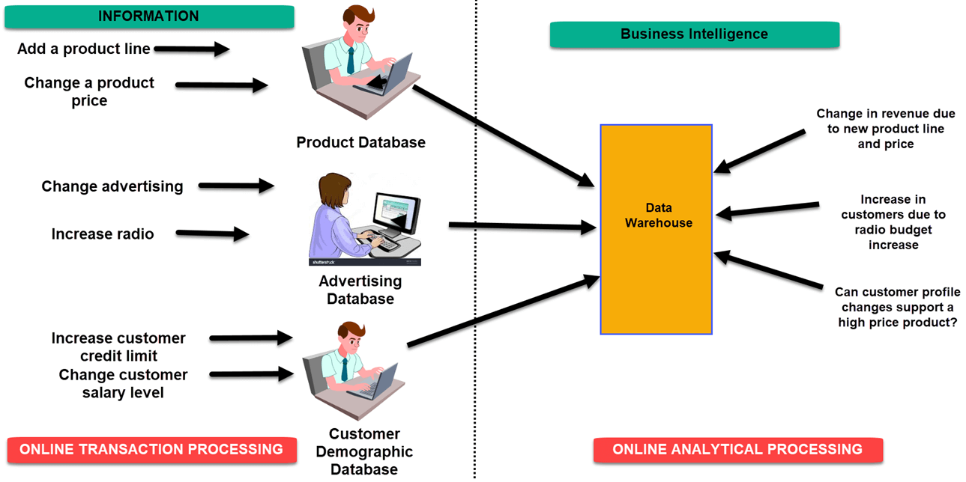
BUSINESS INTELLIGENCE

Slide 16
SCOPE OF BI
Aligning processes to the business objective – BI helps detect functions, people or activities that are improperly aligned with core business objectives. This in turn helps management take immediate action and improve practices. Lean and mean is the way to go.
Providing insights to the most difficult business problems – Quick access to large volumes of data helps extract critical facts at a rapid speed, and as they say, time is money!
Determine patterns in customer behavior – Knowledge of customer patterns helps an enterprise know who its most valuable customers are, how to retain them and in some cases, when to let certain customers go. The better you know your target audience, the more likely you are to grow your business.
Empower employees – BI equips businesses with the most important tool for successful decision making: real-time information! With this, every employee can make informed decisions, increasing the success rates of business processes multi-fold. Real time information helps transform effort into efficiency.

Slide 17
SCOPE OF BI
Monitor the usage of companies’ resources – With BI, organizations can determine the cause of loss of productivity by tracking internet usage and how much time employees spend on activities unrelated to work. Better use of resources equals better returns for the company.
Helps in cost control – BI improves the visibility of functions like inventory management. It lowers storage and maintenance costs by preventing to in manufacturing, by maximizing production efficiency.
Scale performers in the organization – BI helps reveal information on who the top and bottom performers are and enables one to reorganize a team to reap better returns from existing talent. It’s always beneficial to let your top performers know who they are.
Eliminate time spent on data entry –BI, when well-configured, can reduce and in some cases eliminate the time spent on data entry; time which can then be spent analyzing outcomes and making better and more informed decisions.

Slide 18
Fitting BI Solutions into Existing Infrastructure
Integrating BI solutions into existing infrastructure requires careful planning and consideration of various factors:
Compatibility:
Data Sources: Ensuring seamless connectivity with existing databases, applications, and systems.
Hardware and Software: Choosing BI tools that are compatible with the organization's hardware and software environment.
Scalability:
Data Volume: Selecting solutions that can handle current and future data volumes.
User Base: Ensuring the infrastructure can support the number of users accessing the BI system.
Security:
Data Access Control: Implementing security measures to protect sensitive data.
Authentication and Authorization: Controlling user access to data and functionalities.
Performance:
Query Optimization: Ensuring fast query response times for interactive analysis.
System Performance: Optimizing the performance of the entire BI system.

Slide 19
Fitting BI Solutions into Existing Infrastructure
Maintenance and Support:
- Vendor Support: Choosing vendors that offer reliable support and maintenance services.
-Internal Expertise: Building internal expertise to manage and maintain the BI system.

Slide 20
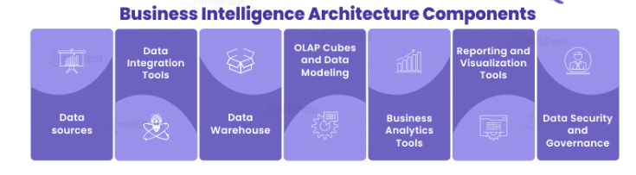
BI Components and architecture
Business intelligence architecture is made up of a number of parts that work together to help organizations gain useful insights from their data. Each element plays a significant role in the overall design, supporting data processing, analysis, and decision-making.
Data Sources: The core components of a business intelligence architecture are data sources. They comprise both internal systems (such as databases, ERP, and CRM systems) and external sources (such as social media, market research data, and web analytics). These sources offer the raw data needed for analysis and decision-making. The format and structure of the data may vary, necessitating the use of proper extraction and integration procedures.

Slide 21
BI Components and architecture
Unstructured, partially structured, or structured data may be present in the data sources. Semi-structured and unstructured data are more flexible in nature and may need extra processing and normalization, whereas structured data refers to well-defined and organized data with a preset format. Effective data integration and analysis require a thorough understanding of the properties and formats of the data sources.
2. Data Integration Tools: Data Integration Tools are responsible for extracting, transforming, and loading (ETL) data from various sources into the Business Intelligence system. These technologies make it possible to clean, combine, and integrate data, guaranteeing its consistency and quality. They manage data transformations, automate the gathering process, and provide easy data loading into the data retention layer.Data quality checks and validations are carried out throughout the integration process to find and fix any discrepancies or mistakes. Data enrichment, in which extra data from outside sources is added to improve the already-existing datasets, may also be a part of it. The data must be appropriately formatted, standardized, and connected for effective analysis and reporting, which is accomplished during the integration phase.

Slide 22
BI Components and architecture
3.Data Warehouse: A data warehouse functions as a centralized repository that houses integrated and well-structured data derived from various sources. Its primary purpose is to support analytical processing, enabling efficient querying and reporting. To enhance data retrieval and analysis, data warehouses employ techniques such as indexing, segmentation, and data compression. They offer a historical perspective and serve as a foundational element for data modeling and research endeavors.
4.OLAP Cubes and Data Modeling: Data modeling involves the creation of logical representations for the data stored within the data warehouse. Popular techniques for dimensional modeling include star schemas and snowflake schemas. These models establish relationships between variables, such as time, product, and customer, and outcomes, such as sales and revenue. Data models serve as the foundation for constructing multidimensional structures known as OLAP (Online Analytical Processing) Cubes, which facilitate efficient and interactive analysis of the data.

Slide 23
BI Components and architecture
5.Business Analytics Tools: The term “business analytics tools” encompasses a diverse array of software applications employed for data analysis and generating valuable insights. These resources encompass predictive modeling software, platforms for machine learning, and programs for statistical analysis. They empower users to explore data, identify patterns, perform complex calculations, and develop models to support decision-making processes.
6.Reporting and Visualization Tools: Reporting and Visualization Tools offer an intuitive user interface for aesthetically appealing and meaningfully displaying analyzed data. They consist of reporting systems, interactive visualization software, and dashboarding tools. With the help of these tools, users may produce personalized reports, interactive charts, and visual dashboards that improve decision-making and enable data exploration.
7.Data Security and Governance: Vital elements of the business intelligence architecture are data security and governance. They entail putting policies into place to guarantee the availability, confidentiality, and integrity of data. This comprises data encryption, data masking, access restrictions, and auditing tools. Additionally, data governance practices ensure compliance with regulatory requirements and establish data quality standards.

Slide 24
BI Components
When you first start to implement the business intelligence technology strategy, it may be sufficient to host all your BI components on a single server. In my experience, a single powerful off-the-shelf server is preferable to several budget servers. I make this point because hardware virtualization enables server administrators to deploy server instances with a lower specification than a modern laptop. These small servers are not appropriate for BI development. BI tools are resource hungry – we measure their efficiency in person-hours and business value, not CPU cycles.
The resource utilization pattern of BI is different from operational systems. The server will either be 80%+ utilized or not at all. It is common to schedule ETL jobs overnight, regular report processing in the early morning, with ad hoc querying and analytics running during the day. With server utilization staggered over the course of the day, it makes sense that each discrete process has access to all the available hardware resources We will consider these in the sub sections below.

Slide 25
BI Components
ONLINE ANALYTICAL PROCESSING (OLAP)
OLAP analyzes business information in a multi-dimensional manner to assist with complex calculations, trend analysis, and data modeling. With OLAP, the end-user gets an opportunity to analyze specific data in multiple dimensions to obtain the necessary insight for making a decision.
Businesses are constantly bringing information together to perform different analysis. They have a sharp need to get all the data in one place to achieve an accurate and reliable understanding of different aspects of the data. OLAP can help them achieve just that: get quick access to multi-dimensional analysis results.
This technology stands behind the majority of business intelligence applications. It deals with data discovery as well as capabilities for report viewing, complex calculations for analytics, and assistance with “what if” scenario planning

Slide 26
BI Components
CORPORATE PERFORMANCE MANAGEMENT
Corporate Performance Management (CPM) encompasses methods, metrics, activities, and systems, which are used to monitor and manage the business performance of a company. CPM software processes the focused information to turn it into operational plans.
This process and methodology offer business owners an integrated approach to planning, forecasting for finance, sales, marketing, HR, and operations. When this methodology is implemented, it joins company strategies with plans and executions, thus helping a business succeed and improve.
CPM is an important component of business intelligence for companies that are looking for such changes as budget remodeling, cost-cutting, upgrading organization strategy, better KPIs alignment, and improving the process of financial planning.

Slide 27
BI Components
REAL-TIME BUSINESS INTELLIGENCE
Real-time business intelligence (RTBI) is used when sorting, and analyzing business data and operations have to be done at the collection stage. Real-time BI allows the company to get insights into the business process as quickly as possible to take strategic action.
This BI component is demanded when live business insight is required, which is not a rarity in the fast-paced environment of some industries. RTBI is becoming especially popular in fast-paced modern society. Using software designed for RTBI, a company can create quick responses to real-time trends over email, apps, messengers, etc.
For example, RTBI can help create special offers at the most suitable time possible to get the highest conversion rate. Another example is limited-time specials for restaurants or supermarkets that have to do with perishable products and high demands at certain times of the day. All of the above can be done while the client is on the website and near one of the company’s physical locations.

Slide 28
BI Components
DATA WAREHOUSING
Data warehousing allows the business owner to go through different data subsets and examine components that could help make the right business decisions. For example, warehousing gives a user an opportunity to monitor certain sales information collected on Mondays for the past 50 weeks.
It helps create important statistics about the business and the industry. Warehousing implies storing formidable amounts of data in numerous special ways, which could be useful for analysis.
Different technologies exist to help the user take advantage of data warehousing quickly and effectively.

Slide 29
BI Components
DATA SOURCES
For the business intelligence process and methodology to be integrated, it is important to have the right understanding of the data sources. Pulling raw data from different sources, internal and external is vital to the diverse analysis options.
Companies tend to store huge amounts of operational data. BI needs to navigate between the data sources. In most companies, mainframe legacy systems create a foundation for the data centers because they can deal with large volumes of data. However, such data is usually difficult to procure since many legacy apps are often obsolete or proprietary.

Slide 30
End user Assumptions
This highlights the importance of understanding what end-users (the people who will use the BI tools) expect and assume about the tools. This could include:
Ease of Use: Users expect intuitive interfaces and easy-to-learn tools.
Performance: Users need tools that are responsive and provide quick results.
Accessibility: Users need access to the data and insights they need, when they need them.
Accuracy: Users rely on the data and insights provided by the tools to be accurate and reliable.
Relevance: Users need insights that are relevant to their roles and responsibilities.

Slide 31
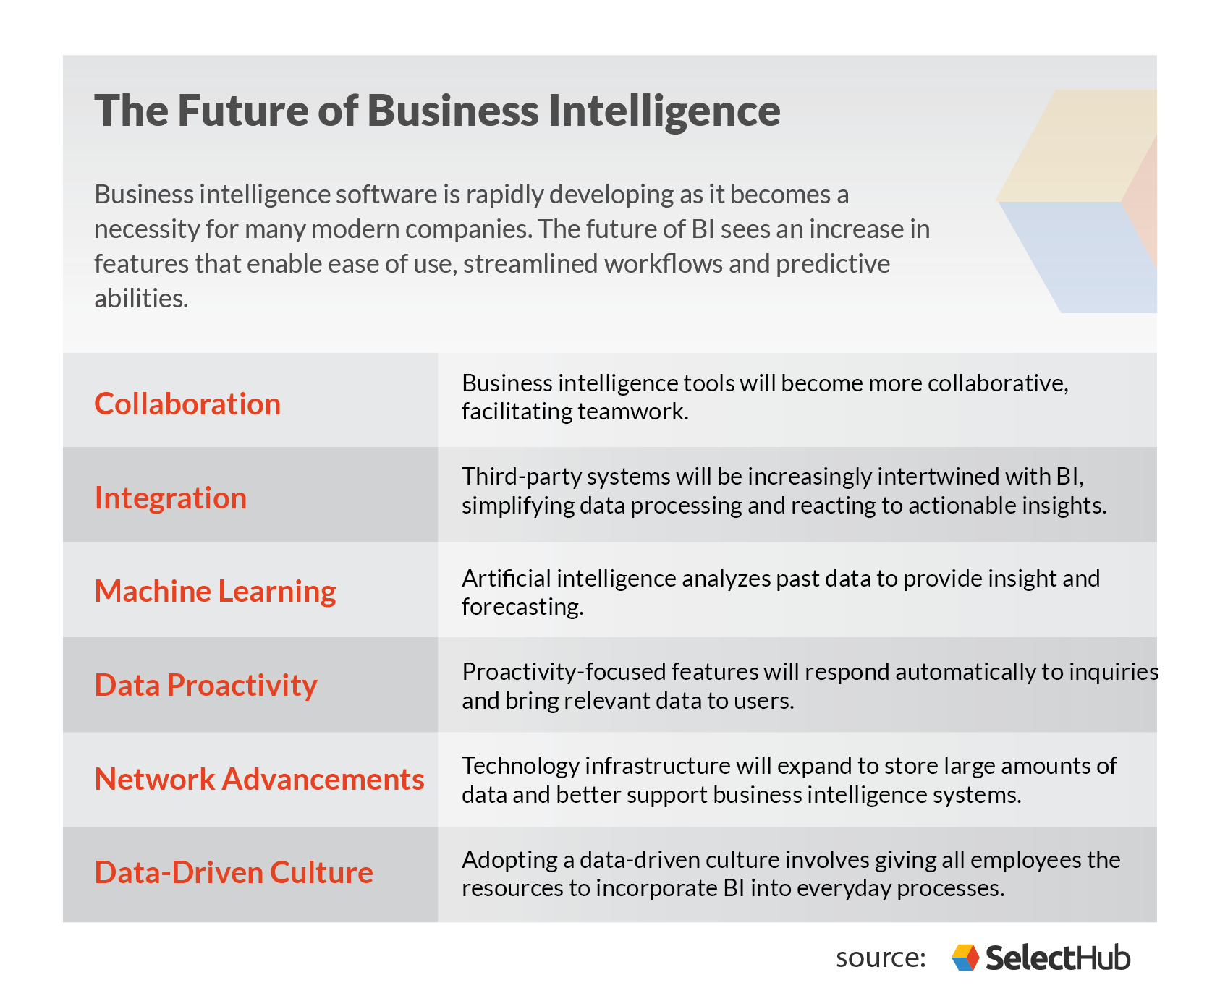
Future Of Business Intelligence

Slide 32
TYPES OF BI TOOLS
BI tools and software come in a wide variety of forms. Let's take a quick look at some common types of BI solutions.
Spreadsheets: Spreadsheets like Microsoft Excel and Google Docs are some of the most widely used BI tools.
Reporting software: Reporting software is used to report, organize, filter, and display data.
Data visualization software: Data visualization software translates datasets into easy-to-read, visually appealing graphical representations to quickly gain insights.
Data mining tools: Data mining tools "mine" large amounts of data for patterns using things like artificial intelligence, machine learning, and statistics.
Online analytical processing (OLAP): OLAP tools allow users to analyze datasets from a wide variety of angles based on different business perspectives.

Slide 33
Functional areas of BI Tools
Business Intelligence (BI) tools play a crucial role in helping organizations make informed decisions by analyzing and presenting business data. Here are some important functionalities of BI tools:
Data Integration:BI tools integrate data from various sources, such as databases, spreadsheets, and external systems, to provide a unified view of information.
Data Warehousing:They often include data warehousing capabilities to store and manage large volumes of data for analysis and reporting purposes.
Data Analysis:BI tools allow users to analyze data through querying, reporting, and visualization. Users can create ad-hoc queries or predefined reports to gain insights into business performance.
Reporting:BI tools generate reports in various formats, such as tables, charts, and graphs, to communicate trends, patterns, and key performance indicators (KPIs) to stakeholders.
Dashboards:Dashboards provide a visual representation of key metrics and performance indicators in real-time. They offer a snapshot of the current state of the business and help in monitoring performance at a glance.
Predictive Analytics:Some advanced BI tools incorporate predictive analytics to forecast future trends and outcomes based on historical data, enabling proactive decision-making.

Slide 34
Functional areas of BI Tools
ETL (Extract, Transform, Load) Processes:BI tools often facilitate ETL processes to extract data from source systems, transform it into a usable format, and load it into a data warehouse for analysis.
OLAP (Online Analytical Processing):OLAP functionality allows users to interactively analyze multidimensional data, enabling them to drill down into specific aspects of the data for a deeper understanding.
Mobile BI:Many modern BI tools provide mobile access, allowing users to access reports and dashboards from smartphones and tablets, enhancing the accessibility and flexibility of business intelligence.
Collaboration and Sharing:BI tools enable users to share reports, dashboards, and insights with team members, fostering collaboration and ensuring that decision-makers have access to relevant information.
Data Mining:BI tools may include data mining capabilities to identify hidden patterns and relationships within the data, helping organizations discover valuable insights.

Slide 35
Functional areas of BI Tools
Integration with Other Systems:BI tools often integrate with other business systems, such as ERP (Enterprise Resource Planning) and CRM (Customer Relationship Management), to provide a comprehensive view of business operations.
User-Friendly Interface:A user-friendly interface is crucial for BI tools, making it easier for non-technical users to create reports, analyze data, and derive insights without extensive training.
Security and Access Control:BI tools include robust security features to control access to sensitive data and ensure that only authorized individuals can view and manipulate certain information.
Scalability:BI tools are designed to handle large volumes of data and scale with the growing needs of an organization, ensuring performance and reliability as data requirements increase

Slide 36
Setting up data for BI
Traditional Approach
Data Extraction: Pulling data from various sources.
Data Transformation: Cleaning, standardizing, and transforming data into a usable format.
Data Loading: Loading the transformed data into a data warehouse or other storage system.
Data Modeling: Defining relationships between different data elements.
Metadata Management: Managing information about the data, such as its meaning, origin, and format.
Modern Approach
Collect and load data
Transform data to be BI ready
Test system with manual queries
Build the reports

Slide 37
Setting up data for BI
In this step-by-step example, we don’t follow the traditional ETL sequence, but the more modern ELT approach. First, we load (L) the data into a Panoply data warehouse and only then run the transformations (T) to prepare the data for BI.
1. Collect and load data
Collecting data entails uploading the data into the data warehouse like Redshift, so that you can leverage its relational database features and capabilities.
2. Transform data to be BI ready
The best way to start this step is by investigation using manual queries on the loaded raw data. You can then evaluate the quality of the data and decide which tables are not relevant or need to be changed. Then, plan and decide on the right transformations accordingly.

Slide 38
Setting up data for BI
3. Test the transformation with manual queries
Try getting the same result using different manual queries. In this step, you can also pull the results data into a spreadsheet (a sample of the data should be enough), or even manually count the result and compare it to the result obtained from the transformation.
4. Build the reports
Create end user reports and charts with the right granularity and resolution.

Slide 39
DATA WAREHOUSE
Data Warehouse is a relational database management system (RDBMS) construct to meet the requirement of transaction processing systems. It can be loosely described as any centralized data repository which can be queried for business benefits. It is a database that stores information oriented to satisfy decision-making requests. It is a group of decision support technologies, targets to enabling the knowledge worker (executive, manager, and analyst) to make superior and higher decisions. So, Data Warehousing support architectures and tool for business executives to systematically organize, understand and use their information to make strategic decisions.
Data Warehouse environment contains an extraction, transportation, and loading (ETL) solution, an online analytical processing (OLAP) engine, customer analysis tools, and other applications that handle the process of gathering information and delivering it to business users.

Slide 40
DATA WAREHOUSE
What is a Data Warehouse?
A Data Warehouse (DW) is a relational database that is designed for query and analysis rather than transaction processing. It includes historical data derived from transaction data from single and multiple sources.
A Data Warehouse provides integrated, enterprise-wide, historical data and focuses on providing support for decision-makers for data modeling and analysis.
A Data Warehouse is a group of data specific to the entire organization, not only to a particular group of users.
It is not used for daily operations and transaction processing but used for making decisions.

Slide 41
DATA WAREHOUSE
A Data Warehouse can be viewed as a data system with the following attributes:
It is a database designed for investigative tasks, using data from various applications.
It supports a relatively small number of clients with relatively long interactions.
It includes current and historical data to provide a historical perspective of information.
Its usage is read-intensive.
It contains a few large tables.

Slide 42
DATA WAREHOUSE
Data Warehouse is a subject-oriented, integrated, and time-variant store of information in support of management's decisions."
A data warehouse, or enterprise data warehouse (EDW), is a system that aggregates data from different sources into a single, central, consistent data store to support data analysis, data mining, artificial intelligence (AI), and machine learning. A data warehouse system enables an organization to run powerful analytics on huge volumes (petabytes and petabytes) of historical data in ways that a standard database cannot.
Data warehousing systems have been a part of business intelligence (BI) solutions for over three decades, but they have evolved recently with the emergence of new data types and data hosting methods. Traditionally, a data warehouse was hosted on-premises—often on a mainframe computer—and its functionality was focused on extracting data from other sources, cleansing and preparing the data, and loading and maintaining the data in a relational database. More recently, a data warehouse might be hosted on a dedicated appliance or in the cloud, and most data warehouses have added analytics capabilities and data visualization and presentation tools.

Slide 43
OLAP
OLAP (for online analytical processing) is software for performing multidimensional analysis at high speeds on large volumes of data from a data warehouse, data mart, or some other unified, centralized data store.
Most business data have multiple dimensions—multiple categories into which the data are broken down for presentation, tracking, or analysis. For example, sales figures might have several dimensions related to location (region, country, state/province, store), time (year, month, week, day), product (clothing, men/women/children, brand, type), and more.
But in a data warehouse, data sets are stored in tables, each of which can organize data into just two of these dimensions at a time. OLAP extracts data from multiple relational data sets and reorganizes it into a multidimensional format that enables very fast processing and very insightful analysis.

Slide 44
OLAP
Online Analytical Processing (OLAP) is a category of software that allows users to analyze information from multiple database systems at the same time. It is a technology that enables analysts to extract and view business data from different points of view.
Analysts frequently need to group, aggregate and join data. These OLAP operations in data mining are resource intensive. With OLAP data can be pre-calculated and pre-aggregated, making analysis faster.

Slide 45
ADVANCED ANALYTICS
Advanced Analytics is the autonomous or semi-autonomous examination of data or content using sophisticated techniques and tools, typically beyond those of traditional business intelligence (BI), to discover deeper insights, make predictions, or generate recommendations. Advanced analytic techniques include those such as data/text mining, machine learning, pattern matching, forecasting, visualization.
Advanced analytics is an umbrella term for a group of high-level methods and tools that can help you get more out of your data. The predictive capabilities of advanced analytics can be used to forecast trends, events, and behaviors. This gives organizations the ability to perform advanced statistical models such as “what-if” calculations, as well as to future-proof various aspects of their operations.
Some of the areas that make up the magic of advanced analytics include machine learning and artificial intelligence, semantic and graph analysis, data and text mining, complex event processing, pattern matching, predictive analytics, data visualizations, sentiment analysis, network, and cluster analysis, multivariate statistics, simulation, neural networks, and the list is constantly growing as new techniques are invented and adapted to the data analytics world
.

Slide 46
Supporting the requirements of senior executives including performance management
Understanding Senior Executive Needs: This implies recognizing the unique challenges and demands faced by senior executives, such as strategic decision-making, leadership development, and navigating complex organizational dynamics.
Performance Management Support: This could involve providing tools, training, and guidance on various aspects of performance management, including: Setting clear and measurable goals, Conducting regular performance reviews, Providing constructive feedback, Identifying areas for development, Implementing performance improvement plans.
Additional Support Areas: Depending on the specific context, "supporting the requirements" might also encompass other areas relevant to senior executives, such as: Executive coaching, Succession planning, Compensation and benefits, Legal and compliance issues ,Board of directors relations .

Slide 47
Faculty Video Links, Youtube & NPTEL Video Links and Online Courses Details
Youtube/other Video Links
https://www.youtube.com/watch?v=2nwgVMsf0xc
https://www.youtube.com/watch?v=jkCCnwvO_fg
https://www.coursera.org/lecture/business-intelligence-tools/bi-concepts-video-lecture-2arFU
https://www.coursera.org/lecture/business-intelligence-tools/business-analytics-video-lecture-Sr8Ic

Slide 48
Daily Quiz
1. This is an approach to selling goods and services in which a prospect explicitly agrees in advance to receive marketing information______
data mining
customer managed relationship
permission marketing
one-to-one marketing
2. ________________defines the structure of the data held in operational databases and used by operational applications.
Data mining metadata
Operational metadata
Data warehouse metadata
User-level metadata

Slide 49
Daily Quiz
3. A creative ________, he was continually dreaming up new projects
merchant
trader
entrepreneur
seller
4. No one doubted that the president was a man of the highest ______
trait
entrepreneur
integrity
Demonstration

Slide 50
Daily Quiz
5. This is an arrangement in which a company outsources some or all of its customer relationship management functions to an application service provider (ASP).
Customer Information Control System
spend management
hosted CRM
online transaction processing
6.Their tribe is a small but _______ group.
intelligent
cohesive
smart
brutal

Slide 51
Weekly Assignment
Q.1 What Are The Different Types Of Business Intelligence?
Q.2 Explain Data Visualization .
Q.3 Explain data warehouse .
Q.4 Explain the tools of BI.
Q.5 Explain the function of BI

Slide 52
MCQ s
1. This is a broad category of applications and technologies for gathering, storing, analyzing, and providing access to data to help enterprise users make better business decisions___________
Data mart
Data mining
Business intelligence
Artificial intelligence
2.Data warehouse architecture is based on _______
RDBMS
Sybase
SQL Server
DBMS

Slide 53
MCQ s
3. Record cannot be updated in __________
files
OLTP
RDBMS
data warehouse
4. The workers chose to ________ their dissatisfaction in a series of strikes.
face
confuse
manifest
create

Slide 54
MCQ s
5. I can catalyze a business’s success in terms of_____________
Distinguish the products and services that drive revenues
Rank customers and locations based on profitability
Ranks customers and locations based on probability
All of above
6.In an Internet context, this is the practice of tailoring Web pages to individual users’ characteristics or preferences__________
customer valuation
customer-facing
Web services
personalization

Slide 55
MCQ s
7. Business intelligence is only possible with big applications like power BI____________
Yes, if it doesn’t have a database, it’s not really BI
No, Business intelligence means using data to support your case and displaying it in an understandable way
No, anything can be used as business intelligence
Yes, Expensive software is necessary
8. The important aspect of the data warehouse environment is that data found within the data warehouses ______
time-variant
subject-oriented
integrated
None

Slide 56
MCQ s
9. This is the processing of data about customers and their relationship with the enterprise in order to improve the enterprise’s future sales and service and lower cost_____________
customer relationship management
CRM analytics
database marketing
customer relationship management
10.This is a broad category of applications and technologies for gathering, storing, analyzing, and providing access to data to help enterprise users make better business decisions___________
Data mart
Data mining
Business intelligence
Artificial intelligence

Slide 57
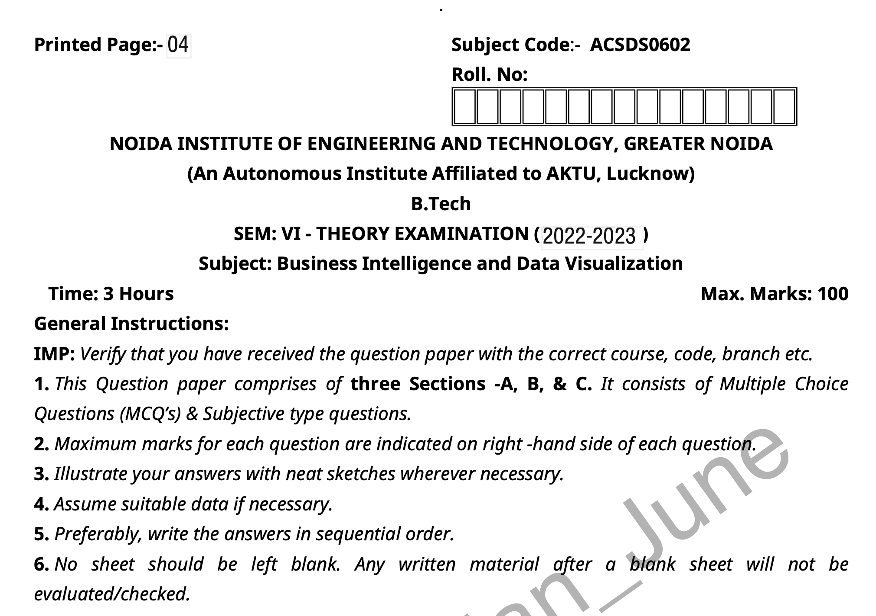
Old Question Papers

Slide 58
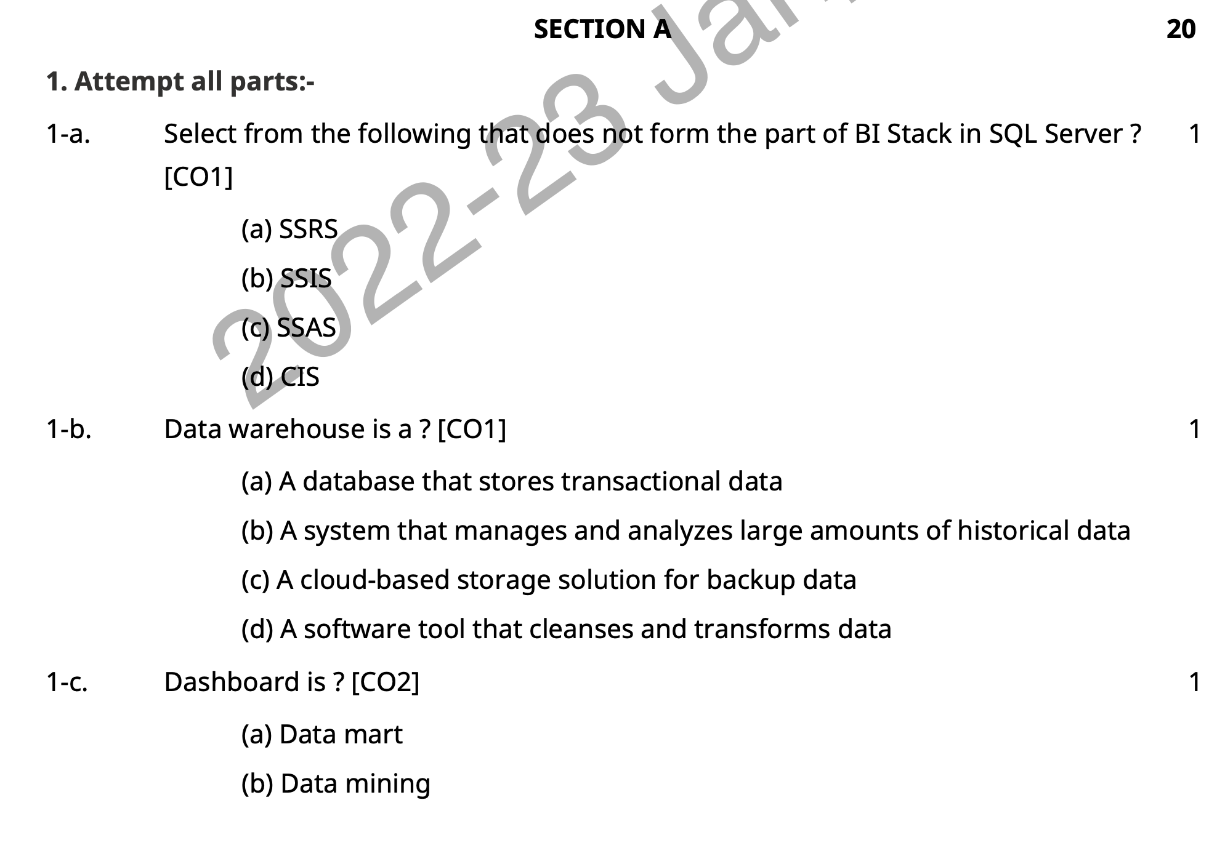
Old Question Papers

Slide 59
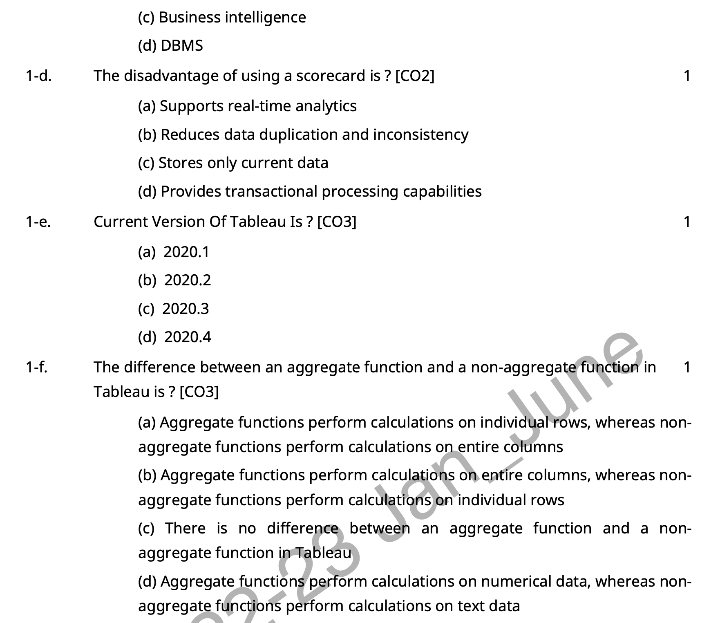

Slide 60
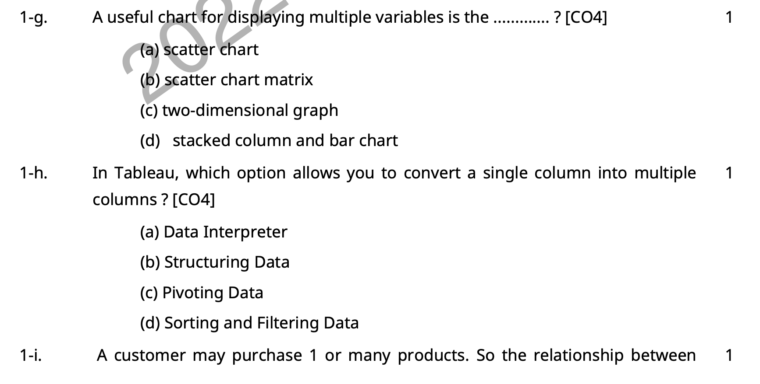
Old Question Papers

Slide 61
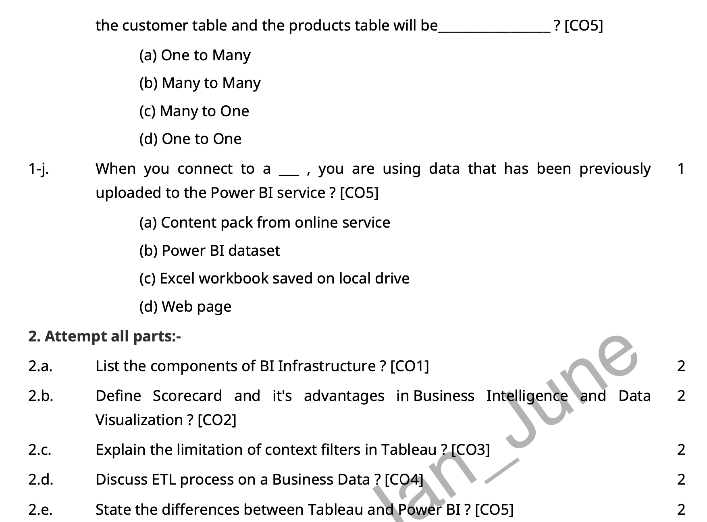
Old Question Papers

Slide 62
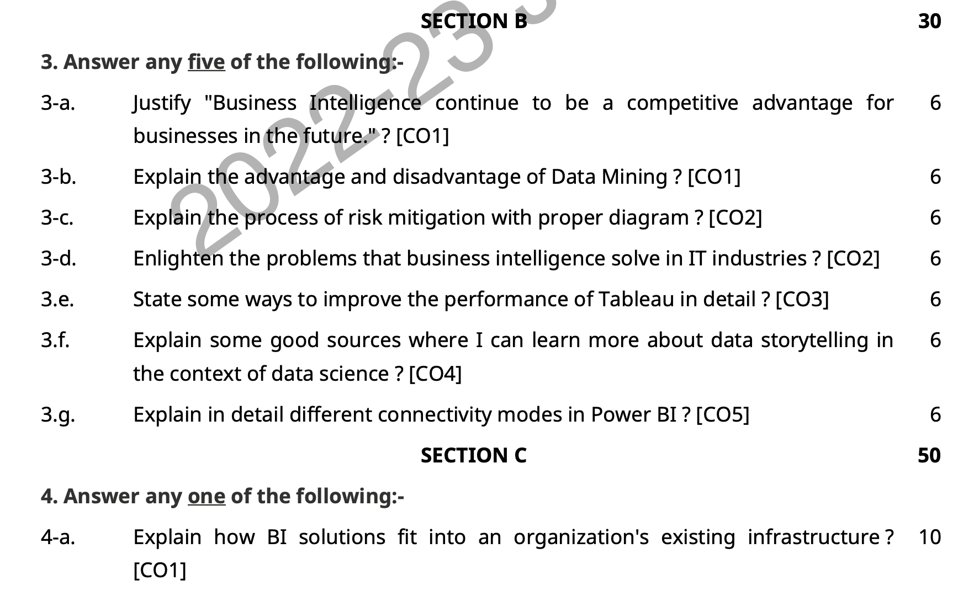
Old Question Papers

Slide 63
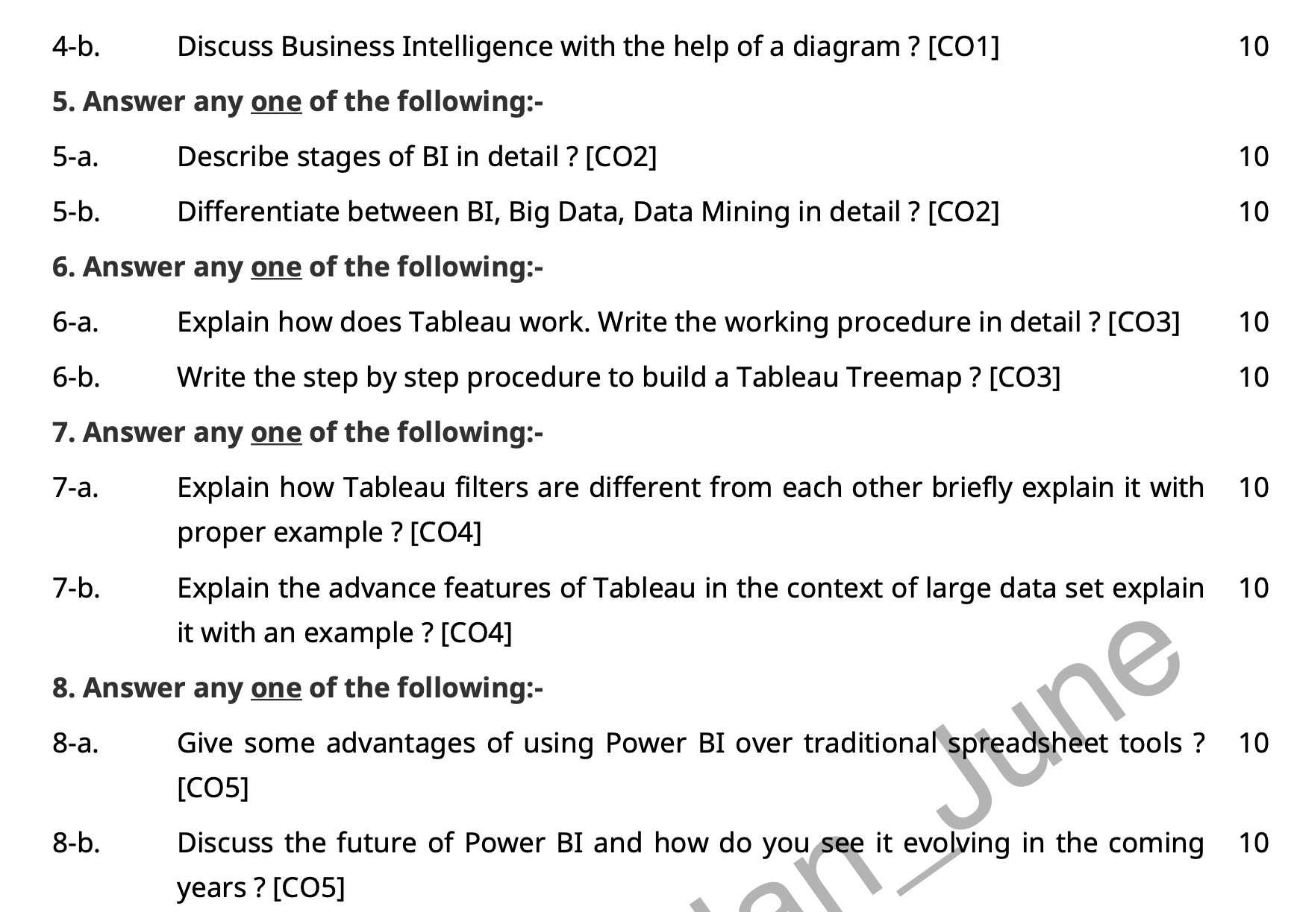
Old Question Papers

Slide 64
Expected Questions for University Exam
https://www.shaalaa.com/question-paper-solution/university-of-mumbai-be-data-warehousing-mining-business-intelligence-semester-7-be-fourth-year-2014-2015-old_9

Slide 65
Summary
Business intelligence uses technology, such as software programs like Excel, to analyze data and provide actionable information to help business executives make informed choices and decisions.
BI can be applied to making both operational and strategic business decisions.
Business intelligence is created by a team of professionals that includes data engineers, data analysts, and data visualization specialists.
Data visualization is the representation of data through use of common graphics, such as charts, plots, infographics, and even animations. These visual displays of information communicate complex data relationships and data-driven insights in a way that is easy to understand.
Data visualization is the visual presentation of data or information. The goal of data visualization is to communicate data or information clearly and effectively to readers. Typically, data is visualized in the form of a chart, infographic, diagram or map.

Slide 66
References
Thank You

