Slide 1
CONTENT MANAGEMENT SYSTEM

Slide 2
ACKNOWLEDGEMENT
I owe my regards to the entire faculty of the department of computer science and information technology at Dr. Shakuntala Misra National Rehabilitaion University from where I have learnt the basis of Computer Science and whose informal discussion and able guidance was a light for me in the entire duration of this work and carry out a project on “CONTENT MANAGEMENT SYSTEM”.
I would also like to thank my teachers who worked with me and our combined efforts led to the completion of the project.

Slide 3
Table Of Contents
Introduction
The System Development Life Cycle
System Analysis
System Requirements analysis
Abstract
Analysis of Project
Authentication of Users
Input Data Validation
Folder Structure of Project
Database of IndianCMS
Database Tables

Slide 4
Table Of Contents
Working of Project IndianCMS
• Front Page For Users
• Post Page For Users
• Registration Page For Users
• Login Section
• Comment Section
• Admin Section
• View All Posts Section For Admin
• Add New Post Section For Admin
• View All Users Section For Admin
• View All Comments Section For Admin
Hardware and Software Used
Bibliograpghy

Slide 5
Introduction
The very first step of developing any system is to study the whole existing system this is called the initial study, analysis and feasibility of the project is being done. Analysis is the detailed study of the various operations performed by the system and their relationship within and outside the system.
The feasibility study is carried out to select the best process that meets the performance requirements. This entails identification, description and evaluation of the CMS process and the selection of the best process(tool) for the job.
So the conclusion of the initial study is that instead of going through various HTML pages to make updates and entries , a tool should be made to make all these changes and updation of the data on the website.This will be able to serve its clients and consumers more efficiently and in a satisfactory manner, also, this type of system will save lot of tremendous time, energy, tiring and repetitive work.

Slide 6
SYSTEM DEVELOPMENT LIFE CYCLE
The System Development Life Cycle is an organized way to build an information system. The System Analysis and Design are keyed to the system life cycle .
The stages of the system development life cycle are:-
1. RECOGNITION OF THE NEED
2. FEASIBILITY STUDY
3. ANALYSIS
4. DESIGN
5. IMPLEMENTATION
6. SYSTEM TESTING
7.POST IMPLEMENTATION & MAINTENANCE

Slide 7
SYSTEM REQUIREMENT ANALYSIS
INTERFACE REQUIREMENT
1.User Interface
The package must be user friendly and robust. It must prompt the user with proper message boxes to help them perform various actions and how to precede further the system must respond normally under any in out conditions and display proper message instead of turning up faults and errors.
2.Hardware Specification
CPU | SPEED | RAM | HARD DISK | KEYBOARD
Intel Pentium IV and above | 1.5GHz and more | 2 GB and above | 80 GB | 105 Keys

Slide 8
SYSTEM REQUIREMENT ANALYSIS
3. Software Specifications
Software is a set of program, documents, and procedure, routines associated with computer system. Software is an essential complement to hardware. It is the computer programs which when “Content Management System” has been developed using various tools.

Slide 9
Abstract
Project Name : IndianCMS
Institute : DSMNRU, Mohan Road Lucknow
Project Type : Content Management System
This is Content management software, has various features of Wordpress to manage dynamic content which is changing at regular and fast intervals. Then the web interface allows users to manage it from anywhere using just a web browser and predefined authentication. The servers can be used to create content, manage content and post or deploy content on the website.
Administrators or mangers etc are able to access the database according to their privilege after authentication using passwords.The fast changing content is also managed.

Slide 10
Analysis of Project
Project : IndianCMS
IndianCMS is a free and open-source project. This project is based on PHP and MySQL. It is mainly designed to manage any content inside a website using GUI instead to coding. You can use it to create a various types of posts.
Don’t misunderstand it as a blogging platform. The salient features of this project can only be managed by users having admin privileges.
The main feature of IndianCMS is its versatility and feasibility to use. There is no use of coding and designing skills for creating a post. Even a non-technical person can also create a post with the help of IndianCMS easily.
The posts can typically include text, photos, videos, animated GIFs, and more other media. Posts can be accessed publicly or is made for private use, it entirely depends upon the admin.

Slide 11
Analysis of Project
Features Of IndianCMS
•Admin Login
•User Login
•User Registration
•Creating pages or posts without logical skill
•Plugins to add functionality
•Free and Open-source platform
•Adding a page is very easy
•More secure
•Inserting Multimedia
•Mobile-Friendly
•Easy to use

Slide 12
Authentication of Users
Access for Users
User Login
User Registration
User Search for getting any content
Email Newsletter
Access for Admin
Admin Login
Block or Delete any user
Authenticating users
Adding new users
Comments Approve
Create Pages
Create Posts
Delete Posts or Pages

Slide 13
Input Data and Validation of Projecton IndianCMS
Server Side Validation
In the Server Side Validation, the input submitted by the user is being sent to the server and validated using one of server side scripting languages such as ASP.Net, PHP etc. But here I have used PHP for server side validation. After the validation process on the Server Side, the feedback is sent back to the client by a new dynamically generated web page. It is better to validate user input on Server Side because you can protect against the malicious users, who can easily bypass your Client Side scripting language and submit dangerous input to the server.
Client Side Validation
In the Client Side Validation you can provide a better user experience by responding quickly at the browser level. This type of validation is done on the browser side using script languages such as JavaScript, VBScript or HTML5 attributes.

Slide 14
Input Data and Validation of Projecton IndianCMS
Mostly the Client Side Validation depends on the JavaScript Language, so if users turn JavaScript off, it can easily bypass and submit dangerous input to the server . So the Client Side Validation can not protect your application from malicious attacks on your server resources and databases.
As both the validation methods have their own significances, it is recommended that the Server side validation is more SECURE!
If a users don't enter any data or enter any invalid data format then they'll get messages such as:
"This field is required" (You can't leave this field blank).
"Please enter your phone number in the format xxx-xxxx" (A specific data format is required for it to be considered valid).
"Please enter a valid email address" (the data you entered is not in the right format).
"Your password needs to be between 8 and 30 characters long and contain one uppercase letter, one symbol, and a number." (A very specific data format is required for your data).

Slide 15
Database of IndianCMS
A database is an organized collection of data, so that it can be easily accessed and managed.
You can organize data into tables, rows, columns, and index it to make it easier to find relevant information.
The main purpose of the database is to operate a large amount of information by storing, retrieving, and managing data.
There are many databases available like MySQL, Sybase, Oracle, MongoDB, Informix, PostgreSQL, SQL Server, etc.
SQL or Structured Query Language is used to operate on the data stored in a database. SQL depends on relational algebra and tuple relational calculus.

Slide 16
Database of IndianCMS
RDBMS - Relational Database Management Systems...All modern database management systems like SQL, MS SQL Server, IBM DB2, ORACLE, My-SQL and Microsoft Access are based on RDBMS.
it is based on relational model.
How it works?
Data is represented in terms of tuples (rows) in RDBMS.
Relational database is most commonly used database. It contains number of tables and each table has its own primary key.
Due to a collection of organized set of tables, data can be accessed easily in RDBMS.

Slide 17
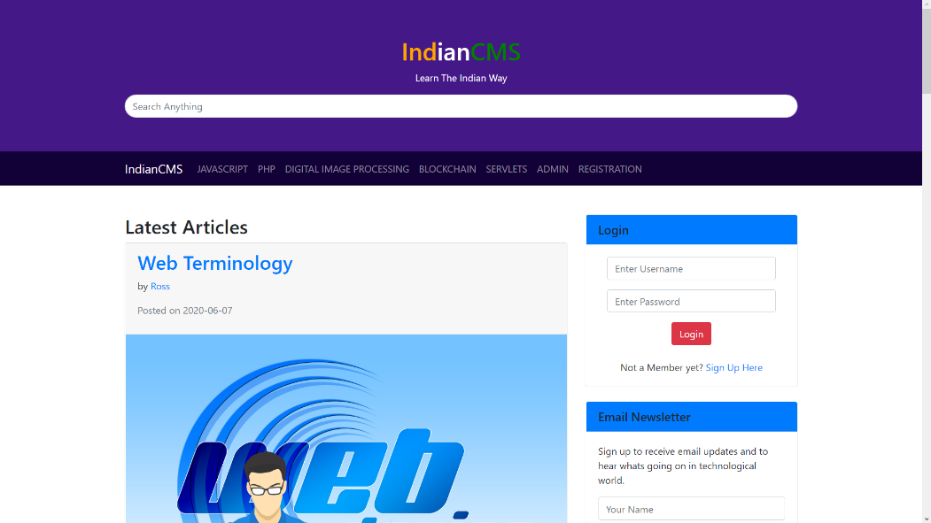
Working of Project of IndianCMS
Front Page for Users
This is the front page when a user visits this website.
A user can login or register. If user has admin previliges then after logging in he or she will be redirected to the admin page otherwise they will remain at the same page as a subscriber

Slide 18
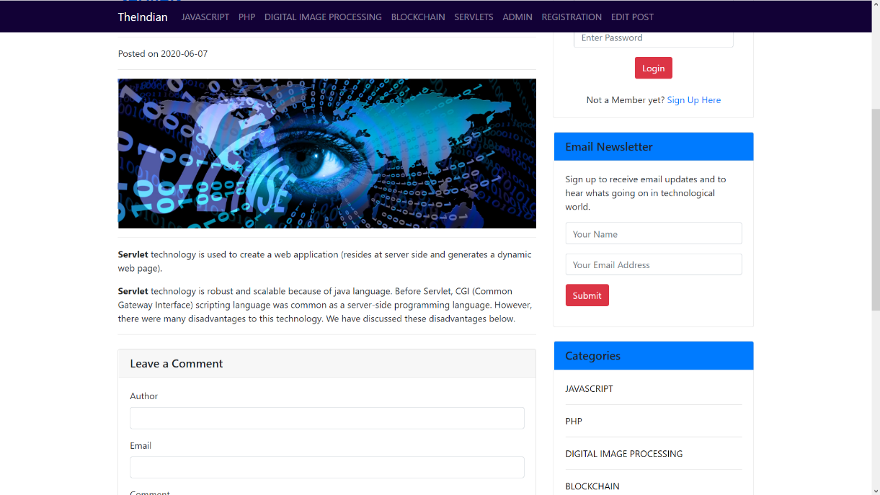
Working of Project of IndianCMS
Post Page For Users
If user clicks on any post they will be directed to this particular post.
User can click on author name to view all posts by a particular author or can also click.

Slide 19
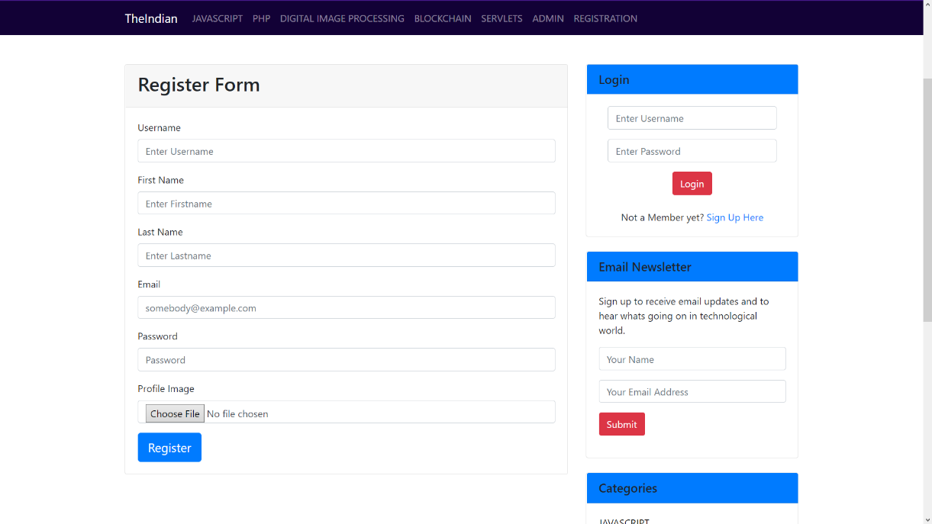
Registration Page For Users
If a users don’t have any account then they may click on “Sign Up Here” link or Registration Button to access this page for creating free account.

Slide 20
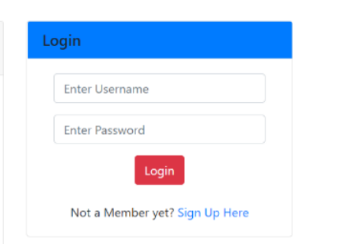
Working of Project of IndianCMS
Login Section
If a user already have an account then they can login by using their username and password.
If they don’t have username and password then they wont be able to login.

Slide 21
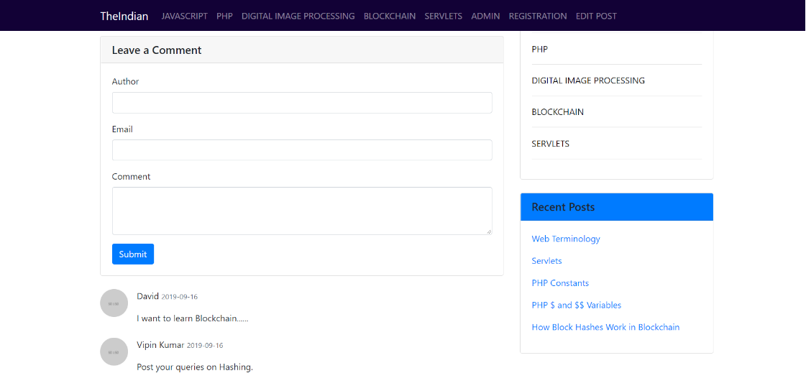
Working of Project of IndianCMS
Comments Section
Any user can comment on any post but comments will be displayed below respective posts but only after the approval of the admin.

Slide 22
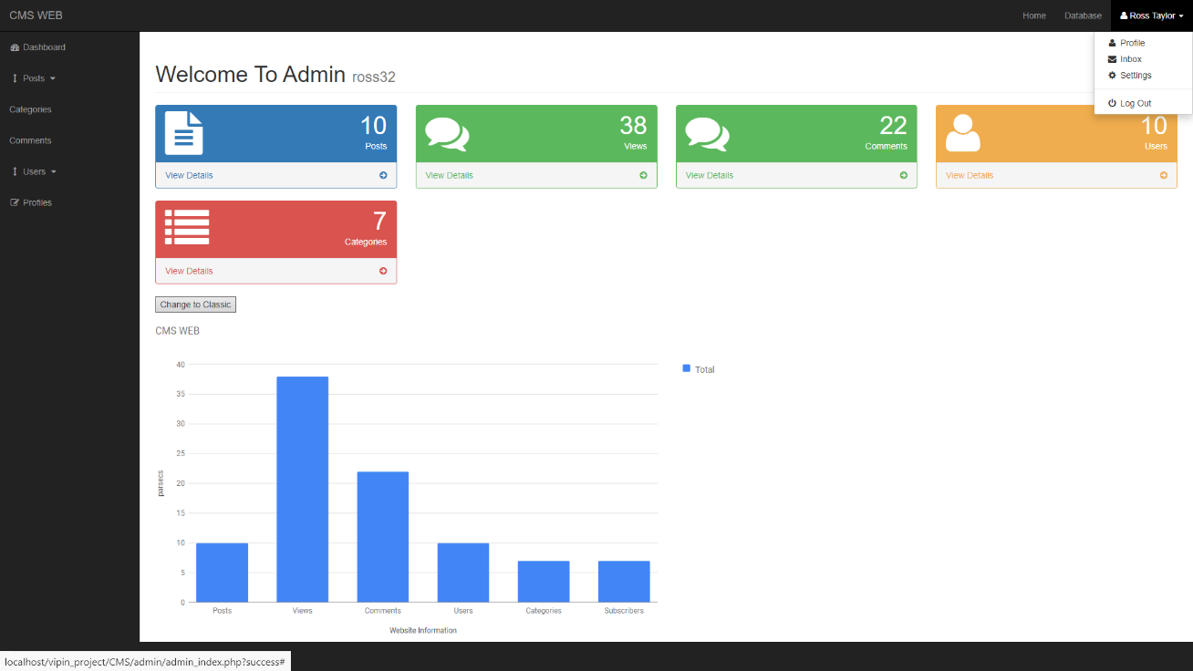
Working of Project of IndianCMS
Admin Section
User with admin previliges will be directed to this page as soon as they login.
This admin section can only be accessed by users having admin privileges.
If a subscriber user tries to access this page then he or she will be redirected to the main page of this website.

Slide 23
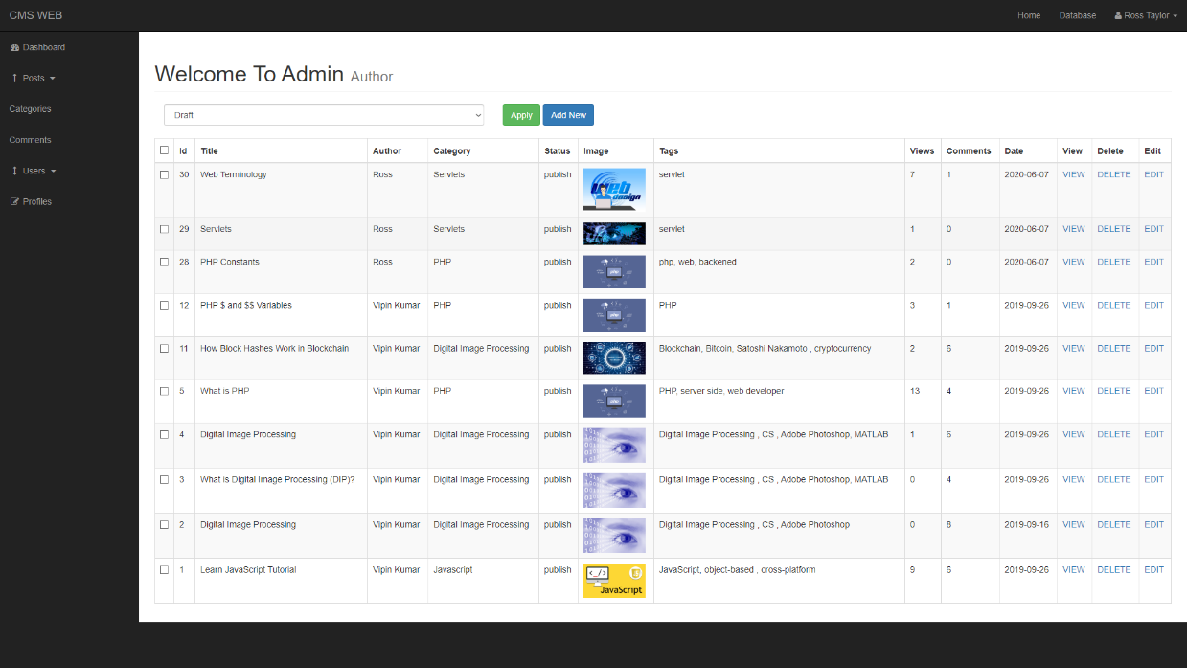
Working of Project of IndianCMS
Views All Posts Section For Admin
Click on views posts in the left section to view all posts.

Slide 24
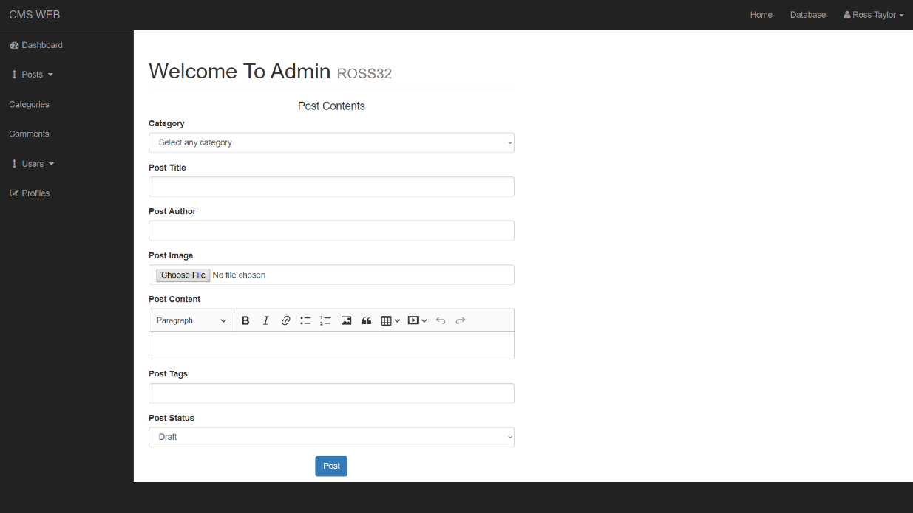
Working of Project of IndianCMS
Add New Post Section For Admin
To access this page click on add new button at the top of view all posts section to add any new post.

Slide 25
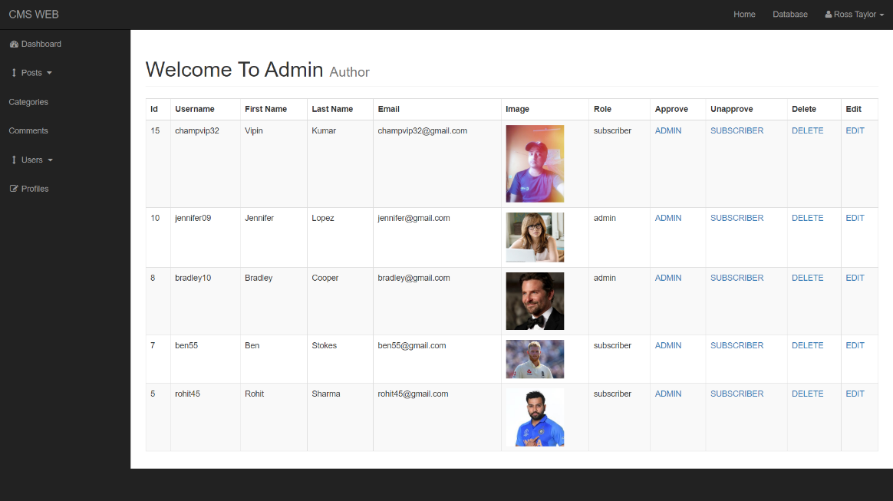
Working of Project of IndianCMS
View All Users Section For Admin
Click on views users in the left section to view all all users.
Role of any user can be changed only by admin they can be made either subscriber or admin.

Slide 26
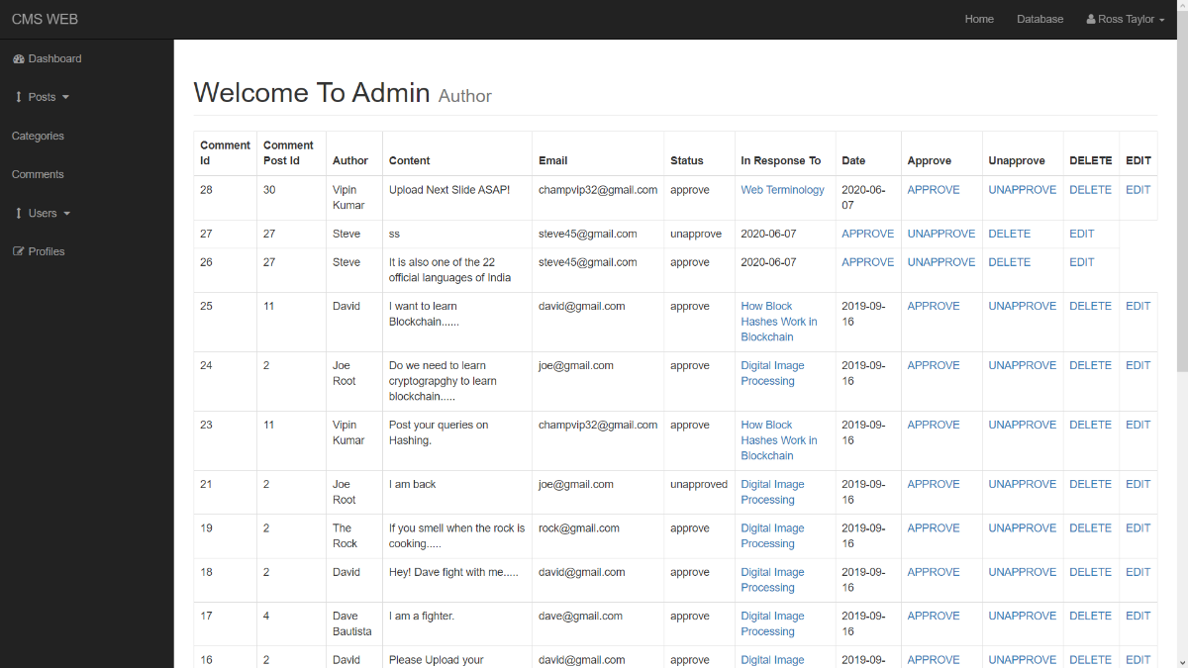
Working of Project of IndianCMS
View All Comments Section For Admin
Click on comments in the left section to view all comments.
Admin can now approve or unapprove any comment to be displayed below any post in the website.
Admin can also edit or delete any comment.

Slide 27
Hardware and Sofware Used
Sofware Used
Component | Softwares
OS | Windows 10
Browser | Google Chrome, Opera
Languages | HTML, CSS, PHP, MySQL,JS
Database | MySql Server
Web Server | Tomcat
Software | Atom

Slide 28
Hardware and Sofware Used
Hardware Used
Component | Hardwares
CPU | Intel(R) Core(TM) i5-7200U
Speed | 2.5 GHz
RAM | 8 GB
Hard Disk | 80 GB and More
Keyboard | 105 Keys

Slide 29
Made by -
Vipin Kumar
Aditya Gaurav
Saurabh Singh Rawat
Anurag Gautam
THANK YOU

