Slide 1
Comparison of Regularization Penalties Pt.2
NCSU Statistical Learning Group
Will Burton
Oct. 3 2014

Slide 2
Review
The goal of regularization is to minimize some loss function (commonly sum of squared errors) while preventing
-Overfitting (high variance, low bias) the model on the training data set.
and being careful not to cause
-Underfitting (low variance, high bias)
Notes:
Underfitting can happen when you apply a high penalty on the B terms causing them to be eliminated or reduced to a very small level.
Overfitting would typically happen when using OLS because the smallest squared error would come from a function that highly matches whatever data set it is given

Slide 3
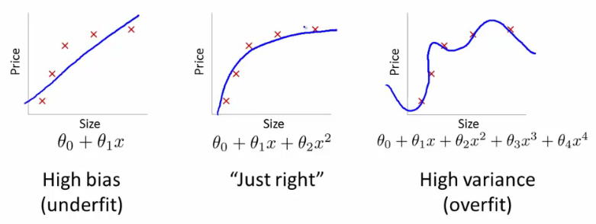
Underfitting vs Overfitting
High Error that comes from approximating a real life problem by a simpler model
Optimal amount of bias and variance
How much would the function change using a different training data set

Slide 4
Review cont.
Regularization resolves the overfitting problem by applying a penalty to coefficients in the loss function, preventing them from too closely matching the training data set.
There are many different regularization penalties that can be applied according to the data type.

Slide 5
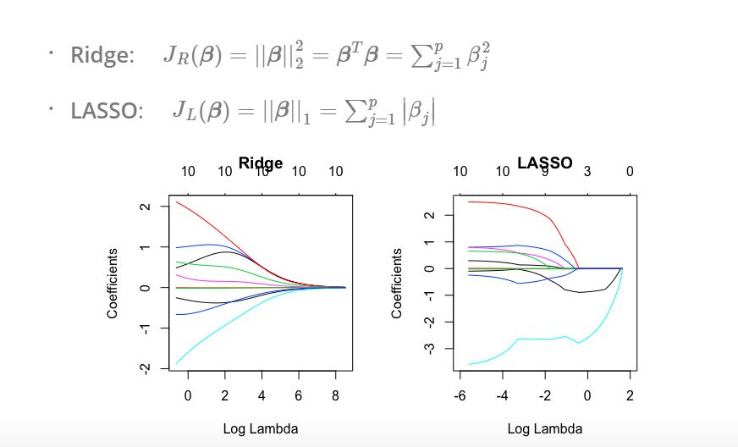
Past Penalties

Slide 6
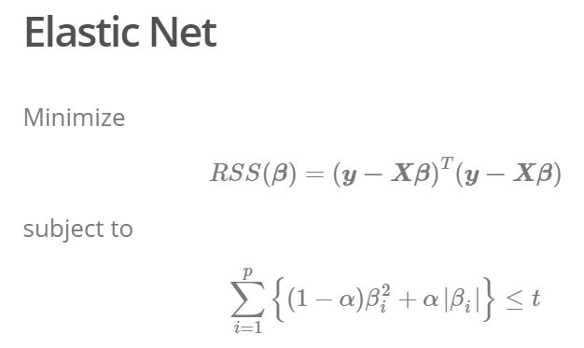
Past Penalties

Slide 7
Additional Penalties
Grouped Lasso
Motivation: In some problems, the predictors belong to pre-defined groups. In this situation it may be desirable to shrink and select the members of a group together. The grouped Lasso achieves this.
ex. Birth weight predicted by the mother’s:
Age, Age^2, Age^3 Weight, Weight^2, Weight^3

Slide 8
Grouped Lasso
Minimize
Where
(Euclidean Norm)
L = The number of groups, p = number of predictors in each group

Slide 9
Grouped Lasso
Group Lasso uses a similar penalty to Lasso but now instead of penalizing one coefficient, it penalizes a group of coefficients
Notes:
If each group is one predictor then it simplifies to Lasso

Slide 10
Example-Group Lasso
Predict birth weights based on
Mothers Age (polynomials of 1st 2nd and 3rd degree)
Mothers Weight (polynomials of 1st 2nd and 3rd degree)
Race: white or black indicator functions
Smoke: smoking status
Number of previous premature labors
History of hypertension
Presence of uterine irritability
Number of physician visits during 1st trimester

Slide 11
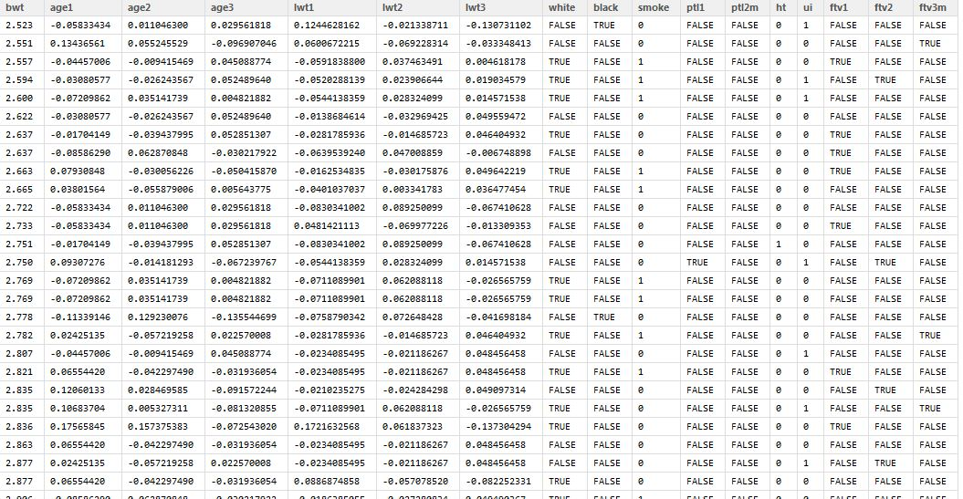
Data Structure
Used R package “grpreg”, model <- grpreg(X,y,groups,penalty = “grLasso”)

Slide 12
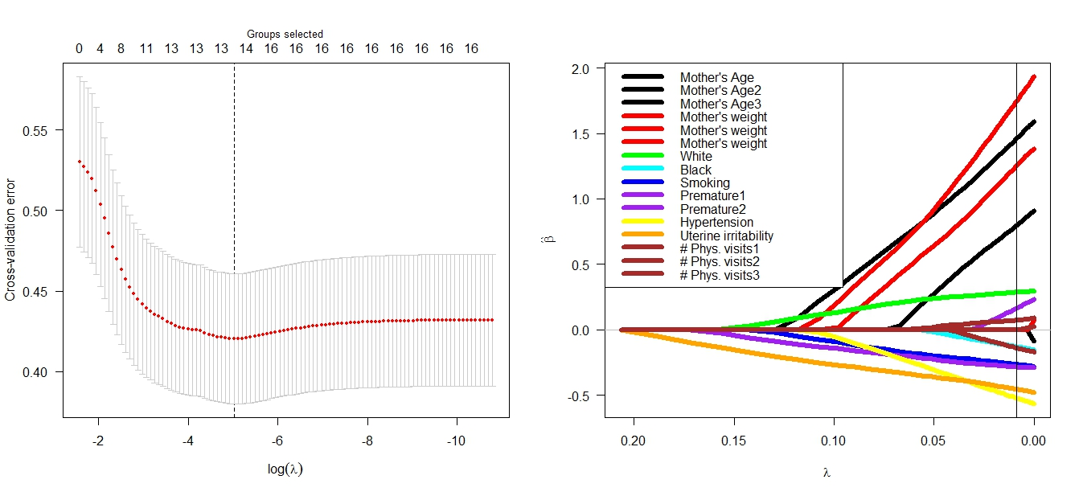
Lasso Fit
Notes:
Fit by 5 fold cross validation, min Lambda … drops out Age 1 weight^2

Slide 13
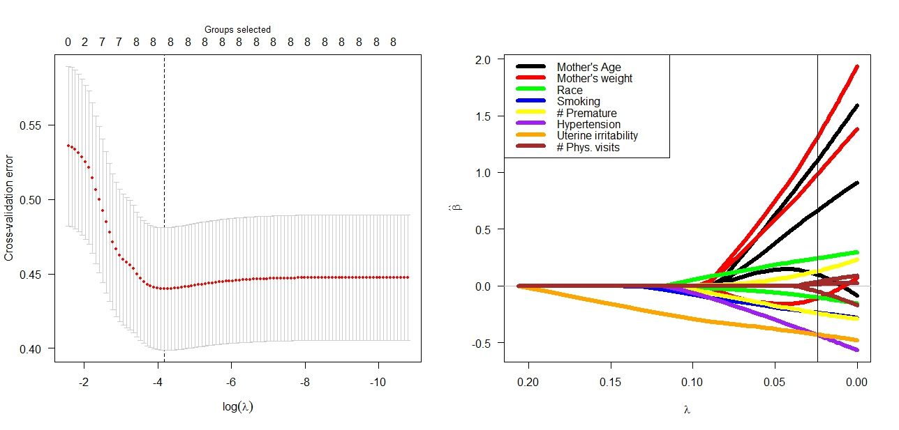
Grouped Lasso Fit

Slide 14
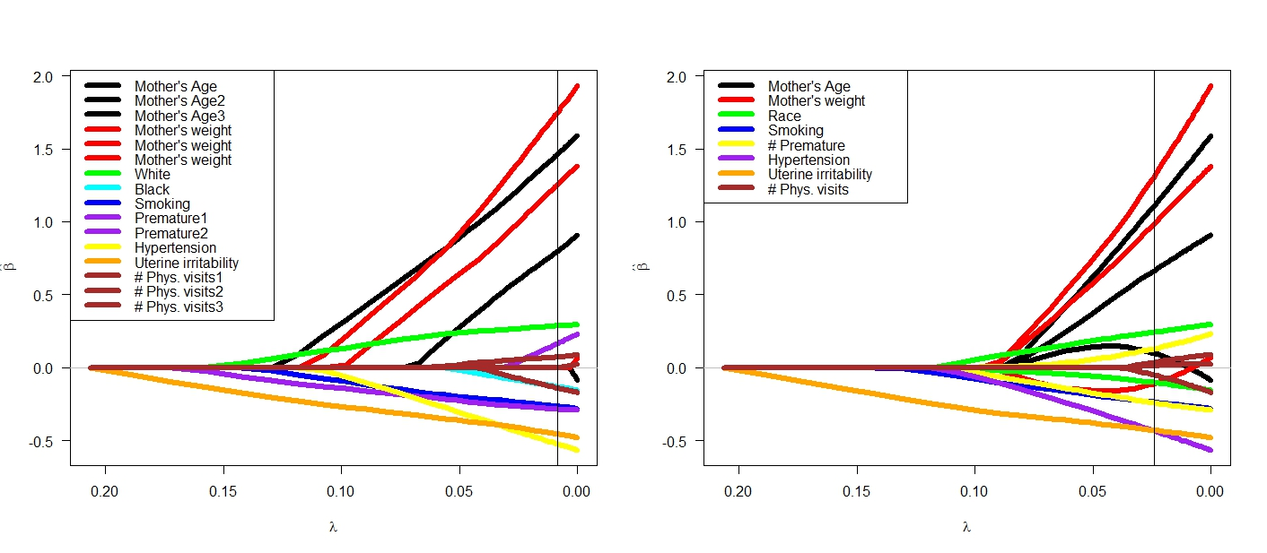
Lasso
Grouped Lasso
Notes:
Grouped smoothes lines together

Slide 15
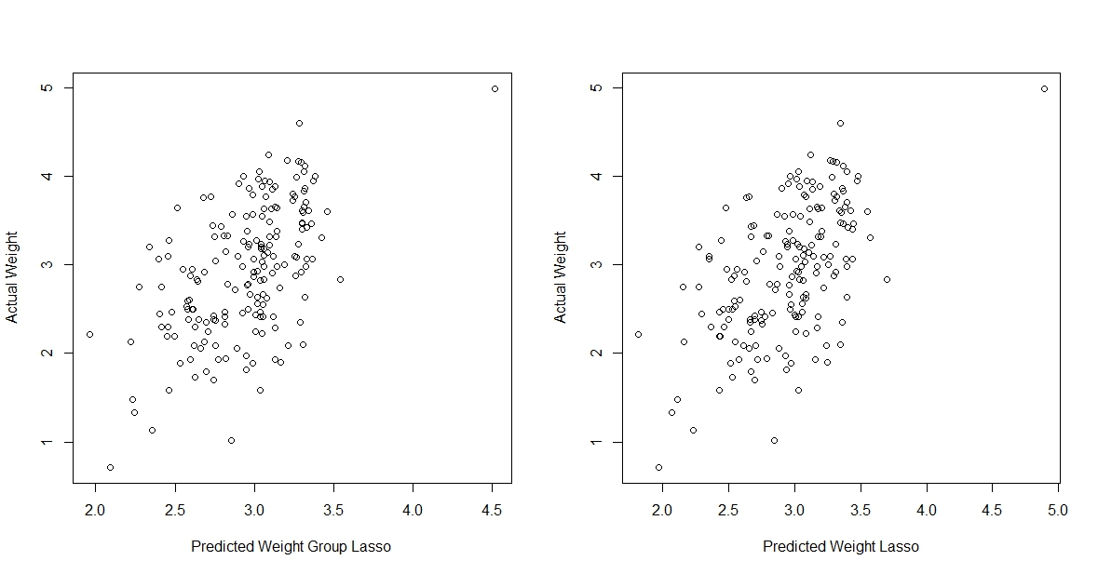
Predictions Versus Actual Weights
Notes:
Roughly the same prediction but the grouped Lasso is more interpretable

Slide 16
Other Penalties
Adaptive Lasso
Motivation: In order for Lasso to select the correct model it must assume that relevant predictors can’t be too correlated with irrelevant predictors. Lasso has a hard time determining which predictor to eliminate, and may eliminate the relevant while keeping the irrelevant predictor.

Slide 17
Adaptive Lasso
Minimize
Where weights are functions of the coefficient Bj: , B is the OLS estimate, and v > 0

Slide 18
How it works
Calculate OLS B’s
Calculate wj’s
Apply wj’s to penalty to find new B’s
Idea:
1)A high Beta from OLS gives low weight; A Low Beta gives high weight
2) Low weight = lower penalty; High weight = high penalty

Slide 19
In appearance, Adaptive Lasso looks similar to Lasso, the only difference is now better predictors need a higher lambda to be eliminated, and poor predictors need a lower lambda to be eliminated

Slide 20
Simulation
To determine if the LASSO or Adaptive LASSO is better at finding the "true" structure of the model a Monte Carlo simulation was done.
The true model was
y = 3x1+1.5x2+ 0x3+ 0x4 + 2x5 + 0x6 + 0x7 + 0x8

Slide 21
Correlation of X’s
Cor(X's) =
1.000 0.800 0.640 0.512 0.410 0.328 0.262 0.210
0.800 1.000 0.800 0.640 0.512 0.410 0.328 0.262
0.640 0.800 1.000 0.800 0.640 0.512 0.410 0.328
0.512 0.640 0.800 1.000 0.800 0.640 0.512 0.410
0.410 0.512 0.640 0.800 1.000 0.800 0.640 0.512
0.328 0.410 0.512 0.640 0.800 1.000 0.800 0.640
0.262 0.328 0.410 0.512 0.640 0.800 1.000 0.800
0.210 0.262 0.328 0.410 0.512 0.640 0.800 1.000
Auto regressive correlation structure with rho=0.8

Slide 22
Data was generated from this true model
X's from a multivariate normal model
Random errors were added with mean 0 and sd=3
Lasso, ADLasso, and OLS were fit.
Process repeated 500 times for n=20, 100
Average and median prediction error reported along with whether or not correct structure (oracle) was selected

Slide 23
Simulation Results
n=20
Mean PE SE Median PE Oracle
OLS 6.490 0.218 5.357 0.000
LASSO 3.136 0.150 2.387 0.102
ADLASSO 3.717 0.151 3.000 0.112
n=100
Mean PE SE Median PE Oracle
OLS 0.760 0.019 0.683 0.000
LASSO 0.534 0.016 0.446 0.134
ADLASSO 0.539 0.019 0.426 0.444
Notes:
Does better with interpretability.

Slide 24
Summary
Covered the basics of regularization as well as 5 different penalty choices: Lasso, Ridge, Elastic, Grouped Lasso, and Adaptive Lasso.
We have finished the regularization section and Neal will take over next October 17th with an overview of classification

