Slide 1

Project Presentation on Dr. ON A CLICK: AI Based Health Care Solution
Presented By:
Abha Dilawari - 2000140130002
Aditya Pal -2100140139001
Hiba Siddiqui- 2100140139002
Project Guide
Dr. Shailesh Saxena
Project In charge
Ms. Sakshi Goal
Department Of Information Technology
Shri Ram Murti Smarak College of Engineering and Technology , Bareilly

Slide 2
Table Of Contents
Introduction
Features
Methodology
AI-driven symptom-based disease predictions
About Data Set
Database
Progress
References

Slide 3
Introduction
Dr. ON A CLICK" revolutionizes healthcare with seamless online access to medical professionals, virtual consultations via WhatsApp, and AI-driven symptom-based disease predictions. Its secure digital locker ensures streamlined record-keeping, while an SOS button boosts patient safety in emergencies. The platform aims to redefine healthcare, offering unparalleled convenience and accessibility.

Slide 4
Features
Online Appointment Scheduling
WhatsApp Video Consultations
Secure Digital Locker
Document Sharing via WhatsApp
SOS Button for Emergencies
Enhance Healthcare Accessibility
AI Based Prescription

Slide 5
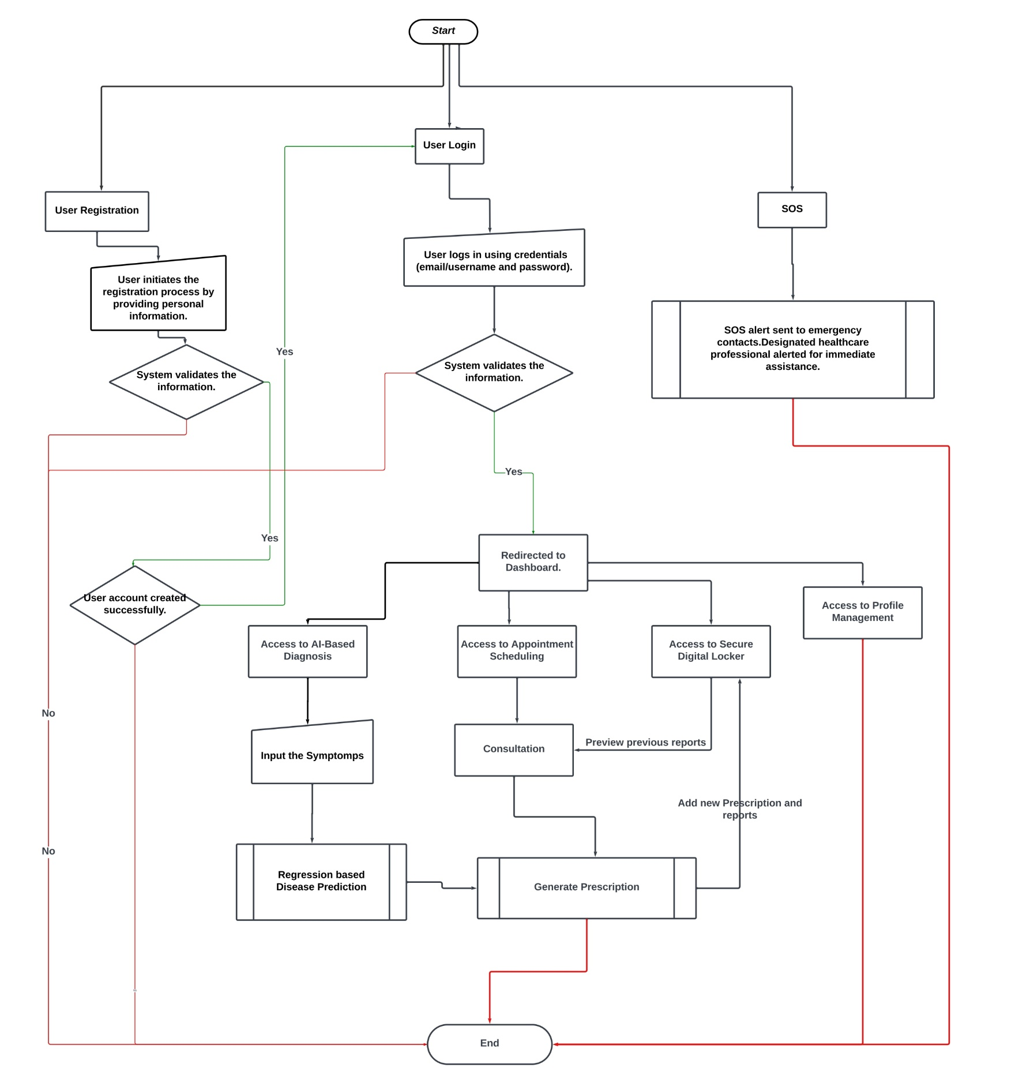
Methodology

Slide 6
Module : AI-driven symptom-based disease predictions
Tasks 1: Create a data Set. - Completed
Task 2: Create a Solution for the Binary Classification Problem. – Completed
Task 3: Create an API for Web Application. - Completed

Slide 7
Data Set
Format – Binary Classification.
No. of symptoms – 132
Possible disease detected – 4920
Source of data set - Disease-Symptom Knowledge Database, Columbia University

Slide 8
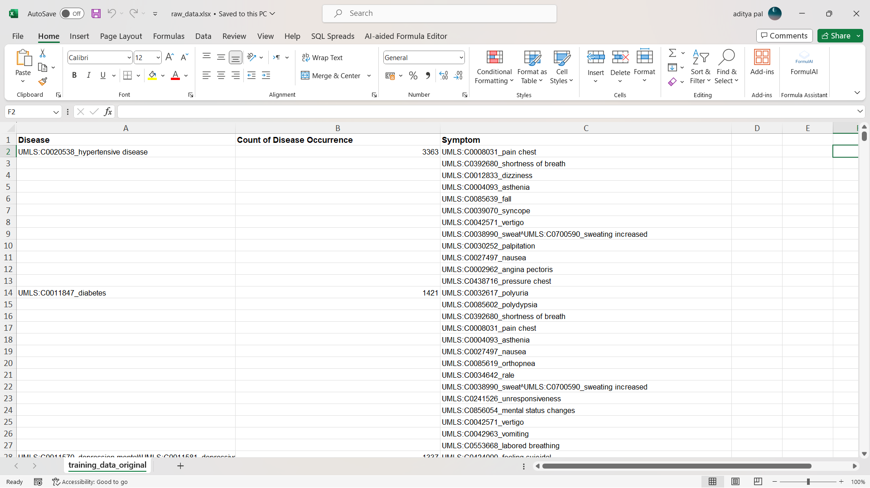

Slide 9
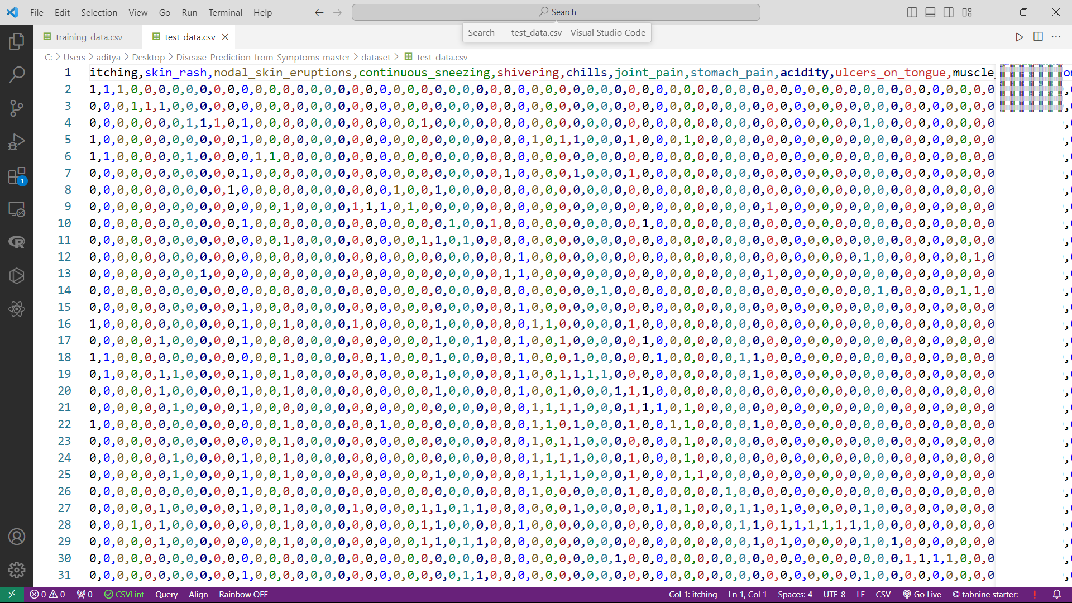

Slide 10
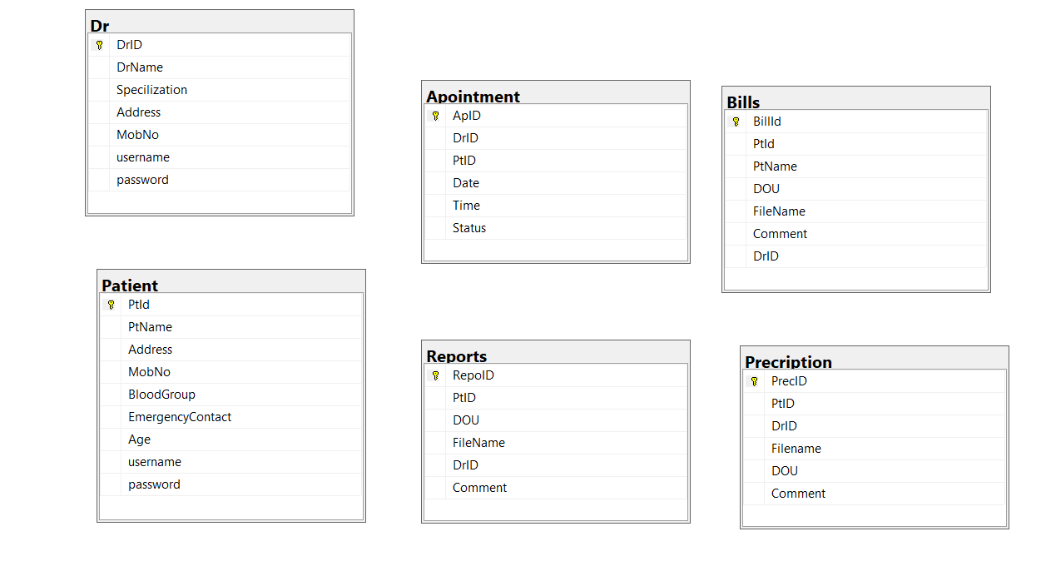
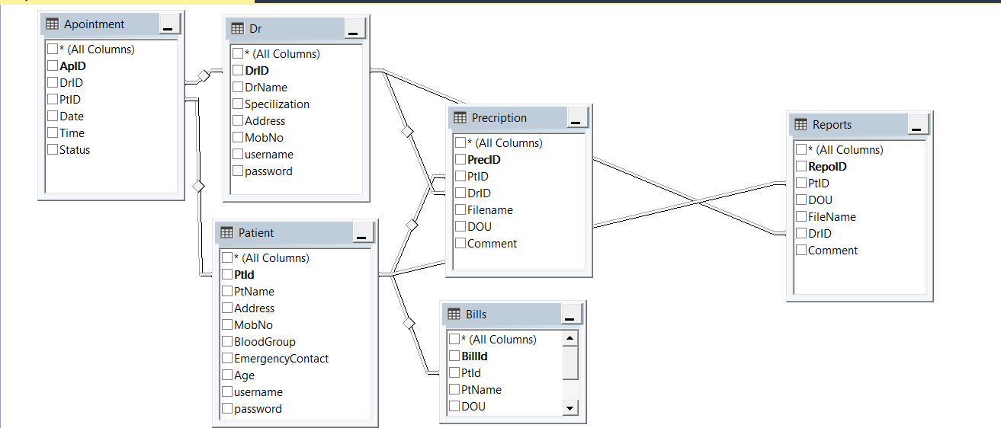
Module : Database
Tasks 1: Design Database - Completed
Task 2: Implement Database – Completed

Slide 11
Progress

Slide 12
References
1. *Knowledge Database*:
Title: "Disease-Symptom Knowledge Database
Authors: Columbia University
Link*: [https://people.dbmi.columbia.edu/~friedma/Projects/DiseaseSymptomKB/index.html]
2. *Telemedicine and Telehealth*:
Title: "Telemedicine and Telehealth: Principles, Policies, Performance, and Pitfalls"
Authors: Adam Darkins
Link*: [Telemedicine and Telehealth (Book)](https://www.ncbi.nlm.nih.gov/books/NBK207146/)
3.*Digi Locker*:
Title: DIGI-LOCKER – AN OVERVIEW
Authors: Merlin Ann George & Dr. A M Viswambharam
Link*:[DIGI-LOCKER – AN OVERVIEW(PDF)] (http://ijrar.com/upload_issue/ijrar_issue_20543086.pdf)

Slide 13

THE END

Slide 14
THANKYOU

