Slide 1

Identifying Areas with Unmet Food Needs During COVID-19 with 2-1-1 Call Data
Katie Janda, PhD, MPH
Postdoctoral Fellow
UTHealth School of Public Health – National Cancer Institute Cancer Control Research Training Program

Slide 2
Background on Using 2-1-1 Call Data
Collaboration with United Way for Greater Austin and their 2-1-1 Call Navigation Program
2-1-1 connects callers to resources in their area
Previous experience using 2018 2-1-1 call log data to identify areas with food needs and limited geographic food access

Slide 3
Purpose of the Analysis
Purpose of the analysis was to identify areas with unmet food needs due to COVID-19 in Travis County
Analyze data by:
January – June 2020
January – June 2019
Call Reason
Zip Code
Food Access Locations during COVID-19
Limited demographic data*

Slide 4
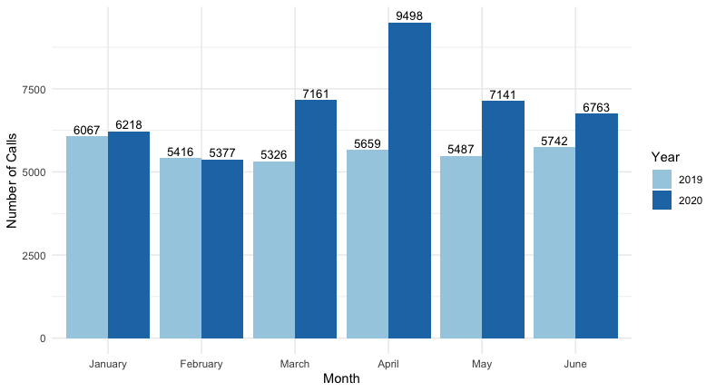
Total Calls to 2-1-1 by Month

Slide 5
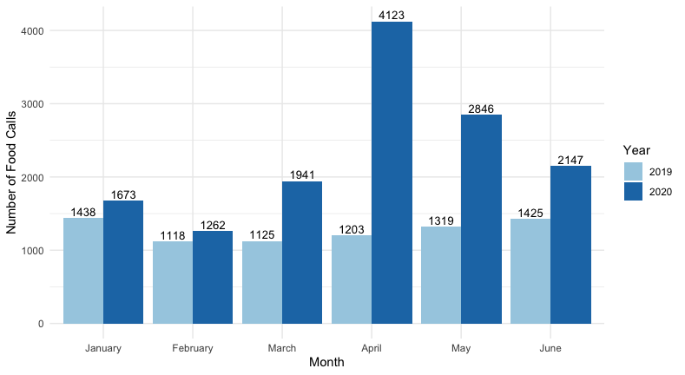
Food Calls to 2-1-1 by Month
Notes:
April 2020 – over 3x food need call volume than April 2019 – spike in April largely due to calls that were transferred from 2-1-1 to HHSC regarding SNAP benefits
May 2020 – over 2x food need call volume than May 2019
June 2020 - over 1.5x food need call volume than June 2019

Slide 6
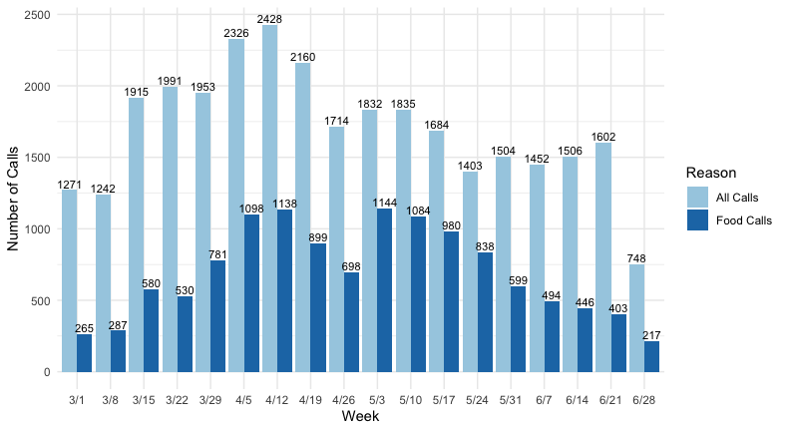
Total and Food Calls to 2-1-1 by Week from March-June 2020

Slide 7
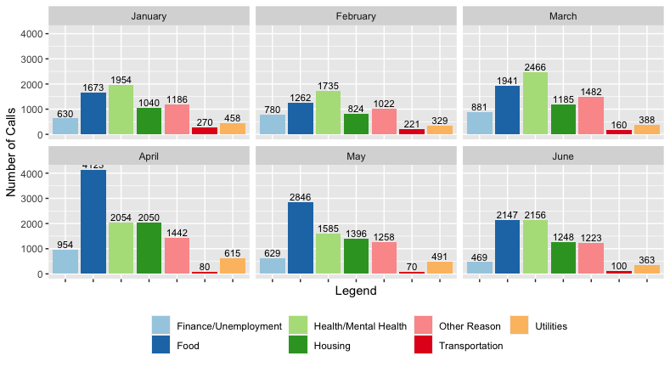
Categorization of 2-1-1 Calls by Month 2020

Slide 8
Geographic Analyses
Call volume is highest in the Eastern Crescent of Travis County for:
Overall Call Volume
Food Need Call Volume
This is somewhat expected given 2018 American Community Survey Data
Maps depicting the proportion of food calls to 2-1-1 by zip code and location of food assets were also created for each report

Slide 9
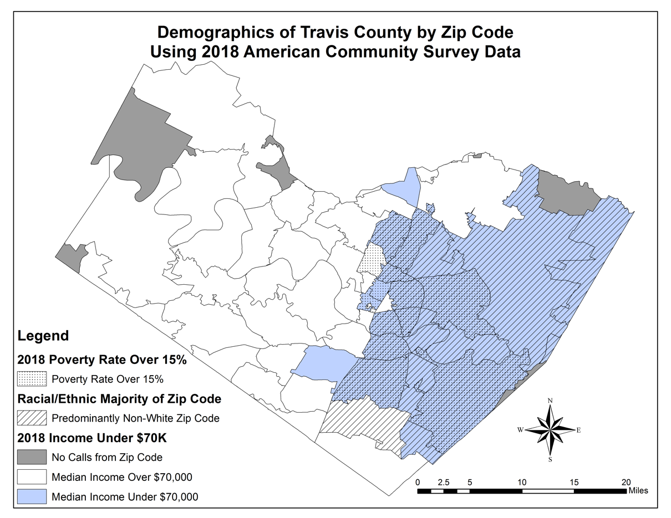

Slide 10
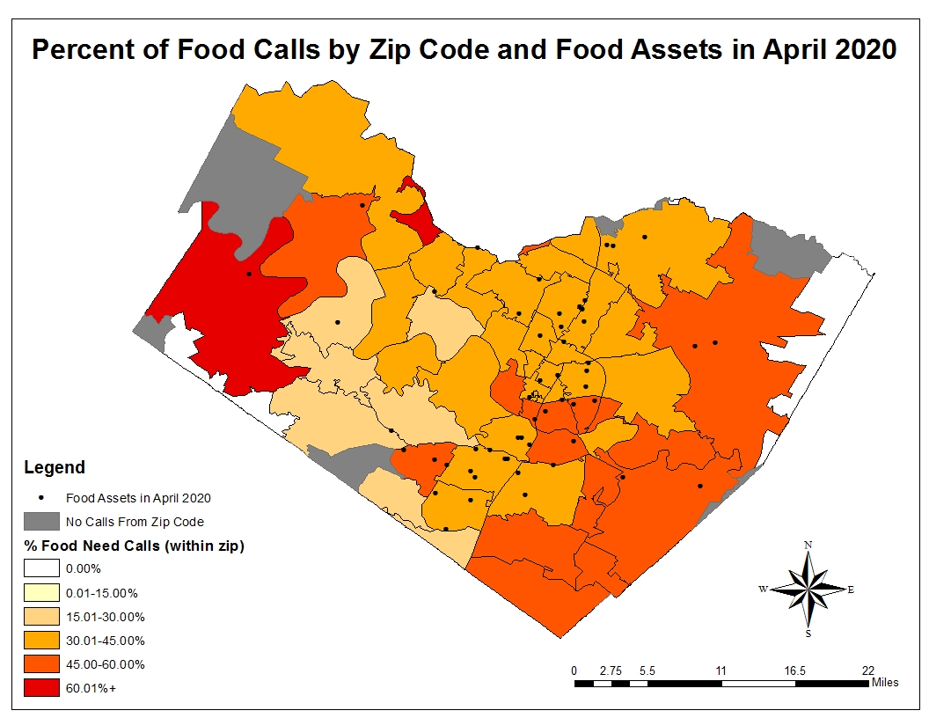

Slide 11
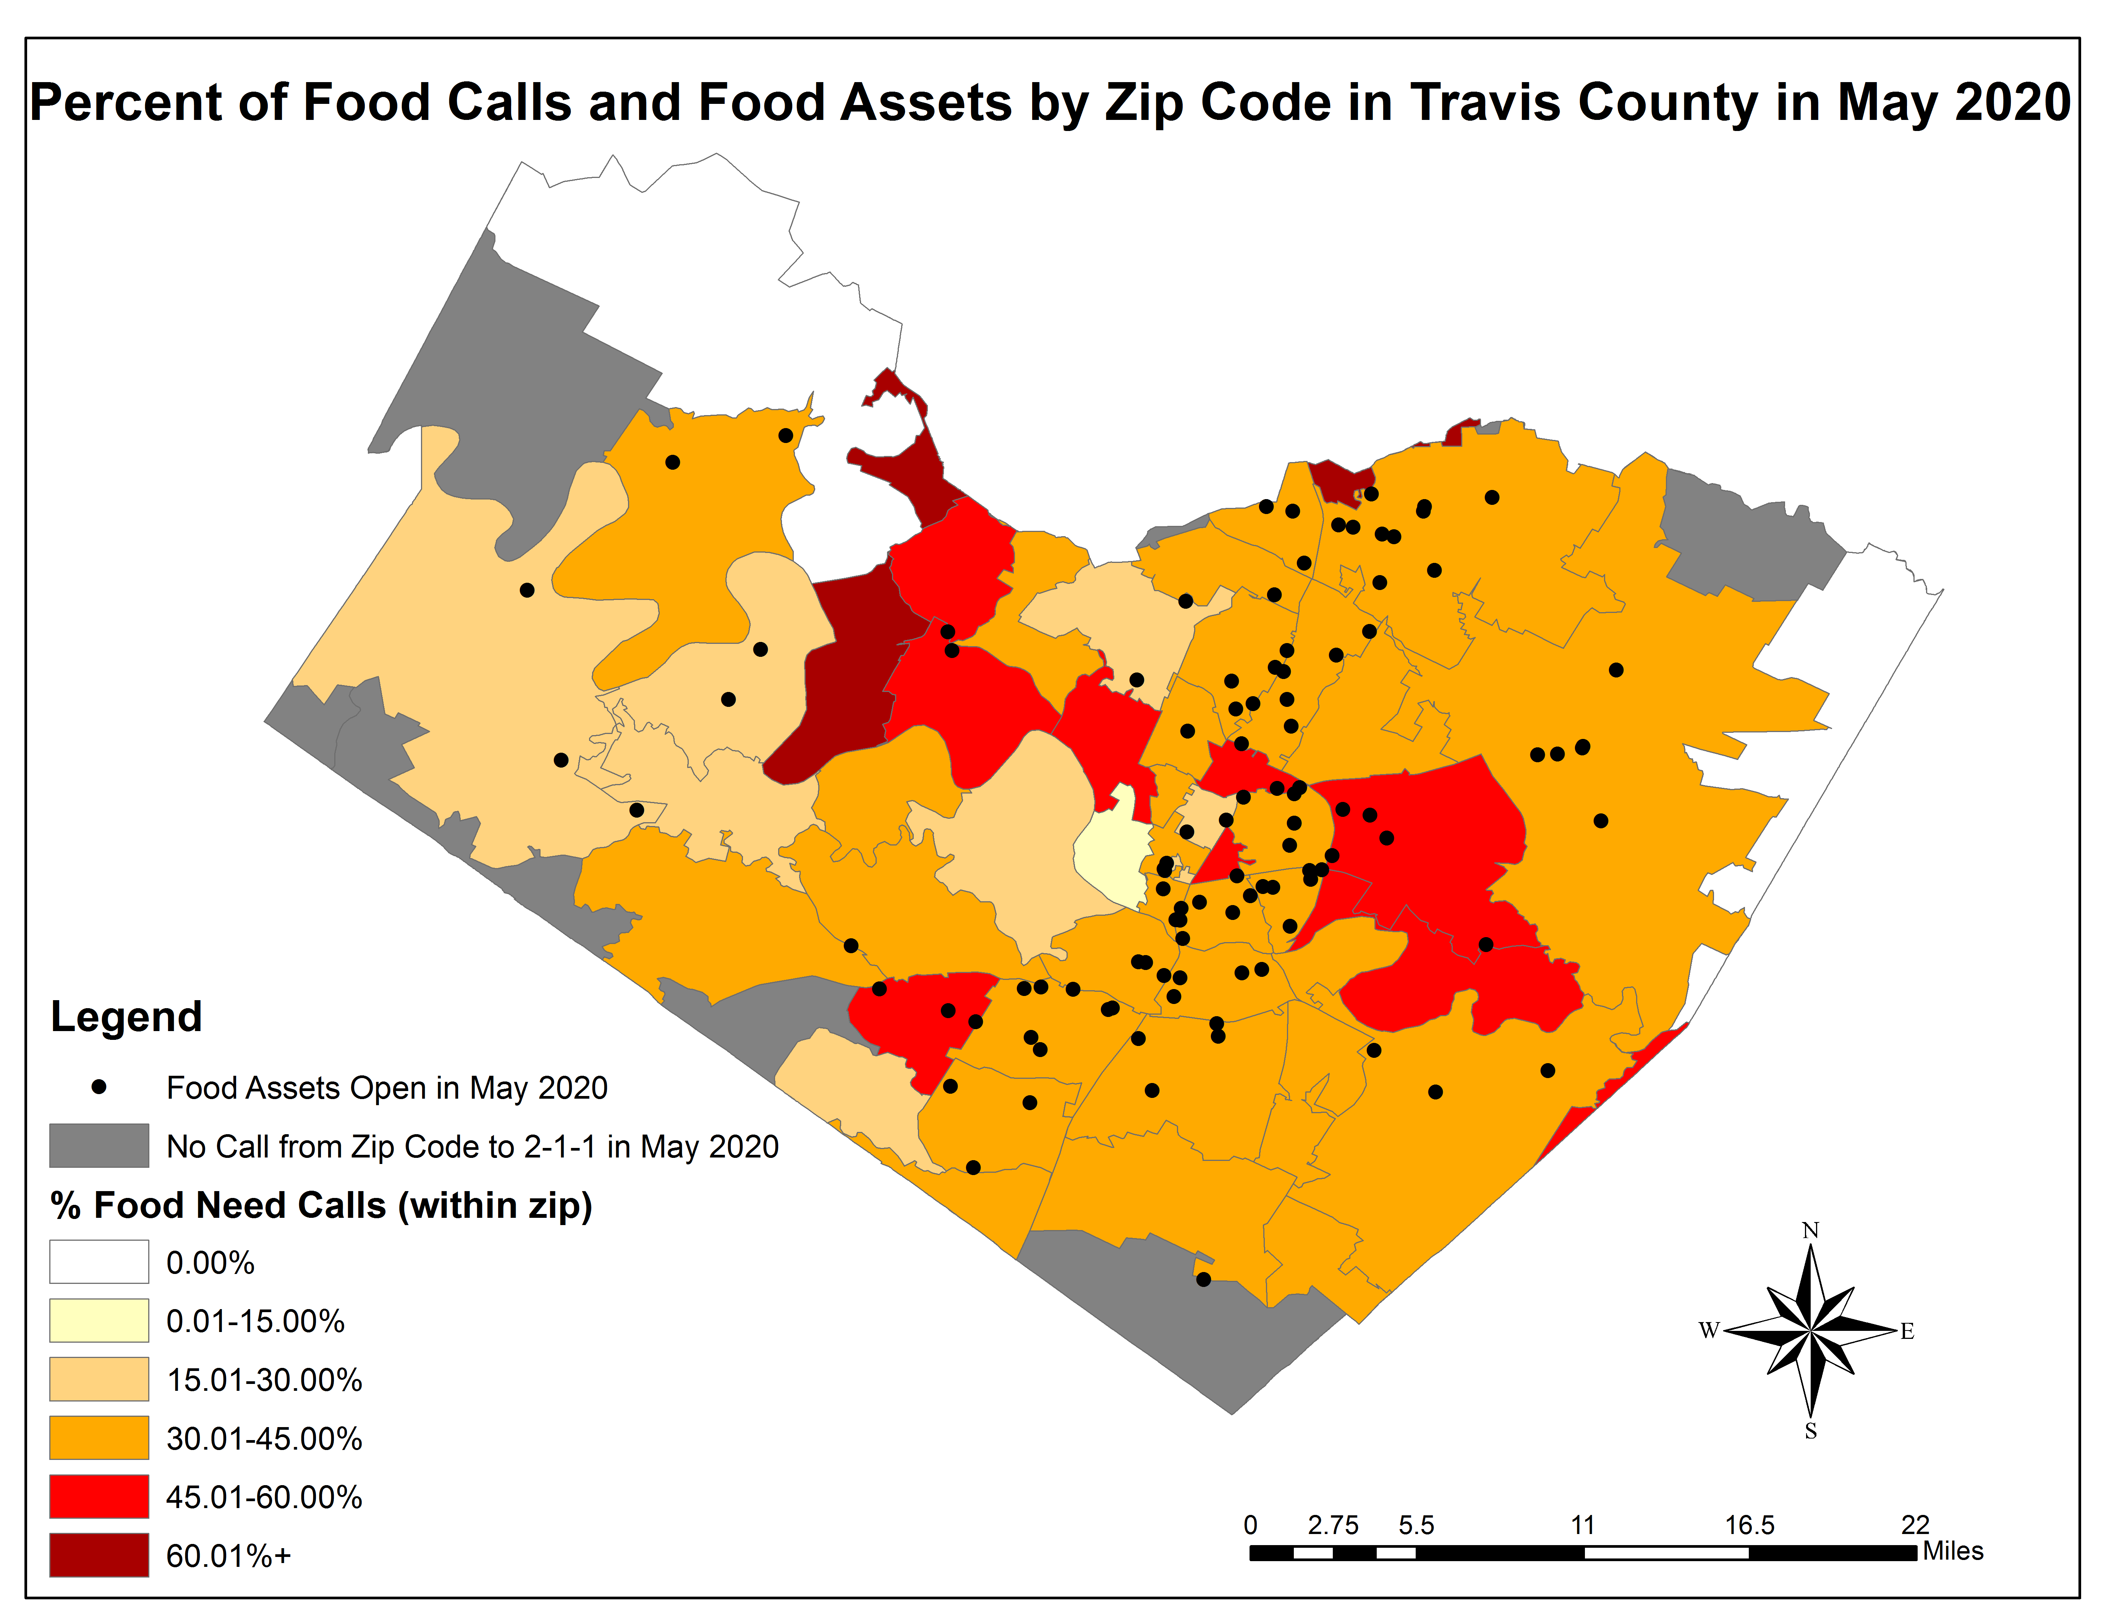
Notes:
The findings from May 2020 show that the proportion of food needs calls by zip code is not as high, however, similar to April 2020 over 80% of zip codes in Travis County had 30% or more of their calls to 2-1-1 were regarding food needs.

Slide 12
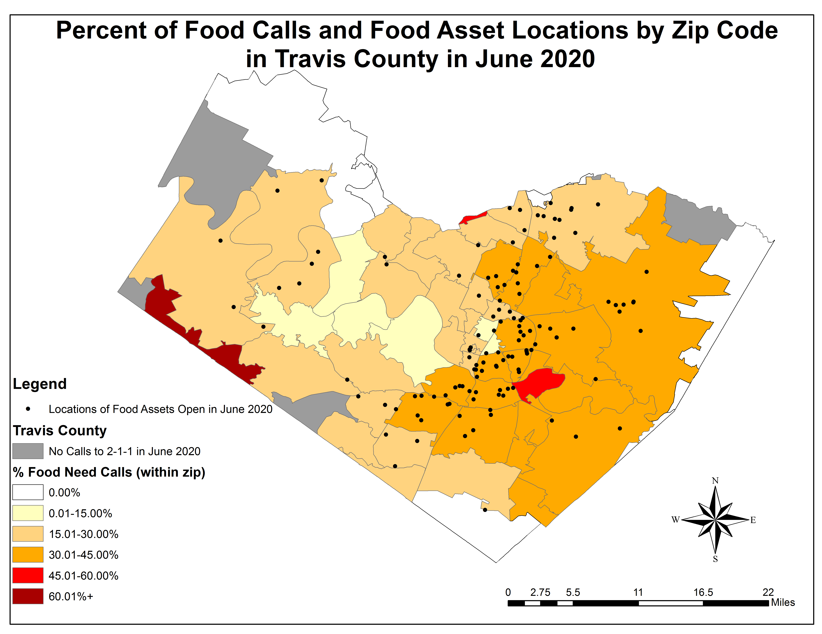
Notes:
Decrease in proportion of food needs calls could be the byproduct of the rise in health/mental health related calls to 2-1-1 in June 2020 because of the spike in # of COVID-19 cases during the month of June or could reflect reduced need – thus future analysis of July and August is needed in order to better understand trends.

Slide 13
Deliverables, Recommendations and Next Steps
Reports have been created and shared with City of Austin, United Way for Greater Austin, Dell Medical School and other collaborators.
March/April 2020 Summary Report
May 2020 Summary Report
June 2020 Summary Report
Provided recommendations for placement of emergency food assets in 78754 and 78747
Continued analysis with July and August 2-1-1 call data

Slide 14

Special Thanks to:
United Way for Greater Austin
Dr. Alexandra van den Berg and Raven Hood
City of Austin – Office of Sustainability
Dell Medical School – Population Health

Slide 15
Questions? Contact Information: Kathryn.M.Janda@uth.tmc.edu

