Slide 1
Getting Real about Fake News
Aditya Tyagi,
BS Industrial Engineering & Operations Research, Class of 2019

Slide 2

A little background: “Fake News” in the News
The term “fake news” has become a regular part of the national conversation in recent years.
In 2014, Twitter’s shares spiked 7% because of a fake “Bloomberg.ma” acquisition report.
The 2017 US Presidential Election was rife with candidates accusing each other & news media outlets of spreading ‘fake news’ about them.
And as ease of self-creating web content rises (Tweets, blog, vlogs, etc.), one would expect the amount of ‘fake news’ to proliferate.

Slide 3
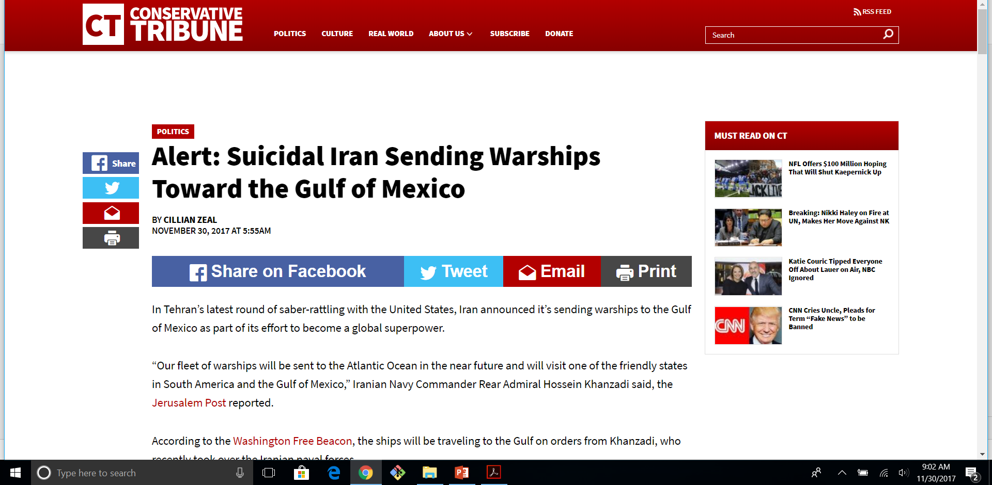






So what do these ‘fake news’ websites look like...
vs.
Answer: Just like any other!

Slide 4
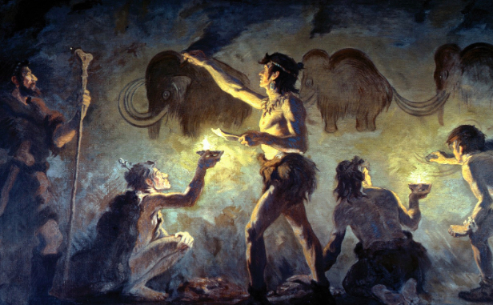
The problem defined formally & informally
We have a collection of websites, the text information on them, a lot of metadata (time article written, author, topic, etc.), and we need to identify which of them is “fake”, “legitimate”, “conspiracy theory”, “satire”, etc. or not. [a multi-class classification problem]
Might sound like a recent problem, but this is a problem that is probably as old as human civilization itself: “You are telling me a story, and I need to figure out whether it is authentic or not!”

Slide 5
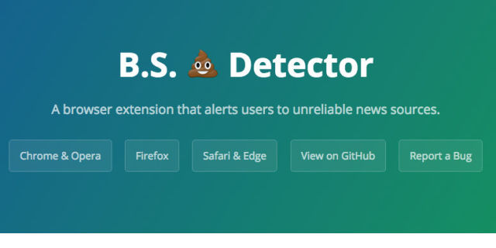
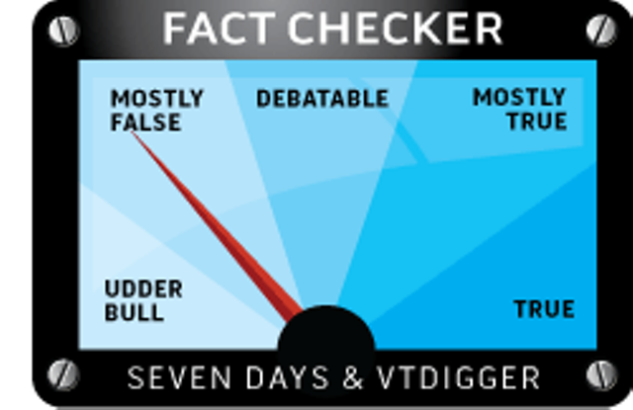
Current Approaches
A manually compiled list of known ‘fake news’ websites that regularly spread misinformation.
BS Detector: a Chrome plug-in using hand-labelled list to alert you when the website you’re visiting is ‘fake’, ‘conspiracy’, ‘junk science’, ‘satire’, etc.
Numerous fact checkers, etc.
There have been some recent attempts to apply Machine Learning & NLP Techniques to solve this problem to varying degrees of success.

Slide 6
The Data- the lifeblood of any analytics project
ID | Site URL | Author | Time Published | Article Title | Article Text | Language | Country | Type
7 | www.100percentfedup.com | Barracuda Brigade | 10/2016 | “WOW! Whistleblower tells story of massive fraud!” | “In 2017, of last year, NYPD received news...” | English | USA | Bias
Add some “legitimate” observations by webscraping/ remove others
~13000 Observations, drops down to ~6000
ID | Site URL | Author | Time Published | Article Title | Article Text | Language | Country | Type
7 | www.100percentfedup.com | Barracuda Brigade | 10/2016 | “WOW! Whistleblower tells story...!” | “In 2017, NYPD received startling news..” | English | USA | Bias
9 | cnn.com | John Doe | 02/2017 | “White House considering replacing...” | “President Trump has indicated in a...” | English | USA | Legitimate
Incorporate additional features (demographic info., social media, etc.) by webscraping
7 Features rises to around ~15
ID | Site URL | Author | ... | Avg. Visitor Age | Avg. Time Spent | Browsing Location | Visitor Gender | FB Likes | FB Shares | Type
7 | www.100percentfedup.com | Barracuda Brigade | ... | 17 | 3 min, 38 sec. | Home | Male | 70 | 500 | Bias
9 | cnn.com | John Doe | ... | 34 | 15 min, 10 sec. | Work | Balanced | 108 | 450 | Legitimate

Slide 7


Analytics applied
The reach goal is to create a form of ensemble model that uses NLP techniques on the text features, possibly differing ML techniques on the site metadata features, demographic features, social media, etc.
Need to think about how to combine predictions for ensemble model, or if not ensemble, pick a single model with a high discriminative power.
Think creatively to add some more features to create the best possible model. (using feature engineering)

Slide 8





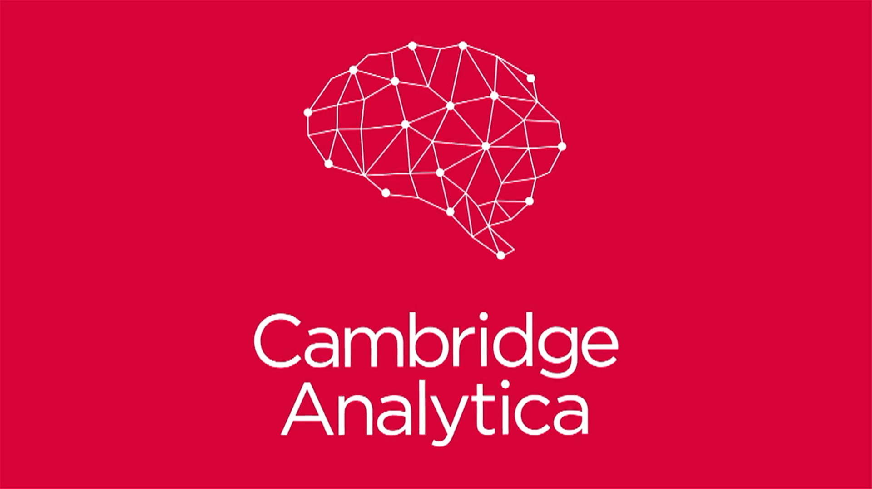

The potential impact
There are many players who stand to benefit from projects of this sort.
News Desks at various publishers/news corporations: Helps verify whether an incoming news story is genuine or not
Netizens who read get their news information online: Identify misinformation (from blogs, smaller websites, etc.)
Social Media Administrators at Facebook, Twitter, etc.: Locate disingenuous stories on their network and monitor their spread.
Campaign Consulting Firms: Assist in Web monitoring for potentially libelous information about their candidate
Financial Regulators: The SEC seeks to monitor the spread of false market information

Slide 9
Where are am I now and the way forward:
Completed the data import, tidying phase of the lifecycle.
Completed the EDA phase on the base dataset; may need to do some more after adding requisite observations & features.
Currently, focusing time learning & doing some webscraping to add some more ‘legitimate’ observations, and also more features.
Still need to explore the NLP topic deeply and learn some more skills
Still need to train & validate models on the different features of the dataset.
Still need to “tell the story”: Report & Communicate Results in an accessible report.

Slide 10
Thank You
Aditya Tyagi – Getting Real about Fake News
BS IEOR, Class of 2019, UC-Berkeley,

