Slide 1
Long term plasticity in networks - II
Aditya Gilra
CAMP 2016

Slide 2
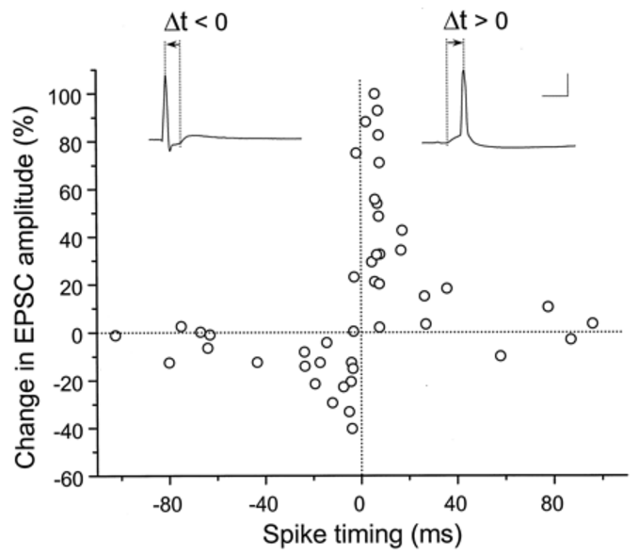
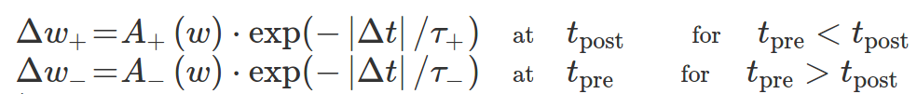
STDP
Bi and Poo, 1998; Gerstner et al book 2

Slide 3
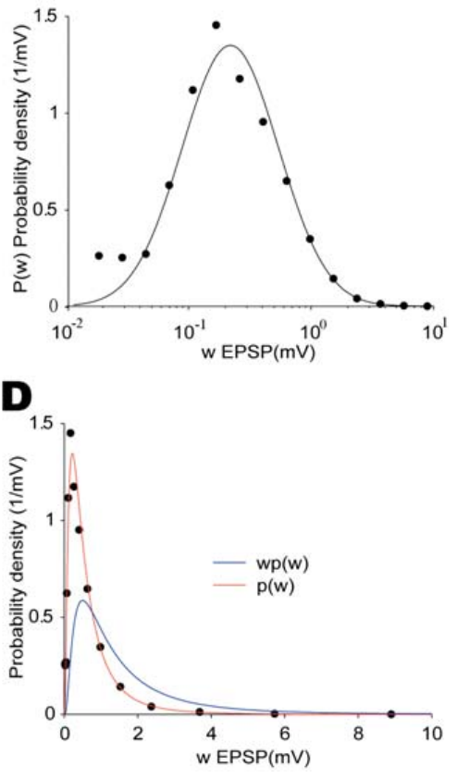
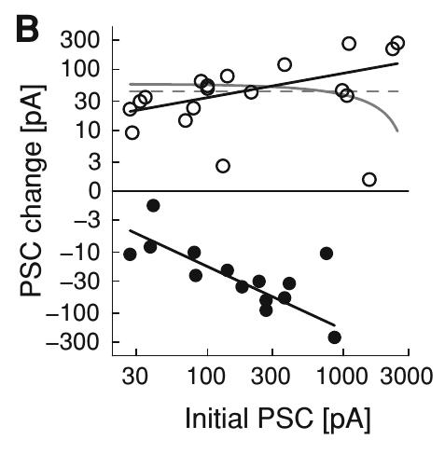
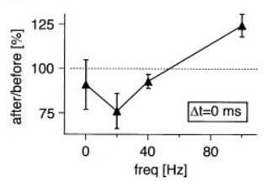
Realistic STDP
Weight dependence of ∆w
(Bi and Poo, 1998)
Log-normal w distribution
(Song et al 2005)
Rate dependence of ∆w
(Sjostrom et al 2001)

Slide 4
Weight-dependent STDP & weight distributions
2000 Poisson inputs at 10Hz into a post-synaptic neuron
See the weight distribution for:
  Additive STDP
  Multiplicative STDP
  Log-STDP

Slide 5
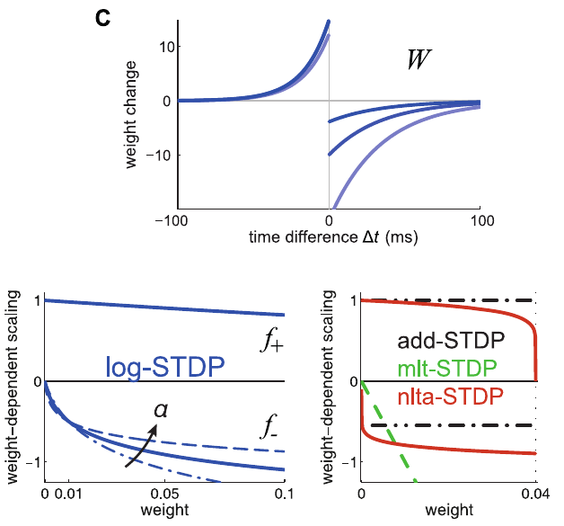
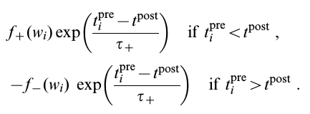
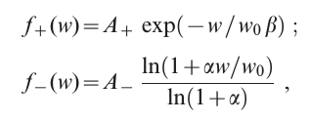
Log-STDP
Gilson, Fukai, Burkitt, 2012

Slide 6
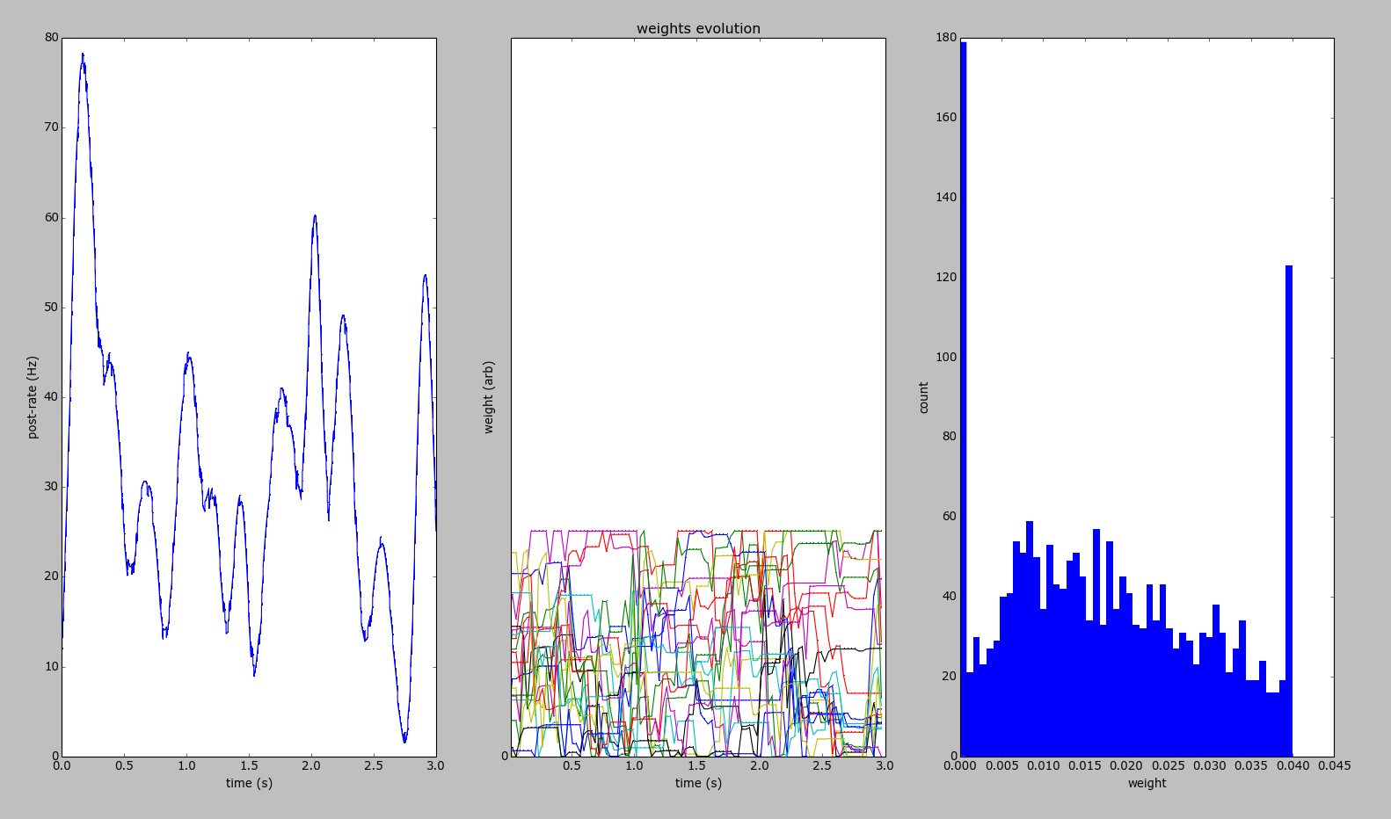
Additive STDP

Slide 7
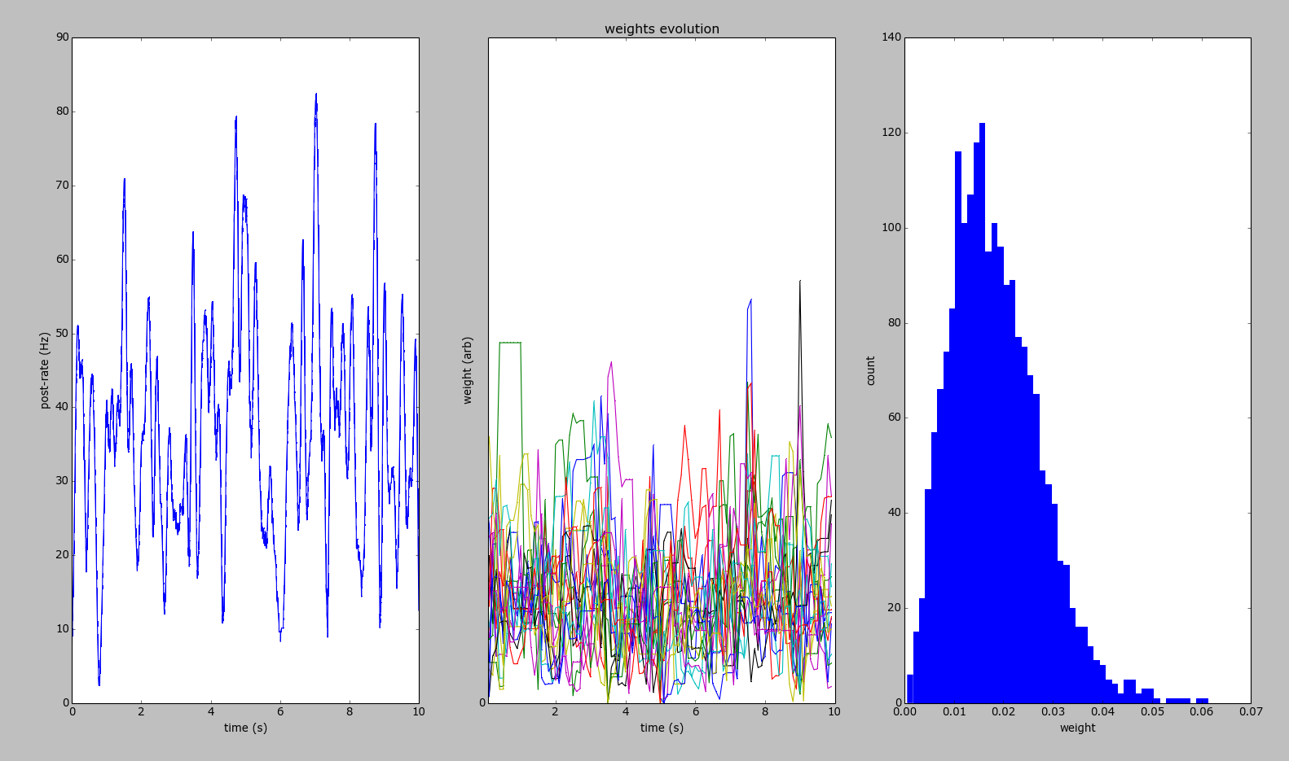
Multiplicative STDP
How fat-tailed distribution with multiplicative STDP, not Gaussian?

Slide 8
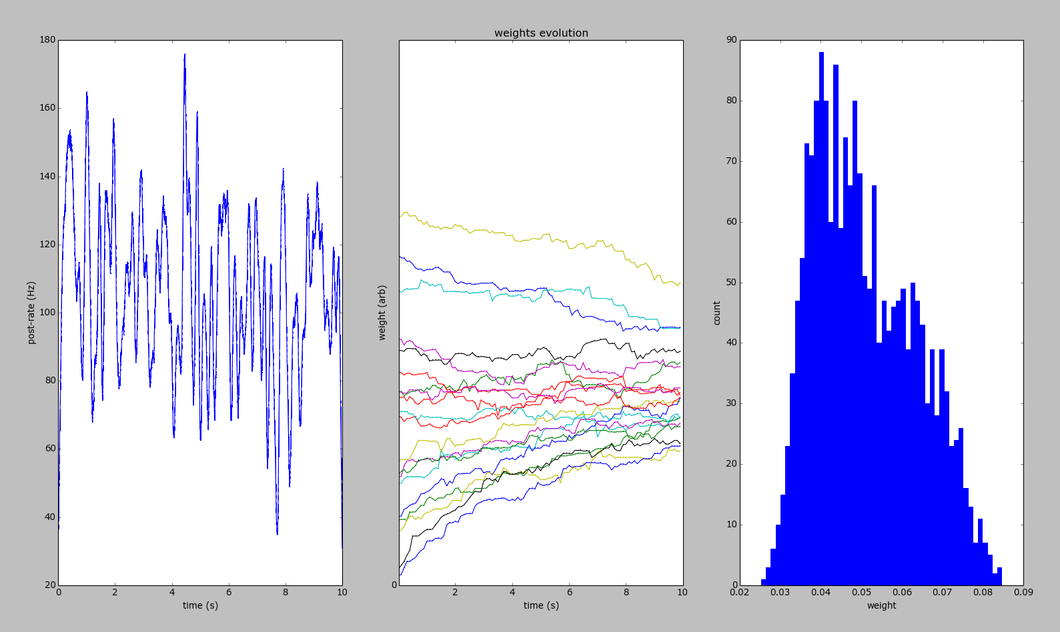
Log-STDP

Slide 9
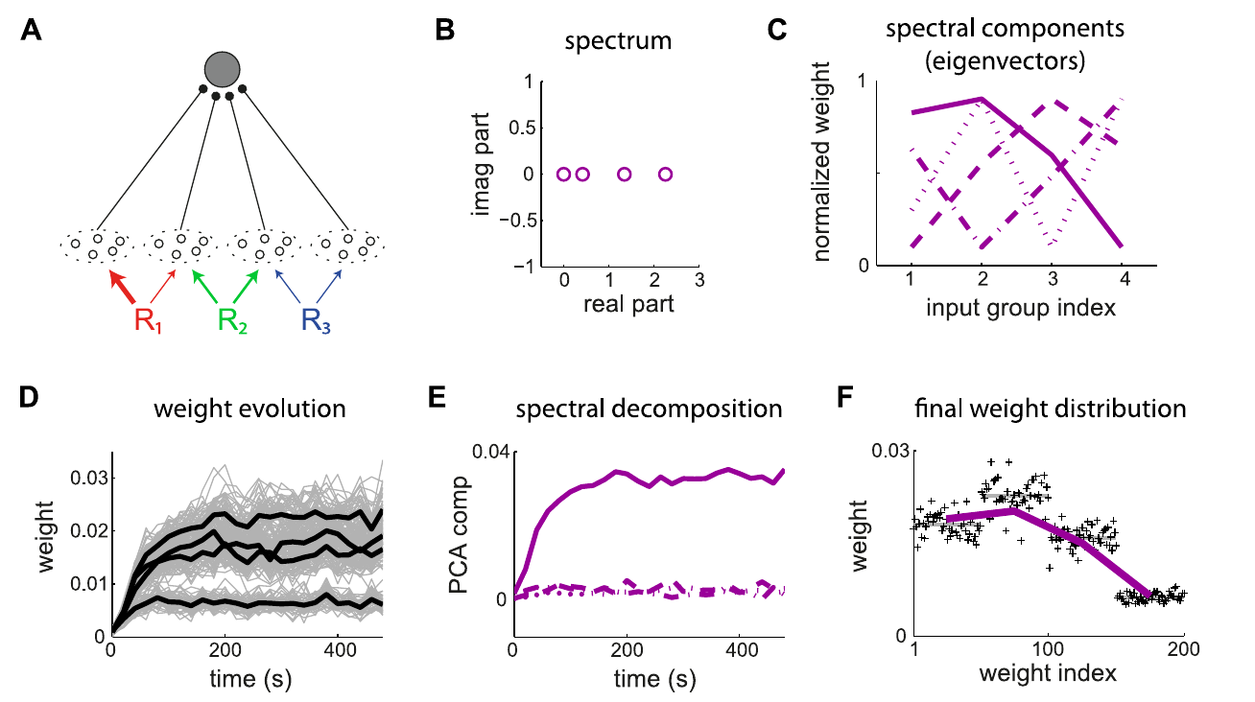
Log-STDP does PCA better
3 sources produce 4 correlated pools of 500 spike-trains each
Respond to 1st PC of the covariance matrix
Compare additive-, multiplicative- and log-stdp
Gilson, Fukai, Burkitt, 2012

Slide 10




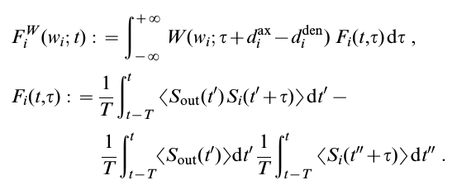



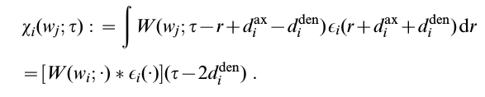
How does log-STDP do PCA?
Gilson, Fukai, Burkitt, 2012

Slide 11
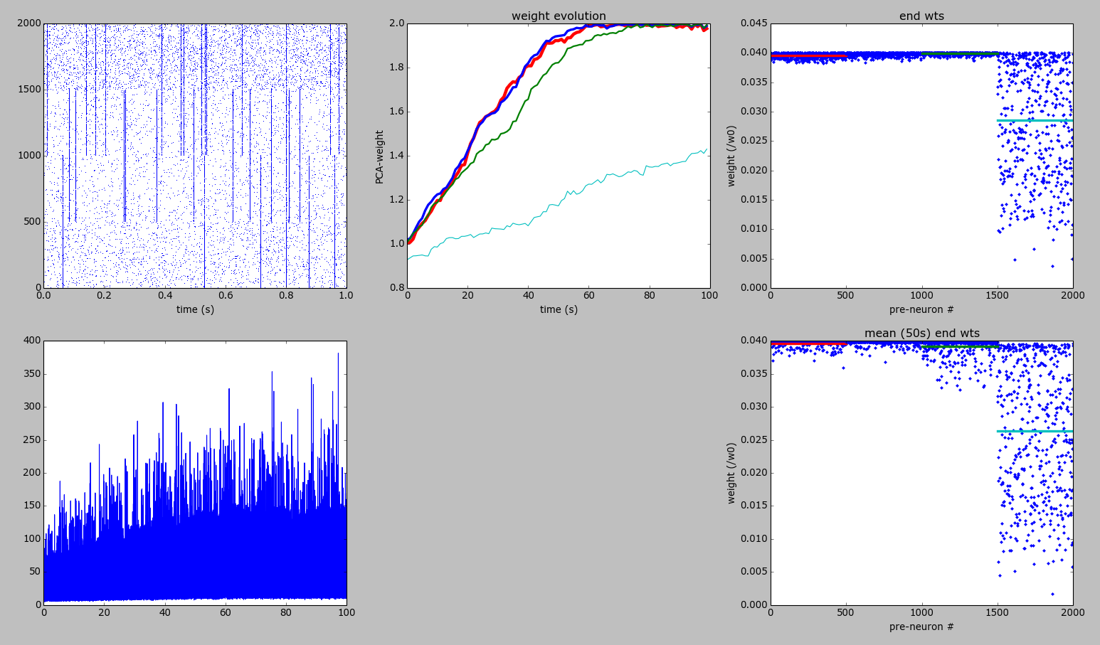
Additive STDP

Slide 12
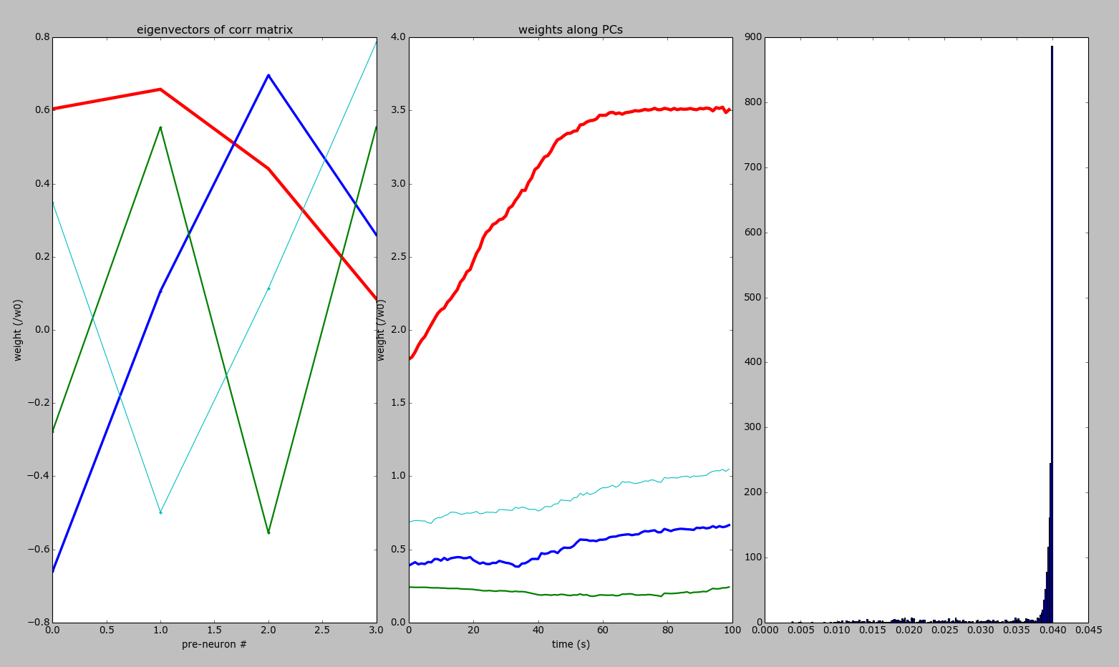
Additive STDP

Slide 13
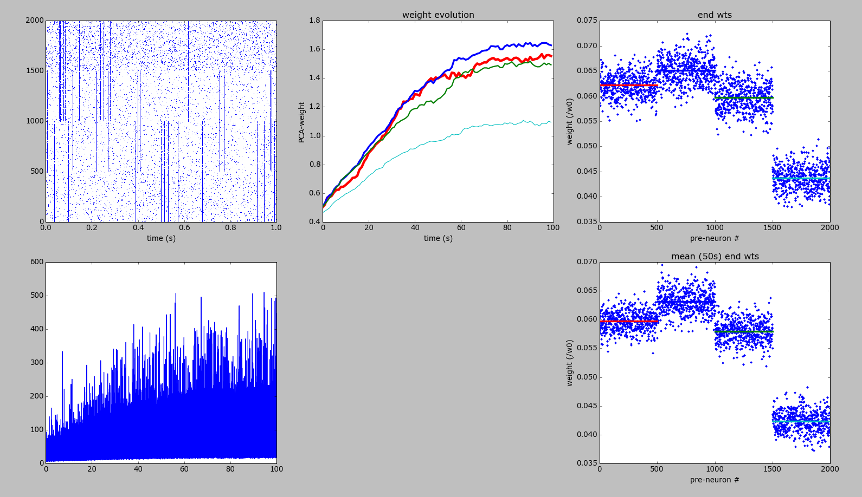
Multiplicative STDP

Slide 14
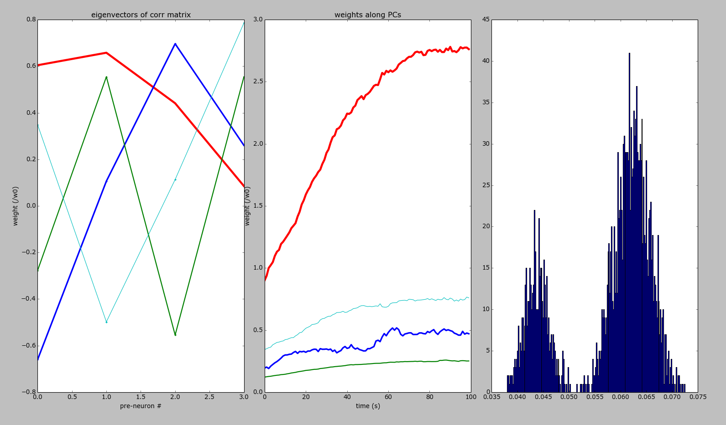
Multiplicative STDP

Slide 15
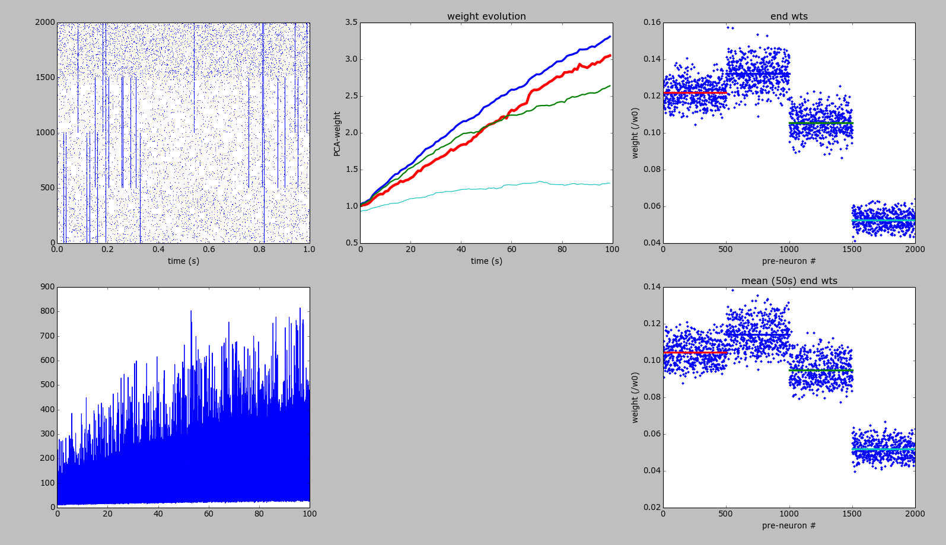
Log-STDP

Slide 16
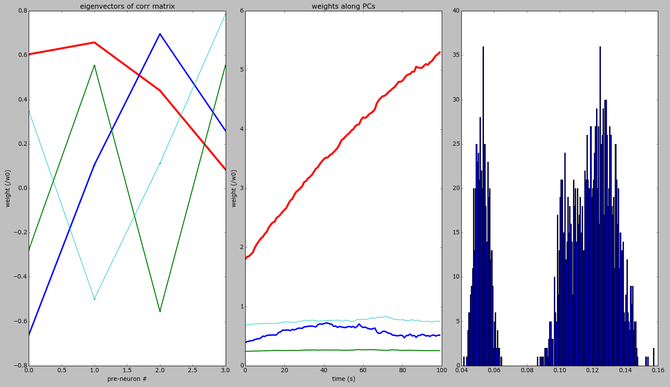
Log-STDP

Slide 17
STDP in networks
Stable weight distributions for background / spontaneous activity
Cell assembly formation
Observe the differences for
  Additive-, multiplicative-, log- and triplet STDP

Slide 18
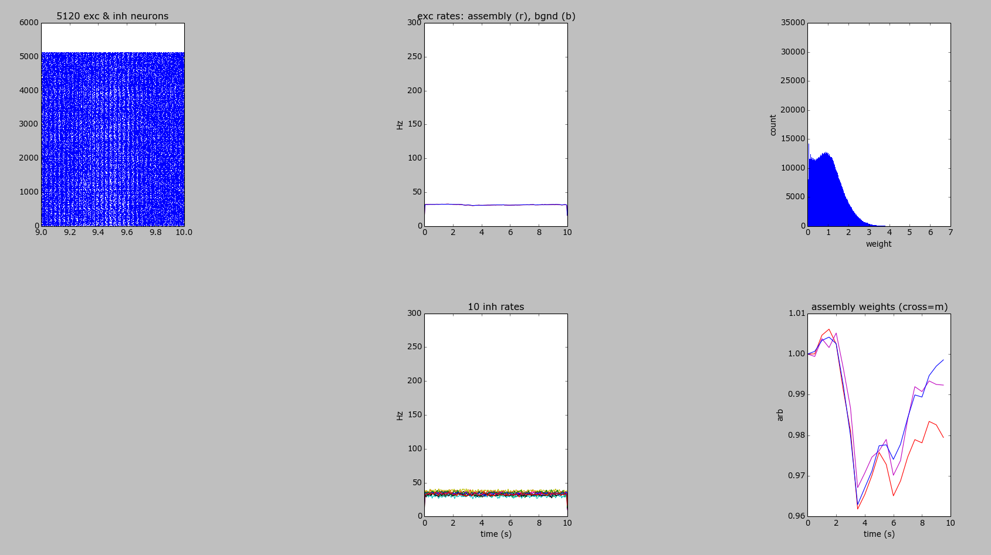
Additive STDP (background)

Slide 19
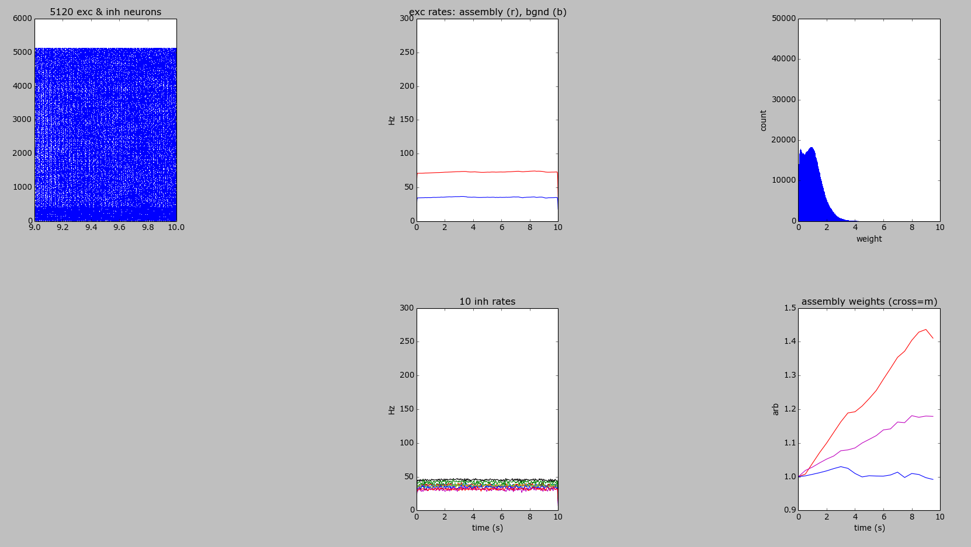
Additive STDP (assembly)

Slide 20
Triplet STDP
Rate-dependence of STDP
Extra term

Slide 21
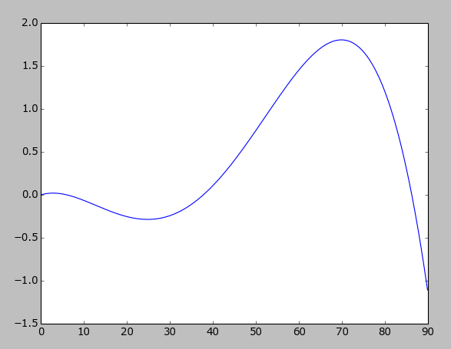
Triplet STDP with heterosynaptic & transmitter-induced plasticity
dw/dt
rate

Slide 22
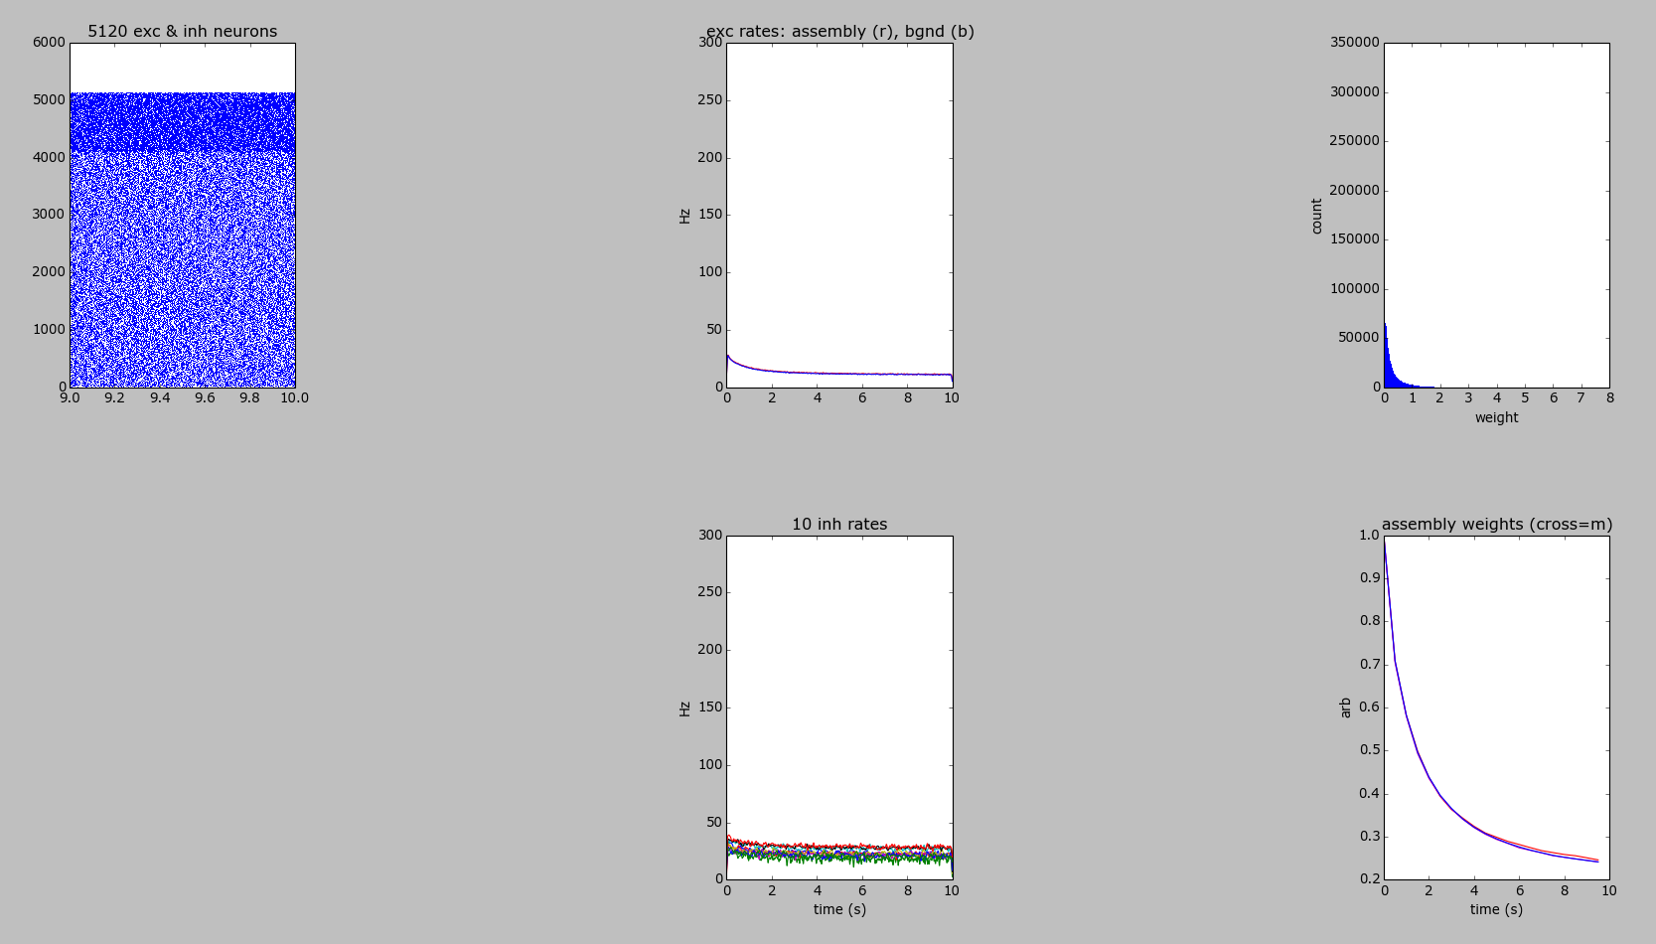
Triplet STDP with heterosynaptic & transmitter-induced plasticity

Slide 23
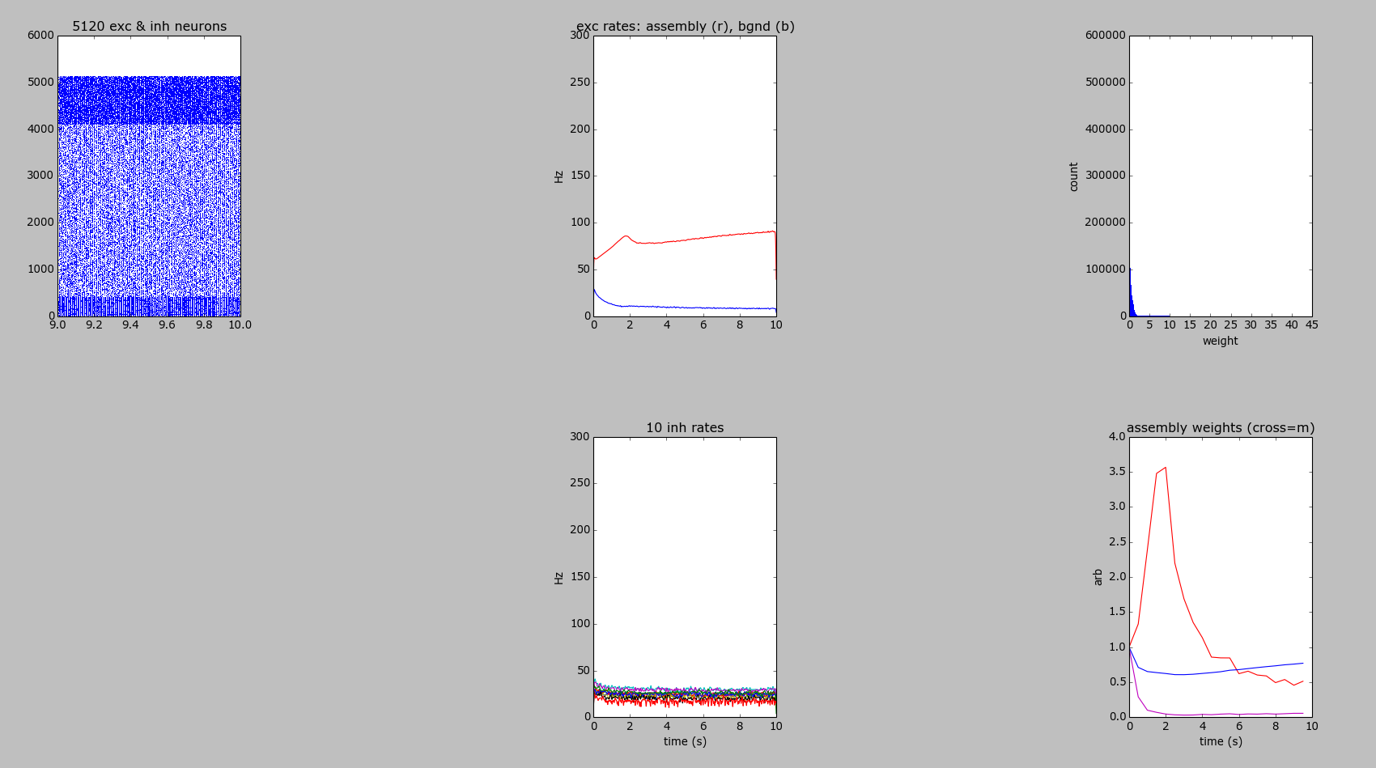
Triplet + Hetero- +Transmitter- (stimulus)

Slide 24


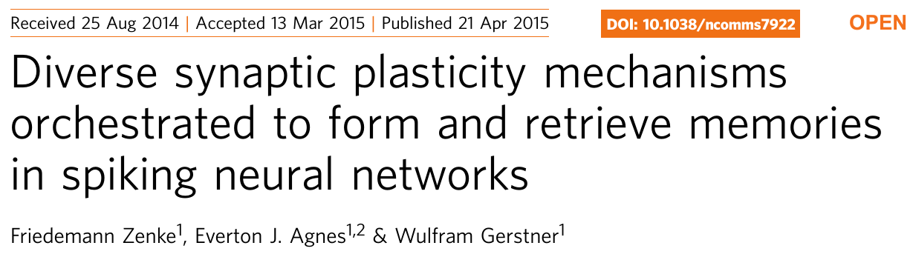
Diverse plasticity needed

Slide 25
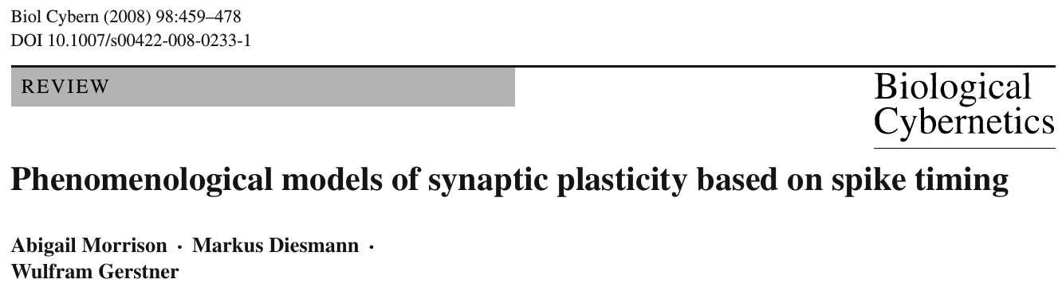
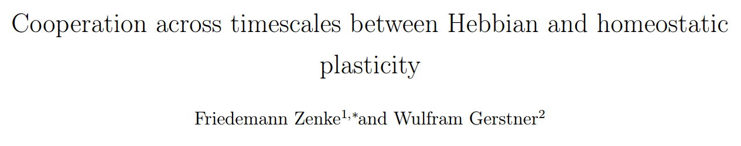
Good references
http://fzenke.net/uploads/images/preprints/2016-zenke_gerstner-preprint.pdf

