Slide 1
Codeshaala Web Technologies- II Project
Abhilash Jaysheel - 01FB16ECS009
Abhimanyu Roy - 01FB16ECS010
Aditya Girisha - 01FB16ECS027
Animesh ND - 01FB16ECS055

Slide 2
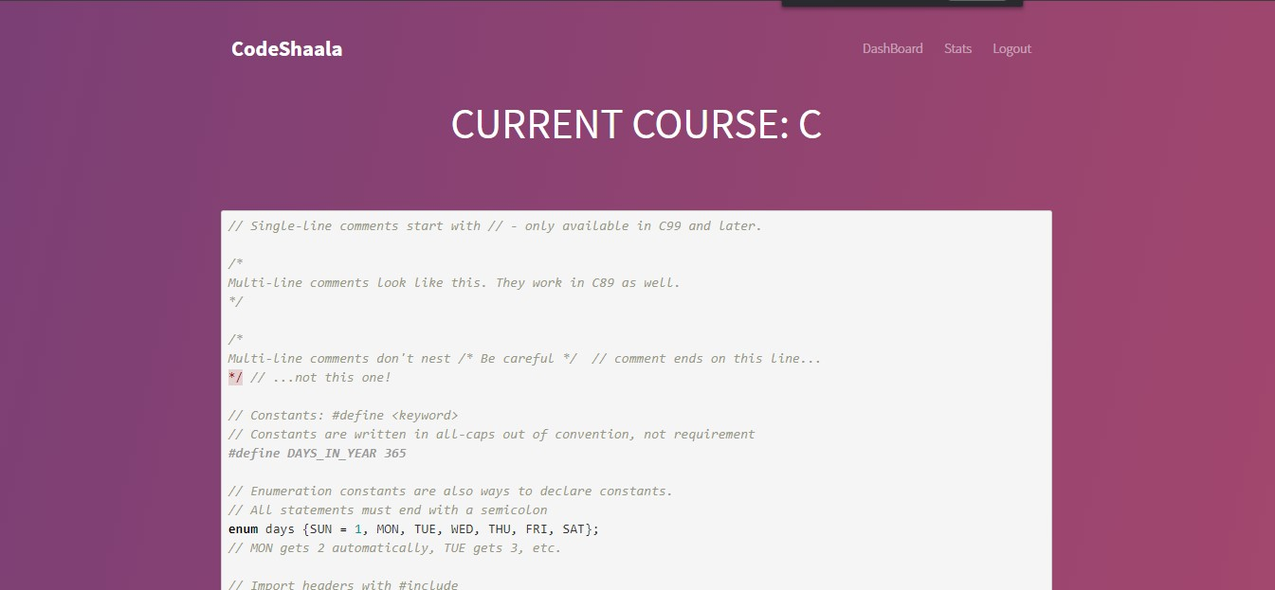
Introduction
Codeshaala is a platform on which introductory courses to programming languages are offered
Each course has a quiz and a rating after completing the course attached to it.
A recommendation system has been put in place which suggests courses based on the experience of users who have experienced similar content.
A ranking system keeps an environment of competition by ranking users based on the number of high scores obtained from courses completed.

Slide 3
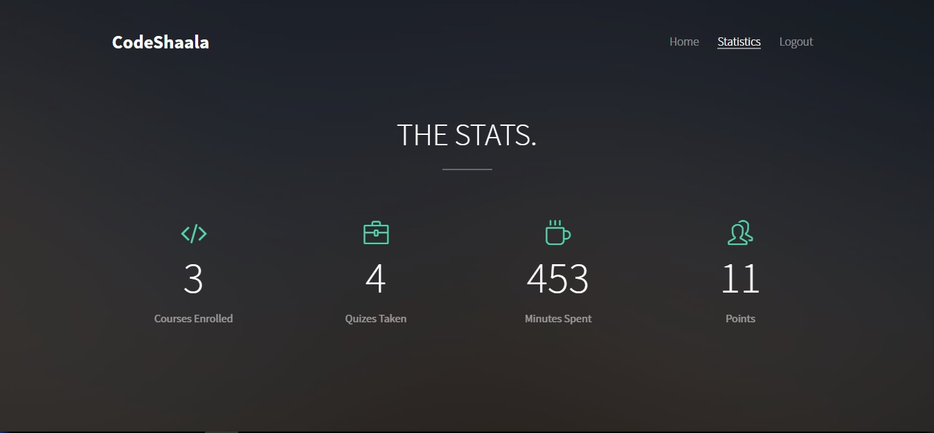
Heartbeat
The session activity of a user gets tracked.
Whenever a user logs out, the session is expired. This data is used in statistics (e.g, number of minutes spent in a particular course).

Slide 4
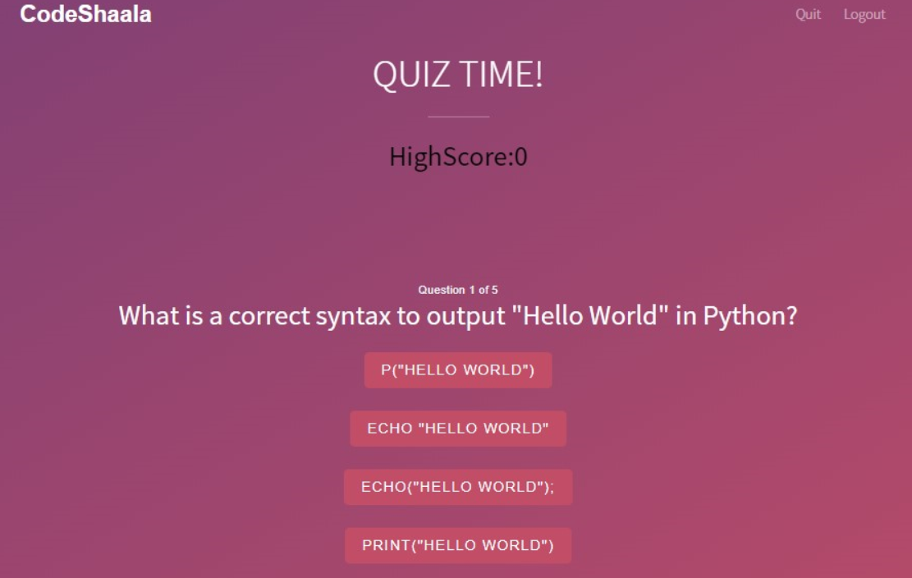
Quiz
A quiz for the current course helps brush up one’s concepts. High scores , if obtained, are used in the ranking system

Slide 5
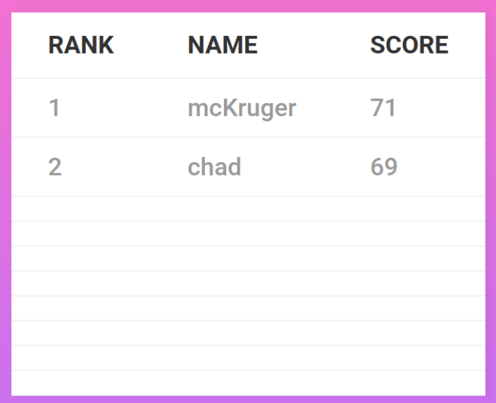
Ranking System
This is used to display the top 10 users in terms of score obtained.

Slide 6
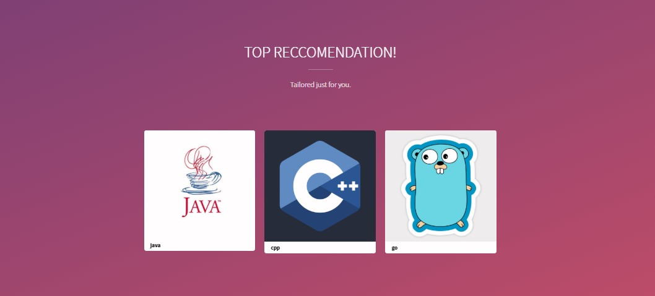
Recommendation System
After completing the course, a user is required to rate the course.
This rating helps in setting up a recommendation for other users, to whom other courses are suggested based on the experience of other people.
This was implemented using K-Nearest Neighbours algorithm.

Slide 7
Multi-Stage Download
The amount of data to be pushed is massive. Hence, whenever a user has almost exhausted his current content while scrolling through the page, the following content gets downloaded. The data gets pushed in segments and in sequence.

Slide 8
THANK YOU!

