Slide 1

INTERNSHIP PROJECT
PRESENTATION
By Aditya Singh
Army Institute of Technology
Electronics and Telecommunication
Summer 2017
Java Developer Intern
Code - INT02468

Slide 2
PROJECTS ASSIGNED
- By Vijay Patel
Project Name | Duration
Complete Sentence Predictor version 4.0 | 1/June/2017 – 20/June/2017
Live Data Insert and Push – A social media plug-in developed for Isha Foundation | 21/June/2017 – 15/July/2017
Testing and Troubleshooting World Card Enterprise Integration with Edelweiss** | 16/July/2017 – 1/Aug/2017

Slide 3

Complete Sentence Predictor Mentor: Sunil Gupta
Versions Built
C.S.P. v1.0 – Aimed to complete word. Later Disbanded.
C.S.P. v2.0 – Implemented via Trie Data structure.
Start up time: 22 minutes.
C.S.P. v3.0 – Implemented via Trace Data Structure.
Start up time: 4 minutes.
Latency period of less than 10 second.
C.S.P. v4.0 – Implemented via Trace (Own) and MongoDB.
Latency period of less than a 1 second.
Collective knowledge using Local Client Cache
Tech Stack: Java, Trie and Trace data structure, MongoDB database, HTML, Postman,
Tomcat Version 8.0 Server.
Project URL: github.com/adityagit11/C.S.P-Dev-Repo
Project Size: 44 MB dataset
22 Kb Script

Slide 4

Proof of Concept: Live Data Insert and Push Isha Foundation Mentor: Sunil Gupta and Dhiraj Kumar Mishra
Agenda
Live video, picture and message insert from
user’s mobile to edelweiss’s own server and
further pushed to official Isha Foundation
social media accounts.
Media on server is deleted to reduce data load.
Simultaneous upload of huge media files.
Built Proof of concept for vendors.
Designed social media Plugins for facebook.com,
youtube.com and twitter.com
Platform: Java later on to Dot Net by DKM.
Tech Stack: Java, YouTube Data API v3.0, Facebook Graph API, Jetty Server,
Tomcat v8.0 server, HTML, CSS, JavaScript
Project URL: github.com/adityagit11/POC-LDIP
Project Size: 232 Kb Script

Slide 5
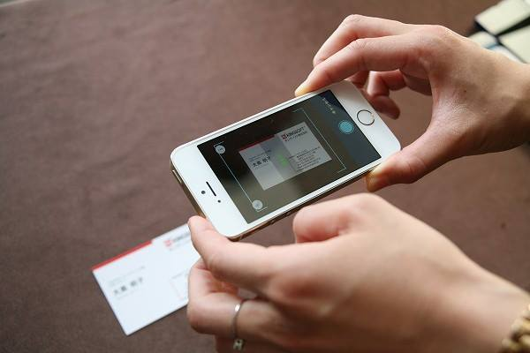
Edelweiss and Pen Power Inc. Integration on World Card Enterprise Mentor: Tej Narayan Upadhyay
Agenda
Tested optical character recognition
engine - World Card Enterprise designed
by Pen Power Incorporation.
Maintaining and troubleshooting
technology.
Acquiring and evaluating information.
Effectively utilizing world card enterprise
tool to complete business card recognition
task.
Tech Stack: Java platform, PostgreSQL database, Postman application.

Slide 6
Learning’s and Outcomes
Client Exposure: Interacted with Outsourced vendors during save river project and also during the integration with pen power incorporation.
The start-up environment: Edelweiss provided a dynamic, less rigid and more lateral environment for learning and being innovative.
Negotiating and arriving at a decision: Project like Complete Sentence Predictor took up to 4 versions to build.
Improving problem-solving and critical thinking skills. Developed communication, interpersonal and other critical skills during the whole tenure of internship.

Slide 7

Thank You!

